Slide 1
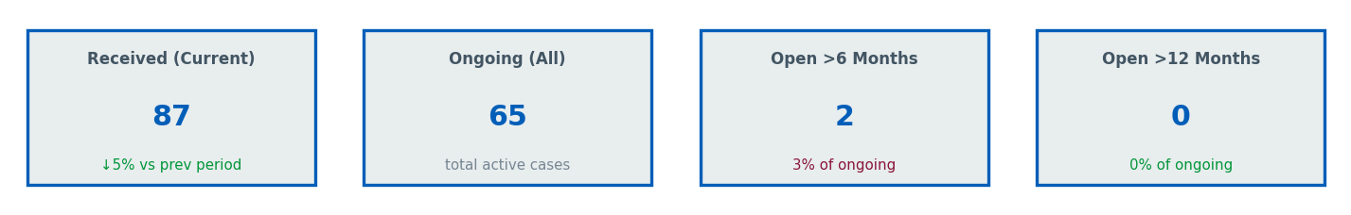
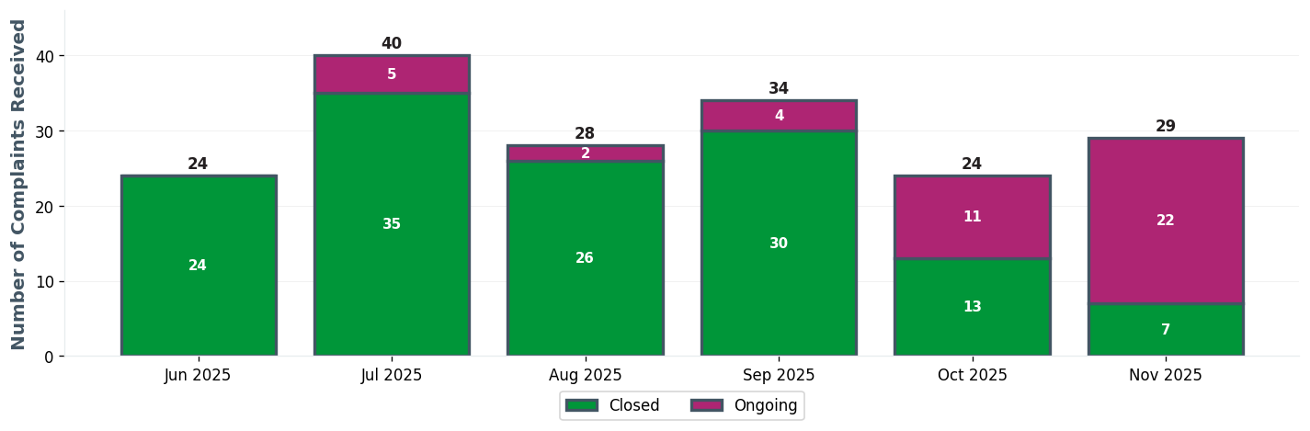
GHH EXEC TEAM | Executive Dashboard
⚠ 2 cases open >6 months

Slide 2
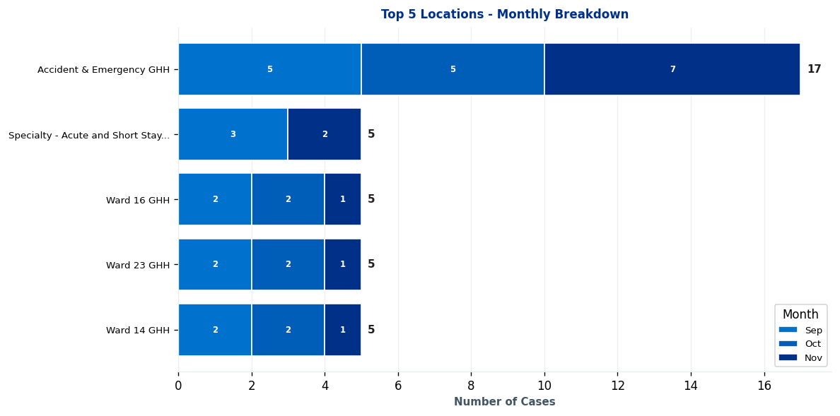
GHH EXEC TEAM | Complaints by Location

Slide 3
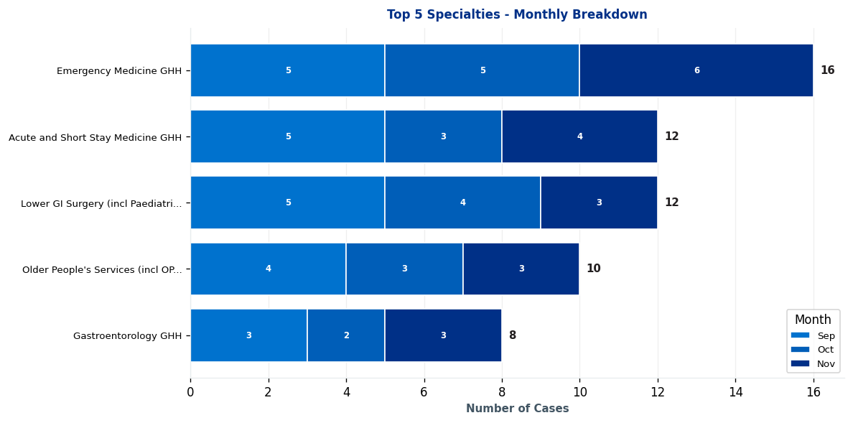
GHH EXEC TEAM | Complaints by Specialty

Slide 4
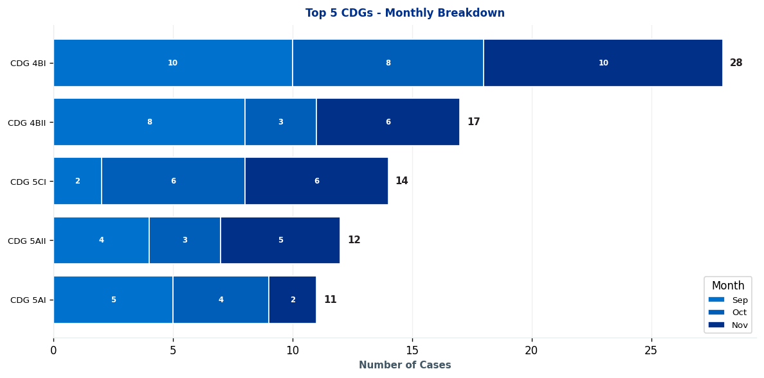
GHH EXEC TEAM | Clinical Decision Group (CDG) Breakdown

Slide 5
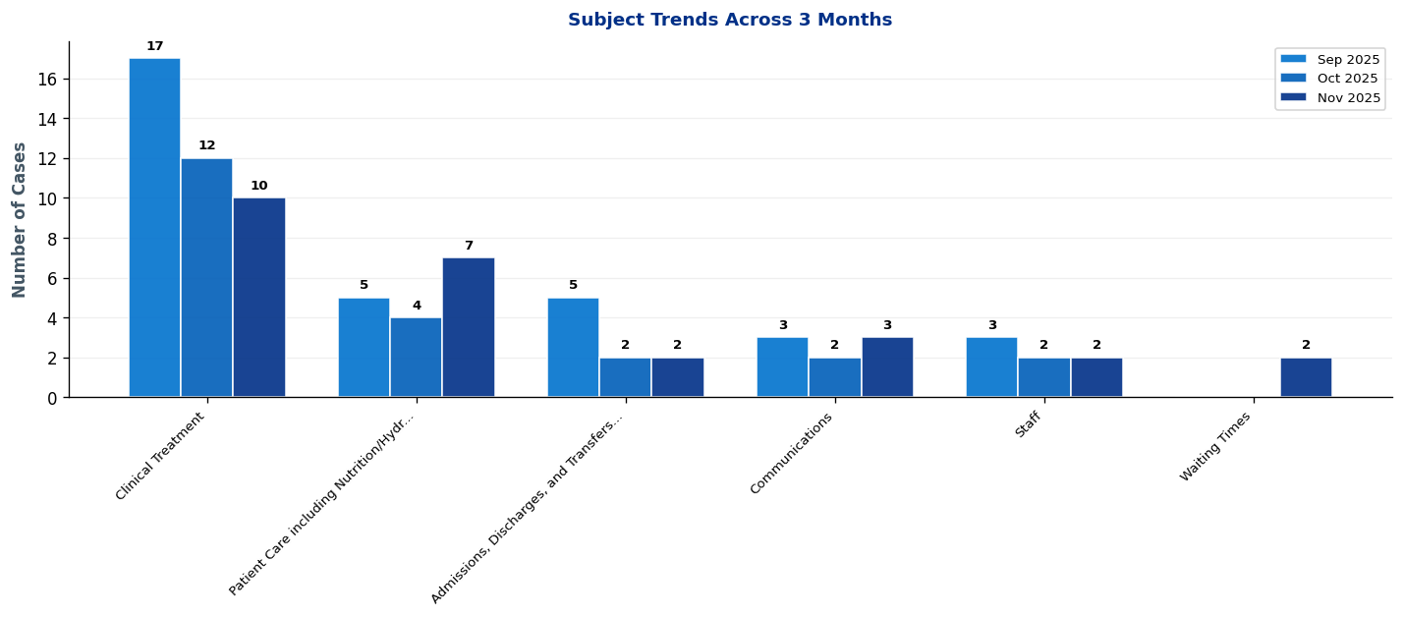
GHH EXEC TEAM | What's Changing? - Subject Trends

Slide 6
GHH EXEC TEAM | Intelligence Report: Key Trends & Patterns
EXECUTIVE SUMMARY: 2 significant trends identified • 2 increases • Latest month (November 2025) vs previous 2-month average
▲ AREAS OF INCREASE
CDG 5CI [MONITOR] ↑ 2 cases (50%)
Main themes: Communications, other, and access to treatment or drugs
→ Continue monitoring - early trend indication
CDG 5AII [MONITOR] ↑ 1 cases (43%)
Main themes: Clinical Treatment and patient care including nutrition/hydration
→ Continue monitoring - early trend indication

Slide 7
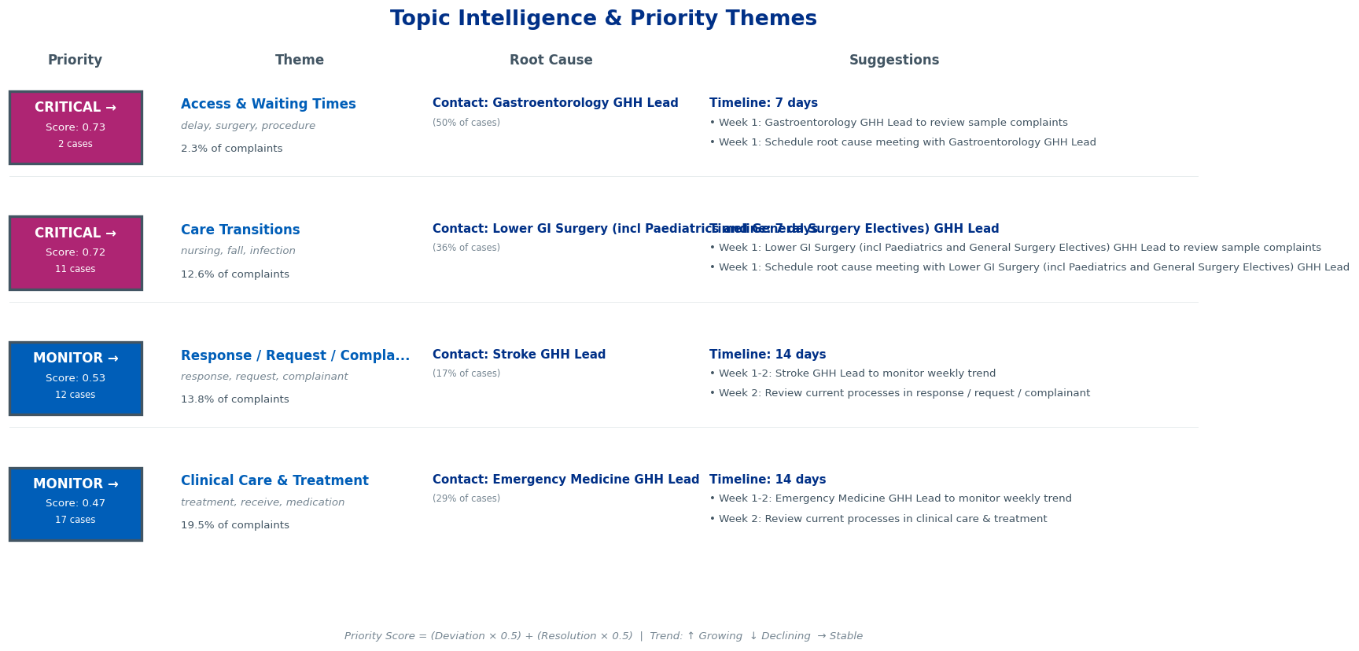
GHH EXEC TEAM | Topic Intelligence & Priority Themes

Slide 8
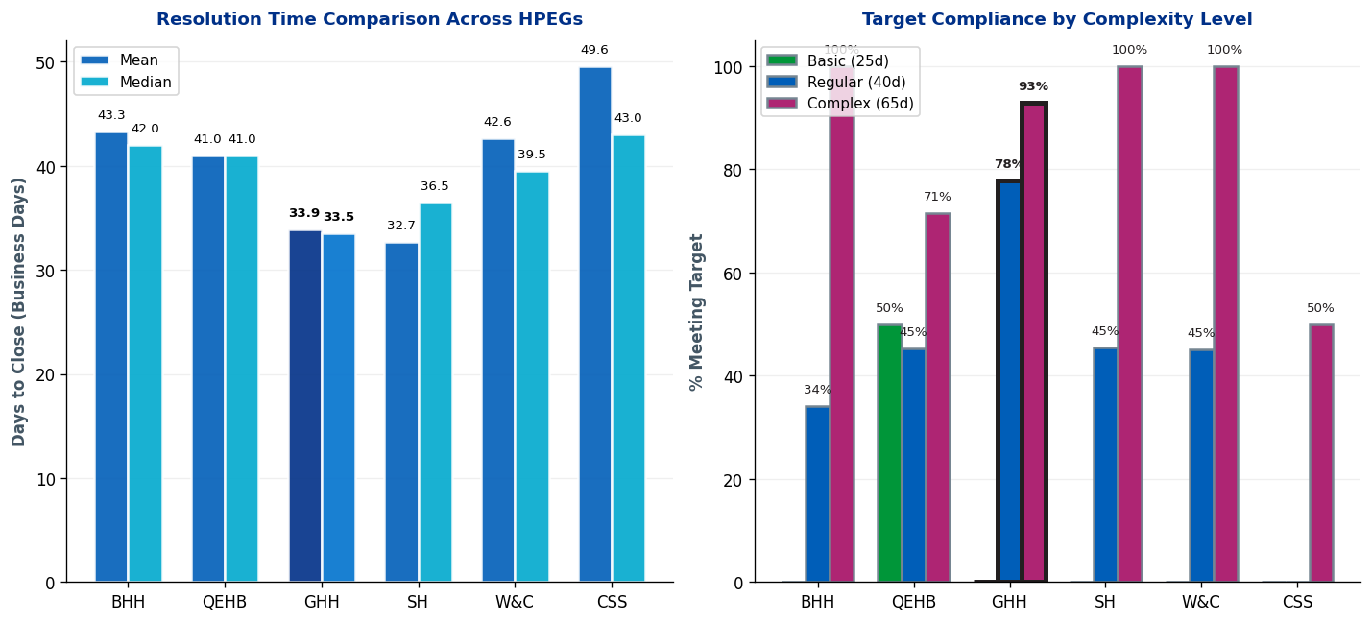
GHH EXEC TEAM | Complaint Resolution Efficiency

Slide 9
GHH EXEC TEAM | Resolution Time Trends by CDG
Current Period (Oct 25-Dec 25) vs 12-Month Rolling Average
1. CDG 4BI
Current period median: 63.0 days • 12-month rolling median: 63.0 days
Stable: matching 12-month average • Acceptable (within Complex target)
2. CDG 2AII
Current period median: 57.0 days • 12-month rolling median: 68.0 days
✓ Improving: 11.0 days BELOW 12-month average • Acceptable (within Complex target)
3. CDG 4BII
Current period median: 49.5 days • 12-month rolling median: 58.0 days
✓ Improving: 8.5 days BELOW 12-month average • Acceptable (within Complex target)
4. CDG 4AI
Current period median: 41.0 days • 12-month rolling median: 41.0 days
Stable: matching 12-month average • Acceptable (within Complex target)
5. CDG 5AI
Current period median: 36.5 days • 12-month rolling median: 40.0 days
✓ Improving: 3.5 days BELOW 12-month average • Good (within Regular target)
Showing top 5 of 7 CDGs by current median. Targets: Basic=25d, Regular=40d, Complex=65d

Slide 10
GHH EXEC TEAM | Resolution Time Trends by Specialty
Current Period (Oct 25-Dec 25) vs 12-Month Rolling Average
1. Emergency Medicine GHH
Current period median: 65.0 days • 12-month rolling median: 65.0 days
Stable: matching 12-month average • Acceptable (within Complex target)
2. Emergency Medicine QEH
Current period median: 54.0 days • 12-month rolling median: 68.5 days
✓ Improving: 14.5 days BELOW 12-month average • Acceptable (within Complex target)
Targets: Basic=25 days, Regular=40 days, Complex=65 days

Slide 11
GHH EXEC TEAM | Resolution Time by Complexity Level (Closed Cases Only)
Resolution Times & Performance Metrics for Oct 25-Dec 25 (Business Days)
Regular
Mean: 35.3 days
Median: 34.5 days
Cases: 36
Target: 40 days
Complex
Mean: 30.4 days
Median: 29.0 days
Cases: 14
Target: 65 days
Performance Summary
Regular: 36 cases • Avg: 35.3 days • Target: 40 days • ✓ Meeting target • 78% compliant
Complex: 14 cases • Avg: 30.4 days • Target: 65 days • ✓ Meeting target • 93% compliant
Overall: 50 total cases • 82.0% overall compliance
Targets: Basic=25d, Regular=40d, Complex=65d

Slide 12
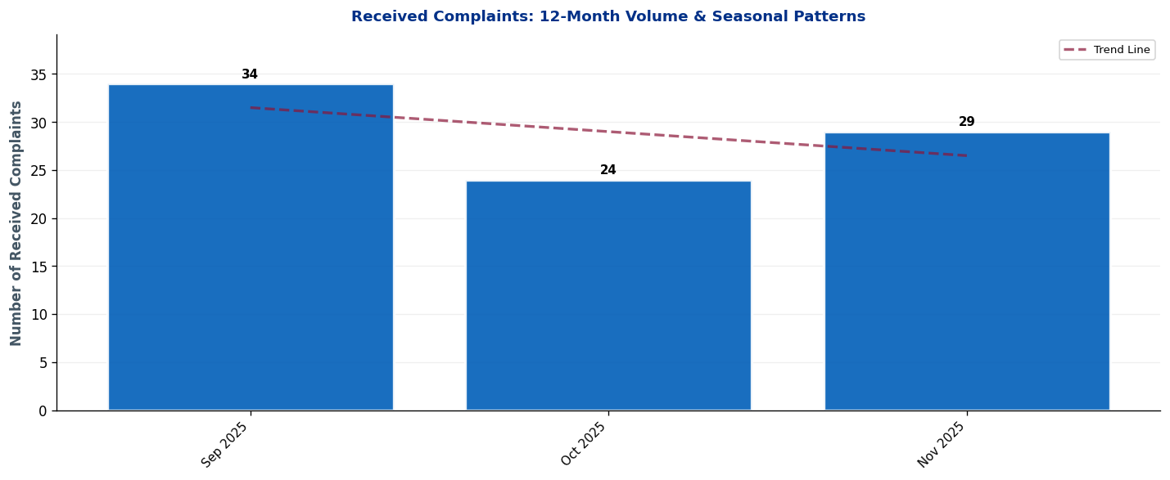
GHH EXEC TEAM | Seasonal Patterns & Volume Trends
Analysis: Trend line shows overall trajectory. Look for seasonal peaks (e.g., winter pressures) and dips.

Slide 13
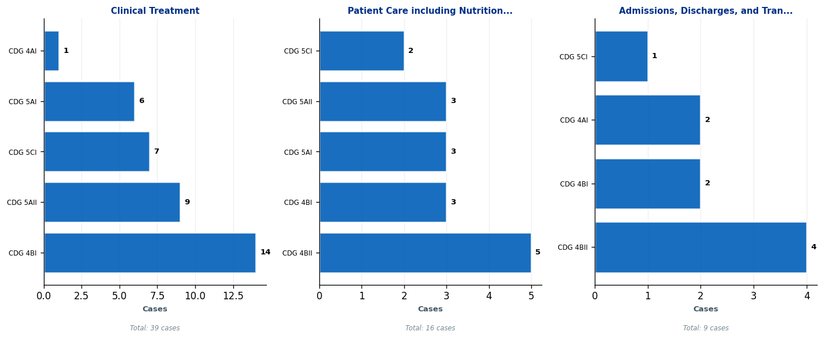
GHH EXEC TEAM | Subject Deep-Dive: Top 3 Complaint Themes
Each panel shows the top 5 CDGs contributing to that subject. Use this to identify which teams need targeted interventions.

Slide 14
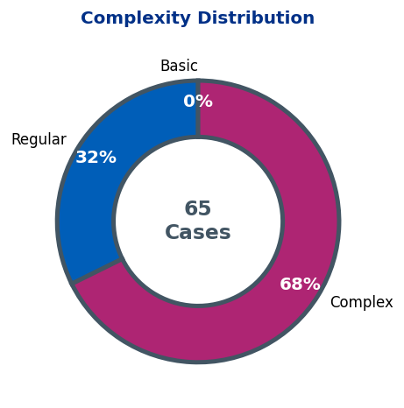
GHH EXEC TEAM | Complaint Complexity Distribution

Slide 15
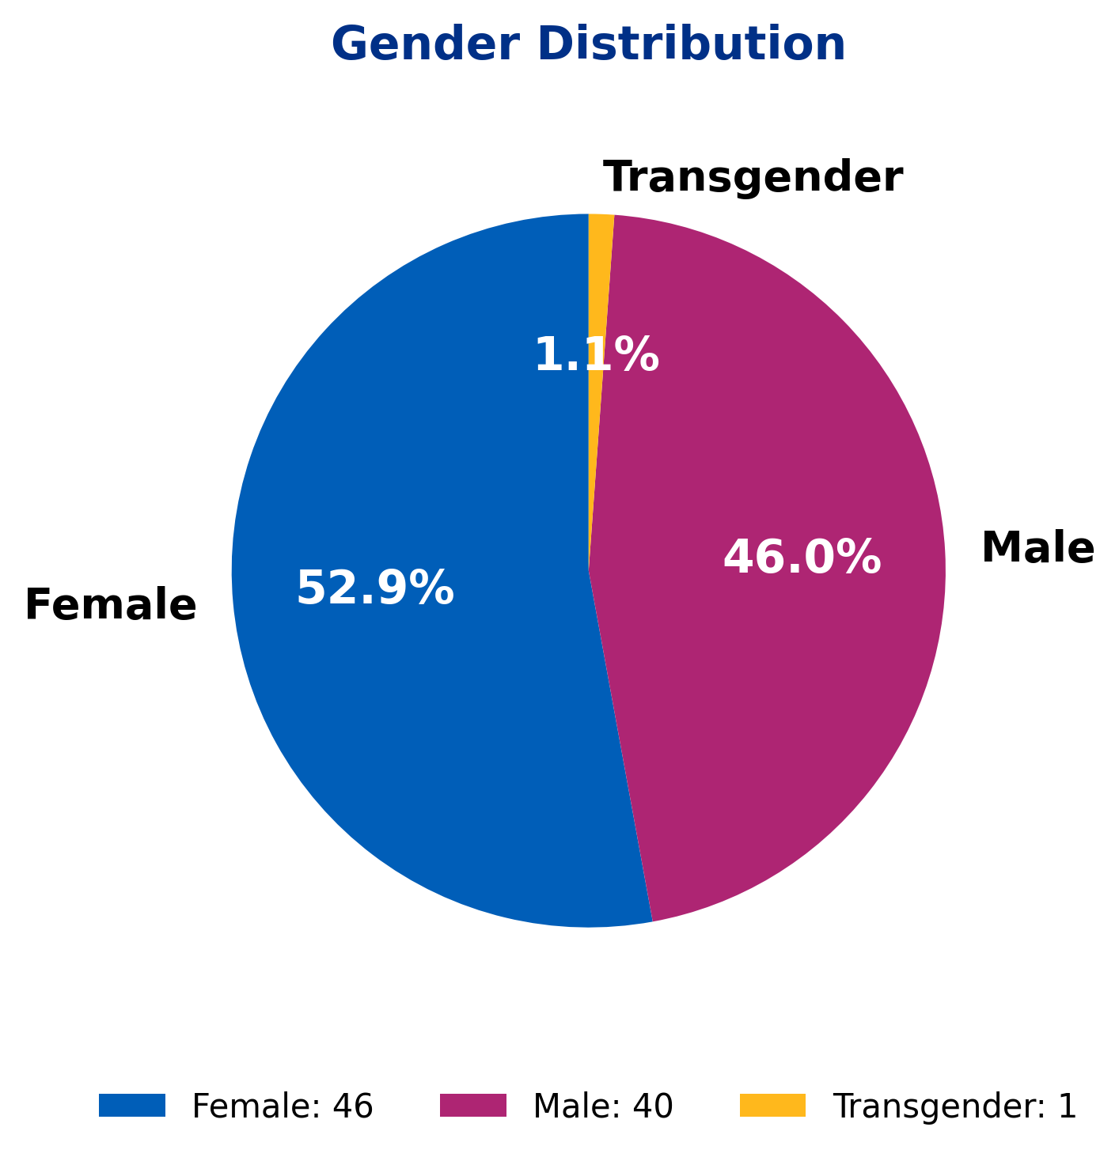
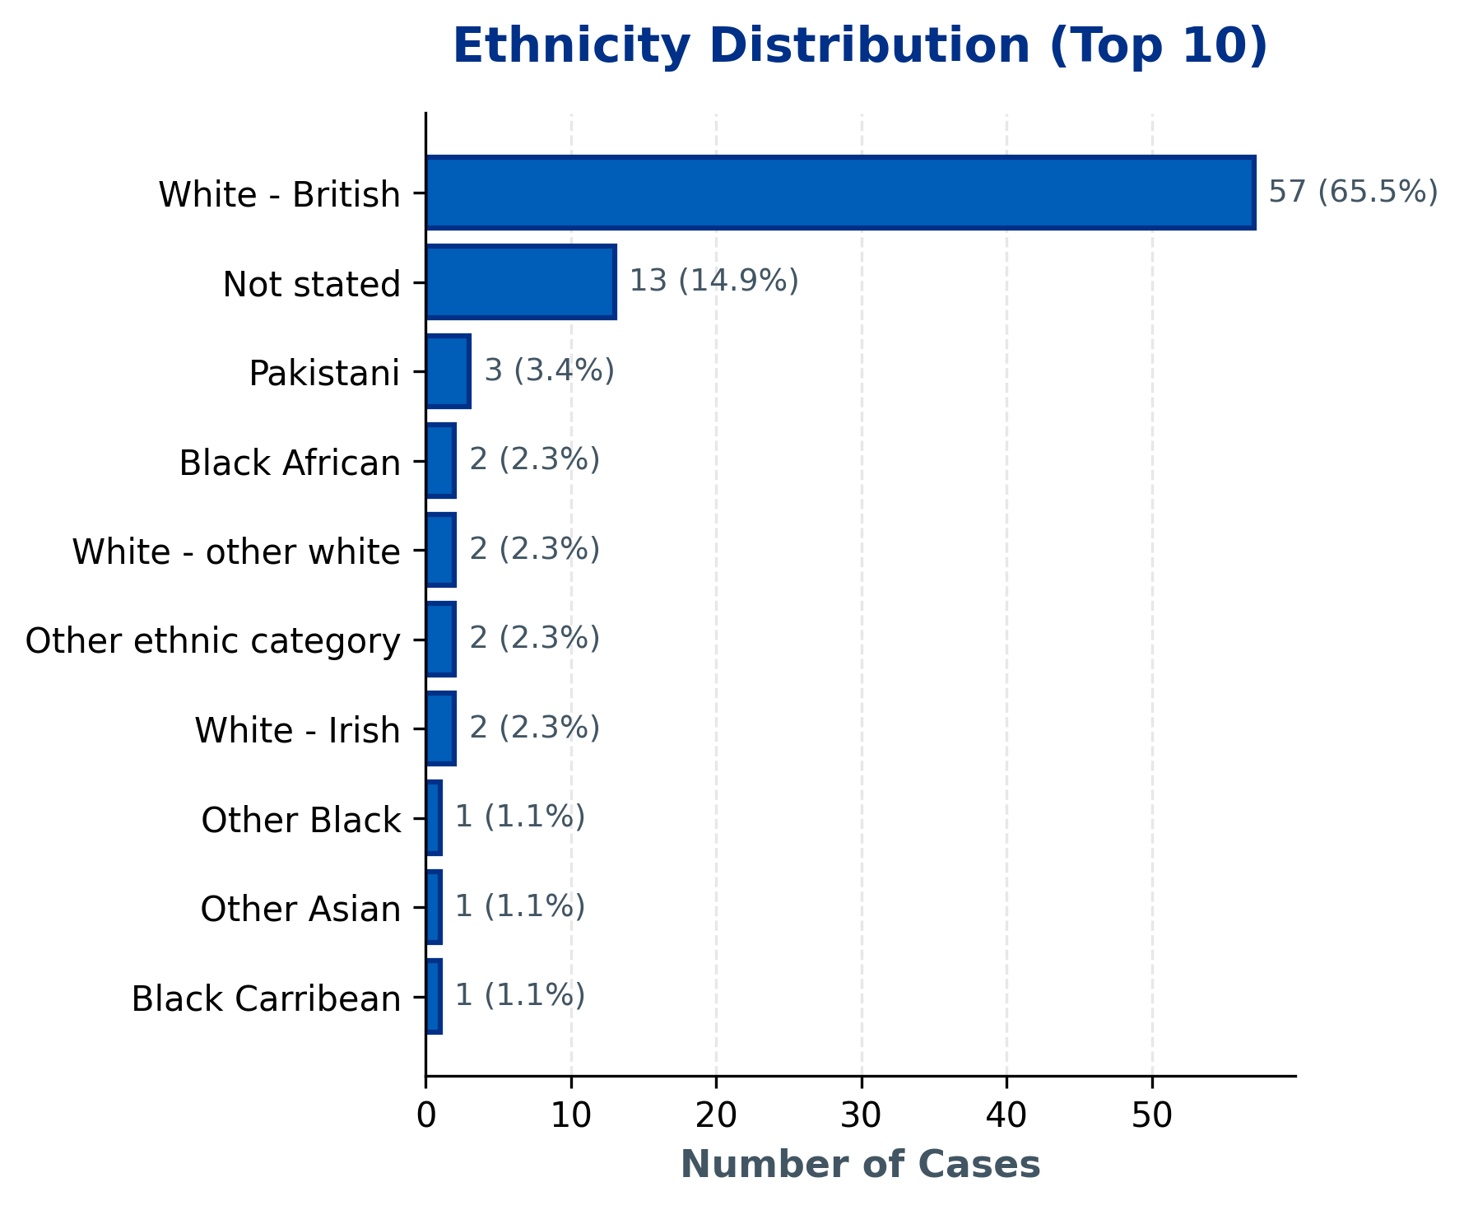
GHH EXEC TEAM | Demographics Overview
Statistical Findings:
• Topic 6 shows association with gender (p=0.011)
• Topic 1 shows association with gender (p=0.043)
Current Period: 87 total cases | Note: Age data not available in current dataset.

Slide 16
GHH EXEC TEAM | 10 Oldest Cases
This slide must be completed manually by the HPEG lead.
Contains patient identifiable information - add details of the 10 oldest ongoing cases including: ID, Date Received, Days Open, Specialty, Subject, and brief description.
Use table format for clarity.

Slide 17
GHH EXEC TEAM | Actions Status
Insert the Actions data for this HPEG
Outstanding Actions from Last Report
• [Add action item here]
• [Add action item here]
• [Add action item here]
New Actions Identified This Quarter
• [Add action item here]
• [Add action item here]
• [Add action item here]
Completed Actions
• [Add action item here]
• [Add action item here]
• [Add action item here]

Slide 18
GHH EXEC TEAM | Current Performance & Key Achievements
Insert most recent DoNs table for this HPEG
Performance Highlights
[Add narrative here - key achievements, notable improvements, strategic priorities]
Areas for Improvement / Focus
[Add narrative here - key achievements, notable improvements, strategic priorities]

