Slide 1
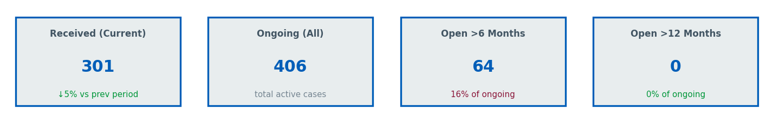
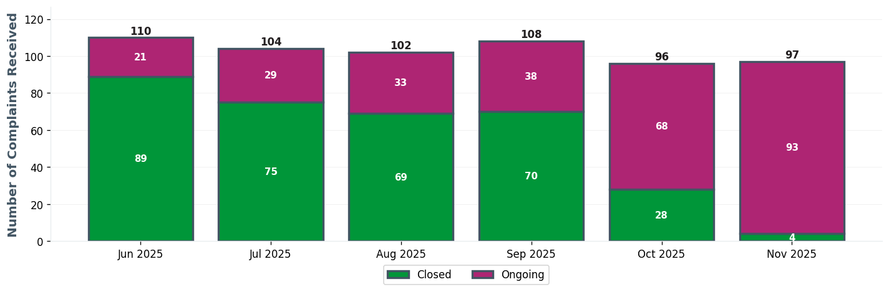
QEH EXEC TEAM | Executive Dashboard
⚠ 64 cases open >6 months

Slide 2
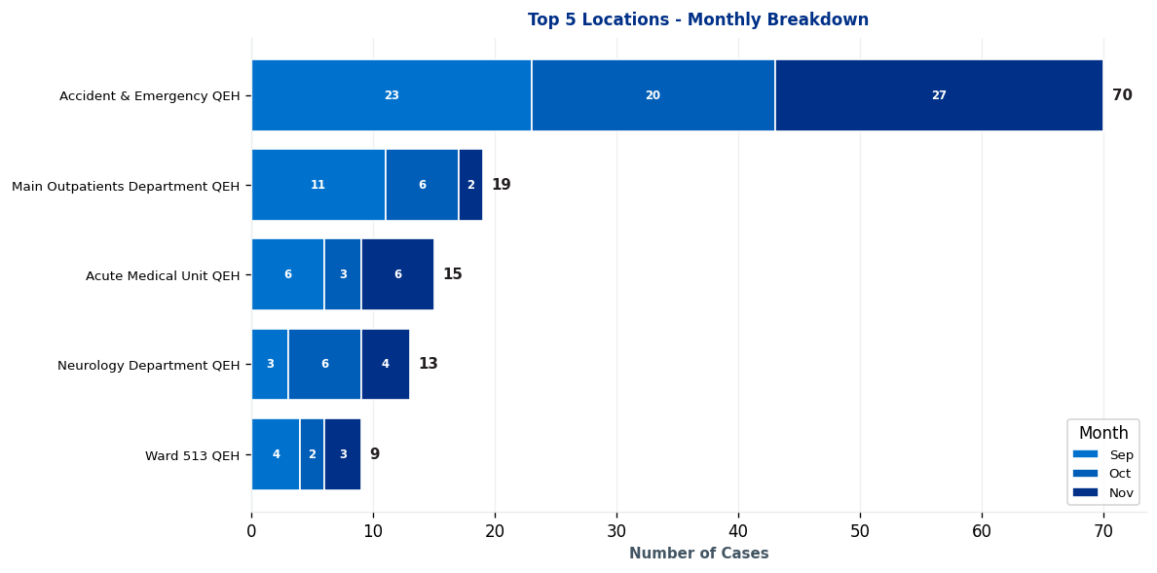
QEH EXEC TEAM | Complaints by Location

Slide 3
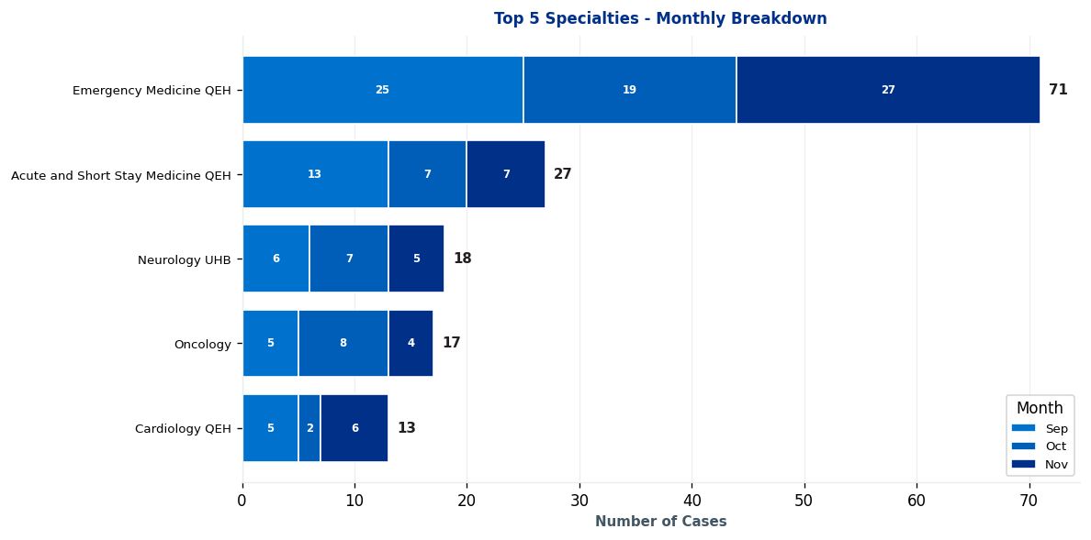
QEH EXEC TEAM | Complaints by Specialty

Slide 4
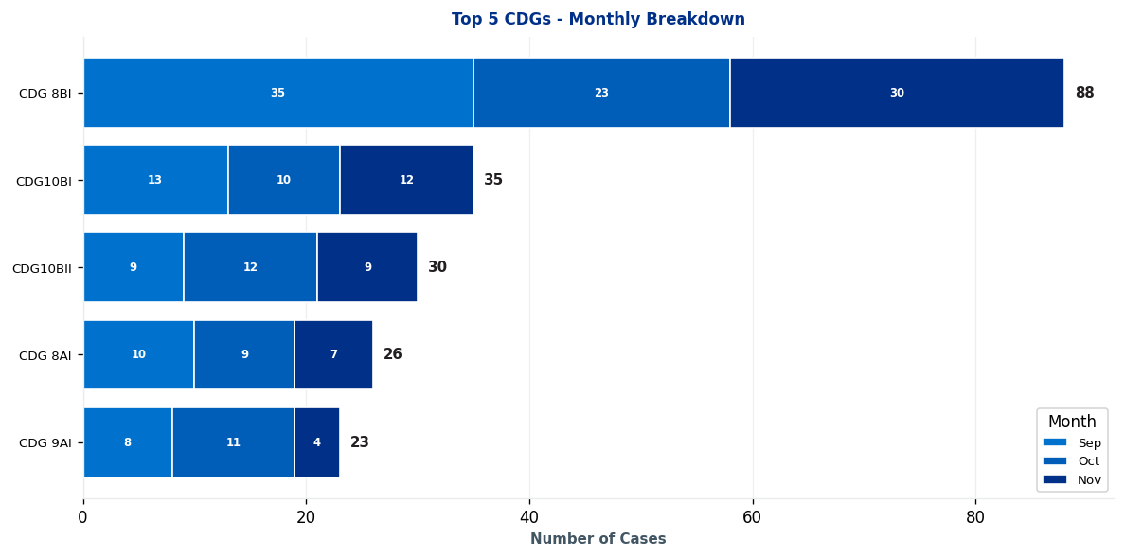
QEH EXEC TEAM | Clinical Decision Group (CDG) Breakdown

Slide 5
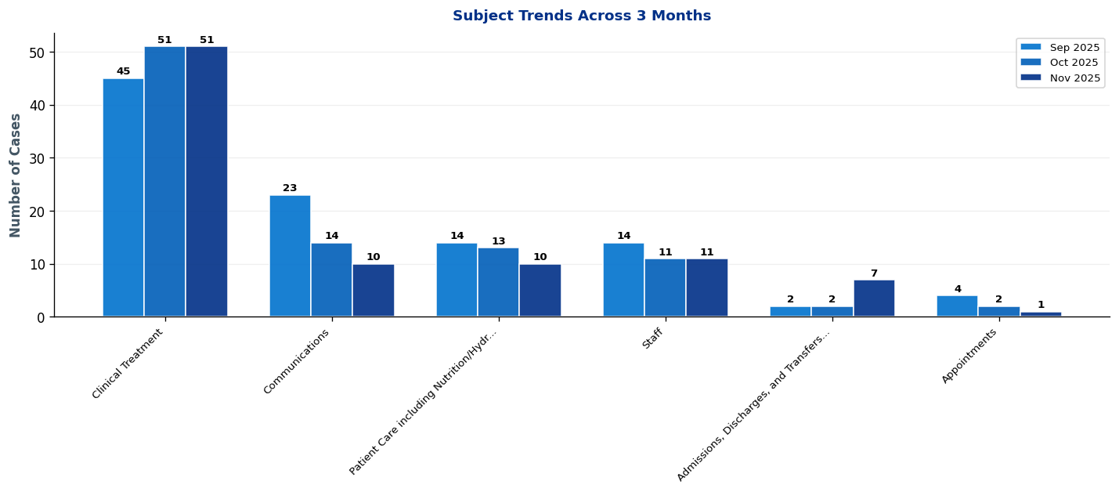
QEH EXEC TEAM | What's Changing? - Subject Trends

Slide 6
QEH EXEC TEAM | Intelligence Report: Key Trends & Patterns
EXECUTIVE SUMMARY: 4 significant trends identified • 1 increases, 3 decreases • Latest month (November 2025) vs previous 2-month average
▲ AREAS OF INCREASE
CDG10AI [MEDIUM] ↑ 6 cases (186%)
Main themes: Clinical Treatment, communications, and admissions, discharges, and transfers (excluding delayed discharge due to absence of care package)
→ Monitor closely and schedule review if trend continues next month
▼ AREAS OF DECREASE
CDG 9AI [POSITIVE] ↓ 5 cases (58%)
Main themes: Waiting Times, end of life care, and clinical treatment
→ Positive trend - continue current approach
CDG10AII [POSITIVE] ↓ 3 cases (38%)
Main themes: Clinical Treatment, patient care including nutrition/hydration, and communications
→ Positive trend - continue current approach

Slide 7
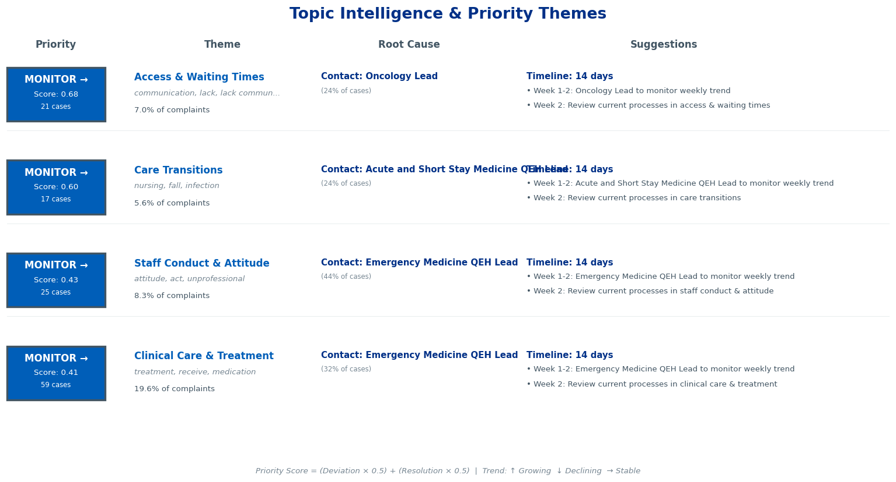
QEH EXEC TEAM | Topic Intelligence & Priority Themes

Slide 8
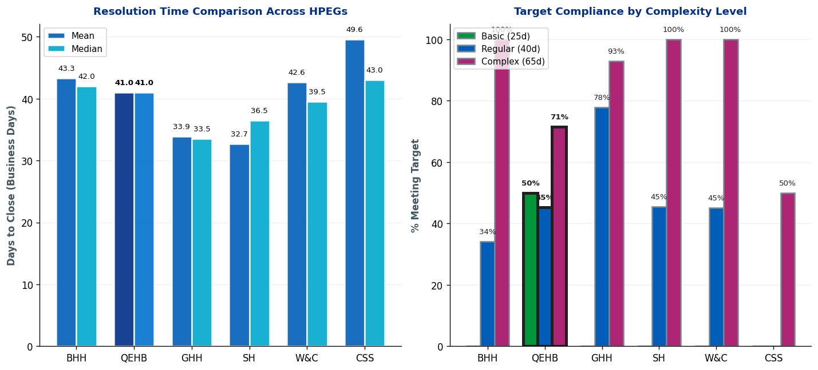
QEH EXEC TEAM | Complaint Resolution Efficiency

Slide 9
QEH EXEC TEAM | Resolution Time Trends by CDG
Current Period (Oct 25-Dec 25) vs 12-Month Rolling Average
1. CDG 9BII
Current period median: 119.0 days • 12-month rolling median: 52.0 days
⚠ Worsening: 67.0 days ABOVE 12-month average • Above target - requires attention
2. CDG 9AII
Current period median: 117.0 days • 12-month rolling median: 67.0 days
⚠ Worsening: 50.0 days ABOVE 12-month average • Above target - requires attention
3. CDG 9AI
Current period median: 76.0 days • 12-month rolling median: 70.0 days
⚠ Worsening: 6.0 days ABOVE 12-month average • Above target - requires attention
4. CDG 9AIII
Current period median: 73.5 days • 12-month rolling median: 67.0 days
⚠ Worsening: 6.5 days ABOVE 12-month average • Above target - requires attention
5. CDG10AII
Current period median: 62.0 days • 12-month rolling median: 69.0 days
✓ Improving: 7.0 days BELOW 12-month average • Acceptable (within Complex target)
Showing top 5 of 14 CDGs by current median. Targets: Basic=25d, Regular=40d, Complex=65d

Slide 10
QEH EXEC TEAM | Resolution Time Trends by Specialty
Current Period (Oct 25-Dec 25) vs 12-Month Rolling Average
1. Acute and Short Stay Medicine QEH
Current period median: 60.5 days • 12-month rolling median: 60.5 days
Stable: matching 12-month average • Acceptable (within Complex target)
2. Neurology UHB
Current period median: 60.0 days • 12-month rolling median: 60.0 days
Stable: matching 12-month average • Acceptable (within Complex target)
3. Emergency Medicine QEH
Current period median: 54.0 days • 12-month rolling median: 68.5 days
✓ Improving: 14.5 days BELOW 12-month average • Acceptable (within Complex target)
4. Neurosurgery QEH
Current period median: 45.0 days • 12-month rolling median: 47.0 days
✓ Improving: 2.0 days BELOW 12-month average • Acceptable (within Complex target)
5. Oncology
Current period median: 45.0 days • 12-month rolling median: 60.0 days
✓ Improving: 15.0 days BELOW 12-month average • Acceptable (within Complex target)
Targets: Basic=25 days, Regular=40 days, Complex=65 days

Slide 11
QEH EXEC TEAM | Resolution Time by Complexity Level (Closed Cases Only)
Resolution Times & Performance Metrics for Oct 25-Dec 25 (Business Days)
Basic
Mean: 24.5 days
Median: 24.5 days
Cases: 2
Target: 25 days
Regular
Mean: 41.5 days
Median: 41.0 days
Cases: 86
Target: 40 days
Complex
Mean: 40.1 days
Median: 35.5 days
Cases: 14
Target: 65 days
Performance Summary
Basic: 2 cases • Avg: 24.5 days • Target: 25 days • ✓ Meeting target • 50% compliant
Regular: 86 cases • Avg: 41.5 days • Target: 40 days • ⚠ 1.5 days over target • 45% compliant
Complex: 14 cases • Avg: 40.1 days • Target: 65 days • ✓ Meeting target • 71% compliant
Overall: 102 total cases • 49.0% overall compliance
Targets: Basic=25d, Regular=40d, Complex=65d

Slide 12
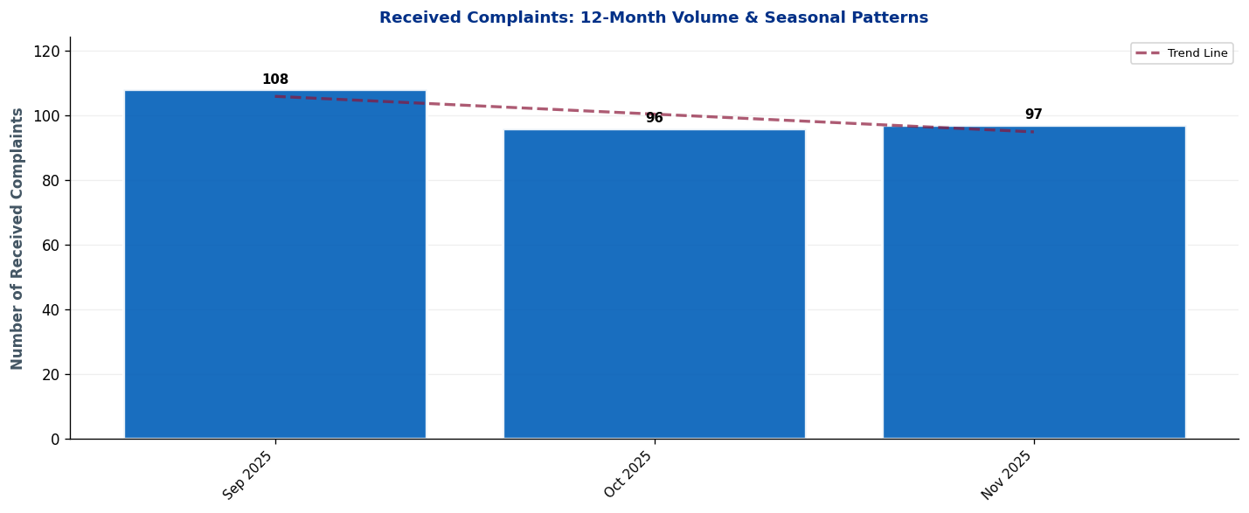
QEH EXEC TEAM | Seasonal Patterns & Volume Trends
Analysis: Trend line shows overall trajectory. Look for seasonal peaks (e.g., winter pressures) and dips.

Slide 13
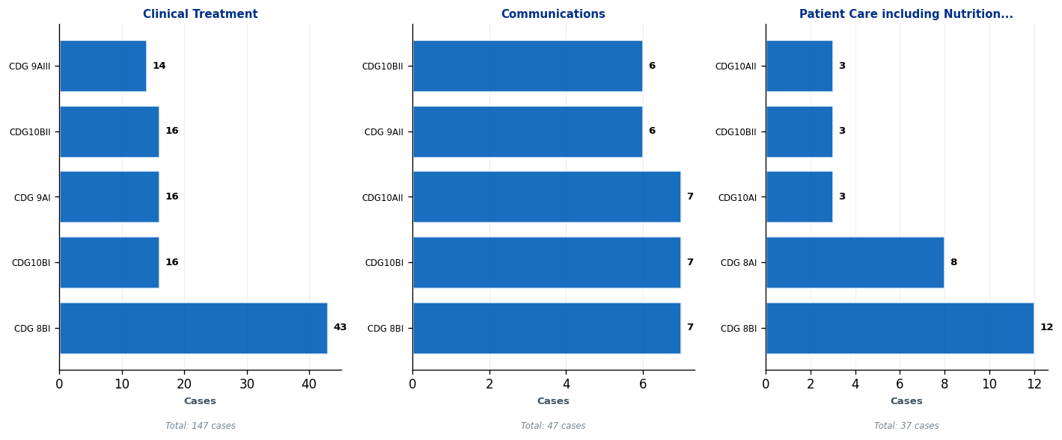
QEH EXEC TEAM | Subject Deep-Dive: Top 3 Complaint Themes
Each panel shows the top 5 CDGs contributing to that subject. Use this to identify which teams need targeted interventions.

Slide 14
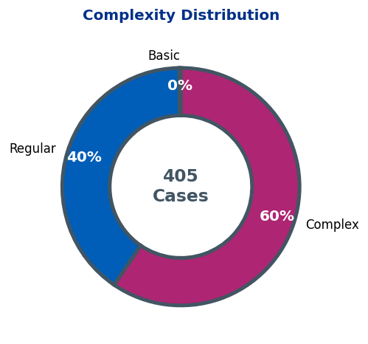
QEH EXEC TEAM | Complaint Complexity Distribution

Slide 15
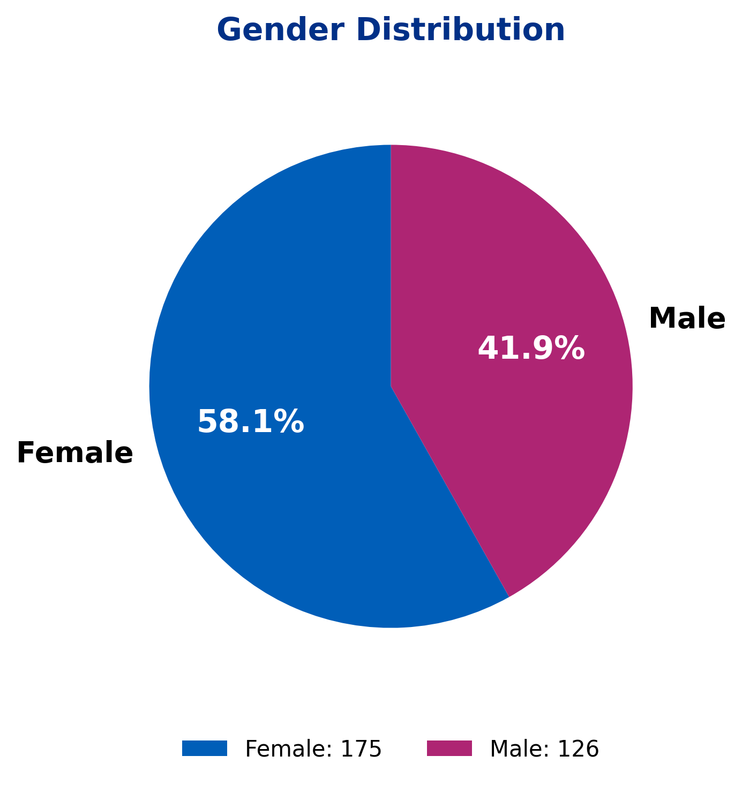
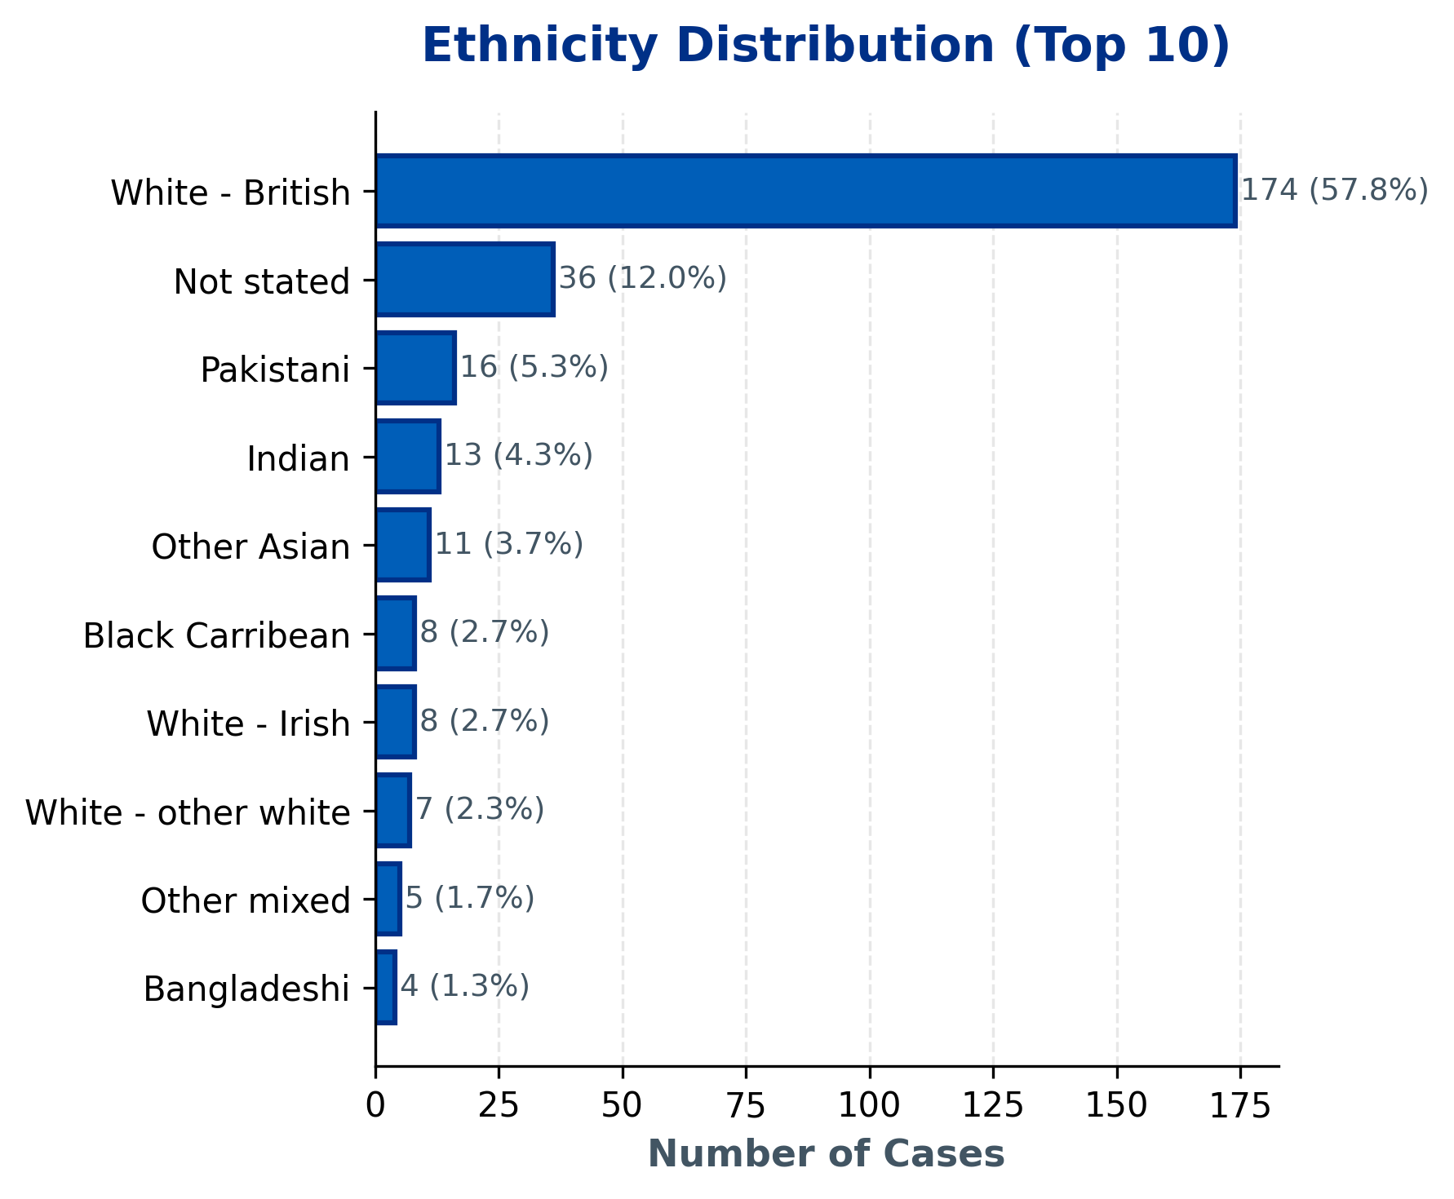
QEH EXEC TEAM | Demographics Overview
Statistical Findings:
• Topic 6 shows association with gender (p=0.011)
• Topic 1 shows association with gender (p=0.043)
Current Period: 301 total cases | Note: Age data not available in current dataset.

Slide 16
QEH EXEC TEAM | 10 Oldest Cases
This slide must be completed manually by the HPEG lead.
Contains patient identifiable information - add details of the 10 oldest ongoing cases including: ID, Date Received, Days Open, Specialty, Subject, and brief description.
Use table format for clarity.

Slide 17
QEH EXEC TEAM | Actions Status
Insert the Actions data for this HPEG
Outstanding Actions from Last Report
• [Add action item here]
• [Add action item here]
• [Add action item here]
New Actions Identified This Quarter
• [Add action item here]
• [Add action item here]
• [Add action item here]
Completed Actions
• [Add action item here]
• [Add action item here]
• [Add action item here]

Slide 18
QEH EXEC TEAM | Current Performance & Key Achievements
Insert most recent DoNs table for this HPEG
Performance Highlights
[Add narrative here - key achievements, notable improvements, strategic priorities]
Areas for Improvement / Focus
[Add narrative here - key achievements, notable improvements, strategic priorities]

