Slide 1
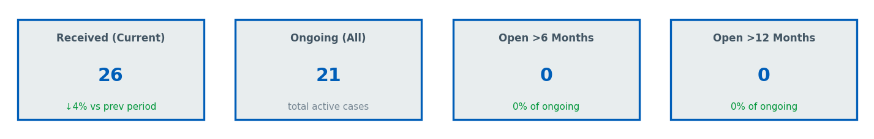
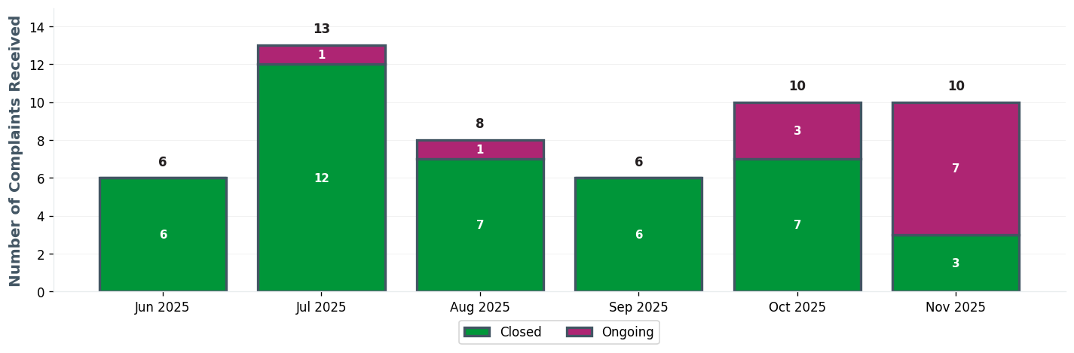
SH EXEC TEAM | Executive Dashboard

Slide 2
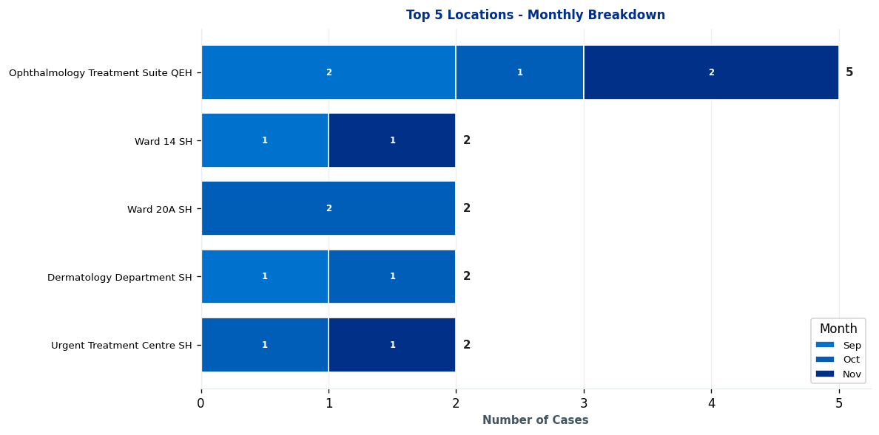
SH EXEC TEAM | Complaints by Location

Slide 3
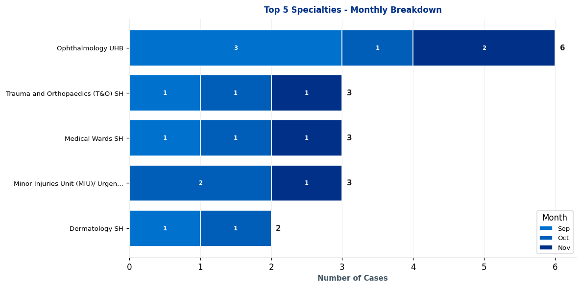
SH EXEC TEAM | Complaints by Specialty

Slide 4
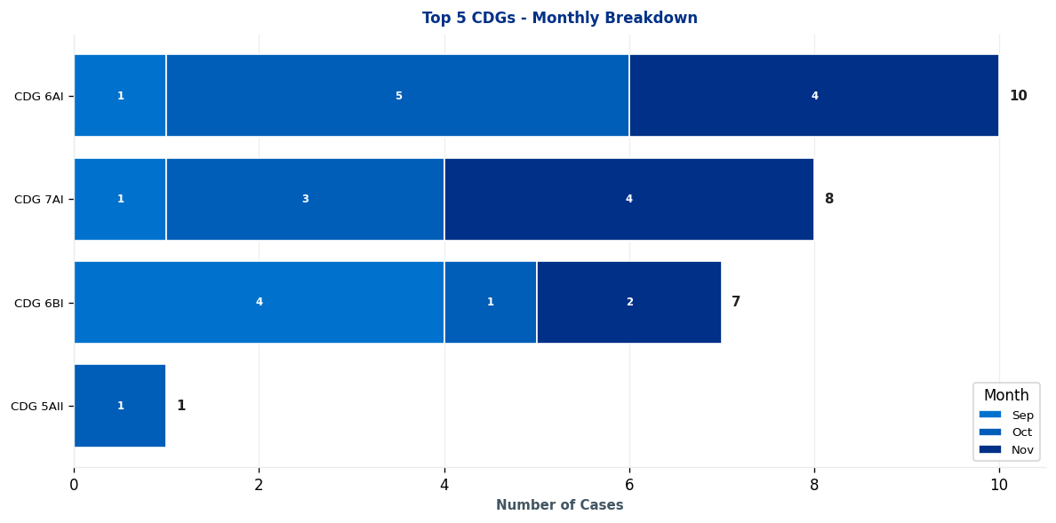
SH EXEC TEAM | Clinical Decision Group (CDG) Breakdown

Slide 5
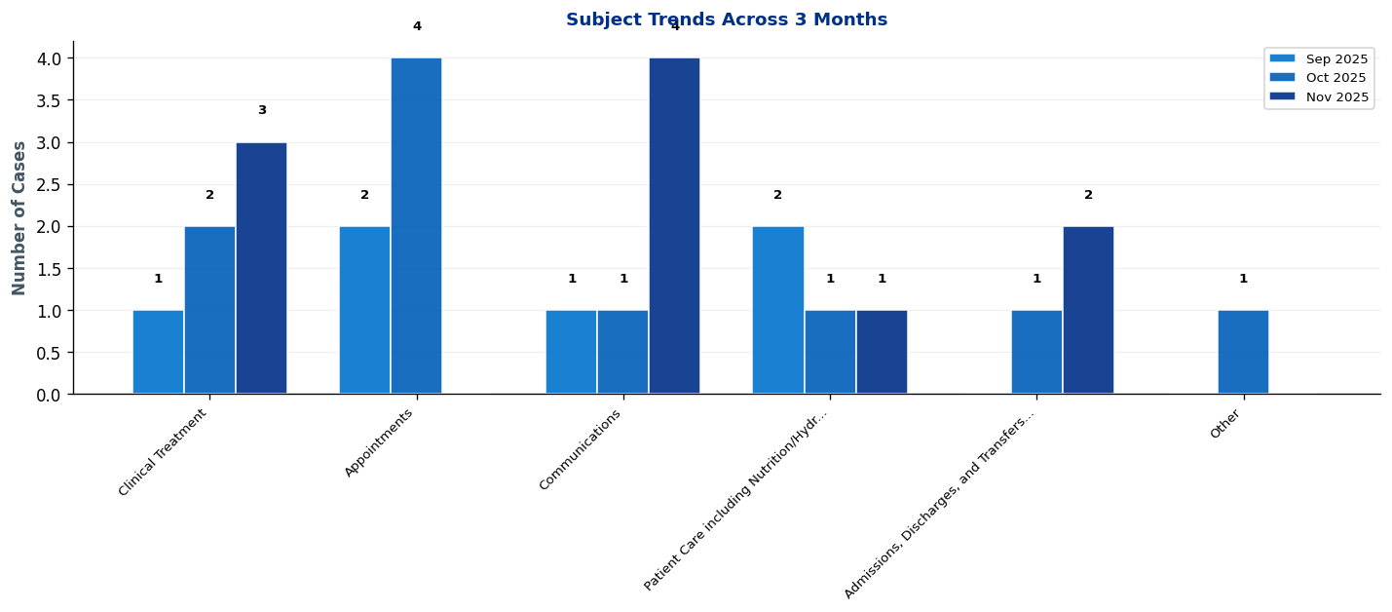
SH EXEC TEAM | What's Changing? - Subject Trends

Slide 6
SH EXEC TEAM | Intelligence Report: Key Trends & Patterns
No significant trends detected for this period.

Slide 7
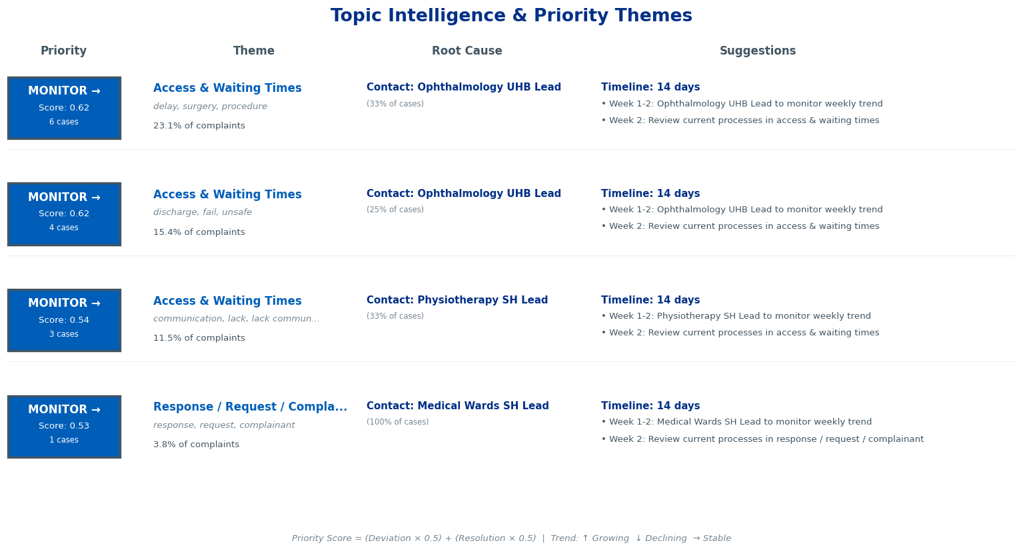
SH EXEC TEAM | Topic Intelligence & Priority Themes

Slide 8
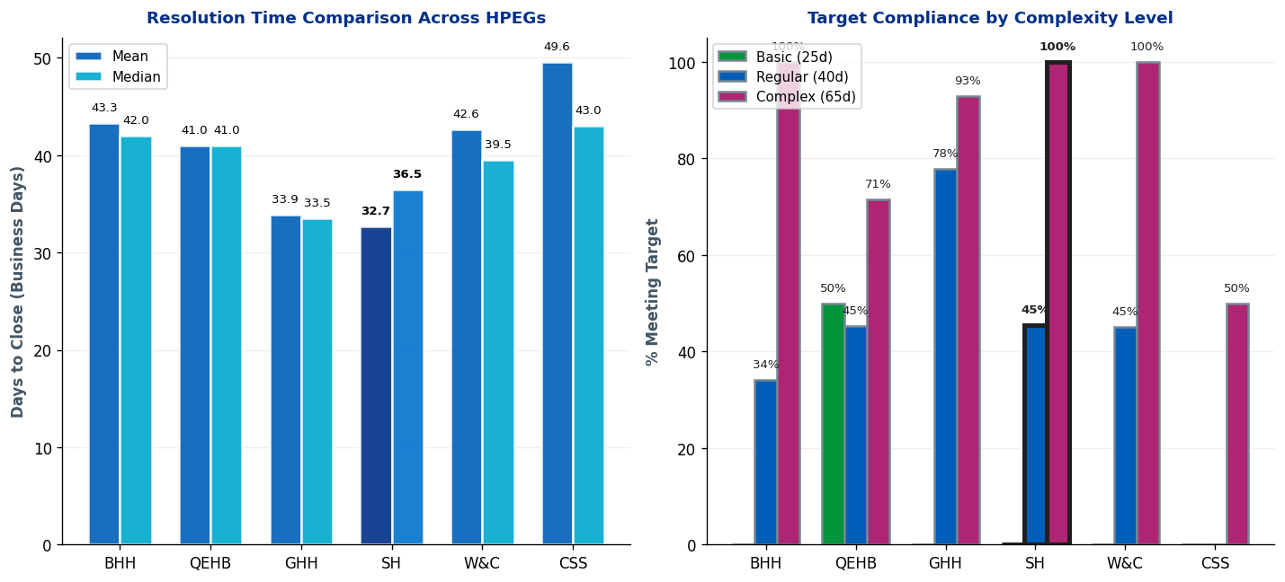
SH EXEC TEAM | Complaint Resolution Efficiency

Slide 9
SH EXEC TEAM | Resolution Time Trends by CDG
Current Period (Oct 25-Dec 25) vs 12-Month Rolling Average
1. CDG 7AI
Current period median: 49.2 days • 12-month rolling median: 44.0 days
⚠ Worsening: 5.2 days ABOVE 12-month average • Acceptable (within Complex target)
2. CDG 6BI
Current period median: 41.5 days • 12-month rolling median: 40.0 days
⚠ Worsening: 1.5 days ABOVE 12-month average • Acceptable (within Complex target)
3. CDG 6AI
Current period median: 35.0 days • 12-month rolling median: 40.0 days
✓ Improving: 5.0 days BELOW 12-month average • Good (within Regular target)
4. CDG 5AII
Current period median: 34.0 days • 12-month rolling median: 28.0 days
⚠ Worsening: 6.0 days ABOVE 12-month average • Good (within Regular target)
Targets: Basic=25 days, Regular=40 days, Complex=65 days

Slide 10
SH EXEC TEAM | Resolution Time Trends by Specialty
No specialty trend data available for this HPEG

Slide 11
SH EXEC TEAM | Resolution Time by Complexity Level (Closed Cases Only)
Resolution Times & Performance Metrics for Oct 25-Dec 25 (Business Days)
Regular
Mean: 38.5 days
Median: 41.0 days
Cases: 11
Target: 40 days
Complex
Mean: 19.8 days
Median: 9.0 days
Cases: 5
Target: 65 days
Performance Summary
Regular: 11 cases • Avg: 38.5 days • Target: 40 days • ✓ Meeting target • 45% compliant
Complex: 5 cases • Avg: 19.8 days • Target: 65 days • ✓ Meeting target • 100% compliant
Overall: 16 total cases • 62.5% overall compliance
Targets: Basic=25d, Regular=40d, Complex=65d

Slide 12
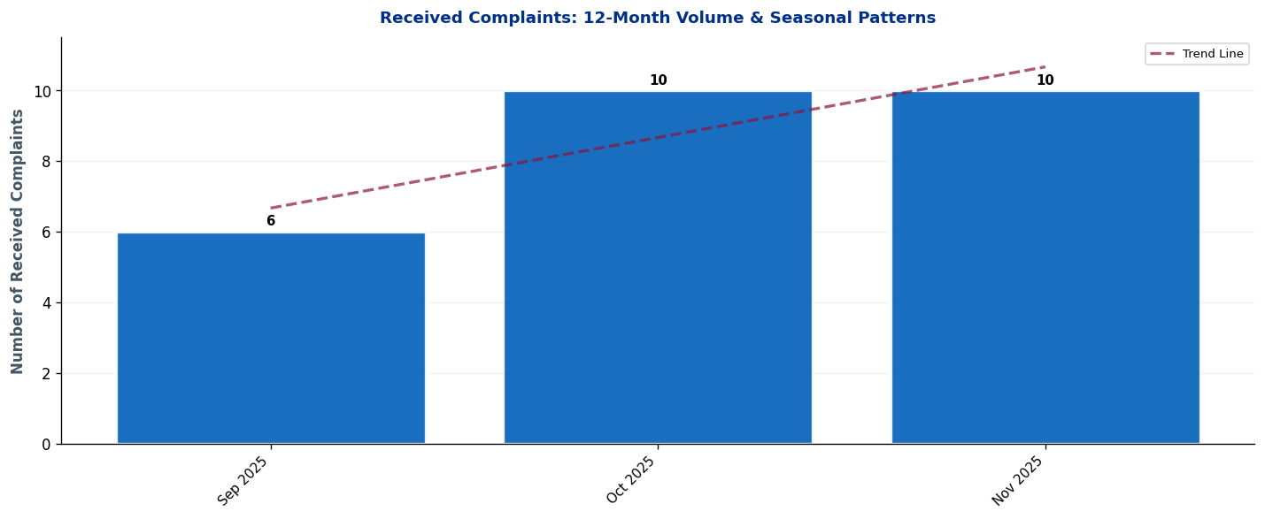
SH EXEC TEAM | Seasonal Patterns & Volume Trends
Analysis: Trend line shows overall trajectory. Look for seasonal peaks (e.g., winter pressures) and dips.

Slide 13
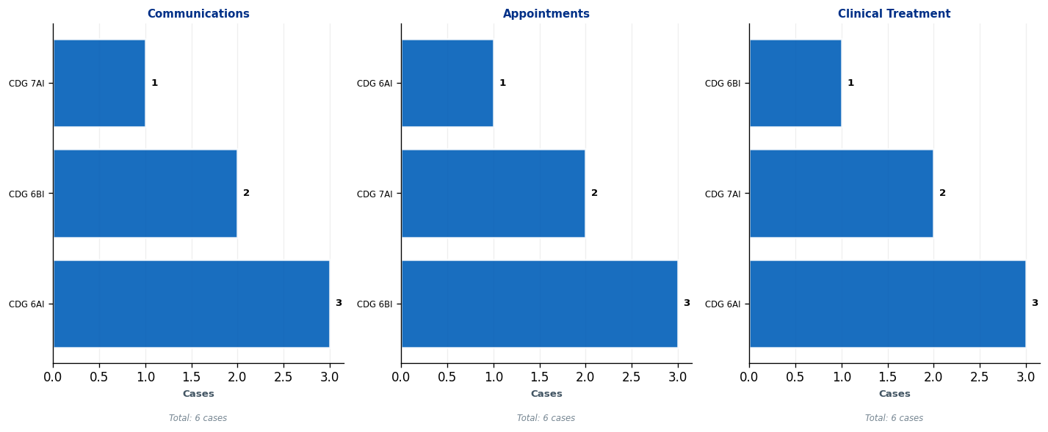
SH EXEC TEAM | Subject Deep-Dive: Top 3 Complaint Themes
Each panel shows the top 5 CDGs contributing to that subject. Use this to identify which teams need targeted interventions.

Slide 14
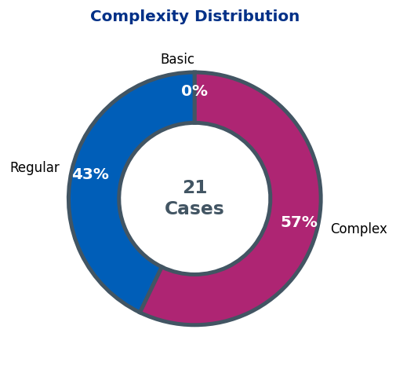
SH EXEC TEAM | Complaint Complexity Distribution

Slide 15
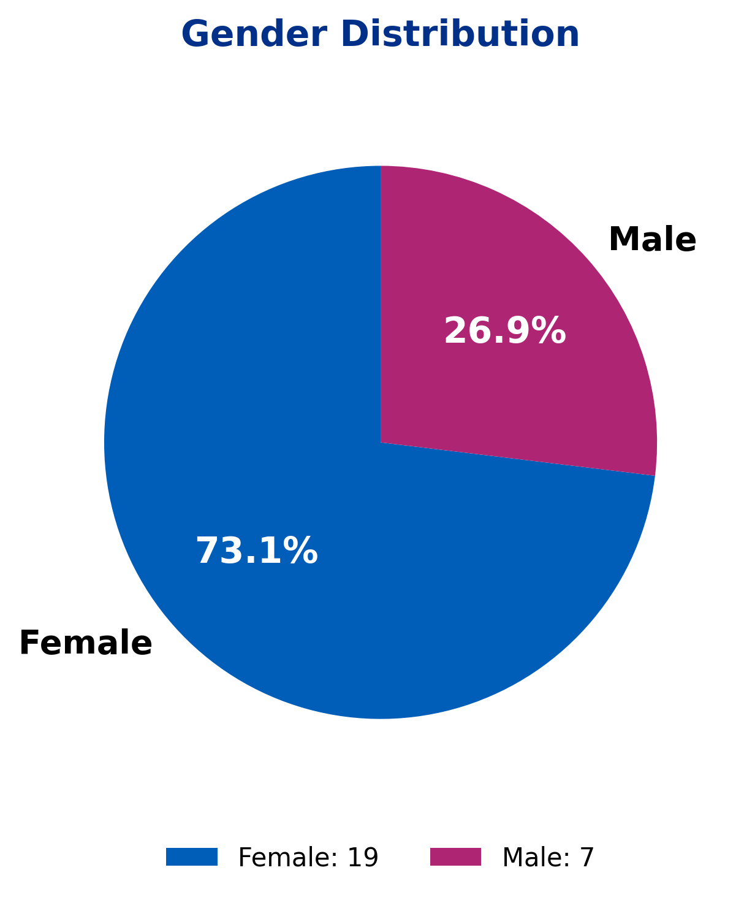
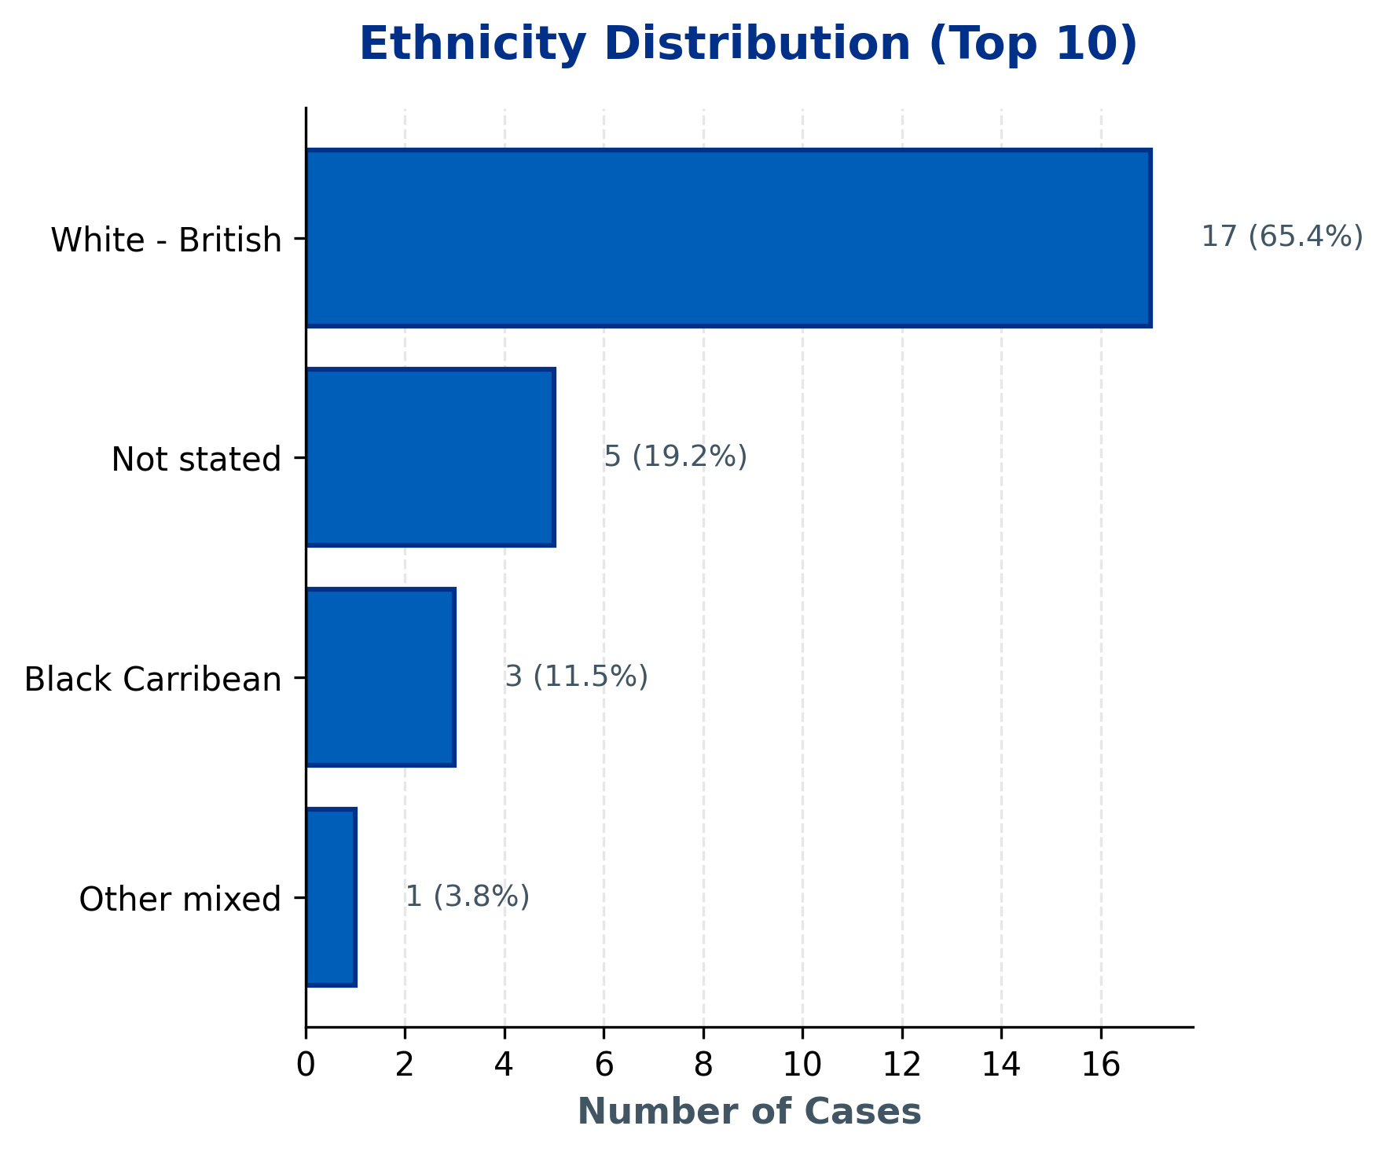
SH EXEC TEAM | Demographics Overview
Statistical Findings:
• Topic 6 shows association with gender (p=0.011)
• Topic 1 shows association with gender (p=0.043)
Current Period: 26 total cases | Note: Age data not available in current dataset.

Slide 16
SH EXEC TEAM | 10 Oldest Cases
This slide must be completed manually by the HPEG lead.
Contains patient identifiable information - add details of the 10 oldest ongoing cases including: ID, Date Received, Days Open, Specialty, Subject, and brief description.
Use table format for clarity.

Slide 17
SH EXEC TEAM | Actions Status
Insert the Actions data for this HPEG
Outstanding Actions from Last Report
• [Add action item here]
• [Add action item here]
• [Add action item here]
New Actions Identified This Quarter
• [Add action item here]
• [Add action item here]
• [Add action item here]
Completed Actions
• [Add action item here]
• [Add action item here]
• [Add action item here]

Slide 18
SH EXEC TEAM | Current Performance & Key Achievements
Insert most recent DoNs table for this HPEG
Performance Highlights
[Add narrative here - key achievements, notable improvements, strategic priorities]
Areas for Improvement / Focus
[Add narrative here - key achievements, notable improvements, strategic priorities]

