Slide 1
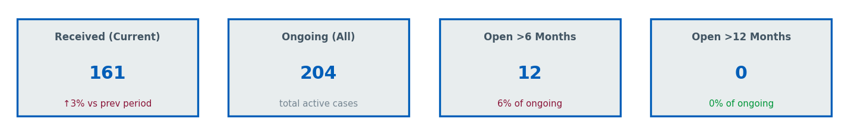
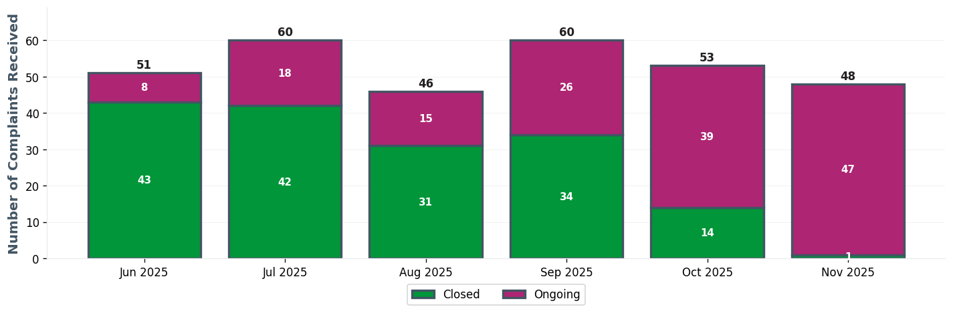
BHH EXEC TEAM | Executive Dashboard
⚠ 12 cases open >6 months

Slide 2
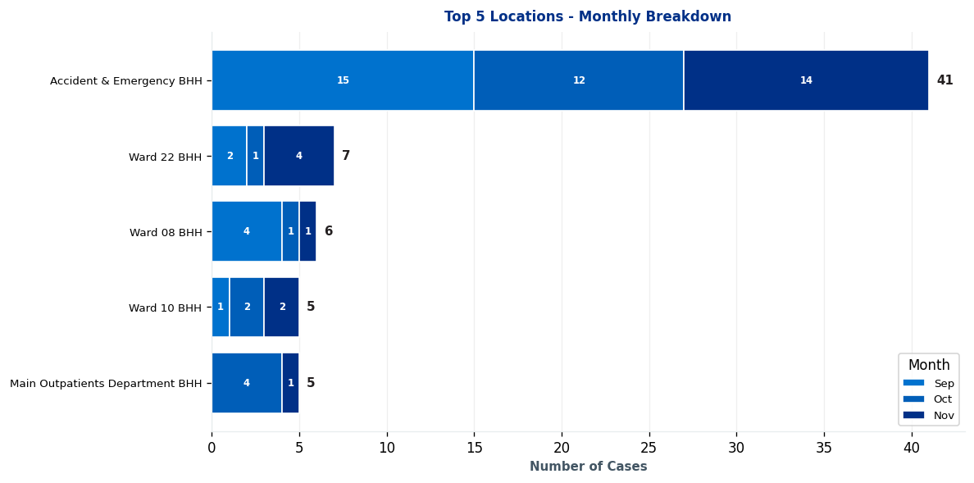
BHH EXEC TEAM | Complaints by Location

Slide 3
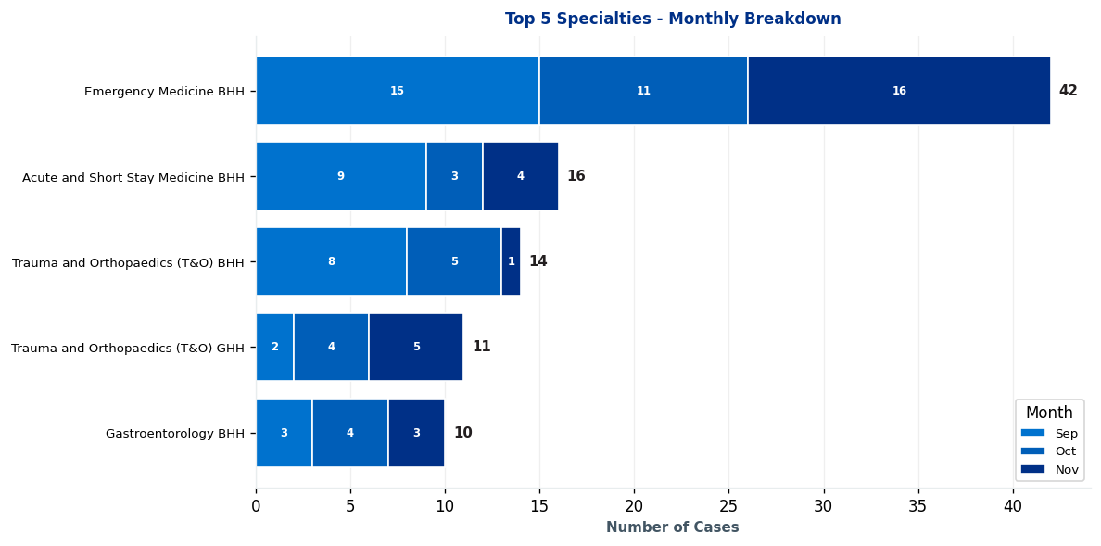
BHH EXEC TEAM | Complaints by Specialty

Slide 4
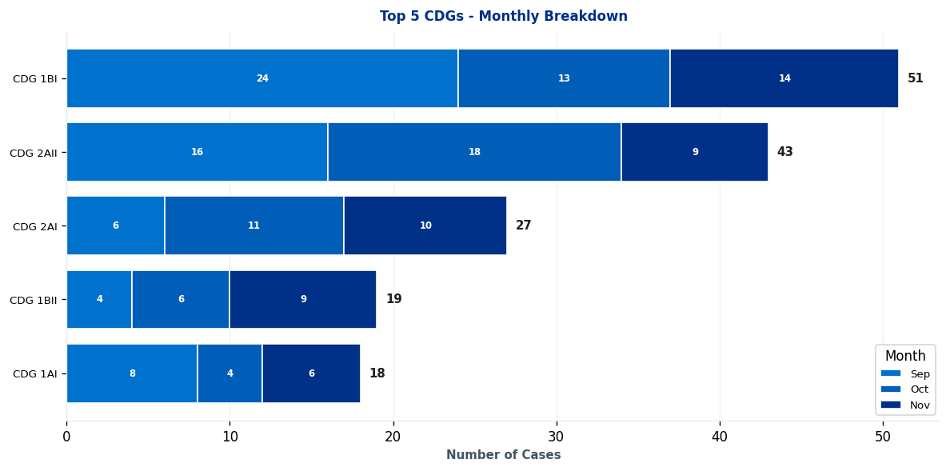
BHH EXEC TEAM | Clinical Decision Group (CDG) Breakdown

Slide 5
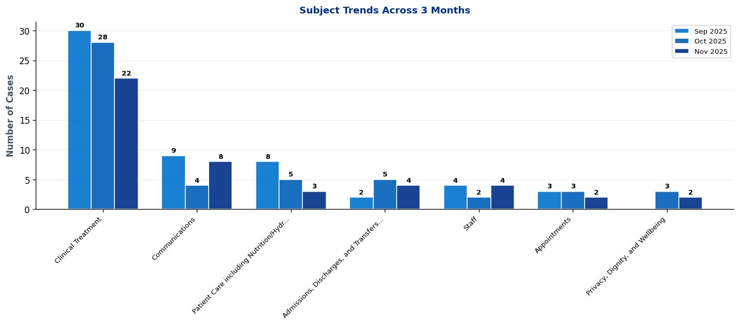
BHH EXEC TEAM | What's Changing? - Subject Trends

Slide 6
BHH EXEC TEAM | Intelligence Report: Key Trends & Patterns
EXECUTIVE SUMMARY: 3 significant trends identified • 1 increases, 2 decreases • Latest month (November 2025) vs previous 2-month average
▲ AREAS OF INCREASE
CDG 1BII [MONITOR] ↑ 4 cases (80%)
Main themes: Clinical Treatment, admissions, discharges, and transfers (excluding delayed discharge due to absence of care package), and communications
→ Continue monitoring - early trend indication
▼ AREAS OF DECREASE
CDG 2AII [POSITIVE] ↓ 8 cases (47%)
Main themes: Clinical Treatment, staff, and admissions, discharges, and transfers (excluding delayed discharge due to absence of care package)
→ Positive trend - continue current approach
CDG 1BI [POSITIVE] ↓ 4 cases (24%)
Main themes: Clinical Treatment, privacy, dignity, and wellbeing, and communications
→ Positive trend - continue current approach

Slide 7
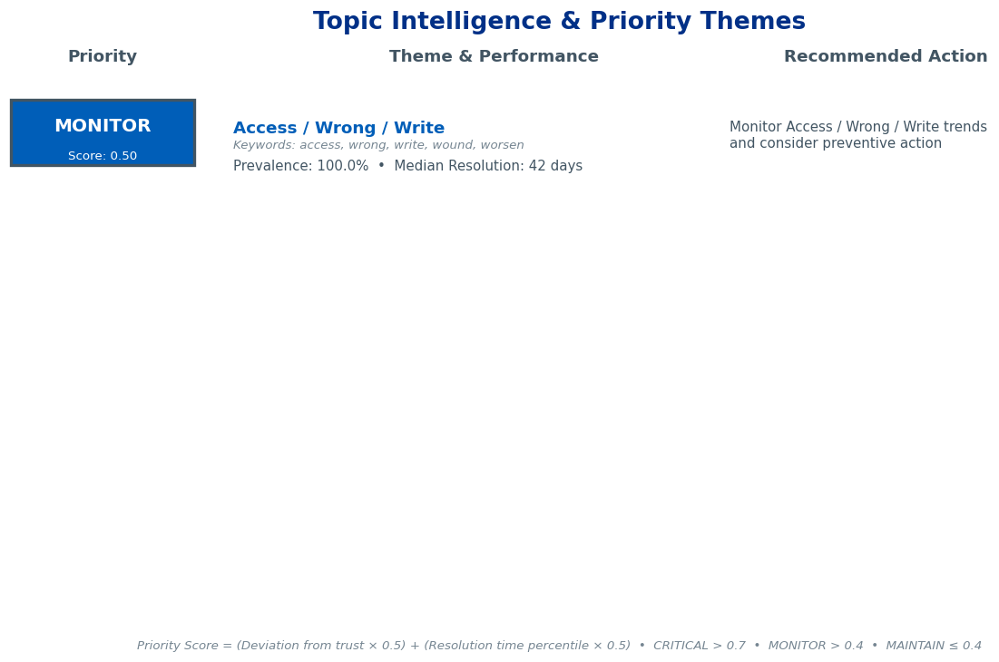
BHH EXEC TEAM | Topic Intelligence & Priority Themes

Slide 8
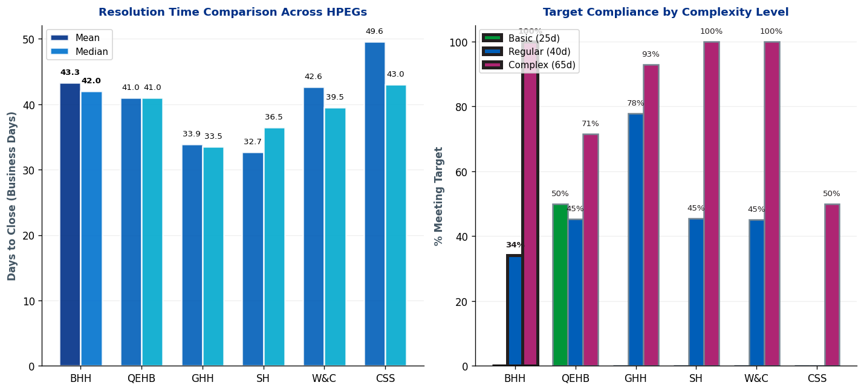
BHH EXEC TEAM | Complaint Resolution Efficiency

Slide 9
BHH EXEC TEAM | Resolution Time Trends by CDG
Current Period (Oct 25-Dec 25) vs 12-Month Rolling Average
1. CDG 2BI
Current period median: 121.0 days • 12-month rolling median: 55.0 days
⚠ Worsening: 66.0 days ABOVE 12-month average • Above target - requires attention
2. CDG 2AI
Current period median: 98.0 days • 12-month rolling median: 68.5 days
⚠ Worsening: 29.5 days ABOVE 12-month average • Above target - requires attention
3. CDG 1AI
Current period median: 79.0 days • 12-month rolling median: 62.0 days
⚠ Worsening: 17.0 days ABOVE 12-month average • Above target - requires attention
4. CDG 1AII
Current period median: 71.0 days • 12-month rolling median: 56.0 days
⚠ Worsening: 15.0 days ABOVE 12-month average • Above target - requires attention
5. CDG 1BI
Current period median: 64.0 days • 12-month rolling median: 64.0 days
Stable: matching 12-month average • Acceptable (within Complex target)
Showing top 5 of 7 CDGs by current median. Targets: Basic=25d, Regular=40d, Complex=65d

Slide 10
BHH EXEC TEAM | Resolution Time Trends by Specialty
Current Period (Oct 25-Dec 25) vs 12-Month Rolling Average
1. Acute and Short Stay Medicine BHH
Current period median: 69.0 days • 12-month rolling median: 69.0 days
Stable: matching 12-month average • Above target - requires attention
2. Acute and Short Stay Medicine QEH
Current period median: 60.5 days • 12-month rolling median: 60.5 days
Stable: matching 12-month average • Acceptable (within Complex target)
3. Emergency Medicine BHH
Current period median: 47.0 days • 12-month rolling median: 56.0 days
✓ Improving: 9.0 days BELOW 12-month average • Acceptable (within Complex target)
Targets: Basic=25 days, Regular=40 days, Complex=65 days

Slide 11
BHH EXEC TEAM | Resolution Time by Complexity Level
Resolution Times & Performance Metrics for Oct 25-Dec 25 (Business Days)
Regular
Mean: 44.0 days
Median: 43.5 days
Cases: 44
Target: 40 days
Complex
Mean: 37.0 days
Median: 41.0 days
Cases: 5
Target: 65 days
Performance Summary
Regular: 44 cases • Avg: 44.0 days • Target: 40 days • ⚠ 4.0 days over target • 34% compliant
Complex: 5 cases • Avg: 37.0 days • Target: 65 days • ✓ Meeting target • 100% compliant
Overall: 49 total cases • 40.8% overall compliance
Targets: Basic=25d, Regular=40d, Complex=65d

Slide 12
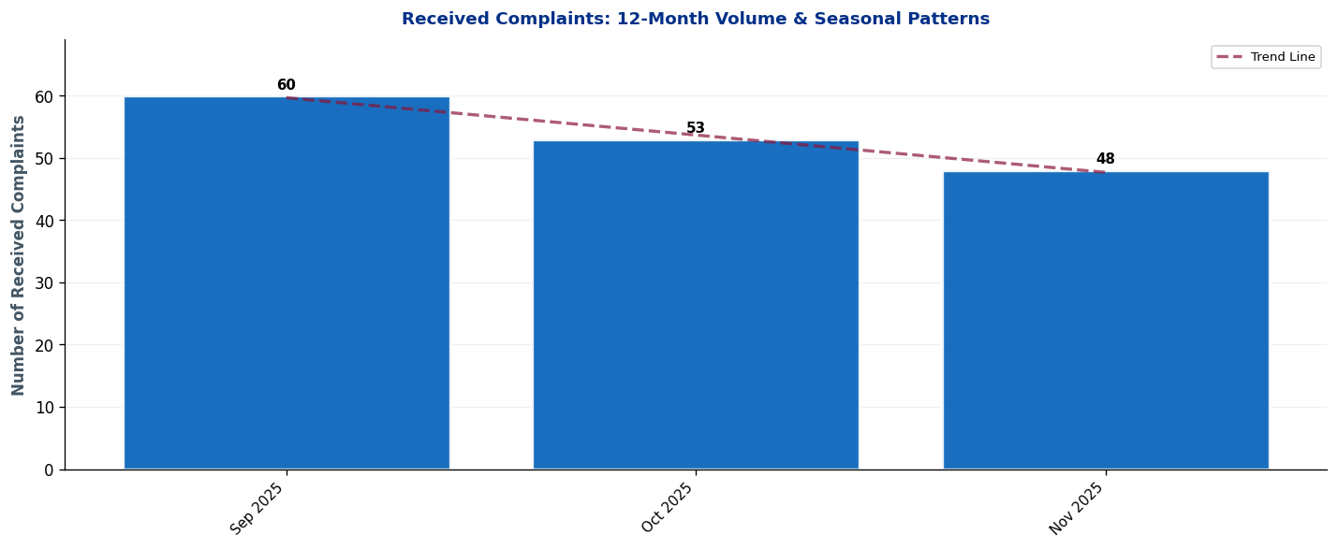
BHH EXEC TEAM | Seasonal Patterns & Volume Trends
Analysis: Trend line shows overall trajectory. Look for seasonal peaks (e.g., winter pressures) and dips.

Slide 13
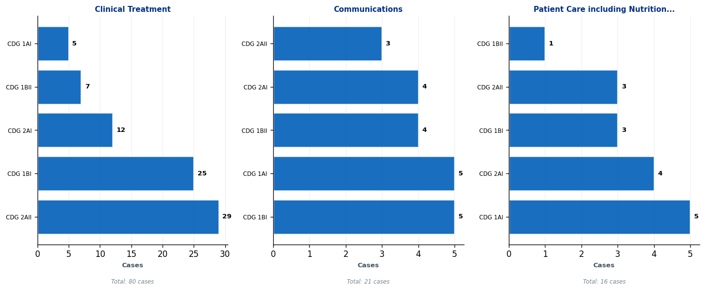
BHH EXEC TEAM | Subject Deep-Dive: Top 3 Complaint Themes
Each panel shows the top 5 CDGs contributing to that subject. Use this to identify which teams need targeted interventions.

Slide 14
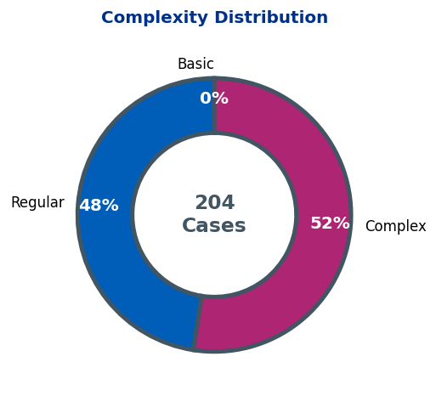
BHH EXEC TEAM | Complaint Complexity Distribution

Slide 15
BHH EXEC TEAM | Risk Dashboard
Cases Open >6 Months: 12
Detailed breakdowns available in operational dashboards.
Focus on specialty-level resolution for long-standing cases.

Slide 16
BHH EXEC TEAM | 10 Oldest Cases
This slide must be completed manually by the HPEG lead.
Contains patient identifiable information - add details of the 10 oldest ongoing cases including: ID, Date Received, Days Open, Specialty, Subject, and brief description.
Use table format for clarity.

Slide 17
BHH EXEC TEAM | Actions Status
Outstanding Actions from Last Report
• [Add action item here]
• [Add action item here]
• [Add action item here]
New Actions Identified This Quarter
• [Add action item here]
• [Add action item here]
• [Add action item here]
Completed Actions
• [Add action item here]
• [Add action item here]
• [Add action item here]

Slide 18
BHH EXEC TEAM | Current Performance & Key Achievements
Performance Highlights
[Add narrative here - key achievements, notable improvements, strategic priorities]
Areas for Improvement / Focus
[Add narrative here - key achievements, notable improvements, strategic priorities]

