Slide 1
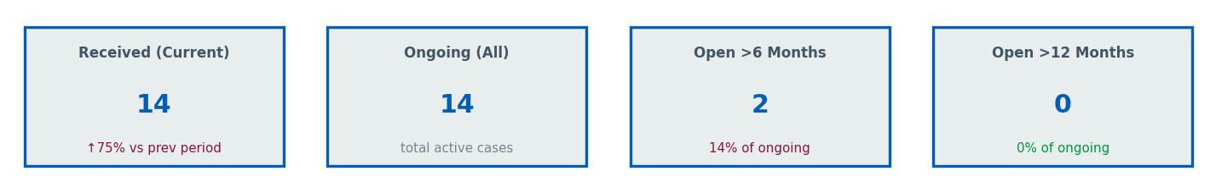
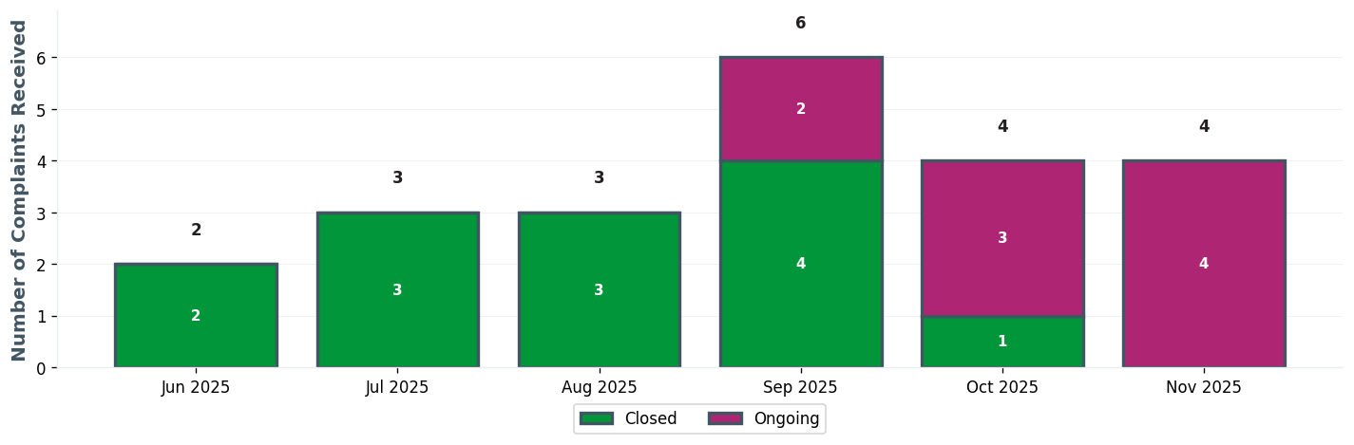
CSS EXEC TEAM | Executive Dashboard
⚠ 2 cases open >6 months

Slide 2
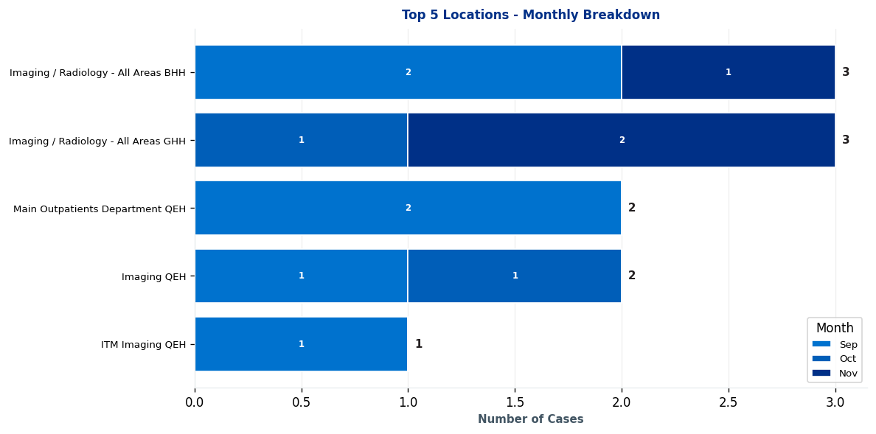
CSS EXEC TEAM | Complaints by Location

Slide 3
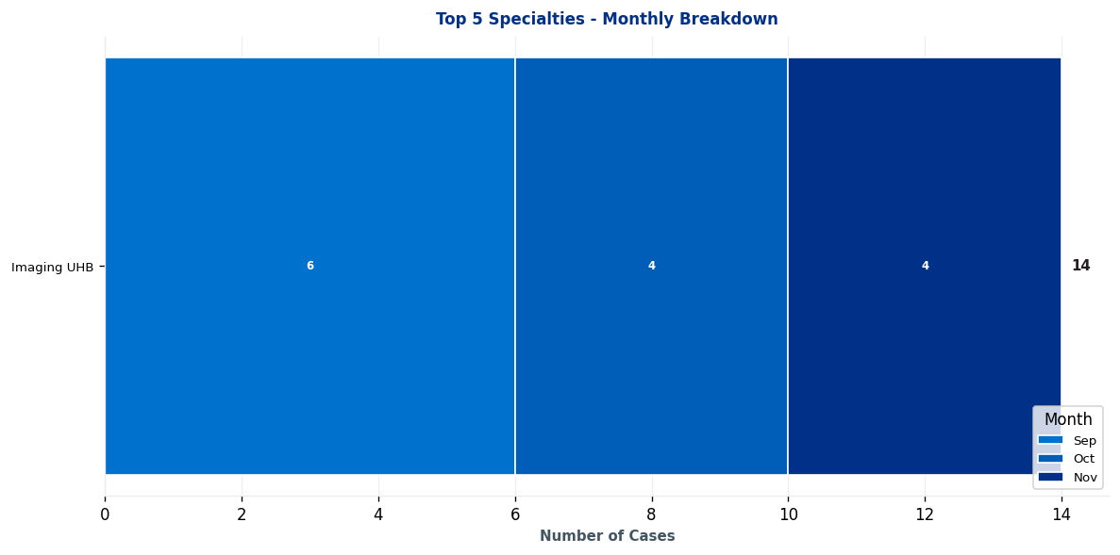
CSS EXEC TEAM | Complaints by Specialty

Slide 4
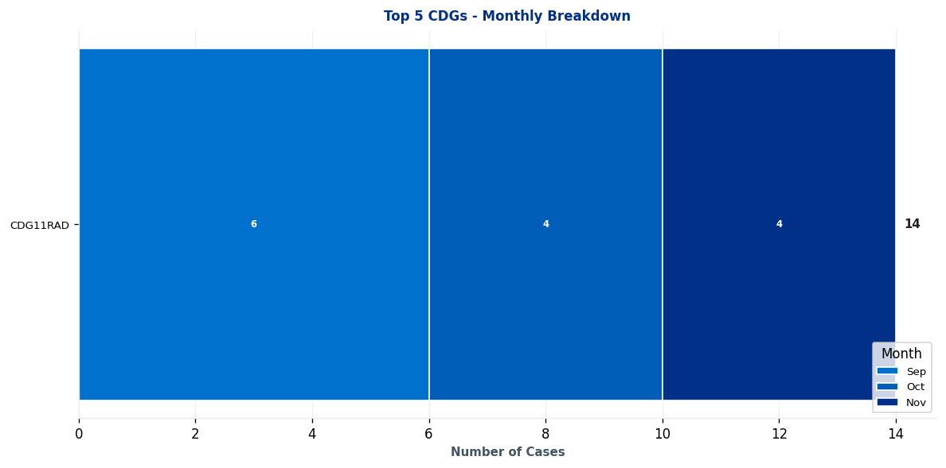
CSS EXEC TEAM | Clinical Decision Group (CDG) Breakdown

Slide 5
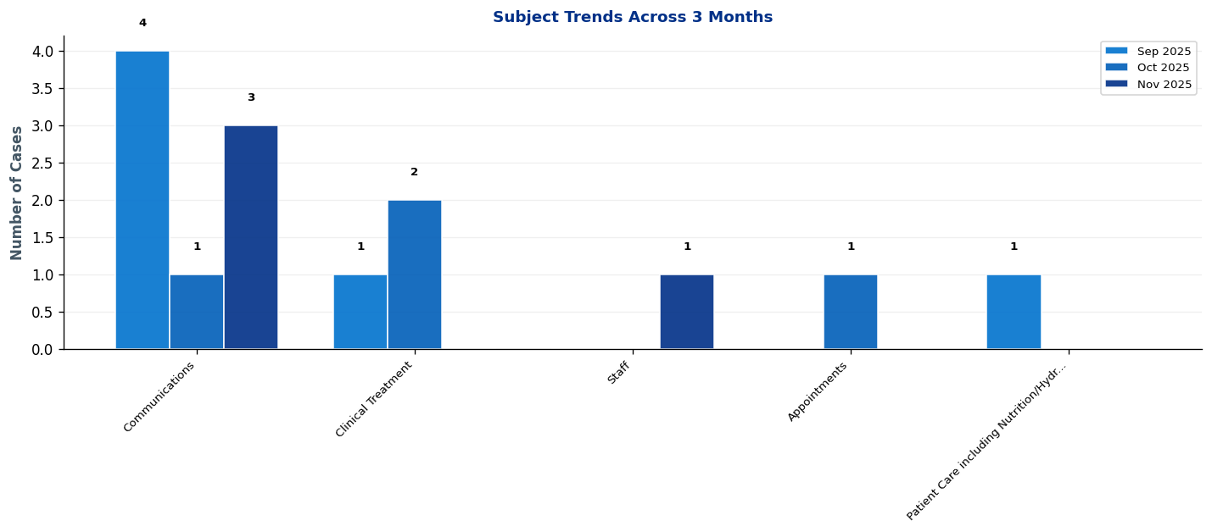
CSS EXEC TEAM | What's Changing? - Subject Trends

Slide 6
CSS EXEC TEAM | Intelligence Report: Key Trends & Patterns
No significant trends detected for this period.

Slide 7
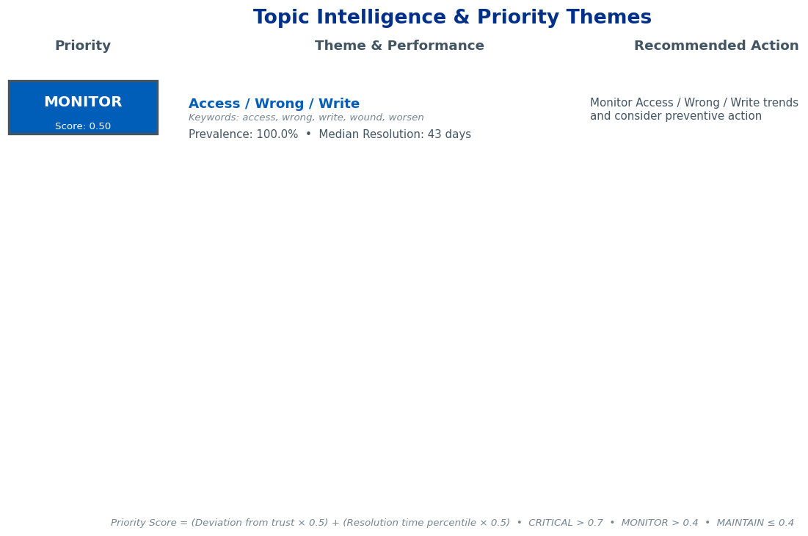
CSS EXEC TEAM | Topic Intelligence & Priority Themes

Slide 8
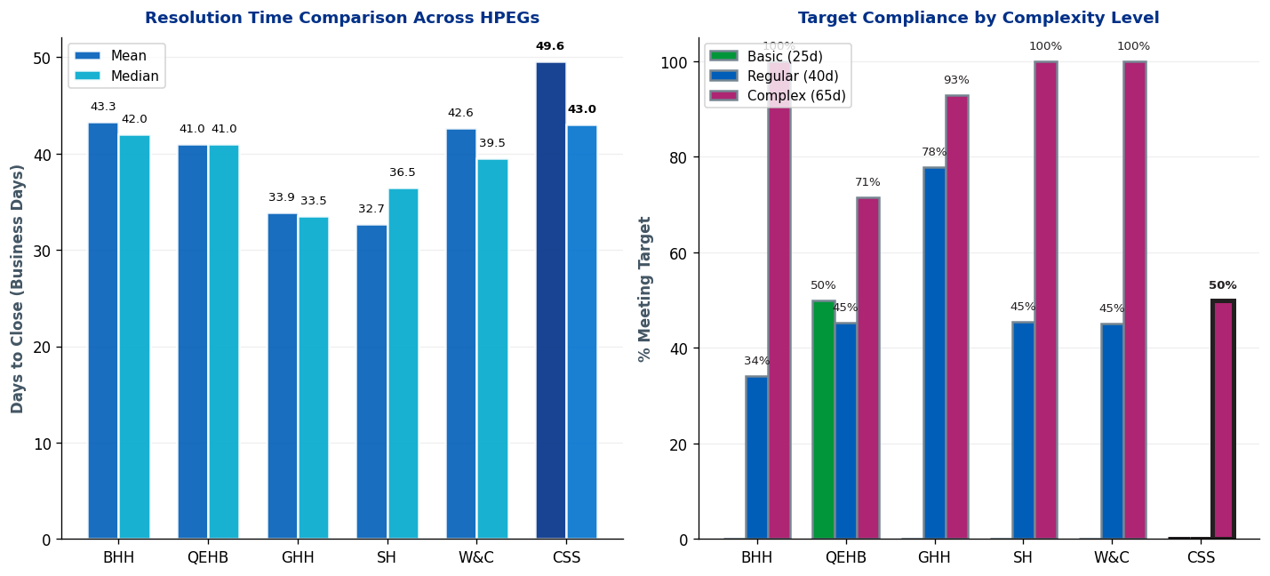
CSS EXEC TEAM | Complaint Resolution Efficiency

Slide 9
CSS EXEC TEAM | Resolution Time Trends by CDG
Current Period (Nov 25-Dec 25) vs 12-Month Rolling Average
1. CDG11RAD
Current period median: 67.5 days • 12-month rolling median: 66.0 days
⚠ Worsening: 1.5 days ABOVE 12-month average • Above target - requires attention
Targets: Basic=25 days, Regular=40 days, Complex=65 days

Slide 10
CSS EXEC TEAM | Resolution Time Trends by Specialty
No specialty trend data available for this HPEG

Slide 11
CSS EXEC TEAM | Resolution Time by Complexity Level
Resolution Times & Performance Metrics for Nov 25-Dec 25 (Business Days)
Regular
Mean: 45.3 days
Median: 43.0 days
Cases: 3
Target: 40 days
Complex
Mean: 56.0 days
Median: 56.0 days
Cases: 2
Target: 65 days
Performance Summary
Regular: 3 cases • Avg: 45.3 days • Target: 40 days • ⚠ 5.3 days over target • 0% compliant
Complex: 2 cases • Avg: 56.0 days • Target: 65 days • ✓ Meeting target • 50% compliant
Overall: 5 total cases • 20.0% overall compliance
Targets: Basic=25d, Regular=40d, Complex=65d

Slide 12
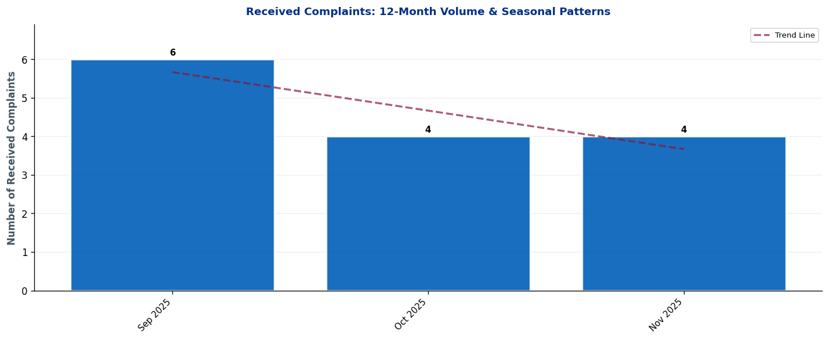
CSS EXEC TEAM | Seasonal Patterns & Volume Trends
Analysis: Trend line shows overall trajectory. Look for seasonal peaks (e.g., winter pressures) and dips.

Slide 13
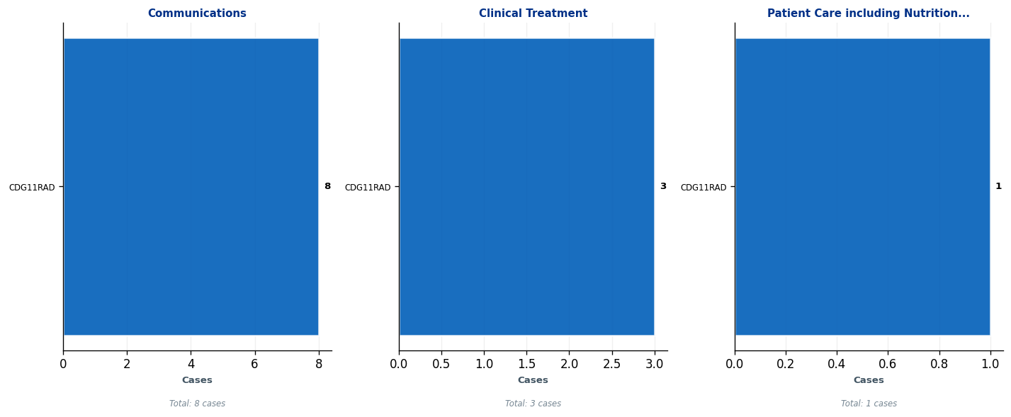
CSS EXEC TEAM | Subject Deep-Dive: Top 3 Complaint Themes
Each panel shows the top 5 CDGs contributing to that subject. Use this to identify which teams need targeted interventions.

Slide 14
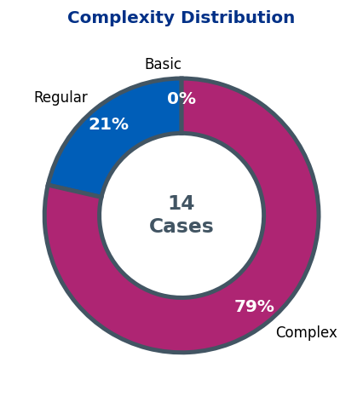
CSS EXEC TEAM | Complaint Complexity Distribution

Slide 15
CSS EXEC TEAM | Risk Dashboard
Cases Open >6 Months: 2
Detailed breakdowns available in operational dashboards.
Focus on specialty-level resolution for long-standing cases.

Slide 16
CSS EXEC TEAM | 10 Oldest Cases
This slide must be completed manually by the HPEG lead.
Contains patient identifiable information - add details of the 10 oldest ongoing cases including: ID, Date Received, Days Open, Specialty, Subject, and brief description.
Use table format for clarity.

Slide 17
CSS EXEC TEAM | Actions Status
Outstanding Actions from Last Report
• [Add action item here]
• [Add action item here]
• [Add action item here]
New Actions Identified This Quarter
• [Add action item here]
• [Add action item here]
• [Add action item here]
Completed Actions
• [Add action item here]
• [Add action item here]
• [Add action item here]

Slide 18
CSS EXEC TEAM | Current Performance & Key Achievements
Performance Highlights
[Add narrative here - key achievements, notable improvements, strategic priorities]
Areas for Improvement / Focus
[Add narrative here - key achievements, notable improvements, strategic priorities]

