Slide 1
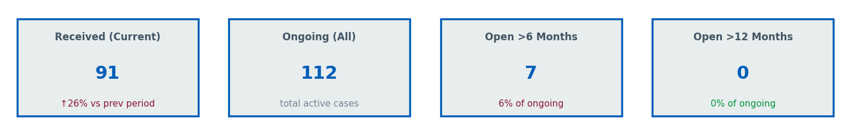
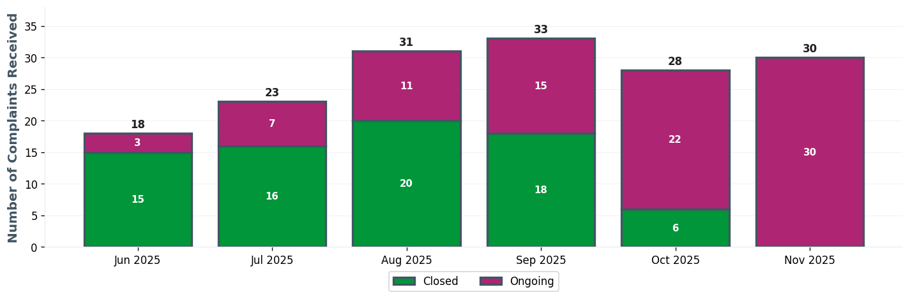
W&C EXEC TEAM | Executive Dashboard
⚠ 7 cases open >6 months

Slide 2
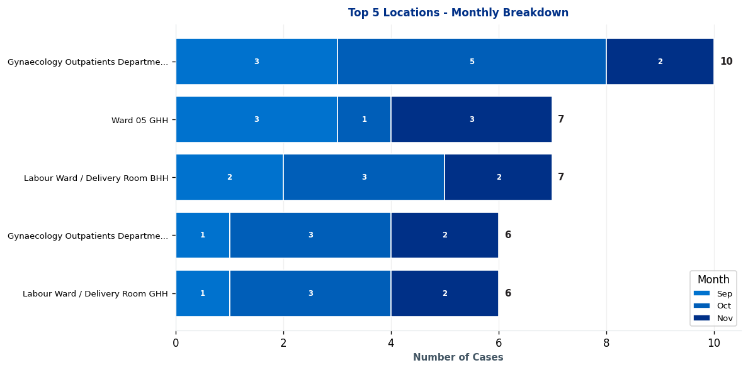
W&C EXEC TEAM | Complaints by Location

Slide 3
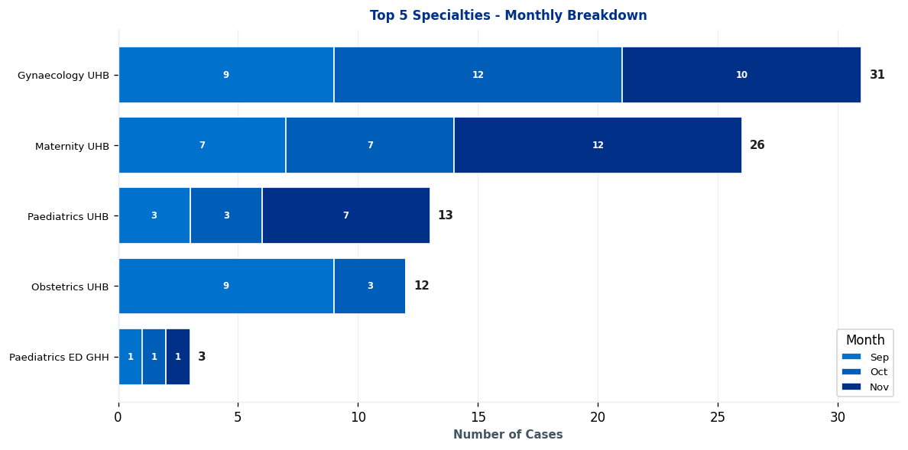
W&C EXEC TEAM | Complaints by Specialty

Slide 4
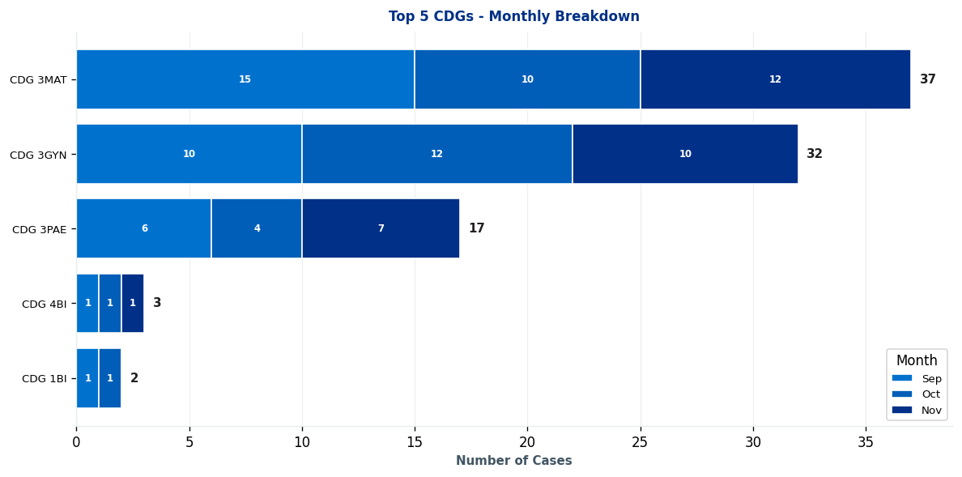
W&C EXEC TEAM | Clinical Decision Group (CDG) Breakdown

Slide 5
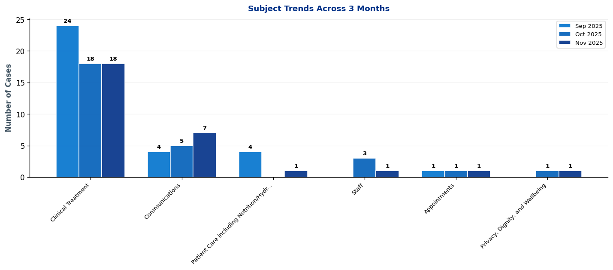
W&C EXEC TEAM | What's Changing? - Subject Trends

Slide 6
W&C EXEC TEAM | Intelligence Report: Key Trends & Patterns
EXECUTIVE SUMMARY: 1 significant trends identified • 1 increases • Latest month (November 2025) vs previous 2-month average
▲ AREAS OF INCREASE
CDG 3PAE [MONITOR] ↑ 2 cases (40%)
Main themes: Communications, clinical treatment, and patient care including nutrition/hydration
→ Continue monitoring - early trend indication

Slide 7
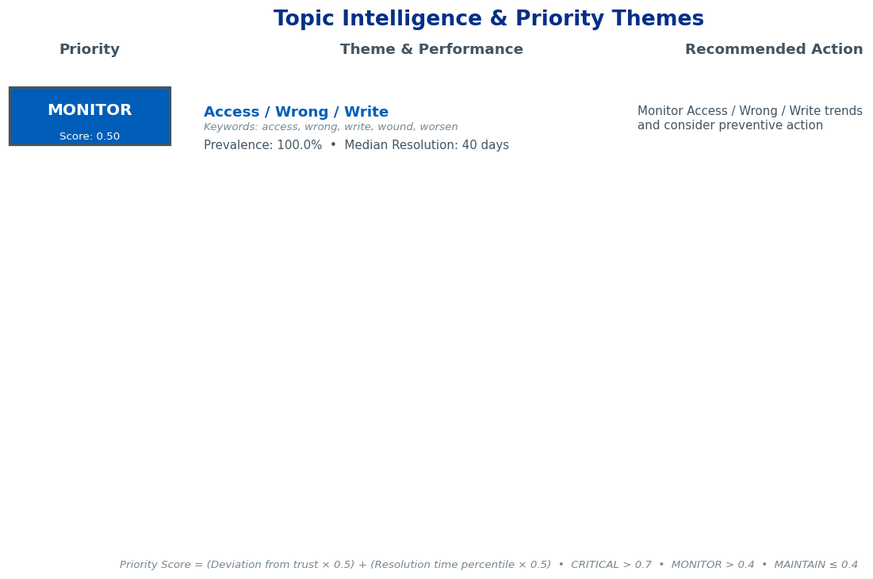
W&C EXEC TEAM | Topic Intelligence & Priority Themes

Slide 8
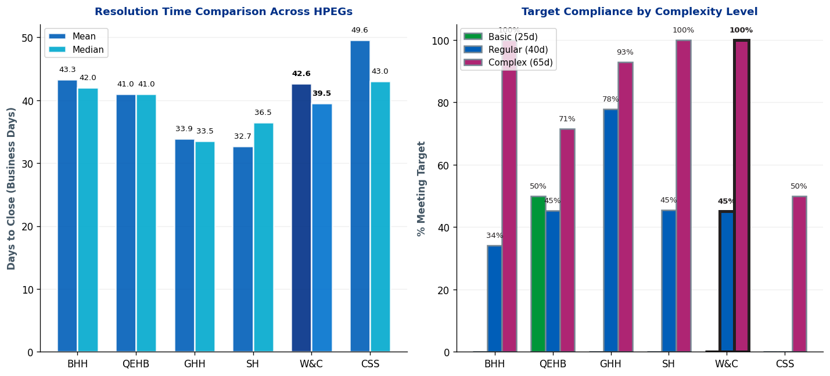
W&C EXEC TEAM | Complaint Resolution Efficiency

Slide 9
W&C EXEC TEAM | Resolution Time Trends by CDG
Current Period (Oct 25-Dec 25) vs 12-Month Rolling Average
1. CDG 3GYN
Current period median: 95.0 days • 12-month rolling median: 69.0 days
⚠ Worsening: 26.0 days ABOVE 12-month average • Above target - requires attention
2. CDG 1BI
Current period median: 64.0 days • 12-month rolling median: 64.0 days
Stable: matching 12-month average • Acceptable (within Complex target)
3. CDG 4BI
Current period median: 63.0 days • 12-month rolling median: 63.0 days
Stable: matching 12-month average • Acceptable (within Complex target)
4. CDG 3MAT
Current period median: 60.0 days • 12-month rolling median: 64.0 days
✓ Improving: 4.0 days BELOW 12-month average • Acceptable (within Complex target)
5. CDG 3PAE
Current period median: 57.5 days • 12-month rolling median: 47.0 days
⚠ Worsening: 10.5 days ABOVE 12-month average • Acceptable (within Complex target)
Targets: Basic=25 days, Regular=40 days, Complex=65 days

Slide 10
W&C EXEC TEAM | Resolution Time Trends by Specialty
Current Period (Oct 25-Dec 25) vs 12-Month Rolling Average
1. Gynaecology UHB
Current period median: 95.0 days • 12-month rolling median: 70.5 days
⚠ Worsening: 24.5 days ABOVE 12-month average • Above target - requires attention
2. Maternity UHB
Current period median: 49.5 days • 12-month rolling median: 63.0 days
✓ Improving: 13.5 days BELOW 12-month average • Acceptable (within Complex target)
Targets: Basic=25 days, Regular=40 days, Complex=65 days

Slide 11
W&C EXEC TEAM | Resolution Time by Complexity Level
Resolution Times & Performance Metrics for Oct 25-Dec 25 (Business Days)
Regular
Mean: 45.1 days
Median: 41.5 days
Cases: 20
Target: 40 days
Complex
Mean: 30.2 days
Median: 29.5 days
Cases: 4
Target: 65 days
Performance Summary
Regular: 20 cases • Avg: 45.1 days • Target: 40 days • ⚠ 5.1 days over target • 45% compliant
Complex: 4 cases • Avg: 30.2 days • Target: 65 days • ✓ Meeting target • 100% compliant
Overall: 24 total cases • 54.2% overall compliance
Targets: Basic=25d, Regular=40d, Complex=65d

Slide 12
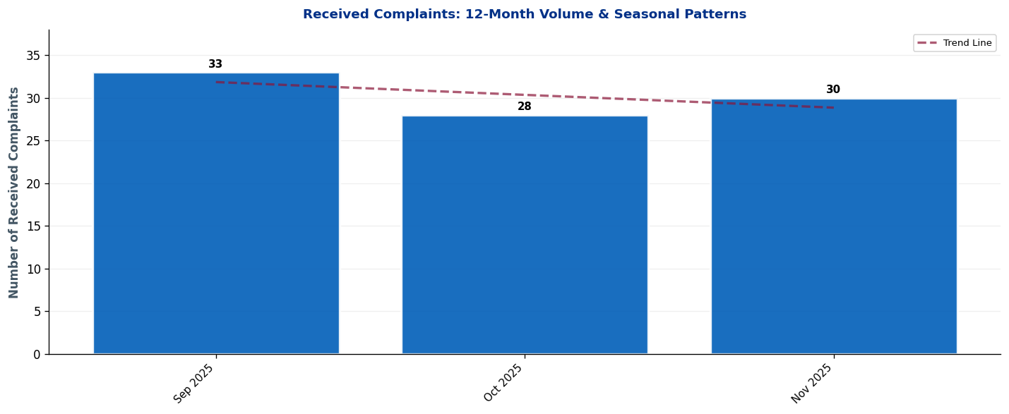
W&C EXEC TEAM | Seasonal Patterns & Volume Trends
Analysis: Trend line shows overall trajectory. Look for seasonal peaks (e.g., winter pressures) and dips.

Slide 13
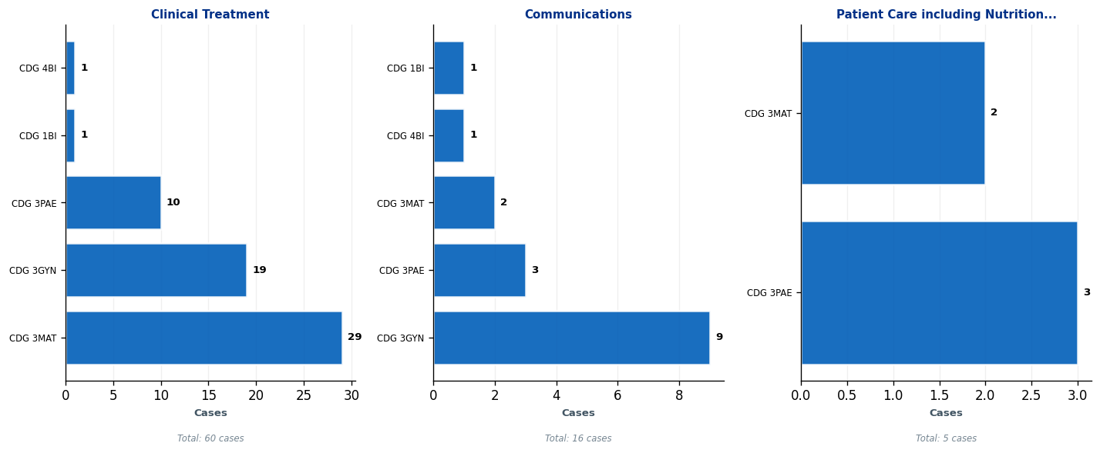
W&C EXEC TEAM | Subject Deep-Dive: Top 3 Complaint Themes
Each panel shows the top 5 CDGs contributing to that subject. Use this to identify which teams need targeted interventions.

Slide 14
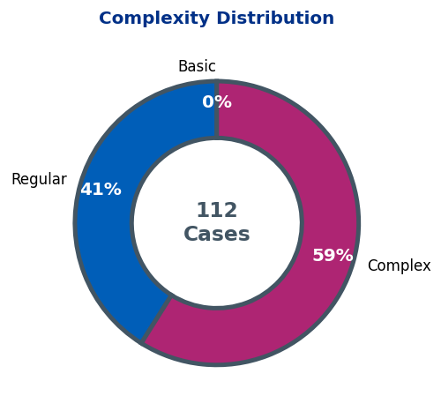
W&C EXEC TEAM | Complaint Complexity Distribution

Slide 15
W&C EXEC TEAM | Risk Dashboard
Cases Open >6 Months: 7
Detailed breakdowns available in operational dashboards.
Focus on specialty-level resolution for long-standing cases.

Slide 16
W&C EXEC TEAM | 10 Oldest Cases
This slide must be completed manually by the HPEG lead.
Contains patient identifiable information - add details of the 10 oldest ongoing cases including: ID, Date Received, Days Open, Specialty, Subject, and brief description.
Use table format for clarity.

Slide 17
W&C EXEC TEAM | Actions Status
Outstanding Actions from Last Report
• [Add action item here]
• [Add action item here]
• [Add action item here]
New Actions Identified This Quarter
• [Add action item here]
• [Add action item here]
• [Add action item here]
Completed Actions
• [Add action item here]
• [Add action item here]
• [Add action item here]

Slide 18
W&C EXEC TEAM | Current Performance & Key Achievements
Performance Highlights
[Add narrative here - key achievements, notable improvements, strategic priorities]
Areas for Improvement / Focus
[Add narrative here - key achievements, notable improvements, strategic priorities]

