Slide 1
Differences in Research Integrity Committee procedures
Lodewijk Pet
PhD candidate Quality & Integrity
20-11-2024
LUMC, The Netherlands

Slide 2
Background
Different research integrity structures in Europe
All dealing with possible breaches of Research Integrity
Some approaches may be preferable
Opportunity to learn from each other
LERU as starting point

Slide 3
Goal today
Overview of the current plan
Provide some details
Gather input
Discuss next step

Slide 4
Some (possible) differences
Committees
Institutional bound
National
Other
Complaints
Submitting parties
Requirements for complaints
Number of cases per year
End product
Only advice
Employment-related advice
Second opinion possibilities
Procedure
What is the workflow
(Inter)nationals code of Conduct
Institutional code

Slide 5
Goal
Direct
Provide descriptive oversight of participation committees
Write small internal LERU report
Future
Work towards policy regarding Research Integrity Committees
Not standardized procedures

Slide 6
Small overview
1. Demographics + background of committee
Country, institution type, committee size
2. Workflow overview
Submitting parties, preliminary assessment, cases per year
3. Investigation process
Main stages, duration, involvement of parties, etc
4. Decision-making
Consensus / vote, tools (codes & regulations), important factors
5. Product
(Binding) advice, labour related, anonymous
6. Challenges and Best practices
Common challenges, ensure fairness, transparency
7. General reflections
Key strengths, Desired changes

Slide 7
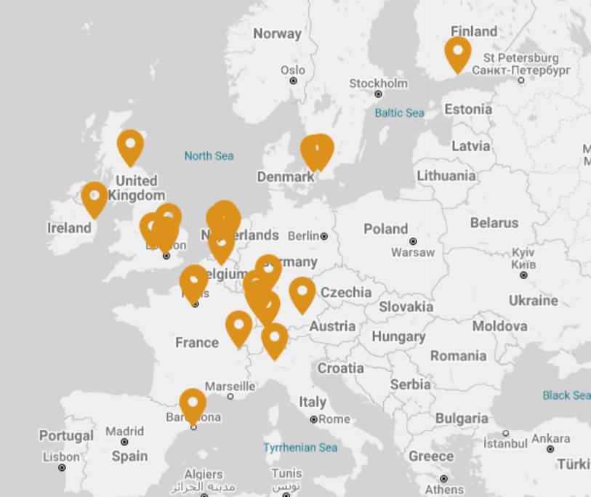
Dissemination
Committees of LERU institutions
Top 3 universities per country
Involving Eastern Europe
No correct overview of all committees

Slide 8
Feedback
General impression
Main goal
What subjects to ask
Who do we include

