Slide 1
Differences in Research Integrity Committee procedures
Lodewijk Pet
PhD candidate Quality & Integrity
08-05-2025
LUMC, The Netherlands

Slide 2
Background
Different research integrity structures in Europe
All dealing with possible breaches of Research Integrity
Some approaches may be preferable
Opportunity to learn from each other

Slide 3
Some (possible) differences
Committees
Institutional bound
National
Other
Complaints
Submitting parties
Requirements for complaints
Number of cases per year
End product
Only advice
Employment-related advice
Second opinion possibilities
Procedure
What is the workflow
(Inter)nationals code of Conduct
Institutional code

Slide 4
Goal
Direct
Provide descriptive oversight of participation committees
Write small internal LERU report
Future
Work towards policy regarding Research Integrity Committees
Not standardized procedures

Slide 5
Small overview
1. Demographics + background of committee
Country, institution type, committee size
2. Workflow overview
Submitting parties, preliminary assessment, cases per year
3. Investigation process
Main stages, duration, involvement of parties, etc
4. Decision-making
Consensus / vote, tools (codes & regulations), important factors
5. Product
(Binding) advice, labour related, anonymous
6. Challenges and Best practices
Common challenges, ensure fairness, transparency
7. General reflections
Key strengths, Desired changes

Slide 6
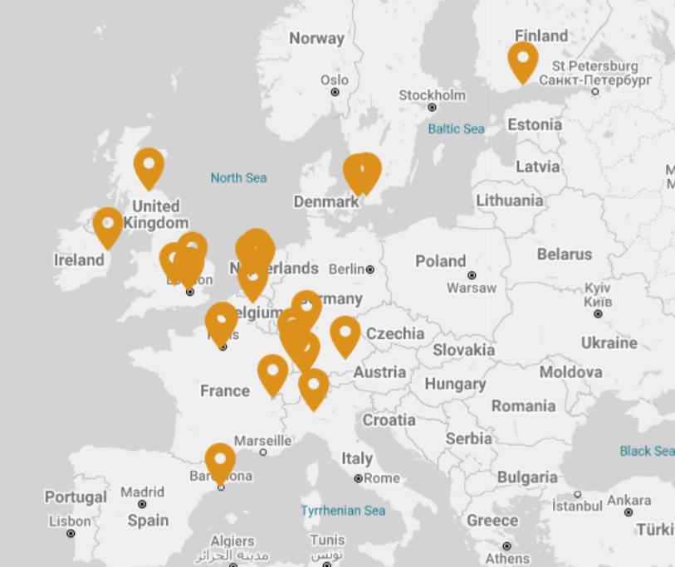
Dissemination
Committees of LERU institutions
Top 3 universities per country
Involving Eastern Europe
No correct overview of all committees

Slide 7
Feedback
General impression
Main goal
What subjects to ask
Who do we include

