Slide 1
Finishing well

Slide 2
Legacy
1: a gift by will especially of money or other personal property : bequest
2: something transmitted by or received from an ancestor or predecessor or from the past

Slide 3
Legacy
Consider your gifts

Slide 4


Slide 5
TRAINING AND PREPARATION
TRAIN FOR THE ELEMENTS
TASK
PERSONALITIES
RISKS
SEEK HELP
ADVISERS
PREDECESSORS
TEAM MEMBERS
JOURNALS

Slide 6
RUN THE RACE
MOTIVATE
PLAN and EXECUTE
TRUST THE WORK YOU HAVE PUT IN
DON’T SLOW DOWN

Slide 7
RUNNER BEWARE
FALSE STARTS
Unsuccessful Attempts to Begin Something
DISTRACTIONS
FAULTS
Accidents and Misfortunes

Slide 8
FINISH YOUR LEG
FINISH WHAT YOU SET OUT TO DO
CONTRUBUTE TO TEAM SUCCESS
PASS THE BATON

Slide 9
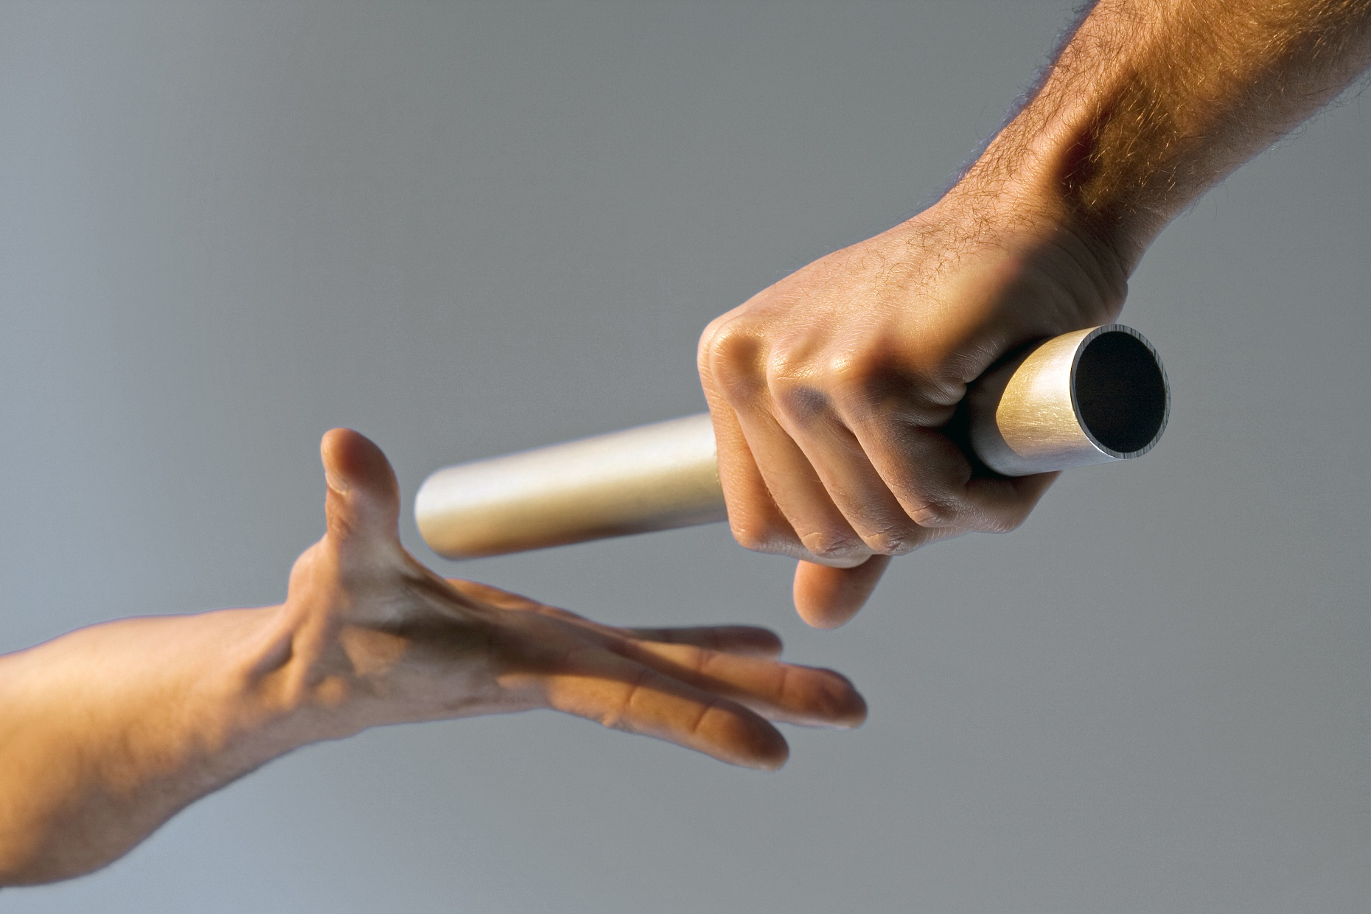
Passing the Baton

Slide 10
Getting ready to pass the Baton
Who do I pass the Baton to?
Identifying people
Developing People
Clean-Up
Don’t slow down!

Slide 11
Passing the Baton
Have a plan for transition
Use the “Exchange Zone”
Don’t Slow Down!
Don’t make your successor have to look back!

Slide 12
After you pass the Baton
Don’t slow down!
Have a Party
Celebrate the past year
Celebrate the new leader
Support the new leader
Get out of the way

Slide 13
Finishing Well Activity
Charting your course:
Vision
Legacy
Finishing Well

Slide 14
Finishing well

