Slide 1
DIABETIC RETINOPATHY PREDICTION IN PATIENTS
P-136 GROUP - 06

Slide 2
PROJECT OBJECTIVE
The variable to be predicted has two values (positive or negative on diabetic retinopathy) Thus, this is a binary classification project.
The goal here is to predict whether a patient will suffer from diabetic retinopathy or not, conditioned on blood test features.
Project Mentor: - Mr. Varun Vennelaganti
Project Group Members:-
Hitesh Patil
Savita Lodiwale
Rohit Ahirrao
Aishwarya Patil
Pranav Harish
Sushmita Singh
Akanksha Mishra
Vindhya Parankusham

Slide 3
PROJECT FLOW
EDA
Model Building
Model Deployment

Slide 4
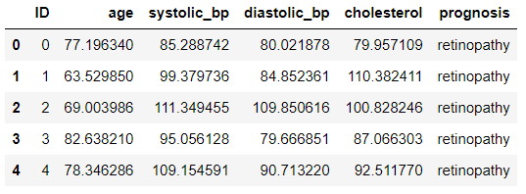
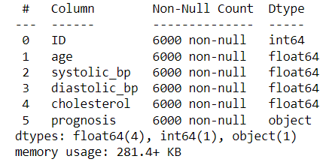
There are total 6000 Observations in our dataset
6 Columns – ID, Age, Systolic_BP, Diastolic_BP, Cholesterol and Prognosis
No null values are present in our dataset
Data types are in the required format

Slide 5

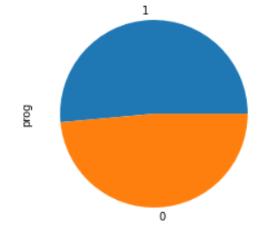
EDA
Predictor Variable Target Variable
Patients with retinopathy – 3087
Patients with no_retinopathy - 2913

Slide 6
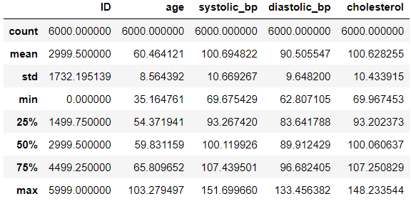
Exploratory Data ANALYSIS
Age range – 35.16 – 103.27
Systolic_bp range – 69.67 – 151.69
Diastolic_bp range – 62.80 – 133.45
Cholesterol range – 69.96 – 148.23
No duplicate observations found in the dataset

Slide 7


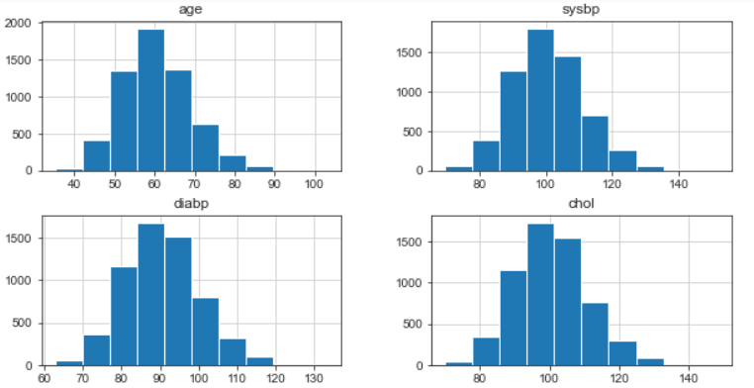
Columns were renamed for easy usage
Dropped the “ID” column
Data is moderately skewed

Slide 8
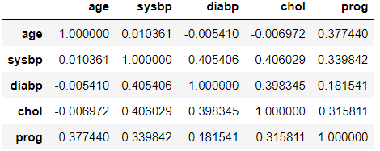
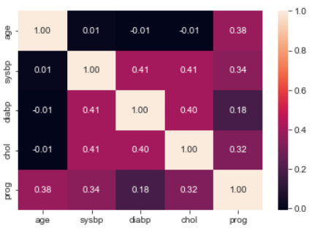
EDA
Correlation Analysis

Slide 9
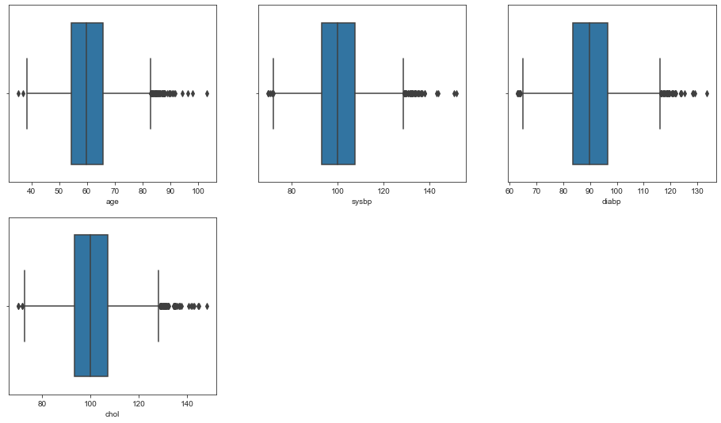
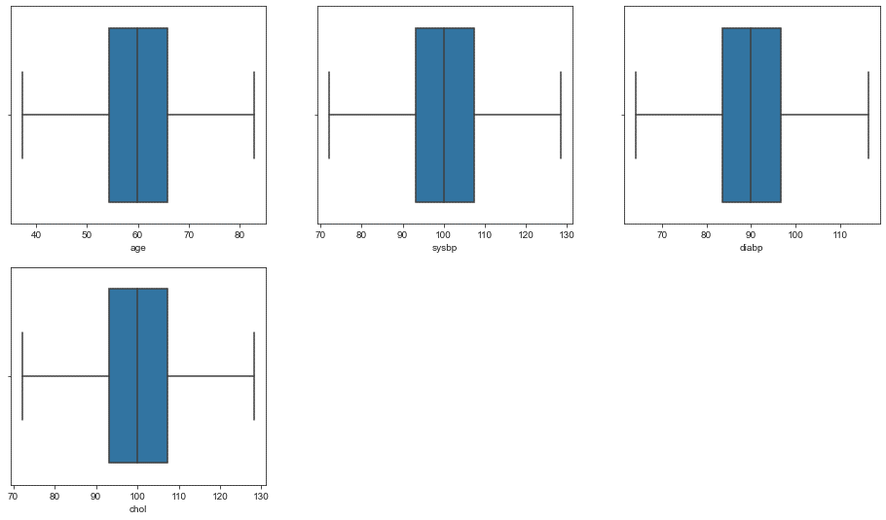
EDA
Outlier Analysis
There were a lot of outliers in the dataset
Removing these many outliers would have reduced the size of the dataset which may have affected the accuracy
So to deal with the outliers we have used Capping Method.
Capping Method: In this technique, we cap our outliers data and make the limit i.e, upper limit and lower limit, values that are above the upper limit value or less than the lower limit value will be considered as outliers

Slide 10
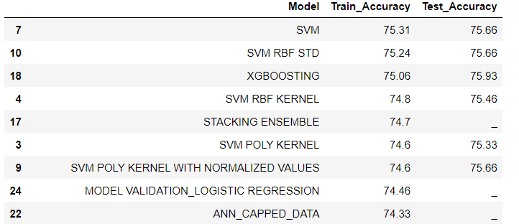
Model Selection
We have performed different Machine Learning technique so as to attain highest accuracy
We have selected SVM model to deploy as it was highest accurate

Slide 11
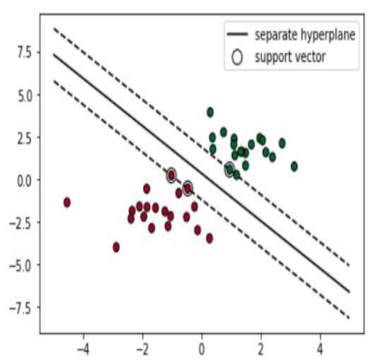
SUPPORT VECTOR MACHINES
Support Vector Machine (SVM) is a discriminative classifier formally defined by a separating hyperplane. In other words, given labelled training data (supervised learning), the algorithm outputs an optimal hyperplane which categorizes new examples. In two dimensional space this hyperplane is a line dividing a plane in two parts where in each class lay in either side.
A Support Vector Machine (SVM) can be imagined as a surface that creates a boundary between points of data plotted in multidimensional that represent examples and their feature values The goal of a SVM is to create a flat boundary called a hyperplane, which divides the space to create fairly homogeneous partitions on either side.
SVMs can be adapted for use with nearly any type of learning task, including both classification and numeric prediction.

Slide 12
Model Deployment
Integration of Machine Learning Model into an existing production environment where the user can
enter the input to generate output & later it can used in making business decisions.
In Python, we can achieve the same by using different frameworks
1) Django
2) Flask
3) Streamlit
Rshiny is another powerful extension based on R to build interactive dashboards

Slide 13
Deployment using Streamlit
Streamlit is an open-source app framework for Machine Learning and Data Science teams.
Reasons to use Streamlit:
Build an app in few lines of code and with simple API .
It doesn't require any web development knowledge
Deploy the code instantly and see the changes simultaneously by saving the source code
It's a open source framework

Slide 14
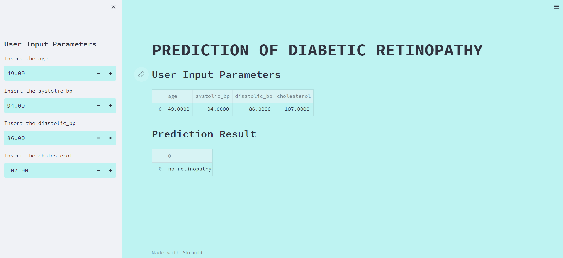
Web Interface of Streamlit Deployment

Slide 15
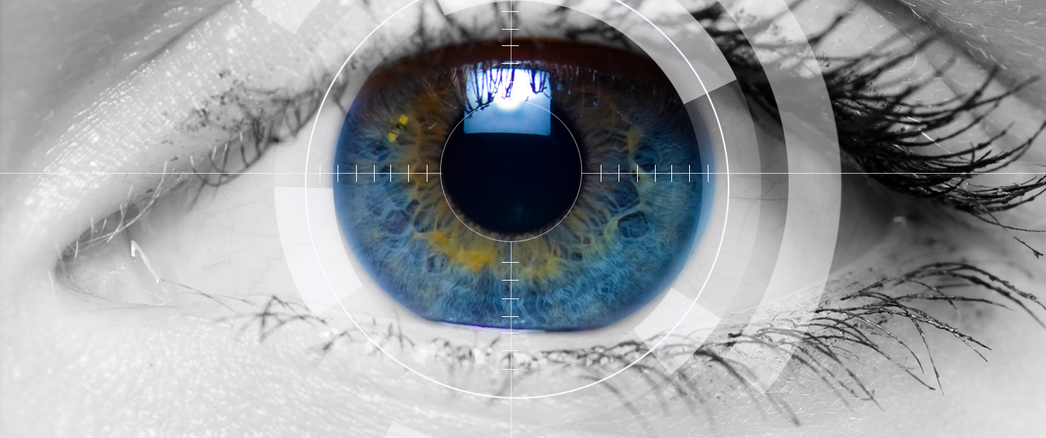
THANK YOU

