Slide 1

Data Intelligence Applications Project
Project: Pricing & Advertising
Team members: Mattia Bosio, Giacomo Lodigiani, Matteo Orsolini
Politecnico di Milano
Academic Year 2019/2020

Slide 2
Index
1) Problem description
2) Our setting
3) Single-phase budget allocation
4) Multi-phase budget allocation
5) Learning algorithm for pricing
6) Context generation algorithm
7) Budget and pricing optimization (multiple prices)
8) Budget and pricing optimization (single price)

Slide 3
Problem description
Problem
We have to model a scenario in which a seller exploits advertising tools to attract more and more users to its website, thus increasing the number of possible buyers. The seller needs to learn simultaneously the conversion rate and the number of users the advertising tools can attract.

Slide 4
Index
1) Problem description
2) Our setting
3) Single-phase budget allocation
4) Multi-phase budget allocation
5) Learning algorithm for pricing
6) Context generation algorithm
7) Budget and pricing optimization (multiple prices)
8) Budget and pricing optimization (single price)

Slide 5
Our setting
Setting description
We imagined a website selling streaming subscriptions to basketball events, and identified three possible classes of target users, and each one can have a targeted campaign:
European men
USA men
Women

Slide 6
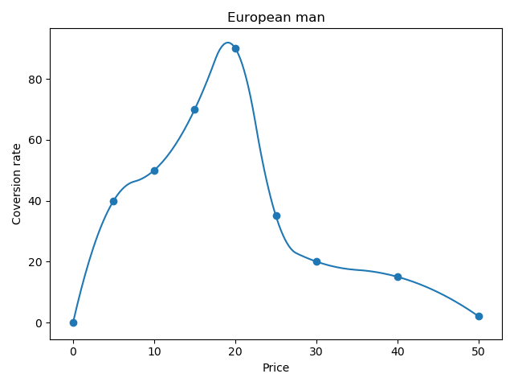
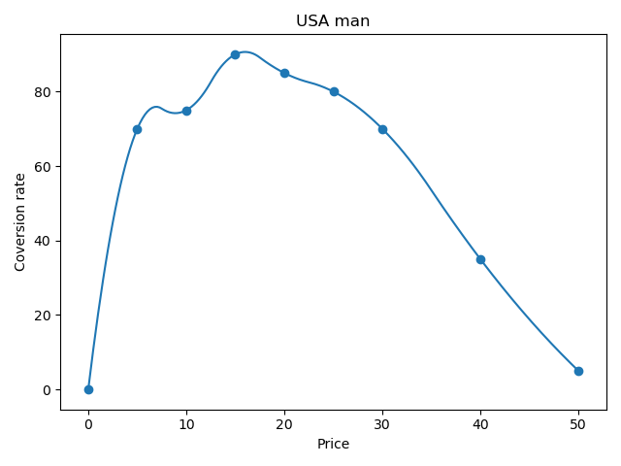
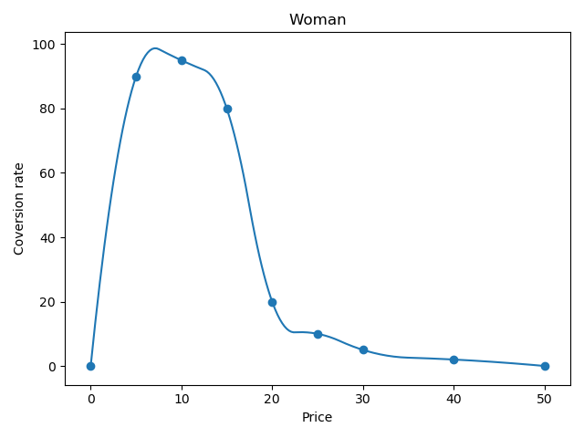
Our setting
Convertion rates
Of course the different classes of users, having different interests, will have different conversion rates.
Conversion rates for the 3 classes of users

Slide 7
Our setting
Abrupt phases
We also imagined different abrupt phases changing the market and subsequently the number of users clicking on ads for a given budget:
Phase 1: the launch of the product
Phase 2: the enter in the market of a new competitor
Phase 3: the updating of the product with new features

Slide 8
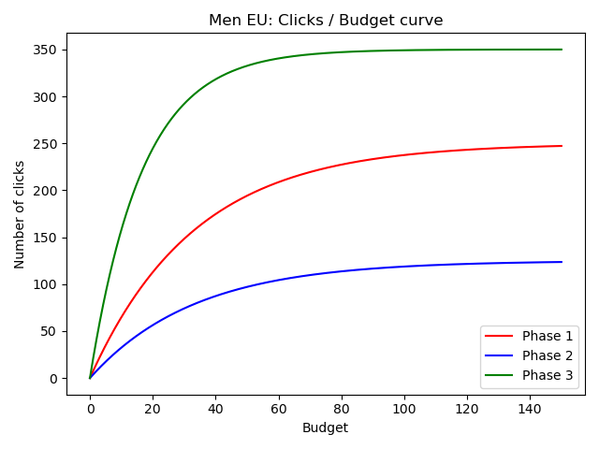
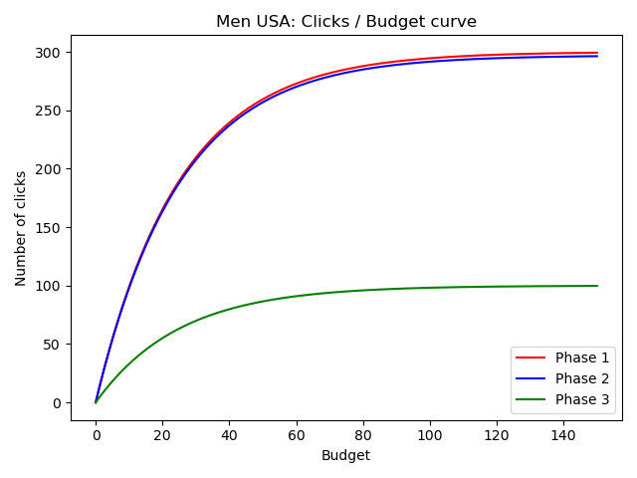
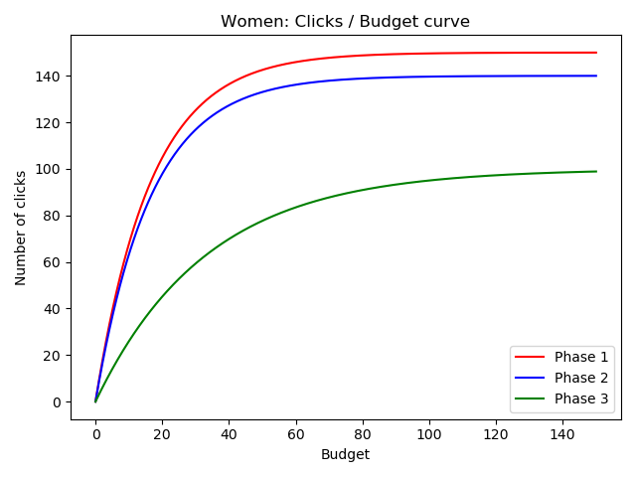
Our setting
Clicks / Budget curves for the 3 user classes and the 3 phases

Slide 9
Index
1) Problem description
2) Our setting
3) Single-phase budget allocation
4) Multi-phase budget allocation
5) Learning algorithm for pricing
6) Context generation algorithm
7) Budget and pricing optimization (multiple prices)
8) Budget and pricing optimization (single price)
Data Intellicence Applications
Pricing & Advertising
Academic Year 2019/2020 9
Notes:
9

Slide 10
Single-phase budget allocation
Our Approach: “Gaussian Process Thompson Sampling”.
Perform regression to estimate the number of clicks per day with respect to the budget allocation of each of the three sub-campaigns.
Use Gaussian Processes in order to obtain a probability distribution over the target value, the number of clicks.
Apply Thompson Sampling algorithm pulling the arms (budget allocation) from the estimated probability distribution.
Solve the combinatorial part of the mab problem using the knapsack tabular algorithm.
Get the realization of the allocation selected, thanks to the Knapsack algorithm, and update the Gaussian Processes.
Data Intellicence Applications
Pricing & Advertising
Academic Year 2019/2020 10
Notes:
10

Slide 11
Single-phase budget allocation
Some Difficulties: Kernel Parameters
We use the product of the Constant Kernel and RBF kernel (defined in “sklearn” library).
constant_value * exp( - d(x_{i}, x_{j})² / 2l² ), where d( , ) is the Euclidean distance.
To estimate them we fit 1000 samples for each function using ‘L-BGFS-B’ optimizer (log marginal likelihood )
We keep them fixed in our experiment in order to achieve better result from the start and reduce the computational time.
Notes:
11

Slide 12
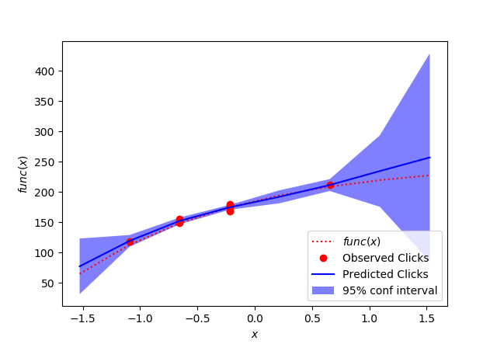
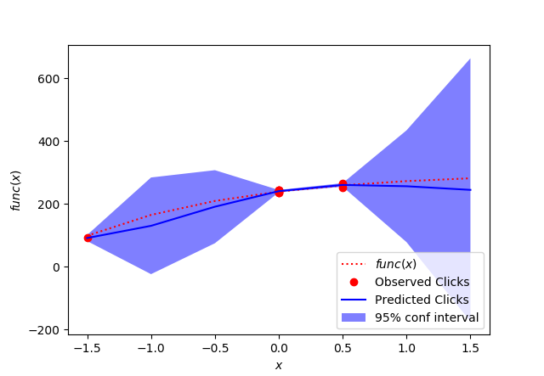
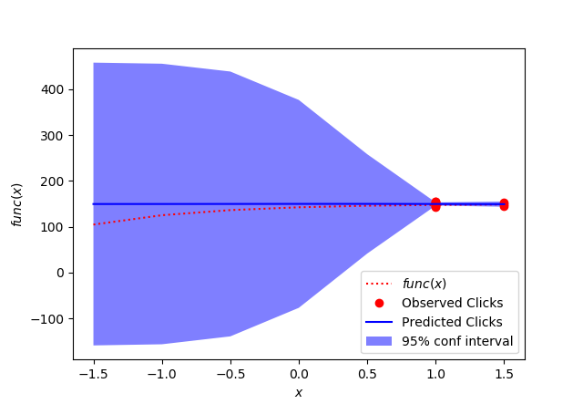
Single-phase budget allocation
Men Eu
Men USA
Women
The Gaussian Processes fitting the corresponding functions after 10 days
Notes:
12

Slide 13
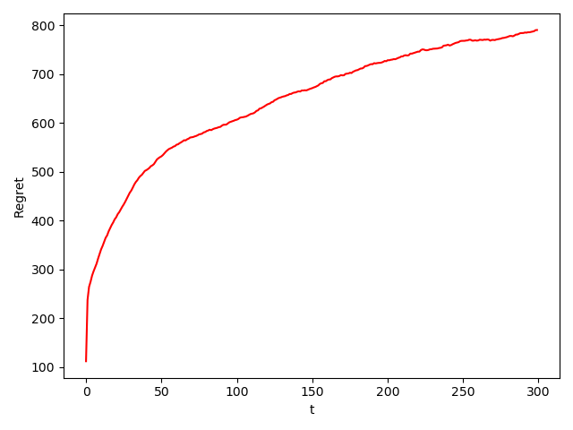
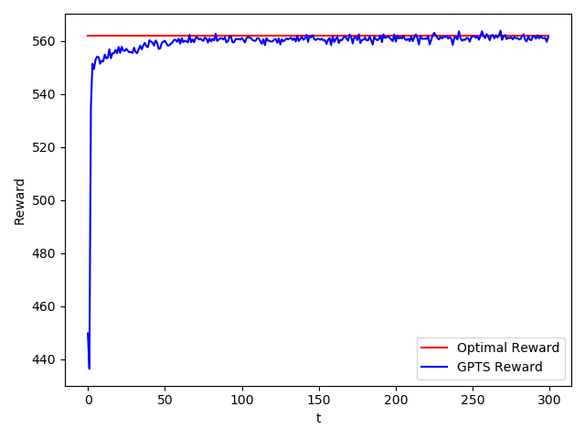
Single-phase budget allocation
Results
Here we can see the regret, which is less than linear as expected, and the reward, which converges to the optimum
Regret and Reward obtained in advertising with 100 experiments and 300 days as T horizon
Data Intellicence Applications
Pricing & Advertising
Academic Year 2019/2020 13
Notes:
13

Slide 14
Index
1) Problem description
2) Our setting
3) Single-phase budget allocation
4) Multi-phase budget allocation
5) Learning algorithm for pricing
6) Context generation algorithm
7) Budget and pricing optimization (multiple prices)
8) Budget and pricing optimization (single price)
Data Intellicence Applications
Pricing & Advertising
Academic Year 2019/2020 14
Notes:
14

Slide 15
Multi-phase budget allocation
Our Approach: sliding-window combinatorial bandit algorithm
We adjust the current algorithm using a sliding-window technique.
Fixed the window size, the Gaussian Processes use only the last n samples inside the sliding window, to fit the function and provide new estimates.
In this way, being in an non-stationary environment, our learners can “forget” about the first samples that are no more relevant and base the next estimates on new samples that are representative of the changed environment.
The kernel parameters are estimated using the same approach for each of the 3 phases. The model uses the same fixed parameters for all the phases: we have used the mean value on the phases.
Data Intellicence Applications
Pricing & Advertising
Academic Year 2019/2020 15
Notes:
15

Slide 16
Multi-phase budget allocation
Different Result
The size of the sliding window, with respect to the length of the abrupt phase, appears to be crucial in the effectiveness of the algorithm.
It must be enough big in order to be able to guarantee a good number of samples, which means a good estimate of the real function, but at the same time it can not be too long, since it has to capture the changes of the environments.
We set it in the order of Θ(√T), more precisely constant * √T, trying different constants.
Data Intellicence Applications
Pricing & Advertising
Academic Year 2019/2020 16
Notes:
16

Slide 17
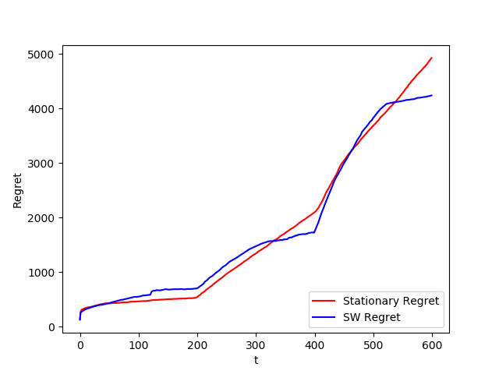
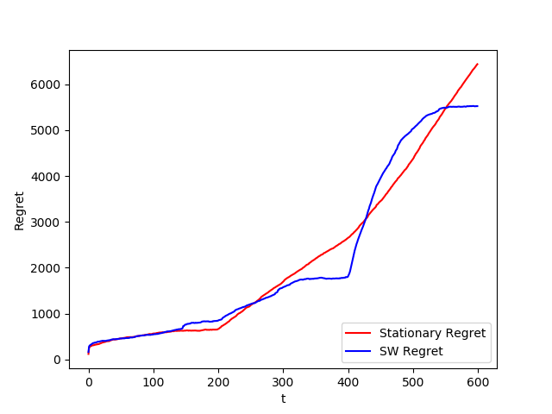
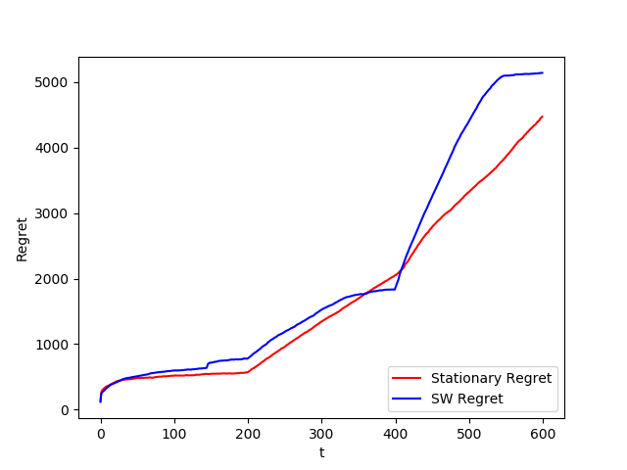
Multi-phase budget allocation
Different size of the sliding-window
This is the regret corresponding to the different window-size. Each plot is the result of 150 experiments.
The three phases start at time step 0, 200 and 400 with a corresponding length of 200 days.
4 * √T
5 * √T
6 * √T
Data Intellicence Applications
Pricing & Advertising
Academic Year 2019/2020 17
Notes:
17

Slide 18
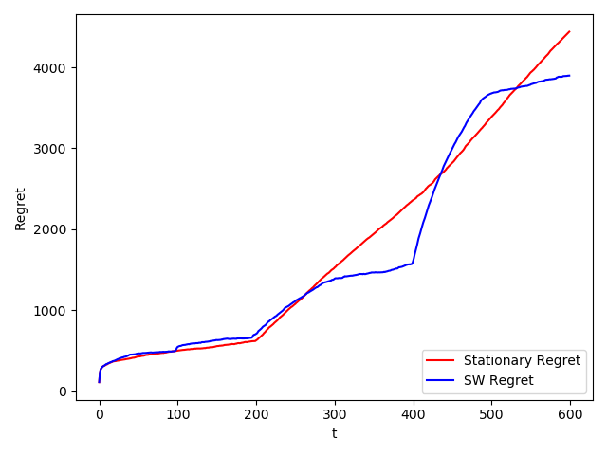
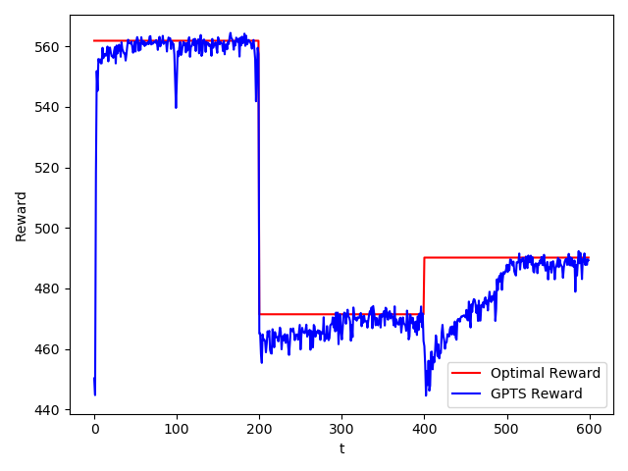
Multi-phase budget allocation
4 * √T wins!
Regret and Reward obtained in sliding window advertising with 100 experiments and a window size of 200.
Data Intellicence Applications
Pricing & Advertising
Academic Year 2019/2020 18
Notes:
18

Slide 19
Index
1) Problem description
2) Our setting
3) Single-phase budget allocation
4) Multi-phase budget allocation
5) Learning algorithm for pricing
6) Context generation algorithm
7) Budget and pricing optimization (multiple prices)
8) Budget and pricing optimization (single price)
Data Intellicence Applications
Pricing & Advertising
Academic Year 2019/2020 19
Notes:
19

Slide 20
Learning algorithm for pricing
Found the optimal price
The environment is defined by the different conversion rate curves, one for each type of user.
The number of users is defined by the daily number of clicks, generated by the advertising environment with a fixed budget allocation.
In this scenario the seller can not perform pricing discrimination therefore has to sell to the same price to all the users.
The clairvoyant is defined as the best price in the aggregate conversion rate curve.
Data Intellicence Applications
Pricing & Advertising
Academic Year 2019/2020 20
Data Intellicence Applications
Pricing & Advertising
Academic Year 2019/2020 20
Notes:
20

Slide 21
Learning algorithm for pricing
Thompson Sampling Algorithm
To solve this Multi Armed Bandit Problem, and found the optimal price, we use Thomspon Sampling Algorithm.
The random variable is the conversion rate of each arm, so what we can observe is a Bernulli reward, for this reason we use a Beta distribution as prior.
The expected reward of an arm is represented by the product between the conversion rate and the price itself.
For each user we choose the price sampling the beta distribution and getting the one with highest reward. We observe the realization and then we update the distribution.
Data Intellicence Applications
Pricing & Advertising
Academic Year 2019/2020 21
Notes:
21

Slide 22
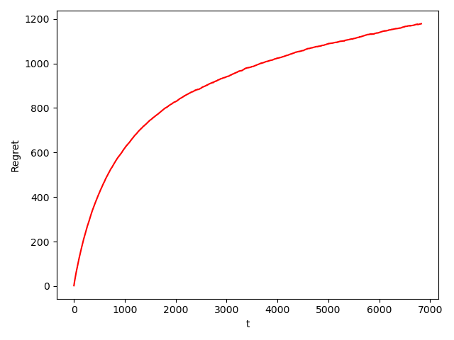
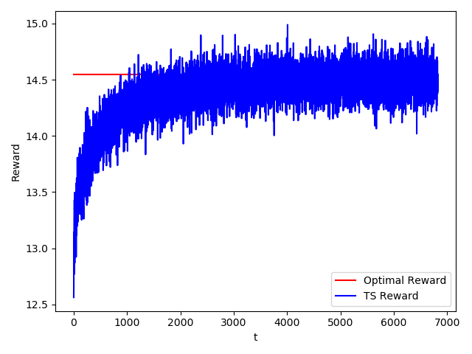
Learning algorithm for pricing
Results
In the few days, since we interact with a huge number of users in a day, we are able to get the optimal price.
Regret and Reward obtained in pricing with 10000 experiments and 14 days as T horizon
Data Intellicence Applications
Pricing & Advertising
Academic Year 2019/2020 22
Notes:
22

Slide 23
Index
1) Problem description
2) Our setting
3) Single-phase budget allocation
4) Multi-phase budget allocation
5) Learning algorithm for pricing
6) Context generation algorithm
7) Budget and pricing optimization (multiple prices)
8) Budget and pricing optimization (single price)

Slide 24
Context generation algorithm
Our approach
For each context inside the partitions, generated by the three sub campaigns we have considered in the advertising problem, we have created a learner which, by applying the Thompson Sampling algorithm, estimates the expected reward, that is the profit, associated to each price for that specific context.
The setting we have used is the following:
The daily number of users is generated according to the advertising problem and the proportion of the users is respected too.
The experiments last 10 weeks.

Slide 25
Context generation algorithm
Considerations (first algorithm)
Since in expectation the daily number of users, divided in proportion to the probability of their context, is slightly lower than 500, we have observed that after one week, thanks to the huge number of samples observed, performing price discrimination on the three targets of the sub campaigns is , with good probability, identified as the best possible choice since we usually reach a very good approximation of the best expected reward for each target.
The problem is that observing this huge amount of sample ruins the performance of the algorithm in later weeks: the bounds are ruined and so the algorithm tends to choose the action of re-aggregation as a plausible option. Our solution to this issue was to use a stopping criterion: once the algorithm chooses to disaggregate, it can only choose as active partition, a partition with a cardinality strictly larger than the currently active one.

Slide 26
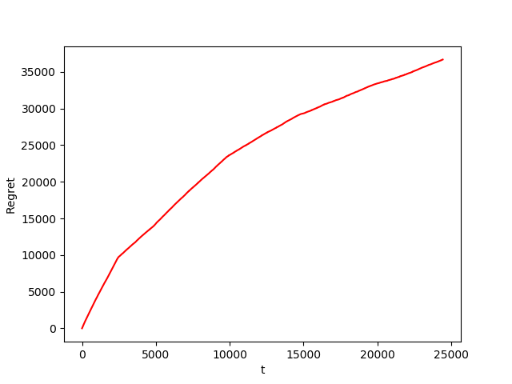
Context generation algorithm
Results
Here we can see the regret of the first approach.
Regret of first context generation algorith with 150 experiments

Slide 27
Context generation algorithm
Our approach (second algorithm)
Thanks to the fact that the daily number of samples is consistent, we have implemented a “ sequential” version of the algorithm using Ɛ-greedy exploration:
Every week we only get samples relative to the active context (represented by an aggregate learner)
At the end of every week we choose the active context for the next one in the following way: random with probability Ɛ, argmax(lower bound) with probability 1 – Ɛ
Ɛ decreseas as we approach the end of the time horizon T (Ɛ = 1 – t/T)

Slide 28
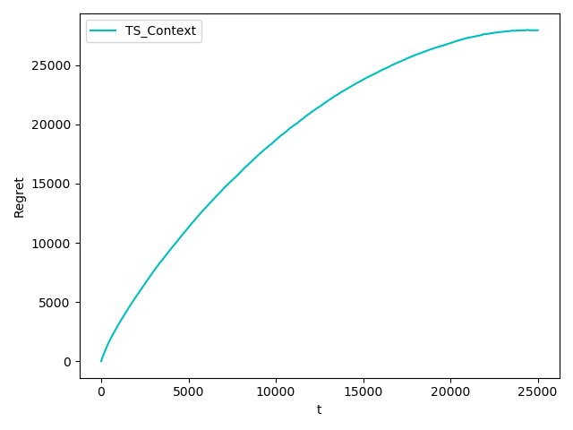
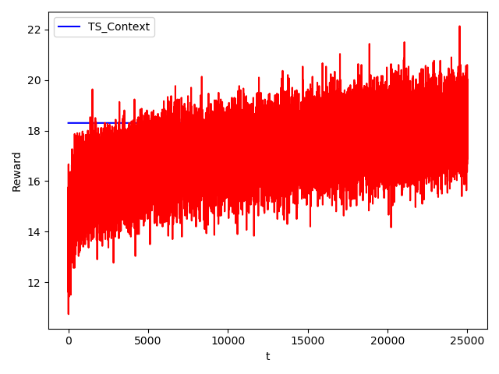
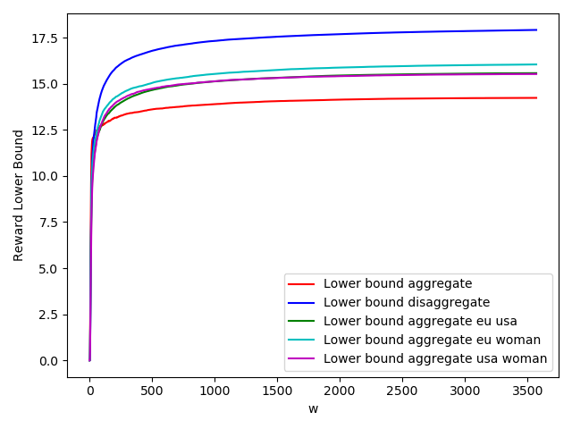
Context generation algorithm
Results
Here we can see the regret, reward and bounds of the second approach.
Regret, Reward and Bounds obtained with the second context generation algorithm with 150 experiments

Slide 29
Index
1) Problem description
2) Our setting
3) Single-phase budget allocation
4) Multi-phase budget allocation
5) Learning algorithm for pricing
6) Context generation algorithm
7) Budget and pricing optimization (multiple prices)
8) Budget and pricing optimization (single price)

Slide 30
Budget and pricing optimization (multiple prices)
Our approach
Since each subcampaign targets a single class of users, the two problems, pricing and advertising, can be decomposed. So at every iteration, first we run our pricing algorithm (with the percentage of users belonging to each class depending on the budget allocation) to find the values per click (conversion rates), and then we run our advertising algorithm to improve budget allocation.
Additional comments
We developed two versions of the algorithm: in the first one we used for the next iteration the prices corresponding to the best budget allocation (the one that maximises number of clicks * value per click) found in previous one; in the second version we just used the best budged allocation found in previous iteration to estimate incoming clicks in the next one, but here the new prices don’t have to be the ones corresponding to previous best budget allocation.

Slide 31
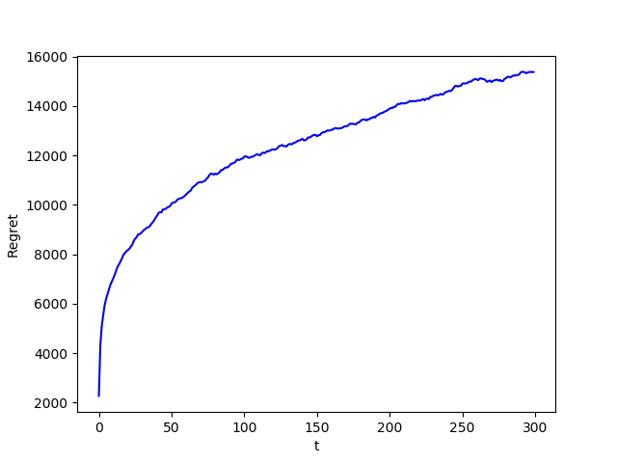
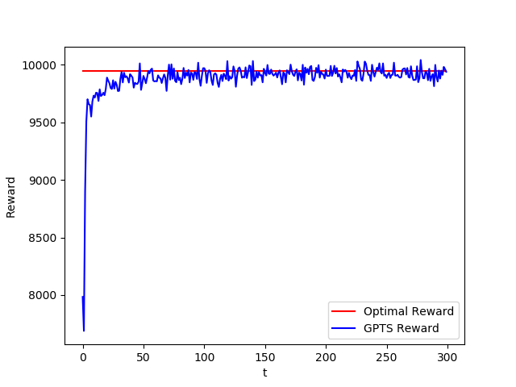
Budget and pricing optimization (multiple prices)
Results
Here we can see the regret and the reward of the first implementation, where the price for each context corresponds to the price which conversion rate guarantees best budget allocation in previous iteration.
Regret and Reward obtained with fixed price and 100 experiments

Slide 32
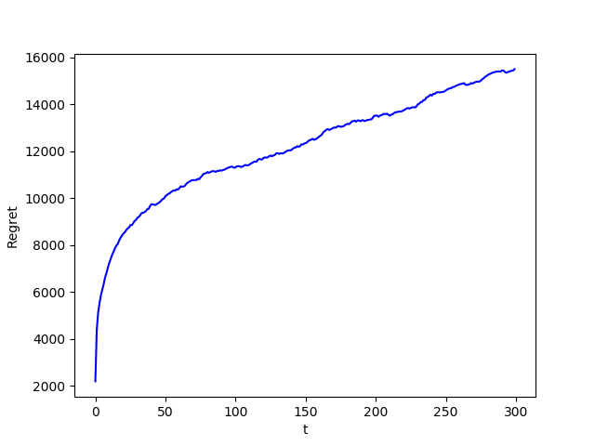
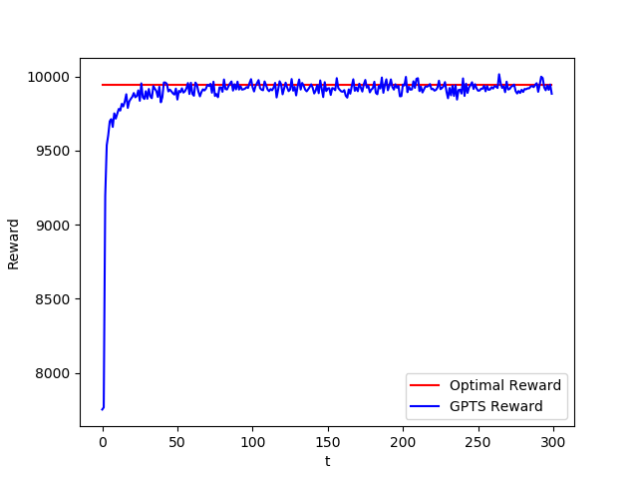
Budget and pricing optimization (multiple prices)
Results
Here we can see the regret and the reward of the second implementation. The price for each context is chosen during the day according to Thompson sampling learner.
Regret and Reward obtained with non fixed price and 100 experiments

Slide 33
Index
1) Problem description
2) Our setting
3) Single-phase budget allocation
4) Multi-phase budget allocation
5) Learning algorithm for pricing
6) Context generation algorithm
7) Budget and pricing optimization (multiple prices)
8) Budget and pricing optimization (single price)

Slide 34
Budget and pricing optimization (single price)
Our approach
We used the same iterative algorithm seen in previous point, but here, instead of finding the best price for each class of users, we tried all the possible unique prices to charge to all the users without discriminating. We use an aggregate (unique) learner to interact with the environment, and 3 different learnes to estimate the conversion rates (values per click) for each class of users.
Additional comments
Having one price for all the users, to find the best budget allocation, we run the knapsack tabular algorithm for each price (each price corresponds to different values per click) to find the budget maximizing number of clicks * value per click. Also here we compared two version of the algorithm, one in which the price corresponding to best budget allocation obtained in previous iteration is used in the next one, and one removing this constraint.

Slide 35
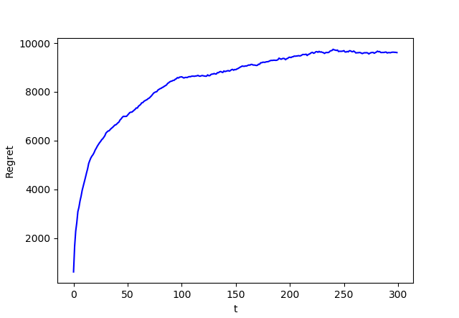
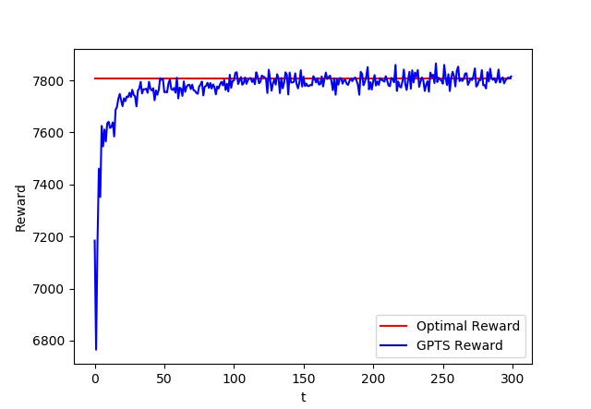
Budget and pricing optimization (single price)
Results
Here we can see the regret and the reward of the first implementation.
Regret and Reward obtained with fixed price and 75 experiments

Slide 36
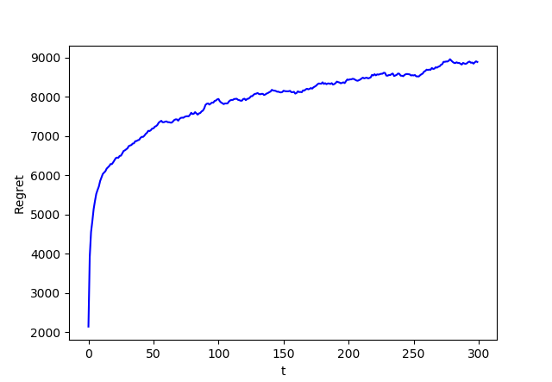
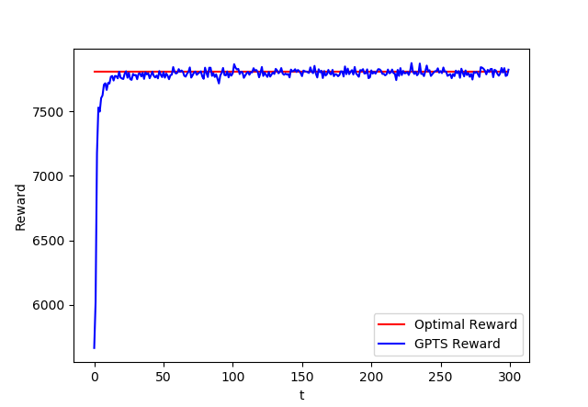
Budget and pricing optimization (single price)
Results
Here we can see the regret and the reward of the second implementation.
Regret and Reward obtained with non fixed price and 75 experiments

Slide 37
Thanks for your attention!

