Slide 1
Report : Cifar10 performance and Robot model with camera

Slide 2
Summary of my internship
Performance on a cifar10 model
Difference of the batch size
Make a pytorch model for the robot
Training of both model on llrai01
Make them work on the jetson
Add the camera

Slide 3
Comparative table Pytorch
Time | PC | Llrai01 | Jetson
Import | 2,04s | 1,15s | 6,37s
Loader setup | 1,90s | 4,50s | 49,5s
Model setup | 0,00s | 2,18s | 108s = 1,48min
Train 1 | 40,6s | 41,03s | 372s = 6,12min
Train 2 | 38,9s | 31,70s | 171s = 2,51min
Train/image | 7,78-1ms | 6,34E-1ms | 3,42ms
Train 3 | 39,2s | 27,7s | 169s = 2,49min
Mean train | 39,6s | 33,5s | 237s = 3,57min
Mean test/epoch | 4,59s | 2,60s | 18,8s
Test/image | 4,59E-1ms | 2,60E-1ms | 1,88ms
Mean loading | 2,82E-2s | 0,34s | 4,13s
Loading/image | 4,7E-04ms | 5,67E-03ms | 6,88E-02ms

Slide 4
Comparative table tensorflow
Time | PC | Llrai01 | Jetson
Import | 6,71s | 3,14s | 16,7s
Loader setup | 57,69s | 1,02s | 87,6s
Model setup | 0,14s | 5,67s | 52,1s
Train 1 | 36s | 31s | 345s
Train 2 | 39s | 27s | 184s
Train/image | 7,8E-1ms | 5,4E-1ms | 3,68ms
Train 3 | 36s | 26s | 193s
Mean train | 36,95s | 28s | 241s
Mean test/epoch | 2,62s | 2 | 62.07s
Test/image | 2,62E-1ms | 2E-1ms | 6,2ms

Slide 5
Comparative table PC
Time | tensorflow | Pytorch
Import | 6,71s | 2,04s
Loader setup | 57,69s | 1,90s
Model setup | 0,14s | 0,00s
Train 1 | 36s | 40,6s
Train 2 | 39s | 38,9s
Train/image | 7,8E-1ms | 7,78-1ms
Train 3 | 36s | 39,2s
Mean train | 36,95s | 39,6s
Mean test/epoch | 2,62s | 4,59s
Test/image | 2,62E-1ms | 4,59E-1ms

Slide 6
Comparative table Llrai01
Time | tensorflow | Pytorch
Import | 3,14s | 1,15s
Loader setup | 1,02s | 4,50s
Model setup | 5,67s | 2,18s
Train 1 | 31s | 41,03s
Train 2 | 27s | 31,70s
Train/image | 5,4E-1ms | 6,34E-1ms
Train 3 | 26s | 27,7s
Mean train | 28s | 33,5s
Mean test/epoch | 2s | 2,60s
Test/image | 2E-1ms | 2,60E-1ms

Slide 7
Comparative table Jetson
Time | tensorflow | Pytorch
Import | 16,7s | 6,37s
Loader setup | 87,6s | 49,5s
Model setup | 52,1s | 108s = 1,48min
Train 1 | 345s | 372s = 6,12min
Train 2 | 184s | 171s = 2,51min
Train/image | 3,68ms | 3,42ms
Train 3 | 193s | 169s = 2,49min
Mean train | 241s | 237s = 3,57min
Mean test/epoch | 18s | 18,8s
Test/image | 1,8ms | 1,88ms

Slide 8
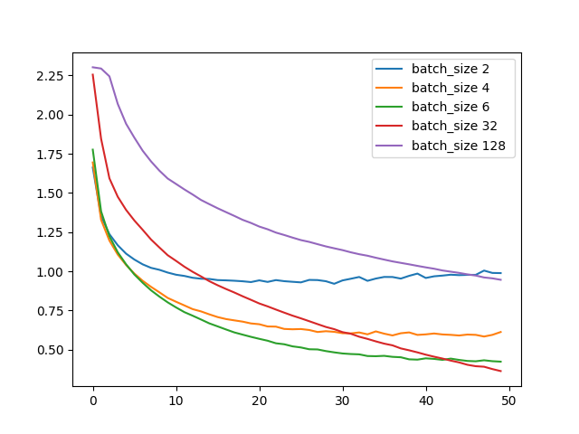
Batch 50 epochs
Loss
epochs

Slide 9
Robot model
Cropping/ BGR to Grayscale/ Resize/ Rescaling
100x180x1
100x180x16
50x90x16
50x90x32
25x45x32
25x45x64
Convolution + ReLU
MaxPooling
Flatten
Linear
Softmax
12x22x64
1x1x16896
1x1x256
1x1x128
1x1x32

Slide 10
Robot model for the Jetson
Cropping/ BGR to Grayscale/ Resize/ Rescaling
100x180x1
100x180x16
50x90x16
50x90x32
25x45x32
25x45x64
12x22x64
Convolution + ReLU
MaxPooling
Flatten
Linear
Softmax
25x45x120
12x22x120
1x1x16896
1x1x256
1x1x128
1x1x32

Slide 11
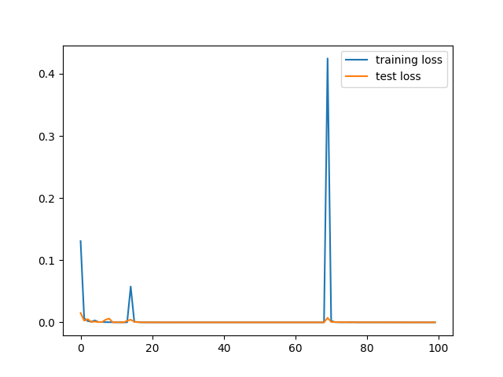
Robot training time on llrai01 : pytorch
Time | Pytorch
Import | 2.43s
Loader setup | 0.24s
Model setup | 1.10s
Mean train* | 112.33s
Train/image | 2.12ms
Mean test/epoch | 11.98s
Test/image | 2.03ms
With training set :
Final loss : 2E-4%
Final accuray : 100%

Slide 12
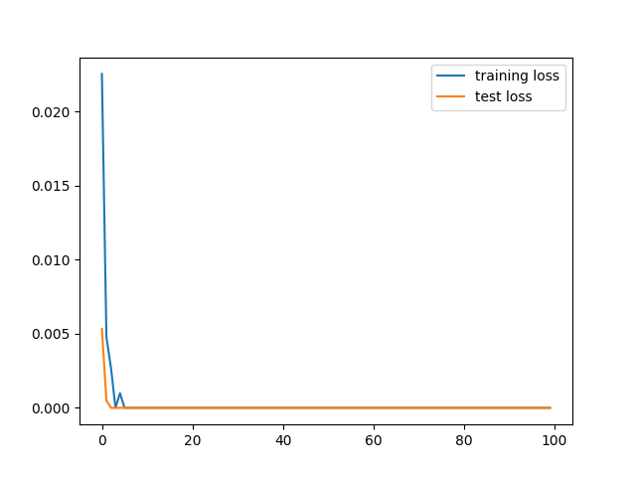
Robot training time on llrai01 : tensorflow
Time | tensorflow
Import | 2.93s
Loader setup | 9.00s
Model setup | 0.15s
Mean train* | 7.58s
Train/image | 1.28E-1ms
Mean test/epoch | 1.17s
Test/image | 9.9E-2ms
With training set :
Final loss : 2E-4%
Final accuray : 100%

Slide 13
Robot training time on llrai01
Time | tensorflow | Pytorch
Import | 2.93s | 2.43s
Loader setup | 9.00s | 0.24s
Model setup | 0.15s | 1.10s
Mean train* | 7.58s | 112.33s
Train/image | 1.28E-1ms | 2.12ms
Mean test/epoch | 1.17s | 11.98s
Test/image | 9.9E-2ms | 2.03ms

Slide 14
Robot with camera time
time | Robot model
Import time | 18.65s
Camera setting time | 2.39s
Model loading time | 15.54s
After 2 min :
Mean image setup time* | 6.31ms
Mean forward time* | 2.78E-1s
Mean frame time* | 2.875E-1s
Test made with a picture took every 2 sec
*mean made on 10 frames

Slide 15
Link to the github :
https://github.com/Loe2b/my_ml

