Slide 1
Workshop Pattern Generation
Loe Feijs for Digital Craftsmanship 2025
Part 1

Slide 2
Spirals
What is a spiral?
Examples
How to make a spiral?
Inspiration: houndstooth spiral
Golden spirals
Calendar spiral
Action: you…

Slide 3
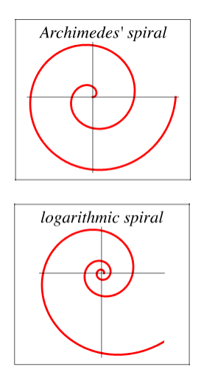
What is a spiral?
Wolfram Mathworld:
A spiral is a curve that gets farther away from a central point as the angle is increased, thus "wrapping around" itself.
Source: https://mathworld.wolfram.com/Spiral.html

Slide 4
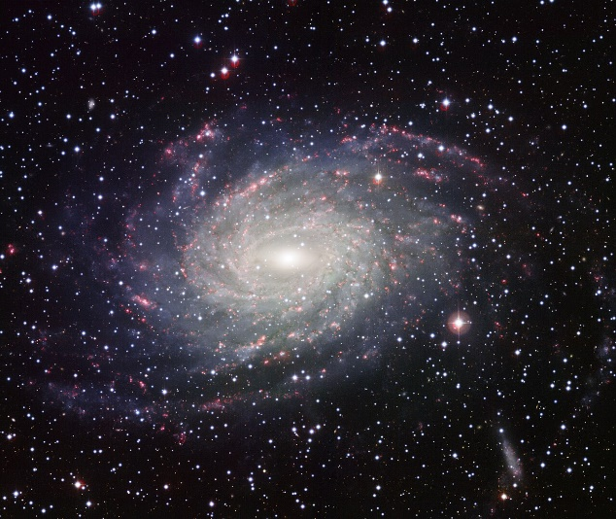
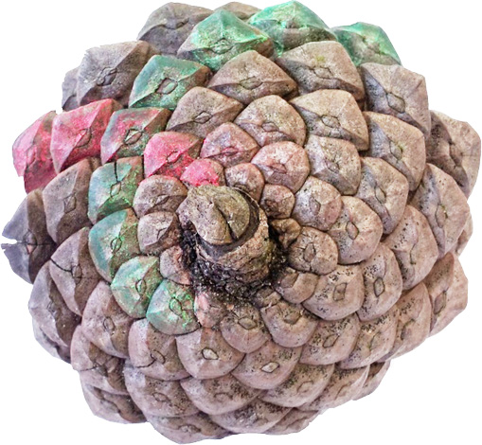
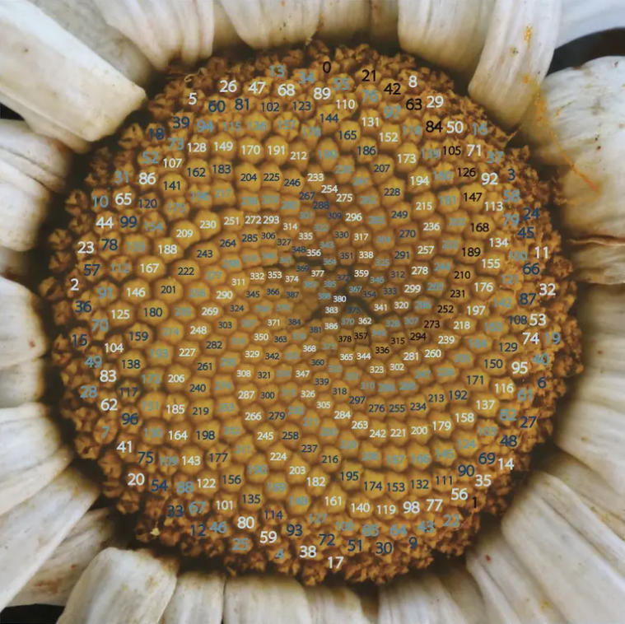
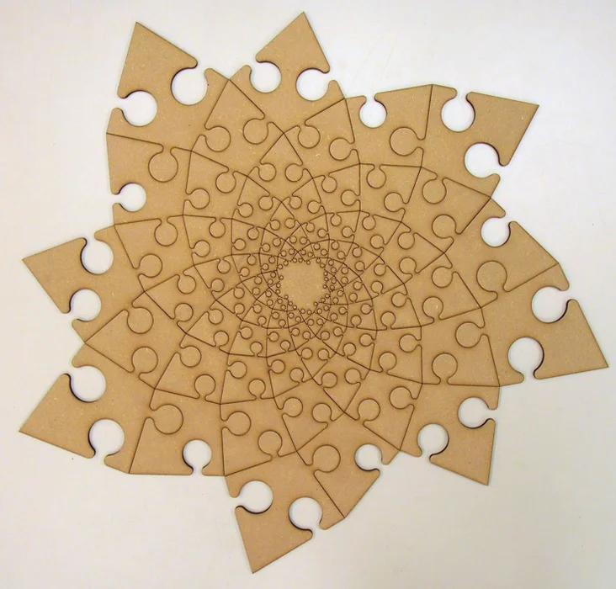
Examples in nature, art and design
Source: https://nl.wikipedia.org/wiki/NGC_6744#/media/Bestand:Wide_Field_Imager_view_of_a_Milky_Way_look-alike_NGC_6744.jpg
Location: found at 51°23'48.5"N 5°33'00.5"E, The Netherlands (Loe Feijs)
gallery.bridgesmathart.org/exhibitions/2022-bridges-conference/sgoldstine
https://www.instructables.com/Fibonacci-Spiral-Jigsaw-puzzle/ by John Edmark

Slide 5
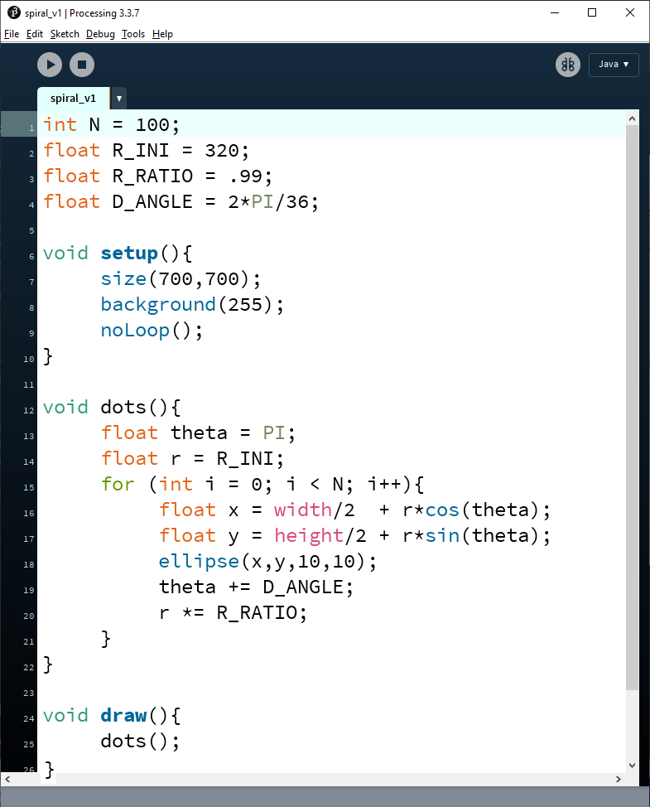
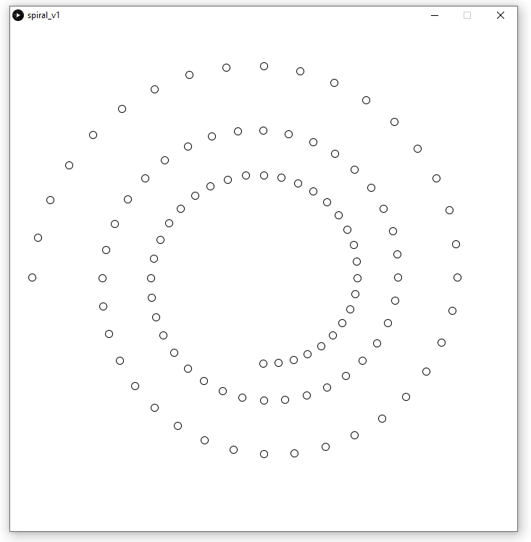
How to make a spiral?

Slide 6
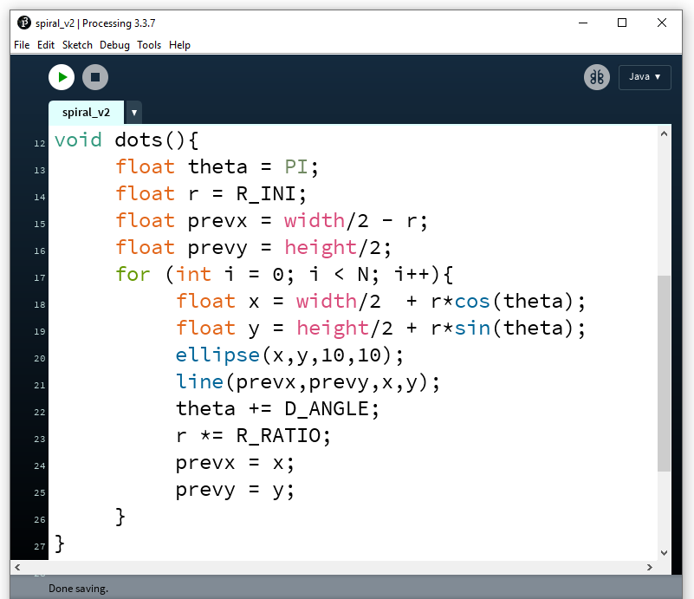
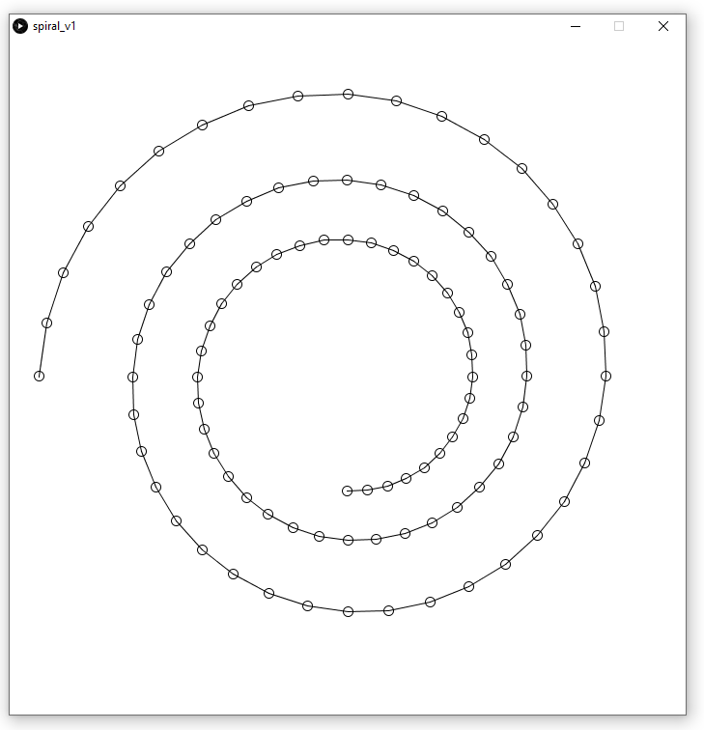

Slide 7
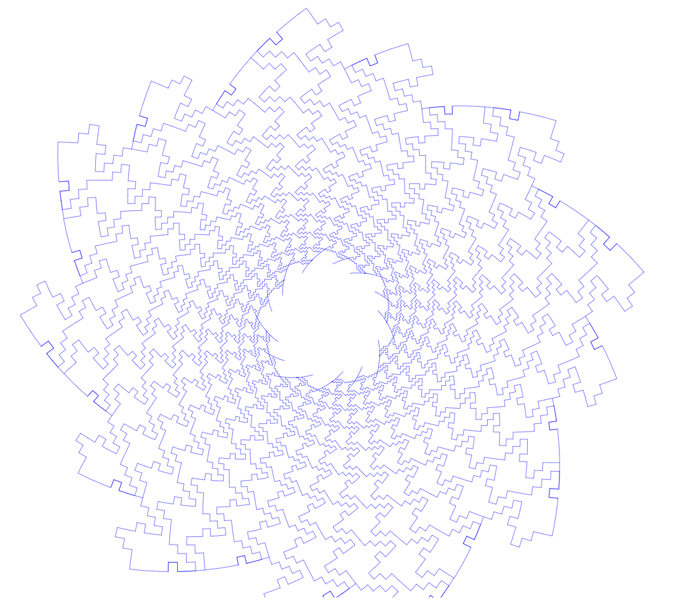
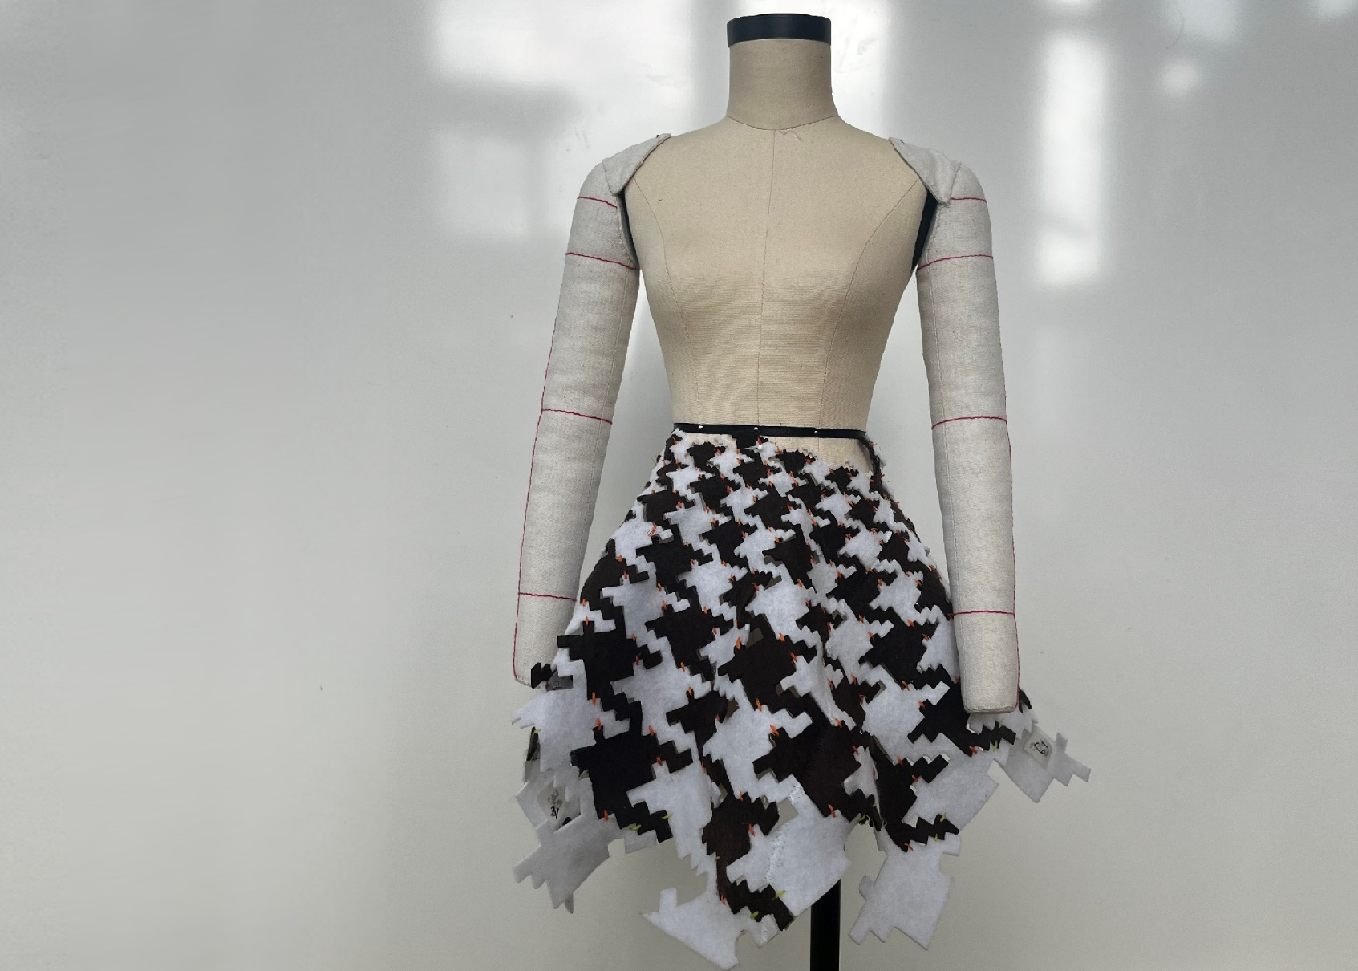

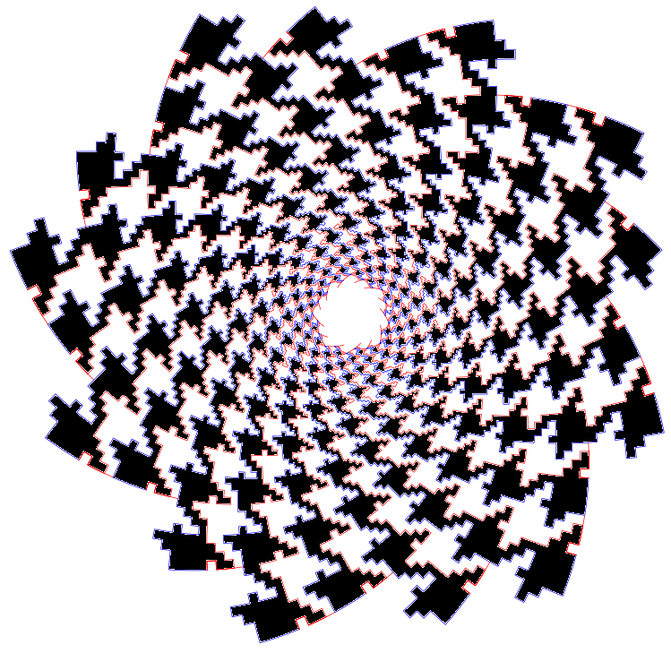
Inspiration: houndstooth spiral

Slide 8
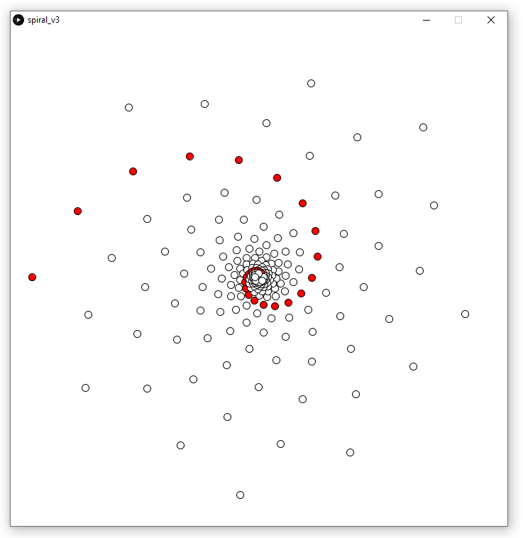
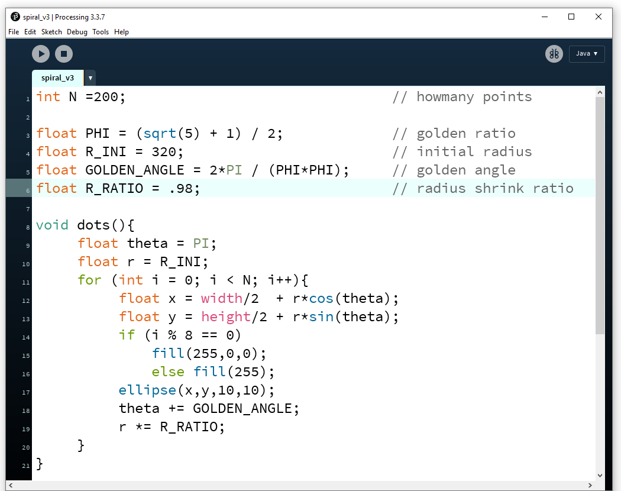
Golden spirals

Slide 9
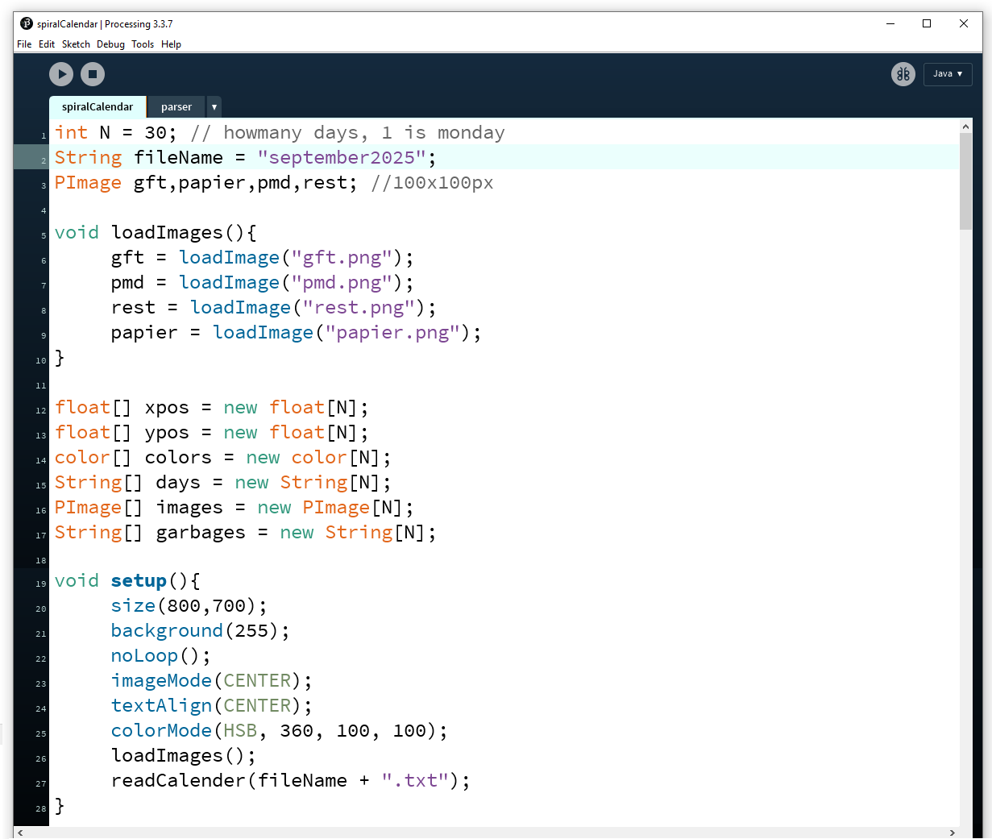
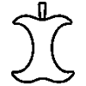
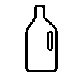

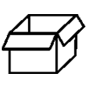
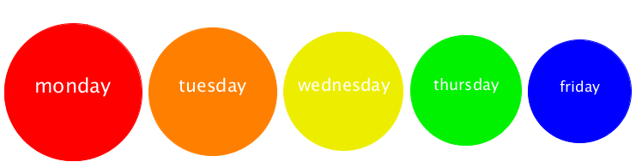
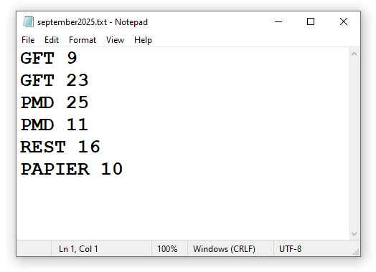
Calendar spiral

Slide 10
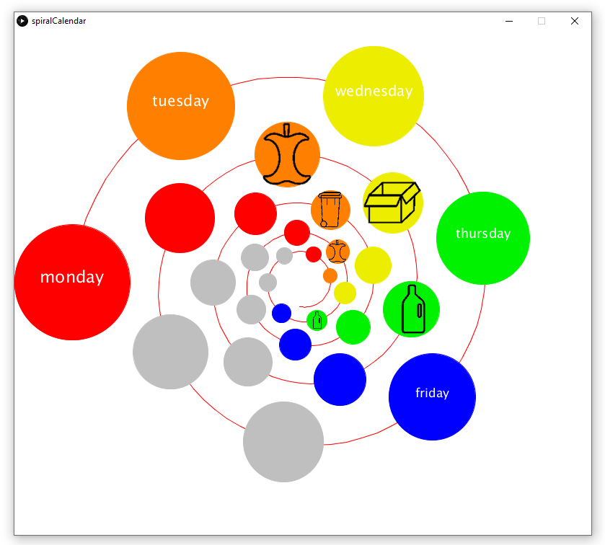

Slide 11
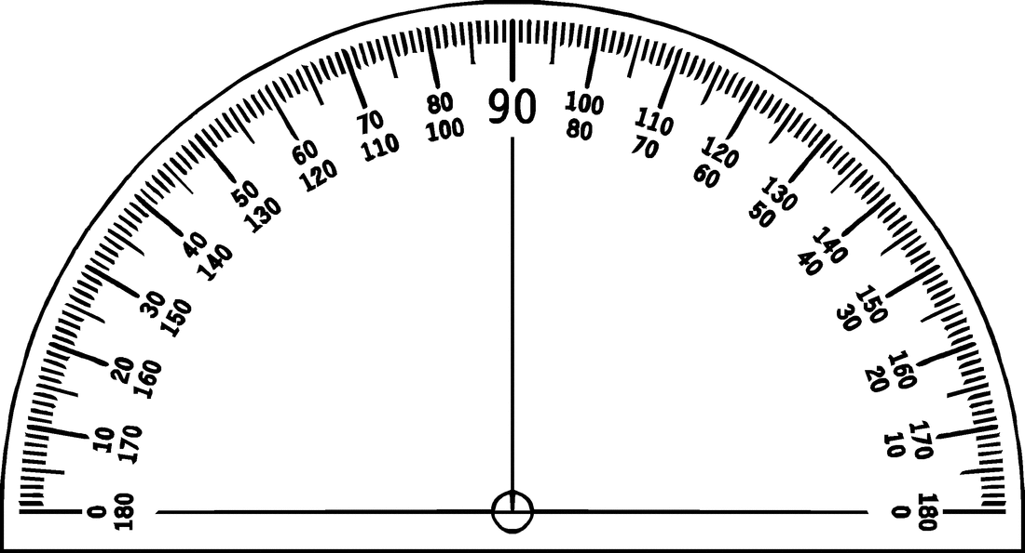

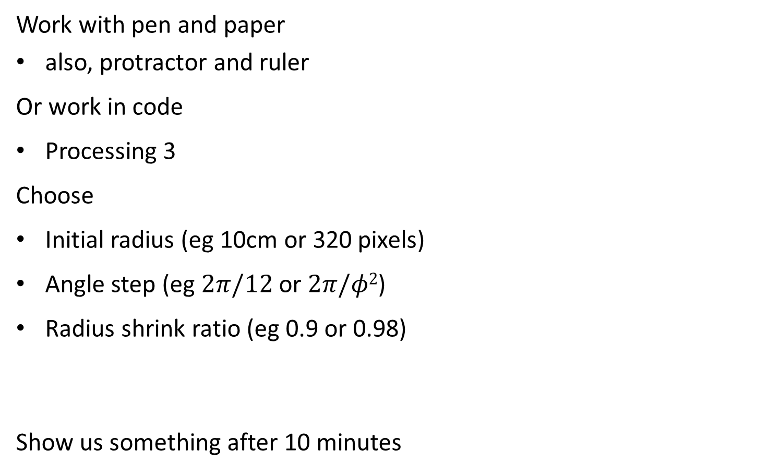
Action: you draw a spiral
Work with pen and paper
also, protractor and ruler
Or work in code
Processing 3
Choose
Initial radius (eg 10cm or 320 pixels)
Angle step (eg $2π/12$ or $2π/φ2$)
Radius shrink ratio (eg 0.9 or 0.98)
Show us something after 10 minutes

