Slide 1

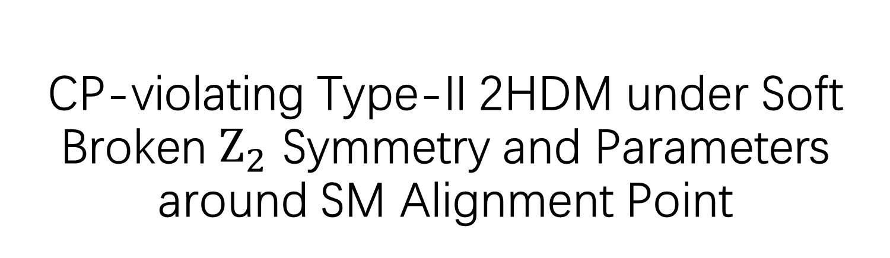
CP-violating Type-II 2HDM under Soft Broken $Z_{2}$ Symmetry and Parameters around SM Alignment Point
Advisor: Prof. Yusheng Wu
School of the Gifted Young PB23000136 Li Shangchengze

Slide 2

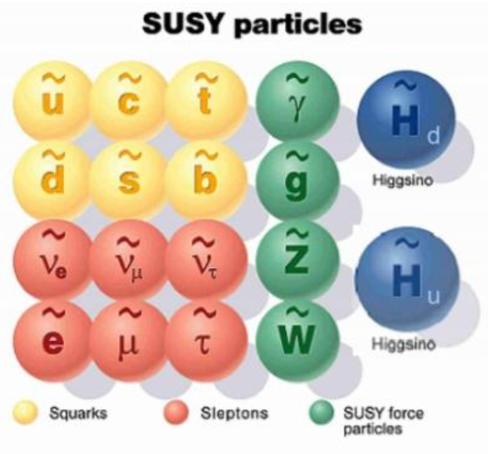
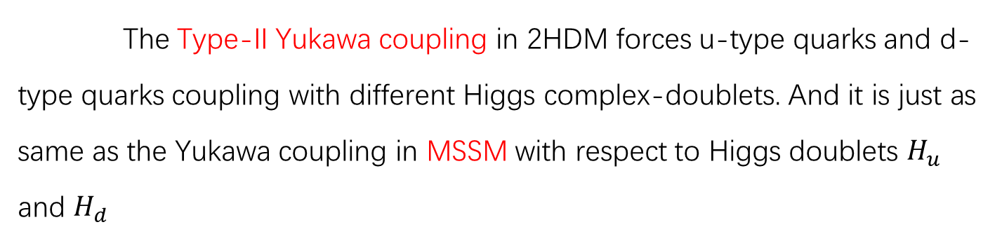
Background
>The Matter-antimatter Asymmetry Problem
The SM does not provide enough CP violation to achieve the observed asymmetry, thus necessitating the exploration of CP violation sources. And 2HDM is one of the simplest CP violation sources.
>Associated with MSSM
The Type-II Yukawa coupling in 2HDM forces u-type quarks and d-type quarks coupling with different Higgs complex-doublets. And it is just as same as the Yukawa coupling in MSSM with respect to Higgs doublets $H_{u}$ and $H_{d}$

Slide 3


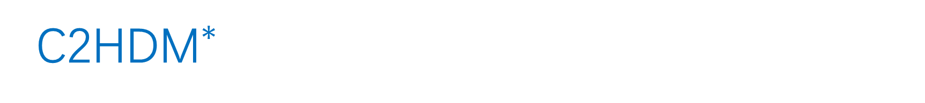
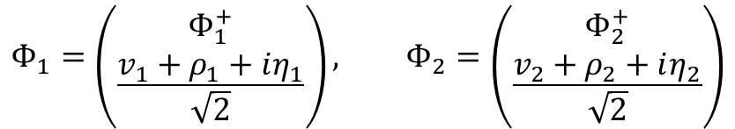
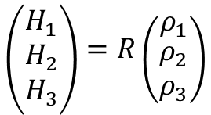
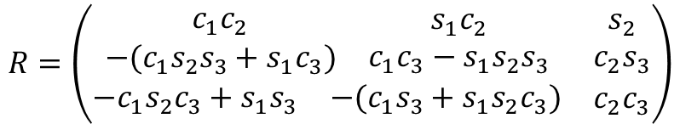

C2${\text{HDM}}^{∗}$
$$ℒ_{2HDM}=m_{11}^{2}Φ_{1}^{†}Φ_{1}+m_{22}^{2}Φ_{2}^{†}Φ_{2}+\left(m_{12}^{2}Φ_{1}^{†}Φ_{2}+h.c.\right)+λ_{1}{(Φ_{1}^{†}Φ_{1})}^{2}+λ_{2}{(Φ_{2}^{†}Φ_{2})}^{2}$$
$$+λ_{3}\left(Φ_{1}^{†}Φ_{1}\right)\left(Φ_{2}^{†}Φ_{2}\right)+λ_{4}\left(Φ_{1}^{†}Φ_{2}\right)\left(Φ_{2}^{†}Φ_{1}\right)+{(λ}_{5}{(Φ_{1}^{†}Φ_{2})}^{2}+h.c.)$$
where $m_{12}^{2}$ and ${ λ}_{5}$ are complex and the rest of the parameters in the potential are real.
In general, the scalar doublets are defined as
$$Φ_{1}=\left({Φ_{1}^{+} \atop \frac{v_{1}+ρ_{1}+iη_{1}}{\sqrt{2}}}\right), Φ_{2}=\left({Φ_{2}^{+} \atop \frac{v_{2}+ρ_{2}+iη_{2}}{\sqrt{2}}}\right)$$
And we define $tanβ= \frac{{ v}_{2}}{{ v}_{1}}$
$$H^{±}=−s_{β}Φ_{1}^{±}+c_{β}Φ_{2}^{±}$$
Scalar Mixing Angles $0< α_{1}$, $α_{2}$, $α_{3}<\frac{π}{2}$ which diagonalize the Higgs mass matrix :
$$\left({H_{1} \atop \begin{matrix}H_{2} \\ H_{3}\end{matrix}}\right)=R\left({ρ_{1} \atop \begin{matrix}ρ_{2} \\ ρ_{3}\end{matrix}}\right)$$
$$R=\left(\begin{matrix}\begin{matrix}\begin{matrix}c_{1}c_{2} \\ −(c_{1}s_{2}s_{3}+s_{1}c_{3})\end{matrix} & \begin{matrix}s_{1}c_{2} \\ c_{1}c_{3}−s_{1}s_{2}s_{3}\end{matrix}\end{matrix} & \begin{matrix}s_{2} \\ c_{2}s_{3}\end{matrix} \\ \begin{matrix}−c_{1}s_{2}c_{3}+s_{1}s_{3} & −(c_{1}s_{3}+s_{1}s_{2}c_{3})\end{matrix} & c_{2}c_{3}\end{matrix}\right)$$
*$ρ_{3}=−s_{β}η_{1}+c_{β}η_{2}$
* C2HDM means CP-violating 2HDM under Soft Broken $Z_{2}$ Symmetry * $c_{i}$, $s_{i}$ and $t_{i}$ mean $cosα_{i}$, $sinα_{i}$ and tan$α_{i}$

Slide 4
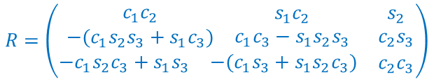



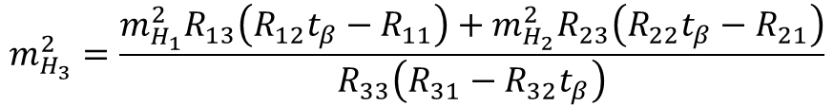

C2HDM
$$m_{H_{3}}^{2}=\frac{m_{H_{1}}^{2}R_{13}\left(R_{12}t_{β}−R_{11}\right)+m_{H_{2}}^{2}R_{23}\left(R_{22}t_{β}−R_{21}\right)}{R_{33}\left(R_{31}−R_{32}t_{β}\right)}$$
9 independent parameters of C2HDM :
$$v, m_{H_{1}},m_{H_{2}},m_{H^{±}}, α_{1},α_{2},α_{3}, tanβ, Re[m_{12}^{2}]$$
* $v=\sqrt{v_{1}^{2}+v_{2}^{2}}$
Usually, we set $v=246$GeV,$m_{H_{1}}<m_{H_{2}}<m_{H_{3}}<1000$GeV.
WW/ZZ couplings modification:
$$c\left(H_{i}VV\right)=c_{β}R_{i1}+s_{β}R_{i2}$$
$$c\left(H_{1}VV\right)=c_{2}c(β−α_{1})$$
$$Φ_{1}=\left({Φ_{1}^{+} \atop \frac{v_{1}+ρ_{1}+iη_{1}}{\sqrt{2}}}\right), Φ_{2}=\left({Φ_{2}^{+} \atop \frac{v_{2}+ρ_{2}+iη_{2}}{\sqrt{2}}}\right)$$
$$R=\left(\begin{matrix}\begin{matrix}\begin{matrix}c_{1}c_{2} \\ −(c_{1}s_{2}s_{3}+s_{1}c_{3})\end{matrix} & \begin{matrix}s_{1}c_{2} \\ c_{1}c_{3}−s_{1}s_{2}s_{3}\end{matrix}\end{matrix} & \begin{matrix}s_{2} \\ c_{2}s_{3}\end{matrix} \\ \begin{matrix}−c_{1}s_{2}c_{3}+s_{1}s_{3} & −(c_{1}s_{3}+s_{1}s_{2}c_{3})\end{matrix} & c_{2}c_{3}\end{matrix}\right)$$
$$ℒ_{2HDM}=m_{11}^{2}Φ_{1}^{†}Φ_{1}+m_{22}^{2}Φ_{2}^{†}Φ_{2}+\left(m_{12}^{2}Φ_{1}^{†}Φ_{2}+h.c.\right)+λ_{1}{(Φ_{1}^{†}Φ_{1})}^{2}+λ_{2}{(Φ_{2}^{†}Φ_{2})}^{2}$$
$$+λ_{3}\left(Φ_{1}^{†}Φ_{1}\right)\left(Φ_{2}^{†}Φ_{2}\right)+λ_{4}\left(Φ_{1}^{†}Φ_{2}\right)\left(Φ_{2}^{†}Φ_{1}\right)+{(λ}_{5}{(Φ_{1}^{†}Φ_{2})}^{2}+h.c.)$$

Slide 5
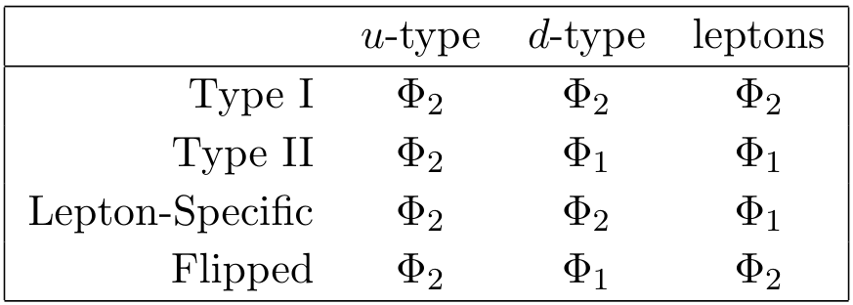



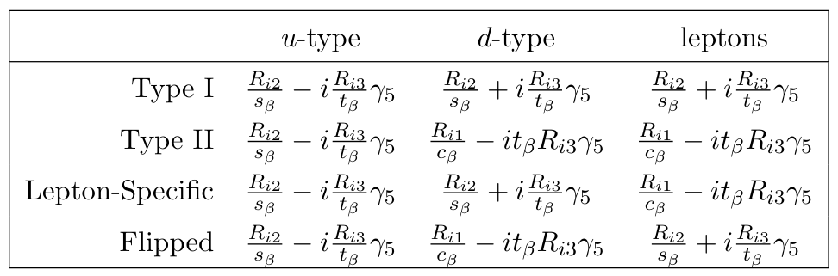

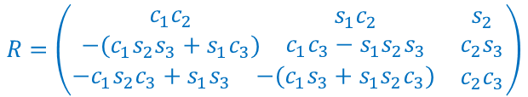
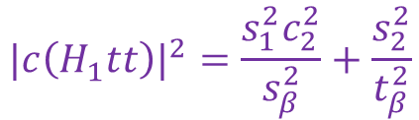

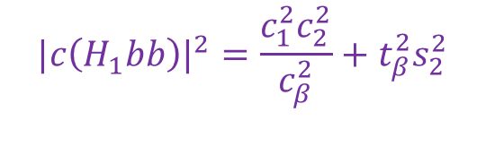


Type-II Yukawa coupling & modification
$$ℒ_{Yukawa}={\overline{Q}}_{L}\left(Y_{2}^{u}{\tilde{Φ}}_{2}\right)u_{R}+{\overline{Q}}_{L}\left(Y_{1}^{d}Φ_{1}\right)d_{R}+{\overline{L}}_{L}\left(Y_{1}^{e}Φ_{1}\right)e_{R}+h.c.$$
Yukawa couplings modifications:
$$|c\left(H_{1}bb\right)|^{2}=\frac{c_{1}^{2}c_{2}^{2}}{c_{β}^{2}}+t_{β}^{2}s_{2}^{2}$$
$$|c\left(H_{1}tt\right)|^{2}=\frac{s_{1}^{2}c_{2}^{2}}{s_{β}^{2}}+\frac{s_{2}^{2}}{t_{β}^{2}}$$
$$b$$
$$t$$
$$H_{1}$$
$$H_{1}$$
$$\overline{b}$$
$$\overline{t}$$
$$R=\left(\begin{matrix}\begin{matrix}\begin{matrix}c_{1}c_{2} \\ −(c_{1}s_{2}s_{3}+s_{1}c_{3})\end{matrix} & \begin{matrix}s_{1}c_{2} \\ c_{1}c_{3}−s_{1}s_{2}s_{3}\end{matrix}\end{matrix} & \begin{matrix}s_{2} \\ c_{2}s_{3}\end{matrix} \\ \begin{matrix}−c_{1}s_{2}c_{3}+s_{1}s_{3} & −(c_{1}s_{3}+s_{1}s_{2}c_{3})\end{matrix} & c_{2}c_{3}\end{matrix}\right)$$

Slide 6
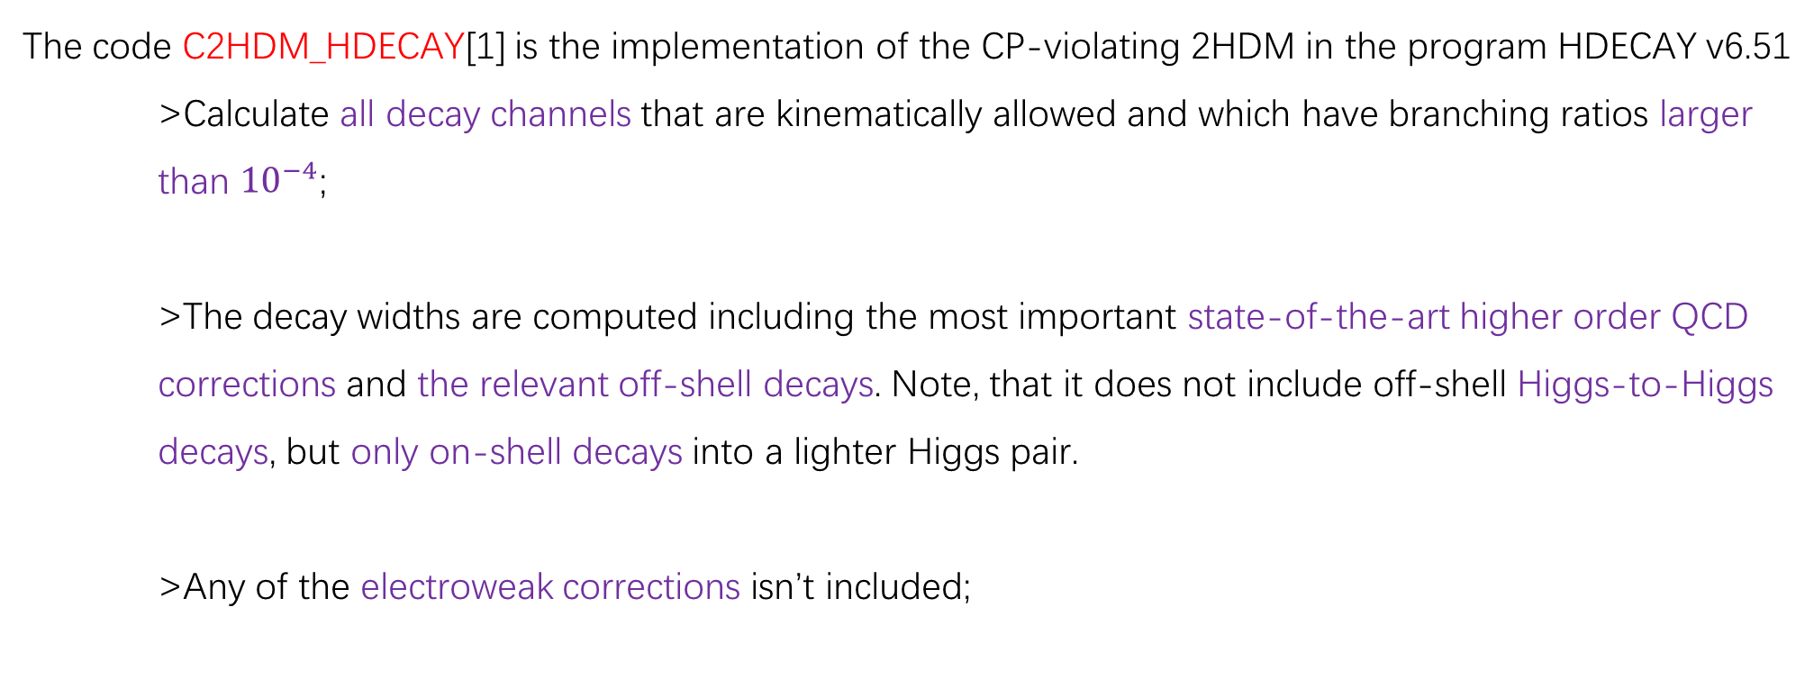
C2HDM_HDECAY
arXiv:1711.09419
arXiv:1711.09419
The code C2HDM_HDECAY[1] is the implementation of the CP-violating 2HDM in the program HDECAY v6.51
>Calculate all decay channels that are kinematically allowed and which have branching ratios larger than ${10}^{−4}$;
>The decay widths are computed including the most important state-of-the-art higher order QCD corrections and the relevant off-shell decays. Note, that it does not include off-shell Higgs-to-Higgs decays, but only on-shell decays into a lighter Higgs pair.
>Any of the electroweak corrections isn’t included;
[1] arXiv:1711.09419

Slide 7
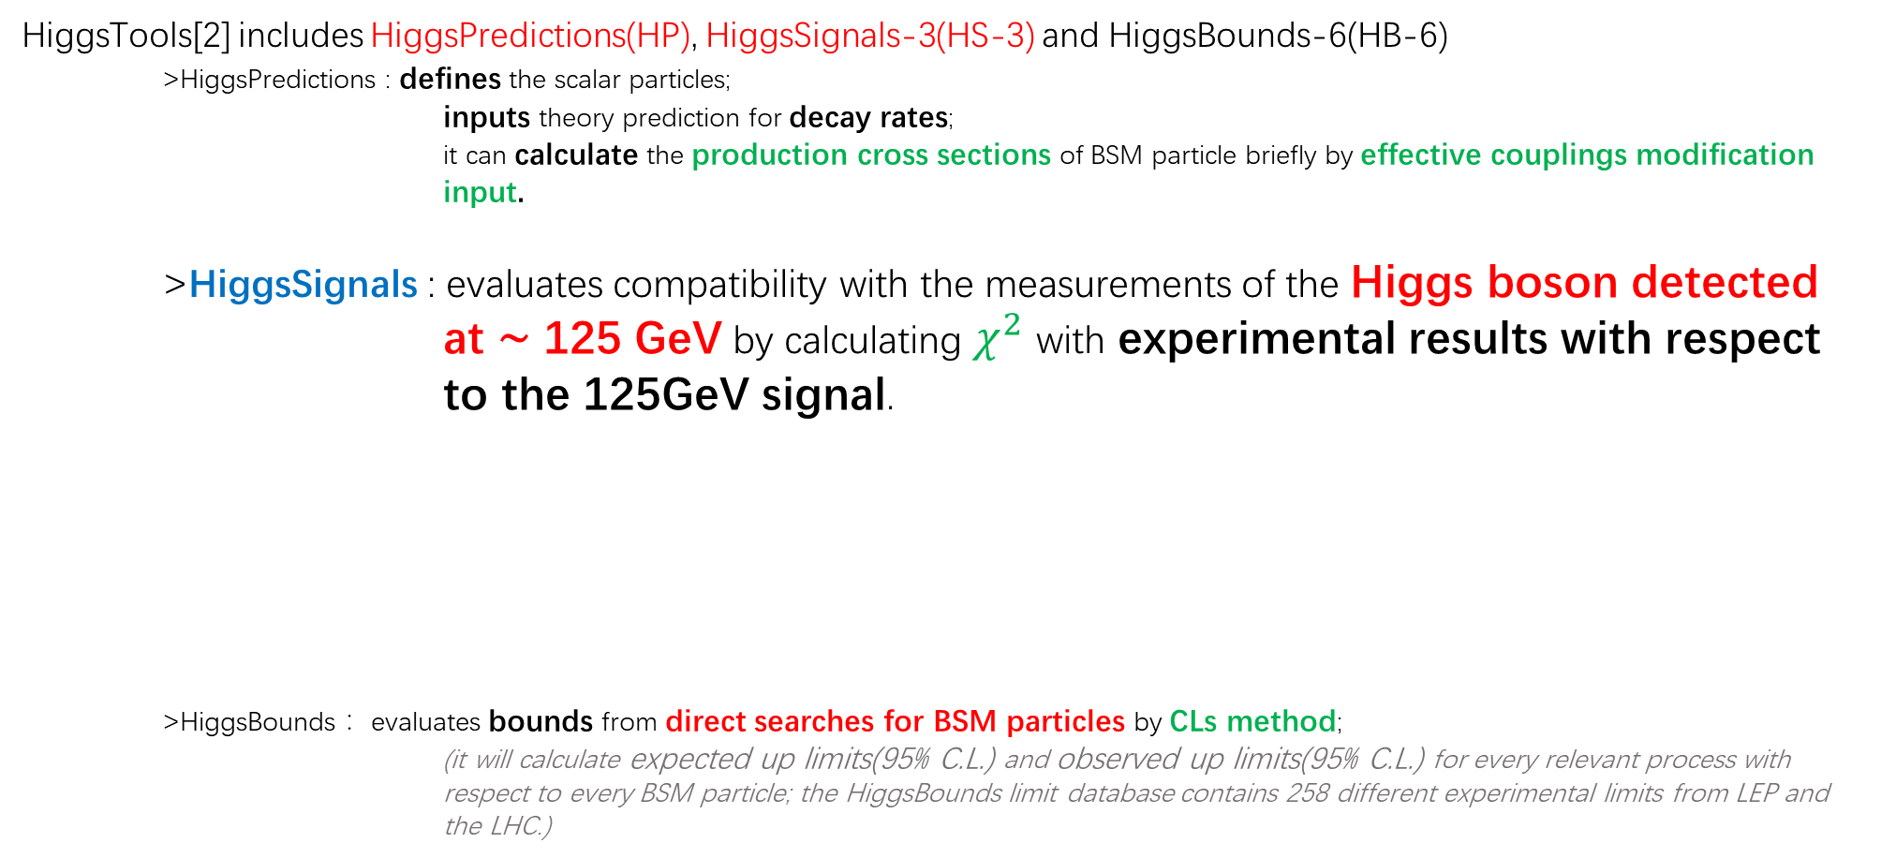
HiggsTools
arXiv:1711.09419
arXiv:1711.09419
HiggsTools[2] includes HiggsPredictions(HP), HiggsSignals-3(HS-3) and HiggsBounds-6(HB-6)
>HiggsPredictions : defines the scalar particles;
inputs theory prediction for decay rates;
it can calculate the production cross sections of BSM particle briefly by effective couplings modification input.
>HiggsSignals : evaluates compatibility with the measurements of the Higgs boson detected at ∼ 125 GeV by calculating $χ^{2}$ with experimental results with respect to the 125GeV signal.
>HiggsBounds ：evaluates bounds from direct searches for BSM particles by CLs method;
(it will calculate expected up limits(95% C.L.) and observed up limits(95% C.L.) for every relevant process with respect to every BSM particle; the HiggsBounds limit database contains 258 different experimental limits from LEP and the LHC.)
inclusive cross sections and branch ratios
SM Higgs boson kinematic template
+
modification factors
$χ^{2}$ of different bins
𝝌^𝟐 of different bins
Global $χ^{2}$ of each measurement
Global 𝝌^𝟐 of each measurement
Global $χ^{2}$
Global 𝝌^𝟐
[2] arXiv:2210.09332

Slide 8
Measurements used by HiggsSignals
arXiv:1711.09419
arXiv:1711.09419
All SM Higgs measurements used by HiggsSignals to compute $χ^{2}$comes from 21 experiment reports about:
LHC 13TeV
$H→WW^{∗}→𝓵ν𝓵^{′}ν^{′}$
2007.01984 CMS
𝑯→𝑾𝑾^∗→𝓵𝝂𝓵^′ 𝝂^′
2007.01984 CMS
LHC 7&8TeV 1606.02266
ggH & VBF production
$H→WW^{∗}→eνμν$
1808.09054 ATLAS
ggH & VBF production
𝑯→𝑾𝑾^∗→𝒆𝝂𝝁𝝂
1808.09054 ATLAS
VH production
1903.10052 ATLAS
$H→f\overline{f}$
𝑯→𝒇𝒇 ̅
$H→μ^{−}μ^{+}$
2009.04363 CMS
2007.07830 ATLAS
𝑯→𝝁^− 𝝁^+
2009.04363 CMS
2007.07830 ATLAS
$H→τ^{−}τ^{+}$
2110.04836 CMS (CP structure)
2204.12957 CMS
1811.08856 ATLAS
𝑯→𝝉^− 𝝉^+
2110.04836 CMS (CP structure)
2204.12957 CMS
1811.08856 ATLAS
$H→γγ$ 2103.06956 CMS 2207.00348 ATLAS
𝑯→𝜸𝜸 2103.06956 CMS 2207.00348 ATLAS
multilepton final states
$$H→b\overline{b}$$
1808.08242 CMS
𝑯→𝒃𝒃 ̅
1808.08242 CMS
$$H→c\overline{c}$$
1912.01662 CMS
ATLAS-CONF-2021-021
𝑯→𝒄𝒄 ̅
1912.01662 CMS
ATLAS-CONF-2021-021
VBF production
2011.08280 ATLAS
ttH production 2111.06712 ATLAS
VH production
2007.02873 ATLAS
$4ℓ$ final states
2103.04956 CMS 2004.03447 ATLAS
𝟒ℓ final states
2103.04956 CMS 2004.03447 ATLAS
ttH production
1803.05485 CMS ($e$, $μ$, and hadronically decaying $τ$ final states)
ATLAS-CONF-2019-045
ttH production
1803.05485 CMS (𝐞, 𝛍, and hadronically decaying 𝛕 final states)
ATLAS-CONF-2019-045

Slide 9

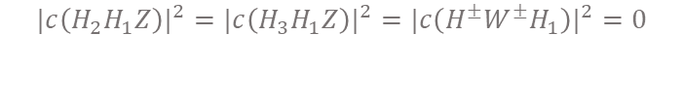




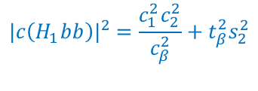
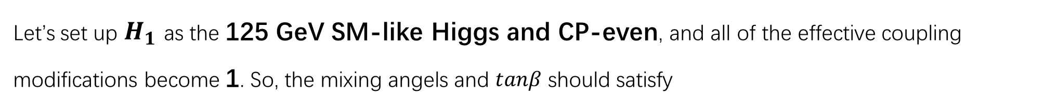

SM Alignment
SM alignment means we should create a scalar particle that is almost the same as SM Higgs boson, and other scalar particles have negligible impacts on it.
Let’s set up $H_{1}$ as the 125 GeV SM-like Higgs and CP-even, and all of the effective coupling modifications become 1. So, the mixing angels and $tanβ$ should satisfy
$$α_{1}=β$$
$$α_{2}=0$$
Then ,the effective couplings modification factors become:
$$m_{H_{2}}=m_{H_{3}}(α_{2}=0)$$
$$|c\left(H_{1}VV\right)|^{2}=|c\left(H_{1}tt\right)|^{2}=|c\left(H_{1}bb\right)|^{2}=1$$
$$|c\left(H_{2}VV\right)|^{2}=|c\left(H_{3}VV\right)|^{2}=0$$
$$|c\left(H_{2}H_{1}Z\right)|^{2}=|c\left(H_{3}H_{1}Z\right)|^{2}=|c\left(H^{±}W^{±}H_{1}\right)|^{2}=0$$
$$|c\left(H_{1}bb\right)|^{2}=\frac{c_{1}^{2}c_{2}^{2}}{c_{β}^{2}}+t_{β}^{2}s_{2}^{2}$$
Then what about other parameters?
Let’s test their impacts on our SM-like Higgs by HiggsSignals.
$$|c\left(H_{1}tt\right)|^{2}=\frac{s_{1}^{2}c_{2}^{2}}{s_{β}^{2}}+\frac{s_{2}^{2}}{t_{β}^{2}}$$
$$c\left(H_{1}VV\right)=c_{2}c(β−α_{1})$$

Slide 10
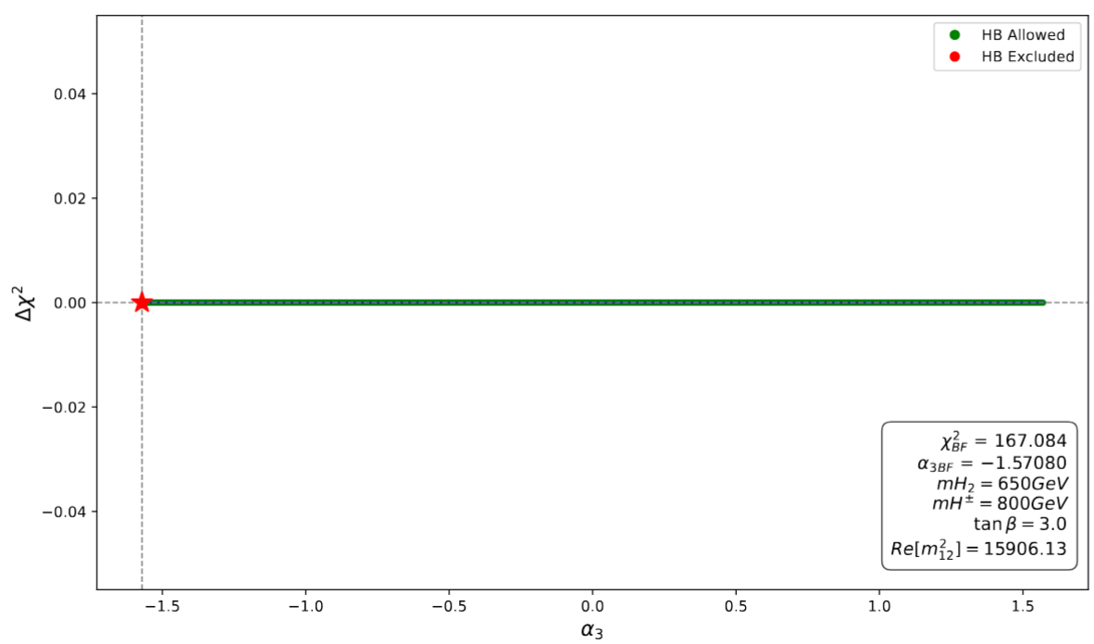
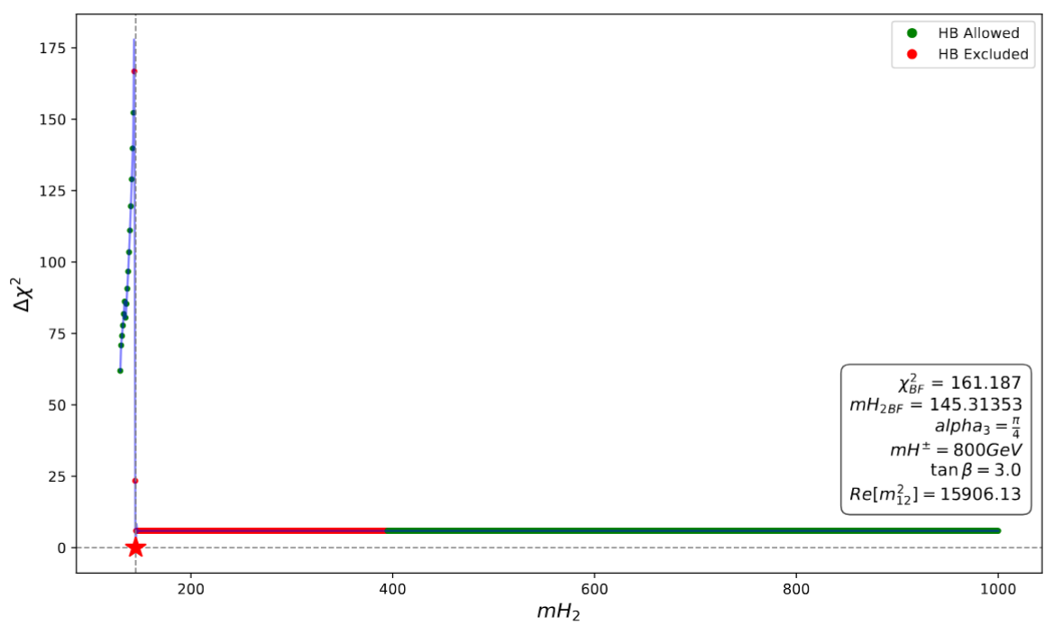
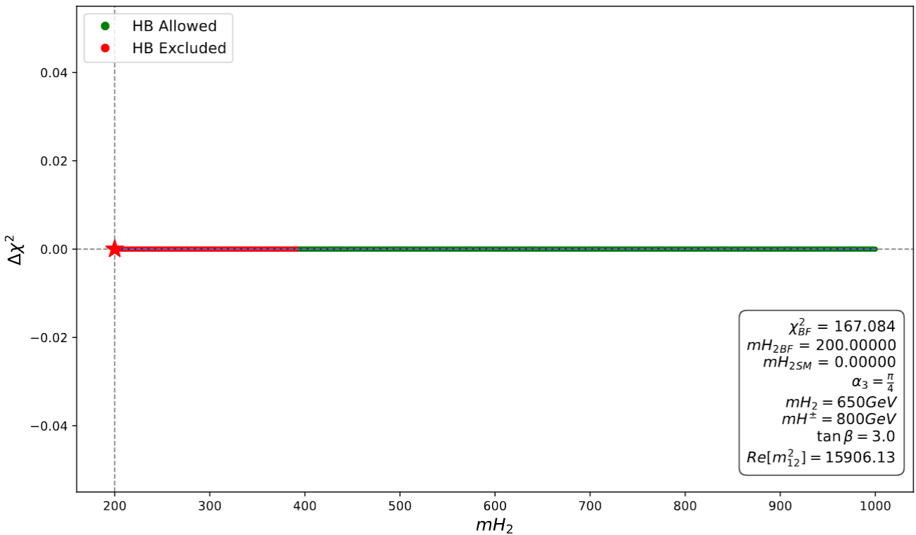
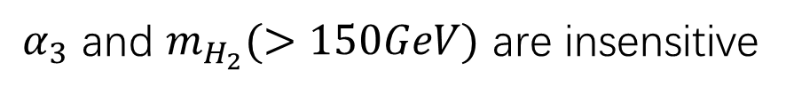

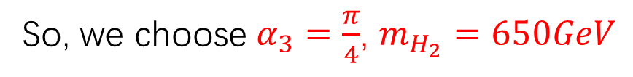




Impacts of other Parameters on $χ^{2}$
$α_{3}$
$$m_{H_{2}}$$
$$m_{H_{2}}$$
$$Δχ^{2}=χ^{2}−χ_{min}^{2}$$
$α_{3}$ and $m_{H_{2}}(>150GeV)$ are insensitive
So, we choose $α_{3}=\frac{π}{4}$, $m_{H_{2}}=650GeV$

Slide 11
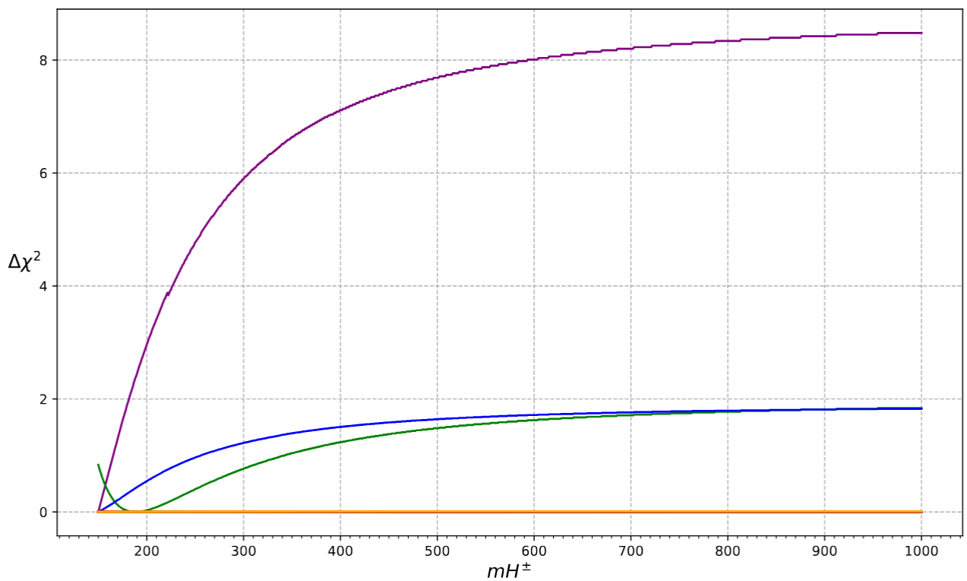
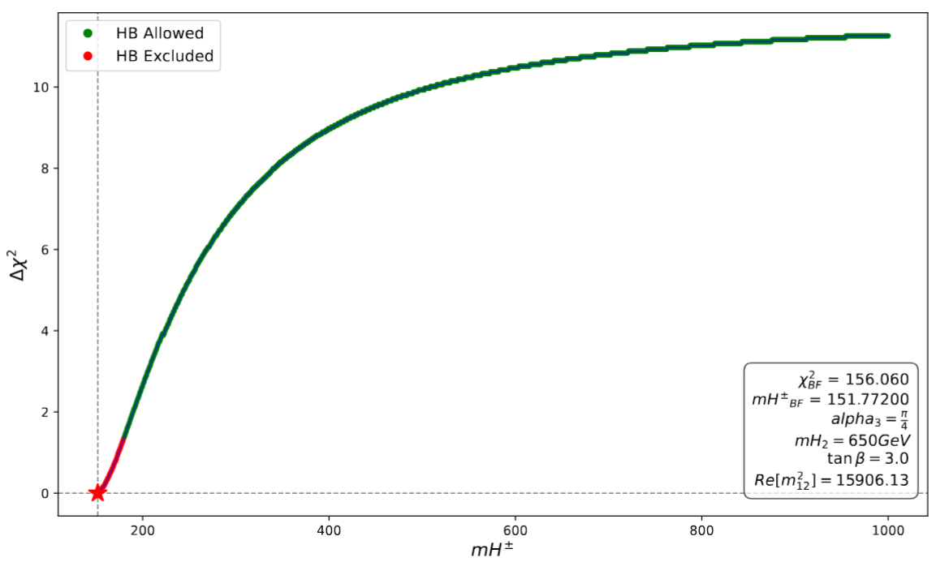
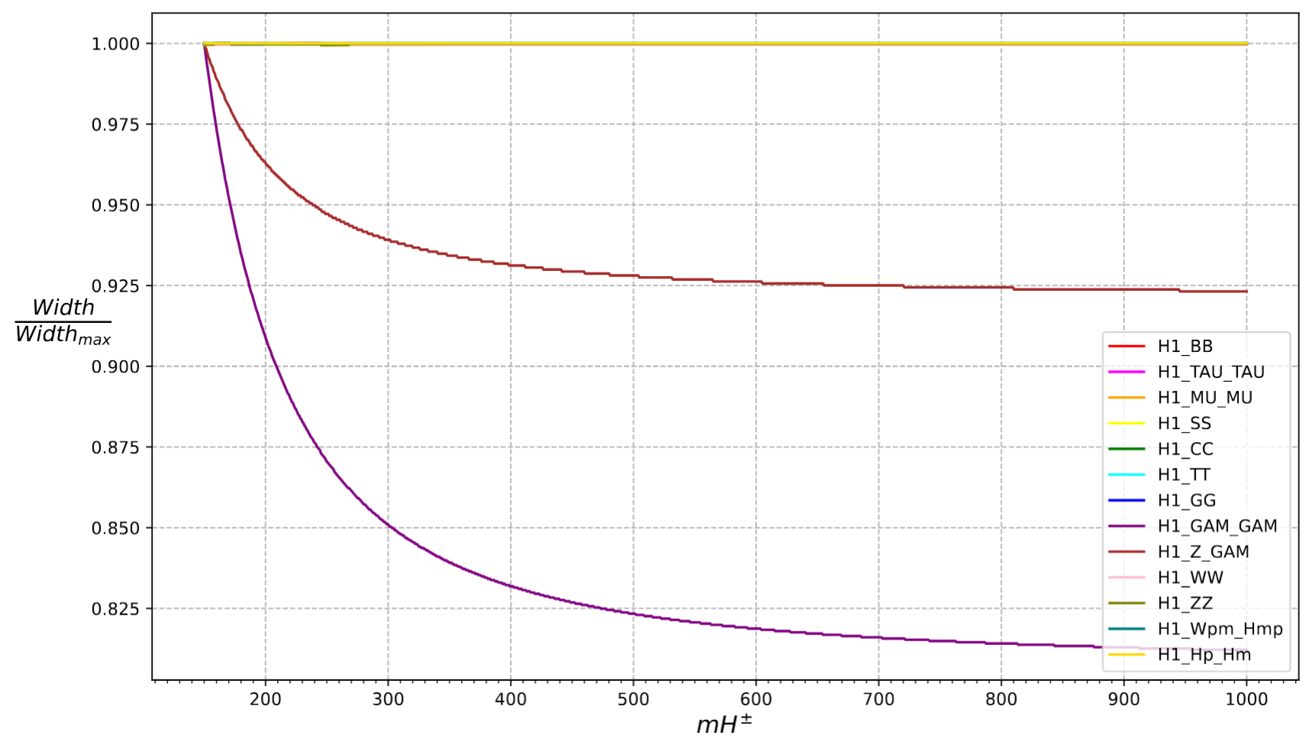
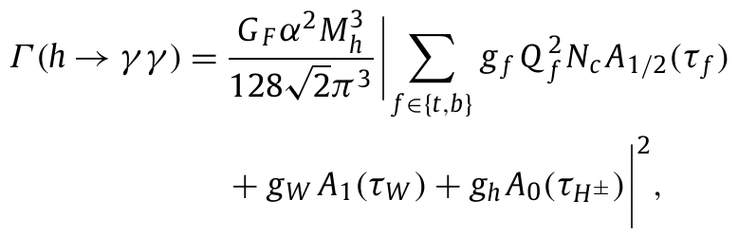

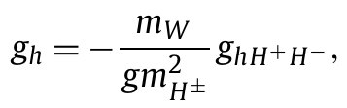








Impacts of other Parameters on $χ^{2}$
Then for $m_{H^{±}}$
2103.06956
$$H_{1}→γγ$$
LHC 7&8TeV
1606.02266
2207.00348
But actually, HiggsSignals computes $χ^{2}$ with experimental results instead
of SM predictions. So the BFP in the figure doesn’t mean SM Alignment.
$$H_{1}→Zγ$$
$$γ$$
[3]
$$H^{+}$$
$$H_{1}$$
$$H^{+}$$
$$H_{1}→γγ$$
$$H^{−}$$
$$γ$$
[3] P.Posch, PhysicsLettersB696(2011)447–453 (10)

Slide 12
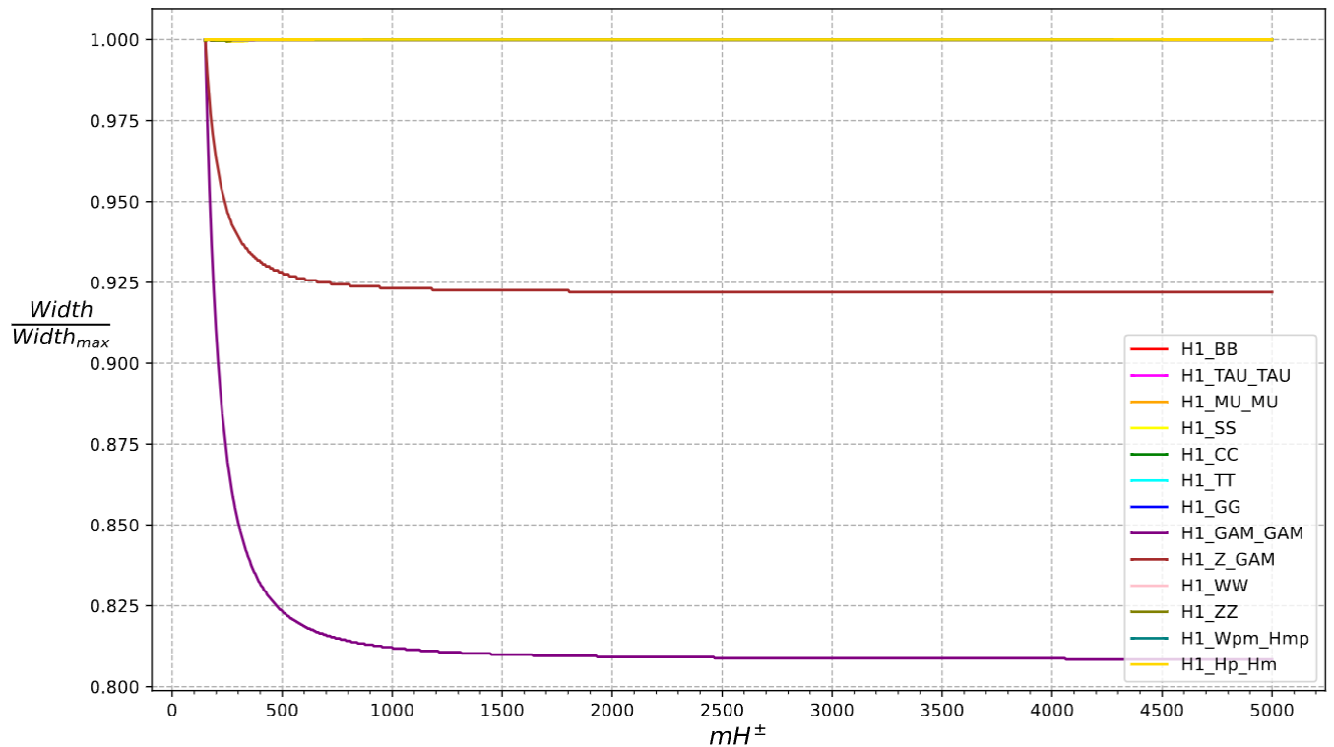


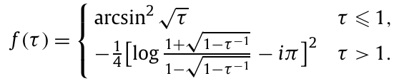
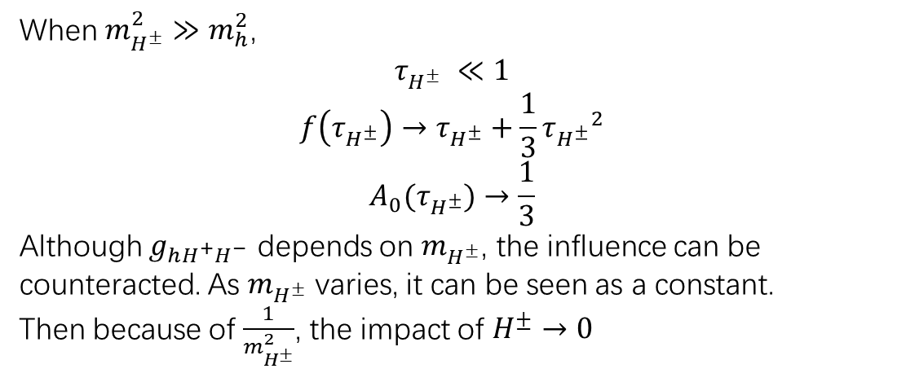

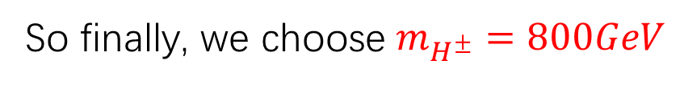
Decoupling of $H^{±}$
So, let’s go back to the theory to find how to decouple $H^{±}$
$$H_{1}→Zγ$$
When $m_{H^{±}}^{2}≫m_{h}^{2}$,
$$τ_{H^{±}} ≪1$$
$$f\left(τ_{H^{±}}\right)→τ_{H^{±}}+\frac{1}{3}{τ_{H^{±}}}^{2}$$
$$A_{0}(τ_{H^{±}})→\frac{1}{3}$$
Although $g_{hH^{+}H^{−}}$ depends on $m_{H^{±}}$, the influence can be counteracted. As $m_{H^{±}}$ varies, it can be seen as a constant.
Then because of $\frac{1}{m_{H^{±}}^{2}}$, the impact of $H^{±}→0$
$$H_{1}→γγ$$
So finally, we choose $m_{H^{±}}=800GeV$

Slide 13
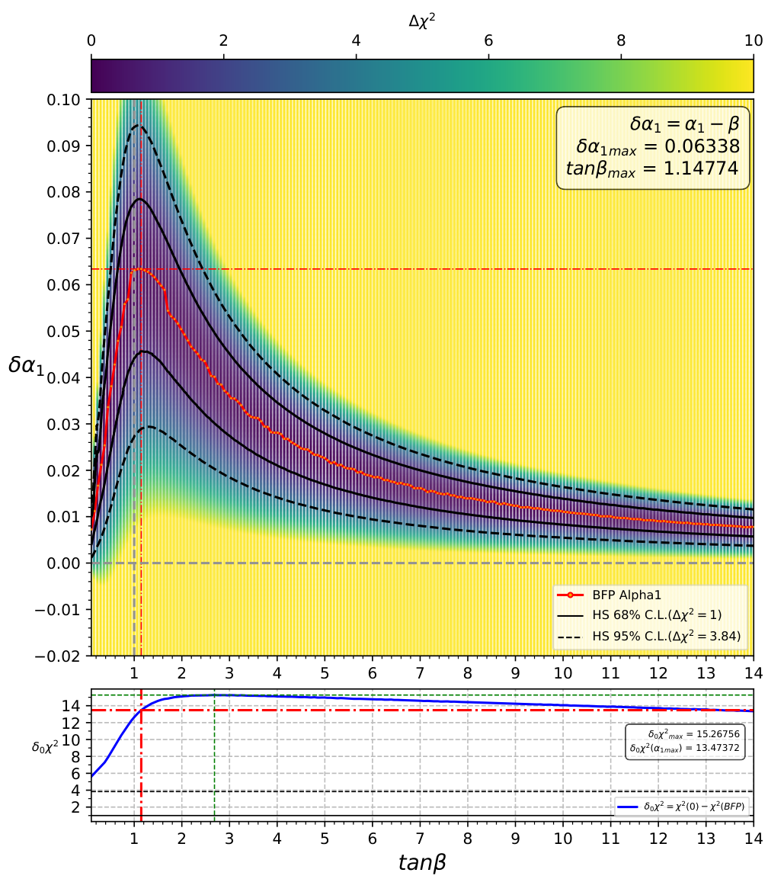
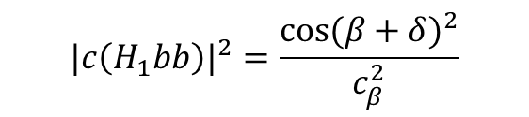



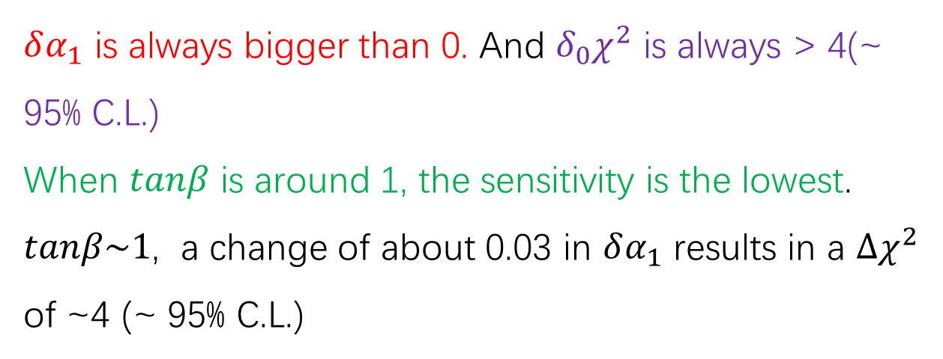
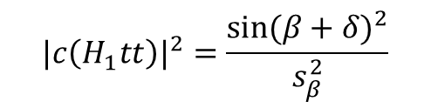
Deviation from the SM Alignment Point of $α_{1}$
When $α_{1}=β+δ$
$$c\left(H_{1}VV\right)=cosδ$$
$$|c\left(H_{1}bb\right)|^{2}=\frac{{cos⁡(β+δ)}^{2}}{c_{β}^{2}}$$
$$|c\left(H_{1}tt\right)|^{2}=\frac{{sin⁡(β+δ)}^{2}}{s_{β}^{2}}$$
$δα_{1}$ is always bigger than 0. And $δ_{0}χ^{2}$ is always > 4(~ 95% C.L.)
When $tanβ$ is around 1, the sensitivity is the lowest.
$tanβ\sim 1$, a change of about 0.03 in $δα_{1}$ results in a $Δχ^{2}$ of ~4 (~ 95% C.L.)

Slide 14
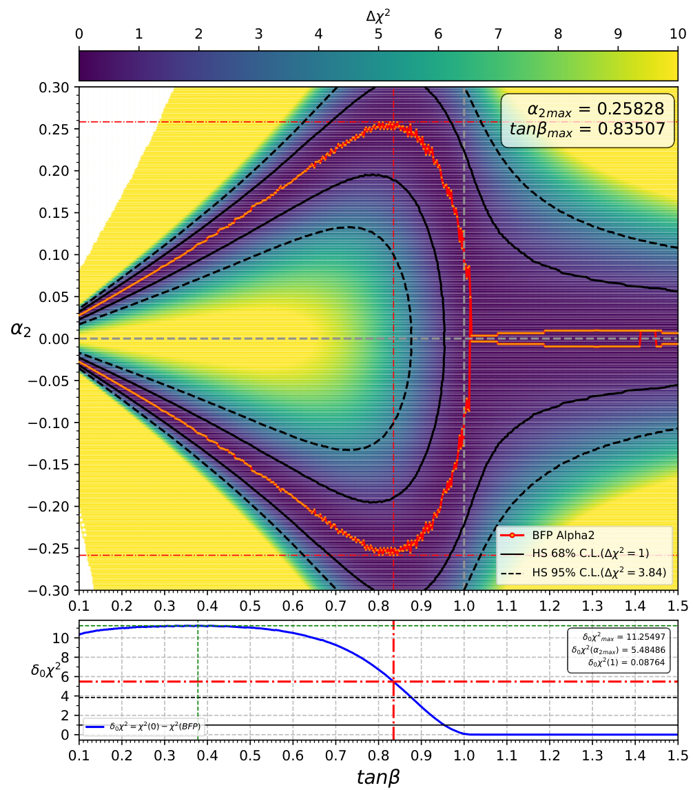



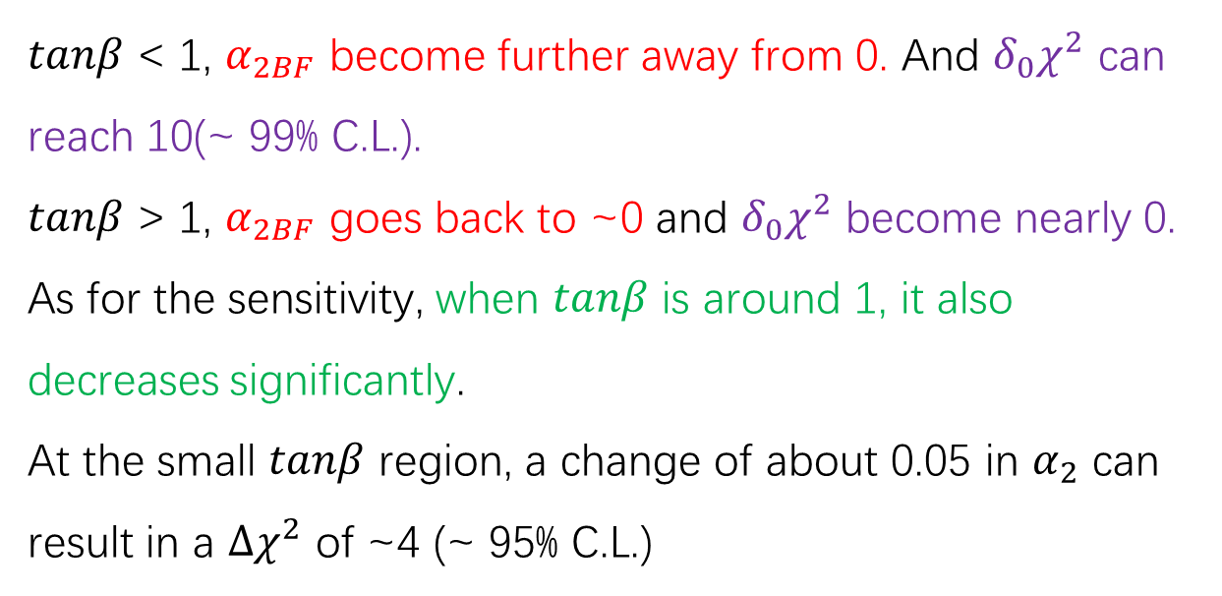

Deviation from the SM Alignment Point of $α_{2}$
When $α_{2}=δ$
$$c\left(H_{1}VV\right)=cosδ$$
$$|c\left(H_{1}bb\right)|^{2}=\cos^{2}δ+t_{β}^{2}\sin^{2}δ$$
$$|c\left(H_{1}tt\right)|^{2}=\cos^{2}δ+\frac{\sin^{2}δ}{t_{β}^{2}}$$
$tanβ$ < 1, $α_{2BF}$ become further away from 0. And $δ_{0}χ^{2}$ can reach 10(~ 99% C.L.).
$tanβ$ > 1, $α_{2BF}$ goes back to ~0 and $δ_{0}χ^{2}$ become nearly 0.
As for the sensitivity, when $tanβ$ is around 1, it also decreases significantly.
At the small $tanβ$ region, a change of about 0.05 in $α_{2}$ can result in a $Δχ^{2}$ of ~4 (~ 95% C.L.)

Slide 15
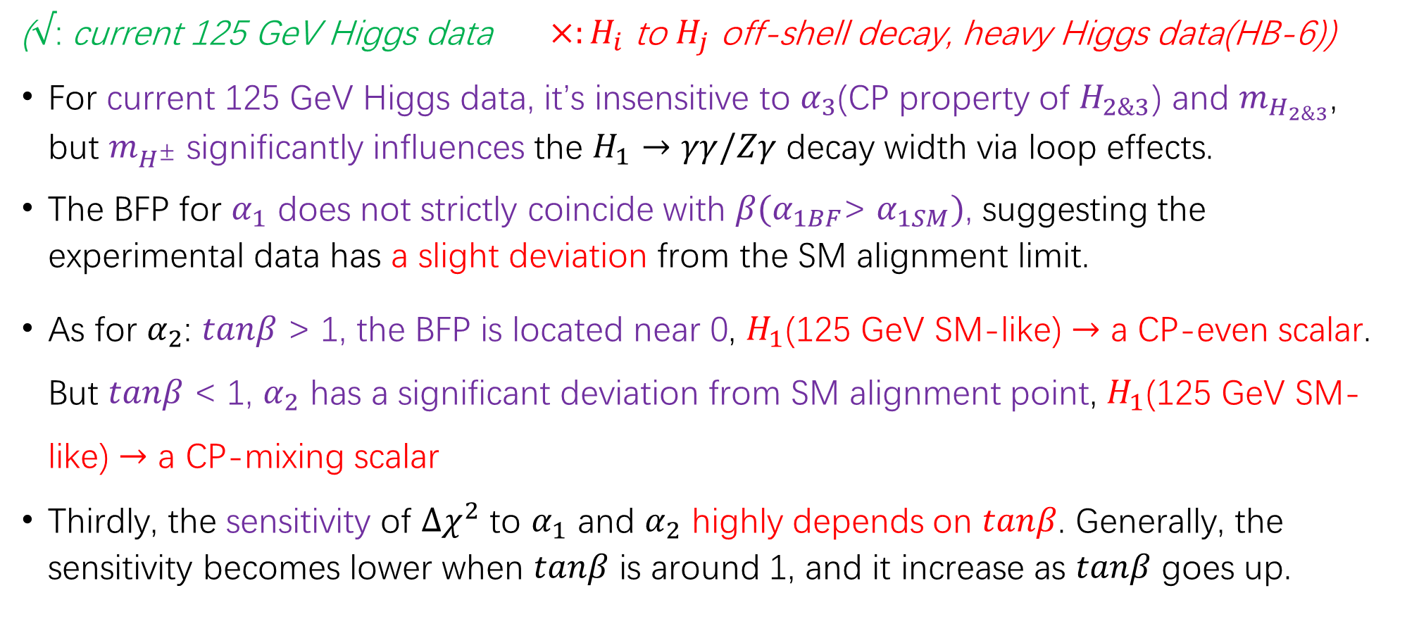
Conclusion
($√$: current 125 GeV Higgs data $×:H_{i}$ to $H_{j}$ off-shell decay, heavy Higgs data(HB-6))
For current 125 GeV Higgs data, it’s insensitive to $α_{3}$(CP property of $H_{2\&3}$) and $m_{H_{2\&3}}$, but $m_{H^{±}}$ significantly influences the $H_{1}→γγ/Zγ$ decay width via loop effects.
The BFP for $α_{1}$ does not strictly coincide with $β(α_{1BF}\text{> }α_{1SM})$, suggesting the experimental data has a slight deviation from the SM alignment limit.
As for $α_{2}$: $tanβ$ > 1, the BFP is located near 0, $H_{1}$(125 GeV SM-like) $→$ a CP-even scalar. But $tanβ$ < 1, $α_{2}$ has a significant deviation from SM alignment point, $H_{1}$(125 GeV SM-like) $→$ a CP-mixing scalar
Thirdly, the sensitivity of $Δχ^{2}$ to $α_{1}$ and $α_{2}$ highly depends on $tanβ$. Generally, the sensitivity becomes lower when $tanβ$ is around 1, and it increase as $tanβ$ goes up.

Slide 16
Further Research
Monte Carlo Simulation !
Firstly, currently we can only provide HiggsSignals with inclusive cross sections and branch ratios, and it uses the SM Higgs boson as a kinematic template to divide inclusive cross sections and branch ratios into different bins. So theoretically we should use MC simulation to get the kinematic distribution in C2HDM to get the modification factors for STXS bins.
Secondly, we should add more theoretical constrains and experimental constrains to get a benchmark parameters region. And use MC stimulation to do further research to find the CP-violation signals.

Slide 17
Thanks!

Slide 18
Backup

Slide 19
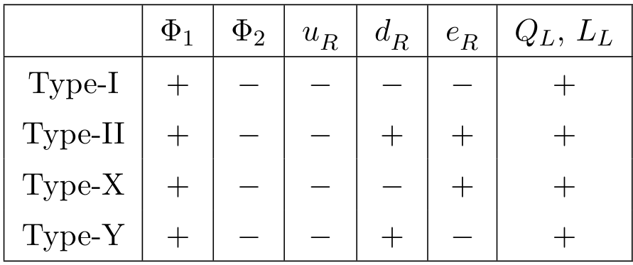

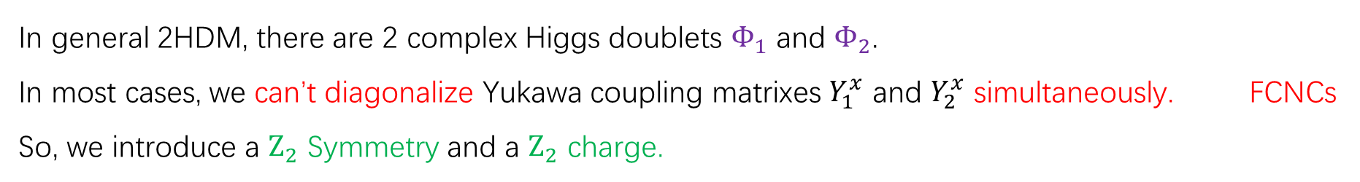
General 2HDM and $Z_{2}$ Symmetry
$$ℒ_{2HDM}=m_{11}^{2}Φ_{1}^{†}Φ_{1}+m_{22}^{2}Φ_{2}^{†}Φ_{2}+\left(m_{12}^{2}Φ_{1}^{†}Φ_{2}+h.c.\right)+λ_{1}{(Φ_{1}^{†}Φ_{1})}^{2}+λ_{2}{(Φ_{2}^{†}Φ_{2})}^{2}+λ_{3}\left(Φ_{1}^{†}Φ_{1}\right)\left(Φ_{2}^{†}Φ_{2}\right)+λ_{4}\left(Φ_{1}^{†}Φ_{2}\right)\left(Φ_{2}^{†}Φ_{1}\right)$$
$$+{(λ}_{5}{(Φ_{1}^{†}Φ_{2})}^{2}+h.c.)+\left(Φ_{1}^{†}Φ_{1}\right){(λ}_{6}\left(Φ_{1}^{†}Φ_{2}\right)+h.c.)+\left(Φ_{2}^{†}Φ_{2}\right){(λ}_{7}\left(Φ_{1}^{†}Φ_{2}\right)+h.c.)$$
$$ℒ_{Yukawa}={\overline{Q}}_{L}\left(Y_{1}^{u}{\tilde{Φ}}_{1}+Y_{2}^{u}{\tilde{Φ}}_{2}\right)u_{R}+{\overline{Q}}_{L}\left(Y_{1}^{d}Φ_{1}+Y_{2}^{d}Φ_{2}\right)d_{R}+{\overline{L}}_{L}\left(Y_{1}^{e}Φ_{1}+Y_{2}^{e}Φ_{2}\right)e_{R}+h.c.$$
In general 2HDM, there are 2 complex Higgs doublets $Φ_{1}$ and $Φ_{2}$.
In most cases, we can’t diagonalize Yukawa coupling matrixes $Y_{1}^{x}$ and $Y_{2}^{x}$ simultaneously. FCNCs
So, we introduce a $Z_{2}$ Symmetry and a $Z_{2}$ charge.

Slide 20


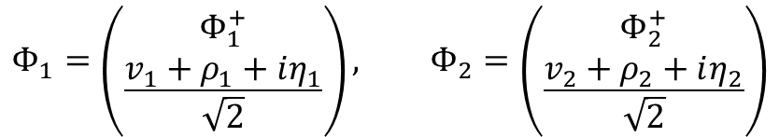

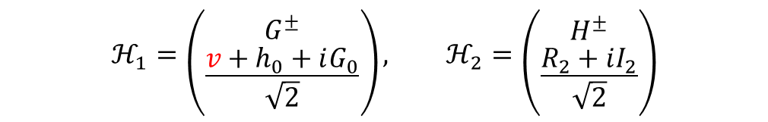
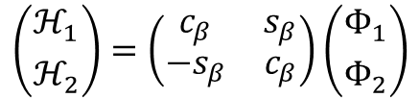
Type-II C2${\text{HDM}}^{∗}$
$$ℒ_{2HDM}=m_{11}^{2}Φ_{1}^{†}Φ_{1}+m_{22}^{2}Φ_{2}^{†}Φ_{2}+\left(m_{12}^{2}Φ_{1}^{†}Φ_{2}+h.c.\right)+λ_{1}{(Φ_{1}^{†}Φ_{1})}^{2}+λ_{2}{(Φ_{2}^{†}Φ_{2})}^{2}$$
$$+λ_{3}\left(Φ_{1}^{†}Φ_{1}\right)\left(Φ_{2}^{†}Φ_{2}\right)+λ_{4}\left(Φ_{1}^{†}Φ_{2}\right)\left(Φ_{2}^{†}Φ_{1}\right)+{(λ}_{5}{(Φ_{1}^{†}Φ_{2})}^{2}+h.c.)$$
where $m_{12}^{2}$ and ${ λ}_{5}$ are complex and the rest of the parameters in the potential are real.
In general, the scalar doublets are defined as
$$Φ_{1}=\left({Φ_{1}^{+} \atop \frac{v_{1}+ρ_{1}+iη_{1}}{\sqrt{2}}}\right), Φ_{2}=\left({Φ_{2}^{+} \atop \frac{v_{2}+ρ_{2}+iη_{2}}{\sqrt{2}}}\right)$$
And we define $tanβ= \frac{{ v}_{2}}{{ v}_{1}}$
Higgs Basis :
$$ℋ_{1}=\left({G^{±} \atop \frac{v+h_{0}+iG_{0}}{\sqrt{2}}}\right), ℋ_{2}=\left({H^{±} \atop \frac{R_{2}+iI_{2}}{\sqrt{2}}}\right)$$
$$\left({ℋ_{1} \atop ℋ_{2}}\right)=\left(\begin{matrix}c_{β} & s_{β} \\ {−s}_{β} & c_{β}\end{matrix}\right)\left({Φ_{1} \atop Φ_{2}}\right)$$
* $v=\sqrt{v_{1}^{2}+v_{2}^{2}}$
* C2HDM means CP-violating 2HDM under Soft Broken $Z_{2}$ Symmetry

Slide 21

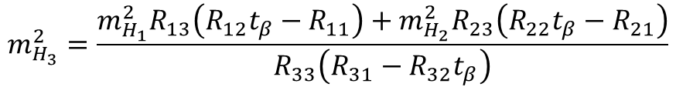

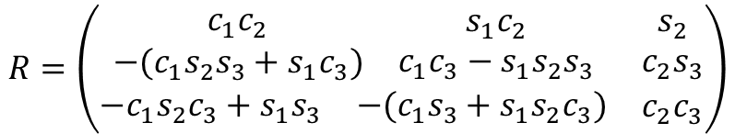
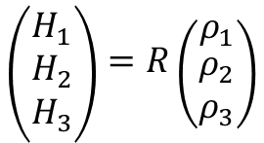

Type-II C2HDM
Scalar Mixing Angles $0< α_{1}$, $α_{2}$, $α_{3}<\frac{π}{2}$ which diagonalize the Higgs mass matrix :
$$\left({H_{1} \atop \begin{matrix}H_{2} \\ H_{3}\end{matrix}}\right)=R\left({ρ_{1} \atop \begin{matrix}ρ_{2} \\ ρ_{3}\end{matrix}}\right)$$
$$R=\left(\begin{matrix}\begin{matrix}\begin{matrix}c_{1}c_{2} \\ −(c_{1}s_{2}s_{3}+s_{1}c_{3})\end{matrix} & \begin{matrix}s_{1}c_{2} \\ c_{1}c_{3}−s_{1}s_{2}s_{3}\end{matrix}\end{matrix} & \begin{matrix}s_{2} \\ c_{2}s_{3}\end{matrix} \\ \begin{matrix}−c_{1}s_{2}c_{3}+s_{1}s_{3} & −(c_{1}s_{3}+s_{1}s_{2}c_{3})\end{matrix} & c_{2}c_{3}\end{matrix}\right)$$
$$m_{H_{3}}^{2}=\frac{m_{H_{1}}^{2}R_{13}\left(R_{12}t_{β}−R_{11}\right)+m_{H_{2}}^{2}R_{23}\left(R_{22}t_{β}−R_{21}\right)}{R_{33}\left(R_{31}−R_{32}t_{β}\right)}$$
9 independent parameters of C2HDM :
$$v, m_{H_{1}},m_{H_{2}},m_{H^{±}}, α_{1},α_{2},α_{3}, tanβ, Re[m_{12}^{2}]$$
* $v=\sqrt{v_{1}^{2}+v_{2}^{2}}$
Usually, we set $v=246$GeV,$m_{H_{1}}<m_{H_{2}}<m_{H_{3}}<1000$GeV.
$$ρ_{3}=−s_{β}η_{1}+c_{β}η_{2}$$
$$Φ_{1}=\left({Φ_{1}^{+} \atop \frac{v_{1}+ρ_{1}+iη_{1}}{\sqrt{2}}}\right), Φ_{2}=\left({Φ_{2}^{+} \atop \frac{v_{2}+ρ_{2}+iη_{2}}{\sqrt{2}}}\right)$$
$$ℒ_{2HDM}=m_{11}^{2}Φ_{1}^{†}Φ_{1}+m_{22}^{2}Φ_{2}^{†}Φ_{2}+\left(m_{12}^{2}Φ_{1}^{†}Φ_{2}+h.c.\right)+λ_{1}{(Φ_{1}^{†}Φ_{1})}^{2}+λ_{2}{(Φ_{2}^{†}Φ_{2})}^{2}$$
$$+λ_{3}\left(Φ_{1}^{†}Φ_{1}\right)\left(Φ_{2}^{†}Φ_{2}\right)+λ_{4}\left(Φ_{1}^{†}Φ_{2}\right)\left(Φ_{2}^{†}Φ_{1}\right)+{(λ}_{5}{(Φ_{1}^{†}Φ_{2})}^{2}+h.c.)$$
* $c_{i}$, $s_{i}$ and $t_{i}$ mean $cosα_{i}$, $sinα_{i}$ and tan$α_{i}$

Slide 22






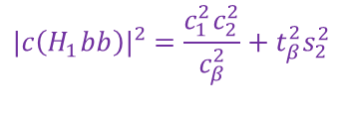





Effective couplings modification
Yukawa couplings
Gauge couplings
$$c\left(H_{i}VV\right)=c_{β}R_{i1}+s_{β}R_{i2}$$
$$c\left(H_{1}VV\right)=c_{2}c(β−α_{1})$$
$$c\left(H_{2}VV\right)=c_{3}s\left(β−α_{1}\right)−s_{2}s_{3}c(β−α_{1})$$
$$c\left(H_{3}VV\right)=−s_{3}s\left(β−α_{1}\right)−s_{2}c_{3}c(β−α_{1})$$
[1]
$$|c\left(H_{1}bb\right)|^{2}=\frac{c_{1}^{2}c_{2}^{2}}{c_{β}^{2}}+t_{β}^{2}s_{2}^{2}$$
$$|c\left(H_{1}tt\right)|^{2}=\frac{s_{1}^{2}c_{2}^{2}}{s_{β}^{2}}+\frac{s_{2}^{2}}{t_{β}^{2}}$$
$$|c\left(H_{2}bb\right)|^{2}=\frac{{(c_{1}s_{2}s_{3}+s_{1}c_{3})}^{2}}{c_{β}^{2}}+t_{β}^{2}c_{2}^{2}s_{3}^{2}$$
Charged Higgs coupling
$$g_{t\overline{b}H^{±}}=\sqrt{2}(\frac{m_{t}}{v}P_{R}κ_{t}^{±}+\frac{m_{b}}{v}P_{L}κ_{b}^{±})$$
$$|c\left(H_{2}tt\right)|^{2}=\frac{{\left(c_{1}c_{3}−s_{1}s_{2}s_{3}\right)}^{2}}{s_{β}^{2}}+\frac{c_{2}^{2}s_{3}^{2}}{t_{β}^{2}}$$
$$κ_{t}^{±}=cotβ κ_{b}^{±}=tanβ$$
$$|c\left(H_{3}bb\right)|^{2}=\frac{{(−c_{1}s_{2}c_{3}+s_{1}s_{3})}^{2}}{c_{β}^{2}}+t_{β}^{2}c_{2}^{2}c_{3}^{2}$$
$$|c\left(H_{3}tt\right)|^{2}=\frac{{\left(c_{1}s_{3}+s_{1}s_{2}c_{3}\right)}^{2}}{s_{β}^{2}}+\frac{c_{2}^{2}c_{3}^{2}}{t_{β}^{2}}$$
$$R=\left(\begin{matrix}\begin{matrix}\begin{matrix}c_{1}c_{2} \\ −(c_{1}s_{2}s_{3}+s_{1}c_{3})\end{matrix} & \begin{matrix}s_{1}c_{2} \\ c_{1}c_{3}−s_{1}s_{2}s_{3}\end{matrix}\end{matrix} & \begin{matrix}s_{2} \\ c_{2}s_{3}\end{matrix} \\ \begin{matrix}−c_{1}s_{2}c_{3}+s_{1}s_{3} & −(c_{1}s_{3}+s_{1}s_{2}c_{3})\end{matrix} & c_{2}c_{3}\end{matrix}\right)$$
[1] P.Posch, PhysicsLettersB696(2011)447–453 (10)

Slide 23
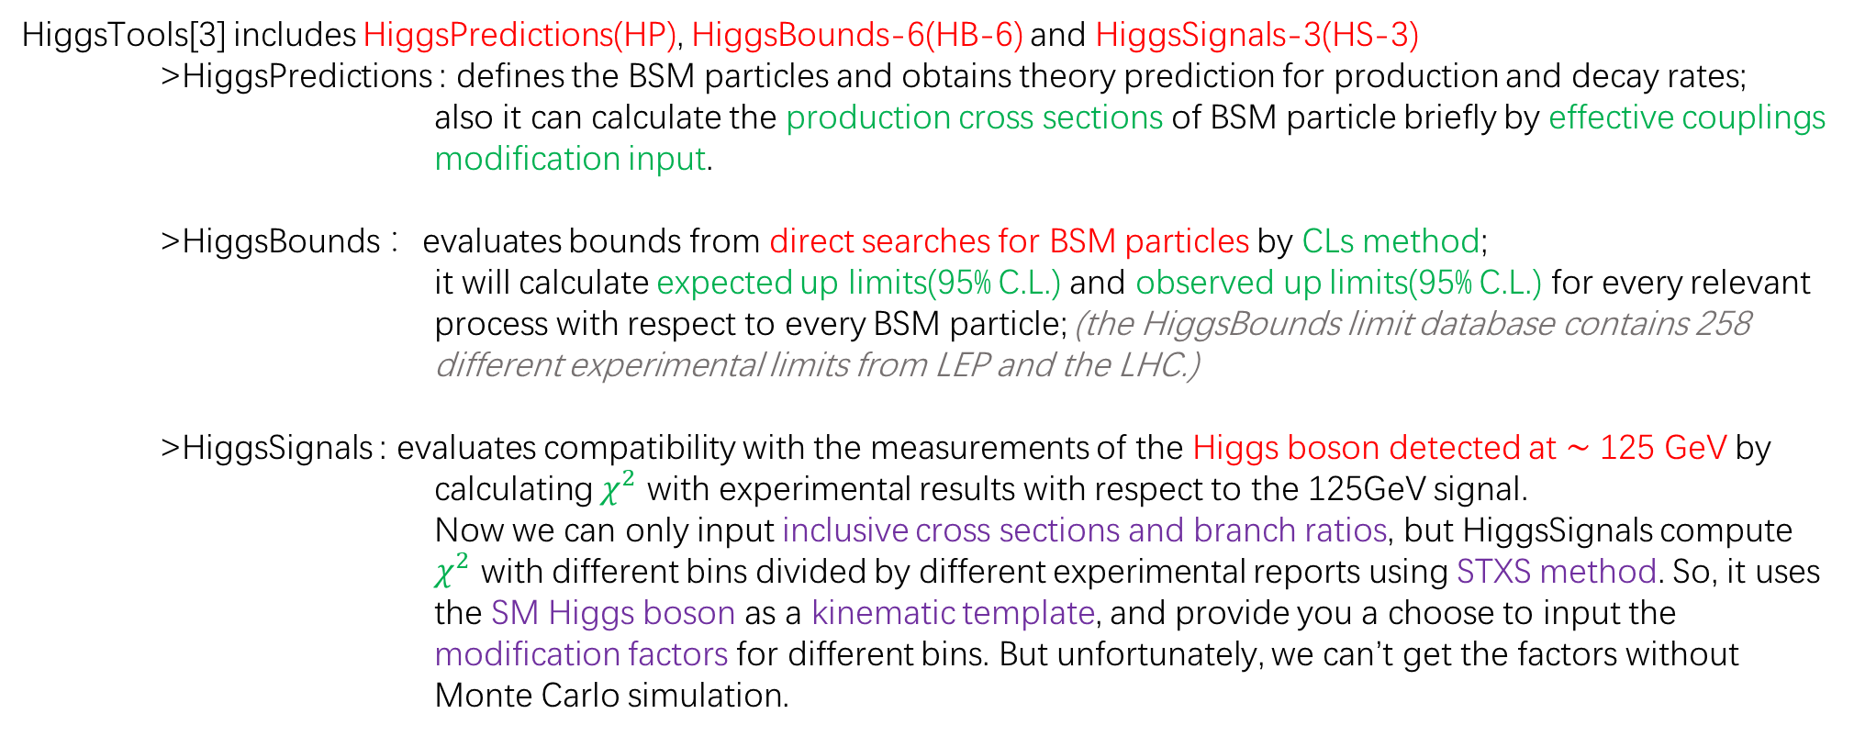
HiggsTools
arXiv:1711.09419
arXiv:1711.09419
HiggsTools[3] includes HiggsPredictions(HP), HiggsBounds-6(HB-6) and HiggsSignals-3(HS-3)
>HiggsPredictions : defines the BSM particles and obtains theory prediction for production and decay rates;
also it can calculate the production cross sections of BSM particle briefly by effective couplings modification input.
>HiggsBounds ：evaluates bounds from direct searches for BSM particles by CLs method;
it will calculate expected up limits(95% C.L.) and observed up limits(95% C.L.) for every relevant process with respect to every BSM particle; (the HiggsBounds limit database contains 258 different experimental limits from LEP and the LHC.)
>HiggsSignals : evaluates compatibility with the measurements of the Higgs boson detected at ∼ 125 GeV by
calculating $χ^{2}$ with experimental results with respect to the 125GeV signal.
Now we can only input inclusive cross sections and branch ratios, but HiggsSignals compute $χ^{2}$ with different bins divided by different experimental reports using STXS method. So, it uses the SM Higgs boson as a kinematic template, and provide you a choose to input the modification factors for different bins. But unfortunately, we can’t get the factors without Monte Carlo simulation.
[3] arXiv:2210.09332

Slide 24
HiggsTools
arXiv:1711.09419
arXiv:1711.09419
All measurements used by HiggsSignals to compute $χ^{2}$: (xxxx.xxxxx means arXiv:xxxx.xxxxx)
<Higgs.signals.Measurement 210304956: 19 bin from 2103.04956>, <Higgs.signals.Measurement 200403447: 12 bin from 2004.03447>,
<Higgs.signals.Measurement 180809054: 2 bin from 1808.09054>, <Higgs.signals.Measurement 200904363: 4 bin from 2009.04363>,
<Higgs.signals.Measurement 210306956: 17 bin from 2103.06956>, <Higgs.signals.Measurement 200701984: 5 bin from 2007.01984>,
<Higgs.signals.Measurement 190310052: 2 bin from 1903.10052>, <Higgs.signals.Measurement 180305485: 6 bin from 1803.05485>,
<Higgs.signals.Measurement 211004836: 3 bin from 2110.04836>, <Higgs.signals.Measurement 2021021: 1 bin from ATLAS-CONF-2021-021>, <Higgs.signals.Measurement 220700348: 28 bin from 2207.00348>, <Higgs.signals.Measurement 2019045: 6 bin from ATLAS-CONF-2019-045>,
<Higgs.signals.Measurement 160602266: 20 bin from 1606.02266>, <Higgs.signals.Measurement 181108856: 2 bin from 1811.08856>,
<Higgs.signals.Measurement 211106712: 1 bin from 2111.06712>, <Higgs.signals.Measurement 180808242: 5 bin from 1808.08242>,
<Higgs.signals.Measurement 191201662: 2 bin from 1912.01662>, <Higgs.signals.Measurement 201108280: 1 bin from 2011.08280>,
<Higgs.signals.Measurement 200702873: 5 bin from 2007.02873>, <Higgs.signals.Measurement 200707830: 1 bin from 2007.07830>,
<Higgs.signals.Measurement 220412957: 16 bin from 2204.12957>
[2] arXiv:2210.09332

Slide 25







SM Alignment
SM alignment means we should create a scalar particle that is almost the same as SM Higgs boson, and other scalar particles have negligible impacts on it.
Let’s set up $H_{1}$ as the 125 GeV SM-like Higgs and CP-even, and all of the effective coupling modifications become 1.
So, the mixing angels and $tanβ$ should satisfy
$$α_{1}=β$$
$$α_{2}=0$$
Then ,the effective couplings modification factors become
$$|c\left(H_{1}VV\right)|^{2}=|c\left(H_{1}tt\right)|^{2}=|c\left(H_{1}bb\right)|^{2}=1$$
$$|c\left(H_{2}tt\right)|^{2}=|c\left(H_{3}tt\right)|^{2}=\frac{1}{t_{β}^{2}}$$
$$|c\left(H_{2}bb\right)|^{2}=|c\left(H_{3}bb\right)|^{2}=t_{β}^{2}$$
$$|c\left(H_{2}VV\right)|^{2}=|c\left(H_{3}VV\right)|^{2}=0$$
$$m_{H_{2}}=m_{H_{3}}(α_{2}=0)$$
$$|c\left(H_{2}H_{1}Z\right)|^{2}=|c\left(H_{3}H_{1}Z\right)|^{2}=|c\left(H^{±}W^{±}H_{1}\right)|^{2}=0$$
$$|c\left(H_{1}bb\right)|^{2}=\frac{c_{1}^{2}c_{2}^{2}}{c_{β}^{2}}+t_{β}^{2}s_{2}^{2}$$
Then what about other parameters?
Let’s test their impacts on our SM-like Higgs by HiggsSignals.
$$|c\left(H_{1}tt\right)|^{2}=\frac{s_{1}^{2}c_{2}^{2}}{s_{β}^{2}}+\frac{s_{2}^{2}}{t_{β}^{2}}$$
$$c\left(H_{1}VV\right)=c_{2}c(β−α_{1})$$

Slide 26






Impacts of other Parameters on $χ^{2}$
As for $α_{3}$, $m_{H_{2}}$ and $m_{H^{±}}$, we use HiggsSignals to do a brief scan to see which parameter region has smaller impacts on $χ^{2}$.
$α_{3}$
$$m_{H_{2}}$$
First, for $α_{3}$ and $m_{H_{2}}$, we compute the $χ^{2}$ and show the figure of $Δχ^{2}$, which means $χ^{2}−χ_{min}^{2}$. (the rest of the parameters are shown in the lower right corner)
In the figure of $α_{3}$ we can see that the $Δχ^{2}$ keeps the same as $α_{3}$ varies from $−\frac{π}{2}$ to $\frac{π}{2}$ and none of the points are excluded by HiggsBounds. So, we can choose $α_{3}$ freely.
For $m_{H_{2}}$, we find almost the same situation as $α_{3}$ except for the small mass region. As we can see in the upper right figure, when $m_{H_{2}}<\sim 150GeV$, the $Δχ^{2}$ goes to $\sim {10}^{2}$. Also, the small region are excluded by HiggsBounds. So, we should choose a bigger $m_{H_{2}}$.
$$m_{H_{2}}$$
So, we choose $α_{3}=\frac{π}{4}$, $m_{H_{2}}=650GeV$

Slide 27

Impacts of other Parameters on $χ^{2}$
Then for $m_{H^{±}}$
2103.06956
$$H_{1}→γγ$$
LHC 7&8TeV
1606.02266
2207.00348
$$H_{1}→Zγ$$
But actually, HiggsSignals computes $χ^{2}$ with experimental results instead
of SM predictions. So the BFP in the figure doesn’t mean SM Alignment.
$$H_{1}→γγ$$

Slide 28









Impacts of other Parameters on $χ^{2}$
So, let’s check the $Δχ^{2}$ computed with arXiv: 2103.06956
$$ggH 0J high p_{T}^{H}$$
: $σB/(σB)_{SM} ≥1$
: $σB/(σB)_{SM}<1$
As $m_{H^{±}}$ increases, the $Γ(γγ)$ goes down. And luckily, we find the $Δχ^{2}$ goes up with respect to almost every bins that $σB/(σB)_{SM} ≥1$. This supports that smaller $χ^{2}$ doesn’t mean SM alignment
Also, We can notice two special bins: ttH & ggH_BSM

Slide 29



Impacts of other Parameters on $χ^{2}$
ttH & ggH_BSM:
In HS, $σB/(σB)_{SM}$ is a little bit > 1
We can see that the $σB/(σB)_{SM}$ of ttH is almost 1. Does this bin can tell which point is the global SM alignment point?
Let’s suppose the star point is the global SM alignment point. So, at that point the $σB/(σB)_{SM}$ of ggH_BSM is ~1. Because as $m_{H^{±}}$ decreases the $Γ(γγ)$ goes up, the $σB/(σB)_{SM}$ of ggH_BSM also increases and becomes bigger than 1 and further away from 0.94. But as we can see in the figure, the $Δχ^{2}$ actually becomes smaller.

Slide 30
Decoupling of $H^{±}$
So, let’s go back to the theory to find how to decouple $H^{±}$
$$H_{1}→Zγ$$
When $m_{H^{±}}^{2}≫m_{h}^{2}$,
$$τ_{H^{±}} ≪1$$
$$f\left(τ_{H^{±}}\right)→τ_{H^{±}}+\frac{1}{3}{τ_{H^{±}}}^{2}$$
$$A_{0}(τ_{H^{±}})→\frac{1}{3}$$
Although $g_{hH^{+}H^{−}}$ depends on $m_{H^{±}}$, the influence can be counteracted. As $m_{H^{±}}$ varies, it can be seen as a constant.
Then because of $\frac{1}{m_{H^{±}}^{2}}$, the impact of $H^{±}→0$
$$H_{1}→γγ$$
So finally, we choose $m_{H^{±}}=800GeV$

Slide 31












Deviation from the SM Alignment Point of $α_{1}$
When $α_{1}=β+δ$
$$δ=0.03597$$
$$c\left(H_{1}VV\right)=cosδ$$
$$|c\left(H_{2}H_{1}Z\right)|^{2}=s_{3}^{2}\sin^{2}δ$$
$$∆|c\left(H_{1}VV\right) |^{2}\sim −1.29×{10}^{−3}$$
$$∆|c\left(H_{1}bb\right) |^{2}\sim −0.205$$
$$∆|c\left(H_{1}tt\right) |^{2}\sim 0.0228$$
$$|c\left(H_{1}bb\right)|^{2}=\frac{{cos⁡(β+δ)}^{2}}{c_{β}^{2}}$$
$$|c\left(H_{3}H_{1}Z\right)|^{2}=c_{3}^{2}\sin^{2}δ$$
$$|c\left(H_{1}tt\right)|^{2}=\frac{{sin⁡(β+δ)}^{2}}{s_{β}^{2}}$$
$$|c\left(H^{±}W^{±}H_{1}\right)|^{2}=\sin^{2}δ$$
As you can see in the figure, $α_{1BF}$> $α_{1SM}$, which means $|c\left(H_{1}VV\right) |^{2}$, $|c\left(H_{1}bb\right) |^{2}$ < 1 and $|c\left(H_{1}tt\right)|^{2}$ > 1
$Δχ^{2}$ between $α_{1BF}$ and $α_{1SM}$ reach ~15
As for the sensitivity, when $Δχ^{2}$ reach about 10(~ 99% C.L.), $δα_{1}$ is about 0.05

Slide 32






Deviation from the SM Alignment Point of $α_{1}$
When $α_{1}=β+δ$
$$c\left(H_{1}VV\right)=cosδ$$
$$|c\left(H_{1}bb\right)|^{2}=\frac{{cos⁡(β+δ)}^{2}}{c_{β}^{2}}$$
$$|c\left(H_{1}tt\right)|^{2}=\frac{{sin⁡(β+δ)}^{2}}{s_{β}^{2}}$$
In the left figure we can see that as $tanβ$ varies from ~0 to 14, $δα_{1}$ is always bigger than 0. And $δ_{0}χ^{2}$ is always > 4(~ 95% C.L.)
When $tanβ$ is around 1, the sensitivity is the lowest. And when $tanβ$ becomes bigger, it goes up. Although when $tanβ$ becomes closer to 1 the sensitivity decrease, a change of about 0.03 in $δα_{1}$ results in a $Δχ^{2}$ of ~4 (~ 95% C.L.)

Slide 33












Deviation from the SM Alignment Point of $α_{2}$
When $α_{2}=δ$
$$δ=0.00429$$
$$c\left(H_{1}VV\right)=cosδ$$
$$|c\left(H_{2}H_{1}Z\right)|^{2}=c_{3}^{2}\sin^{2}δ$$
$$∆|c\left(H_{1}VV\right) |^{2}\sim −1.84×{10}^{−5}$$
$$∆|c\left(H_{1}bb\right) |^{2}\sim 1.47×{10}^{−4}$$
$$∆|c\left(H_{1}tt\right) |^{2}\sim −1.64×{10}^{−5}$$
$$|c\left(H_{1}bb\right)|^{2}=\cos^{2}δ+t_{β}^{2}\sin^{2}δ$$
$$|c\left(H_{3}H_{1}Z\right)|^{2}=s_{3}^{2}\sin^{2}δ$$
$$|c\left(H_{1}tt\right)|^{2}=\cos^{2}δ+\frac{\sin^{2}δ}{t_{β}^{2}}$$
$$|c\left(H^{±}W^{±}H_{1}\right)|^{2}=\sin^{2}δ$$
As you can see in the figure, $α_{2BF}$> $α_{2SM}$, which means $|c\left(H_{1}VV\right) |^{2}$ < 1, $|c\left(H_{1}bb\right) |^{2}$ > 1 and $|c\left(H_{1}tt\right)|^{2}$ < 1 ($tanβ$ > 1)
$Δχ^{2}$ between $α_{2BF}$ and $α_{2SM}$ is nearly 0
As for the sensitivity, when $Δχ^{2}$ reach about 4 (~ 95% C.L.), $δα_{2}$ is about 0.05

Slide 34



Deviation from the SM Alignment Point of $α_{2}$
When $α_{2}=δ$
$$tanβ=0.4$$
$$c\left(H_{1}VV\right)=cosδ$$
$$|c\left(H_{1}bb\right)|^{2}=\cos^{2}δ+t_{β}^{2}\sin^{2}δ$$
$$|c\left(H_{1}tt\right)|^{2}=\cos^{2}δ+\frac{\sin^{2}δ}{t_{β}^{2}}$$
In the left figure we can see that as $tanβ$ becomes < 1, $α_{2BF}$ become further away from 0. And $δ_{0}χ^{2}$ can reach 10(~ 99% C.L.). When $tanβ$ become > 1, $α_{2BF}$ goes back to ~0 and $δ_{0}χ^{2}$ become nearly 0.
As for the sensitivity, when $tanβ$ is around 1, it also decreases significantly. But as $tanβ$ increases, the sensitivity goes up. When $tanβ$ < 0.8, the sensitivity goes up apparently as $tanβ$ decreases. At the small $tanβ$ region, a change of about 0.05 in $α_{2}$ can result in a $Δχ^{2}$ of ~4 (~ 95% C.L.)

Slide 35




Deviation from the SM Alignment Point of $α_{2}$
When $α_{2}=δ$
$$tanβ=0.4$$
$$c\left(H_{1}VV\right)=cosδ$$
$$|c\left(H_{1}bb\right)|^{2}=\cos^{2}δ+t_{β}^{2}\sin^{2}δ$$
$$|c\left(H_{1}tt\right)|^{2}=\cos^{2}δ+\frac{\sin^{2}δ}{t_{β}^{2}}$$
As $tanβ$ becomes larger, $α_{2BF}$ become close to 0 and $δ_{0}χ^{2}$ is nearly 0.
As for the sensitivity, it goes up significantly while $tanβ$ increases. In the large $tanβ$ region, a change of about 0.02 in $α_{2}$ can result in a $Δχ^{2}$ of ~4 (~ 95% C.L.)

Slide 36
References
[1] Fontes, D., Mühlleitner, M., Romão, J.C. et al. The C2HDM revisited. J. High Energ. Phys. 2018, 73 (2018). https://doi.org/10.1007/JHEP02(2018)073
[2] H. Bahl et al., HiggsTools: BSM scalar phenomenology with new versions of HiggsBounds and HiggsSignals, Comput.Phys. Commun. 291 (2023) 108803 [arXiv:2210.09332] [INSPIRE].
[3] P. Posch, Phys. Lett. B 696, 447 (2011).

