Slide 1

Introduction to Tensor Regression
—— An example of simple least square regression
?
Zixiang Xu
11-2022

Slide 2
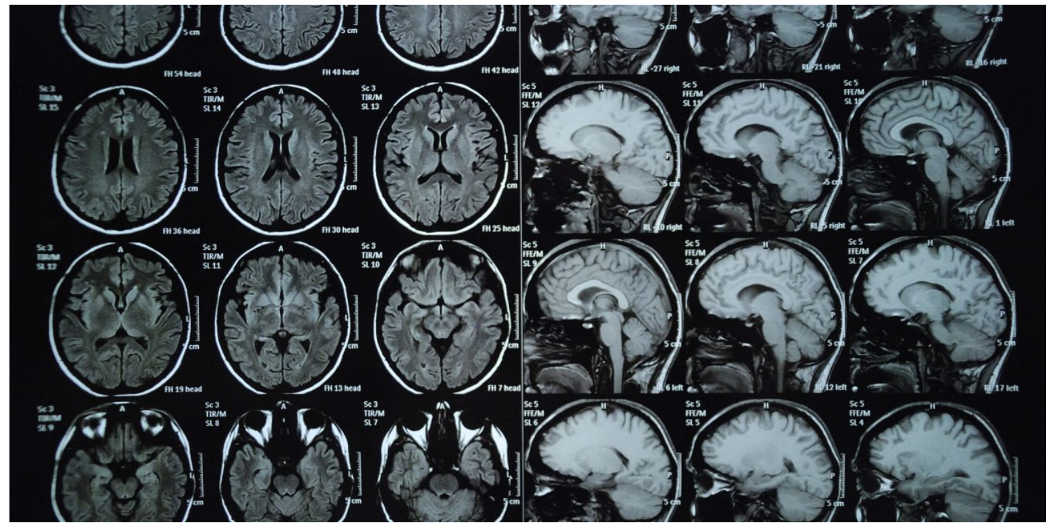
What is tensor

Slide 3
Model
Goal: Test if this is a valid model

Slide 4
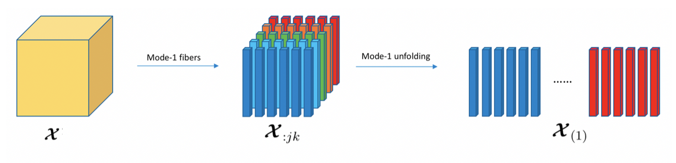
Algorithm

Slide 5
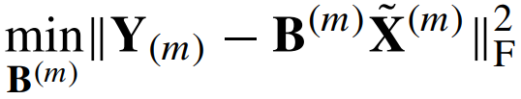
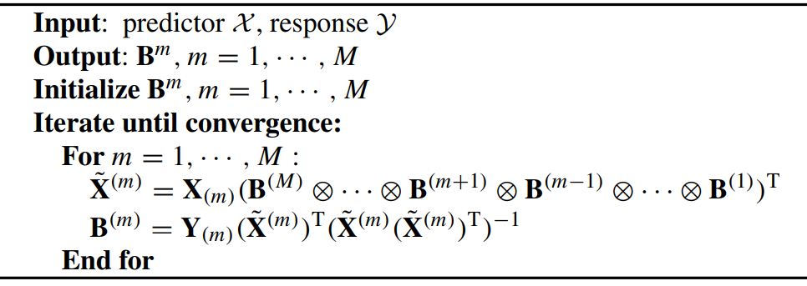
Algorithm

Slide 6










Simulation Study
Generate $X, B, ε$
Set initial ${\hat{B}}_{0}$
Get $\hat{B}$
Get $\hat{Y}$
Compare with $Y$
Generate $Y (X, B, ε)$
Package: rTensor
Generate $X2, ε2$
Get $\hat{Y2}$
Compare with $Y2$
Generate $Y2 (X2, B, ε2)$

Slide 7
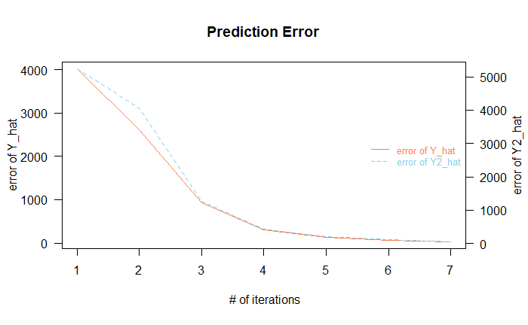
Results

Slide 8

Future Discussion
Different setting of data (e.g. sparse data,
$X$ and $Y$with different dimensions,
different distribution of $ε$).

Slide 9

Future Discussion
Thanks!
Different setting of data (e.g. sparse data,
$X$ and $Y$with different dimensions,
different distribution of $ε$).
References: Will Wei Sun , Botao Hao , and Lexin Li, Tensors in Modern Statistical Learning
Yipeng Liu, Jiani Liu, Zhen Long, Ce Zhu, Tensor Computation for Data Analysis
James Li and Jacob Bien and Martin Wells, rTensor: Tools for Tensor Analysis and Decomposition
Wikipedia contributors, Kronecker product. Wikipedia, The Free Encyclopedia.

