Slide 1
Music Therapy in the Treatment of Dementia: A Systematic Review and Meta-Analysis
2020

Slide 2
Overview
Objective of the review
Methods used
Search strategy
Studies used
conclusion
Findings
Efficacy findings

Slide 3
Object of the review
The objective of the systematic review is to see whether the application of music therapy in people living with dementia has an effect on cognitive function, quality of life, and/or depressive state

Slide 4
Methods
The systematic review was written in accordance with the PRISMA statement.
Preferred Reporting Items for Systematic Reviews and Meta-Analyses: PRISMA is an evidence-based minimum set of items for reporting in systematic reviews and meta-analyses.

Slide 5

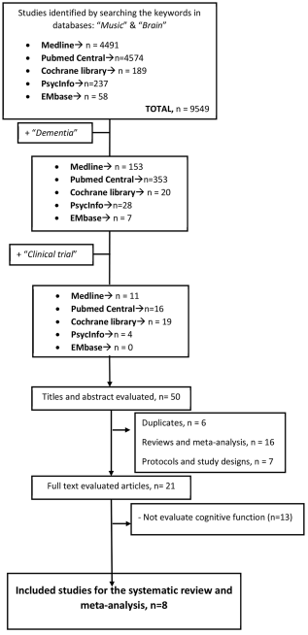
Search strategy used
Online databases were searched with they keywords “Music” & “Brain”
After these studies were found the keyword “dementia” was added to those results.
Thereafter they searched for only the clinical trials to find the studies appropriate for screening:

Slide 6
Studies used

Slide 7
Studies used

Slide 8
Findings
6 of these studies found improvement in mood, quality of life as well as depression in participants
5 showed improvement in cognitive function or delayed the deterioration
Only one study using singing as intervention showed no significant differences to the control group

Slide 9
Efficacy of Musical Intervention in Cognitive Function
It was observed that shorter intervention periods, less than 20 weeks and passive intervention such as listening to music had greater effects on people living with dementia.
Playing an instrument and signing did not appear to have an effect on cognitive function unless it is pared with listening to music but does not improve the effect of just listening to music.

Slide 10
Efficacy of Musical Intervention in Quality of Life
The results suggested that there was a positive effect on patients quality of life after the intervention ended, but no significant effect of music therapy was observed when analysis was done on the quality of live of participants six months after intervention.

Slide 11
Efficacy of Musical Intervention in the Depressive State
When studying the depressive states of patients six moths after intervention the results indicated a positive effect even though the meta-analysis suggested there was no short term effect.

Slide 12
Conclusion
The Study not only shows a positive trend of supporting music therapy for improving cognitive function in people living with dementia but also a positive result for treatment of long-term depression.
Music therapy also seems to improve quality of life of people with dementia once the intervention is finished, but does not have a long-lasting effect, thus is it advised as a continuous therapy.

