Slide 1

Feasibility and effects of serious games for people with dementia: A systematic review and recommendations for future research

Slide 2


Table of content
Study done by
Serious game as defined by the study
Focus of the review
Methods used
Search strategy
Feasibility analysis
Effectiveness
Studies used
Studies focused on
Results
conclusion

Slide 3
Academics
Institute of Movement and Sport Gerontology, German Sport University Cologne, Cologne, Germany
Corinna Dietlein
Dr. Sabine Eichberg
Dr. Tim Fleiner
Dr. Wiebren Zijlstra
Current head of department

Slide 4
Serious game Defenition
This Study defines a serious game as:
A game that does not have entertainment, enjoyment, or fun as their primary purpose.
“Serious” indicates that the game is assumed to have effects on the player in the context of education, knowledge, training, skills, health or inter-personal communication.
Serious games provide a low cost alternative that can easily be installed in the users home, which allows users to train whenever they want.

Slide 5
Focus of the review
Analysing the implementation of serious games and the effects on
cognition
physical performance
personal/behavioural aspects
The paper attempts to determine whether serious games are feasible or effective, as well as which factors need to be considered when using serious games with people with dementia.

Slide 6
Methods
The systematic review was written in accordance with the PRISMA statement.
Preferred Reporting Items for Systematic Reviews and Meta-Analyses: PRISMA is an evidence-based minimum set of items for reporting in systematic reviews and meta-analyses.

Slide 7
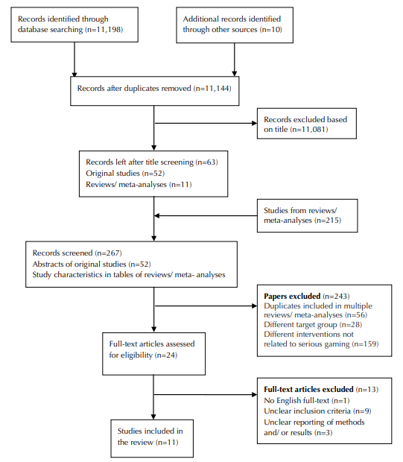
Search strategy used
Online databases were searched for publications on serious games for people with dementia with no publication date limitations.
After the studies were found the titles were screened and then the abstract of these studies were screened.
Flow chart of literature searched and study selection:

Slide 8
Feasibility analysis
Evaluated according to Mayring’s approach for qualitative content analysis based on the following categories:
Comprehension/Playability
Adherence/Commitment
Acceptance/Enjoyment
Risk/Safety Issues

Slide 9
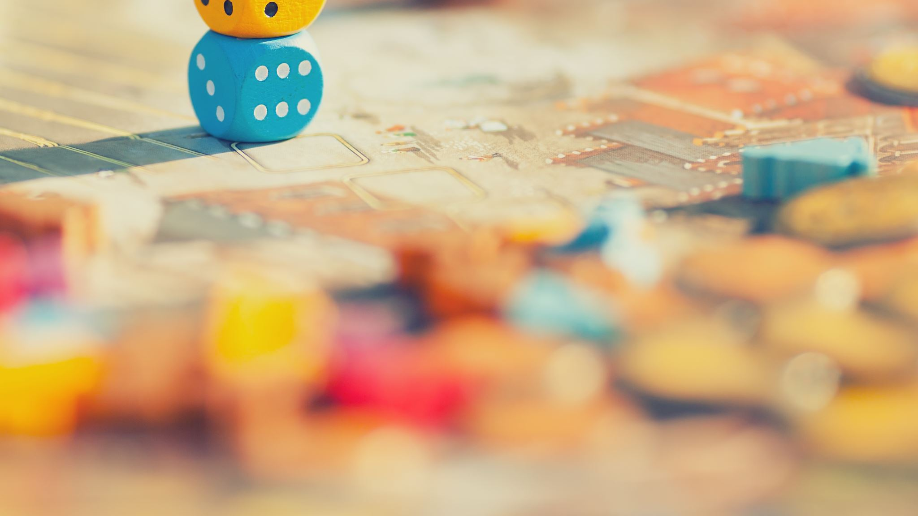
Effectiveness
The effectiveness of serious games were avaluated using the following outcome domains:
Cognitive function
Attention, language, memory, orientation, verbal learning etc.
Physical function
Balance, gait, and ADL(activities of daily living)
Personal/behavioral aspects
QoL(Quality of Life) and mood

Slide 10
Studies
6 studies could be used to evaluate effectiveness where 4 saw improvement in cognitive function and 1 had stable MMSE score where the CG MMSE score declined
2 Studies found that the overall design of the game should be simple with few moving parts and big buttons
5 studies found that participants enjoyed and appreciated the games. 3 studies reported that participants especially enjoyed playing in groups.
No study reported any adverse affect caused by the serious games

Slide 11
Studies used

Slide 12
Studies focused on

Slide 13
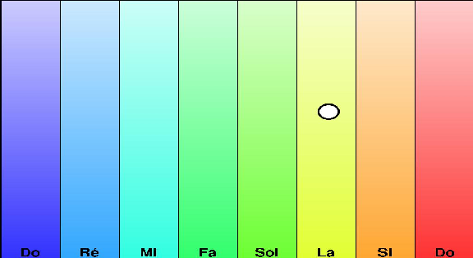
Benveniste et al. 2010
Used the video game based music therapy MINWii where users can either play notes themselves or follow notes as indicated to play a popular song.
Focus of study was on the QoL.
Acceptance/Enjoyment: Participants experienced great fun when playing together with other patients or their family

Slide 14
Cutler et al. 2015
Games on Nintendo DS, apple iPad and other devices playing musical/instrumental games as well as other games.
Acceptance/Enjoyment:
Learning to use new technology was the most enjoyable aspect of the sessions. Participants feel highly motivated to learn new skills. Digital physical activity games were found to be enjoyable.

Slide 15
Lee et al. 2013
CELP (Computer error-less learning program) using a touch screen-screen notebook computer. Training of attention, working memory and focus on one memory training theme
Acceptance/Enjoyment: Participants enjoyed the memory training and found them to be helpful for their daily life.
Cognitive function: Experienced greater cognitive improvement for CELP than TELP (Therapist-led errorless learning program)

Slide 16
Conclusion
The review shows that serious gaming in people with dementia is feasible and recommends that people with dementia need to be familiarized with the technologies as well as have assistance while playing
Supervision and playing in groups seem to be the keys to success when implementing serious games.

