Slide 1
Music Therapy in the Treatment of Dementia: A Systematic Review and Meta-Analysis
2020

Slide 2
Overview
Study done by
Serious game as defined by the study
Focus of the review
Methods used
Search strategy
Feasibility analysis
Effectiveness
Studies used
Studies focused on
Results
conclusion

Slide 3
Focus of the review
Analysing the implementation of serious games and the effects on
cognition
physical performance
personal/behavioural aspects
The paper attempts to determine whether serious games are feasible or effective, as well as which factors need to be considered when using serious games with people with dementia.

Slide 4
Methods
The systematic review was written in accordance with the PRISMA statement.
Preferred Reporting Items for Systematic Reviews and Meta-Analyses: PRISMA is an evidence-based minimum set of items for reporting in systematic reviews and meta-analyses.

Slide 5

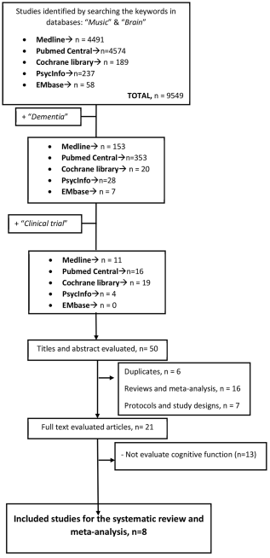
Search strategy used
Online databases were searched with they keywords “Music” & “Brain”
After these studies were found the keyword “dementia” was added to those results.
Thereafter they searched for only the clinical trials to find the studies appropriate for screening:

Slide 6
Studies used

Slide 7
Findings
6 of these studies found improvement in mood, quality of life as well as depression in participants
5 showed improvement in cognitive function or delayed the deterioration
Only one study using singing as intervention showed no significant differences to the control group

Slide 8
Efficacy of Musical Intervention in Cognitive Function
It was observed that shorter intervention periods, less than 20 weeks and passive intervention such as listening to music had greater effects on people living with dementia.
Playing an instrument and signing did not appear to have an effect on cognitive function unless it is pared with listening to music but does not improve the effect of just listening to music.

Slide 9
Efficacy of Musical Intervention in Quality of Life
The effectiveness of serious games were avaluated using the following outcome domains:
Cognitive function
Attention, language, memory, orientation, verbal learning etc.
Physical function
Balance, gait, and ADL(activities of daily living)
Personal/behavioral aspects
QoL(Quality of Life) and mood

Slide 10
Efficacy of Musical Intervention in the Depressive State
The effectiveness of serious games were avaluated using the following outcome domains:
Cognitive function
Attention, language, memory, orientation, verbal learning etc.
Physical function
Balance, gait, and ADL(activities of daily living)
Personal/behavioral aspects
QoL(Quality of Life) and mood

Slide 11
Conclusion
The Study not only shows a positive trend of supporting music therapy for improving cognitive function in people living with dementia but also a positive result for treatment of long-term depression.
Music therapy also seems to improve quality of life of people with dementia once the intervention is finished, but does not have a long-lasting effect, thus is it advised as a continuous therapy.

