Slide 1

Feasibility and effects of serious games for people with dementia: A systematic review and recommendations for future research

Slide 2


Table of content
Study done by
Serious game as defined by the study
Focus of the review
Methods used
Search strategy
Feasibility analysis
Effectiveness
Studies used
Studies focused on
Results
conclusion

Slide 3
Academics
Institute of Movement and Sport Gerontology, German Sport University Cologne, Cologne, Germany
Corinna Dietlein
Dr. Sabine Eichberg
Dr. Tim Fleiner
Dr. Wiebren Zijlstra
Current head of department

Slide 4
Serious game Defenition
This Study defines a serious game as:
A game that does not have entertainment, enjoyment, or fun as their primary purpose.
“Serious” indicates that the game is assumed to have effects on the player in the context of education, knowledge, training, skills, health or inter-personal communication.
Serious games provide a low cost alternative that can easily be installed in the users home, which allows users to train whenever they want.

Slide 5
Focus of the review
Analysing the implementation of serious games and the effects on
cognition
physical performance
personal/behavioural aspects
The paper attempts to determine whether serious games are feasible or effective, as well as which factors need to be considered when using serious games with people with dementia.

Slide 6
Methods
The systematic review was written in accordance with the PRISMA statement.
Preferred Reporting Items for Systematic Reviews and Meta-Analyses: PRISMA is an evidence-based minimum set of items for reporting in systematic reviews and meta-analyses.

Slide 7
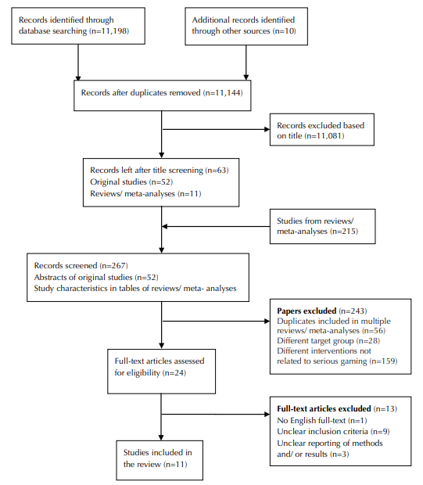
Search strategy used
Online databases were searched for publications on serious games for people with dementia with no publication date limitations.
After the studies were found the titles were screened and then the abstract of these studies were screened.
Flow chart of literature searched and study selection:

Slide 8
Feasibility analysis
Evaluated according to Mayring’s approach for qualitative content analysis based on the following categories:
Comprehension/Playability
Adherence/Commitment
Acceptance/Enjoyment
Risk/Safety Issues

