Slide 1
Music Therapy in the Treatment of Dementia: A Systematic Review and Meta-Analysis
2020

Slide 2
Overview
Study done by
Serious game as defined by the study
Focus of the review
Methods used
Search strategy
Feasibility analysis
Effectiveness
Studies used
Studies focused on
Results
conclusion

Slide 3
Academics
Institute of Movement and Sport Gerontology, German Sport University Cologne, Cologne, Germany
Corinna Dietlein
Dr. Sabine Eichberg
Dr. Tim Fleiner
Dr. Wiebren Zijlstra
Current head of department

Slide 4
Serious game Defenition
This Study defines a serious game as:
A game that does not have entertainment, enjoyment, or fun as their primary purpose.
“Serious” indicates that the game is assumed to have effects on the player in the context of education, knowledge, training, skills, health or inter-personal communication.
Serious games provide a low cost alternative that can easily be installed in the users home, which allows users to train whenever they want.

Slide 5
Focus of the review
Analysing the implementation of serious games and the effects on
cognition
physical performance
personal/behavioural aspects
The paper attempts to determine whether serious games are feasible or effective, as well as which factors need to be considered when using serious games with people with dementia.

Slide 6
Methods
The systematic review was written in accordance with the PRISMA statement.
Preferred Reporting Items for Systematic Reviews and Meta-Analyses: PRISMA is an evidence-based minimum set of items for reporting in systematic reviews and meta-analyses.

Slide 7

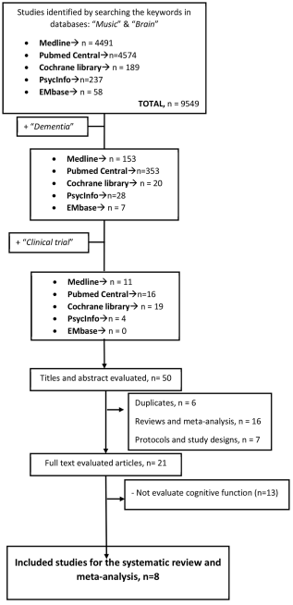
Search strategy used
Online databases were searched with they keywords “Music” & “Brain”
After these studies were found the keyword “dementia” was added to those results.
Thereafter they searched for only the clinical trials to find the studies appropriate for screening:

Slide 8
Feasibility analysis
Evaluated according to Mayring’s approach for qualitative content analysis based on the following categories:
Comprehension/Playability
Adherence/Commitment
Acceptance/Enjoyment
Risk/Safety Issues

Slide 9
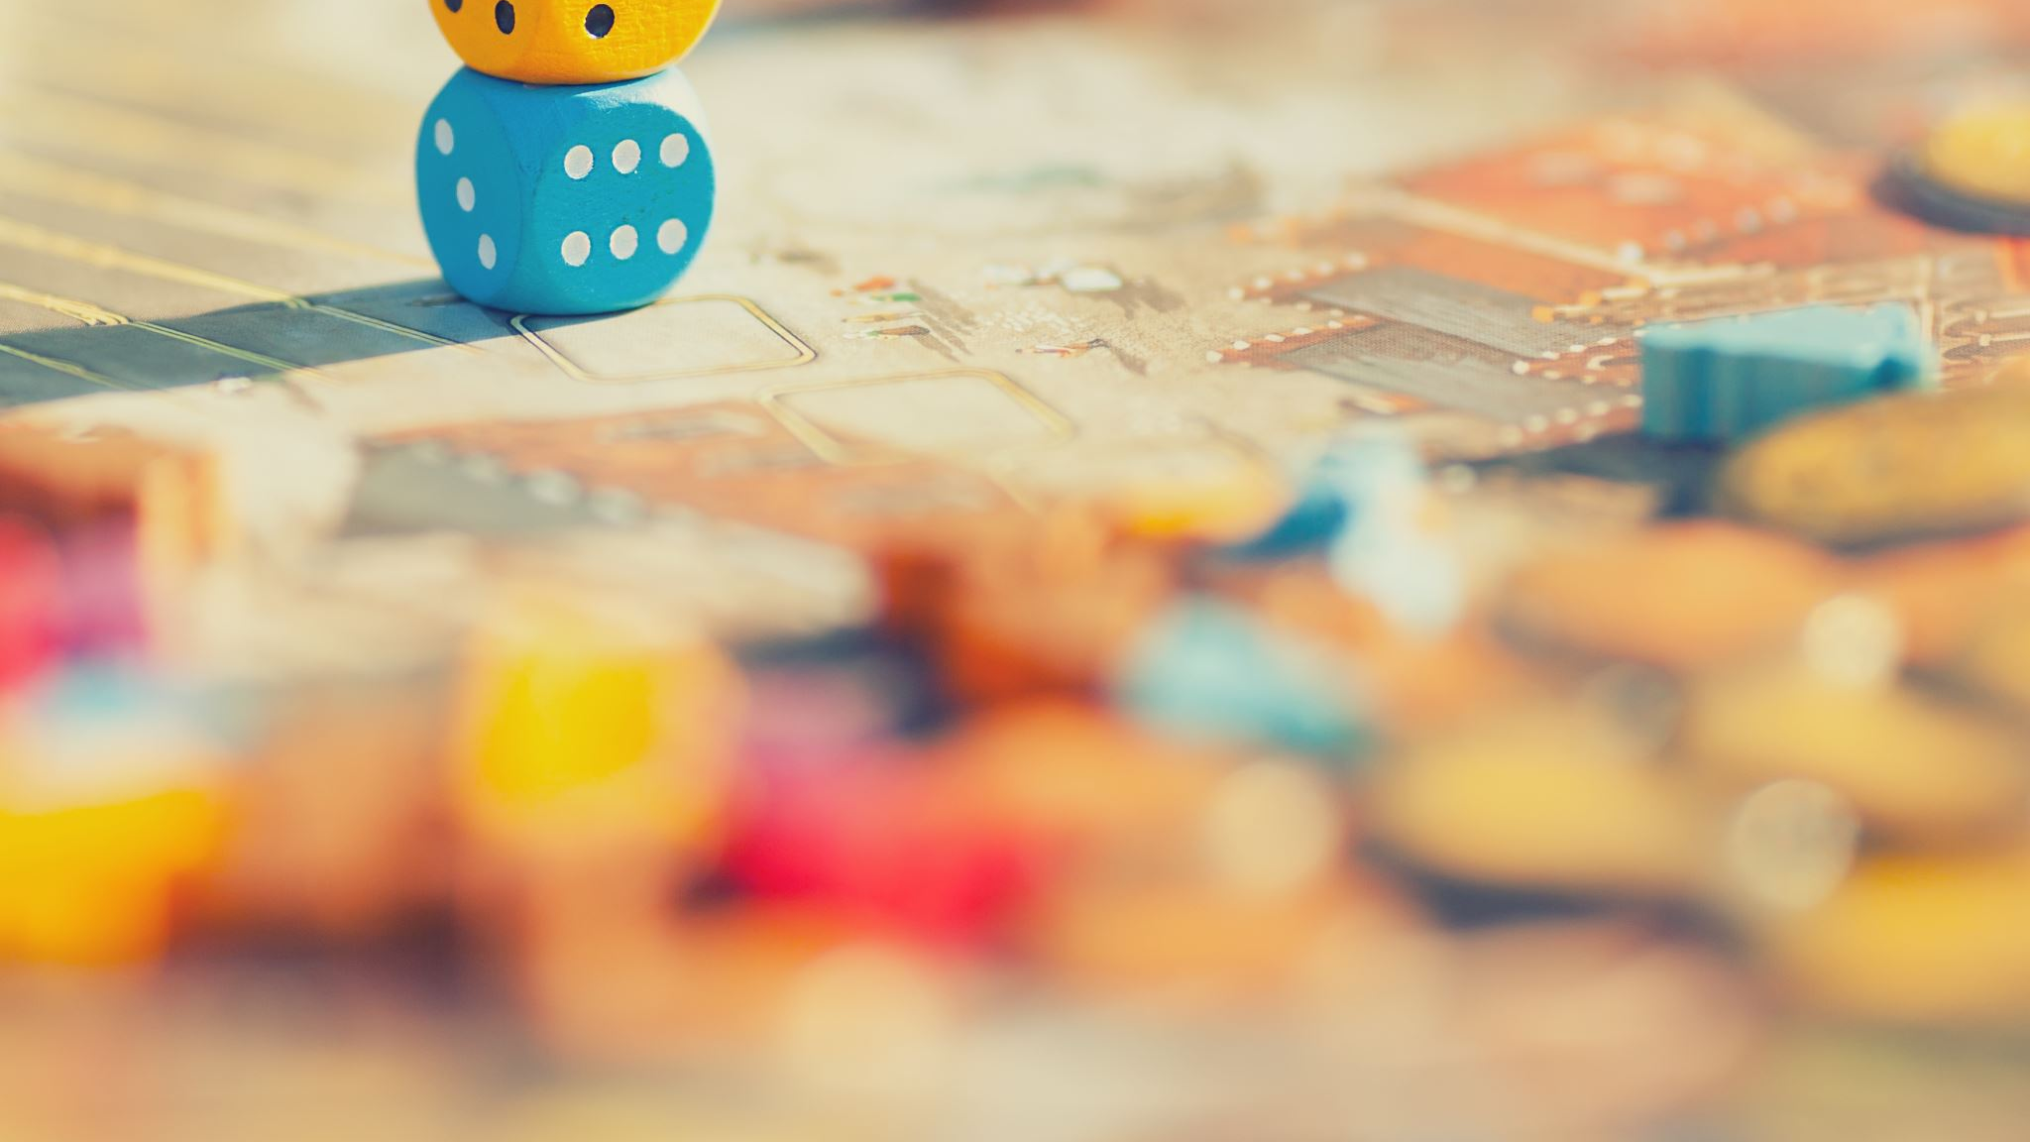
Effectiveness
The effectiveness of serious games were avaluated using the following outcome domains:
Cognitive function
Attention, language, memory, orientation, verbal learning etc.
Physical function
Balance, gait, and ADL(activities of daily living)
Personal/behavioral aspects
QoL(Quality of Life) and mood

Slide 10
Studies
6 studies could be used to evaluate effectiveness where 4 saw improvement in cognitive function and 1 had stable MMSE score where the CG MMSE score declined
2 Studies found that the overall design of the game should be simple with few moving parts and big buttons
5 studies found that participants enjoyed and appreciated the games. 3 studies reported that participants especially enjoyed playing in groups.
No study reported any adverse affect caused by the serious games

Slide 11
Studies used

Slide 12
Conclusion
The Study not only shows a positive trend of supporting music therapy for improving cognitive function in people living with dementia but also a positive result for treatment of long-term depression.
Music therapy also seems to improve quality of life of people with dementia once the intervention is finished, but does not have a long-lasting effect, thus is it advised as a continuous therapy.

