Slide 1
Machine Learning for Nursery Admissions: A Logistic Regression and Random Forest Study
Hugo van Schalkwyk
31586872
Loftie Fourie
31607500

Slide 2
Agenda
Introduction
Background
Dataset
Data Preprocessing
Logistic Regression model
Random Forest model
Hyperparameter Tuning
Results
Model Comparison
Discussion
Scalability and Real-World Application
Conclusion

Slide 3
Introduction
.
Project explores machine learning in nursery admissions.
Focus on Logistic Regression and Random Forest models.
Results of the models are compared using evaluation metrics

Slide 4
Background
Logistic Regression and Random Forest models were reviewed for their applicability on the categorical Nursery dataset from the UCI Machine Learning Repository.
A Python script utilizing the scikit-learn library was used to train and test the models.
The assessment stage included a demonstration of the training procedures, methods used, and outcomes from both models.

Slide 5
Nursery Dataset
The dataset contains information about children in a nursery school
Contains 8 attributes as well as 12960 instances
The target variable is the class of the child, which can be one of 5 categories.

Slide 6
Data Preprocessing
preprocessed by converting categorical variables to numerical variables
The dataset was split into training and testing sets with a 80:20 ratio
Training set was used to train the data and the testing set for evaluation

Slide 7
LR Model
a Linear model used for binary classification
Trained on the Nursery dataset using the scikit-learn library.
Provides interpretable results based on statistical probability

Slide 8
RF Model
An ensemble model used for classification and regression.
Trained on the Nursery dataset using the scikit-learn library.
Provides robust, interpretable results by handling categorical data effectively

Slide 9
Hyperparameter Tuning
LR Model
Searched optimal 'C' value, inverse of regularization strength:
Lower 'C' = stronger regularization to prevent overfitting.
Higher 'C' = more freedom for the model, can increase variance.
Utilized scikit-learn's LogisticRegressionCV for efficient cross-validated tuning.
RF Model
Executed exhaustive GridSearchCV to fine-tune:
n_estimators: Number of trees in the forest.
max_depth: Maximum depth of each tree.
min_samples_split & min_samples_leaf: Minimum samples for internal node splitting and leaf nodes.
Aimed to optimize model for both accuracy and computational efficiency.

Slide 10
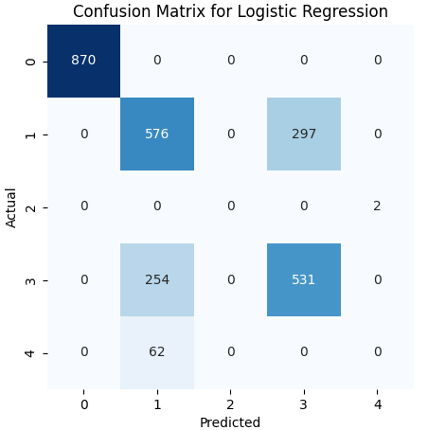
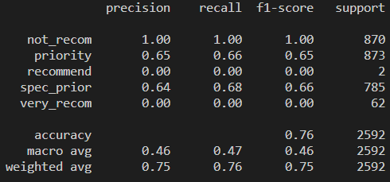
LR Results

Slide 11
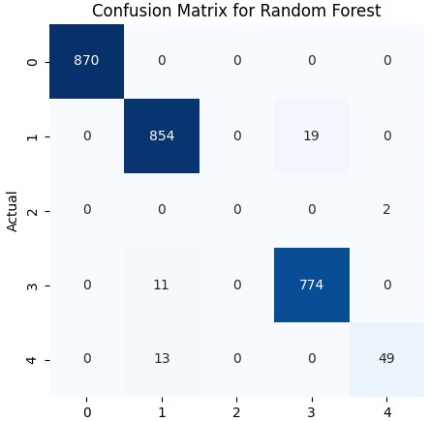
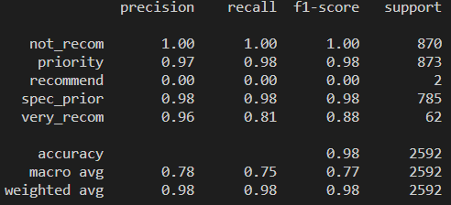
RF Results

Slide 12
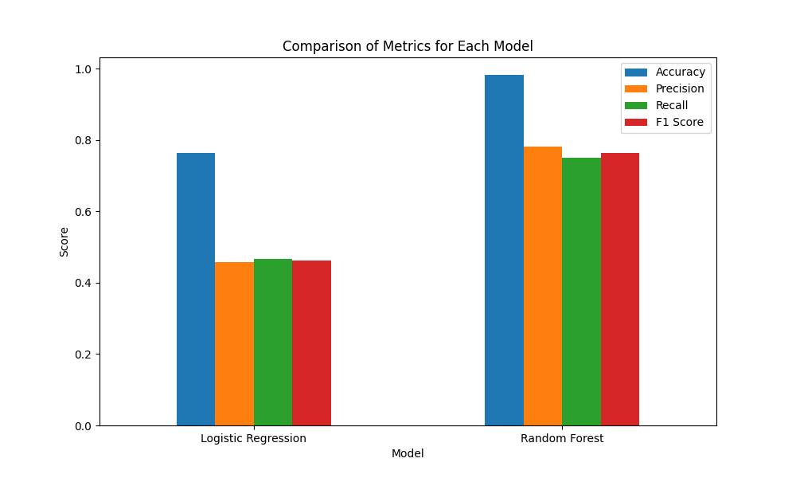
Model Comparisons

Slide 13
Model Comparisons
Performance Overview:
Logistic Regression showed moderate accuracy but lower precision and recall.
Random Forest excelled with high accuracy and balanced performance metrics.
Strengths and Limitations:
Logistic Regression: Beneficial for interpretability; less effective with complex multi-class data.
Random Forest: Strong in handling complex datasets; computationally more intensive.
Key Takeaways:
Model selection should align with data complexity and desired outcome.
Random Forest's robustness makes it a preferred choice for complex categorical data.

Slide 14
Discussion
Random Forest showed superior accuracy and generalizability.
Logistic Regression offered valuable insights despite lower performance metrics.
Findings highlight the importance of model selection based on dataset complexity.
Results inform potential improvements in educational admission processes.

Slide 15
Scalability & Real-World Application
Our models allow for real-world adaptability by modifying labels to suit different datasets. However, deploying machine learning in practical scenarios comes with challenges such as data quality, adaptability, and bias mitigation. Scalability can be addressed through cloud-based hardware, software adaptability, and low-latency optimization, while user feedback integration ensures responsiveness and reliability.

Slide 16
Conclusion
• Logistic Regression and Random Forest models thoroughly evaluated.
• Random Forest outperformed with high accuracy and balance across metrics.
• Study confirms the effectiveness of machine learning in educational assessments.
• Future work to explore model enhancements and real-world applications.

Slide 17
Thank You For Your Time

