Slide 1

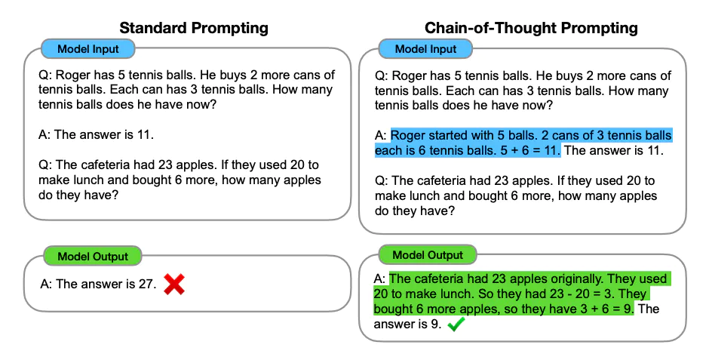
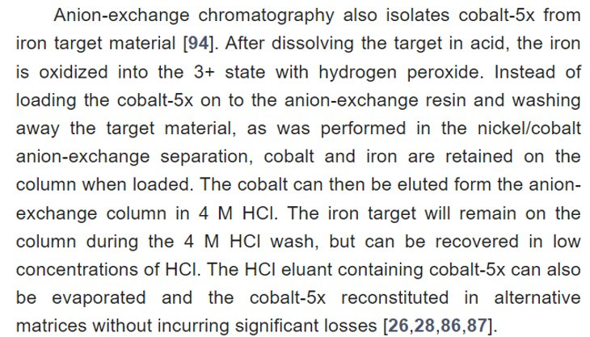
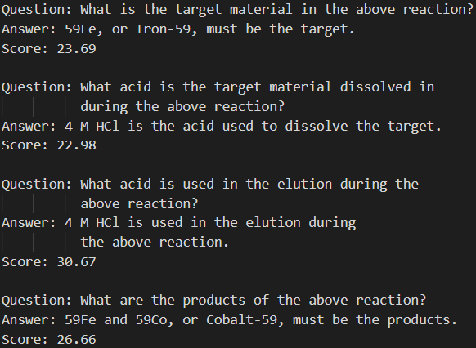



Large Language Models for Isotope Separation
Logan Endes, Department of Computer Science, Rochester Institute of Technology, Rochester, NY, 14623
Carlos Soto, Computer Science Initiative, Brookhaven National Laboratory, Upton, NY, 11973
Jasmine Hatcher-Lamarre, Collider-Accelerator Department, Brookhaven National Laboratory, Upton, NY, 11973
Abstract
The Brookhaven National Laboratory Medical Isotope Research and Production group researches and produces experimental isotopes that are used in nuclear medicine using the Brookhaven Linac Isotope Producer. Before producing isotopes, scientists must go through the process of analyzing research papers to identify ideal separation conditions of these isotopes. This study examines the use of open-source, frozen, large language models (LLMs), such as Galactica, MPT, and LLaMA-2 to extract information on separation conditions of isotopes from scientific literature using prompt tuning and prompt engineering. To test these models, we will be engineering prompts with different techniques to find which are most effective at extracting information from research papers. We found the best approach is Chain of Thought prompting with LLaMA-2-13b. This will support research of automated chemical extraction using artificial intelligence. As a result of this summer, I have developed research skills and have a grander understanding of prompt tuning LLMs.
Introduction / Motivation
BNL produces Actinium-225 and other isotopes that are used for imaging and treatment of diseases
Production of isotopes is a time-consuming process where much of the time is spent identifying chemical separation methodologies from previously published scientific literature
The use of a large language model to interact with text from research papers may accelerate research by extracting critical information for chemical separations.
Related Work
“Attention Is All You Need”¹ proposed the transformer architecture of machine learning models, which caused a boom in the advancement of large language models
Large language models (LLMs) are machine learning algorithms designed to process text in a word-by-word generative mode
At large scales, LLMs demonstrate impressive information extraction and reasoning capabilities
Target material
Name | Publisher | Parameters | Quantized? | Scientific?
Galactica-1.3b | Meta AI | 1.3 billion | No | 83%
Galactica-6.7b | Meta AI | 6.7 billion | Yes | 83%
LLaMA-2-7b | Meta AI | 7 billion | Yes | --%
LLaMA-2-13b | Meta AI | 13 billion | Yes | --%
MPT-7b-Instruct* | MosaicML | 7 billion | Yes | 5.2%
Particle* beam
Target
Decay
Target + Desired Isotope(s)
Target Processing
Pure Isotope
Approach
LLMs are used as fixed ML models, with “learned” capabilities emerging through prompt manipulation and engineering
Of the many prompt engineering strategies, the following were selected:
Zero-Shot Prompting
Few-Shot Prompting
Chain-of-Thought (CoT) Prompting²
Automatic Prompt Engineer³
In order to determine the best language model, we tested 8 different models with varying parameters and configurations in tandem with text extracted from papers with different filtering techniques.
Table 1 depicts relevant models to our problem, their publisher, the parameters in the model, whether the model is quantized, and the percentage of training data which was scientific literature. LLaMA-2 did not report its data training corpus.
Results / Insights
After working with an existing automatic prompt engineer², we decided that it would be best to follow other avenues before revisiting it. Ultimately, we concluded from research that CoT prompting would be best for extracting information.
Through testing, we concluded the following based on a benchmark of conclusions drawn by a human:
Galactica-1.3b⁴ identified 37% with 77 generations per minute
Galactica-6.7b identified 35% with 7 generations per minute
LLaMA-2-7b⁵ identified 53% with 10 generations per minute
LLaMA-2-13b identified 69% with 8 generations per minute
(These results come from generations made by the models on keyword-filtered data from 2 different radioisotope research papers. I went through these papers, and extracted important paragraphs with key features and drew conclusions based on those. The score is how accurate the model was compared to my conclusions).
Figure 2 shows human annotations (left) vs. AI generations (right) on a paragraph from “Production, Purification, and Applications of a Potential Theranostic Pair: Cobalt-55 and Cobalt-58m”⁶
Figure 1 shows Standard Prompting (left) vs. Chain-of-Thought prompting (right). Standard prompting gives an example (few-shot) without much reasoning whereas Chain-of-Thought embeds reasoning in examples given.
Acknowledgements
This project was supported in part by the U.S. Department of Energy, Office of Science,
Office of Workforce Development for Teachers and Scientists (WDTS) under the
Science Undergraduate Laboratory Internships Program (SULI).
I would like to especially thank my mentor, Carlos Soto, and my PI, Jasmine Hatcher-Lamarre, for the great experience this summer, all the help, and the great insights that they have provided me.
Not export controlled.
* MPT-7B has not been tested yet but will be and is a good candidate for this project
1. Vaswani, Ashish, et al. “Attention Is All You Need.” arXiv.Org, 24 July 2023, arxiv.org/abs/1706.03762.
2. Wei, Jason, et al. “Chain-of-Thought Prompting Elicits Reasoning in Large Language Models.” arXiv.Org, 10 Jan. 2023, arxiv.org/abs/2201.11903.
3. Zhou, Yongchao, et al. “Large Language Models Are Human-Level Prompt Engineers.” arXiv.Org, 10 Mar. 2023, arxiv.org/abs/2211.01910.
4. Taylor, Ross, et al. “Galactica: A Large Language Model for Science.” arXiv.Org, 16 Nov. 2022, arxiv.org/abs/2211.09085.
5. Touvron, Hugo, et al. “Llama 2: Open Foundation and Fine-Tuned Chat Models.” arXiv.Org, 19 July 2023, arxiv.org/abs/2307.09288.
6. Barrett, Kendall E., et al. “Production, Purification, and Applications of a Potential Theranostic Pair: Cobalt-55 and Cobalt-58M.” MDPI, 9 July 2021, www.mdpi.com/2075-4418/11/7/1235.
Acknowledgements
This project was supported in part by the U.S. Department of Energy, Office of Science, Office of Workforce Development for Teachers and Scientists (WDTS) under the Science Undergraduate Laboratory Internships Program (SULI).
I’d like to especially thank my mentor, Carlos Soto, and my PI, Jasmine Hatcher-Lamarre for the great experience, all their help, and the great insight they provided me in pursuit of this project.

