Slide 1
Employee Data Analysis using Excel
STUDENT NAME:M.LOGA RANJINI
REGISTER NO:312200861
DEPARTMENT:B.COM GENERAL
COLLEGE: PACHIYAPPAS COLLEGE FOR WOMEN KPM

Slide 2
PROJECT TITLE
Employee attrition analysis using Excel Dashboards

Slide 3


AGENDA
Problem Statement
Project Overview
End Users
Our Solution and Proposition
Dataset Description
Modelling Approach
Results and Discussion
Conclusion
3/21/2024 Annual Review

Slide 4

PROBLEM STATEMENT
Objective:To analyse historical attrition data to identify trends and patterns.To understand the impact of various factors (e.g., department, tenure, age, job role) on employee attrition.To create interactive Excel dashboards that provide actionable insights and support data-driven decision-making to mitigate attrition.
Scope:Data Collection:Gather historical data on employee demographics, tenure, job roles, reasons for leaving, and other relevant factors.Data Preparation:Clean and structure the data to ensure accuracy and consistency.Analysis:Perform statistical analysis to identify key trends and factors associated with higher attrition rates.Segment the data by different dimensions such as department, age group, job role, etc.

Slide 5

PROJECT OVERVIEW
1. Project ObjectivesObjective 1: To analyse historical attrition data and identify trends and patterns.Objective 2: To understand the impact of various factors on employee attrition.Objective 3: To create interactive Excel dashboards for actionable insights and decision-making.2. Project ExecutionData Collection:Status: Data was collected from HR records, employee surveys, and exit interviews.Challenges: Data completeness and consistency issues were encountered but resolved through additional data cleaning efforts.
.
Data Preparation:Status: Data was cleaned and structured effectively. Redundant or inconsistent data was addressed.Challenges: Some historical data gaps were filled with reasonable assumptions or estimated values.

Slide 6

WHO ARE THE END USERS?
HR Managers: They use the dashboards to understand attrition trends, identify high-turnover departments, and assess the effectiveness of retention strategies.Senior Management: They rely on dashboards for high-level insights into overall attrition rates and to make strategic decisions regarding workforce planning and resource allocation.Recruitment Teams: They analyze attrition data to refine recruitment strategies and address any patterns that may affect hiring practices.Department Heads: They use dashboards to review attrition rates within their specific departments and to implement targeted interventions.Employee Relations Specialists: They monitor the impact of various factors on employee satisfaction and retention, using the data to address issues proactively.

Slide 7

OUR SOLUTION AND ITS VALUE PROPOSITION
The solution for employee attrition analysis using Excel dashboards involves the development of an interactive and visually intuitive dashboard that provides comprehensive insights into employee attrition data. The solution includes:Data Integration:Collect and consolidate data from various sources such as HR systems, employee surveys, and exit interviews.Data Cleaning and Structuring:Clean and structure the data to ensure accuracy and consistency, making it ready for analysis.Interactive Dashboards:Create Excel dashboards with interactive elements such as slicers, filters, and pivot tables to allow users to drill down into specific aspects of the data.Visualise key metrics through charts and graphs, such as attrition rates by department, tenure, job role, and other relevant factors.

Slide 8
Dataset Description
Dataset Description1. Employee Information:Employee ID: Unique identifier for each employee.Name: Employee’s full name (optional for analysis, primarily for identification).Age: Employee’s age or age group.Gender: Employee’s gender.Department: Department where the employee works.Job Title/Role: Employee’s current job role or title.Location: Geographical location of the employee (e.g., office or branch).2. Employment Details:Hire Date: Date when the employee was hired.Tenure: Length of time the employee has been with the company.Employment Status: Current status (e.g., active, on leave, resigned).Resignation Date: Date when the employee resigned (if applicable).

Slide 9

THE "WOW" IN OUR SOLUTION
The Wow Factor in Our Solution1. Interactive Visualizations:Dynamic Charts and Graphs: Incorporate interactive charts such as bar graphs, pie charts, and line graphs that update in real-time based on user inputs.Customizable Dashboards: Allow users to tailor the view according to their specific needs using slicers and filters to drill down into data such as department, tenure, or job role.2. Advanced Analytical Capabilities:Trend Analysis: Provide advanced trend analysis to forecast future attrition patterns based on historical data.Correlation Insights: Use statistical functions to reveal correlations between attrition and factors like salary, performance ratings, or job satisfaction.3. User-Friendly Interface:Intuitive Design: Ensure that dashboards are visually appealing and easy to navigate, even for users with minimal technical skills.Guided Insights: Include tooltips and help sections to guide users through complex data and explain key metrics and findings.
3/21/2024 Annual Review
9

Slide 10
MODELLING
1. Data Preparation1.1. Data Collection:Gather data from various sources, such as HR systems, employee surveys, and exit interviews.Ensure data includes key fields like employee demographics, employment history, compensation, performance, and reasons for leaving.1.2. Data Cleaning:Remove duplicates and correct errors.Handle missing values by either imputing them or excluding them from the analysis.1.3. Data Structuring:Organize data into a consistent format.Create separate sheets or tables for different data categories if needed (e.g., employee details, attrition reasons, compensation).
2. Data Analysis2.1. Descriptive Statistics:Attrition Rates: Calculate overall and departmental attrition rates.Demographic Analysis: Analyze attrition by age, gender, department, job role, etc.2.2. Trend Analysis:Historical Trends: Identify trends over time, such as monthly or yearly attrition rates.Seasonal Patterns: Check for seasonal variations in attrition.
2.3. Factor Analysis:Correlation Analysis: Determine the correlation between attrition and factors like salary, performance ratings, job satisfaction.Segmentation: Segment data by different factors (e.g., tenure, department) to identify pattern
10

Slide 11
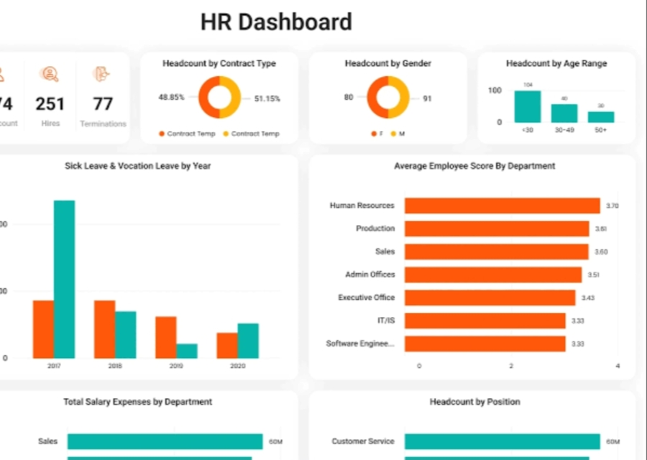
RESULTS
11

Slide 12
conclusion
Key Takeaways:Comprehensive Analysis:The dashboards enable a thorough examination of attrition trends, patterns, and contributing factors. This includes demographic analysis, trend analysis, and predictive modeling.Enhanced Decision-Making:By providing clear and interactive visualizations, the dashboards support informed decision-making. Users can easily explore different scenarios, identify high-risk areas, and assess the impact of potential interventions.Proactive Management:The ability to monitor real-time data and generate alerts allows for proactive management of employee attrition. This helps in addressing issues before they escalate and implementing targeted retention strategies.User-Friendly Interface:Designed to be intuitive and user-friendly, the dashboards ensure that all stakeholders, from HR managers to senior executives, can effectively utilize the data without requiring advanced technical skills.Actionable Insights:The analysis provides actionable recommendations based on the data, such as improving job satisfaction, adjusting compensation, or enhancing employee engagement programs.
Ongoing Improvement:Continuous updates and feedback loops ensure that the dashboards remain relevant and useful. Regular data refreshes and user input help in refining the dashboards and adapting to evolving organizational needs.

