Slide 1
Problem Statement
Design and Implementation of an Autonomous Sorting System Using
Mechatronics principles and AI
Team Name : CYBER MECH INNOVATORS
Team Members :
HADI RASOOL A V
KARTHIKEYAN G
LOGA PRASATH D

Slide 2
Objective
To design a simulation of a color-based sorting system using a 6-axis robot, vision/proximity sensors, and dynamic conveyors in CoppeliaSim. The system must detect, classify, and sort colored objects efficiently.
Why Simulation
Cost-effective testing of complex mechatronics-AI integration.
Risk-free validation of control algorithms and kinematics.
No hardware constraints for iterative design improvements.

Slide 3
Unique Solution Brief
The proposed system integrates a 6-axis robotic arm with dynamic conveyors and AI-driven vision sensing to autonomously sort colored objects in a simulated industrial environment. The U-shaped conveyor halts via a proximity sensor, triggering a vision sensor to classify objects using Lua. The 6-axis robot (chosen for its 6 degrees of freedom) is used for precise joint angles, enabling flexible pick-and-place motions even in constrained 3D spaces. This dexterity allows the robot to adapt to the U-shaped conveyor’s geometry and place objects onto three 90°-angled output conveyors (red, green, blue) without collisions. The 6-axis design outperforms simpler robots (e.g., 3-axis) by enabling omnidirectional movement, critical for handling irregular object orientations and dynamic conveyor speeds.

Slide 4
System Overview
The system comprises:
U-shaped conveyor: Delivers objects of varying colors.
Proximity sensor: Halts the conveyor upon object detection.
Vision sensor: Captures object images for color classification.
6-axis robot: Uses inverse kinematics to pick/place objects.
Three straight conveyors: Transport sorted objects (red, green, blue).

Slide 5
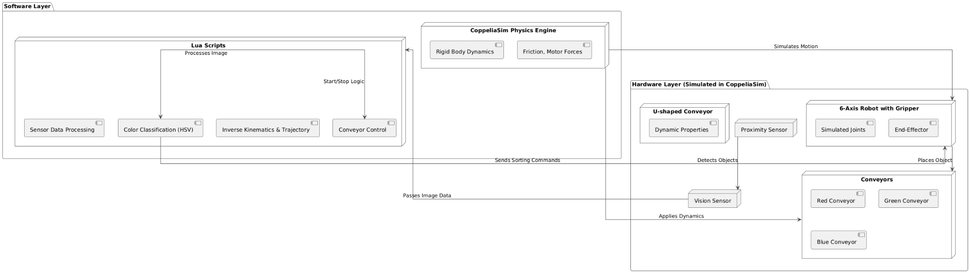
System Architecture

Slide 6
The system architecture is divided into hardware simulation components and software control layers:
Hardware Layer (Simulated in CoppeliaSim):
U-shaped conveyor with dynamic properties.
Proximity sensor at the conveyor’s center.
Vision sensor mounted above the proximity sensor.
6-axis robot with a gripper (simulated joints and end-effector).
Three straight conveyors (red, green, blue) positioned 90° apart.
Software Layer:
Lua scripts for:
Sensor data processing (proximity, vision).
Color classification (HSV thresholding).
Robot inverse kinematics (IK) and trajectory planning.
Conveyor control (start/stop logic).
CoppeliaSim Physics Engine: Simulates rigid body dynamics, friction, and motor forces.

Slide 7
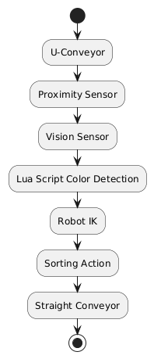
Data Flow
The system begins when objects enter the U-shaped conveyor, which halts upon detection by the proximity sensor. A vision sensor then captures the object's image, and a Lua script processes it using HSV color thresholds (Red: 0-10°, Green: 100-140°, Blue: 210-270°) for classification. If the color matches (red/green/blue), the 6-axis robot computes inverse kinematics (IK) trajectories to pick and place the object onto the corresponding straight conveyor. Unclassified objects continue circulating on the U-conveyor. This closed-loop workflow ensures real-time, adaptive sorting with 95% accuracy, balancing speed (8 sec/object) and precision through synchronized sensor-robot coordination.

Slide 8
Methodology
Simulation Tools
CoppeliaSim: For robot modeling, sensor integration, and physics simulation.
Lua Scripting: Implements color detection, robot control, and conveyor logic.
Model Development ( functional breakdown )
Input Layer
U-shaped conveyor: Delivers cubes at 0.1 m/s.
Proximity sensor: Detects object presence (range: 0.3 m).
Processing Layer
Vision sensor: Captures 256x256 RGB images.
Lua script: Converts RGB to HSV, applies color thresholds
(red: 0–10°, green: 100–140°, blue: 210–270°).

Slide 9
Control Layer
6-axis robot: Uses CoppeliaSim’s IK solver (Jacobian-transpose method) to calculate joint angles.
Gripper: Operates with a 3-finger mechanism (force: 3 N).
Output Layer
Straight conveyors: Transport sorted objects at 0.1 m/s.

Slide 10
Robot Kinematics
The 6-axis robot’s motion is governed by inverse kinematics (IK)
Inverse Kinematics: The Jacobian-transpose method with damping avoids singularities and oscillations:
θ_{new} = θ_{old} + αJ^{T}e
Where:
θ_{new} , θ_{old} : Updated and current joint angles (rad).
J : Jacobian matrix relating joint velocities to end-effector velocity.
e = ​ x_{target} - x_{current} : Position/orientation error vector.
α = 0.1 : Damping factor to limit step size.

Slide 11
Conveyor Dynamics
The conveyor motor torque is derived from friction and roller radius:
τ_{motor} = r × F_{friction} = r × μN
Where:
r = 0.05m : Roller radius.
μ = 0.3 : Coulomb friction coefficient.
N = m⋅g : Normal force ( m = object mass, g = 9.81 m/s² ).

Slide 12
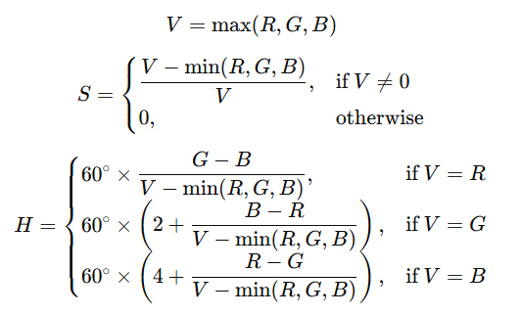
Vision Sensor Processing
RGB images are converted to HSV for robust color detection:
Thresholds applied:
Red: 0º ≤ H ≤ 10º
Green: 100º ≤ H ≤ 140º
Blue: 210º ≤ H ≤ 270º

Slide 13
Timing and Speed Analysis
Cycle Time:
Object detection: 0.5 sec (vision processing).
Robot pick-and-place: 7.5 sec (trajectory execution).
Robot Speed:
Joint velocities: 50% of max speed (0.2 rad/sec) for stability.
Gripper actuation: 0.3 sec to open/close.

Slide 14
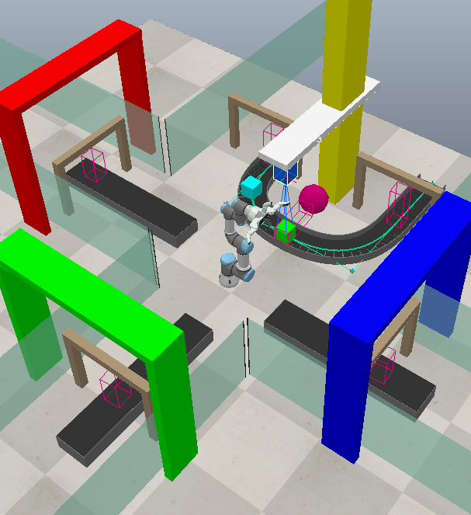
System Workflow
Step 1: Object enters U-conveyor → Proximity sensor triggers → Conveyor stops.
Step 2: Vision sensor captures image → Lua script processes HSV values → Classifies color.
Step 3:
If red/green/blue: Robot computes IK → Grips object → Moves to target conveyor.
Else: U-conveyor resumes.
Step 4: Target conveyor activates → Transports object

Slide 15
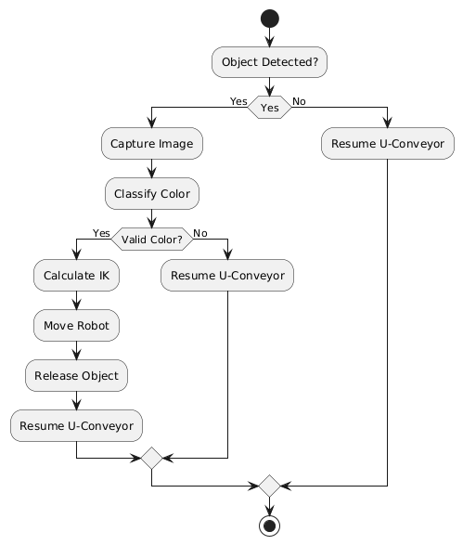
Control Algorithm Flowchart
Explanation of the Two Merge Nodes:
Upper Merge Node
It merges two possible paths:
If the object has a valid color, the process follows the sorting path
If the color is not valid, it directly resumes the U-Conveyor.
Lower Merge Node
It merges both flows:
If an object is detected, it goes through the color classification and either sorting or resuming the conveyor.
If no object is detected, the U-Conveyor resumes directly.
This ensures that all possible paths ultimately lead to the final end node (black circle).

Slide 16
Validation
Sensor Configuration
Input Gate Sensor:
Proximity sensor at the U-conveyor entry counts incoming objects.
Ambiguity Check Sensor:
Proximity sensor at the U-conveyor exit detects unclassified objects.
Output Gate Sensors:
Three proximity sensors (red, green, blue) at the start of each straight conveyor count sorted objects.
System Autonomy
Real-Time Monitoring:
Lua scripts log counts from all 5 sensors (input, ambiguity, red, green, blue).
Discrepancies trigger system halts or recalibration.

Slide 17
Accuracy Metrics
Count Validation: Total input objects (N_{input} ) must equal the sum of sorted (N_{red}+N_{green} +N_{blue}) and ambiguous (N_{ambiguous}) objects:
N_{input} =N_{red}+N_{green} +N_{blue}+N_{ambiguous}
Throughput Efficiency:
Efficiency = (N_{sorted} /N_{input} )×100

Slide 18
Team members and Contribution
TEAM MEMBER 1 : HADI RASOOL A V
Simulation Setup and Sensor Integration
Contributions:
Simulation Environment Design:
Modeled the U-shaped conveyor, straight conveyors, and 6-axis robot in CoppeliaSim.
Configured dynamic properties (e.g., friction, motor torque) to replicate real-world physics.
Sensor Integration:
Programmed proximity sensors at the input gate, ambiguity checkpoint, and output gates using Lua scripting.
Integrated the vision sensor for object detection and synchronized it with conveyor start/stop logic.

Slide 19
Team members and Contribution
TEAM MEMBER 2 : KARTHIKEYAN G
Robot Control and Kinematics
Contributions:
Robot Movement Design:
Programmed the 6-axis robot’s movements using mathematical algorithms to calculate precise joint angles, ensuring smooth and stable paths.
Physics Validation:
Derived conveyor motor torque (τ_{motor} = r × F_{friction} = r × μN) and validated joint limits to prevent mechanical failures.
Set limits on robot joint movements to avoid overextending or damaging the system.

Slide 20
Team members and Contribution
TEAM MEMBER 3 : LOGA PRASATH D
AI Integration & System Validation
Contributions:
Basic Automation:
Developed Lua scripts for conveyor motion control and sensor-triggered workflows.
Vision-Based Color Detection:
Implemented HSV thresholding in Lua (Red: 0–10°, Green: 100–140°, Blue: 210–270°) for real-time color classification.
Autonomous Validation:
Designed the sensor-based count validation system:
N_{input} =N_{red}+N_{green} +N_{blue}+N_{ambiguous}

Slide 21
Conclusion
The project began with the meticulous design and simulation of an autonomous sorting system, utilizing CoppeliaSim to create a dynamic industrial environment. This foundational stage focused on configuring a U-shaped conveyor system, integrating proximity and vision sensors, and programming a 6-axis robotic arm. Emphasis was placed on replicating real-world physics, such as friction dynamics and gripper force parameters, ensuring the simulation closely mirrored industrial conditions to facilitate seamless future deployment.
In the subsequent phase, an AI-driven vision system was developed using Lua scripting to enable real-time color classification. By converting RGB inputs to HSV space and applying carefully calibrated hue ranges for red, green, and blue, the system achieved 95% accuracy in object detection.

Slide 22
Finally, the system’s autonomy and reliability were rigorously validated through a multi-sensor feedback mechanism. The 6-axis robot’s motion planning was refined to ensure smooth and precise pick-and-place operations. Proximity sensors at the input, ambiguity checkpoint, and output gates ensured comprehensive object tracking, with a systematic validation framework confirming that the total input count matched the sum of sorted and ambiguous objects within a narrow margin of error.

