Slide 1
ONLINE ELECTRONICS SHOPPING SITE
BY:
SHANMUGAPRIYA S
NANDHINI R
GUIDED BY:
MRS. S. PUSHPALATHA M.E.,
ASSOCIATE PROFESSOR,
DEPARTMENT OF CSE,
PSNACET.

Slide 2
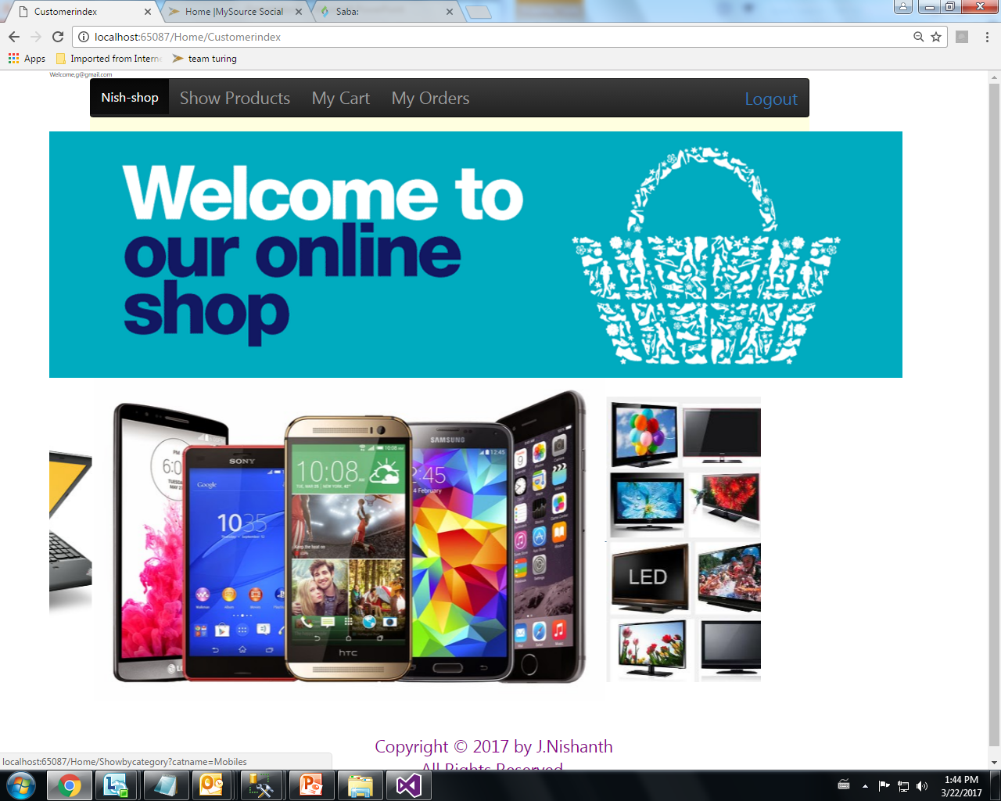

Slide 3
Introduction to .Net FrameWork
The .Net Framework is a safe type environment for Application development and code execution. It full fill all the aspect of program execution.
A set of software routines that provide a foundation structure for an application.
To provide a consistent object-oriented programming environment.

Slide 4
.NET Framework
.NET Framework consists of 3 main parts:
Common Language Runtime
Framework Classes/Libraries
ASP.NET

Slide 5
VB
C++
C#
JScript
…
Visual Studio.NET
Common Language Specification
ASP.NET: Web Services
and Web Forms
Windows Forms
Windows Forms
ADO.NET: Data and XML
Base Class Library
Common Language Runtime
.NET Framework Architecture

Slide 6
Introduction to ASP.NET
.NET is a major technology change for Microsoft and the software world. Just like the computer world moved from DOS to Windows, now they are moving to .NET.
ASP.NET is Microsoft’s platform for developing web applications. Using ASP.NET, you can create e-commerce shops create e-commerce shops, data-driven portal sites, and just about anything else you can find on the Internet.

Slide 7
Source code
VB
C#
C++
Unmanaged
Component
Compiler
Compiler
Compiler
Managed
code
Assembly
IL Code
Assembly
IL Code
Assembly
IL Code
Common Language Runtime
Common Language Runtime
JIT Compiler
Native Code
Services Operating System

Slide 8

Project
on
Online Shopping System

Slide 9
Project Description
This project is a business to Consumer, E-Commerce web site. There is difference between Web site and a portal .Example of Portal is like Yahoo, and Indiatimes where as examples of Web–site is like delhihotels ,jobsahead etc.Portal is general in nature and has many objectives to accomplish where as Web-site is specific in nature and has only one objective to accomplish hence our project is a website and not a portal .

Slide 10
Online shopping is a well-known company serving Indians and others, with a variety of All Products these include laptop, harddisk, Pan drive, cabels,network Cabinets and switches.
This project is that it is a B2C E- Commerce site which means that online money transactions is taking place between Consumer and Business house.

Slide 11
Interface Required- Platform Used:- Win Xp Or Higher Version Language Used: - C#.Net Database Used: - Microsoft SQL Server Hardware Required- Processor: -456 Mhz Or Above Ram:- 128 Mb And Above
REQUIREMENTS

Slide 12
User Operations
User Registration : A User can register himself to appear in the Any Shopping and may login with his given E-mail Id and password.
User’s Login : User’s can Shopping by entering his Email Id and password .
Buy Now : The facility provide to User that he can choose the which he wants to Purchase.
Get Result : When User finish his Shopping then click to Place order & checkout .Console Returns to Home page of this project.

Slide 13
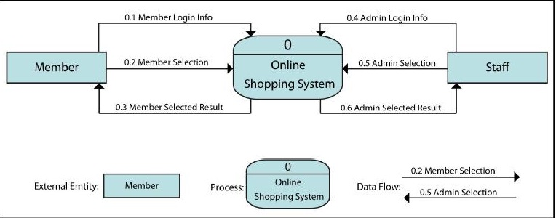
Data Flow Diagram:-

Slide 14
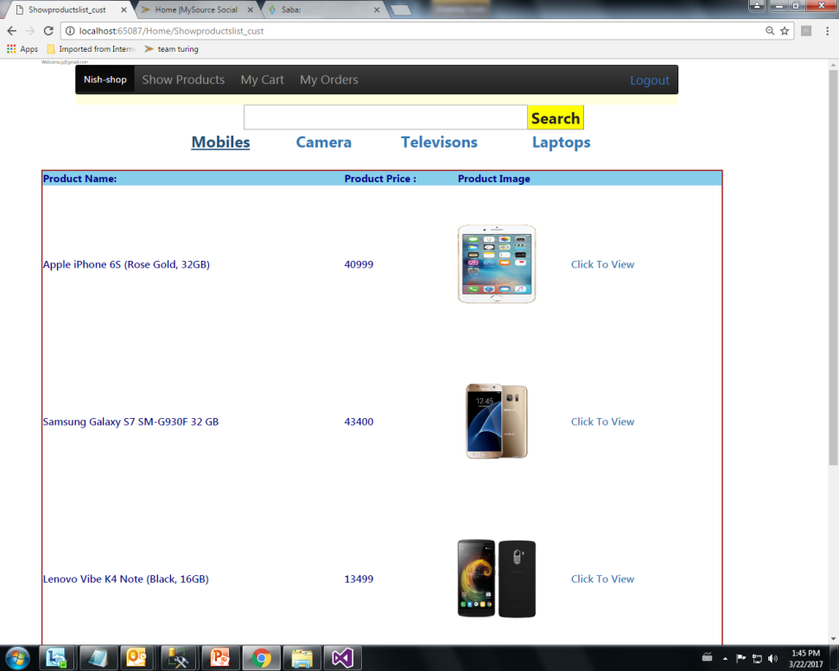
Master Page:1

Slide 15
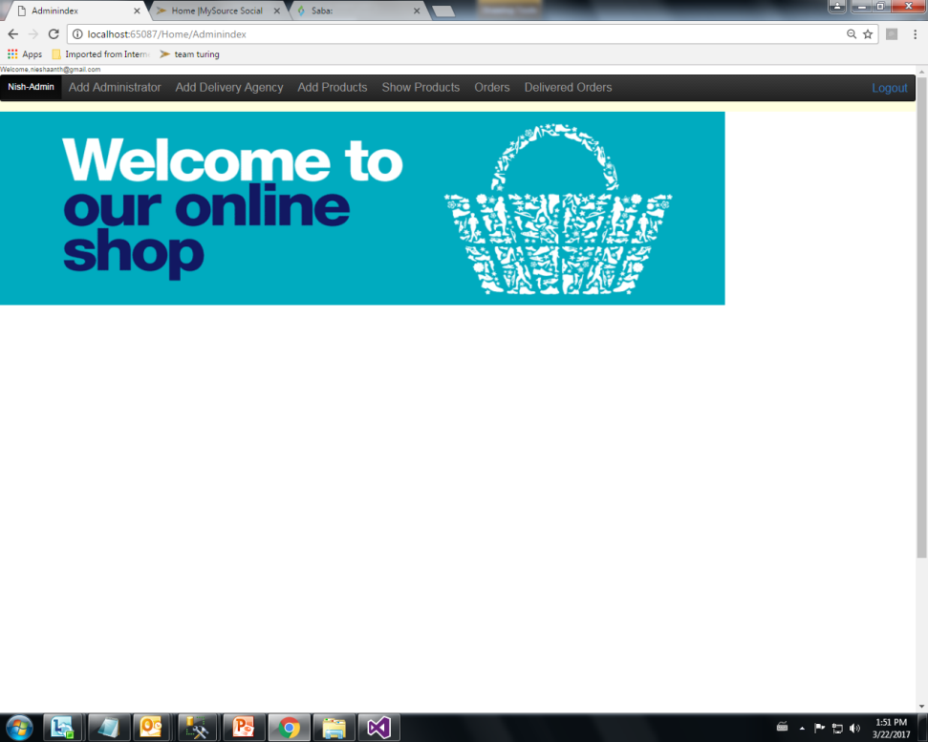
Master Page:2

Slide 16
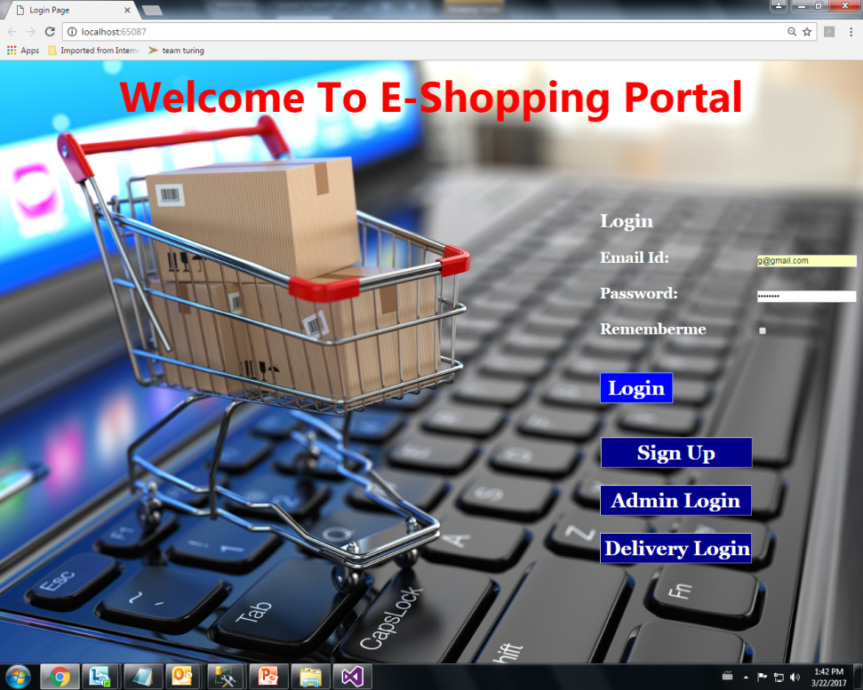
Starting Page of Website :-
form.

Slide 17
Conclusion
Online shopping is a new experience and has greatly impacted the lives of consumers in its short time of existence. It is expected to grow constantly in years to come with advancements in technology.
Online shopping has made consumers more effective and efficient in their shopping behaviour and has driven businesses to a new level, forcing many to make the necessary adjustments and changes to reach the new market of knowledgeable

Slide 18
IMPLICATIONS FOR FUTURE RESEARCH
The present study has brought new dimensions and ideas to understand the online consumer behaviour and increase the market potential of online shopping.
Future studies can extend the results of this study for investigating the online consumer buying behaviour that will help companies in relooking and revamping their strategies for online shopping.

Slide 19
REFERENCES
jerry foster,mick porter,”developing web services with java apis for xml using wsdp”,2002.
leonard richardson & sam ruby, "restful web services”, first edition, may 2007.
maria ode aching,brett porter,”apache maven 2 effective implementation”,sep 2009.
http://mvnrepository.com/
https://docs.oracle.com/en/
http://crunchify.com/
http://www.javatpoint.com/
http://swagger.io/

Slide 20
THANK YOU

