Slide 1
Movie roulette
University of Arizona Coding Bootcamp
Tom, Logan, KJ, Emily
January 3, 2022

Slide 2
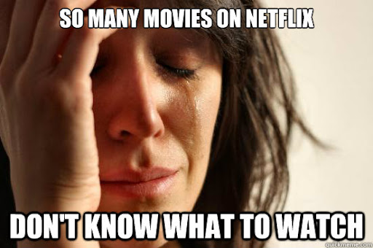
Not sure what to watch?
User Story:
AS A subscriber of a streaming service
I WANT to see randomized movie options
SO THAT I can spend more time watching and less time
searching
Acceptance Criteria:
GIVEN I am using a subscription streaming service
WHEN I search by streaming service and genre
THEN I am presented with random movie options in that
genre available on that service
WHEN I click on the movie poster
THEN I am presented with the movie titles,
release dates, runtimes, IMDb ratings, and plots

Slide 3
Concept
Description
Motivation for development
To minimize time searching for movies so you can spend more time watching and less time searching
Upon initial visitation to Movie Roulette, the user will be prompted to select their preferred service and genre. The user will be presented with six random movies from their selected provider and the selected genre. The user can click on one of the six results to learn more about their selected movie through a modal. If the user decides they would like to switch the service and genre, they can change their selection with the supported drop-down boxes

Slide 4
Process
Technologies used
Bulma, IMDB API, Streaming Services API, HTML, CSS, Javascript, jQuery, VS code, GitHub, google fonts, icons
Challenges
Design, initial concept, working with APIs, implementing bulma/styling, using modals, clearing search history, using GitHub and combining/merging work, changing concept/idea
Staying within the scope of our idea, keeping a clean code to minimize confusion
Successes
Team work – willingness to adapt when initial plan could not be successfully implemented, finding solutions to minor bugs, working with each other to help with personal assignments that hit roadblock, flexibility and dedication to project (working outside of class hours)
Functionality successfully implemented as envisioned

Slide 5
Process – Breakdown of Tasks
Tom
Streaming services API implementation, both modals, README
Emily
HTML/CSS, Bulma framework, initial modal, Kanban
Logan
API implementation, second modal, user story/acceptance criteria
KJ
Debugging
CSS styling
GROUP EFFORT
Javascript, converting to jQuery, fixing bugs, design concept, trouble shooting issues, GitHub merging
Group Effort
Notes:
Group effort: Javascript, fixing bugs, design concept, trouble shoot issues

Slide 6
DEMO

Slide 7
Future Development
Further randomization of movies
Advanced search options (multiple genres, multiple streaming services, rating, year)
Include assessment on main page of search history and most popular genre by users
Expand to TV series

Slide 8
Links
https://github.com/Logan-Bonnesen/Movie-Roulette
https://logan-bonnesen.github.io/Movie-Roulette
Deployed Application
GitHub Repository

Slide 9

Questions?

