Slide 1
Orchestration for Research-Level Mathematics
Vijay Ganesh
61
61
Notes:
So now, before concluding, I’ll briefly talk about another technique we’ve developed — RLSF, or Reinforcement Learning via Symbolic Feedback.
While it was originally proposed in the context of code generation -- we believe it is HIGHLY relevant for mathematical reasoning as well -- especially in neuro-symbolic settings where verifiers and feedback loops are central.

Slide 2
Auto-Formalization of Research-Level Statements
Source: OpenAI preprint, Theorem 1.2
ℓ₁ has metric Markov cotype two:
for all n, t ≥ 1, every probability vector π, every stochastic A reversible w.r.t. π, and all x₁…xₙ ∈ ℓ₁, there are y₁…yₙ ∈ ℓ₁ with
Σᵢ πᵢ‖xᵢ−yᵢ‖² + t Σᵢⱼ πᵢaᵢⱼ‖yᵢ−yⱼ‖²
≤ C · Σᵢⱼ πᵢ ( ¹⁄ₜ Σₛ₌₁ᵗ (Aˢ)ᵢⱼ ) ‖xᵢ−xⱼ‖² (C = 3024)
Resolves Ball's extension problem for ℓ₁ targets.
abbrev L1 : Type := lp (fun _ : ℕ => ℝ) 1
theorem openaimath_332_metricmarkovcotypel1
(n t : ℕ) (ht : 1 ≤ t) (π : Fin n → ℝ) (hπ : IsProbVec π)
(A : Matrix (Fin n) (Fin n) ℝ) (hA : IsStochastic A)
(hrev : IsReversible π A) (x : Fin n → L1) :
∃ y : Fin n → L1,
∑ i, π i * ‖x i - y i‖ ^ 2
+ t * ∑ i, ∑ j, π i * A i j * ‖y i - y j‖ ^ 2
≤ 3024 * ∑ i, ∑ j, π i *
((1 / t) * ∑ s ∈ Finset.Icc 1 t, (A ^ s) i j)
* ‖x i - x j‖ ^ 2
Captain formalizes
compiles in 28 s
Auditor back-translates
Lean → math, never sees the source
Captain compares
verdict: FAITHFUL
Final checks
statement matches · standard axioms
Vijay Ganesh
62
Notes:
Formalization is the first stage and the one most likely to go silently wrong, so it is audited. The captain writes Lean definitions and the theorem statement. A separate auditor model translates the Lean back into mathematics without seeing the source, and the captain compares the two. For 332 that took under a minute and came back faithful. The final proof is also checked to prove exactly this statement using only the standard axioms. The constant 3024 comes from the source paper.

Slide 3
Orchestration: Architecture and Lean-Gated Pipeline
Captain · Claude Opus 5.5
formalizes, splits the proof into lemmas, answers hand-backs, assembles
+ blind auditor · sketch judge · reviewer
AIProver solver pool
open-weight prover + Lean tools · GH200 / vLLM
Informal problem
statement + proof
(an OpenAI preprint)
lemmas
Verified Lean proof
checked locally + LaTeX report
proofs / errors
FAITHFUL
0 sorry
FAITHFUL
Formalize
Lean statement
+ definitions
Blind audit
back-translate
& compare
Sketch
proof → lemmas
as sorry
Prove
parallel AIProver
jobs per lemma
Assemble
compile in
dependency order
Review
independent
faithfulness check
Report
LaTeX write-up
+ informal proof
unfaithful → revise
lemmas stuck → replan (keeps proved lemmas)
review finds a problem → replan
Vijay Ganesh
63
Notes:
Formalization is the first stage and the one most likely to go silently wrong, so it is audited. The captain writes Lean definitions and the theorem statement. A separate auditor model translates the Lean back into mathematics without seeing the source, and the captain compares the two. For 332 that took under a minute and came back faithful. The final proof is also checked to prove exactly this statement using only the standard axioms. The constant 3024 comes from the source paper.

Slide 4
Results: OpenAI Problems Verified in Lean
Problem 332: Metric Markov Cotype of ℓ₁
Problem 011: Erdős's Conjecture on Totient Fibers
Functional analysis; OpenAI preprint, October 5, 2026
Number theory; OpenAI preprint, September 24, 2026
For every ε > 0, Euler's totient function φ satisfies
For every probability vector π, stochastic matrix A reversible with respect to π, t ≥ 1 and x₁, …, xₙ ∈ ℓ₁, there exist y₁, …, yₙ ∈ ℓ₁ with
Problem 164: Hindman's Finite Sums and Products
Combinatorics; OpenAI preprint, September 23, 2026
Corollary 1.2, from Theorem 1.1: for every finite coloring and m ≥ 1, some m-set A has monochromatic subset sums and products, with
where C = 3024: ℓ₁ has metric Markov cotype two, answering Mendel and Naor (Ball's extension problem for ℓ₁).
Table: all three proofs compile in Lean 4 with Mathlib, without sorry and with the standard axioms only, and were judged faithful by an independent reviewer; 164 proves Corollary 1.2 with the paper's Theorem 1.1 as a hypothesis. Claude usage at API list prices.
Problem | Area | Lemmas | Lines of Lean | Claude usage
332 Metric Markov cotype of ℓ₁ | Functional analysis | 39 | 1,888 | ≈ $12
011 Erdős's totient-fiber conjecture | Number theory | 20 | 1,135 | ≈ $3
164 Hindman's sums and products (Cor. 1.2) | Combinatorics | 15 | 839 | ≈ $1
64
Notes:
Three research results from OpenAI's October 2026 math release, none formalized by OpenAI, now have verified Lean proofs produced by the orchestration. Problem 332: real l1 has metric Markov cotype two, Mendel and Naor's question; 39 lemmas in about 8.5 hours. Problem 011: Erdős's conjecture on the largest totient fibers; 20 lemmas. Problem 164: Corollary 1.2 of the Hindman paper, that some m-element set has monochromatic and pairwise distinct subset sums and products, derived in Lean from the paper's main Theorem 1.1, which is taken as a hypothesis; 15 lemmas in under 9 hours and about one dollar of Claude usage. All proofs use only the standard axioms and were judged faithful by an independent reviewer.

Slide 5
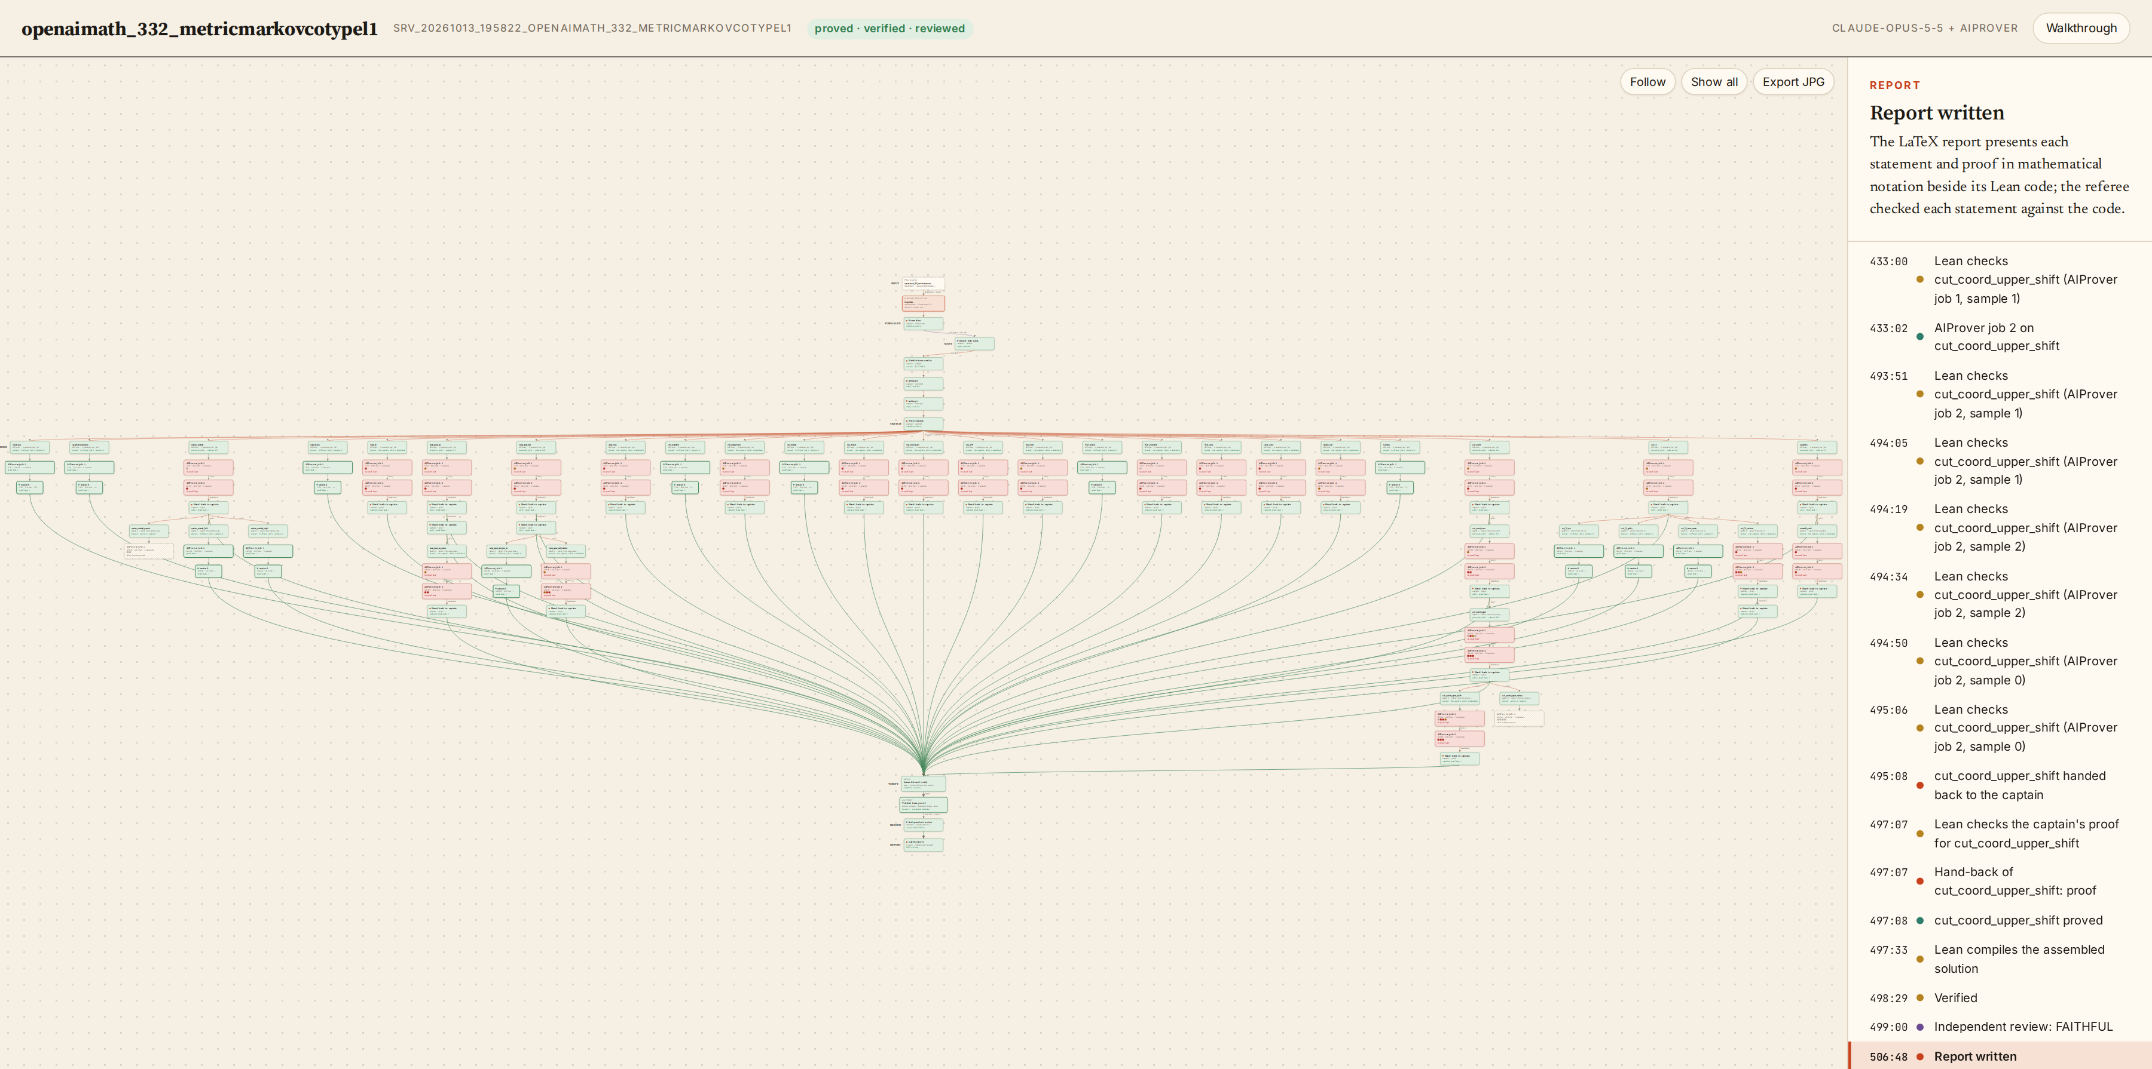
Trace of a Verified Run: Problem 332
Top: formalization, blind audit, setting check and sketch
Columns: one per lemma (24), with AIProver jobs below; green verified, red Lean errors
Subtrees: hand-backs in which the captain splits a lemma
Bottom: assembly, verification, review and report
Figure: final state of the trace viewer for the 8.5-hour run on Problem 332 (63 AIProver jobs, 83 sessions).
Vijay Ganesh
65
Notes:
Seven stages, each gated by the Lean compiler. The sketch turns the informal proof into lemma statements left as sorry plus a main proof that must already compile. Proving runs AIProver jobs on all lemmas in parallel. If lemmas stay stuck, the captain replans and proved lemmas are reused. The assembled proof gets an independent review, then a LaTeX report and an informal write-up.

Slide 6
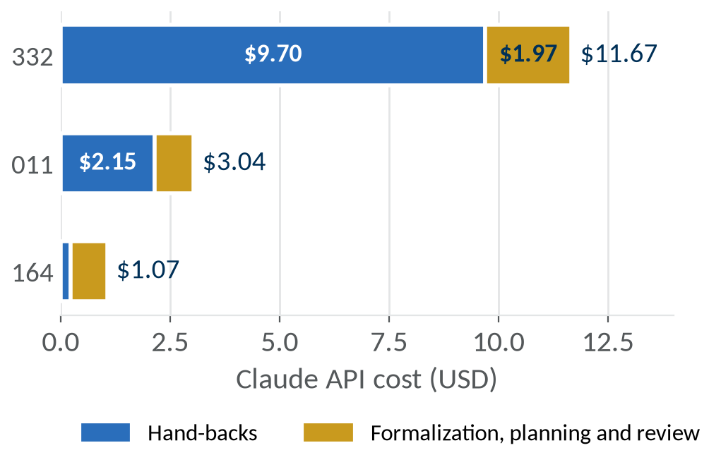
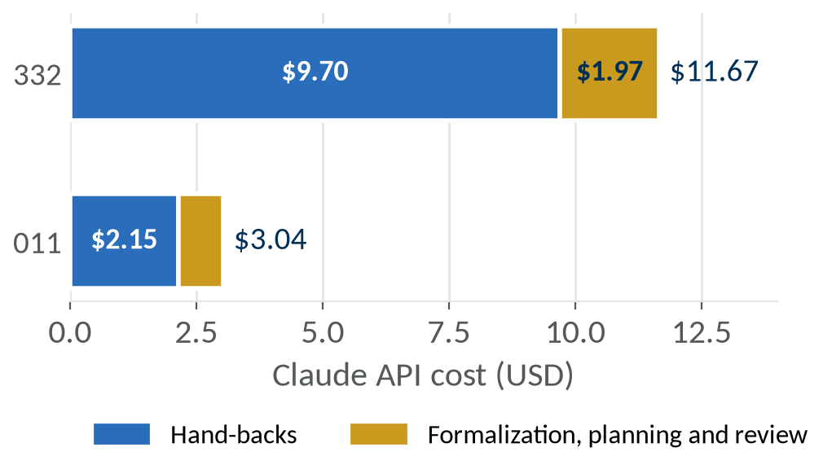
Cost: Claude Usage and Prover Compute
Claude usage: ≈ $12, ≈ $3 and ≈ $1 for 332, 011 and 164 at API list prices
Prover compute: 17 and 57 GH200 GPU-hours over 83 and 204 AIProver sessions; 164 ran 26 sessions on a DGX server
Session outcomes: 73%, 40% and 50% of sessions reach the time limit; session policy is the main lever on cost
Figure: Claude cost per problem by role, LaTeX write-up excluded.
Vijay Ganesh
66
Notes:
Claude usage is modest: about 12 dollars for 332, 3 for 011 and 1 for 164 to formalize, prove and review, most of it in hand-backs. The dominant cost is prover compute. Most sessions end at the time limit rather than with an answer, so the session policy is where further gains lie.

Slide 7
Orchestration: Conclusions and Future Work
Key result: results from three OpenAI math release problems, previously unformalized, are verified in Lean from their informal statements
Division of labor: a frontier model formalizes, decomposes and repairs; the open-weight AIProver model attempts every lemma in parallel; Lean gates every stage
Cost: about $1–12 of Claude usage per problem; prover compute dominates
Future work:
  CDCL-style proof search: analyze failed attempts as conflicts and learn lemmas that prune later attempts, in the spirit of RLSF and CDES
  Specialized subagents: dedicated roles for library search, definition synthesis and counterexample search alongside the captain and prover
  More OpenAI problems: complete Hilbert's tenth problem over ℚ (004) and Theorem 1.1 of Hindman's sums and products (164), then the remaining unformalized families
  Mathematicians in the loop: researchers running the tool on their own problems and assessing the verified proofs
Code: github.com/Logan-Cole-Luna/aiprover-orchestration
Vijay Ganesh
67
Notes:
Summary. The orchestration takes a research-level statement from an informal preprint to a verified, independently reviewed Lean proof. AIProver does most of the proving, the frontier model plans and repairs, and the API bill is small. The bottleneck is prover sessions that run out of time, and that is where the next round of work goes.

