Slide 1
Pre-training Context and Time Aware Location Embeddings from Spatial-Temporal Trajectories for User Next Location Prediction
Yan Lin, BJTU
2021.2
Notes:
今天由我来为大家讲解一下注意力机制的发展以及其多种变体。

Slide 2
Pre-training Location Embeddings
Intro-duction
Spatial-temporal trajectory mining
Increasing availability of LBS data led to a burst of studies on location prediction
Learning location embeddings
A fundamental problem, essential for accurate prediction
Fully-connected embedding layers
Hard to migrate to other models
Might suffer from over-fitting problems
Pre-trained embedding vectors
Can be shared across various downstream models
Incorporate more general and comprehensive information
How FC embedding layer works

Slide 3
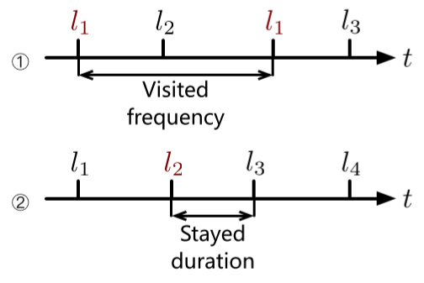
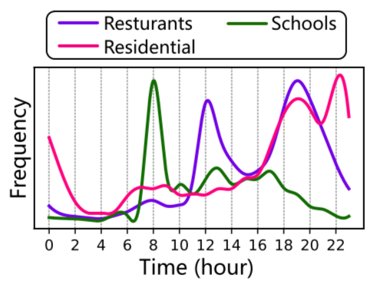
Pre-training Location Embeddings
Intro-duction
Basic idea of pre-training location embeddings
Borrowed from language modeling in NLP
Based on distributed word representations like word2vec^{[1]}
Temporal information
Relative visited time difference between locations: reflect visited frequency or stayed duration
Absolute visited time: reflect locations’ functionalities
Incorporated by multiple location embedding methods^{[2,3]}, yet rarely simultaneously considered
Relative visited time difference
Absolute visited time distributions

Slide 4
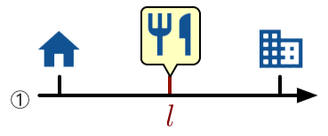
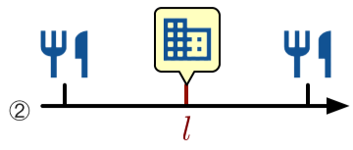
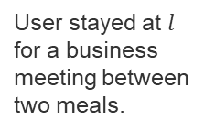
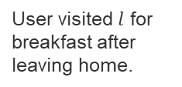
Pre-training Location Embeddings
Intro-duction
Multi-functionality of locations
People may visit the same location for different purposes in dissimilar contextual neighbors
Incorporate the specific context of a location into embedding methods can yield higher quality representations
Distributed representation-based methods mix a location’s various functionalities into one latent vector
User visited $l$ for breakfast after leaving home.
User stayed at $l$ for a business meeting between two meals.
Different functionalities of a location in dissimilar contextual neighbors

Slide 5
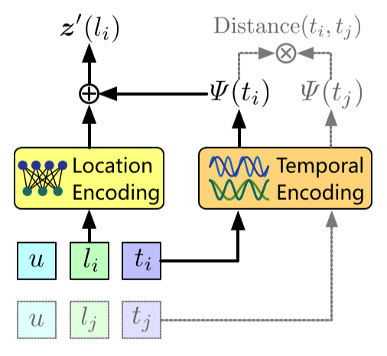
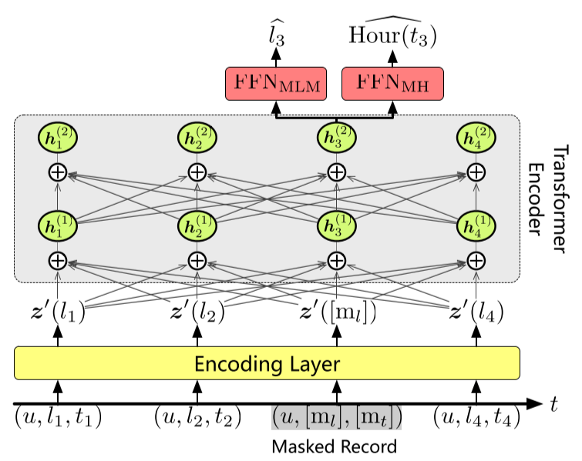
Overview of the Proposed Method
Intro-duction
Context and Time Aware Location Embedding (CTLE)
Calculate target location’s embedding by a mapping function of its contextual neighbors
Incorporate context-specific functionalities
Incorporate two aspects of temporal information
Further improve embedding quality
Encoding layer
Overall architecture

Slide 6
Embed Locations into Latent Vectors
Related Work
Necessity of location embedding
Feature-based models require locations begin represented by latent vectors
Fully-connected embedding layers
Randomly initialize one latent vector for each location
Trained with task-specific objectives
Hard to migrate to other models
Suffers from over-fitting when dealing with small-scale data

Slide 7
Pre-trained Location Embeddings
Related Work
Pre-trained latent representation
Trained with un-supervised or self-supervised objectives
Common practice in Language Process and Computer Vision
Pre-training location embeddings from trajectories
Akin to pre-training word embeddings from sentences
Model the co-occurrence of targets and contexts to extract functionality information
Sentence
The proposed method can incorporate temporal information …
The proposed method can fuse temporal information …
context
target
context
Trajectory
Beijing Jiaotong University$→$ Xi Zhi Men $→$ Peking University
Beijing Jiaotong University$→$Tian An Men$→$ Peking University
Similarity between sentences and trajectories

Slide 8
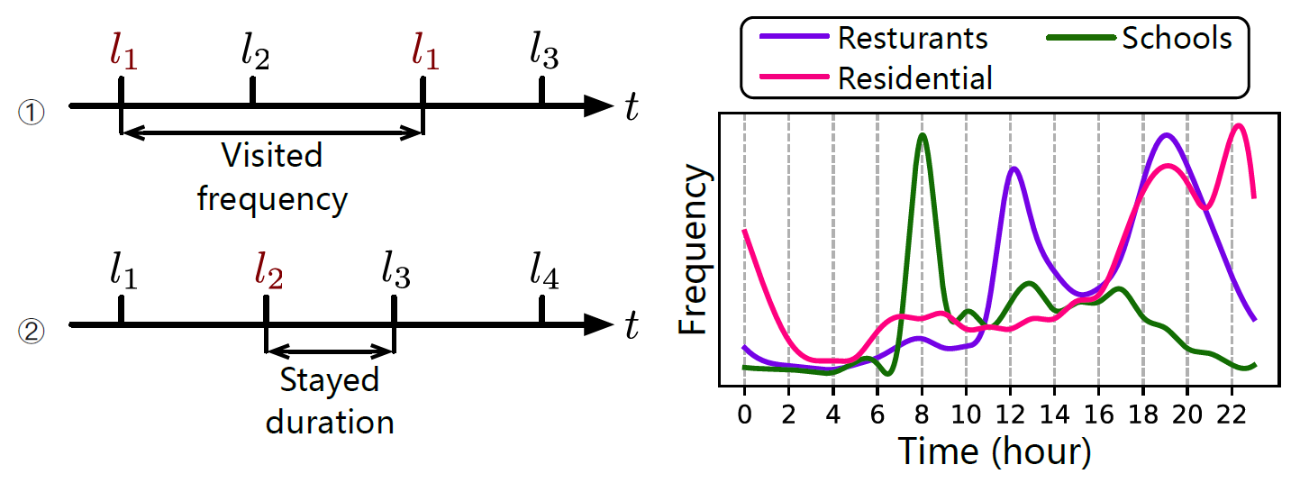
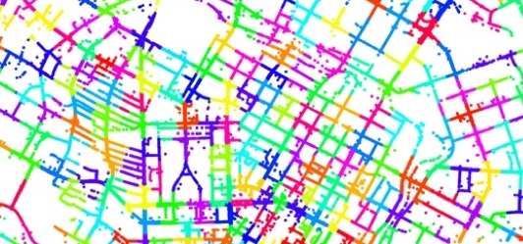
Uniqueness of Trajectories
Related Work
Temporal correlation
Extract more accurate characteristic information
(a)Relative time difference
(b)Absolute time distribution
Temporal information in trajectories
Spatial information in trajectories

Slide 9
Multi-functionality of Locations
Related Work
Multi-functional locations
Common in real-world
People’s one visit to a location is still single-purposed
Indicate the specific functionality through contexts
Inspiration from NLP
Tackle the problem ambiguity of words: contextual embedding
Migrate to location embedding: calculate representation vectors based on targets’ specific contextual neighbors
User visited $l$ for breakfast after leaving home.
User stayed at $l$ for a business meeting between two meals.
Different functionalities of a location in dissimilar contextual neighbors

Slide 10
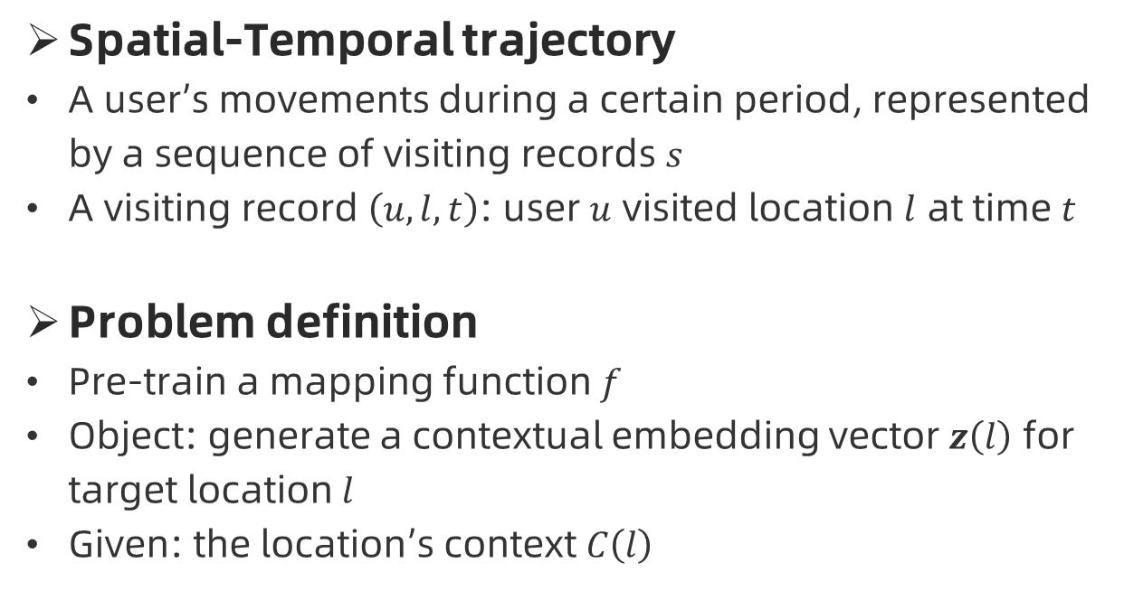
Preliminary Definitions
Method
Spatial-Temporal trajectory
A user’s movements during a certain period, represented by a sequence of visiting records $s$
A visiting record $\left(u,l,t\right)$: user $u$ visited location $l$ at time $t$
Problem definition
Pre-train a mapping function $f$
Object: generate a contextual embedding vector $z\left(l\right)$ for target location $l$
Given: the location’s context $C\left(l\right)$
A trajectory generated by user

Slide 11
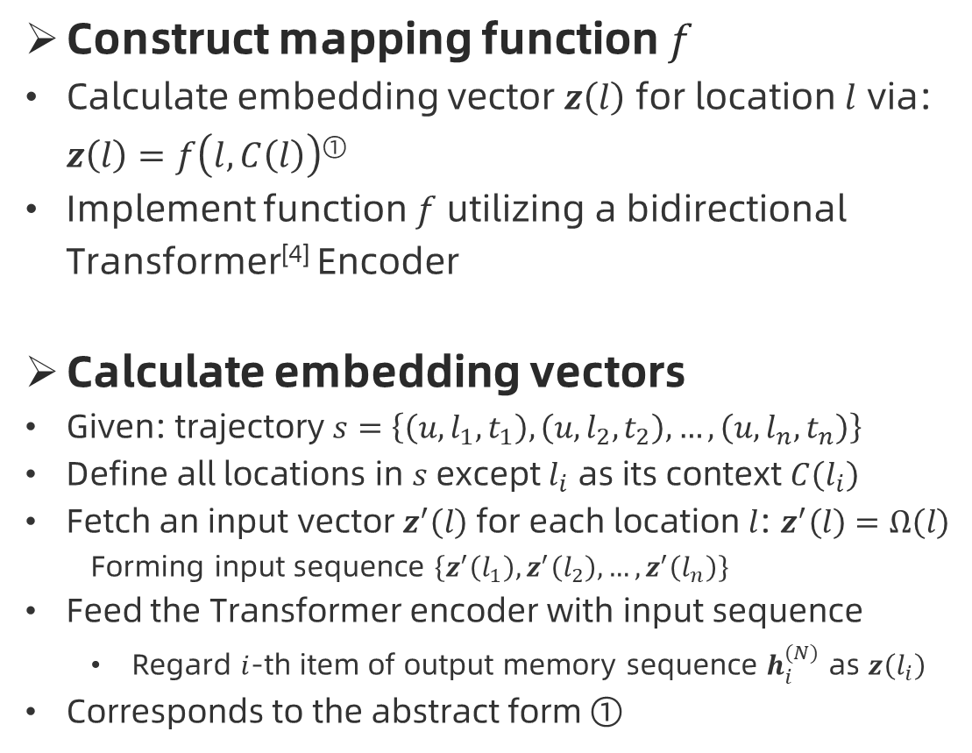
Context-aware Location Embedding
Method
Construct mapping function $f$
Calculate embedding vector $z\left(l\right)$ for location $l$ via: $z\left(l\right)=f\left(l, C\left(l\right)\right)$^{①}
Implement function $f$ utilizing a bidirectional Transformer^{[4]} Encoder
Calculate embedding vectors
Given: trajectory $s=\left\{\left(u,l_{1},t_{1}\right),\left(u,l_{2},t_{2}\right),…,\left(u,l_{n},t_{n}\right)\right\}$
Define all locations in $s$ except $l_{i}$ as its context $C\left(l_{i}\right)$
Fetch an input vector $z^{′}\left(l\right)$ for each location $l$: $z^{′}\left(l\right)=Ω\left(l\right)$
Forming input sequence $\left\{z^{′}\left(l_{1}\right),z^{′}\left(l_{2}\right),…,z^{′}\left(l_{n}\right)\right\}$
Feed the Transformer encoder with input sequence
Regard $i$-th item of output memory sequence $h_{i}^{(N)}$ as $z\left(l_{i}\right)$
Corresponds to the abstract form ①
Embedding vectors
Input sequence
Trajectory
Calculate embedding vectors

Slide 12
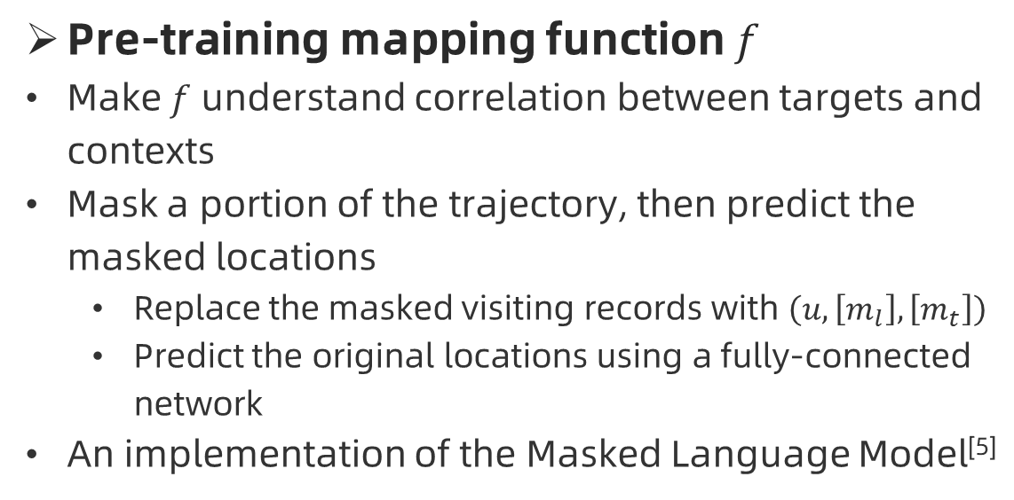
Context-aware Location Embedding
Method
Pre-training mapping function $f$
Make $f$ understand correlation between targets and contexts
Mask a portion of the trajectory, then predict the masked locations
Replace the masked visiting records with $\left(u,\left[m_{l}\right],\left[m_{t}\right]\right)$
Predict the original locations using a fully-connected network
An implementation of the Masked Language Model^{[5]}
Pre-train the model using MLM

Slide 13
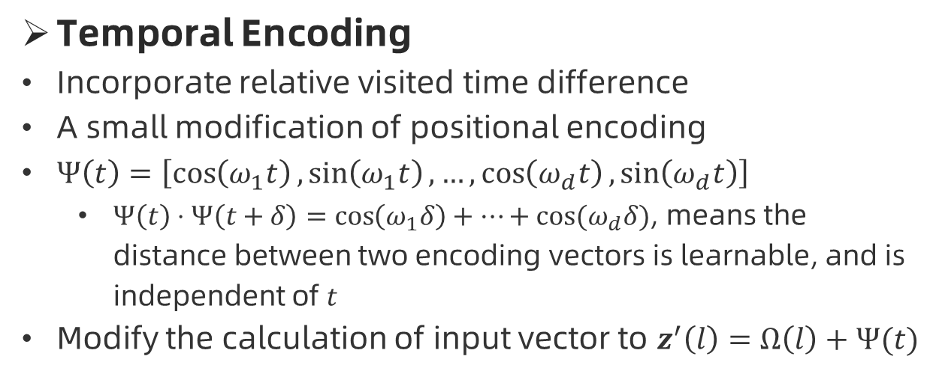
Incorporating Temporal Information
Method
Temporal Encoding
Incorporate relative visited time difference
A small modification of positional encoding
$Ψ\left(t\right)=\left[\cos\left(ω_{1}t\right),\sin\left(ω_{1}t\right),…,\cos\left(ω_{d}t\right),\sin\left(ω_{d}t\right)\right]$
$Ψ\left(t\right)⋅Ψ\left(t+δ\right)=\cos\left(ω_{1}δ\right)+…+\cos{(ω_{d}δ)}$, means the distance between two encoding vectors is learnable, and is independent of $t$
Modify the calculation of input vector to $z^{′}\left(l\right)=Ω\left(l\right)+Ψ(t)$
Encoding layer with temporal encoding

Slide 14
Incorporating Temporal Information
Method
Masked Hour Pre-training Objective
Incorporate absolute visited time
Predict the original visited hour index for a masked visiting record
Forms a multi-task learning objective with the prediction of location index
Pre-train the model with MLM and MH

Slide 15
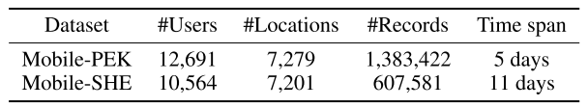
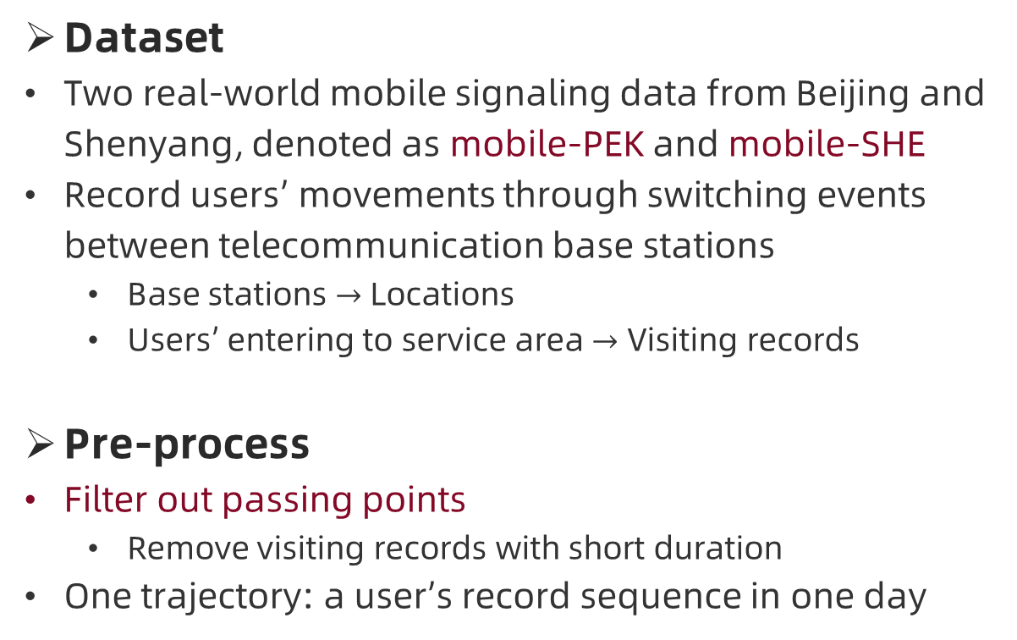
Dataset and Pre-process
Experiments
Dataset
Two real-world mobile signaling data from Beijing and Shenyang, denoted as mobile-PEK and mobile-SHE
Record users’ movements through switching events between telecommunication base stations
Base stations $→$ Locations
Users’ entering to service area $→$ Visiting records
Pre-process
Filter out passing points
Remove visiting records with short duration
One trajectory: a user’s record sequence in one day
Statistics of datasets

Slide 16
Baselines
Experiments
Baseline Location Embedding Methods
Two classic distributed embedding models and some state-of-the-art location embedding models
Downstream Prediction Models
User next location prediction models
Utilized for evaluating the effectiveness of embedding methods
Baselines | Pre-trained | Extra information
FC Layer | No | N/A
Skip-Gram | Yes | N/A
POI2Vec | Yes | Spatial
Geo-Teaser | Yes | Temporal + Spatial
TALE | Yes | Temporal
HIER | Yes | Temporal
Models | Based-on | Extra information
ST-RNN | RNN | Spatial and temporal intervals
ERPP | LSTM | Visited timestamp
ST-LSTM | LSTM | Spatial and temporal intervals

Slide 17
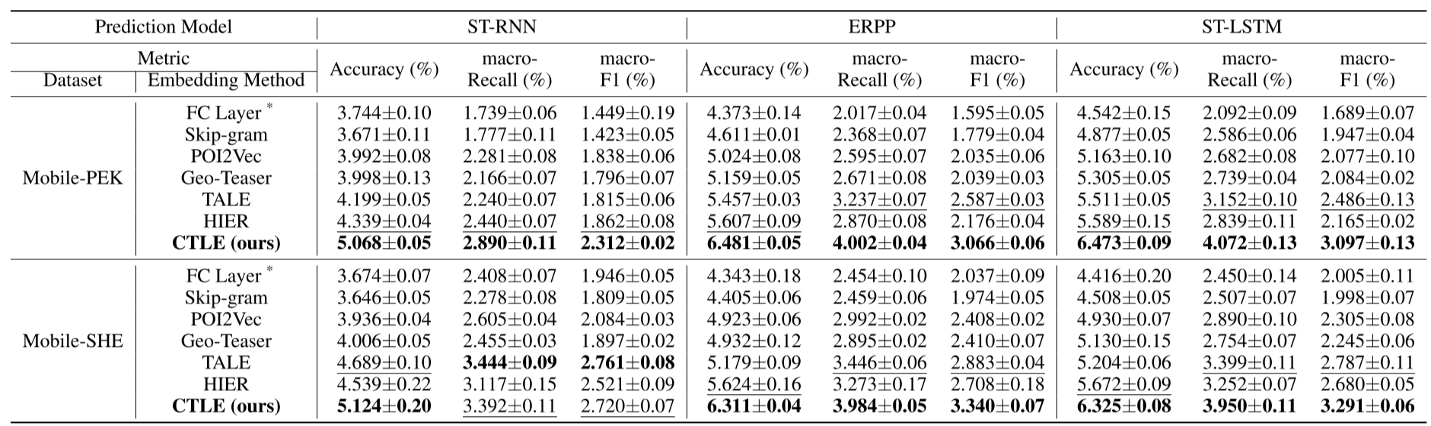
Results and Analysis
Experiments
Prediction performance comparison of different approaches
Incorporating temporal information can improve representational quality
Context-aware embedding can provide more accurate representation for multi-functional locations

Slide 18
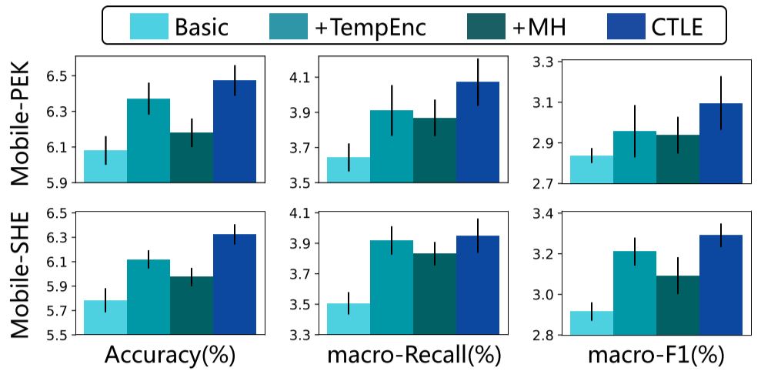
Results and Analysis
Experiments
Component analysis
Comparing our proposed method with three of its variants
Variants | Encoding | Pre-train objective
Basic | Positional Encoding | MLM
+TempEnc | Temporal Encoding | MLM
+MH | Positional Encoding | MLM+MH
CTLE | Temporal Encoding | MLM+MH
Component analysis results
Combine two aspects of temporal information can be beneficial

Slide 19
Future Works
End
How to more accurately model temporal information in absolute visited time distribution?
How to further incorporate spatial correlation?

Slide 20
Thank you for your time!
End

