Slide 1

Intro to Python
json
[1]

Slide 2
J.S.O.N.
JavaScript Object Notation.
A format for storing and exchanging data.
Always text (human-readable)
Widely used
A cross-platform tool

Slide 3
Ta Da
JSON data is a python dictionary

Slide 4
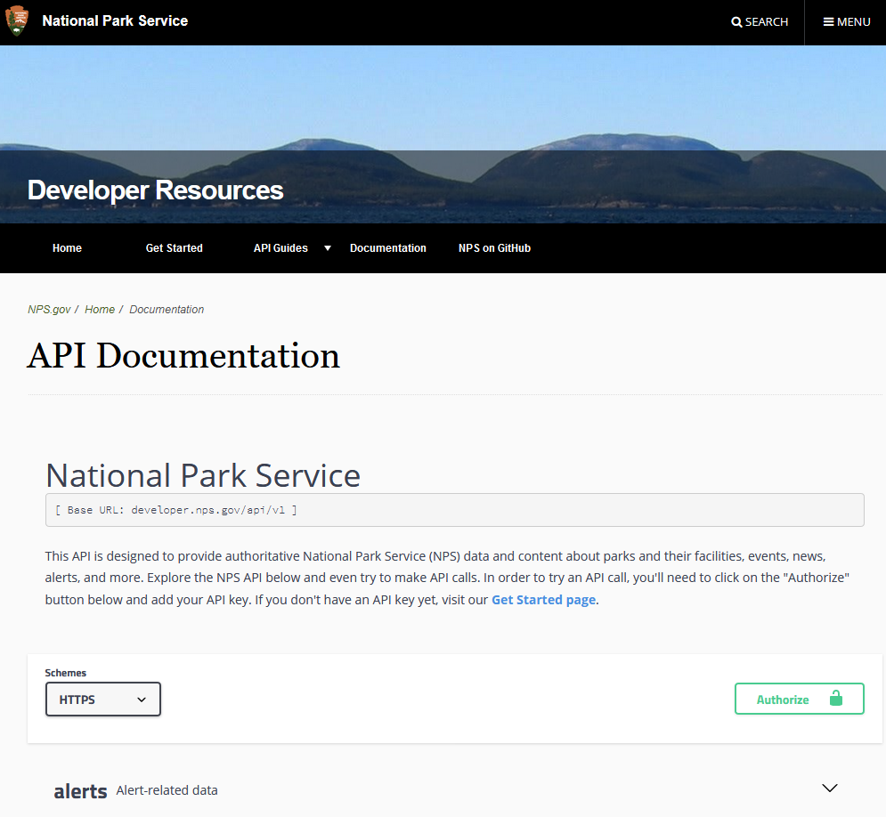
APIs may communicate in JSON
https://www.nps.gov/subjects/developer/api-documentation.htm#/alerts/getAlerts
https://developer.nps.gov/api/v1/alerts?parkCode=grsm&api_key=pfJKDXPzTykVL73ehnPyY8pkDQLjfq5cz5LqCkl3

Slide 5
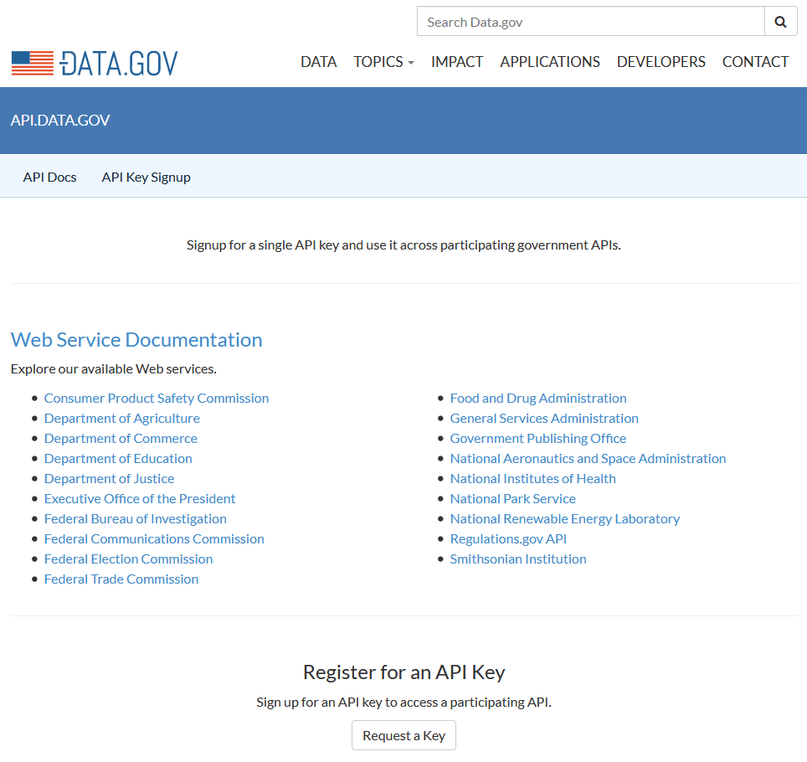
A World of Free APIs
https://api.data.gov

Slide 6
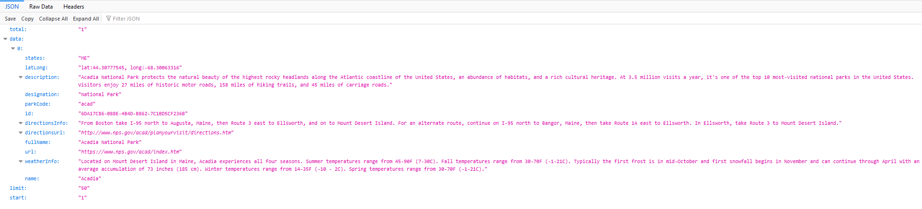
Browse to an API Endpoint
https://developer.nps.gov/api/v1/parks?parkCode=acad&api_key=pfJKDXPzTykVL73ehnPyY8pkDQLjfq5cz5LqCkl3
The code behind the page

Slide 7
Ask for info on 2 parks
https://developer.nps.gov/api/v1/parks?parkCode=acad,grsm&api_key=pfJKDXPzTykVL73ehnPyY8pkDQLjfq5cz5LqCkl3

Slide 8
Some Python that JSONs
response = requests.get('https://developer.nps.gov/api/v1/parks?parkCode=acad&api_key=pfJKDXPzTykVL73ehnPyY8pkDQLjfq5cz5LqCkl3')
json_string = response.content
parsed_json = json.loads(json_string) # Now we have a python dictionary
#print(parsed_json)
#print(parsed_json['data'][0]['description'])
#print(parsed_json['data'][0]['directionsInfo'])
total = int(parsed_json['total']) # The number of parks that were returned
for park in parsed_json['data']:
print (park)

Slide 9
References
[1] https://www.python.org/community/logos/

