Slide 1
Events Manager
Képiró Balázs

Slide 2
Overview
This webapp lets the user create, view and delete their events in a list
The user must be pre registered
The user must be logged in to access the events
Ai helpdesk is aveliable

Slide 3
Under the hood
The application’s frontend made in React typescript, with occasional bootstrap
The backend is purely laravel
The AI agent being used is QWEN3 hosted by Huggingface, accessed by POST requests over cURL
It is following a script in storage/app/private/Agent.txt
The application runs in docker, docker-compose.yml provided.

Slide 4
A deeper dive...
Frontend: React + Vite SPA for login, event list/create/delete
Backend: Laravel API with Sanctum tokens, event endpoints and a chat endpoint that calls Qwen3 hosted by Huggingface through a POST request, chat can also be handed over to a person.
Data: Users+Events in relational DB, supportchats are stored as JSON for simplicity

Slide 5
User Flow
On the main page the user either enters their email address password or chooses to the password in case they lost it. The forgot password button does not open a link, it re renders the login page.
After succesful login we land straight onto the main page. The user’s events are listed, below that they can add a new event. First the event title, then the date in DD/MM/YYYY format and time, in a 12 hour format
The backend enforces per-user ownership on all event operations, enabling multiuser usage.

Slide 6
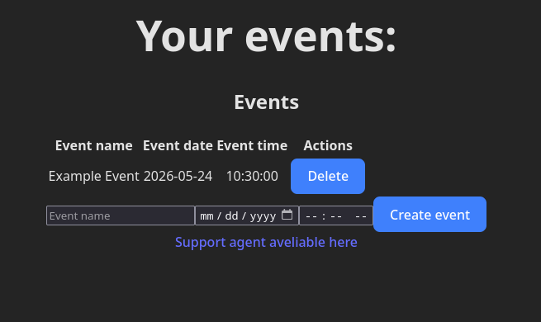
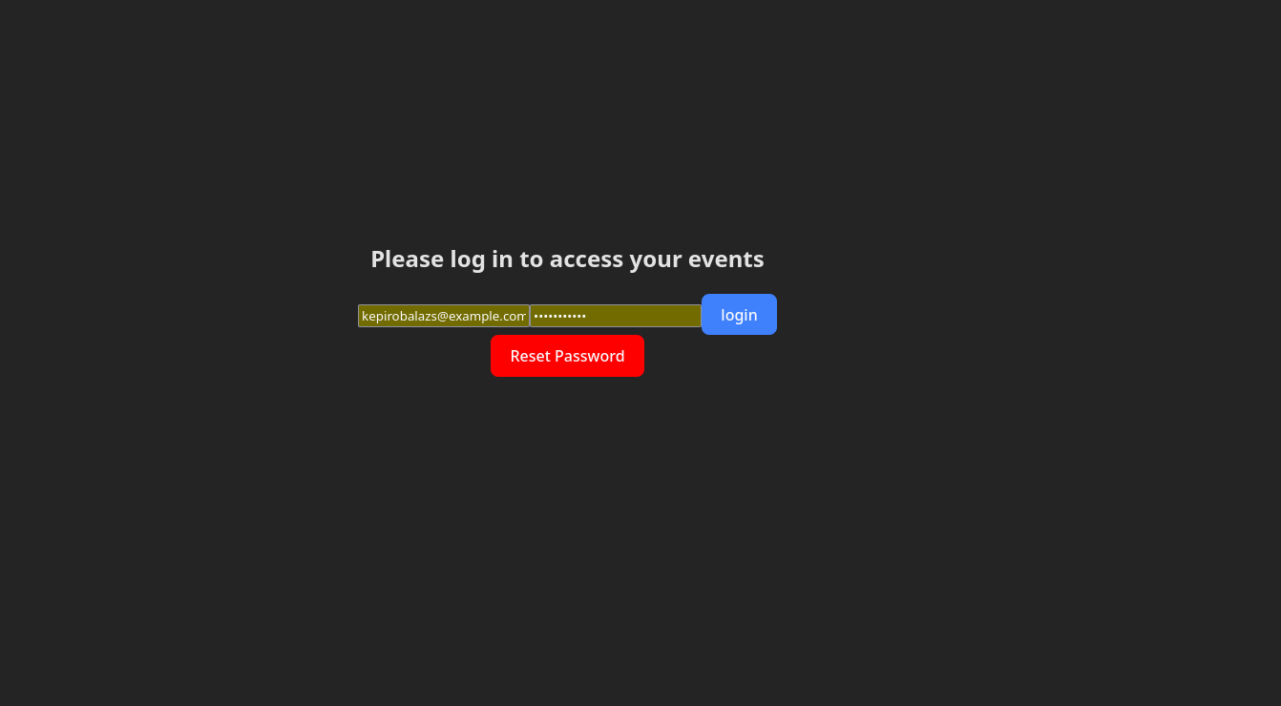
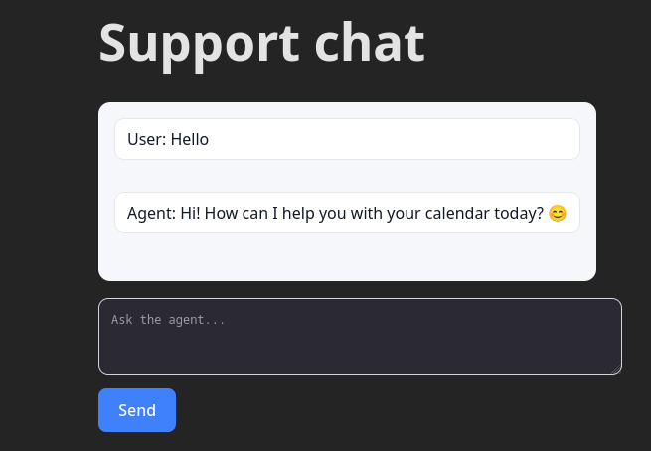
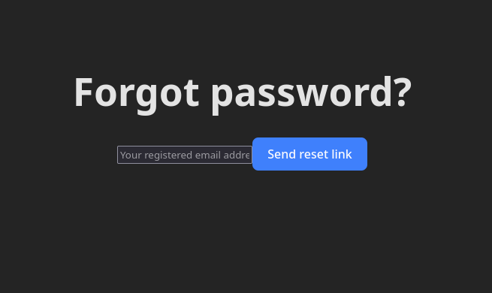

Slide 7
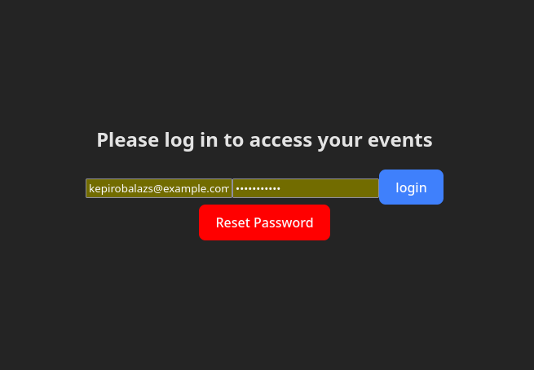

Slide 8
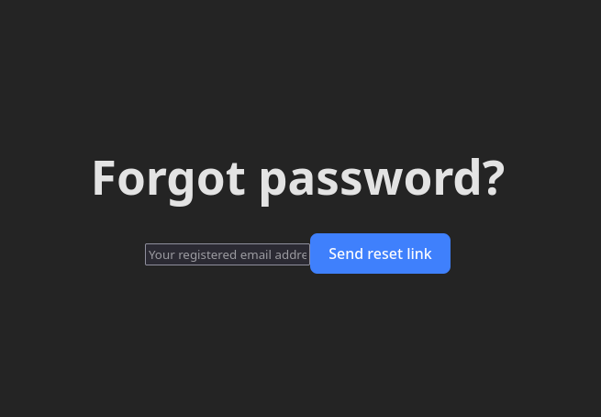

Slide 9
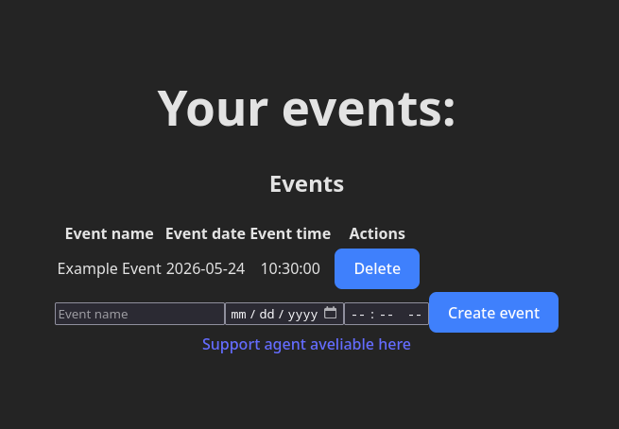

Slide 10
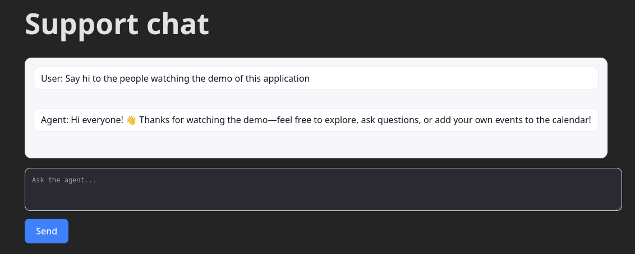

Slide 11
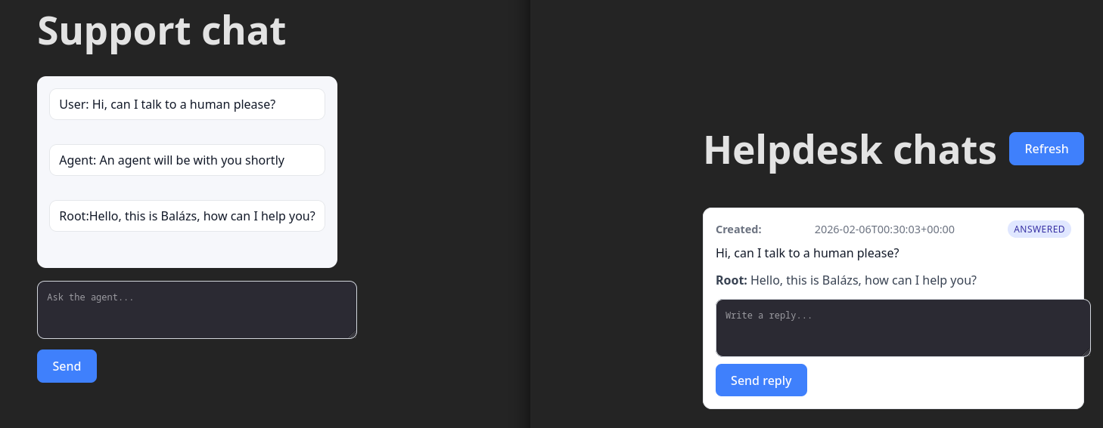
Hello, this is Balázs, how can I help you?

Slide 12
Why this approach?
Separation of user interaction and database related actions.
Token based Authentication keeps the API stateless and scalable
Chat handoff is intentionally lightweight to keep this demo simple, while still showing real operational flow
Bootstrap, to make UI design easier where alignment is required, and to make the webapp responsive
Despite being built for code Qwen3 was the best free LLM based on my tests

