Slide 1

Designing and Simulating a
Secure Tech Startup Network
VLAN Segmentation | DMZ | VPN Access
CS 7/5344 — Computer Networks & Distribution
Karrie Butcher • Camryn McPhaul • Daniel Opemipo Oni
Notes:
Camryn: Welcome to our presentation on designing and simulating a secure network for a modern tech startup. Our focus was on implementing three critical security pillars: VLAN segmentation, a DMZ, and robust VPN access.

Slide 2



Project Overview
This project designs and simulates a secure network for a tech startup using Cisco Packet Tracer. The architecture follows a three-tier model (core, distribution, access) with department-level VLAN segmentation, a DMZ for public-facing servers, and a VPN gateway for remote employees.
Three-Tier
Architecture
Defense in
Depth
Remote Access
Ready
Core, distribution, and access layers for scalable routing
Firewall, VLANs, ACLs, and port security at every layer
IPSec VPN gateway for secure off-site connectivity
Notes:
Camryn: The goal of this project was to design and simulate a secure network architecture using Cisco Packet Tracer. Our design is based on the industry-standard three-tier model, which provides a scalable foundation. Key security features include VLAN segmentation by department, a DMZ for public-facing assets, and an IPSec VPN gateway to support secure remote work.

Slide 3
Device Inventory
21 devices across 10 device types
Device Type | Qty | Role
Core Router | 1 | Central routing and backbone connectivity
L3 Distribution Switch | 2 | Inter-VLAN routing and ACL enforcement
L2 Access Switch | 3 | End devices in HR, Engineering, Finance
Firewall (ASA 5505) | 1 | Perimeter security between zones
VPN Gateway Router | 1 | Encrypted remote access
Web Server | 1 | Public website in DMZ
Email Server | 1 | Email service in DMZ
Department PCs | 9 | 3 per VLAN (HR, Eng, Finance)
Remote Laptop | 1 | Simulates remote VPN employee
Internet Cloud Node | 1 | External internet connection
Notes:
Camryn: We focused on three core principles. First, the Three-Tier Architecture uses core, distribution, and access layers for organized and scalable routing.
Second, we employed Defense in Depth, layering security with a firewall, VLANs, Access Control Lists, and port security at every layer.
Third, the network is Remote Access Ready with an IPSec VPN gateway for secure off-site connectivity.
In total, our simulation used 21 devices across 10 different device types.

Slide 4
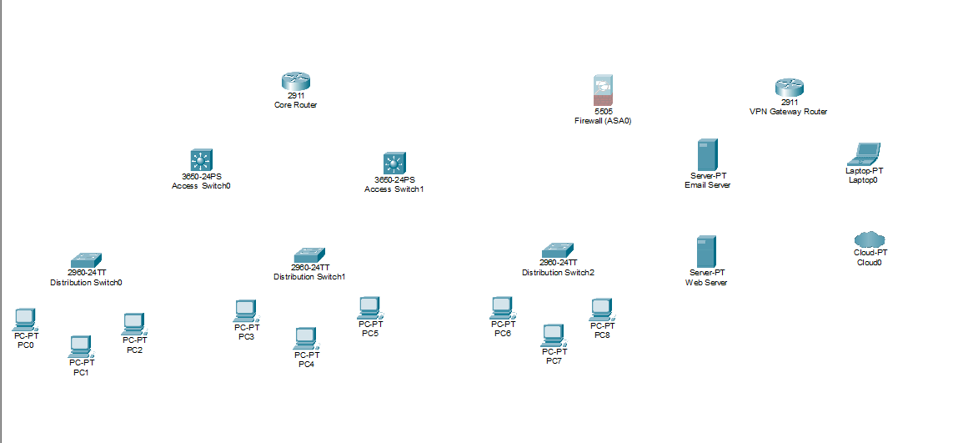
Network Topology
Cisco Packet Tracer — Initial Logical View
Notes:
Camryn: This slide shows our starting point—the initial device placement in Cisco Packet Tracer. This logical view simply illustrates the basic hardware components before any configuration or security policies were applied

Slide 5
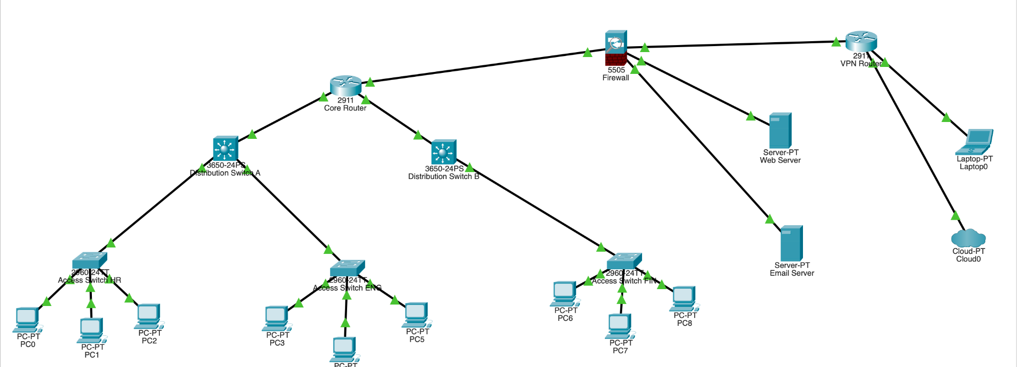
Network Topology
Cisco Packet Tracer — Final Logical View
Notes:
Karrie: Here is the final logical view of our network. You can visually see the segmentation and how our key areas—Core, Distribution, Access, and DMZ—are logically connected and secured according to our design.

Slide 6
Five Major Network Areas
1
Core Layer
2
Distribution Layer
3
Access Layer
Backbone connecting distribution switches for fast inter-segment traffic
Routes between VLANs and enforces inter-department policies
End-device connections across HR, Engineering, and Finance VLANs
4
DMZ
5
Remote Access
Isolated segment for web and email servers accessible from the internet
VPN gateway enabling encrypted connections for off-site employees
Notes:
Karrie: Our network is divided into five functional areas.
The Core Layer is the high-speed backbone connecting the distribution switches for fast inter-segment traffic.
The Distribution Layer handles routing between the different VLANs and is where inter-department policies are enforced.
The Access Layer is where end-devices connect for HR, Engineering, and Finance, separated by dedicated VLANs.
The DMZ is an isolated segment for public servers like the web and email server.
Finally, the Remote Access area uses the VPN gateway for encrypted connections from off-site employees.

Slide 7




Security Measures — Overview
Security is applied at every layer of the network, following a defense-in-depth strategy. Six measures work together to control access, isolate segments, and protect data in transit.
Perimeter Firewall
VLAN Segmentation
Access Control Lists
ASA 5505 — Stateful inspection
Isolated L2 broadcast domains
Whitelist inter-VLAN traffic
DMZ Architecture
VPN Gateway
Port Security
Isolated public-facing servers
IPSec encrypted remote access
Sticky MAC, port violation shutdown
Notes:
Karrie: Our entire design follows a defense-in-depth strategy, where security is applied at every layer.
These six measures work together to control access, isolate network segments, and ensure data is protected in transit. The key measures include a Perimeter Firewall, VLAN Segmentation, Access Control Lists, a strict DMZ Architecture, a VPN Gateway, and Port Security.

Slide 8
Firewall & VLAN Segmentation
Perimeter Firewall (ASA 5505)
VLAN Segmentation
Sits at the boundary between the internet, the DMZ, and the internal network
Performs stateful packet inspection — tracks active connections rather than evaluating packets in isolation
All traffic denied by default; only flows defined in the security policy are permitted
Distinguishes legitimate response traffic from unsolicited inbound probes
HR, Engineering, and Finance each placed on a separate VLAN
Creates isolated Layer 2 broadcast domains between departments
A compromised device in HR cannot directly reach Engineering or Finance at Layer 2
Cross-VLAN traffic must pass through the distribution layer where ACLs are enforced
Notes:
Daniel: Our Perimeter Firewall, an ASA 5505, sits between the internet, the DMZ, and the internal network. It performs stateful packet inspection, tracking active connections, and denies all traffic by default. We used VLAN Segmentation to place HR, Engineering, and Finance on separate Layer 2 broadcast domains. This means a compromised device in one department cannot directly reach devices in another; all cross-VLAN traffic must pass through security checkpoints.

Slide 9
ACLs & DMZ Architecture
Access Control Lists
DMZ Architecture
Applied on distribution-layer SVIs (Switch Virtual Interfaces)
Define a whitelist of permitted inter-VLAN traffic flows
Cross-department communication blocked by default
Functions as the internal equivalent of the perimeter firewall
Web server and email server isolated in a dedicated DMZ segment
Firewall enforces strict directional rules between zones
Inbound internet traffic reaches DMZ on designated ports only
DMZ servers cannot initiate connections into the internal network — a compromise stays contained
Notes:
Daniel: Access Control Lists are applied to the distribution-layer Switch Virtual Interfaces (SVIs).
They function as an internal firewall, defining a whitelist of permitted inter-VLAN traffic flows and blocking everything else by default.
In the DMZ Architecture, our public servers are isolated.
The firewall enforces strict directional rules: inbound internet traffic is limited to designated ports, and critically, DMZ servers cannot initiate connections into the secure internal network, ensuring containment if compromised.

Slide 10
VPN & Port Security
VPN Gateway
Port Security
All remote connections encrypted using IPSec
Authentication required before any internal access is granted
Prevents interception of remote employee traffic in transit
Only authorized users can establish connections to internal resources
Configured on all access-layer switch ports
Sticky MAC address learning — only the first connected device is permitted
Unknown MAC addresses trigger a port violation
Violating port is shut down until an administrator reviews it
Notes:
Daniel: The VPN Gateway encrypts all remote connections using IPSec, preventing interception of employee traffic in transit.
Authentication is required before any access to internal resources is granted.
Port Security is configured on all access-layer ports using sticky MAC address learning.
If an unknown MAC address connects, it triggers a port violation, and the port is immediately shut down until an administrator can review the incident.

Slide 11

Workload Distribution
Karrie Butcher
Project topic selection, motivation write-up, overall project plan, report compilation, and video presentation introduction, video demo
Camryn McPhaul
Device type and quantity documentation, Packet Tracer initial device placement and topology setup, and video presentation, report compilation
Daniel Opemipo Oni
Number of major areas documentation, security measures write-up, VLAN and ACL design planning, and video security section
Notes:
We want to briefly acknowledge the division of work on this project.
Karrie: I handled the project planning, report compilation, and the video introduction, simulation, and demo.
Camryn: I documented the device inventory, set up the initial topology in Packet Tracer, and contributed to the presentation and report.
Daniel: I documented the network areas, wrote the security measures, and planned the VLAN and ACL designs.

Slide 12
Conclusion
This project demonstrates how a tech startup can implement a secure, scalable, and well-organized network using industry-standard design principles. VLAN segmentation, a DMZ for public servers, ACLs at the distribution layer, and encrypted VPN access work together to address the most common attack vectors a startup would face.
Simulating in Cisco Packet Tracer allowed the team to validate every design decision before committing to real hardware — reinforcing the importance of planning security from the ground up.
Questions?
CS 7/5344 — Spring 2026
Notes:
Daniel: In summary, this project successfully demonstrated how a tech startup can build a secure, scalable, and well-organized network. By combining VLAN segmentation, a DMZ, ACLs, and encrypted VPN access, we addressed the most common attack vectors a startup faces. Simulating the network in Cisco Packet Tracer was essential, allowing us to validate every design decision and reinforcing the critical need to plan security from the ground up. Thank you for your time.

