Slide 1

Mealforge
Nutrition-based Meal Prep Application
Logan Dawes

Slide 2
Problem Statement
It can be a challenge for people who are conscious about health and nutrition to find recipes in a simple and easy way.
Recipe websites are often filled with unnecessary content that doesn’t help the user. Research is usually needed to validate it fits the user’s diet and allergies.
The people affected are people who care about their personal diet or want to find recipes that avoid certain allergies.
It is very important that these people make a living by finding recipes that are accessible to them.

Slide 3
Motivation & Objectives
I chose this problem specifically because it is a relevant problem in my life. I do not have any complicated allergies that make it difficult for me to find recipes, but as someone who is getting more into cooking, I wanted to learn more about the nutritional details that go into every ingredient.
Goals:
Make an application that has a wide assortment of ingredients and recipes with nutritional details.
Implement features that allow to user to save ingredients and recipes to reference later or use to guide further searching.
Include details and features without overcomplicating the experience.

Slide 4
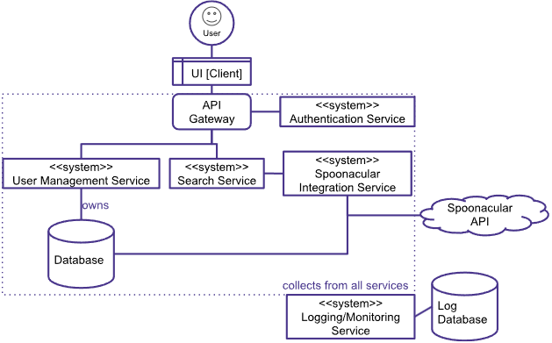
System Architecture
Microservices Architecture
Major Components:
Frontend UI
API Gateway
User Management Service
Authentication Service
Search Service
Integration Service
Databases
Third-party APIs
Data Flow:
User interacts with UI > API Gateway routes request to service > Service fulfills request > API Gateway returns response to the frontend

Slide 5
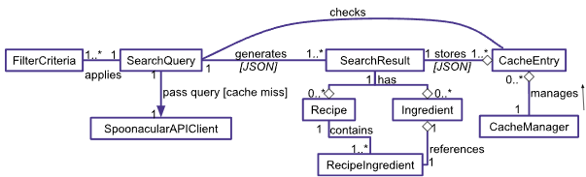
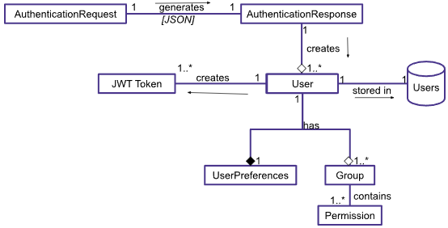
System Modelling & Design
Searching Diagram
Design Choices:
Microservices design meant I made an app designed to pass JSON data between small apps (services). This means the design is based off API communication between apps
Made with Google Docs
Authentication & User Diagram

Slide 6
Functional Requirements
User Management
The system shall allow Users to sign up to create their own account, with unique identifying information.
Users shall be able to log in, log out, and switch accounts.
The system shall securely store passwords using encryption.
Users shall be able to customize their preferences including name, diet, intolerances, calories, and nutrients.
The system shall validate the user’s email and password format before creating an account.
Users shall be able to recover their password with a password recovery method.
The system shall allow administrators to manage registered users and not reveal their password.
Recipe Management
Each recipe shall include breakdown of dietary groups, nutrients, calories, intolerances, and other health benefits.
Each recipe shall provide a link to the original recipe page.
Users shall be able to search for recipes by name, category, and/or tag.
The system’s recipe search functionality shall be sortable and filterable based on diet, intolerances, calories, and nutritional value.
Each ingredient shall have a link provided to the ingredient’s information page.
Users shall be able to save recipes on their personal recipe book.
Ingredient Management
Each ingredient shall include breakdown of dietary groups, nutrients, calories, intolerances, and other health benefits.
Users shall be able to search for ingredients by name, category, and/or tag.
The system’s ingredient search functionality shall be sortable and filterable based on diet, intolerances, calories, and nutritional value.
The system shall dynamically update the recipe list based on available ingredients.
Users shall be able to add ingredients to their personal collection of ingredients for use in recipes.
Personalization
The system shall implement a search algorithm that reflects the user’s preferences.
The system shall provide personalized health benefits for each recipe based on the user’s preferences.

Slide 7
Non-Functional Requirements
Scalability
The system shall allow new features and modules to integrate easily.
The system shall have proper API integration for ingredients and recipes.
The system’s database shall be able to expand without degradation of performance.
Security
User data shall be secure and stored with encryption.
The system shall prevent unauthorized access through multiple protocols.
The system shall properly audit user activity.
The system shall provide multi-factor authentication options.
Maintainability
The system shall include proper documentation of the system and code provided to simplify development.
The system shall incorporate a modular, microservices design to ensure quick updating of features.
The system shall support version control to track updates in the application.
Reliability
The system shall have proper error handling and provide easy debugging.
The system shall have constant up time, and any downtime shall be communicated to users.
The system shall save and keep track of the user’s input data across instances.
Performance
The system shall respond to queries in less than 2 seconds.
The system shall handle 1,000 concurrent users and sudden spikes in activity.
Usability
The system’s UI shall be adaptable to multiple screen resolutions and can open on a mobile device.
The system’s UI shall allow any key action to be performed within 3 clicks.
The system shall include clear contrast of color and formatting to indicate nutritional aspects.

Slide 8
Implementation Highlights
Frontend: React.js – for dynamic and responsive UI, with reusable components.
Backend: Django – for high-level Python framework with built-in authentication and database management features.
Django REST API used for microservices architecture: passing JSON requests between apps.
Spoonacular API: third-party database of ingredients, recipes, and more with nutritional facts from the USDA database.
Other technologies: MySQL database on Microsoft Azure, Docker containerization, Postman, VSCode, GitHub
Challenges:
Translating a microservices architecture to Django required research into REST API, and learning how these requests are handled between each app.
Connecting these services to a cloud database required some research into how Django apps manage a database connection with environment variables.
Connecting the services to the frontend required some research into NGINX, a reverse proxy to route the requests, and Axios, a React library used to make API calls.

Slide 9
Demonstration Video:

Slide 10
Planned Features NYI:
Intolerances reflected in ingredients and recipes, ability to filter ingredients by diet.
Full email authentication via emailing the user. Used for password recovery & MFA.
Display cost on ingredients & recipes.
“Health benefits”: section of nutrition that gets info based on USDA description.
SSL Database connection.
Deployment platform, domain name, API subscription (Not done because of cost)
Future Work:
Grocery products page: sorting based on location, price, etc. Integrate with recipes for price breakdown.
Restaurants page: also based on location. Would be a great source of nutritional content on menu items.
User-defined recipes.
Print button for all relevant tabs.
Mobile App (Flutter / React Native)

Slide 11
Summary
The base functionality of the app solves the problem of making recipe searching easy, without removing complexity of the recipe.
The application has a microservices architecture, which makes scalability an easier task. The addition of modules doesn’t require heavy modification of existing code.
Coded in Python and JavaScript using relevant frameworks and libraries.
In development, to overcome challenges I learned a lot about REST APIs, Cloud database connection, and containerizing an app using Docker.
For further development, fixing some key issues such as ingredient filters would make the app a much better experience.
The scalability of the app makes adding sections such as grocery/restaurant products much quicker.

Slide 12
Any Questions?

