Slide 1
SECURING BIG DATA IN HADOOP
WORKSHOP https://github.com/chicolinux/dc26
BY MIKE GUIRAO
@miguelguirao

Slide 2

SO… WHAT IS APACHE HADOOP?
The Apache Hadoop software library is a framework that allows for the distributed processing of large data sets across clusters of computers using simple programming models.

Slide 3
Apache Hadoop
The project includes these modules:
Hadoop Common: The common utilities that support the other Hadoop modules.
Hadoop Distributed File System (HDFS™): A distributed file system that provides high-throughput access to application data.
Hadoop YARN: A framework for job scheduling and cluster resource management.
Hadoop MapReduce: A YARN-based system for parallel processing of large data sets.

Slide 4
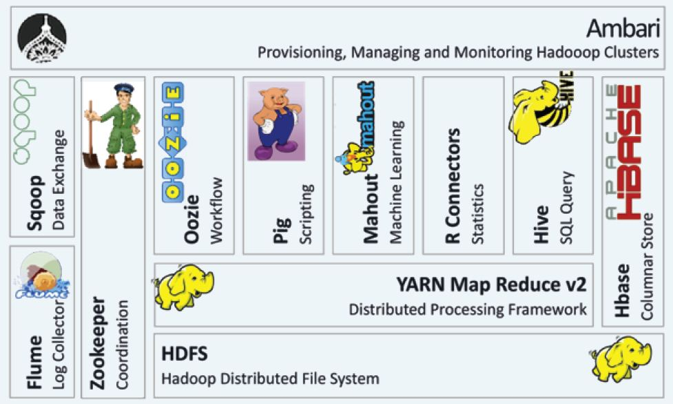
Apache Hadoop ecosystem

Slide 5
ARE YOU ALL SETUP
AND READY TO GO?
30 MIN

Slide 6

What is kerberos?
Kerberos is a network authentication protocol. It is designed to provide strong authentication for client/server applications by using secret-key cryptography.
The Kerberos protocol uses strong cryptography so that a client can prove its identity to a server (and vice versa) across an insecure network connection.
After a client and server has used Kerberos to prove their identity, they can also encrypt all of their communications to assure privacy and data integrity as they go about their business.

Slide 7
Kerberos related terms
PRINCIPAL. A server or client to which Kerberos can assign tickets.
AUTHENTICATION SERVER (AS). A server that gives authorizes the principal and connects them to the Ticket Granting Server (TGS).
TICKET GRANTING SERVER (TGS). A server that provides tickets.
KEY DISTRIBUTION CENTER (KDC). A server that provides the initial ticket and handles TGS requests; often runs both AS and TGS services.
TICKET GRANTING TICKET (TGT). The ticket that is granted during the authentication process.
TICKET. Used to authenticate to the server; contains client identity, sesión key, timestamp, and checksum and is encripted with server’s key.
SESSION KEY. Temporary encryption key.

Slide 8
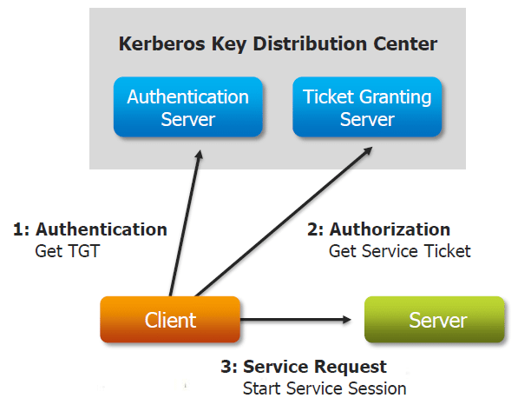
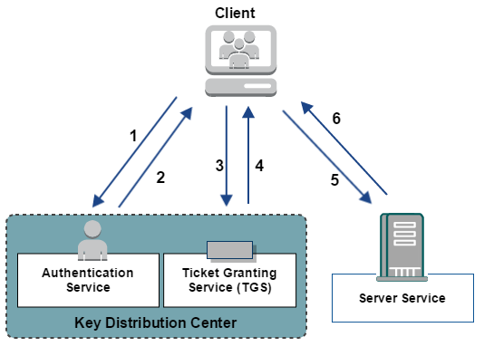
Kerberos components
Database Principals

Slide 9

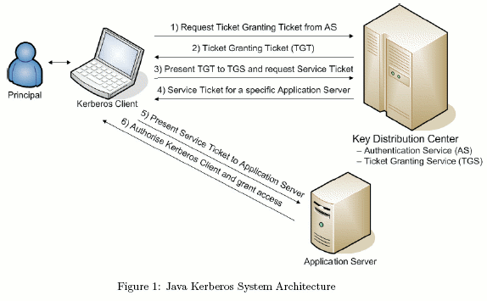
How does it work?

Slide 10
KERBEROS
Establishing user identity with strong authentication is the basis for secure access in Hadoop.
  But why?
  Users
  Services
Users need to reliably identify themselves and then have that identity propagated throughout the Hadoop cluster to access cluster resources.
  Why is this necessary?

Slide 11
KERBEROS
Because cluster resources (hosts or services) cannot provide a password each time to decrypt the TGT, they use a special file, called a keytab , which contains the resource principal's authentication credentials.
The set of hosts, users, and services over which the Kerberos server has control is called a realm.
Each service and sub-service in Hadoop must have its own principal.
A principal name in a given realm consists of a primary name and an instance name, in this case the instance name is the FQDN of the host that runs that service.

Slide 12
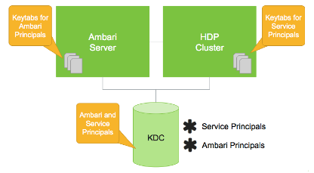
KERBEROS
Asset | Convention | Example
Principals | $service_component_name/$FQDN@EXAMPLE.COM | nn/c6401.ambari.apache.org@EXAMPLE.COM
Keytabs | $service_component_abbreviation.service.keytab | /etc/security/keytabs/nn.service.keytab

Slide 13
KERBEROS LAB
60 MIN

Slide 14

Apache Ambari
The Apache Ambari project is aimed at making Hadoop management simpler by developing software for:
provisioning,
managing, and
monitoring Apache Hadoop clusters.
Ambari provides an intuitive, easy-to-use Hadoop management web UI backed by its RESTful APIs.

Slide 15
AMBARI LAB
30 MIN

Slide 16

APACHE KNOX
The Apache Knox™ Gateway is an Application Gateway for interacting with the REST APIs and UIs of Apache Hadoop deployments.
The Knox Gateway provides a single access point for all REST and HTTP interactions with Apache Hadoop clusters.

Slide 17
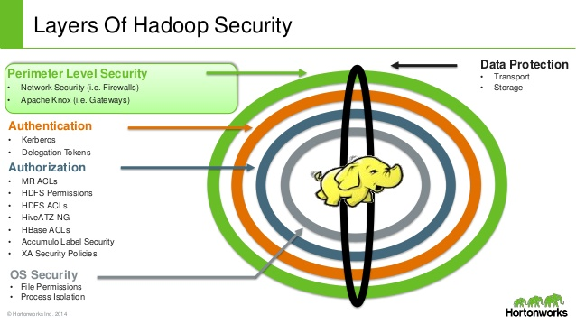

Slide 18
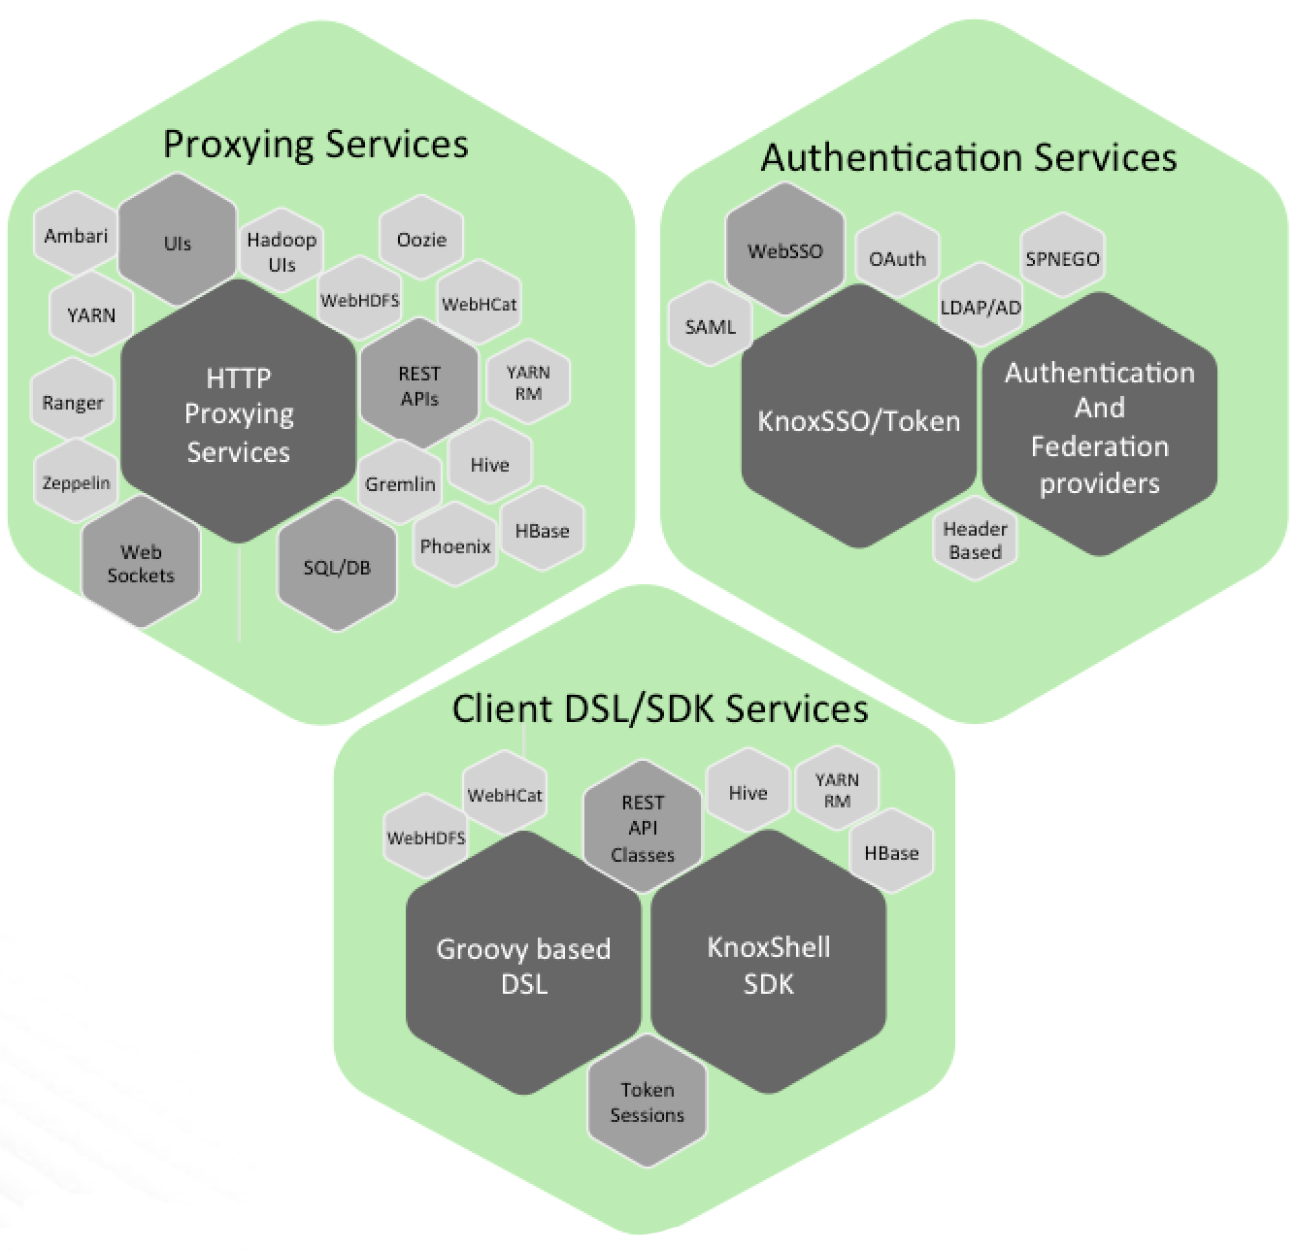
Knox delivers three groups of user facing services:

Slide 19
Supported Apache Hadoop Services
Ambari
WebHDFS (HDFS)
Yarn RM
Stargate (Apache HBase)
Apache Oozie
Apache Hive/JDBC
Apache Hive WebHCat (Templeton)
Apache Storm
Apache Tinkerpop - Gremlin
Apache Avatica/Phoenix
Apache SOLR
Apache Livy (Spark REST Service)
Kafka REST Proxy

Slide 20
Supported Apache Hadoop ecosystem UIs
Name Node UI
Job History UI
Yarn UI
Apache Oozie UI
Apache HBase UI
Apache Spark UI
Apache Ambari UI
Apache Ranger Admin Console
Apache Zeppelin
Apache NiFi

Slide 21
goals of the gateway:
Provide perimeter security for Hadoop REST APIs to make Hadoop security easier to setup and use
  Provide authentication and token verification at the perimeter
  Enable authentication integration with enterprise and cloud identity management systems
  Provide service level authorization at the perimeter
Expose a single URL hierarchy that aggregates REST APIs of a Hadoop cluster
  Limit the network endpoints (and therefore firewall holes) required to access a Hadoop cluster
  Hide the internal Hadoop cluster topology from potential attackers

Slide 22
goals of the gateway:
Knox Gateways provides security for multiple Hadoop clusters, with these advantages:
Simplifies access: Extends Hadoop’s REST/HTTP services by encapsulating Kerberos to within the Cluster.
Enhances security: Exposes Hadoop’s REST/HTTP services without revealing network details, providing SSL out of the box.
Centralized control: Enforces REST API security centrally, routing requests to multiple Hadoop clusters.
Enterprise integration: Supports LDAP, Active Directory, SSO, SAML and other authentication systems.

Slide 23
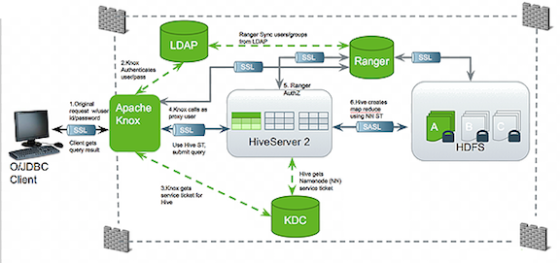
goals of the gateway:

Slide 24
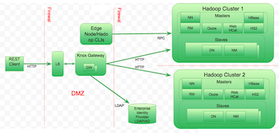
goals of the gateway:
Users who access Hadoop externally do so either through Knox, via the Apache REST API, or through the Hadoop CLI tools.

Slide 25

Apache ranger
Apache Ranger™ is a framework to enable, monitor and manage comprehensive data security across the Hadoop platform.
The vision with Ranger is to provide comprehensive security across the Apache Hadoop ecosystem.

Slide 26
Apache ranger goals overview
Centralized security administration to manage all security related tasks in a central UI or using REST APIs.
Fine grained authorization to do a specific action and/or operation with Hadoop component/tool and managed through a central administration tool
Standardize authorization method across all Hadoop components.
Enhanced support for different authorization methods - Role based access control, attribute based access control etc.
Centralize auditing of user access and administrative actions (security related) within all the components of Hadoop.

Slide 27
references
http://www.roguelynn.com/words/explain-like-im-5-kerberos/

