Slide 1
SECURING BIG DATA IN HADOOP WORKSHOP https://github.com/chicolinux/dc26
BY MIKE GUIRAO
@miguelguirao

Slide 2

SO… WHAT IS APACHE HADOOP?
The Apache Hadoop software library is a framework that allows for the distributed processing of large data sets across clusters of computers using simple programming models.

Slide 3
Apache Hadoop
The project includes these modules:
Hadoop Common: The common utilities that support the other Hadoop modules.
Hadoop Distributed File System (HDFS™): A distributed file system that provides high-throughput access to application data.
Hadoop YARN: A framework for job scheduling and cluster resource management.
Hadoop MapReduce: A YARN-based system for parallel processing of large data sets.

Slide 4
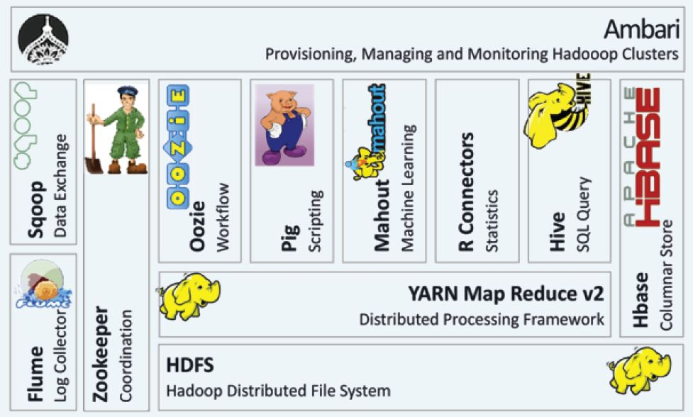
Apache Hadoop ecosystem

Slide 5
ARE YOU ALL SETUP AND READY TO GO?
30 MIN

Slide 6

Apache Ambari
The Apache Ambari project is aimed at making Hadoop management simpler by developing software for:
provisioning,
managing, and
monitoring Apache Hadoop clusters.
Ambari provides an intuitive, easy-to-use Hadoop management web UI backed by its RESTful APIs.

Slide 7
AMBARI LAB
30 MIN

Slide 8

APACHE KNOX
The Apache Knox™ Gateway is an Application Gateway for interacting with the REST APIs and UIs of Apache Hadoop deployments.
The Knox Gateway provides a single access point for all REST and HTTP interactions with Apache Hadoop clusters.

Slide 9
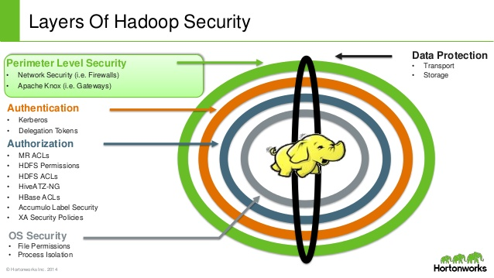

Slide 10
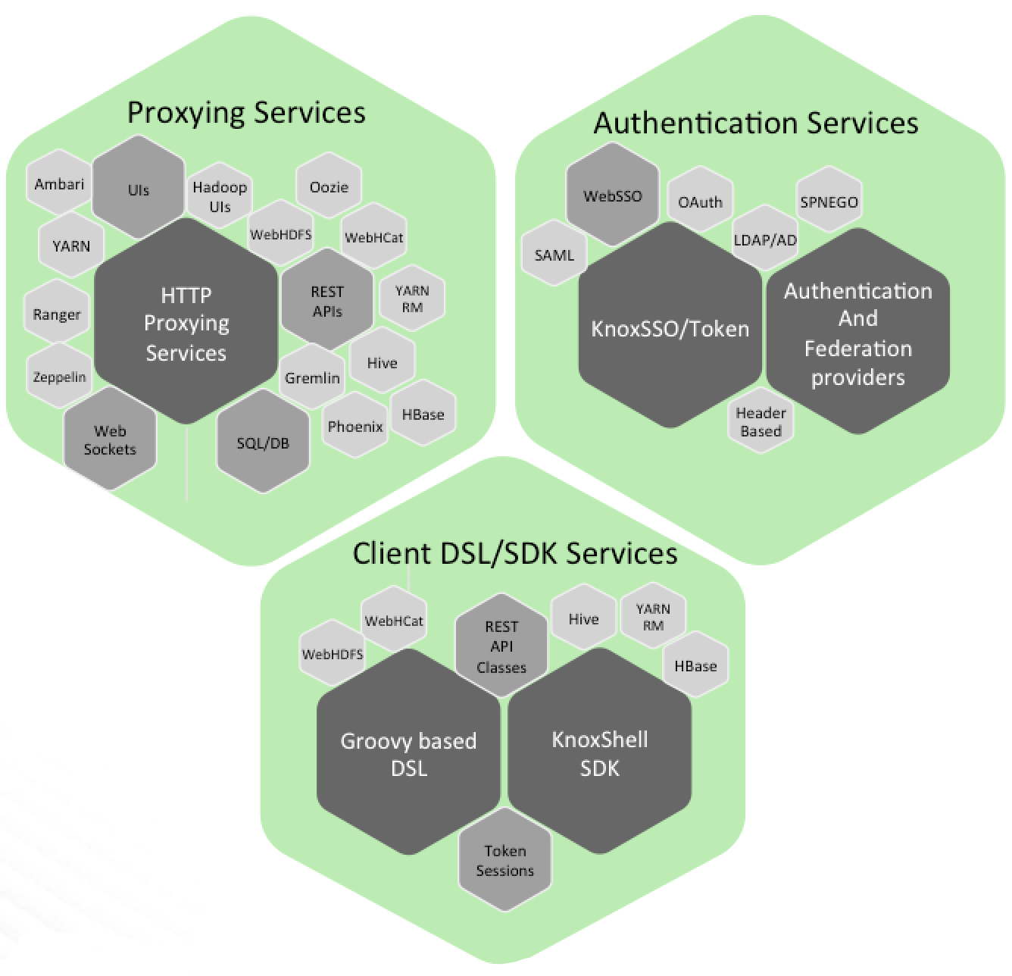
Knox delivers three groups of user facing services:

Slide 11
Supported Apache Hadoop Services
Ambari
WebHDFS (HDFS)
Yarn RM
Stargate (Apache HBase)
Apache Oozie
Apache Hive/JDBC
Apache Hive WebHCat (Templeton)
Apache Storm
Apache Tinkerpop - Gremlin
Apache Avatica/Phoenix
Apache SOLR
Apache Livy (Spark REST Service)
Kafka REST Proxy

Slide 12
Supported Apache Hadoop ecosystem UIs
Name Node UI
Job History UI
Yarn UI
Apache Oozie UI
Apache HBase UI
Apache Spark UI
Apache Ambari UI
Apache Ranger Admin Console
Apache Zeppelin
Apache NiFi

Slide 13
goals of the gateway:
Provide perimeter security for Hadoop REST APIs to make Hadoop security easier to setup and use
Provide authentication and token verification at the perimeter
Enable authentication integration with enterprise and cloud identity management systems
Provide service level authorization at the perimeter
Expose a single URL hierarchy that aggregates REST APIs of a Hadoop cluster
Limit the network endpoints (and therefore firewall holes) required to access a Hadoop cluster
Hide the internal Hadoop cluster topology from potential attackers

Slide 14
APACHE KNOX LAB
60 MIN

Slide 15

Apache ranger
Apache Ranger™ is a framework to enable, monitor and manage comprehensive data security across the Hadoop platform.
The vision with Ranger is to provide comprehensive security across the Apache Hadoop ecosystem.

Slide 16
Apache ranger goals overview
Centralized security administration to manage all security related tasks in a central UI or using REST APIs.
Fine grained authorization to do a specific action and/or operation with Hadoop component/tool and managed through a central administration tool
Standardize authorization method across all Hadoop components.
Enhanced support for different authorization methods - Role based access control, attribute based access control etc.
Centralize auditing of user access and administrative actions (security related) within all the components of Hadoop.

Slide 17
APACHE RANGER LAB
60 MIN

Slide 18

What is kerberos?
Kerberos is a network authentication protocol. It is designed to provide strong authentication for client/server applications by using secret-key cryptography.
The Kerberos protocol uses strong cryptography so that a client can prove its identity to a server (and vice versa) across an insecure network connection.
After a client and server has used Kerberos to prove their identity, they can also encrypt all of their communications to assure privacy and data integrity as they go about their business.

Slide 19

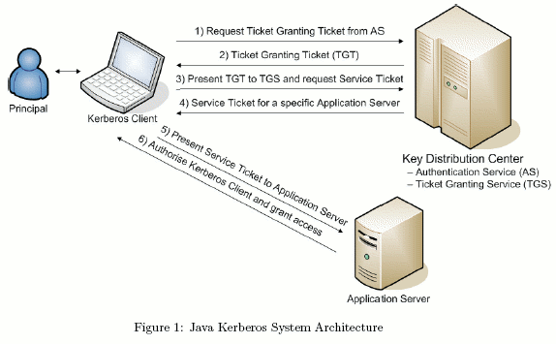
How does it work?

Slide 20
Kerberos related terms
PRINCIPAL. A server or client to which Kerberos can assign tickets.
AUTHENTICATION SERVER (AS). A server that gives authorizes the principal and connects them to the Ticket Granting Server (TGS).
TICKET GRANTING SERVER (TGS). A server that provides tickets.
KEY DISTRIBUTION CENTER (KDC). A server that provides the initial ticket and handles TGS requests; often runs both AS and TGS services.
TICKET GRANTING TICKET (TGT). The ticket that is granted during the authentication process.
TICKET. Used to authenticate to the server; contains client identity, sesión key, timestamp, and checksum and is encripted with server’s key.
SESSION KEY. Temporary encryption key.

Slide 21
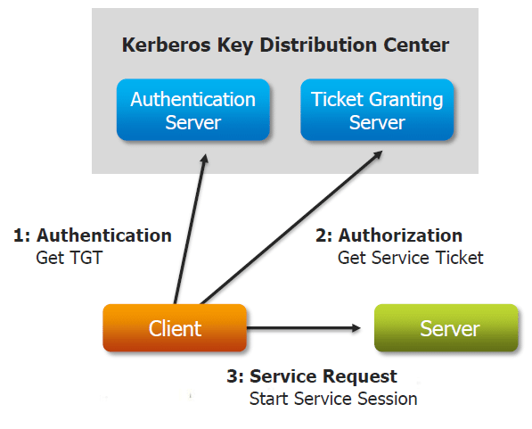
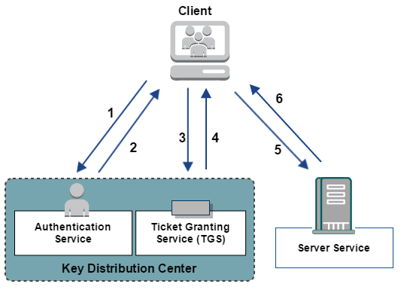
Kerberos components

Slide 22
KERBEROS LAB
60 MIN

Slide 23
references
http://www.roguelynn.com/words/explain-like-im-5-kerberos/

