Slide 1
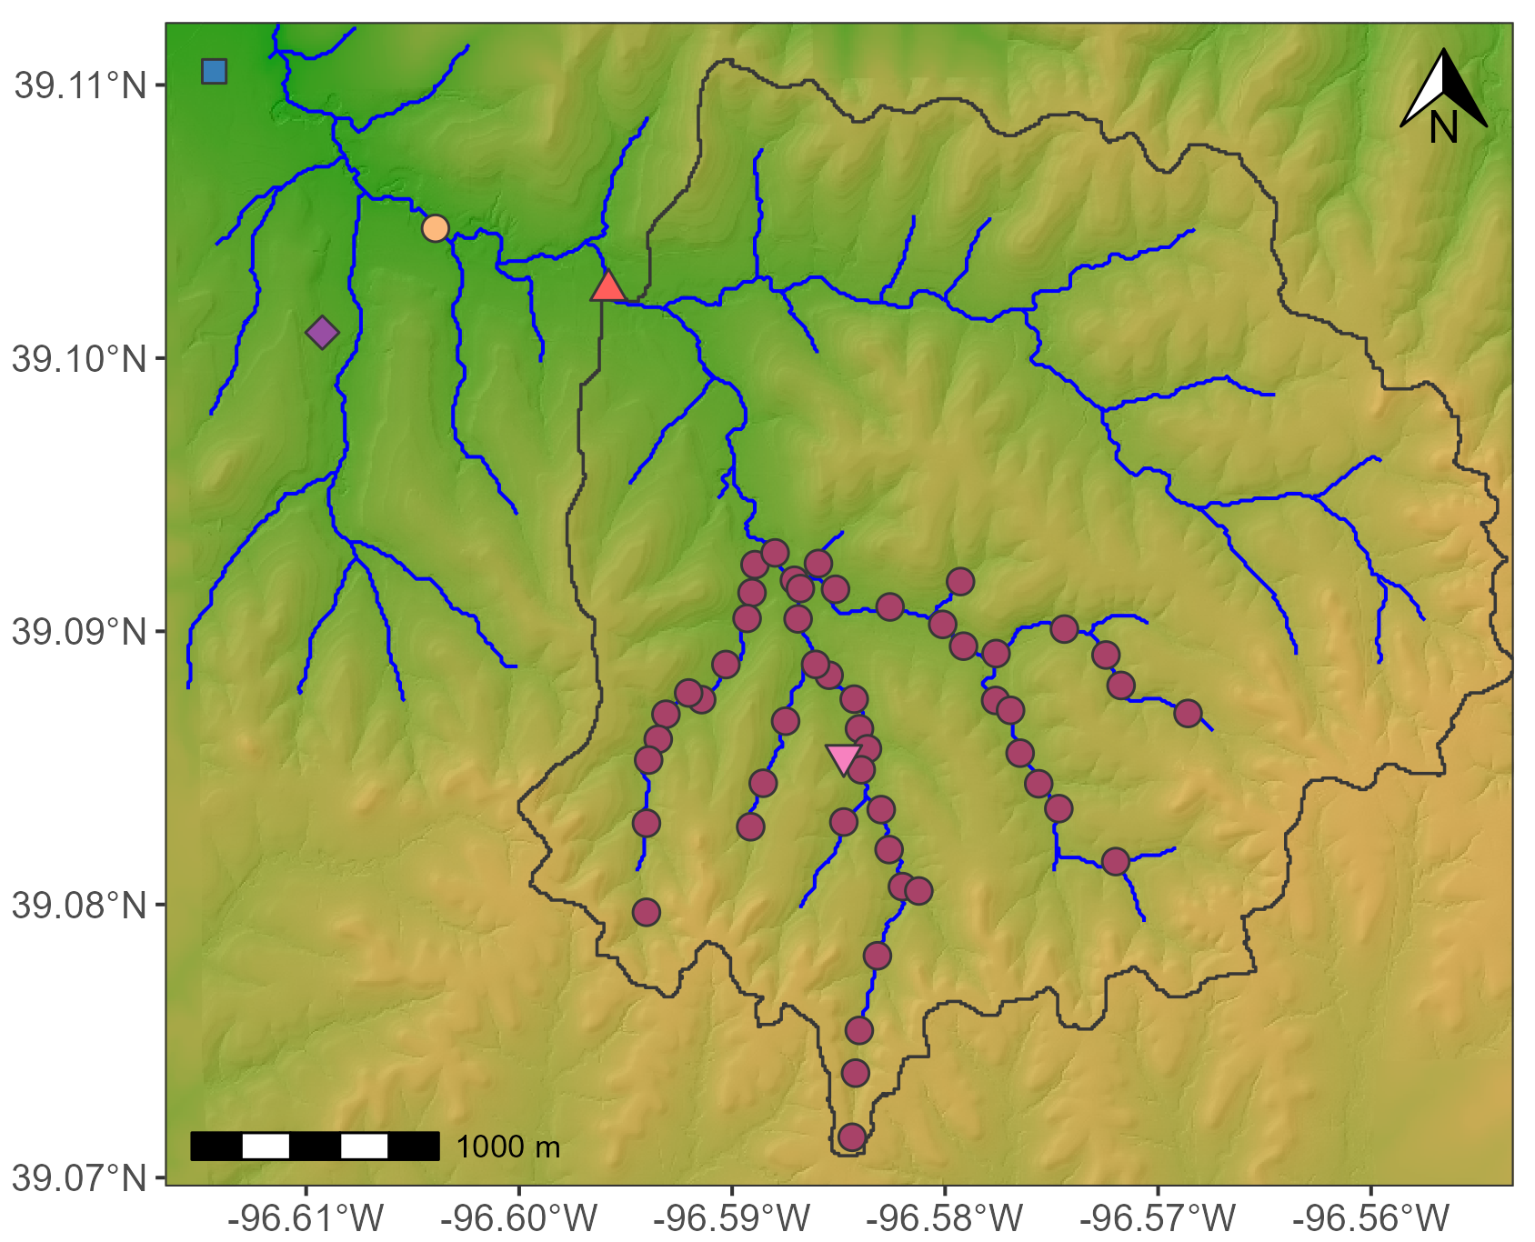
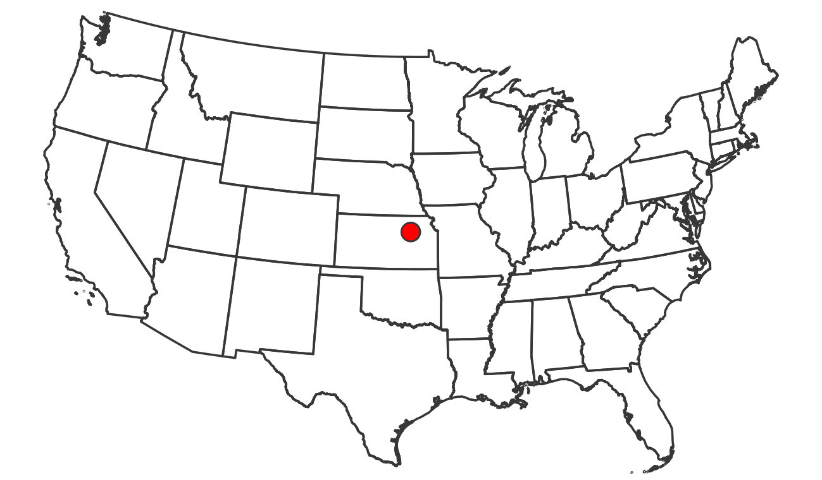

a
Kings Creek
North Fork
b
South Fork

Slide 2
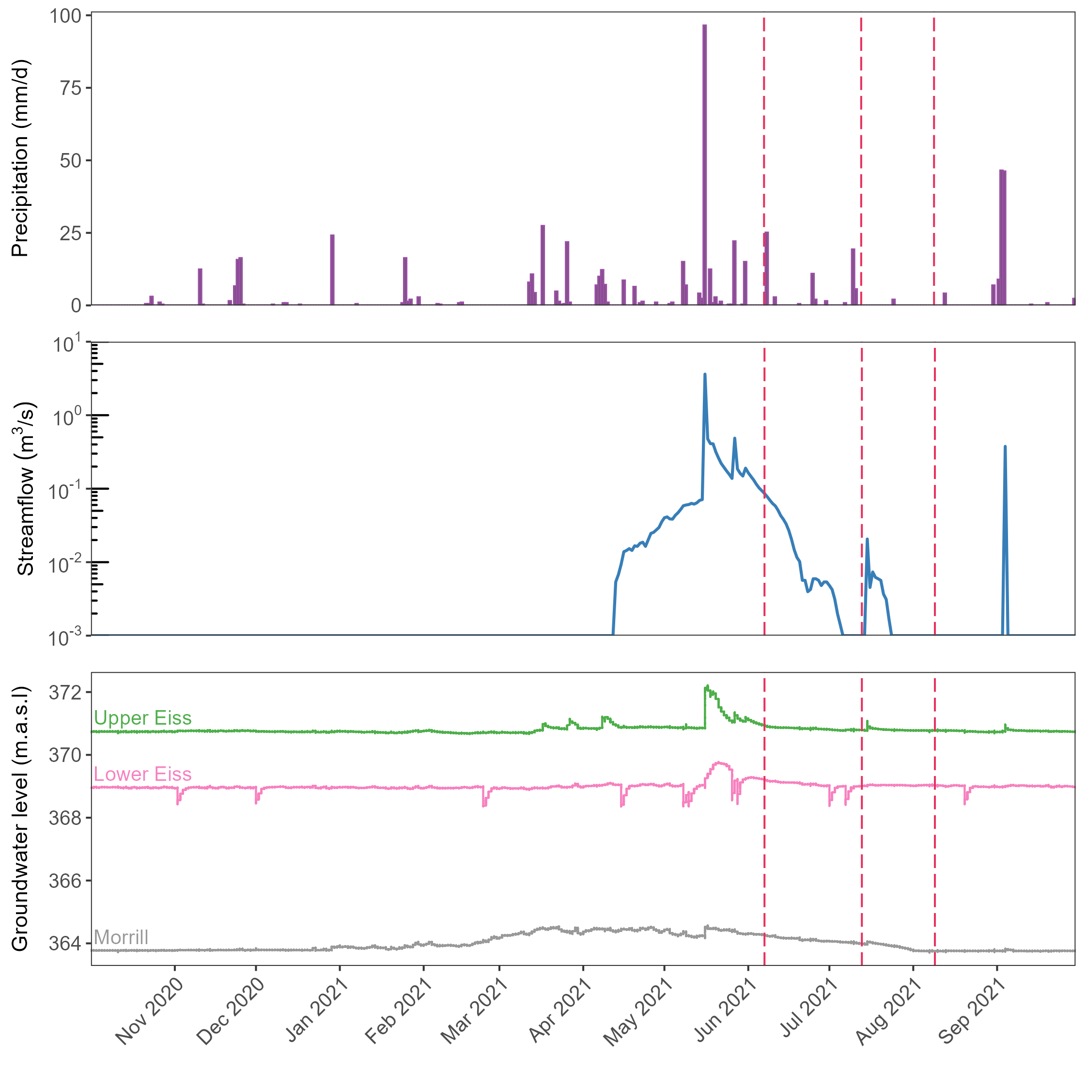
a
b
c

Slide 3
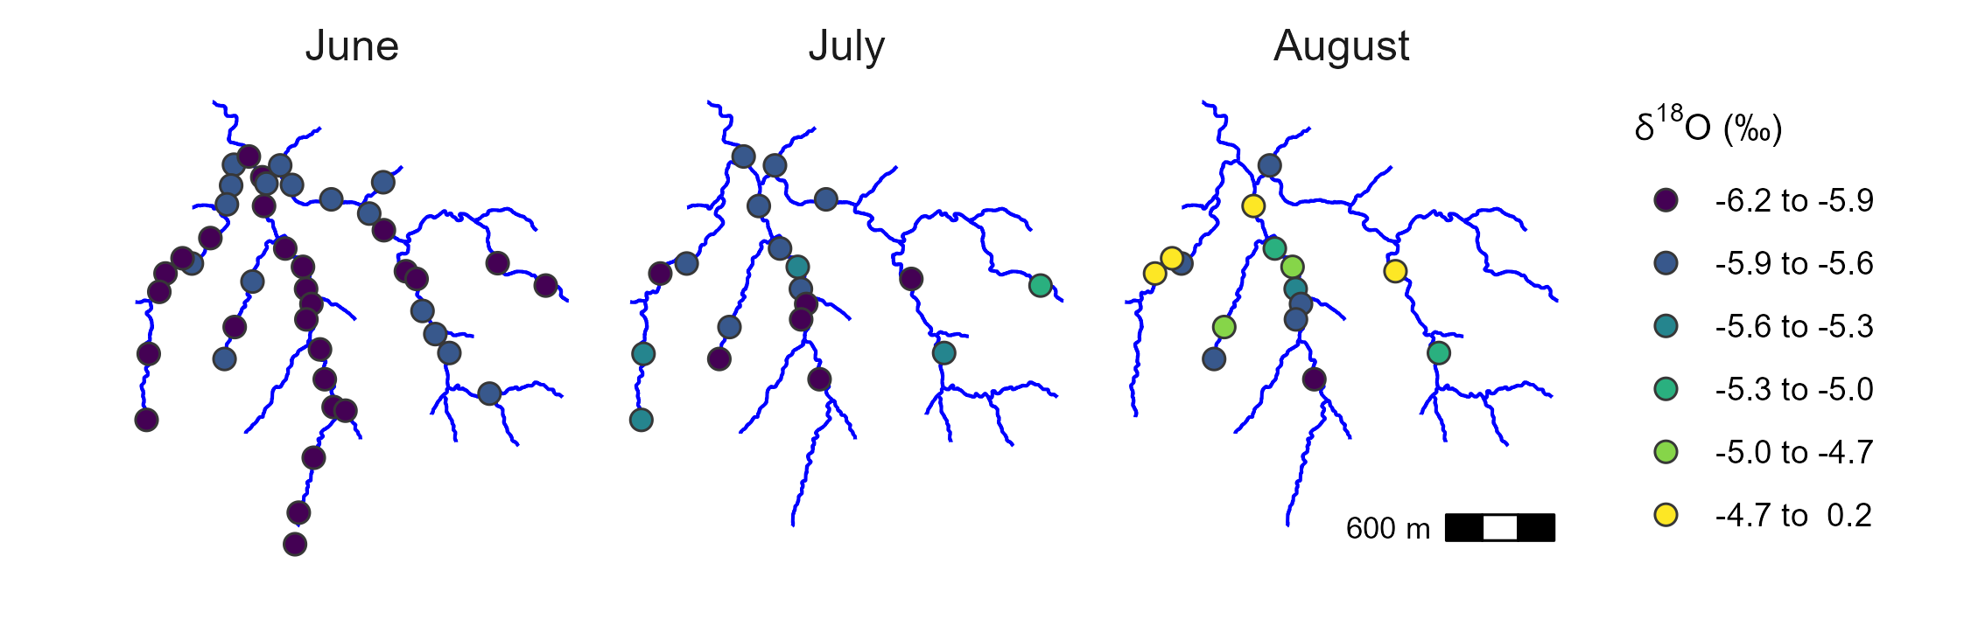

Slide 4
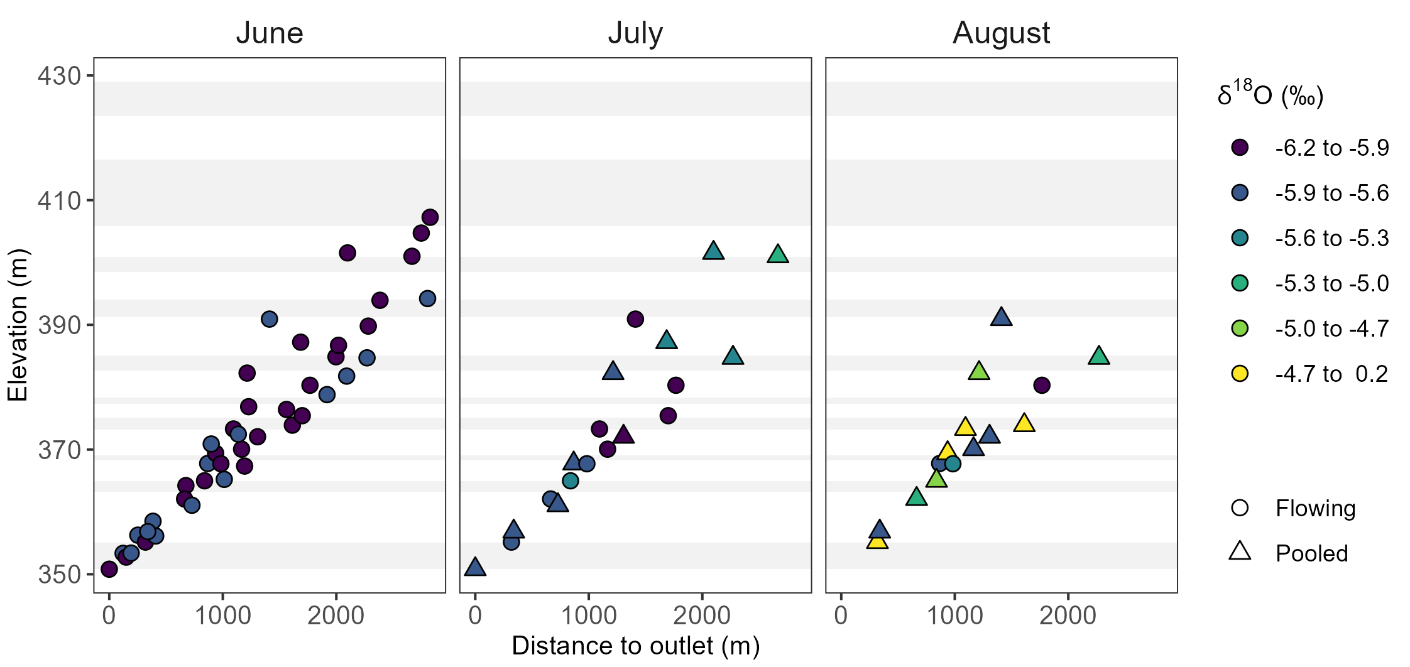
Eiss Ls
Morrill Ls
Flow direction

Slide 5
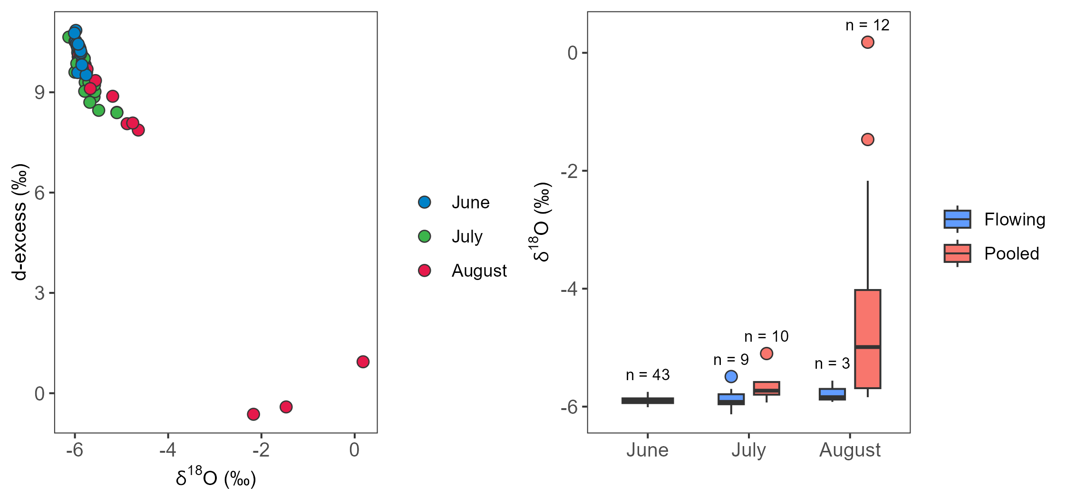
a
b

Slide 6
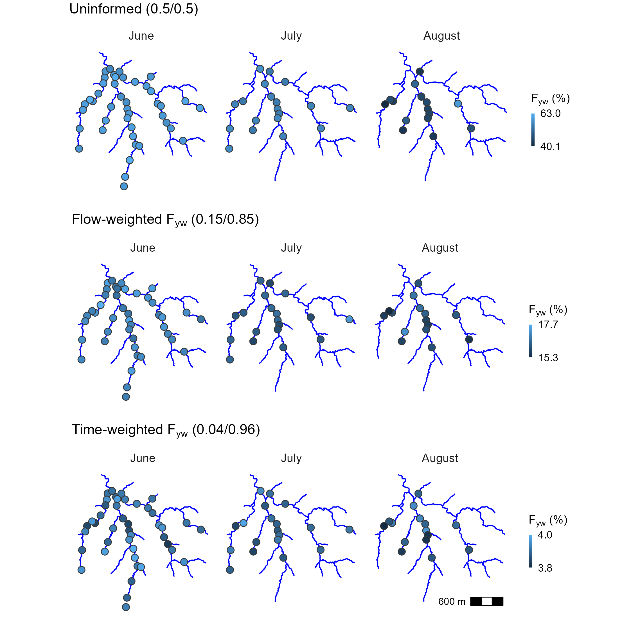
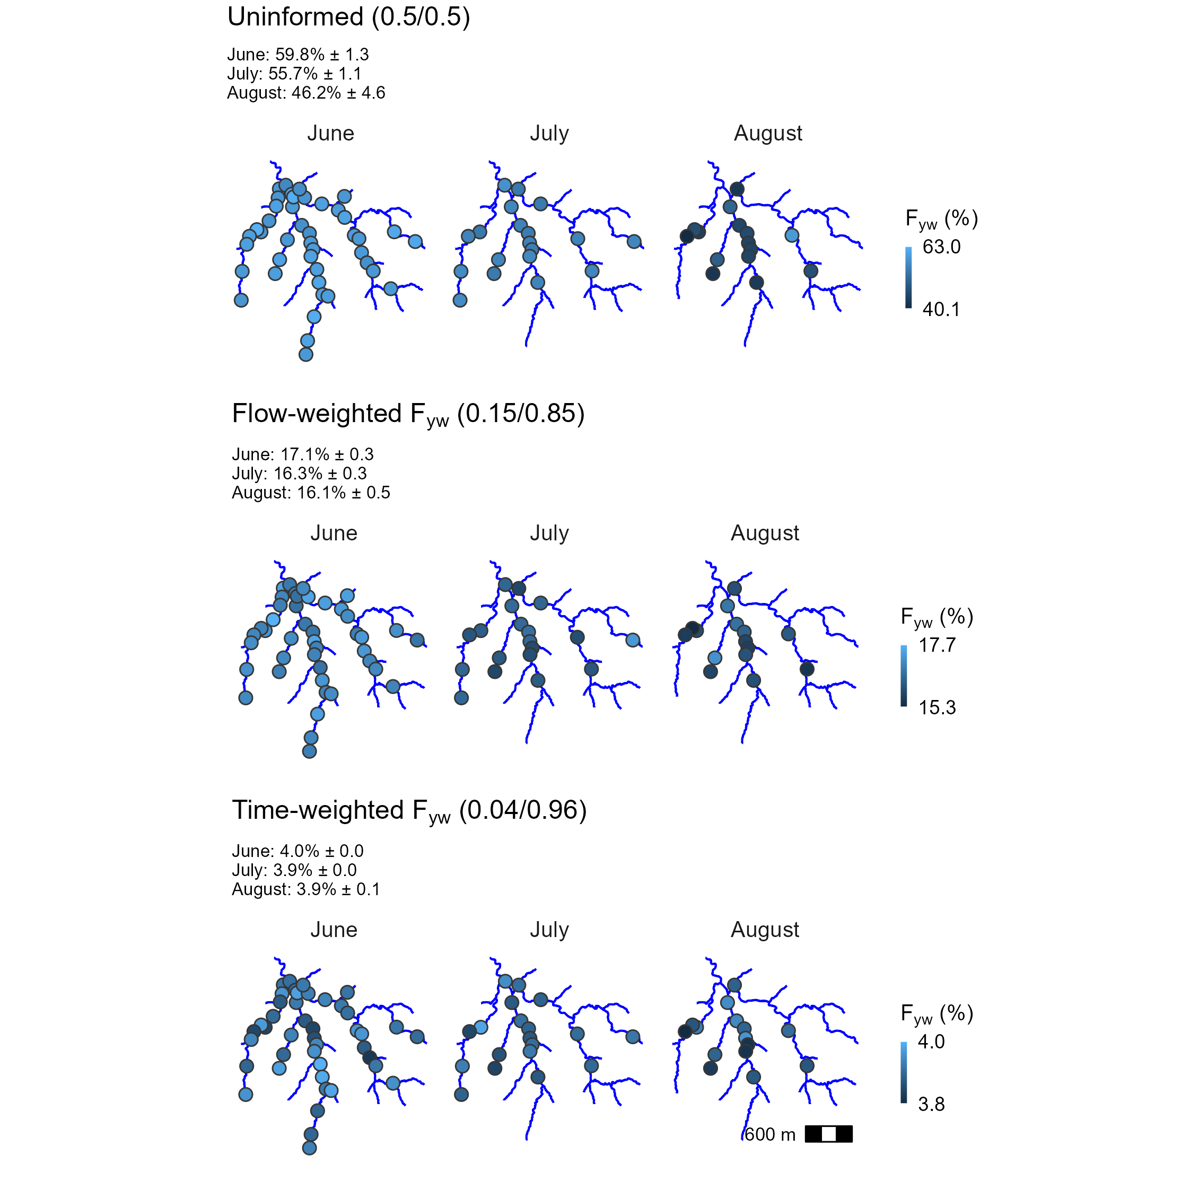
a
b
c

Slide 7
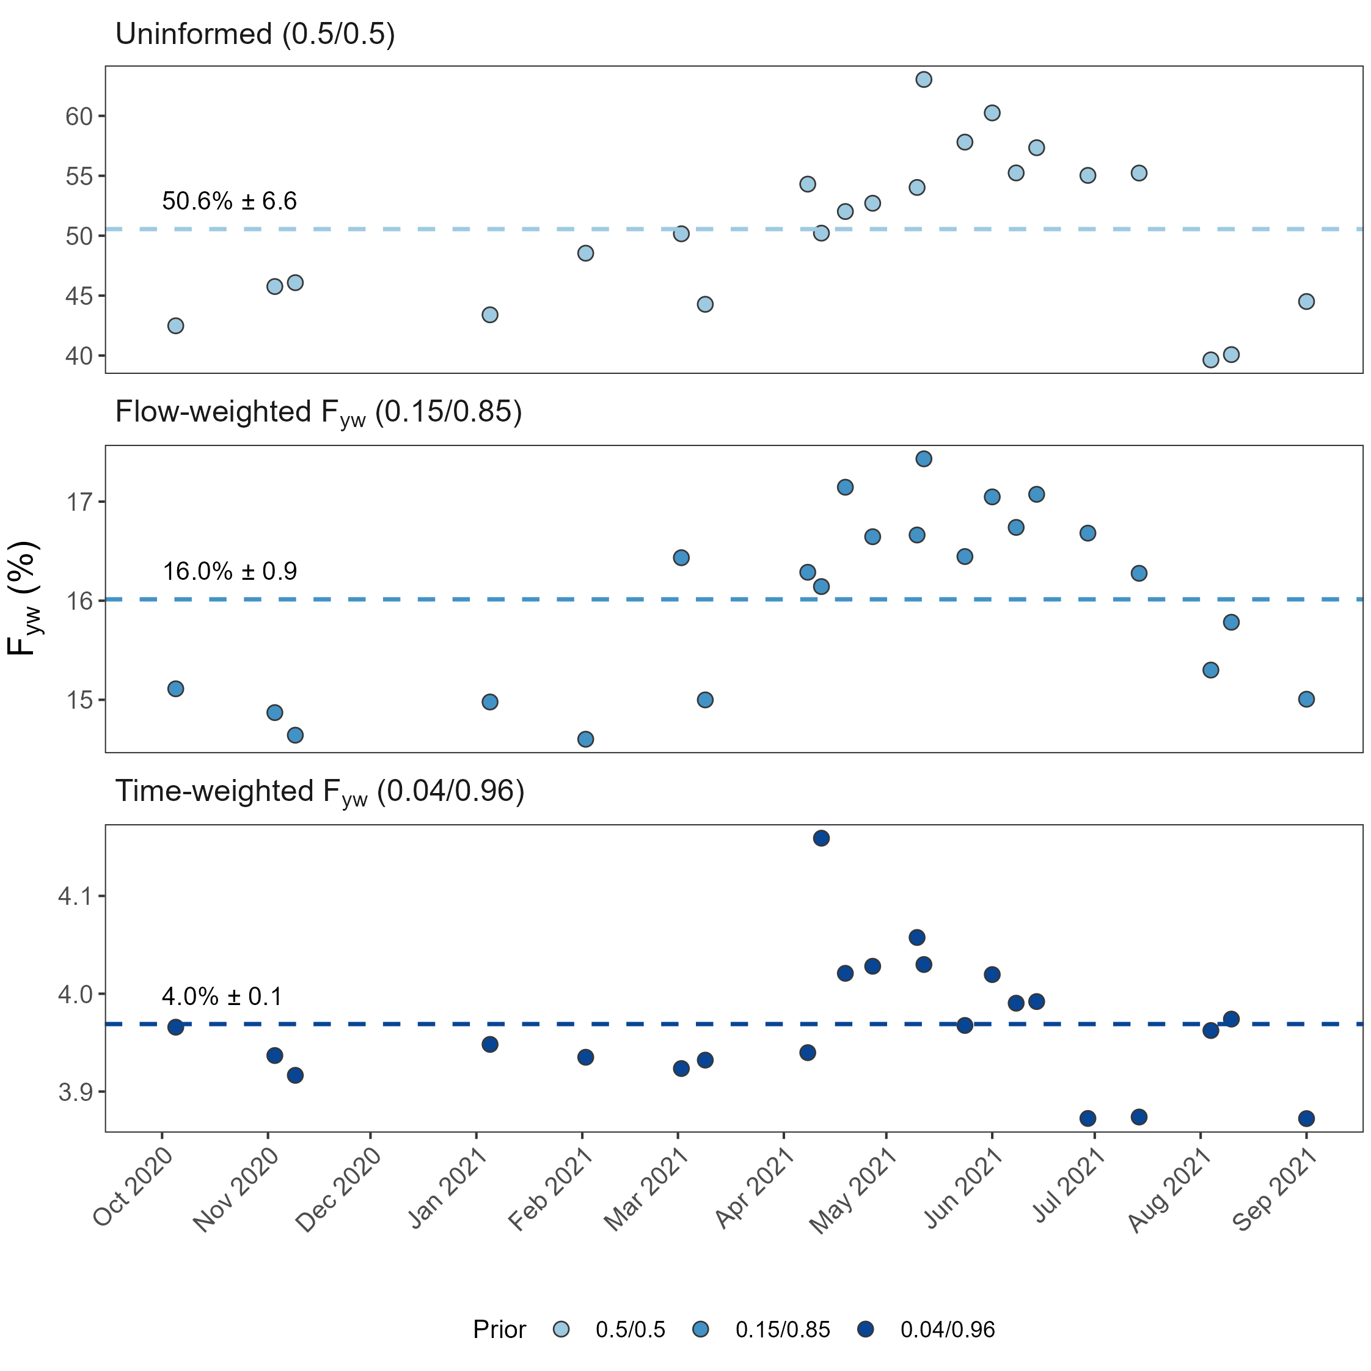
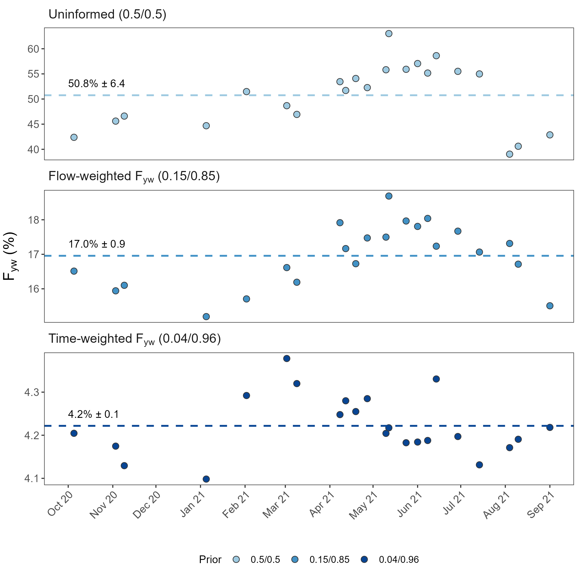
a
b
c

Slide 8
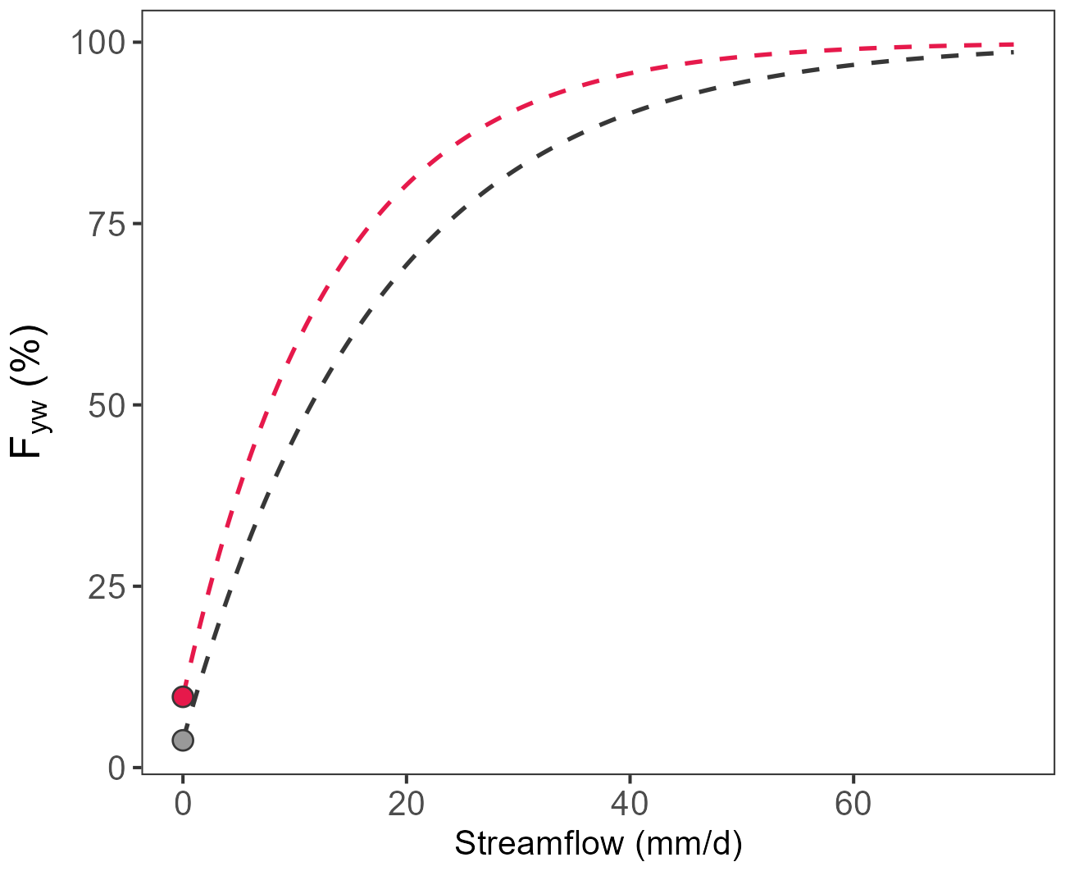
Time-weighted F_{yw}: 3.8% ±1.7
Flow-weighted F_{yw}: 14.5% ± 4.3
2021 sinusoidal model
2015-2022 sinusoidal model
F₀: 3.8% S_{d}: 0.06 d mm⁻¹
F₀: 9.8% S_{d}: 0.08 d mm⁻¹

Slide 9
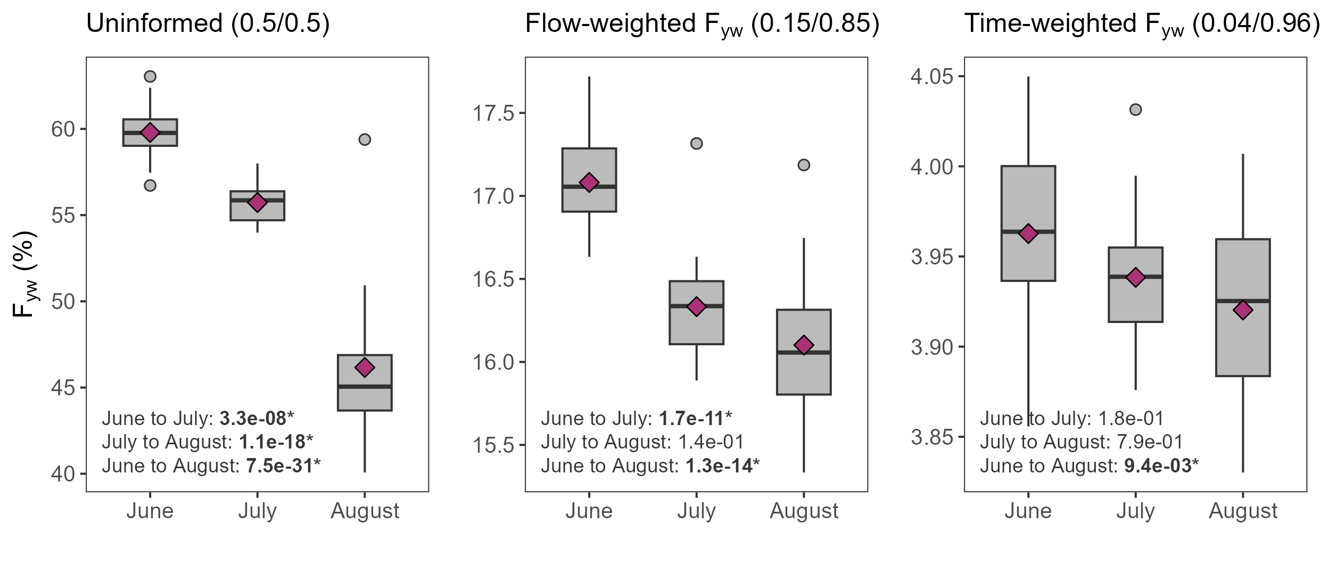
a
b
c

Slide 10
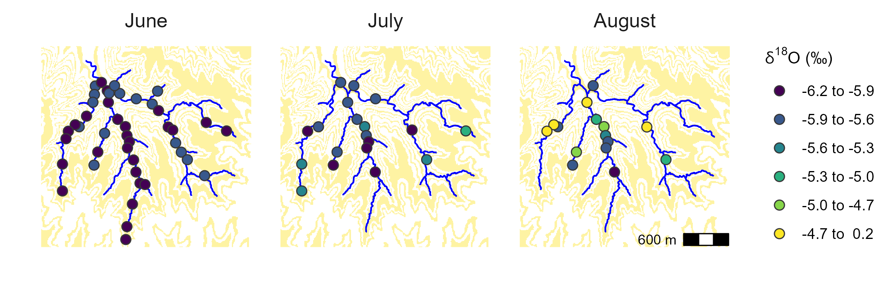

Slide 11
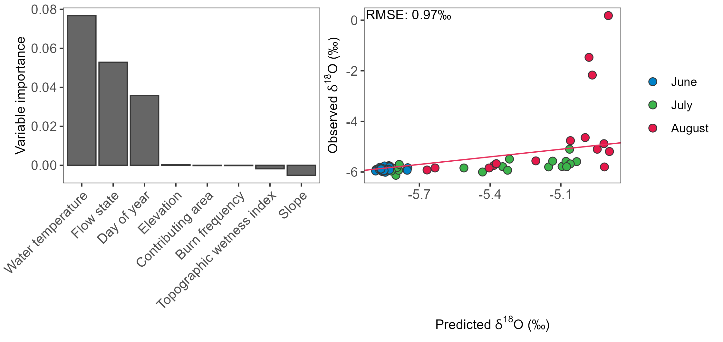
a
b

Slide 12
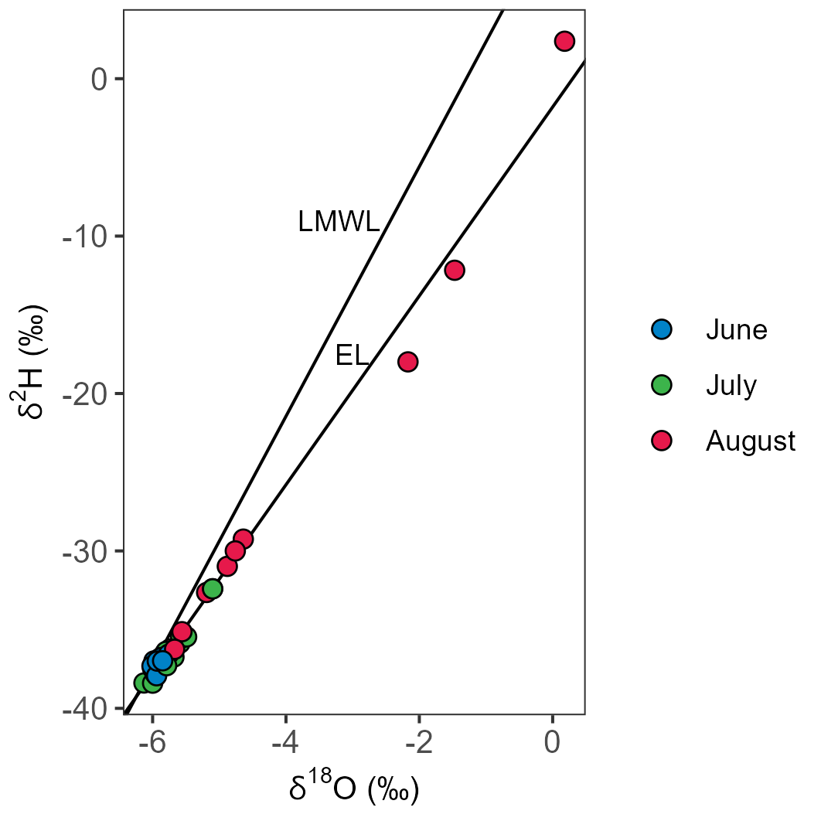

Slide 13
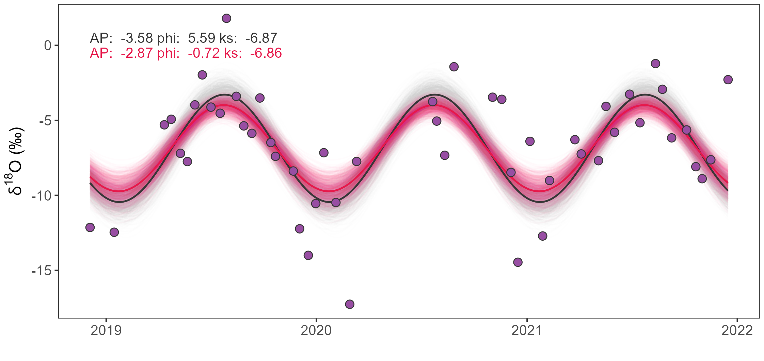

Slide 14
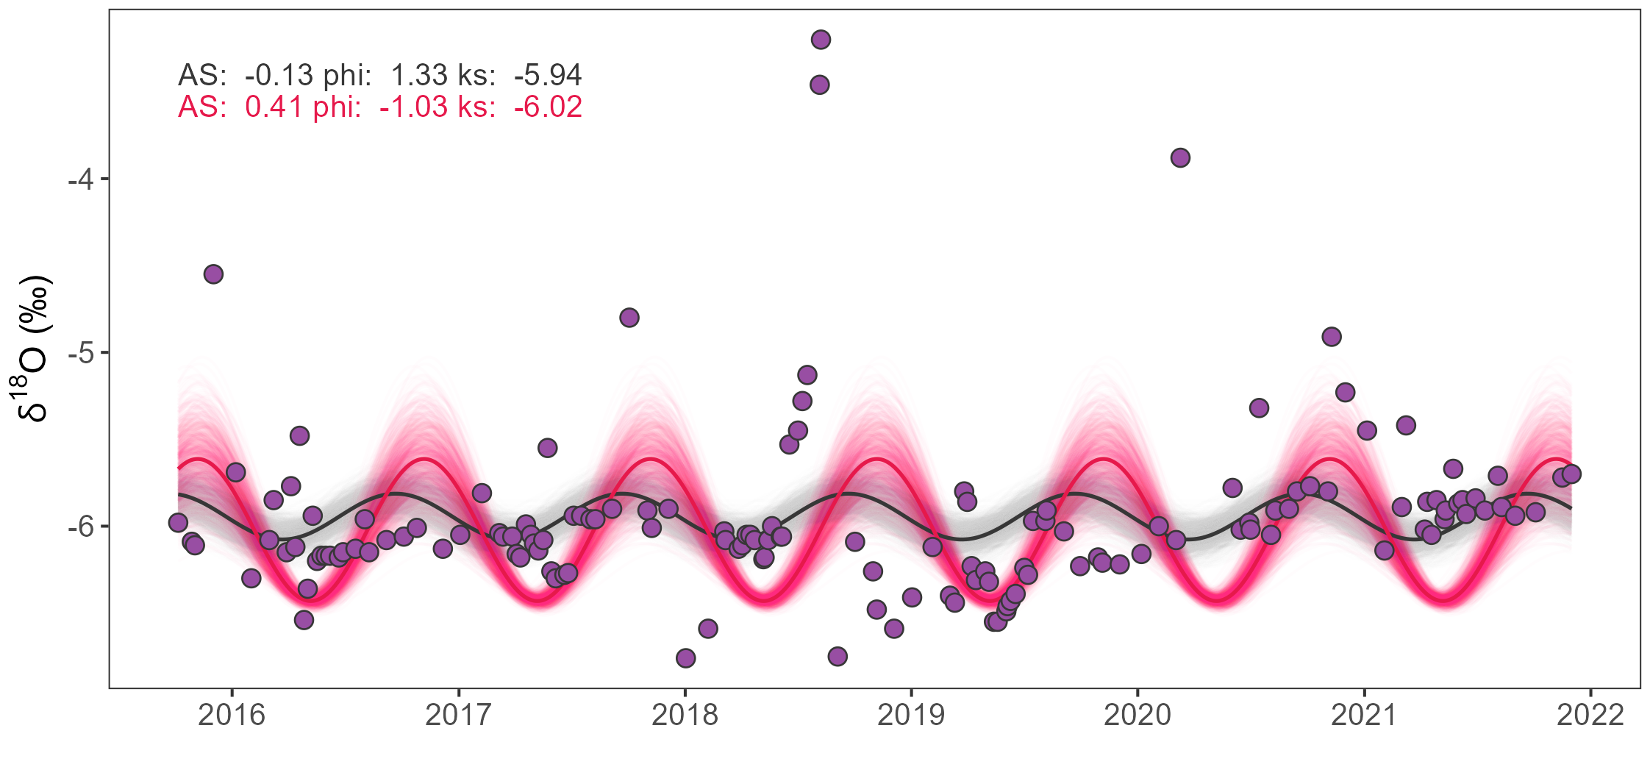

Slide 15
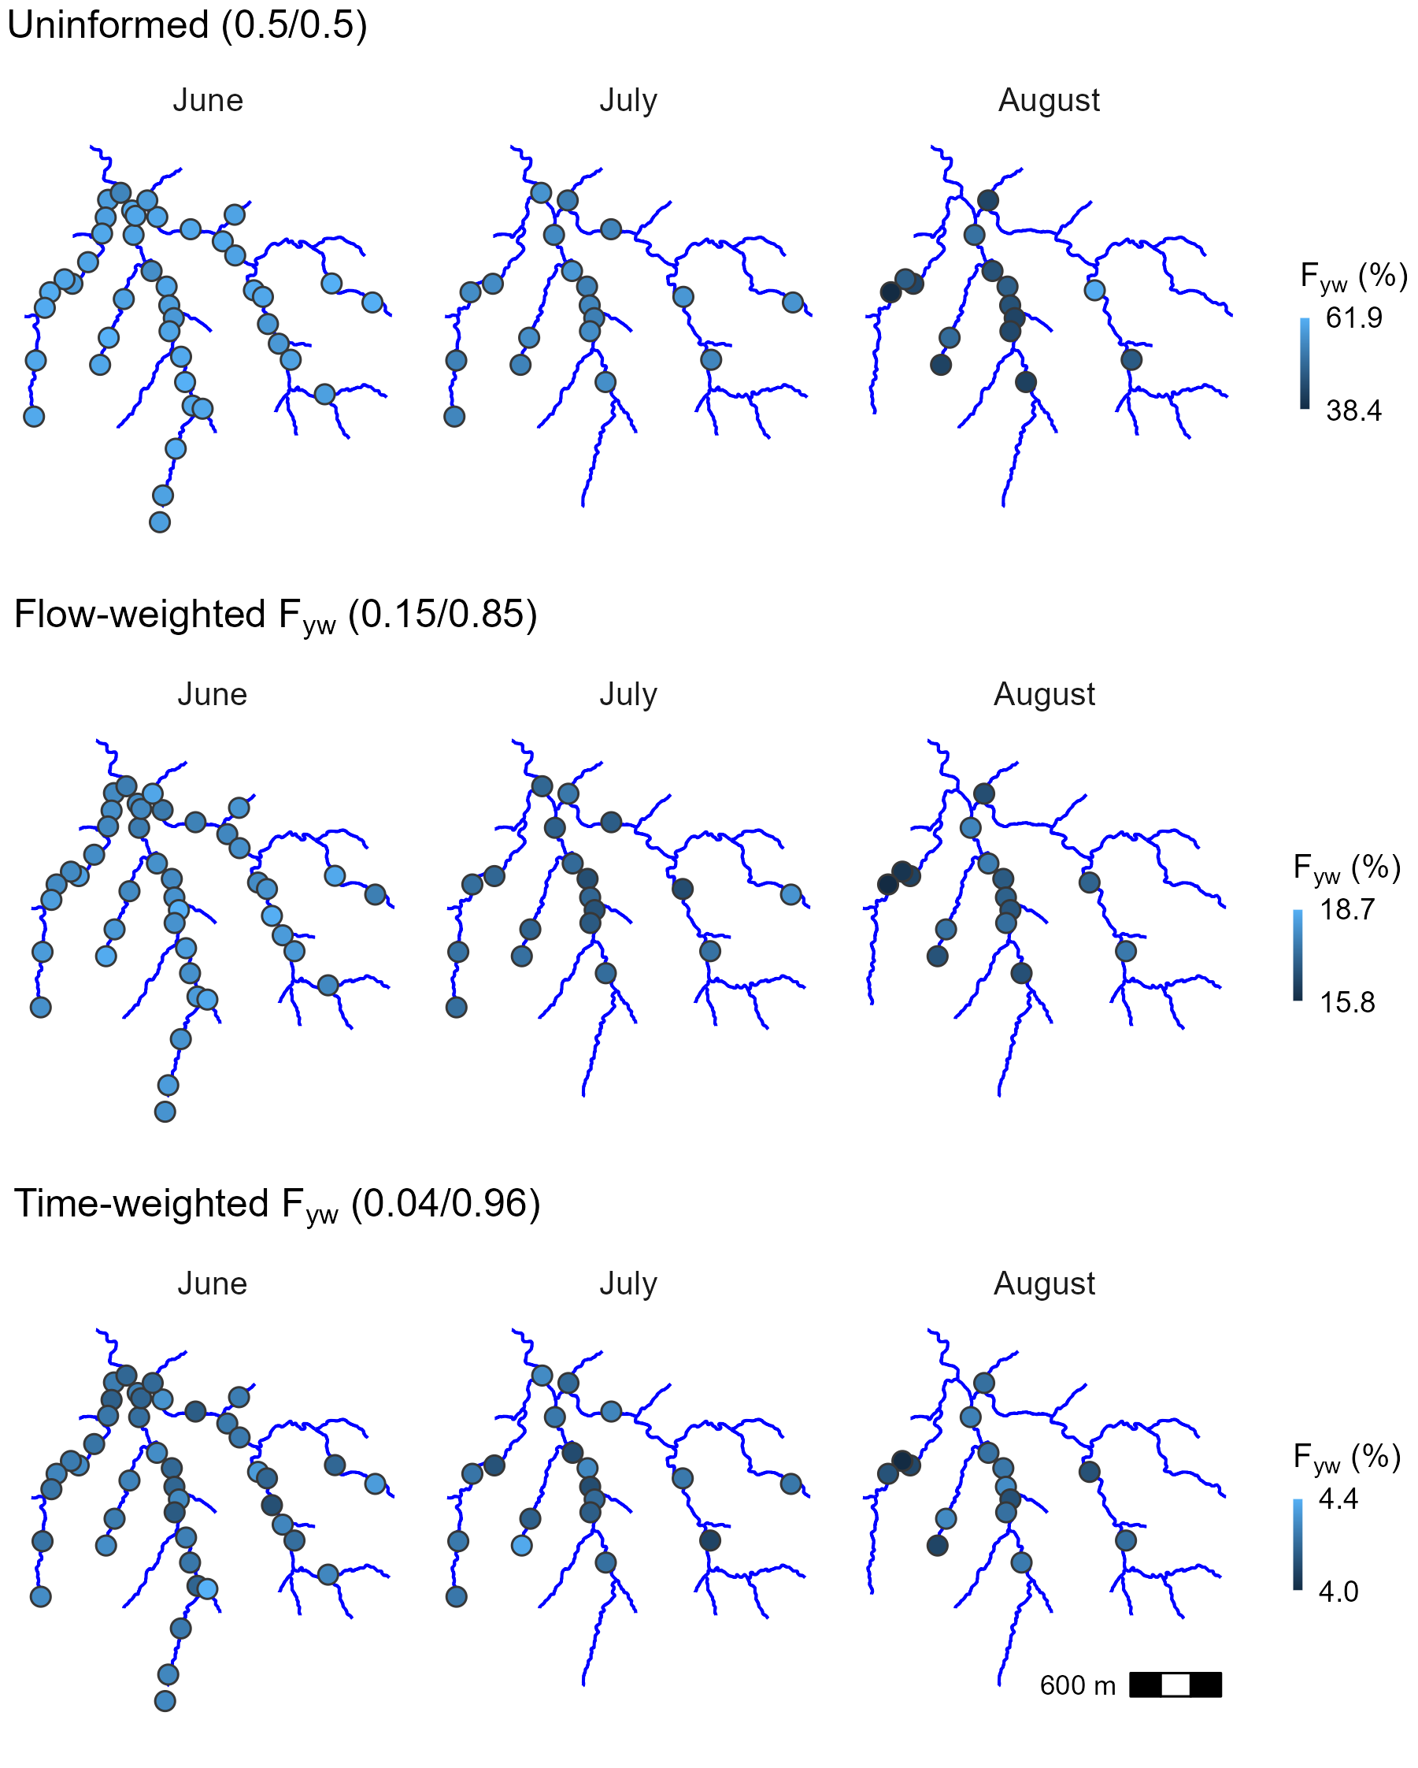
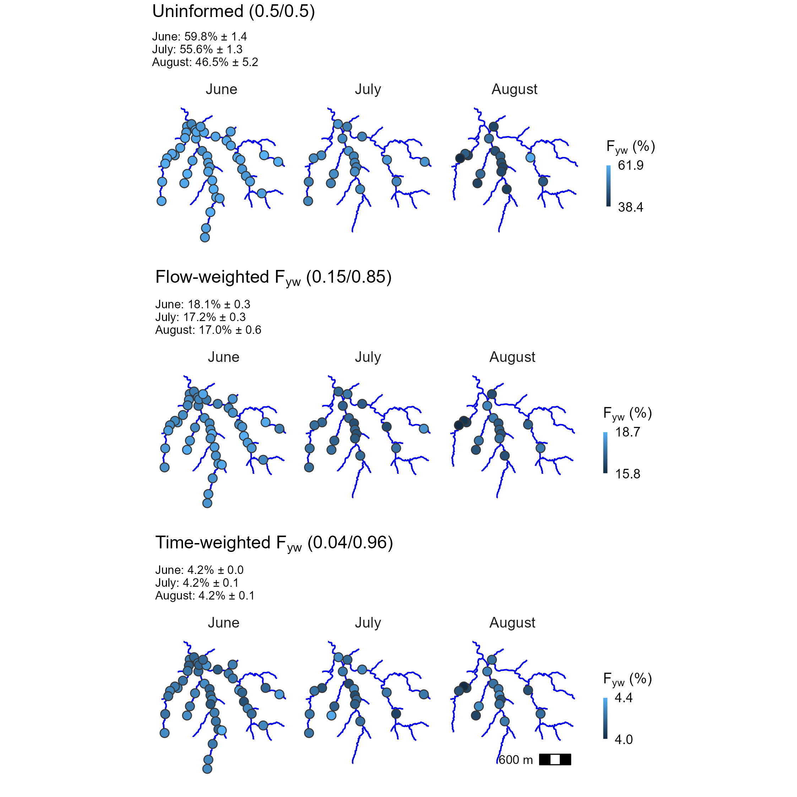
a
b
c

Slide 16
a
b
c

Slide 17
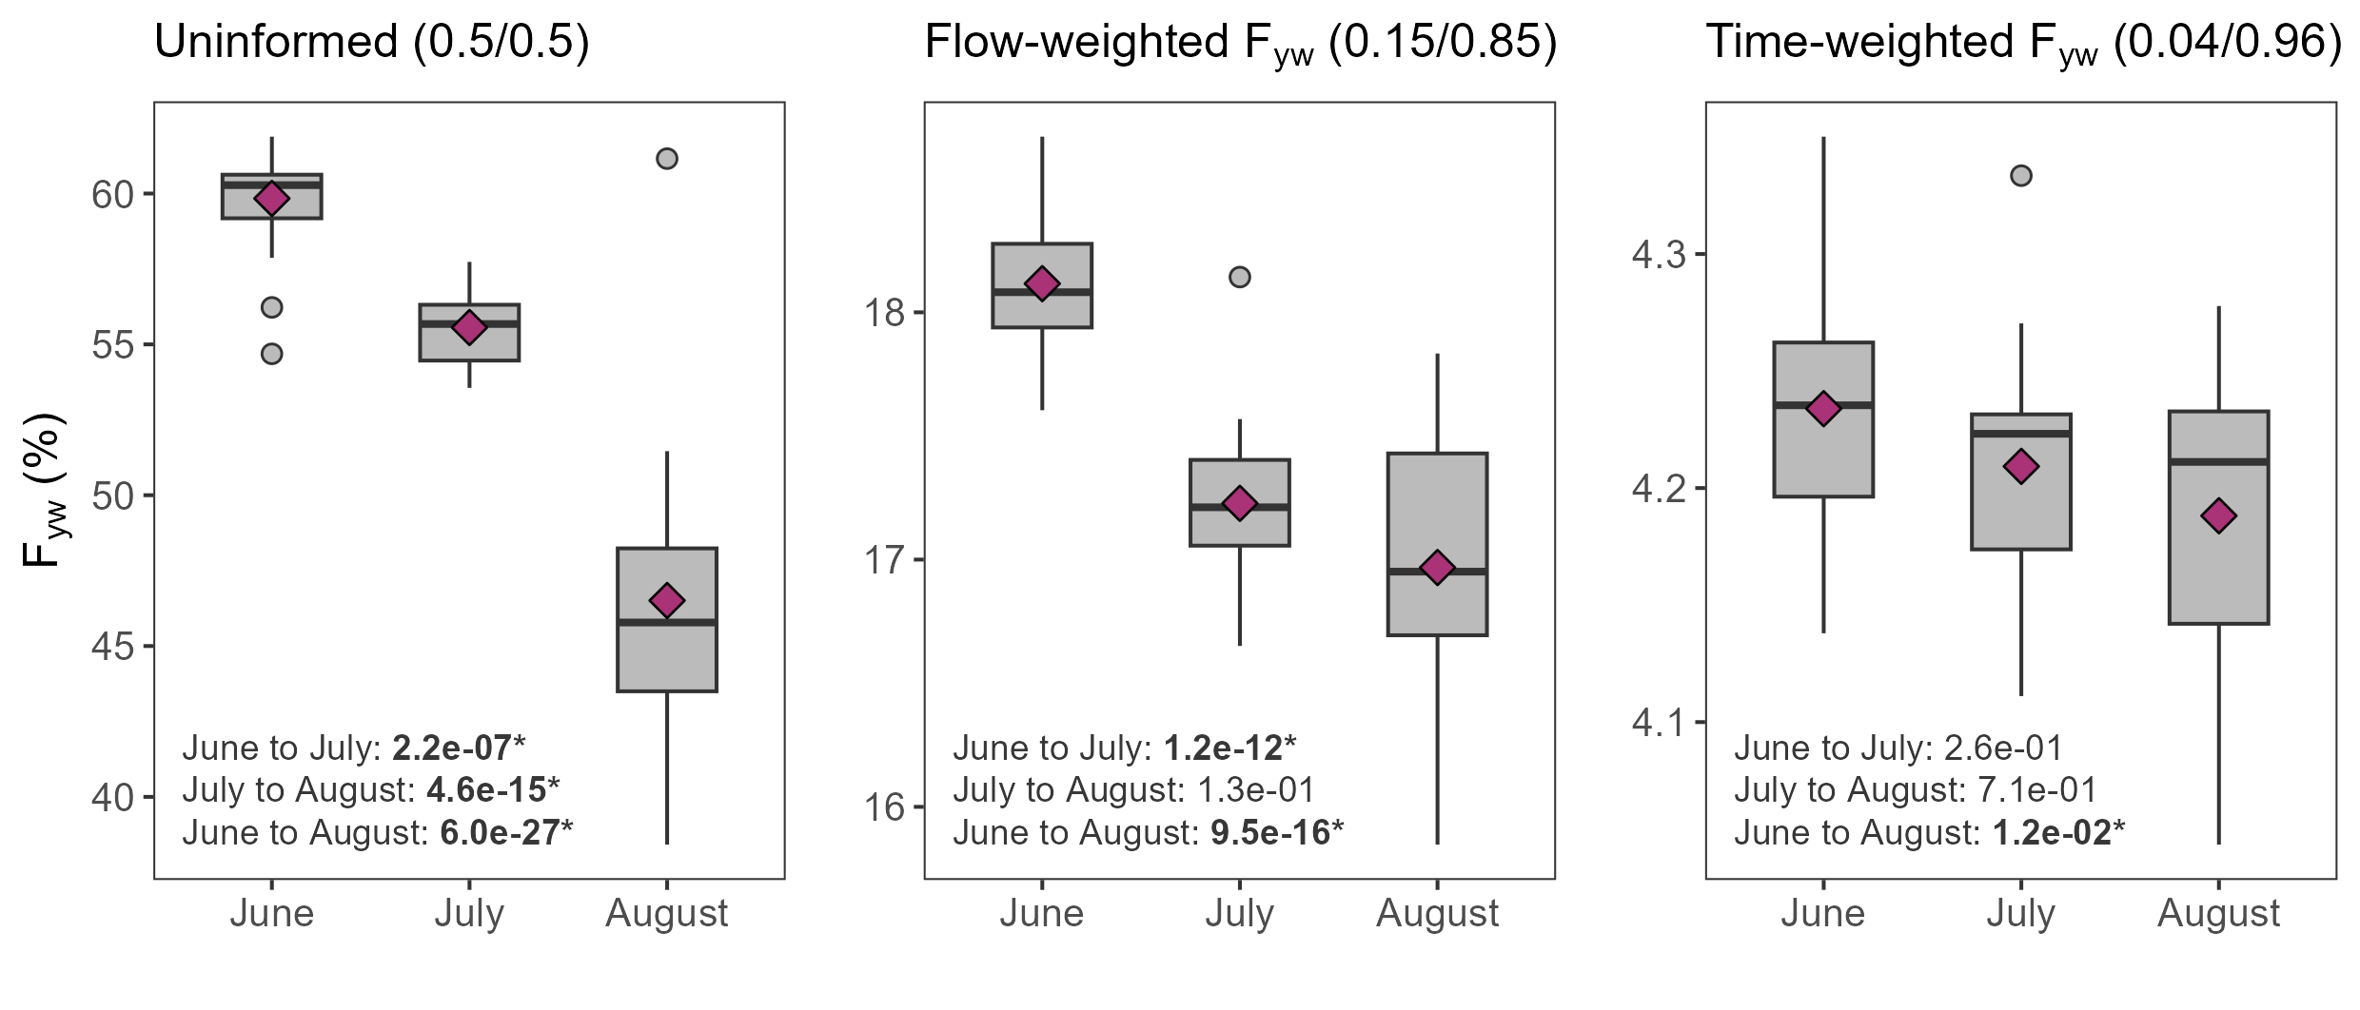
a
b
c

