Slide 1

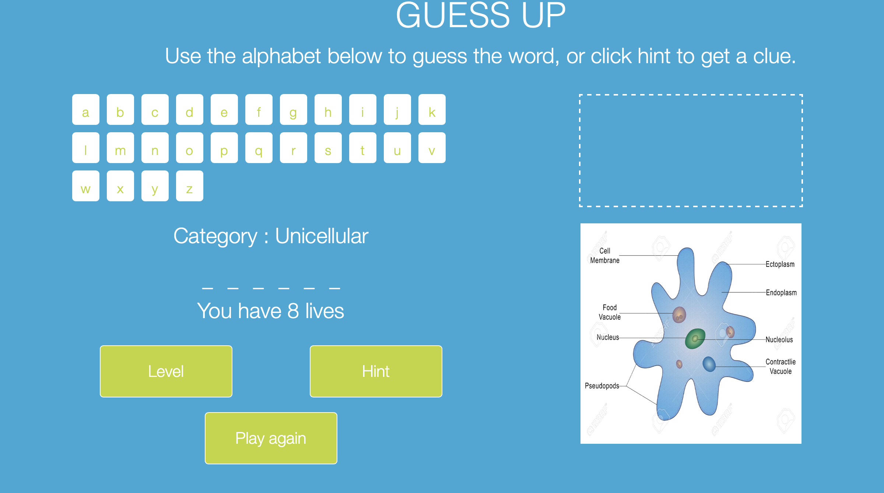
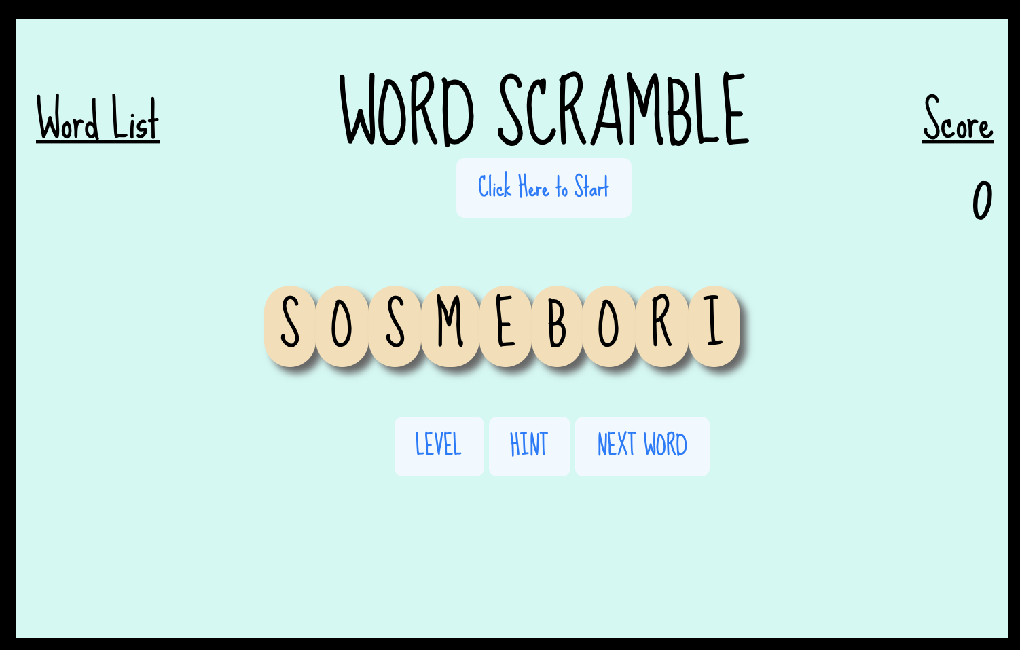
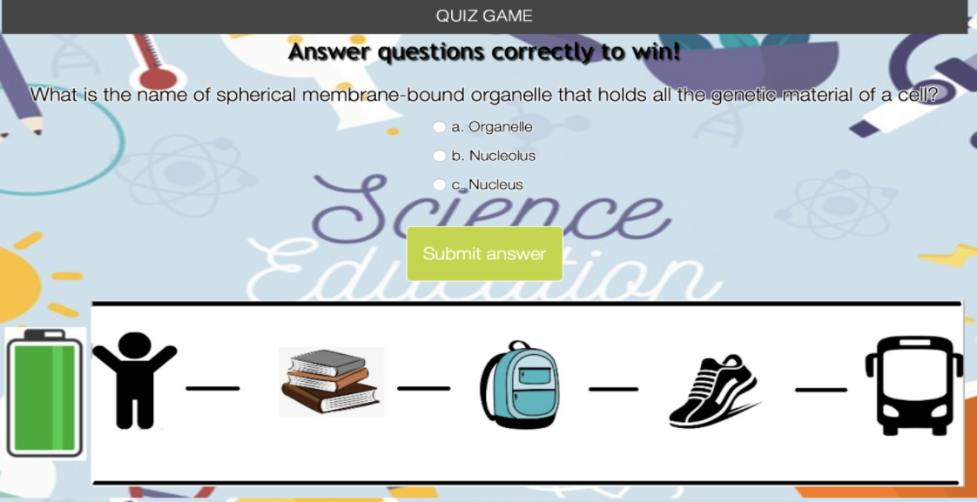
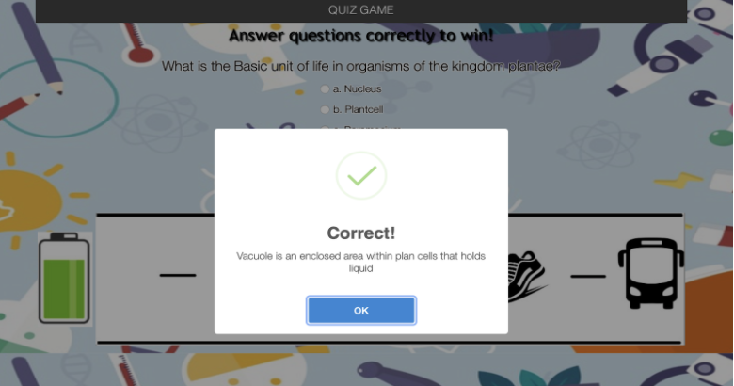
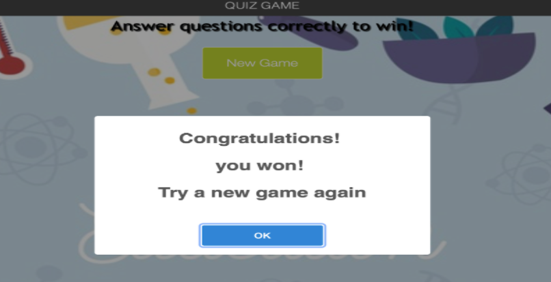
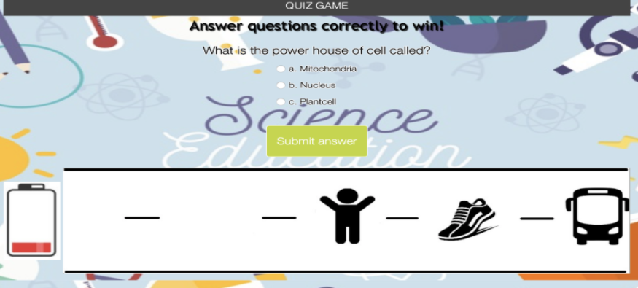
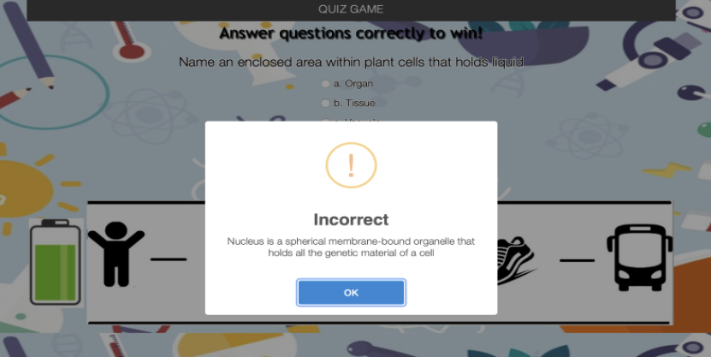
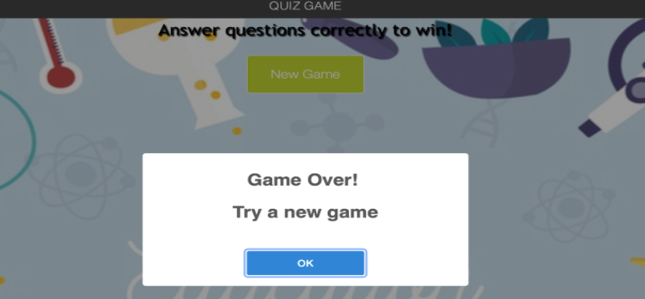
Cell Biology Learning Games
John Griffin, Venkata Sameer Kumar Betana Bhotla, Darakshan Anwar, Rohit Jain, Nimoshika Jayaraman, Tanu Shree
Texas A&M University, College Station
Introduction
User Interface
Tools for development
Cell Biology Learning games are educational games designed for the reinforcement of biology concepts for middle school students. Currently this system consists of three games: Guessup, Word Scramble and Quiz game. Our customer for this project is the Veterinary Medical & Biomedical Sciences Department of Texas A&M. Our main focus in this project includes:
1.Enhancement on the existing games: Guess-Up and Scramble.
2.Development of a new game called Quiz Game.
3.Testing of all three games on different browsers and devices.
4.Deployment to StepStone environment.
5.Development of a generic content template across modules.
Changes made in the existing games.
We cooperated with server managers from Veterinary Medical & Biomedical Sciences department to migrate applications to customer server as official deployment.
Programming/Game configuration data: JavaScript
UI development and verification: Bootstrap.
Embedding environment: StepStone authorizing system
Testing deployment: FTP server (futuredogter.com), through WinSCP.
Official deployment: Production server (Vetmed).
Guess-up Game
Scramble Game
User Stories
Testing and verification
User Stories for guess-Up game:
User Stories for Scramble game:
As a player, I want the number of lives to be based on the difficulty of the word and the difficulty setting.
As a player, I want the words to be given to me in random order.
As a player, I want to select from the difficulties: easy, medium, and hard, so that I can be given words that appropriately match my knowledge.
As a player, I do not want to see the text selection cursor while clicking and dragging tiles.
As a player, I want each tile of a given Scramble word to have the same size.
As a player, I only want to be allowed to move a tile horizontally.
Dynamic number of lives .
Randomness of image on new game load.
New button ‘Level’ added for difficulty.
Text selection cursor removed.
Title size normalized.
Only horizontal movement of tiles allowed.
After modification, we tested both applications on browsers including Google Chrome, Mozilla Firefox, and Microsoft Edge to verify that the flow of each game is not disturbed.
To make the games more responsive across multiple devices, we also conducted verification on iPad, iPhone, android phones and Chromebook to make sure the user interface presents properly.
We ran tests by playing the games on multiple screens with different resolutions and controls (touch vs mouse).
After completion of offline testing, we deployed the games to FTP server (futuredogter.com) to make sure it works on internet environment.
Quiz Game
Quiz game is a new game introduced as a part of this project
User Stories for Quiz game
As a player, I should only be asked one question at a time.
As a player, I want to be able to select the option that best answers the question.
As a game administrator, I want to easily be able to add new questions to quiz Game.
As a player, I should be able to determine how many “lives” I have by the charge on the battery. Each time I get a question wrong, it should deplete by 1/5th of the total capacity. Once it is empty, I lose.
As a player, I should receive a notification pop-up once the game is over. This should tell me whether I won or lost.
As a player, I should win whenever I get 4 questions correct and lose whenever I get 4 questions wrong.
As a player, I should receive audible feedback indicating whether or not my answer was correct.
As a player, I should be able to determine my progress in the game by the number of images that remain. For each question I get correct, one of the images goes away and my player image should move forward.
As a player, I should not always see the same questions appear in the same order.
As a player, the answer choices for each question should not always be displayed in the same order.
As a player, I should be told immediately after answering a question whether my answer is correct or incorrect. The feedback should be accompanied by further explanation about the question.
asasd
Conclusion
Our team completed more than 20 user stories. We improved the current games and implemented a new game with animations. We tested the compatibility of our games on all devices and web browsers. As a team, we thoroughly documented all the work allowing future teams to create animations and deploy the games on StepStone. We have also compiled a lot of data files that can be used in tandem with the current games and deploy for all different modules present in the Peer program One Health curriculum.
Fig 1. Starting the game
Fig 3. Correct answer screen
Fig 5. Winning screen
Fig 2. General Gameplay screen
Fig 4. Incorrect answer screen
Fig 6. Losing screen

