Slide 1

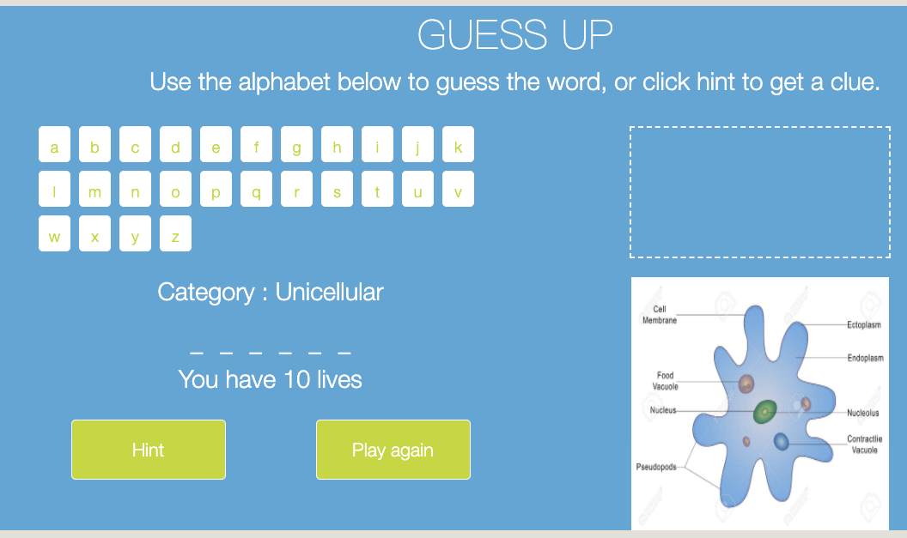
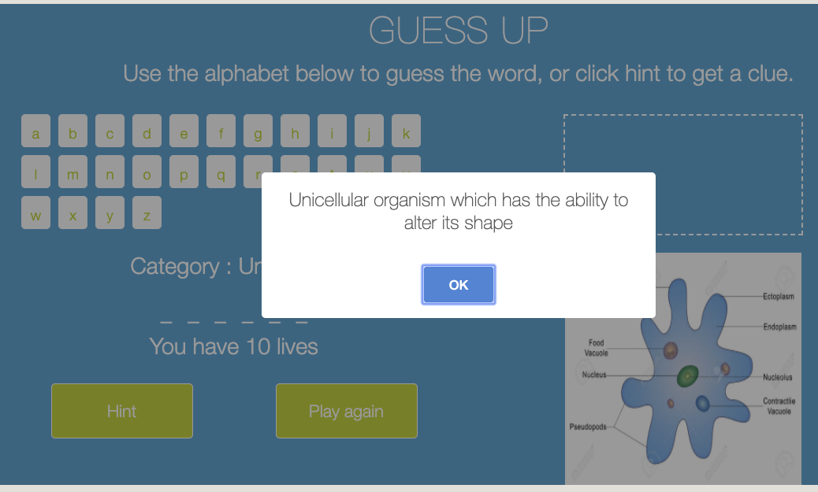
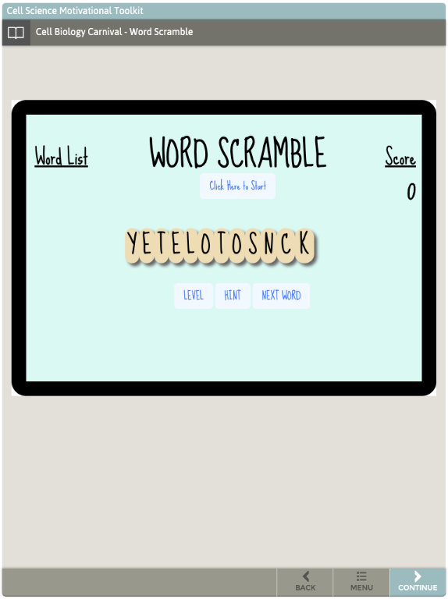
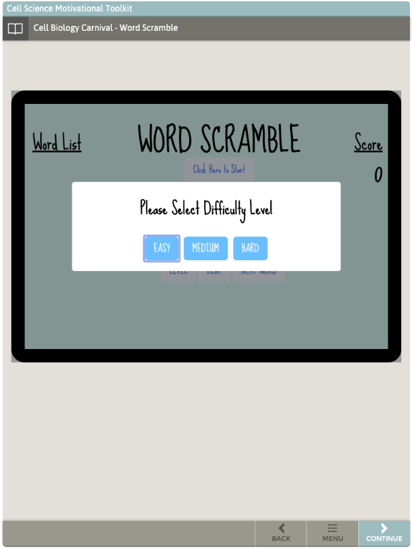
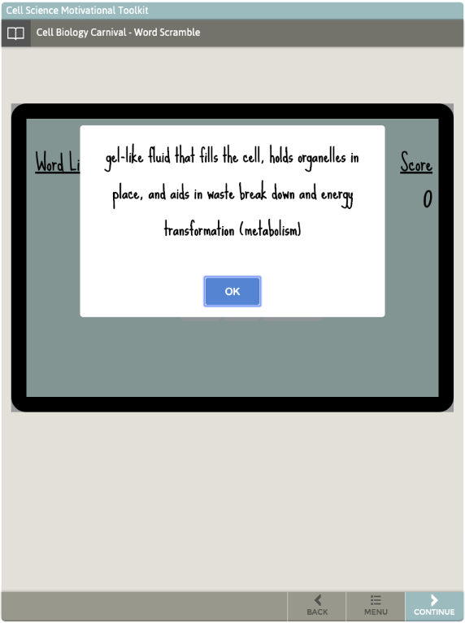
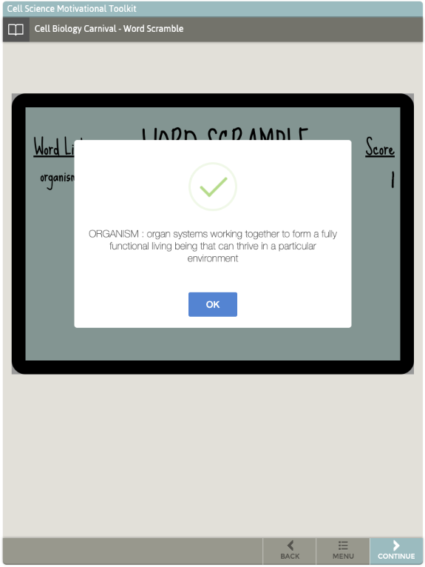
Biology Learning Games
Keerthana Reddy Nerella, Ravikiran Ramesh, Sriharish Srinivasan, Hsing-Yu Chen, I-Fang Huang, Jian-Siang Hong
Texas A&M University
Introduction
User Interface
Biology Learning Games application is designed for 6th-grade students to learn biology in a fun way. This system consists of two applications: Guessup and Word Scramble games, both integrated into JavaScript environment hooked to StepStone authoring system. During this semester, we had intensive cooperation with Veterinary Medical & Biomedical Sciences department of Texas A&M. Our achievements in this project include:
Integrating codes in response to customer’s stories
Verifying if the applications work well on different browsers and devices
Editing game database to make it friendlier for non-technical users
Officially launched the system to production server
Game 1-GuessUp:
Fig. (a): Game1 Demo on PC
Fig. (b): Hint Message for Answering Question
Game 2-Word Scramble:
Tools for development
We cooperated with server managers from Veterinary Medical & Biomedical Sciences department to migrate applications to customer server as official deployment.
Programming / Game configuration data: JavaScript
UI development and verification: Bootstrap
Embedding environment: StepStone authorizing system
Testing deployment: FTP server (futuredogter.com), through FileZilla
Official deployment: Production server (Vetmed)
User Stories
As a user, when I am on the main page, I should have the option of choosing the game GuessUp or Scramble.
For GuessUp game, I must be able to guess a word by clicking on the alphabets. The corresponding image for the word should be displayed. As I guess the letters, if I guess the correct letter, it must appear on the blanks. For every wrong guess, the hangman animation should be progressively revealed. The number of remaining lives should be shown.
Fig. (c): Game2 Demo on iPad
Fig. (d): Difficulty Level Selection
When I click Hint, I should be able to see a useful hint describing the word.
For the scramble game, after pressing start, I should be able to unscramble a list of letters to make a meaningful word.
When I have completed unscrambling the word, a message must be shown that I have successfully unscrambled the word, and the word must be added to a word list. The score must be incremented accordingly.
I should not see words that I have played before in Word Scramble game.
I should be either able to play again or quit when hitting an answer. In addition, I should be able to go to the next word if I am stuck at a word I cannot solve.
I should be able to create word lists based on the difficulty for the Scramble game.
Fig. (e): Hint Message for Answering Question
Fig. (f): Score Screen
Conclusion
We have observed the following technical overviews.
Game Database: We create separated JavaScript files as game configuration database, where we declared all the variables associated with the game data. We also edited annotations so that other users can update new contents to it accordingly.
While implementing game database, we were not allowed to add JSON files without significantly altering the structure of our code. This was because JavaScript does not have permission to read local files without a specialized framework like NodeJS, due to a security feature called CORS (cross origin resource sharing) policy, which is kept in place to prevent websites from gaining access to local computer files without permission. Therefore, we decided to export game data to separated JavaScript files as alternative.
While deploying applications to FTP server, the root of mini-apps must be in the “apps” folder, moreover, each step could load only one single mini-app (Even though it is able to deploy multiple mini-apps to the folder). While doing this, we change the name of the folder in the JSON file that points to the mini-app so that StepStone can get access to these mini-apps correctly.
The browser is caching assets (i.e., HTML, CSS, JavaScript files) and does not re-fetch files. We need some cache-busting strategies in order for so that the contents can be freshly loaded to StepStone every time we access to the web.
Testing and Verification
After modification, we tested both applications on browsers including Google Chrome, Mozilla Firefox, and Microsoft Edge to verify that the flow of each game is not disturbed.
To make the games more responsive across multiple devices, we also conducted verification on iPad, iPhone (landscape view), android phones and Chromebook to make sure the user interface presents properly.
We ran tests by playing the games on multiple screens with different resolutions and controls (touch vs mouse).
After completion of offline testing, we deployed the games to FTP server (futuredogter.com) to make sure it works on internet environment.

