Slide 1

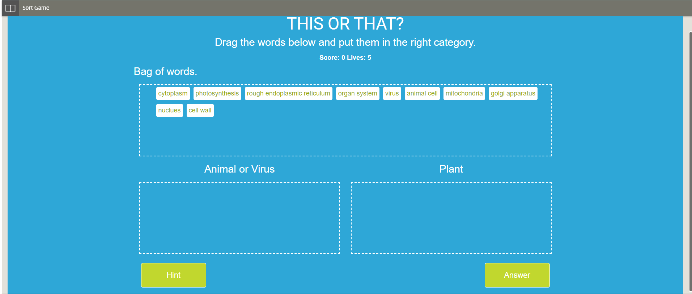
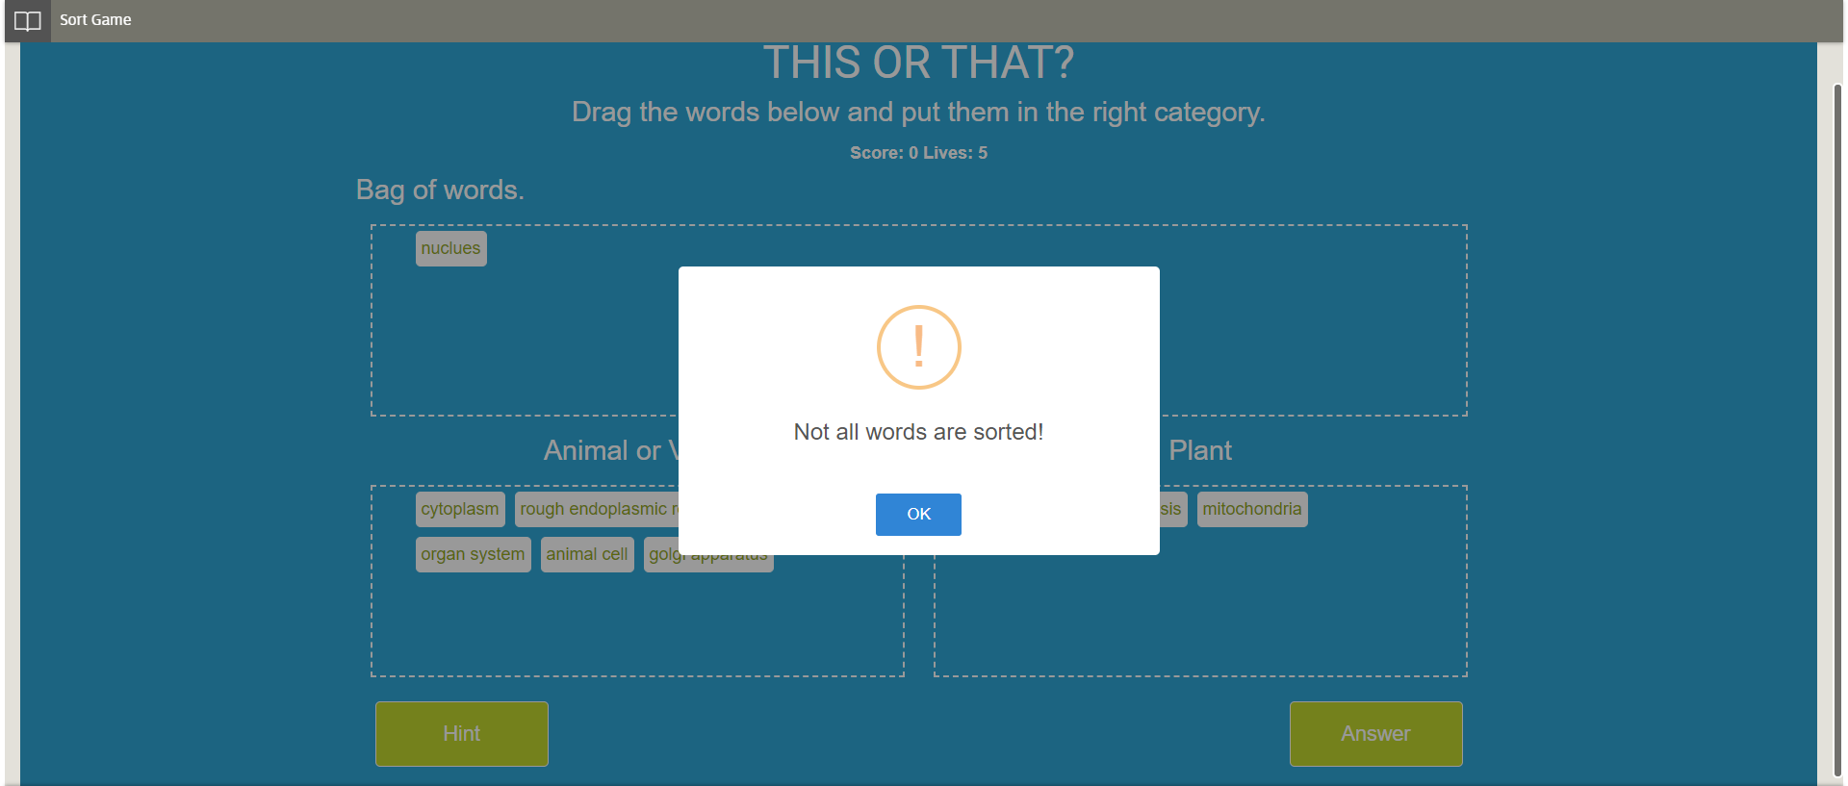
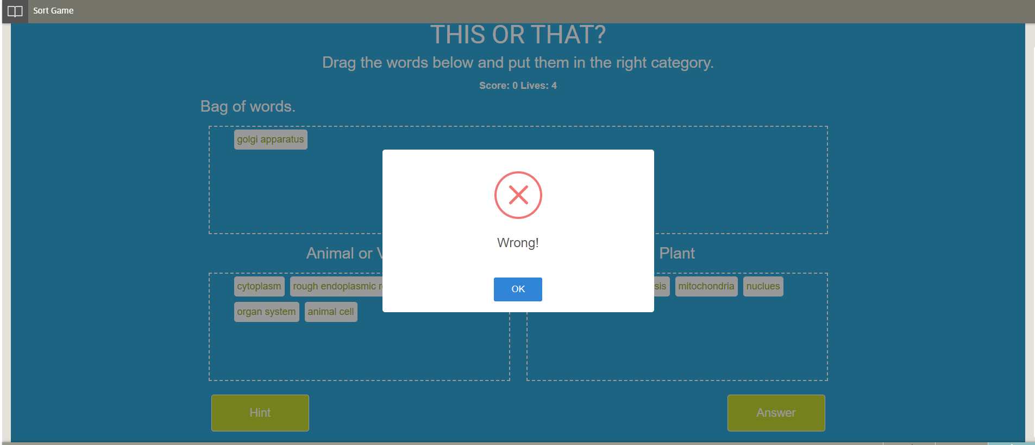
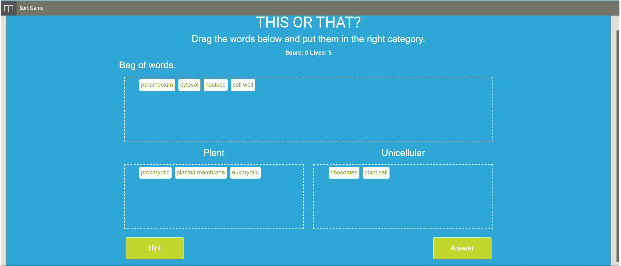
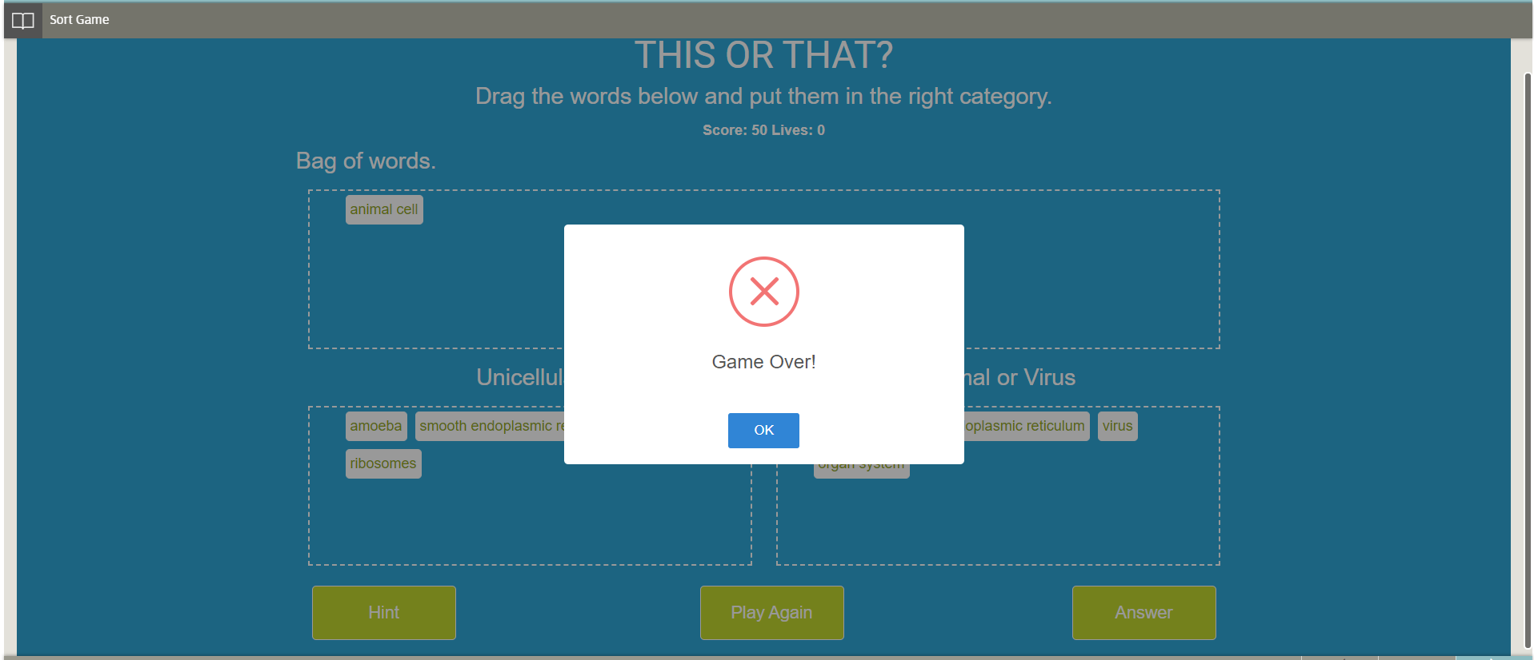
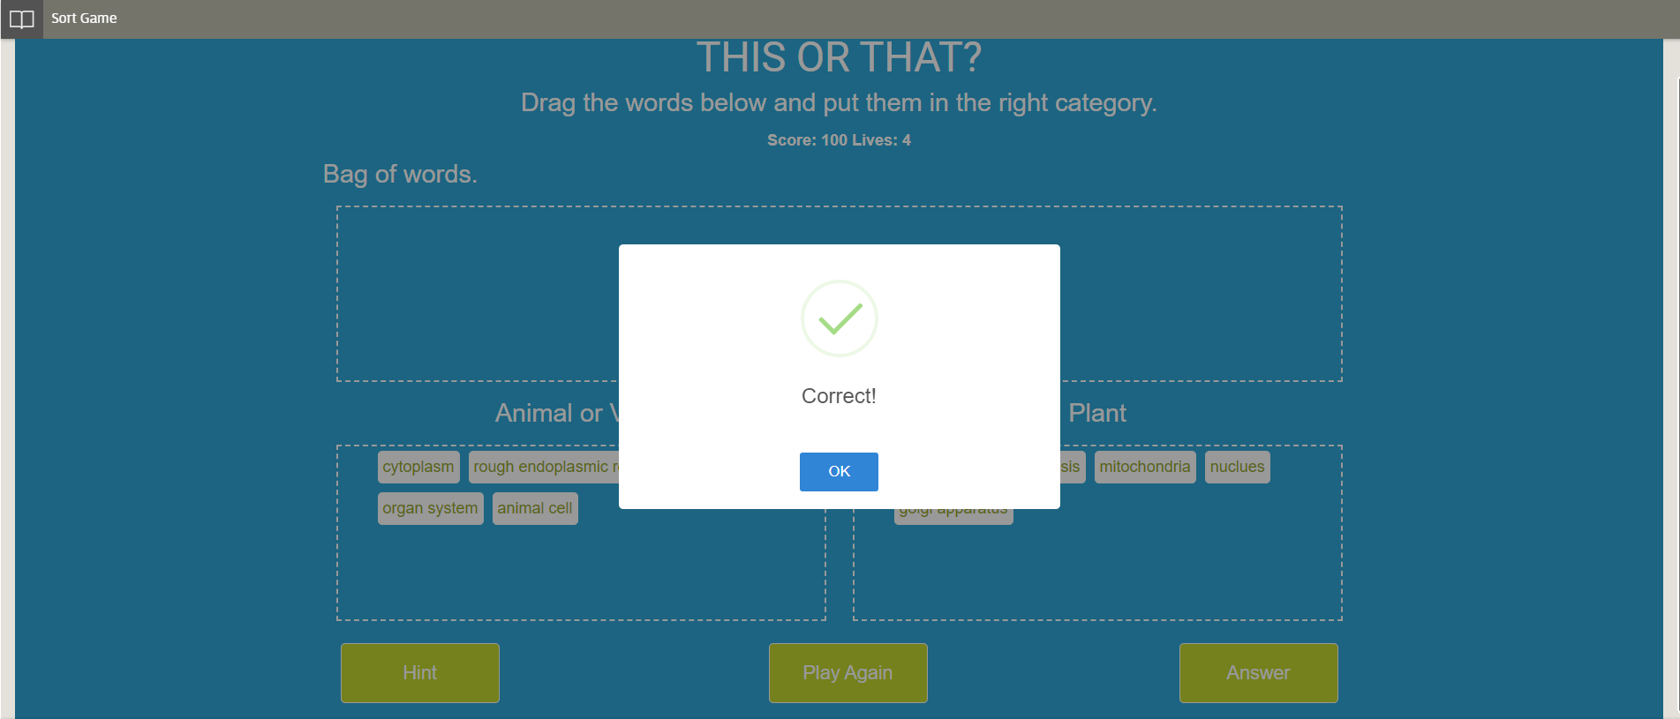
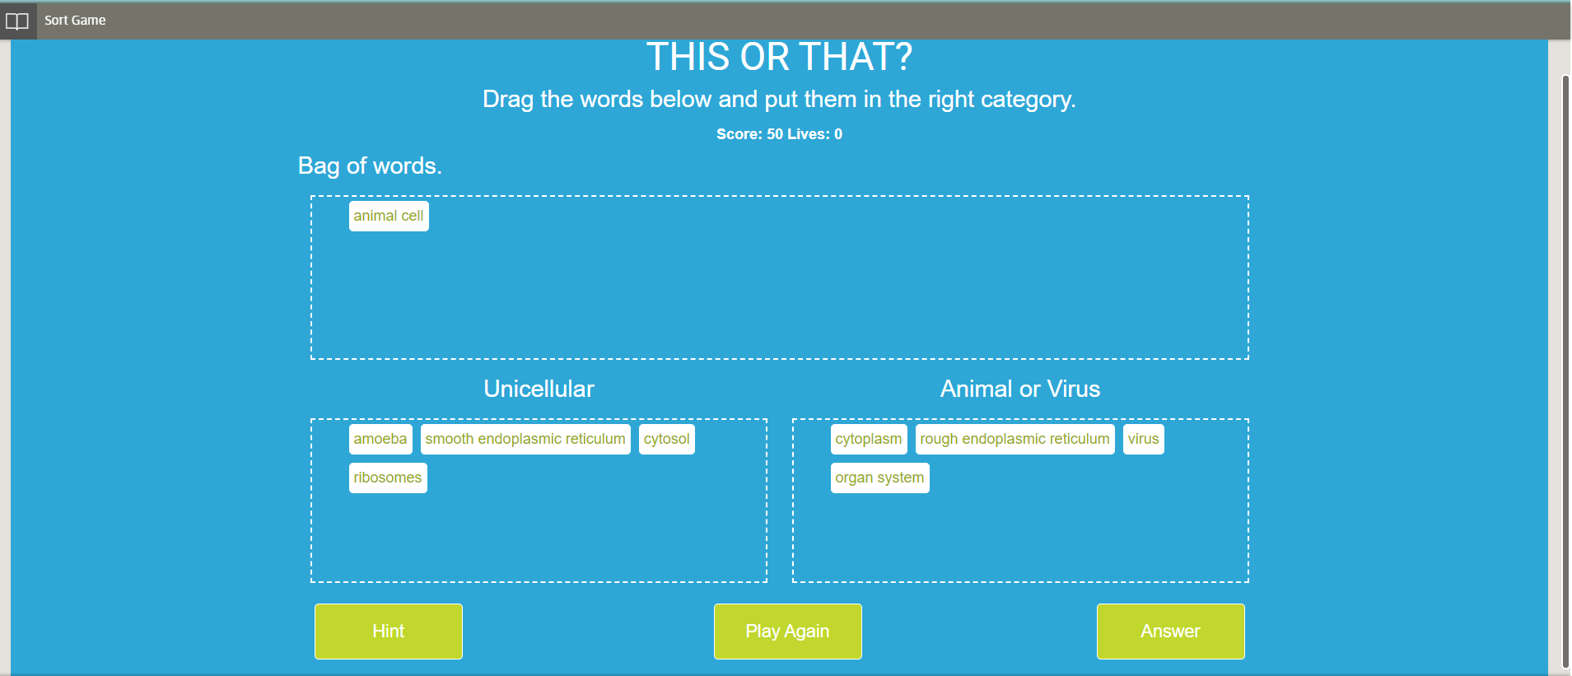
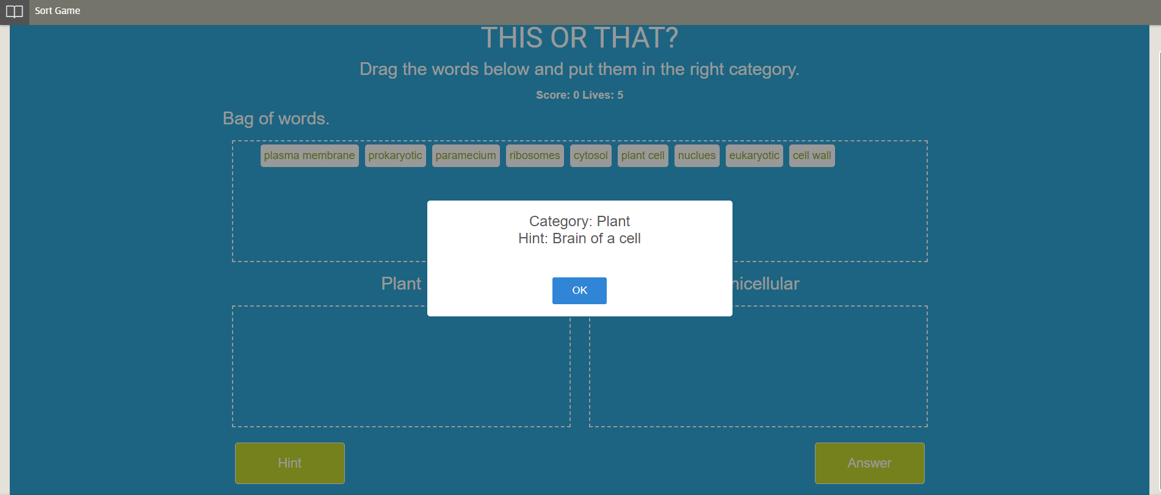
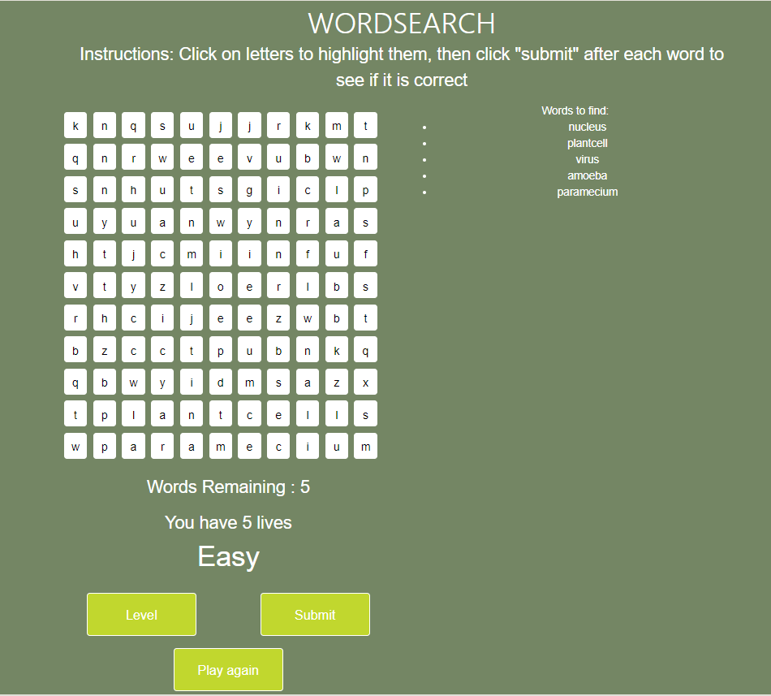
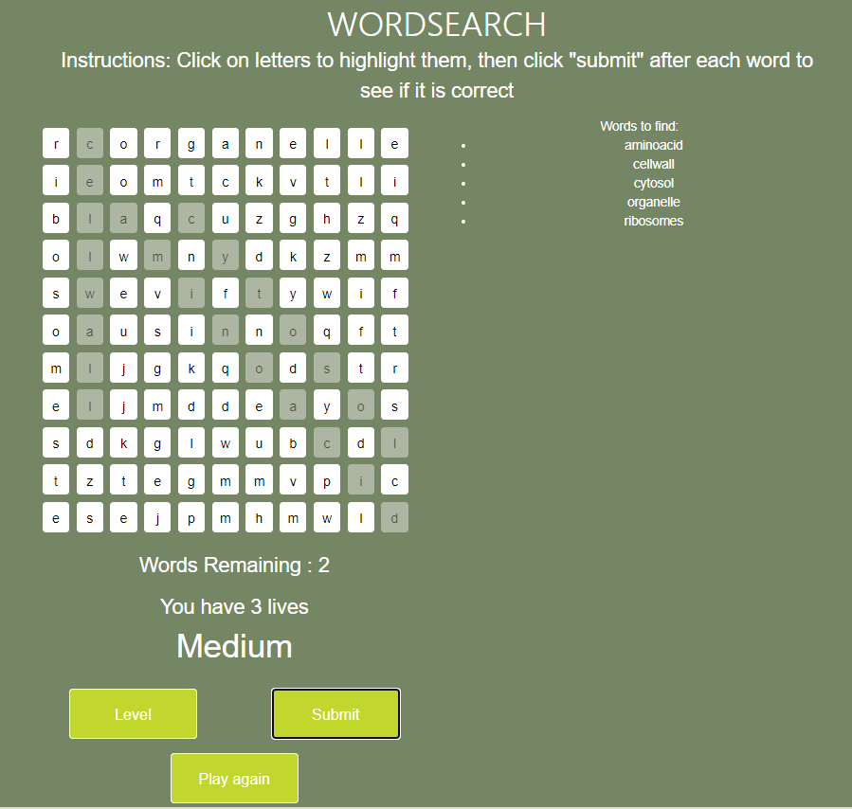
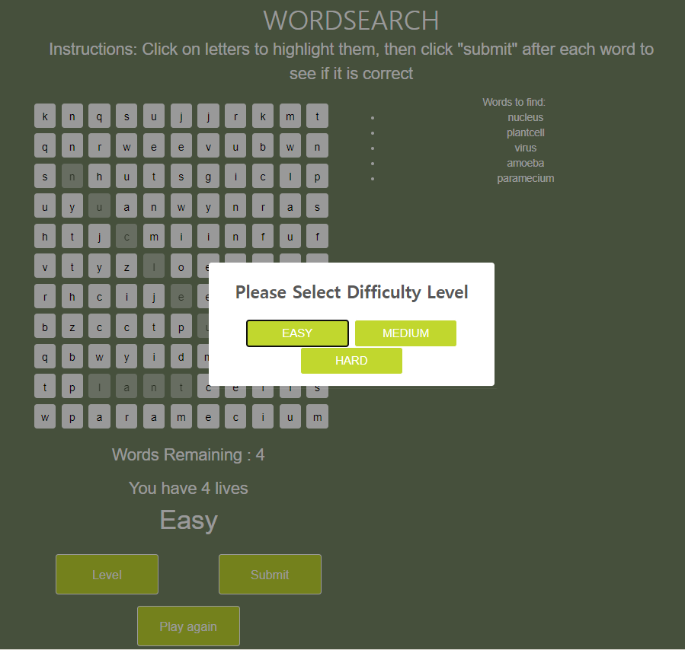
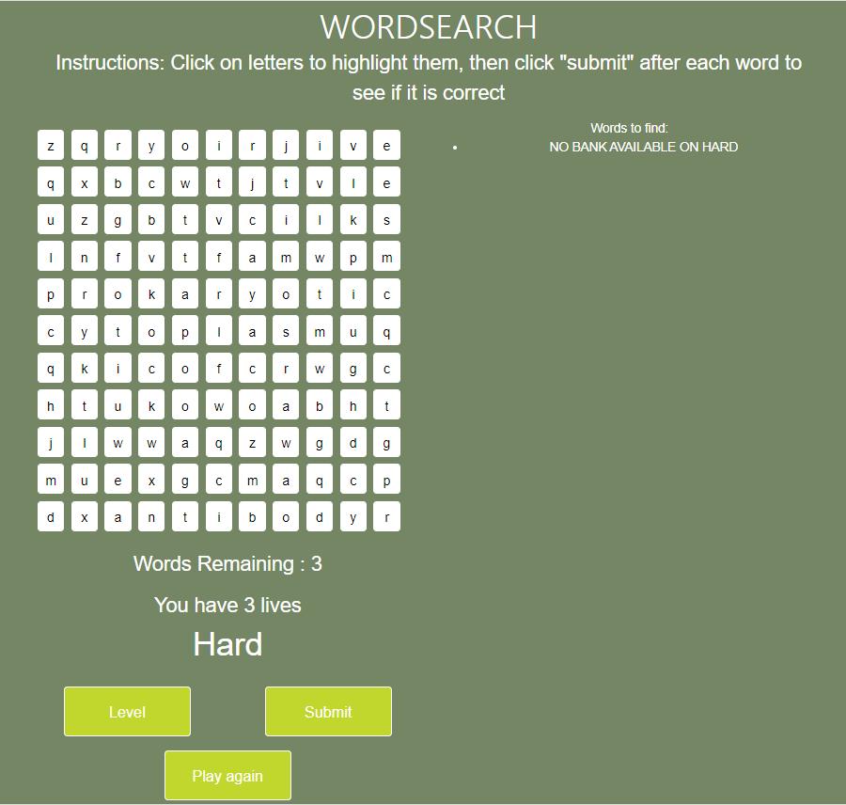
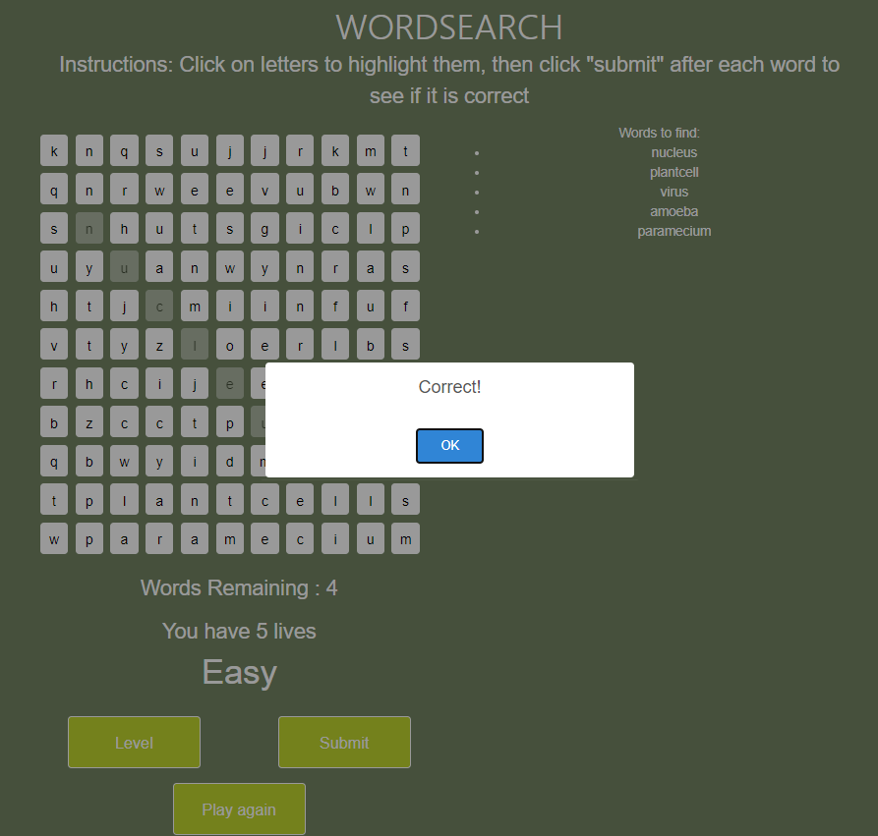
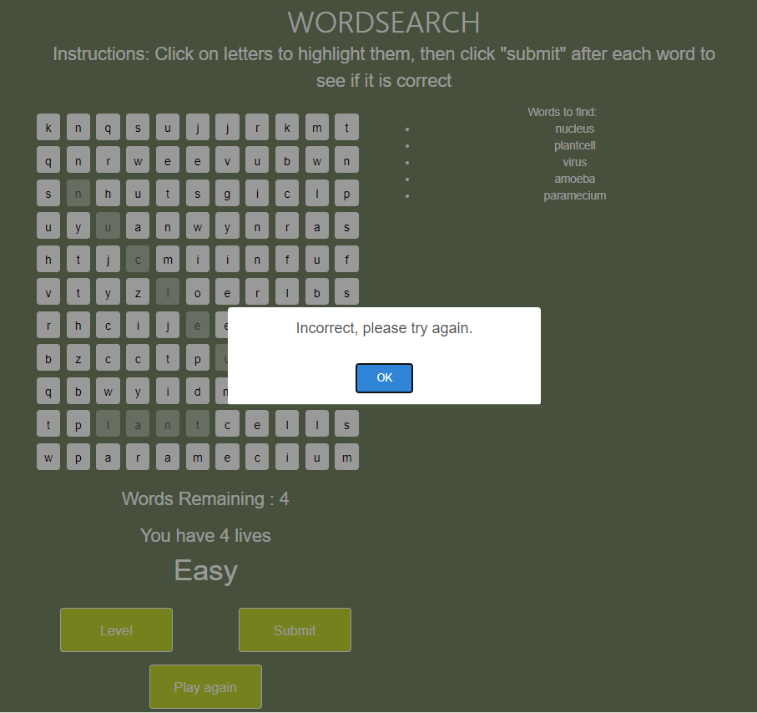
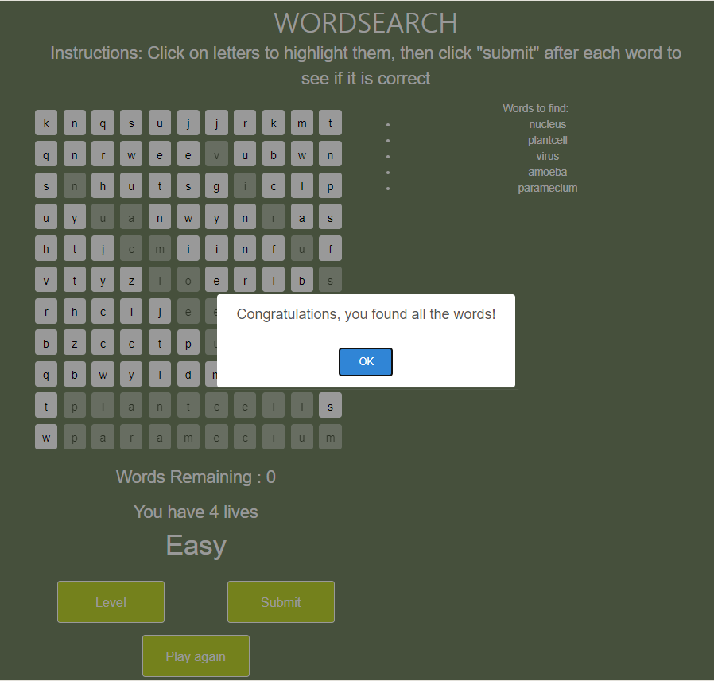
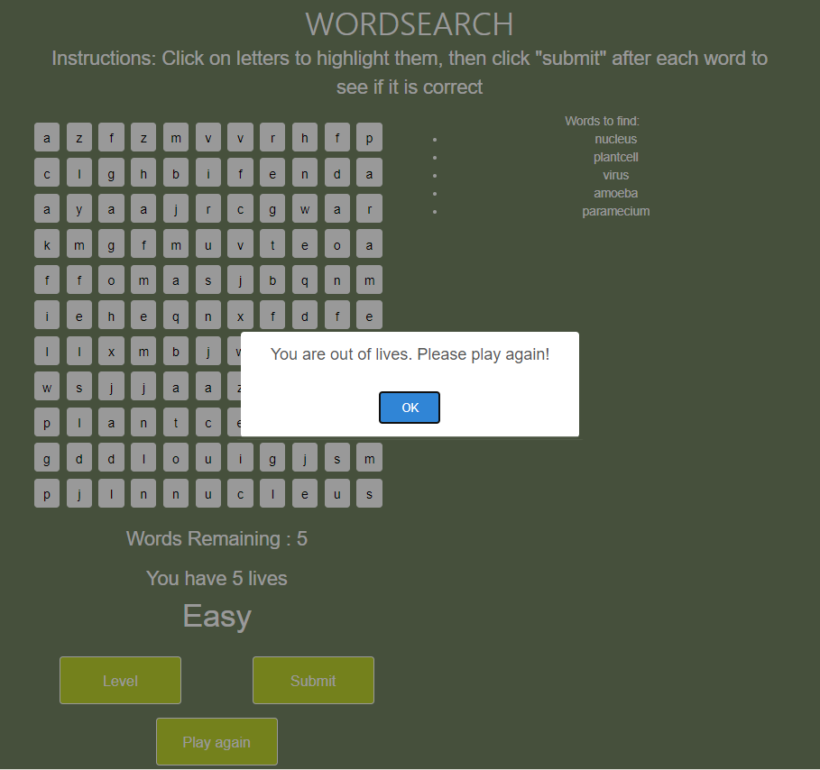
Biology Learning Games
Jack Shirley, Sun Yul Lee, Brady Testa, Logan Keim, Mounika Kunduru, Varsha Venkataramu, Whittney Ford
Texas A&M University, College Station
Introduction
User Interface
Tools for development
Biology Learning games are educational games designed for the reinforcement of biology concepts for middle school students. Our contribution to this system is two games: Sort Game and WordSearch Game. Our customer for this project is the Veterinary Medical & Biomedical Sciences Department of Texas A&M. Our main focus in this project includes:
1. Development of two new games, Word Search and Sort game.
2. Testing of both games on several PC based browsers.
3. Deployment to StepStone environment.
4. Allowing ease of adding new content.
Sort Game
We cooperated with server managers from Veterinary Medical & Biomedical Sciences department to migrate applications to customer server as official deployment.
Programming/Game configuration data: JavaScript
UI development and verification: Bootstrap.
Embedding environment: StepStone authorizing system
Testing deployment: FTP server (futuredogter.com), through WinSCP.
Official deployment: Production server (Vetmed).
Sort Game is a new game introduced as a part of this project
Fig 1. Start Screen
Fig 2. Not All Sorted
Fig 3. Incorrect Sort
Fig 4. General Gameplay
User Stories
Testing and verification
User Stories for Sort game:
As a player, I want the categories in the game to be selected in a random order.
As a player, I want the words in the bag of words to be selected in a random order.
As a player, I want the hint from the Category game to be selected in a random order.
As a player, I want the words in the Category game to be dragged and dropped in the appropriate locations.
As a player, I want to see words clearly.
As a player, I want to check whether I have the correct answer or wrong answer.
As a player, I want to play the sort game again when I click the “play again” button.
As a player, I want to see the score that I make in the sort game.
As a player, I want to set the number of challenges that I can have in the sort game.
As a player, I want to play Sort game with words from the cell biology, ecology, infectious disease, and stress module
We tested both games on Google Chrome, Mozilla Firefox, and Microsoft Edge in the stepstone environment as well as the mobile development mode in Chrome
We ran tests by playing the games on multiple screens with different resolutions.
After testing offline in Chrome we tested both games in all 3 browsers mentioned previously.
For integration testing, we play-tested the two games on the production server to ensure that everything worked together smoothly
Fig 5. Game Over
Fig 6. Victory Screen
Fig 7. Play Again
Fig 8. Hint Screen
WordSearch Game
WordSearch Game is a new game introduced as a part of this project
asasd
Conclusion
User Stories for WordSearch game
Our team successfully implemented, tested, and integrated two new biology-themed games. Our process was guided by Agile, with frequent meetings to check in on progress. Our code allows an administrator to easily add new words to the games without having to change the source code. We tested our code on several different browsers, including Microsoft Edge, Firefox, and Google Chrome. This code was installed on the production server, where students will be able to interact with it.
As a player, I should not see the same letter grid for each game.
As a player, I should not see the exact same word list for each game.
As a player, I want to select letters in the letter grid to find words.
As a player, I want to unselect letters in the letter grid.
As a player, I want to check whether I have the correct answer or wrong answer.
As a player, I want to select the difficulty of the game.
As a player, I want to play the Wordsearch game again when I click the “play again” button.
As a player, I should not see the word list in “Hard” level.
As a player, I want to see a message once the game is over to be notified whether I win or lose.
As a player, I want to play WordSearch game with words from the cell biology, clinical trials, ecology, infectious disease, and stress module.
Fig 1. Starting the game
Fig 2. General Gameplay Screen
Fig 3. Level Selection Screen
Fig 4. Hard Level Screen
Fig 5. Correct answer screen
Fig 6. Incorrect answer screen
Fig 7. Winning screen
Fig 8. Losing screen

