Slide 1
Parallel API Fetching: Crypto Portfolio Price Tracker
By: Logan Morof

Slide 2
Project Motivation and Goals
Motivation:
Cryptocurrency markets have high volatility and rapid price fluctuations.
Price differences across exchanges create profitable arbitrage opportunities.
Traders benefit from quickly identifying and exploiting these differences.
Project Goals:
Develop a real-time cryptocurrency price tracker.
Use parallel programming (async methods) to quickly aggregate crypto prices.
Compare efficiency against traditional sequential approaches.
Detect arbitrage opportunities across exchanges (future goal).

Slide 3



Tools and data Source
Tools:
Python 3.11 – Main programming language for development and scripting.
aiohttp – Asynchronous HTTP client for making non-blocking API requests.
asyncio – Built-in Python library for concurrent programming and managing async tasks.
python-dotenv – Loads API keys and environment variables securely from a .env file.
Data Source:
Aggregates real-time cryptocurrency market data from major exchanges.
Provides access to current prices, trading volume, and market caps.
Requires a free API key for access.
Easy to use, reliable, and well-documented.

Slide 4
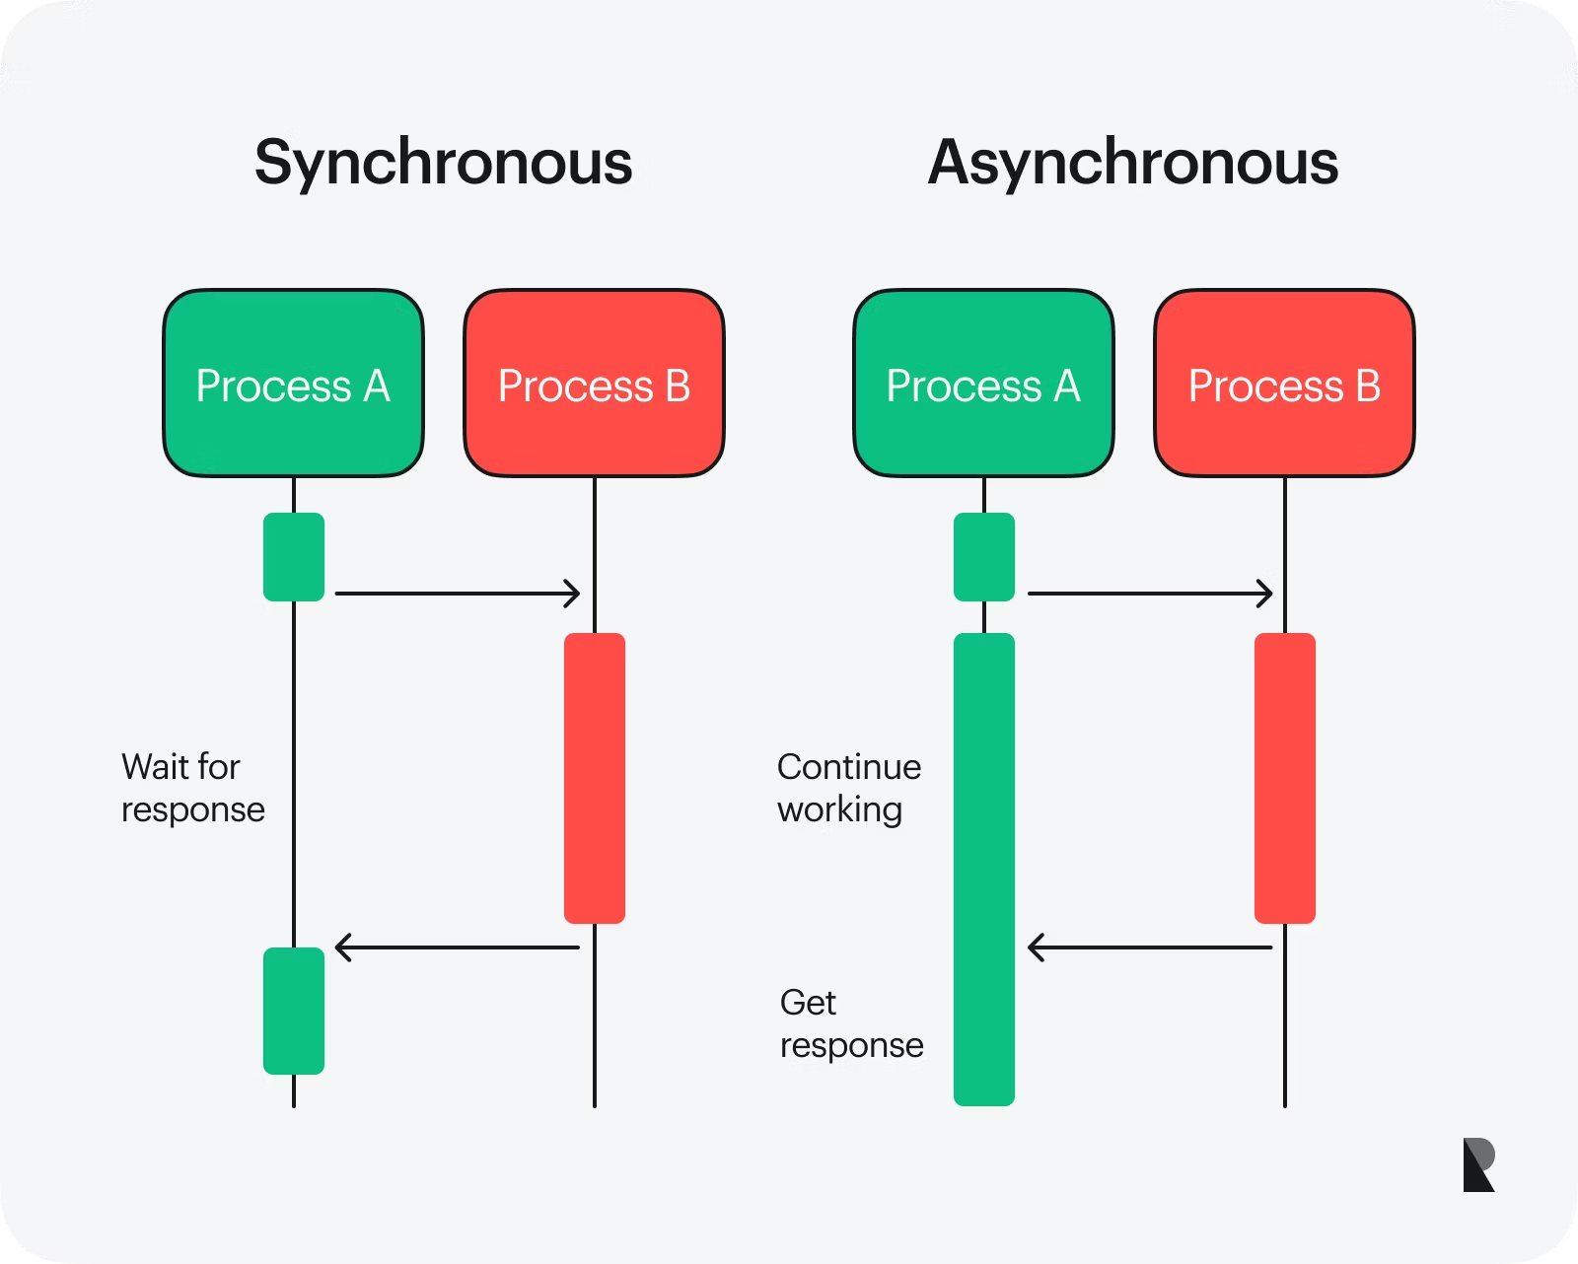
Why Asynchronous Programing
Speeds up I/O-bound tasks like API calls by running them concurrently
Reduces total wait time by handling multiple requests at once
Uses system resources more efficiently than sequential or blocking code
Scales easily to support more simultaneous data sources
Ideal for real-time applications like price tracking and arbitrage detection
Python's async/await syntax keeps code readable and organized
https://www.ramotion.com/blog/synchronous-vs-asynchronous-programming/

Slide 5
Example Workflow
API Request
Parallel Fetching
Data Aggregation
Results Displayed
CoinMarketCap
The program initiates a request to get price data for selected cryptocurrencies
CoinMarketCap receives the request and prepares real-time market data.
Prices for different coins (e.g., BTC, ETH, SOL) are retrieved simultaneously using async functions.
All responses are collected and parsed into a unified format.
The final prices are printed or shown in a user-friendly format on the screen.

