Slide 1
Movie Library Management System
Code Walkthrough Presentation
Logan Young

Slide 2
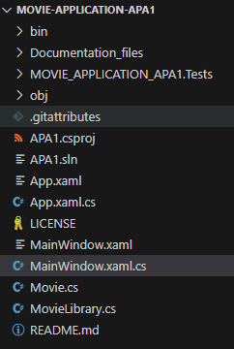
Project Structure
`MainWindow.xaml` / `MainWindow.xaml.cs`: UI layout and logic
`Movie.cs`: Model class for movie objects
`MovieLibrary.cs`: Backend logic for managing movies
`MOVIE_APPLICATION_APA1.Tests`: xUnit test project

Slide 3
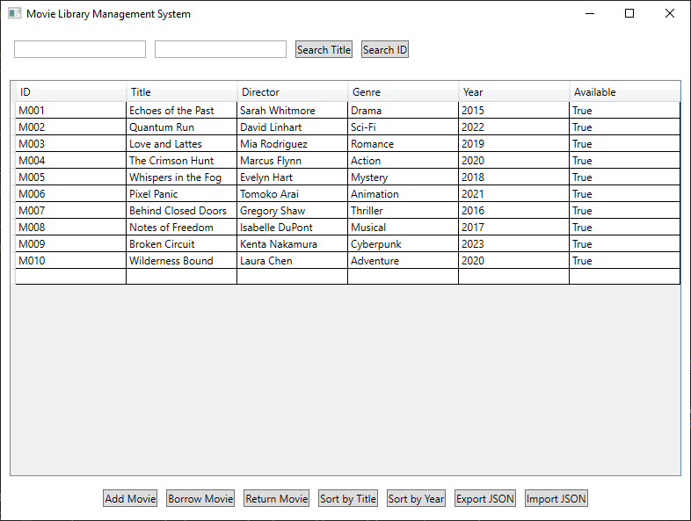
Key Features
Add, search, and sort movies
Borrow and return functionality
Queue system for unavailable movies
JSON import/export
WPF UI for interaction

Slide 4
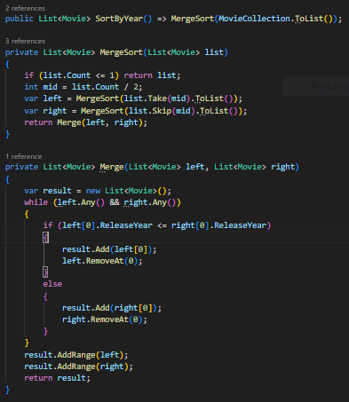
Implemented Algorithm: Sort by Year (Merge Sort)
Recursively splits movie list into halves
Merges sorted halves based on `ReleaseYear`
Ensures stable and predictable sorting for large datasets

Slide 5
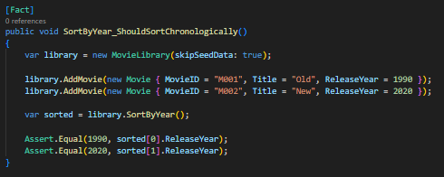
Testing Strategy
Unit tests using xUnit
Add, search, sort, borrow, return
Edge cases like duplicate MovieIDs
Manual UI testing with screenshots
Use of `skipSeedData` flag to isolate logic for clean test state

Slide 6
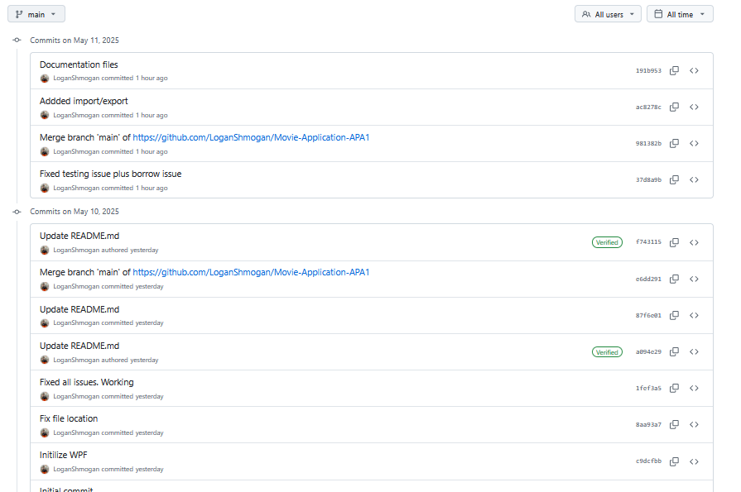
Git Workflow
Used GitHub to manage the repository
Commit messages tracked each feature
Manual commits and pushes after testing
One main branch used for this solo project

Slide 7
Design Decisions
`LinkedList<Movie>` for ordered, dynamic movie list
`Dictionary<string, Movie>` for fast lookup by ID
`Queue<string>` to manage waiting lists fairly
Chose WPF for its modern, flexible UI capabilities
JSON for data portability and ease of editing

