Slide 1

Basic Models in TensorFlow
CS 20SI:
TensorFlow for Deep Learning Research Lecture 3
1/20/2017

Slide 3
Agenda
Review
Linear regression in TensorFlow Optimizers
Logistic regression on MNIST Loss functions

Slide 4
Review

Slide 5
Computation graph
TensorFlow separates definition of computations from their execution
Phase 1: assemble a graph
Phase 2: use a session to execute operations in the graph.

Slide 6
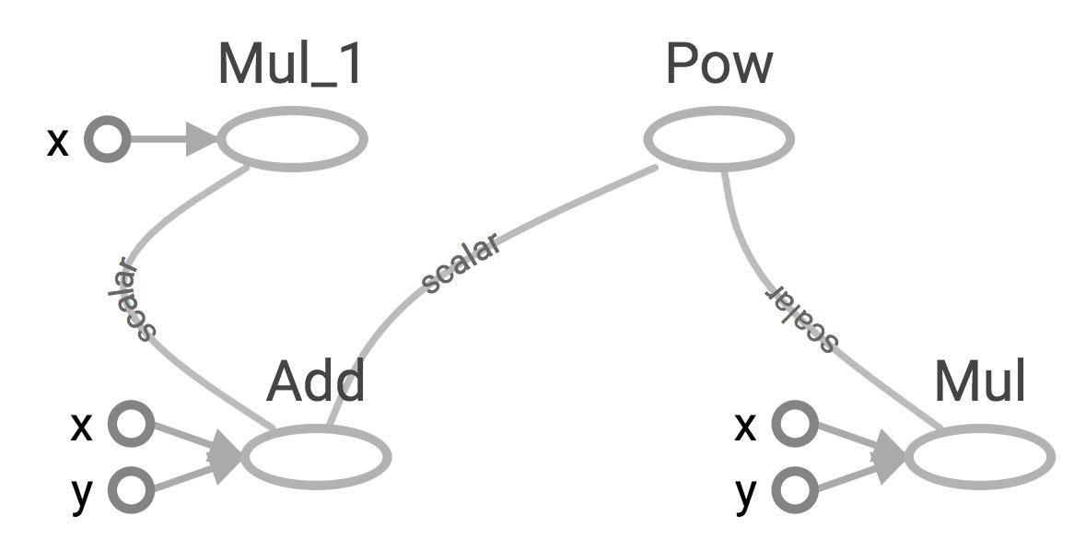
TensorBoard
a = 2
b = 3
a
useless
z
x = tf.add(a, b)
y = tf.mul(a, b)
useless = tf.mul(a, x)
a b
a b
x
y
z = tf.pow(y, x)
with tf.Session() as sess:
Create a FileWriter object to write your graph to event files
z = sess.run(z)

Slide 7
tf.constant and tf.Variable
Constant values are stored in the graph definition
Sessions allocate memory to store variable values

Slide 8
tf.placeholder and feed_dict
Feed values into placeholders by dictionary (feed_dict)
You can feed values in variables too

Slide 9
Avoid lazy loading
Separate the assembling of graph and executing ops
Use Python attribute to ensure a function is only loaded the first time it’s called

Slide 10
Go to GitHub
From examples
03_linear_regression_starter.py 03_logistic_regression_mnist_starter.py From data
Get the file fire_theft.xls

Slide 11
Linear Regression

Slide 12
Model relationship between a scalar dependent variable y and independent variables X

Slide 13
The City of Chicago
X: number of incidents of fire Y: number of incidents of theft

Slide 14
Want
X: number of incidents of fire Y: number of incidents of theft Predict Y from X

Slide 15
Model
w * X + b
(Y - Y_predicted)²

Slide 16
Phase 1: Assemble our graph

Slide 17
Step 1: Read in data
I already did that for you

Slide 18
Step 2: Create placeholders for inputs and labels
tf.placeholder(dtype, shape=None, name=None)

Slide 19
Step 3: Create weight and bias
tf.Variable(initial_value=None, trainable=True, collections=None, name=None, dtype=None, ...)

Slide 20
Step 4: Build model to predict Y
Y_predicted = X * w + b

Slide 21
Step 5: Specify loss function
tf.square(Y - Y_predicted, name="loss")

Slide 22
Step 6: Create optimizer
tf.train.GradientDescentOptimizer(learning_rate=0.001).minimize(loss)

Slide 23
Phase 2: Train our model
Initialize variables
Run optimizer op
(with data fed into placeholders for inputs and labels)

Slide 24
See your model in TensorBoard
Step 1: writer = tf.summary.FileWriter('./my_graph/03/linear_reg', sess.graph)
Step 2: $ tensorboard --logdir='./my_graph'

Slide 25
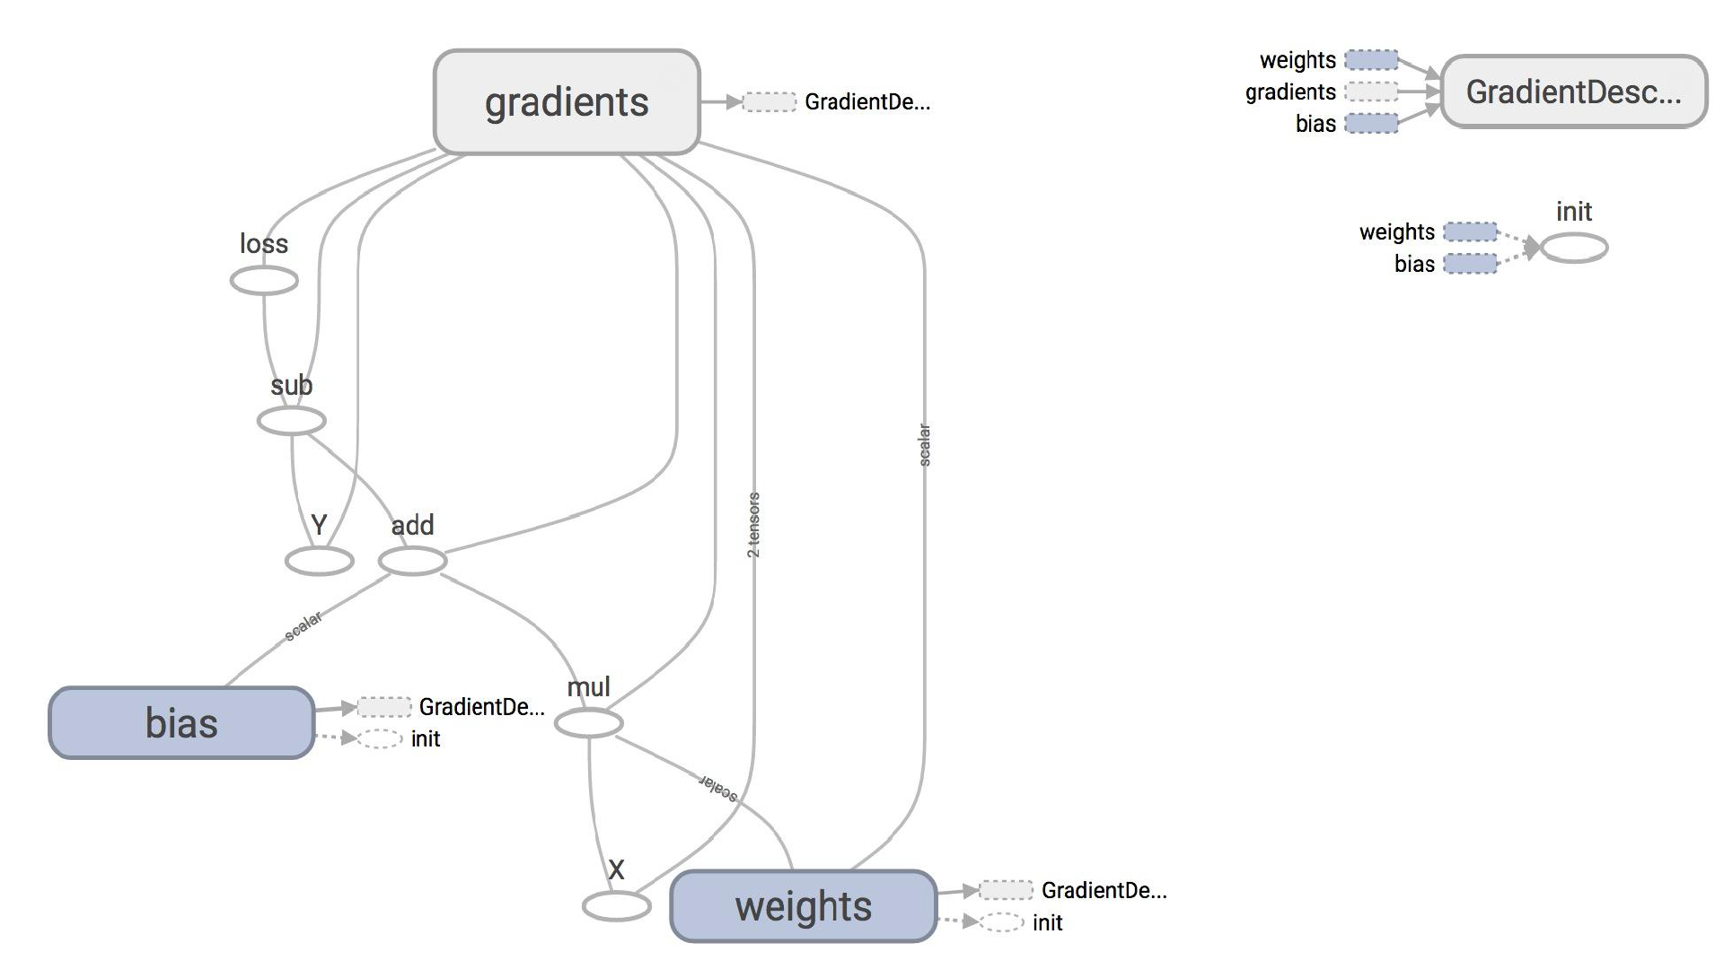

Slide 26
Plot the results with matplotlib
Step 1: Uncomment the plotting code at the end of your program
Step 2: Run it again
If run into problem of matplotlib in virtual environment, go to GitHub/setups and see the file possible setup problems

Slide 27
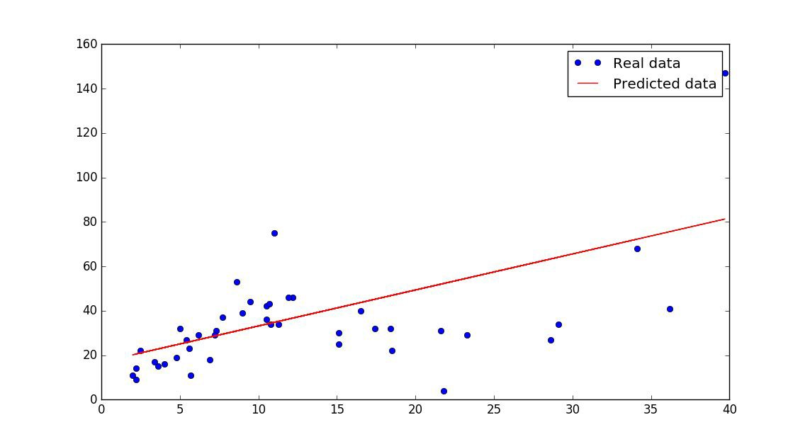

Slide 28
ValueError?

Slide 29
ValueError?
w, b = sess.run([w, b])

Slide 30
How does TensorFlow know what variables to update?

Slide 31
Optimizer
optimizer = tf.train.GradientDescentOptimizer(learning_rate=0.001).minimize(loss)
_, l = sess.run([optimizer, loss], feed_dict={X: x, Y:y})

Slide 32
Optimizer
optimizer = tf.train.GradientDescentOptimizer(learning_rate=0.001).minimize(loss)
_, l = sess.run([optimizer, loss], feed_dict={X: x, Y:y})
Session looks at all
trainable
variables that loss depends on and update them

Slide 33
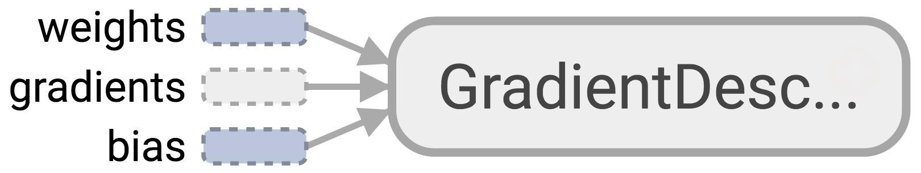
Optimizer
Session looks at all
trainable
variables that optimizer depends on and update them

Slide 34
Trainable variables
tf.Variable(initial_value=None, trainable=True, collections=None, validate_shape=True, caching_device=None, name=None, variable_def=None, dtype=None, expected_shape=None, import_scope=None)

Slide 35
List of optimizers in TF
tf.train.GradientDescentOptimizer
tf.train.AdagradOptimizer tf.train.MomentumOptimizer tf.train.AdamOptimizer tf.train.ProximalGradientDescentOptimizer tf.train.ProximalAdagradOptimizer tf.train.RMSPropOptimizer
And more

Slide 36
Discussion question
How to know that our model is correct?
How to improve our model?

Slide 37
How to improve our model

Slide 38
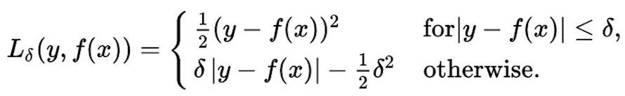
Huber loss
Robust to outliers
Intuition: if the difference between the predicted value and the real value is small, square it
If it’s large, take its absolute value

Slide 39
Implementing Huber loss
Can’t write:
if Y - Y_predicted < delta:

Slide 40
Huber loss
def huber_loss(labels, predictions, delta=1.0):
residual = tf.abs(predictions - labels) condition = tf.less(residual, delta) small_res = 0.5 * tf.square(residual)
large_res = delta * residual - 0.5 * tf.square(delta) return tf.select(condition, small_res, large_res)

Slide 41
Assignment 1
Out midnight today Due 1/31
Optional Interactive Grading

Slide 42
Logistic Regression

Slide 43
Then he separated the light from the darkness
The first logistic regression model
43

Slide 44
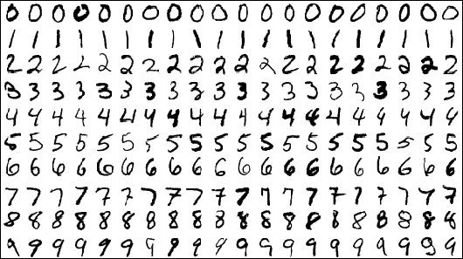
MNIST Database
Each image is a 28x28 array, flattened out to be a 1-d tensor of size 784

Slide 45
MNIST
X: image of a handwritten digit Y: the digit value

Slide 46
Want
X: image of a handwritten digit Y: the digit value
Recognize the digit in the image

Slide 47
Model
logits = X * w + b
Y_predicted = softmax(logits) loss = cross_entropy(Y, Y_predicted)
*Y is a one-hot vector

Slide 48
Batch ‘em up
X = tf.placeholder(tf.float32, [batch_size, 784], name="image")
Y = tf.placeholder(tf.float32, [batch_size, 10], name="label")
*Y is a one-hot vector

Slide 49
Process data
from tensorflow.examples.tutorials.mnist import input_data MNIST = input_data.read_data_sets("/data/mnist", one_hot=True)

Slide 50
Process data
from tensorflow.examples.tutorials.mnist import input_data MNIST = input_data.read_data_sets("/data/mnist", one_hot=True)
MNIST.train: 55,000 examples
MNIST.validation: 5,000 examples
MNIST.test: 10,000 examples

Slide 51
Phase 1: Assemble our graph

Slide 52
Step 2: Create placeholders for inputs and labels
X = tf.placeholder(tf.float32, [batch_size, 784], name="image")
Y = tf.placeholder(tf.float32, [batch_size, 10], name="label")

Slide 53
Step 3: Create weight and bias
tf.Variable(initial_value=None, trainable=True, collections=None, name=None, dtype=None, ...)

Slide 54
Step 4: Build model to predict Y
logits = X * w + b

Slide 55
Step 5: Specify loss function
entropy = tf.nn.softmax_cross_entropy_with_logits(logits, Y)
loss = tf.reduce_mean(entropy)

Slide 56
Step 6: Create optimizer
tf.train.GradientDescentOptimizer(learning_rate=0.001).minimize(loss)

Slide 57
Phase 2: Train our model
Initialize variables
Run optimizer op
(with data fed into placeholders for inputs and labels)

Slide 58
Run our model
Average loss epoch 0: 1.28812279526
Average loss epoch 1: 0.732620414598
Average loss epoch 2: 0.600486441648
Average loss epoch 3: 0.53647331619
Average loss epoch 4: 0.497578099683
...
Average loss epoch 9: 0.41295143427 Total time: 8.83596801758 seconds Optimization Finished!
Accuracy 0.8977

Slide 59
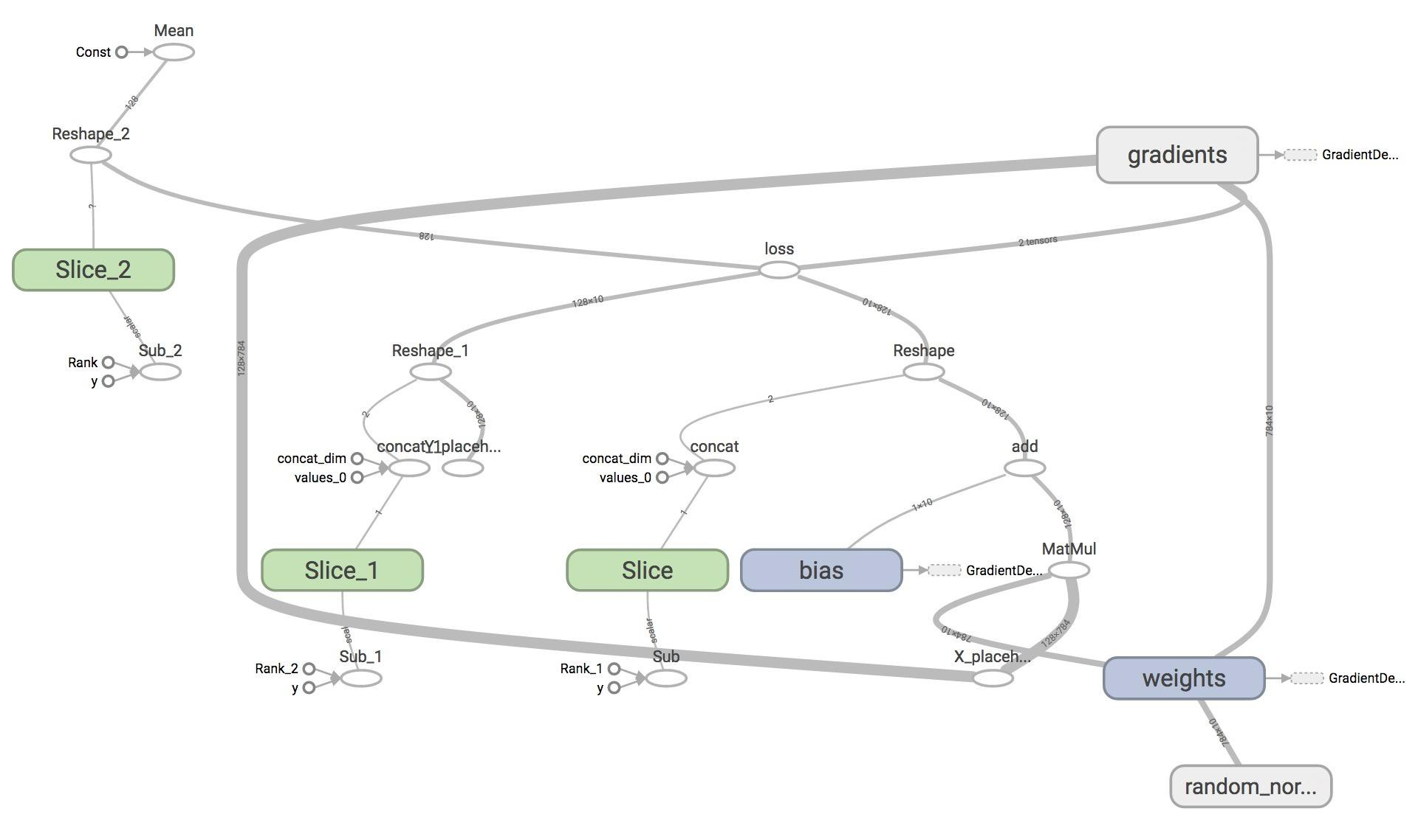
TensorBoard it

Slide 60
Next class
Structure your model in TensorFlow
Example: word2vec

