Slide 1
Predicting twitter for 2016 Presidency Election
Gaoyang Ye

Slide 2
What’s this Project for?

Slide 3
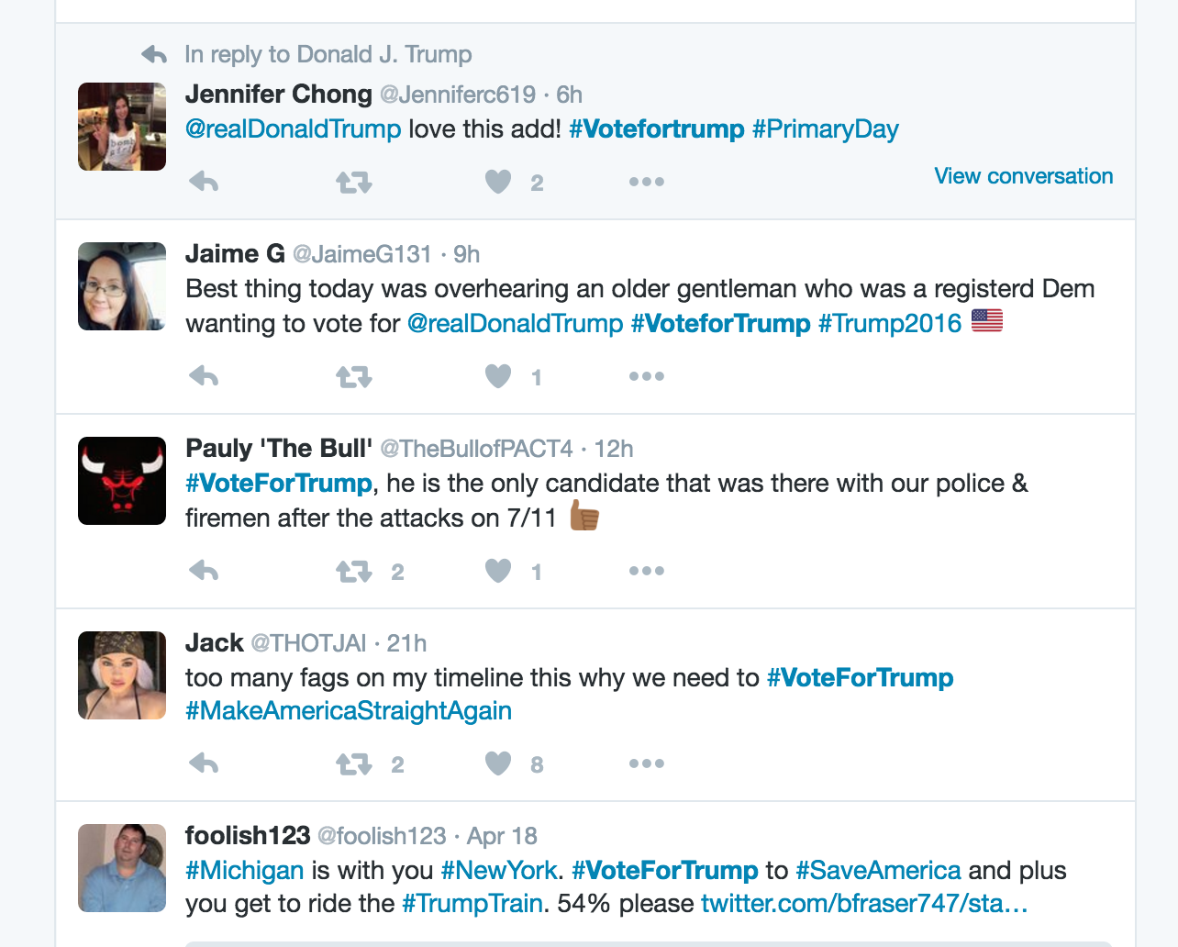
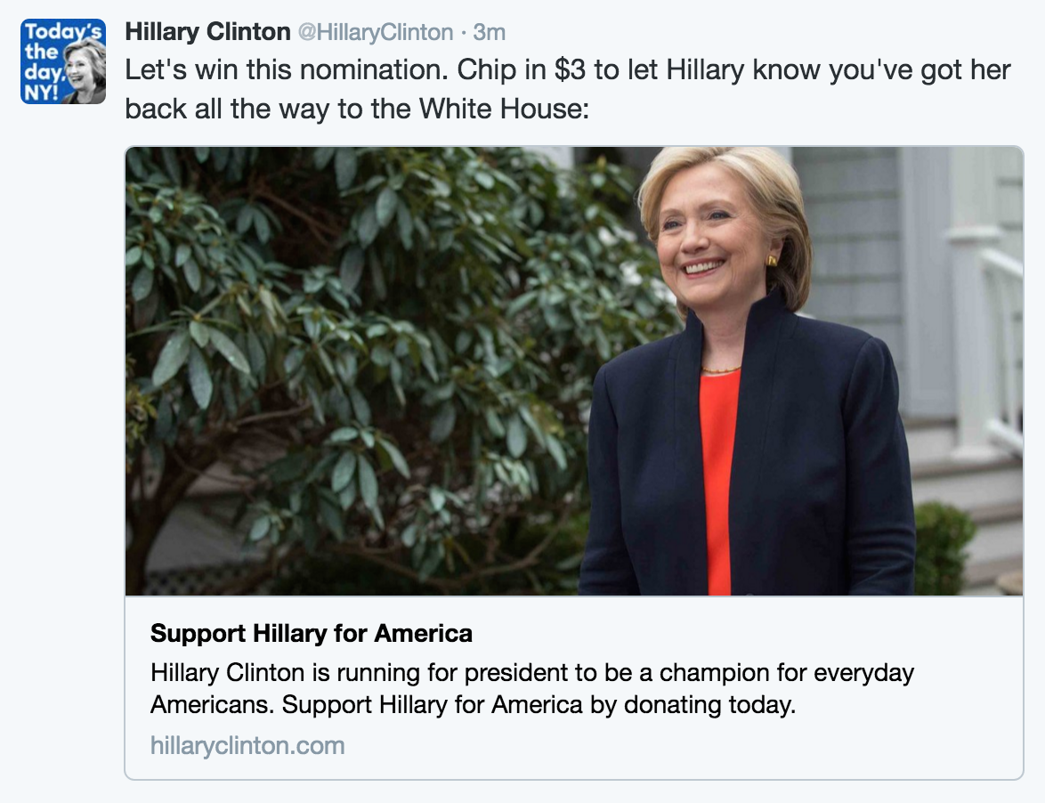
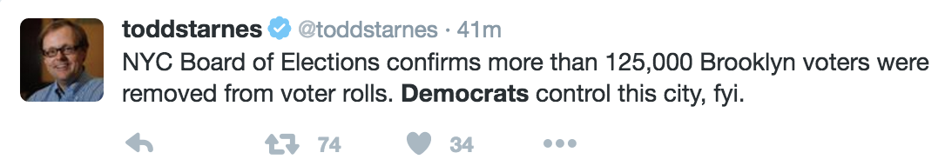
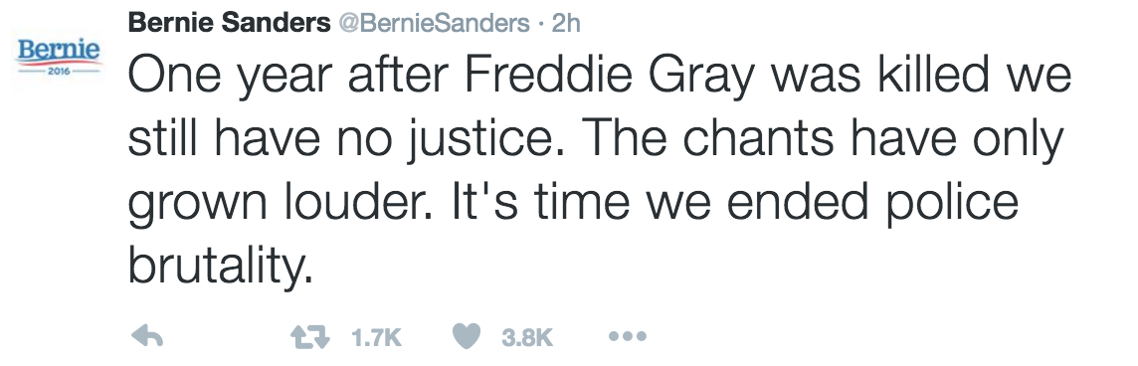
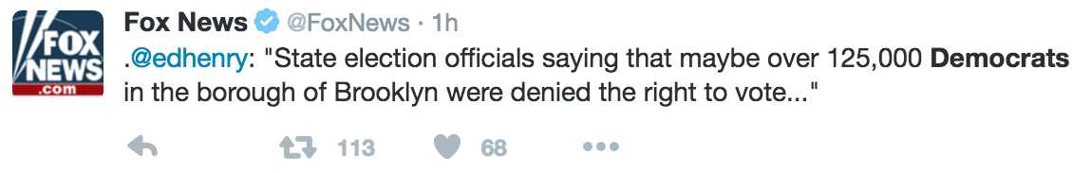

Slide 4
Data
Grab from Twitter using API “tweepy”

Slide 5
Training data
Grab hashtable
Use hashtable as class

Slide 6
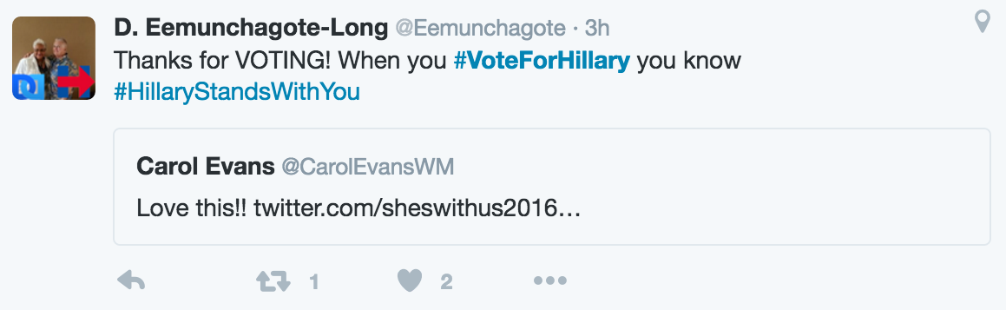

Slide 7
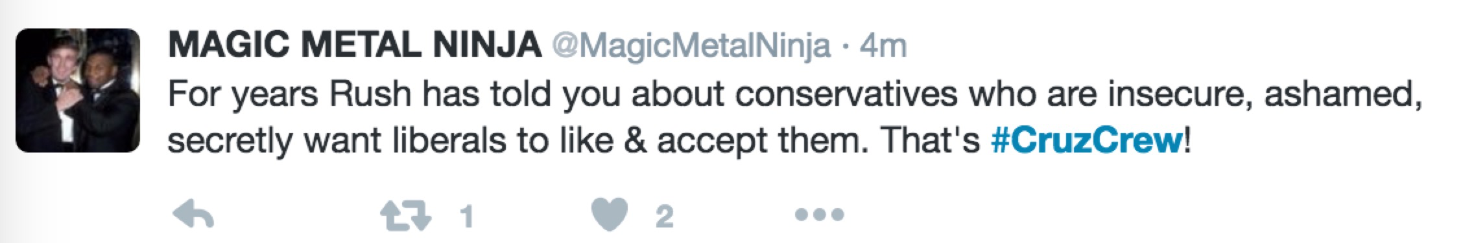

Slide 8
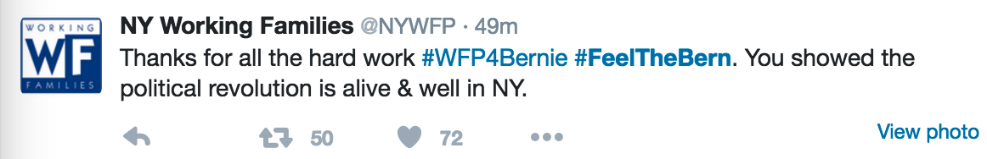

Slide 9
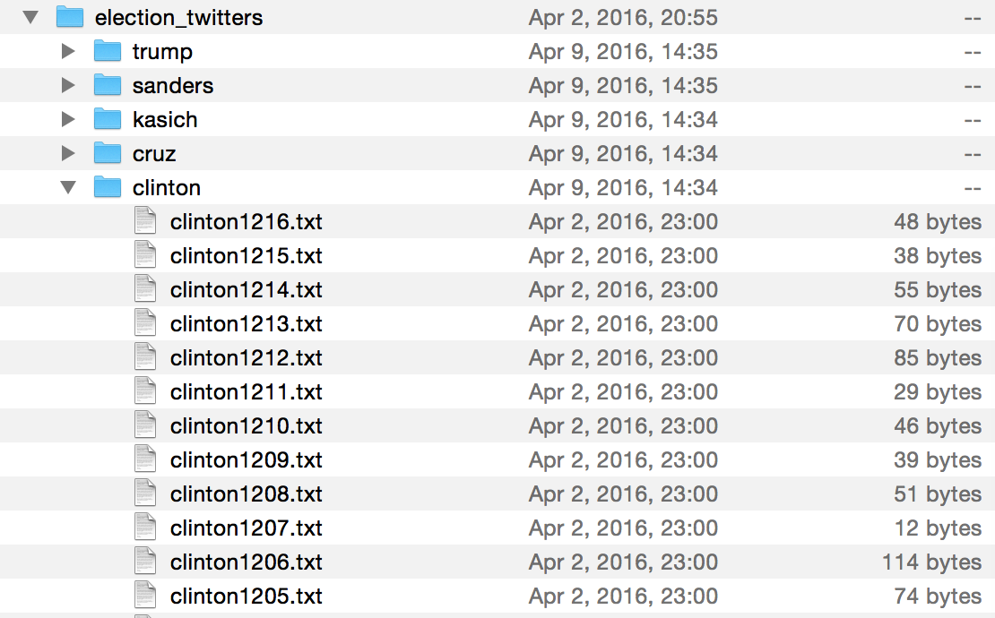
Store every tweets as txt file.

Slide 10
Test data
Grab from twitter using same package
No hashtable

Slide 11
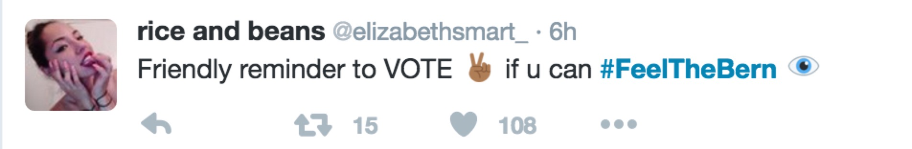
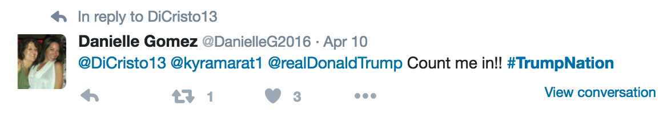
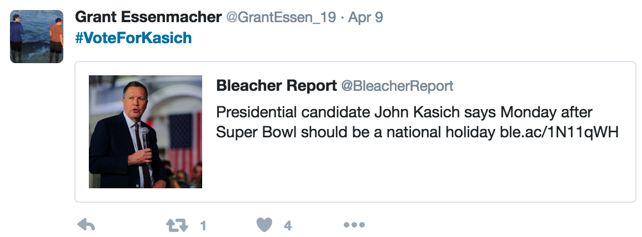

Slide 12
Model
Naïve Bayes
Neural Network

Slide 13
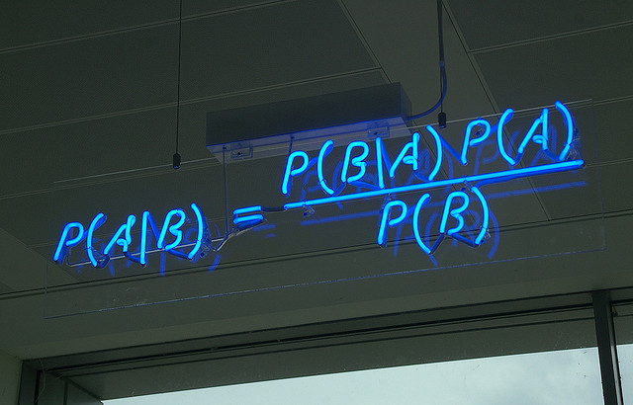


Slide 14
Runtime
Naïve Bayes: few seconds
Neural Network: More than 40 min

Slide 15
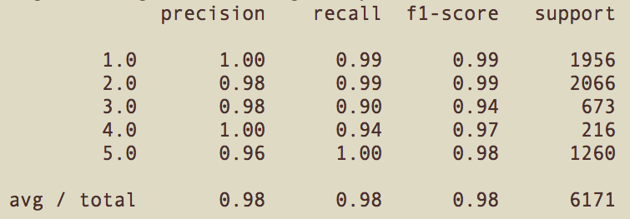
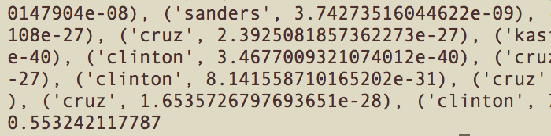
Accuracy
Naïve Bayes: 55%
Neural Network: 64%

Slide 16
Let’s try it!

Slide 17
Questions?

Slide 18
Thank you!

