Slide 1

Windows Azure Storage Introduction IaaS VM Pod Logan Zhao
July 2018
Illustrations may be used in internal and external audience presentations, but this slide library is not intended for distribution outside of Microsoft.
©2016 Microsoft Corporation. All rights reserved.

Slide 2
Agenda
Basic Introduction and data abstraction
Architecture and data operations
Design choices

Slide 3
What is Windows Azure Storage?
WAS is Microsoft's cloud storage solution for modern data storage scenarios. Azure Storage offers a massively scalable object store for data objects, a file system service for the cloud, a messaging store for reliable messaging, and a NoSQL store.
Durable and highly available
Secure
Scalable
Managed
Accessible
Notes:
Durable and highly available. Redundancy ensures that your data is safe in the event of transient hardware failures. You can also opt to replicate data across datacenters or geographical regions for additional protection from local catastrophe or natural disaster. Data replicated in this way remains highly available in the event of an unexpected outage.
Secure. All data written to Azure Storage is encrypted by the service. Azure Storage provides you with fine-grained control over who has access to your data. SSE
Scalable. Azure Storage is designed to be massively scalable to meet the data storage and performance needs of today's applications.
Managed. Microsoft Azure handles maintenance and any critical problems for you.
Accessible. Data in Azure Storage is accessible from anywhere in the world over HTTP or HTTPS. Microsoft provides SDKs for Azure Storage in a variety of languages -- .NET, Java, Node.js, Python, PHP, Ruby, Go, and others -- as well as a mature REST API. Azure Storage supports scription in Azure PowerShell or Azure CLI. And the Azure portal and Azure Storage Explorer offer easy visual solutions for working with your data.

Slide 4
Azure Storage services Data Abstraction
Azure Blobs: A massively scalable object store for text and binary data.
Azure Files: Managed file shares for cloud or on-premises deployments.
Azure Queues: A messaging store for reliable messaging between application components.
Azure Tables: A NoSQL store for schemaless storage of structured data.
Notes:
Blobs –Azure Blob storage is Microsoft's object storage solution for the cloud. Blob storage is optimized for storing massive amounts of unstructured data, such as text or binary data.
Serving images or documents directly to a browser.
Storing files for distributed access.
Streaming video and audio.
Storing data for backup and restore, disaster recovery, and archiving.
Storing data for analysis by an on-premises or Azure-hosted service.
Tables – Massively scalable structured storage
CosmosDB
Azure Table storage is a service that stores structured NoSQL data in the cloud, providing a key/attribute store with a schemaless design.
Queues – Reliable storage and delivery of messages
Creating a backlog of work to process asynchronously
Passing messages from an Azure web role to an Azure worker role
Files – Durable NTFS volumes for Windows Azure applications

Slide 5
A quick demo for how to use blob API
https://docs.microsoft.com/en-us/rest/api/storageservices/operations-on-blobs
Operations for block blobs and page blob.
Difference between them:
Block blob: upload and commit
Page blob: Immediate Update
Notes:
Immediate Update Semantics – As soon as a write request for a sequential set of pages succeeds in the blob service, the write has committed, and success is returned back to the client. The update is immediate, so there is no commit step as there is for block blobs.

Slide 6
Windows Azure Storage Architecture

Slide 7
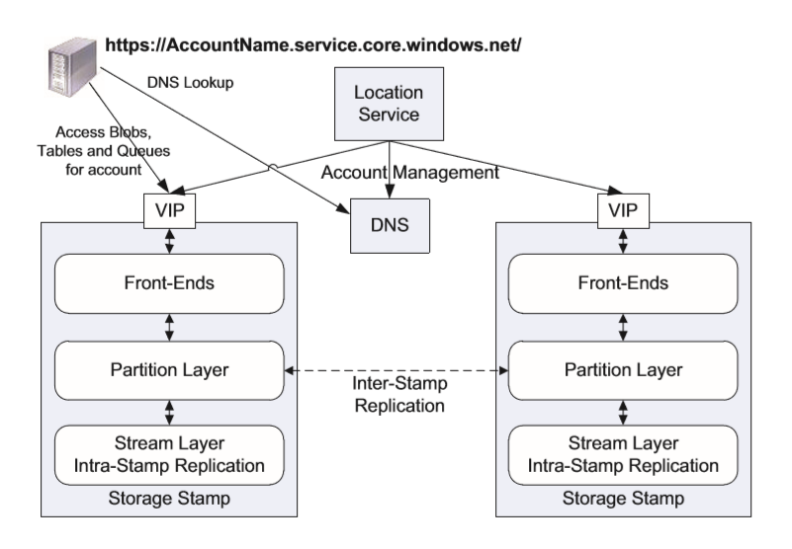
http(s)://AccountName.<service>.core.windows.net/PartitionName/ObjectName Location service:
Notes:
To provide this capability we leverage DNS as part of the storage namespace and break the storage namespace into three parts: an account name, a partition name, and an object name. As a result, all data is accessible via a URI of the form: http(s)://AccountName.<service>1.core.windows.net/PartitionName/ObjectName
DNS host name. The AccountName DNS translation is used to locate the primary storage cluster and data center where the data is stored.
PartitionName locates the data once a request reaches the storage cluster. 同时partition name用来做scale out.
When a PartitionName holds many objects, the ObjectName identifies individual objects within that partition.
The LS then stores the account metadata information in the chosen storage stamp, which tells the stamp to start taking traffic for the assigned account. The LS then updates DNS to allow requests to now route from the name https://AccountName.service.core.windows.net/ to that storage stamp’s virtual IP (VIP, an IP address the storage stamp exposes for external traffic).

Slide 8
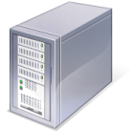
Storage Stamp Architecture
Stateless Servers
Authentication + authorization
Request routing
Front End Layer
FE
FE
FE
FE
FE
Partition
Master
Lock Service
Partition Layer
Partition
Server
Partition
Server
Partition
Server
Partition
Server
M
Stream
Layer
M
Paxos
M
Extent Nodes (EN)
Notes:
Upon receiving a request, an FE looks up the AccountName, authenticates and authorizes the request, then routes the request to a partition server in the partition layer (based on the PartitionName)
The system maintains a Partition Map that keeps track of the PartitionName ranges and which partition server is serving which PartitionNames.

Slide 9
Storage Stamp Architecture – Partition Layer
Managing and understanding higher level data abstractions (Blob, Table, Queue)
Stores and reads the objects to/from extents in the Stream layer
Provides inter-stamp (geo) replication by shipping logs to other stamps
Scalable object index via partitioning
Partition
Master
Lock Service
Partition Layer
Partition
Server
Partition
Server
Partition
Server
Partition
Server
M
Stream
Layer
M
Paxos
M
Extent Nodes (EN)
Notes:
面向对象存储 – abstract some of the lower layers of storage away from the administrators and applications. Thus, data is exposed and managed as objects instead of files or blocks.
NAS
SAN
Achieve scalability by partitioning all of the data objects within a stamp. they are broken down into disjointed ranges based on the PartitionName values and served by different partition servers.
This layer manages which partition server is serving what PartitionName ranges for Blobs, Tables, and Queues. In addition, it provides automatic load balancing of PartitionNames across the partition servers to meet the traffic needs of the objects.
The following is the partition key used for our three storage abstractions:
Blobs – ContainerName + BlobName
Entities – TableName + PartitionKey
Messages - QueueName

Slide 10
Storage Stamp Architecture – Stream Layer
Append-only distributed file system
All data from the Partition Layer is stored into files (extents) in the Stream layer
An extent is replicated 3 times across different fault and upgrade domains
Checksum all stored data
Verified on every client read
Scrubbed every few days
Re-replicate on disk/node/rack failure or checksum mismatch
M
Stream Layer
(Distributed
File System)
M
Paxos
M
Extent Nodes (EN)
Notes:
对于stream 来说， partition就是他唯一的client
分布式系统
Extents - large chunks of blocks NTFS file
为何要设计两层layer：
Stream layer 被看作是WAS的文件系统， 他只关心extent的存储， replicate, 校验以及应对读写失败。 并不理解high-lvl的object type。
而 partition 主要负责不同object type的逻辑。 包括将大的block 分配到不同的EN上. 需要有一个scable 的index 来记录。 总的来说就是p 主要负责照顾对象存储的对象部分 stream负责数据存储。

Slide 11
Storage Stamp Architecture
Ack
Incoming Write Request
Front End Layer
FE
FE
FE
FE
FE
Partition
Master
Lock Service
Partition Layer
Partition
Server
Partition
Server
Partition
Server
Partition
Server
M
Stream
Layer
M
Paxos
M
Extent Nodes (EN)

Slide 12
Partition layer

Slide 13
Partition Layer – Scalable Object Index
Target:
100s of Billions of blobs, entities, messages across all accounts can be stored in a single stamp
Need to efficiently enumerate, query, get, and update them
Traffic pattern can be highly dynamic
Hot objects, peak load, traffic bursts, etc
Need a scalable index for the objects that can
Spread the index across 100s of servers
Dynamically load balance
Dynamically change what servers are serving each part of the index based on load
Notes:
Partition:
Container service里的Master agent
Inode 和 actual data

Slide 14
Scalable Object Table via Partitioning
Partition Layer maintains an internal Object Table for each data abstraction:
The Account Table
The Blob Table
…
Object Table is dynamically split into thousands of Index RangePartitions based on load.
RangePartitions are automatically load balanced across servers to quickly adapt to changes in load
Notes:
A RangePartition is a contiguous range of rows in an OT from a given low-key to a high-key.

Slide 15
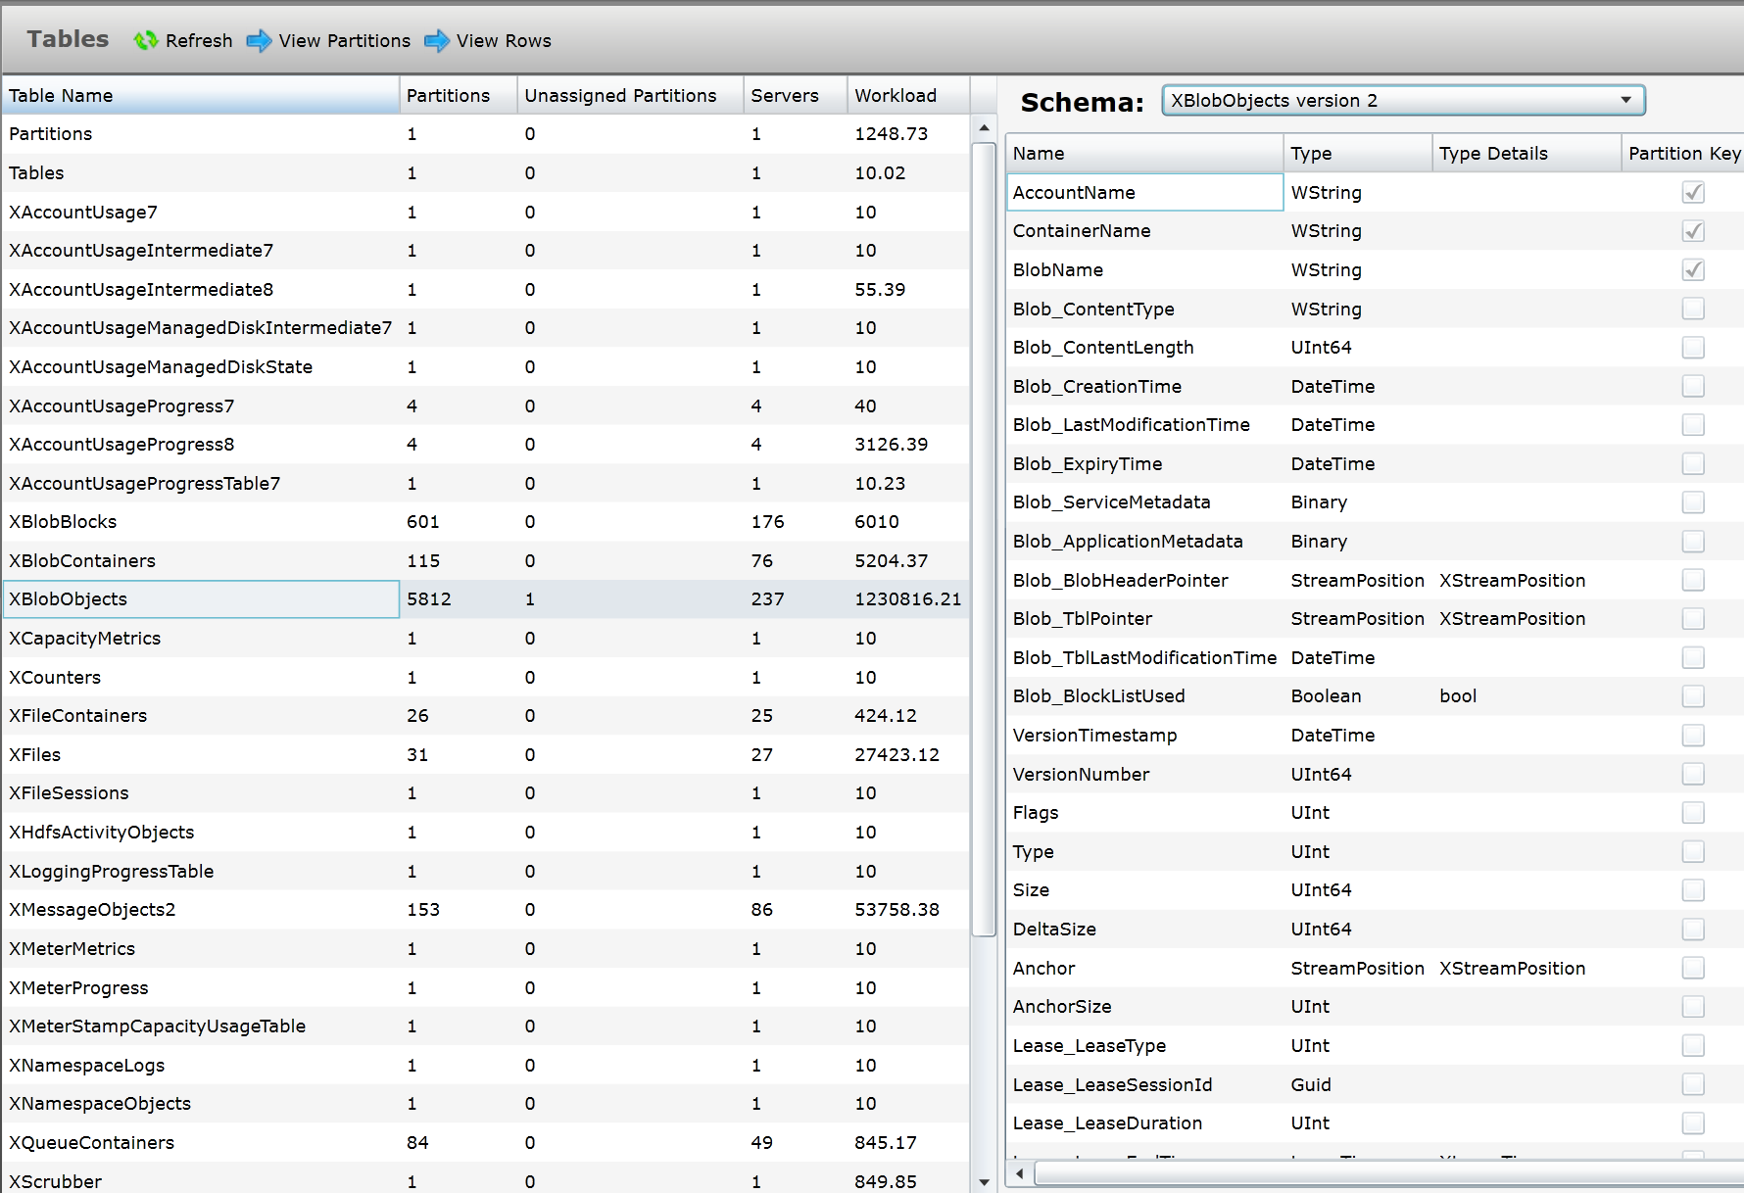
https://ty1prdstr08a.stamp-diagnostics.store.core.windows.net/#/XTable/TablesSummary

Slide 16
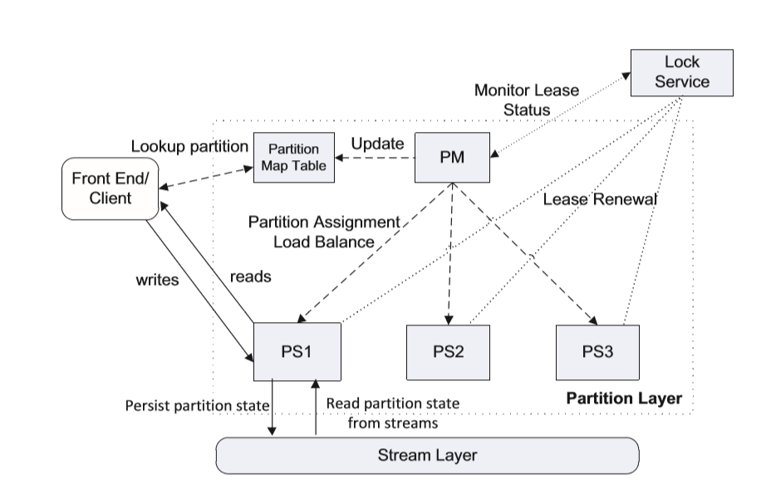
Partition Layer Architecture
Notes:
PM: The PM splits the Object Tables into N RangePartitions in each stamp, keeping track of the current RangePartition breakdown for each OT and to which partition servers they are assigned.
The PM stores this assignment in the Partition Map Table.
PS: A partition server is responsible for serving requests to a set of RangePartitions assigned to it by the PM. A PS can concurrently serve multiple RangePartitions from different OTs.

Slide 17
Each RangePartition – Log Structured Merge-Tree
Writes
Read/Query
Memory Table
Memory Data
Row Cache
Index Cache
Bloom Filters
Load Metrics
Persistent Data (Stream Layer)
Row Data Stream
Commit Log Stream
Checkpoint
File Table
Checkpoint
File Table
Checkpoint
File Table
Blob Data Stream
Metadata log Stream
Blob Data
Blob Data
Blob Data
Notes:
The metadata stream is the root stream for a RangePartition. The PM assigns a partition to a PS by providing the name of the RangePartition’s metadata stream. including the name of the commit log stream and data streams for that RangePartition, as well as pointers (extent+offset) into those streams for where to start operating in those streams
Commit log stream : used to store the recent insert, update, and delete operations applied to the RangePartition (after checkpoint generate for Row data stream)
Memory table This is the in-memory version of the commit log for a RangePartition, containing all of the recent updates that have not yet been checkpointed to the row data stream.
Memory 写满的时候，Stores the checkpoint row data and index for the RangePartition. Blob data stream stores blob data bits.
Index cache for Row data stream cache.
Write -> it appends the operation to commit log and cache row to memory table.
all the modifications to the partition are recorded persistently in the commit log, and also reflected in the memory table.
When the size of the memory table reaches its threshold size (256GB) or the size of the commit log stream reaches its threshold, the partition server will write the contents of the memory table into a checkpoint stored persistently in the row data stream for the RangePartition.
periodically combine the checkpoints into larger checkpoints, and then remove the old checkpoints via garbage collection.
对于pageblob来说 直接写commit log stream， 然后直接更改指针到blob data stream里面。为了减少写的次数

Slide 18
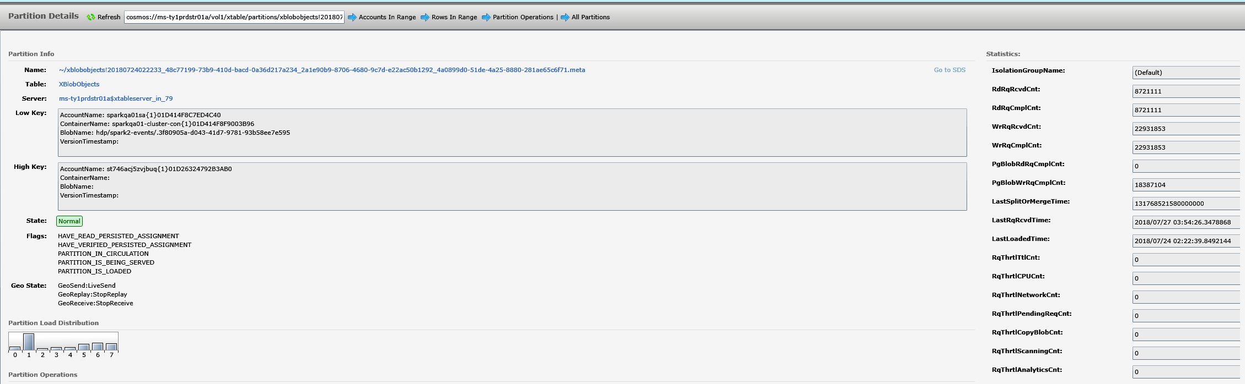
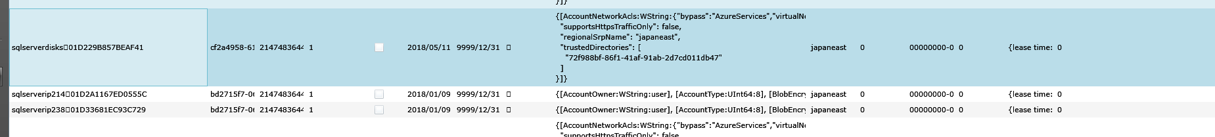
A sample for range partition
http://sqlserverdisks.blob.core.windows.net/vhds/2012r220170504150505.vhd?comp=page&se=9999-01-01&sk=system-1&sp=rw&sr=b&sv=2014-02-14&timeout=10
Table server name: ms-ty1prdstr01a$xtableserver_in_79
Range partition name: xblobobjects!20180724022233_48c77199-73b9-410d-bacd-0a36d217a234
Notes:
A RangePartition is a contiguous range of rows in an OT from a given low-key to a high-key.

Slide 19
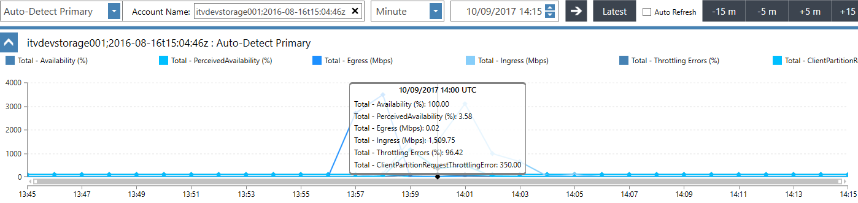
Throttling errors due to memory table buffer full
error: XTableServer.exe: Throttling Blob Requests (PutListBlob): partition=cosmos://ms-bn6prdstr15a/vol1/xtable/partitions/xblobobjects!20171006221045_1df20abd-8423-4481-9a54-00b2e8dbf3f6_a3e7035f-2faf-408c-9aa6-cfa75dba8c7f_8bf4eb3b-776b-4744-bb0f-b6825ca552f5.meta, account=itvdevstorage00101D1F7CF86DED321, pending count=94, pending bytes=268729888 10/09/2017 13:59:07.171020 - pid: 21004 tid: 70804 @ XStore::XTable::XBlobTypeServer::PutListBlob (xblobtypeserver.cpp:1110) on XTableServer_IN_200 / cosmosErrorLog_XTableServer.exe_013370.log / A8D4E2BC-001E-00A1-5706-4162BD062BC4 / A8D4E2BC-001E-00A1-5706-4162BD000000
<XStreamWriterQueuedDataSizeThrottleThreshhold>268435456</XStreamWriterQueuedDataSizeThrottleThreshhold>
boolPartition::BlobStoreWriteNeedsThrottling(__in_zPCSTRaccountName, UINT32blobType)
{
…
if(m_blobStatistics.GetPendingWriteBytes(blobType) > GET_DC_SETTING(XStreamWriterQueuedDataSizeThrottleThreshhold))
{
SetRequestThrottleReason(RqThrtlRsn_PendingStreamWriteDataSize);
returntrue;
}
…
}

Slide 20
Range Partition Load Balancing
The PM performs three operations to spread load across partition servers and control the total number of partitions in a stamp:
1. Load Balance
2. Split
3. Merge
Notes:
Load Balance – This operation identifies when a given PS has too much traffic and reassigns one or more RangePartitions to less loaded partition servers.
(a) transactions/second, (b) average pending transaction count, (c) throttling rate, (d) CPU usage, (e) network usage, (f) request latency, and (g) data size of the RangePartition
Split
have the RangePartition write a current checkpoint before offloading it. The PM then assigns the RangePartition to its new PS and updates the Partition Map Table to point to the new PS.
table server has max of 10 RangePartitions per server

Slide 21
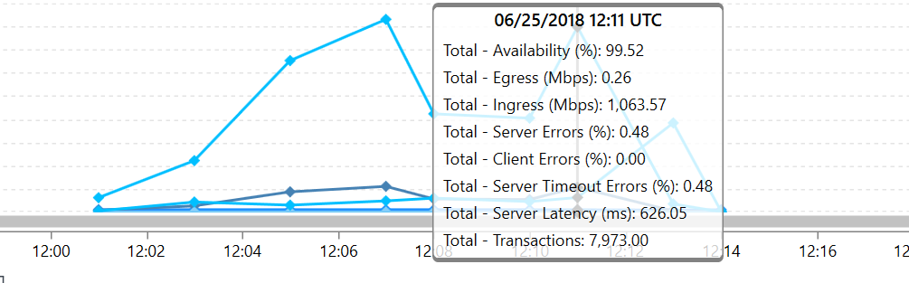
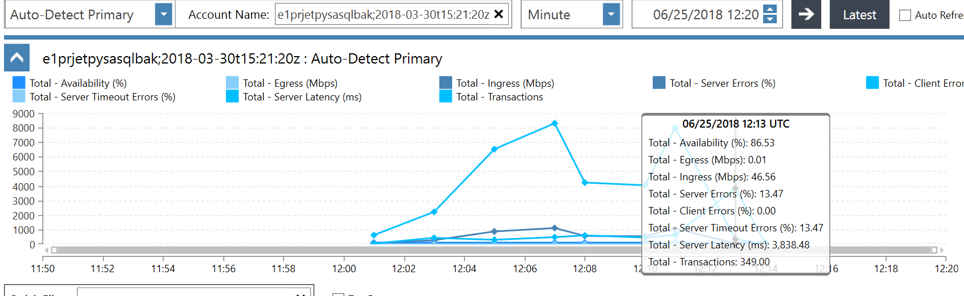
Example: customer reported his sql backup failed on the storage account.

Slide 22
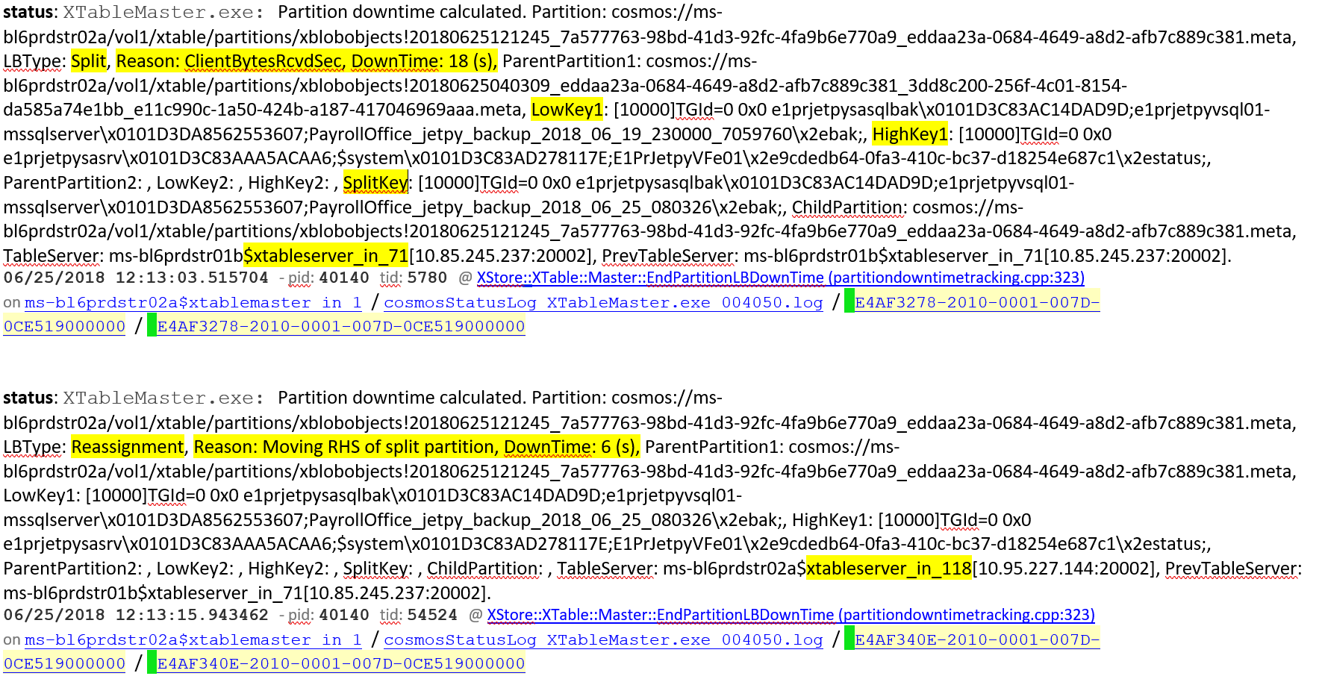
Split

Slide 23
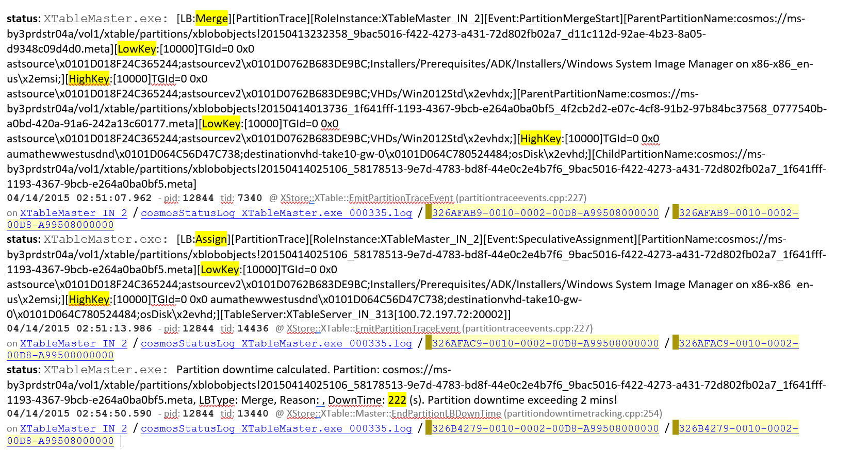
Merge

Slide 24
Partition Layer Inter-Stamp Replication
GEO replication:
Compared with intra-stamp replication at the stream layer
Async to the secondary stamp in different location
Used for migration/Disaster Recovery
Notes:
After the update has been committed in stamp P, the partition layer in stamp P will asynchronously geo-replicate the change to the secondary stamp S using inter-stamp replication.

Slide 25
Stream Layer

Slide 26
Stream layer
Append-Only Distributed File System
Streams are very large files
Has file system like directory namespace
Stream Operations
Open, Close, Delete Streams
Rename Streams
Concatenate Streams together
Append for writing
Random reads

Slide 27
Stream Layer Concepts
Block
Min unit of write/read
Checksum
Up to N bytes (e.g. 4MB)
Extent
Unit of replication
Sequence of blocks
Size limit (e.g. 1GB)
Sealed/unsealed
Stream
Hierarchical namespace
Ordered list of pointers to extents
Append/Concatenate
Stream //foo/myfile.data
Ptr E1
Ptr E2
Ptr E3
Ptr E4
Block
Block
Block
Block
Block
Block
Block
Block
Block
Block
Block
Block
Block
Block
Block
Extent E1
Extent E2
Extent E3
Extent E4
sealed
unsealed
unsealed
unsealed
sealed
sealed
Notes:
Block: A client read gives an offset to a stream or extent. When performing a read, the entire contents of a block are read. This is because the stream layer stores its checksum validation at the block level, one checksum per block.
Extent: Each extent is stored in an NTFS file . Replication in fault domain

Slide 28
Creating an Extent
Paxos
SM
SM
Create Stream/Extent
Stream Master
Partition Layer
EN1 Primary EN2, EN3 Secondary
Allocate Extent replica set
EN 1
EN 2
EN 3
EN
Primary
Secondary A
Secondary B
Notes:
When a stream is opened, the metadata for its extents is cached at the client, so the client can go directly to the ENs for reading and writing without talking to the SM until the next extent needs to be allocated for the stream.
If during writing, one of the replica’s ENs is not reachable or there is a disk failure for one of the replicas, a write failure is returned to the client. The client then contacts the SM, and the extent that was being appended to is sealed by the SM at its current commit length

Slide 29
Replication Flow
Paxos
SM
SM
SM
Partition Layer
EN1 Primary EN2, EN3 Secondary
Append
Ack
EN 1
EN 2
EN 3
EN
Primary
Secondary A
Secondary B
Notes:
Replication flow
All appends to an extent go to the Primary
Primary orders all incoming appends and picks the offset for the append in the extent
Primary then forwards offset and data to secondaries
Primary performs in-order acks back to clients for extent appends
Primary returns the offset of the append in the extent
An extent offset can commit back to the client once all replicas have written that offset and all prior offsets have also already been completely written
This represents the committed length of the extent

Slide 30
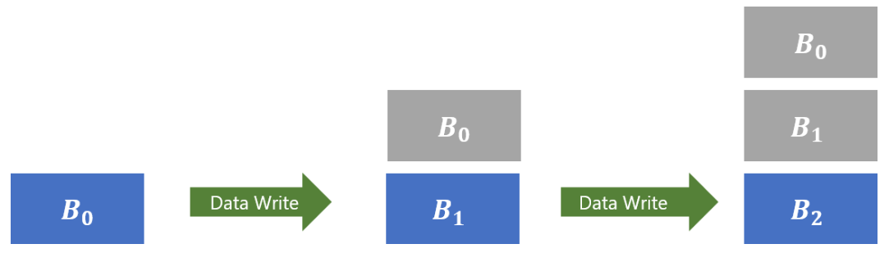
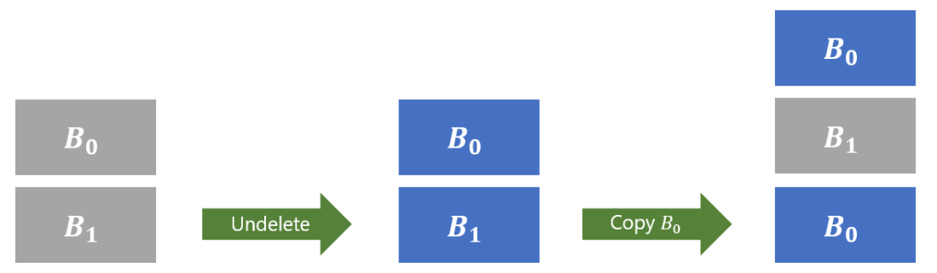
Append only file system
1. Create snapshot or copy VHD
COW or ROW?
2. Soft delete
Notes:
创建snapshot或者同个storage account上copy vhd的时候 速度很快 而且不会相互影响。

Slide 31
CAP Theorem
Consistency: Every read receives the most recent write or an error
Availability: Every request receives a (non-error) response – without guarantee that it contains the most recent write
Partition tolerance: The system continues to operate despite an arbitrary number of messages being dropped (or delayed) by the network between nodes
Notes:
CAP which says a distributed system cannot have availability, consistency, and partition tolerance at the same time.
分布式文件系统 数据一致性 :由于服务器的增多 故障概率增加。 通过多副本的方式来解决 但是故障有可能造成数据不一致性
可用性：不影响客户端的读写
分区容错性： 网络故障。
Layering and co-design provides extra flexibility to achieve “C” and “A” at same time while being partition/failure tolerant for our fault model
Stream Layer
For Consistency, replicas are bit-wise identical up to the commit length
HA: 3 replica
Partition Layer
Consistency with Partition/failure tolerance
For Availability, RangePartitions can be served by any partition server and are moved to available servers if a partition server fails
Designed for specific classes of partitioning/failures seen in practice
Process to Disk to Node to Rack failures/unresponsiveness
Node to Rack level network partitioning
Consistency: Partition layer commit log to get every change
This layering allows us to decouple the nodes responsible for providing strong consistency from the nodes storing the data with availability in the face of network partitioning.
For example, the type of network partitioning we have seen within a storage stamp are node failures and top-of-rack (TOR) switch failures. STREAM USING IN FD
When a TOR switch fails, the given rack will stop being used for traffic — the stream layer will stop using that rack and start using extents on available racks to allow streams to continue writing. In addition, the partition layer will reassign its RangePartitions to partition servers on available racks to allow all of the data to continue to be served with high availability and strong consistency.

Slide 32
Design Choices
Multi-Data Architecture
Use extra resources to serve mixed workload for incremental costs
Blob -> storage capacity
Table -> IOps
Queue -> memory
Multiple data abstractions from a single stack
Improvements at lower layers help all data abstractions
Simplifies hardware management
Tradeoff: single stack is not optimized for specific workload pattern
Append-only System
Greatly simplifies replication protocol and failure handling
Consistent and identical replicas up to the extent’s commit length
Keep snapshots at no extra cost
Benefit for diagnosis and repair
Erasure Coding
Tradeoff: GC overhead
Scaling Compute Separate from Storage
Allows each to be scaled separately
Important for multitenant environment
Moving toward full bisection bandwidth between compute and storage
Tradeoff: Latency/BW to/from storage

Slide 33
Scalability Targets and optimize your storage performance
1. Partition Naming Convention
Azure Storage uses a range-based partitioning scheme to scale and load balance the system. The partition key is used to partition data into ranges and these ranges are load-balanced across the system.
This means naming conventions such as lexical ordering (e.g. msftpayroll, msftperformance, msftemployees, etc) or using time-stamps (log20160101, log20160102, log20160102, etc) will lend itself to the partitions being potentially co-located on the same partition server
Notes:
We decided to use range-based partitioning/indexing instead of hash-based indexing (where the objects are assigned to a server based on the hash values of their keys) for the partition layer’s Object Tables.
One reason for this decision is that range-based partitioning makes performance isolation easier since a given account’s objects are stored together within a set of RangePartitions (which also provides efficient object enumeration).

Slide 34
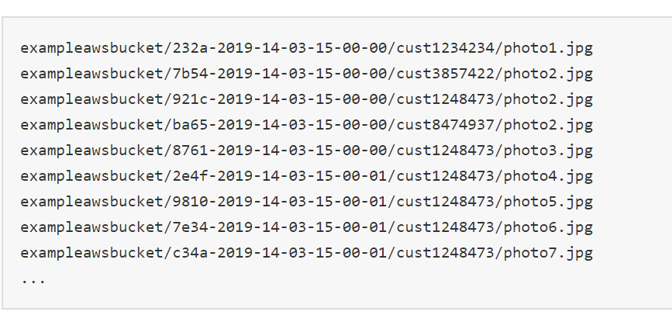
AWS choice
https://aws.amazon.com/cn/premiumsupport/knowledge-center/s3-bucket-performance-improve/
Hash-based schemes have the simplicity of distributing the load across servers, but lose the locality of objects for isolation and efficient enumeration.
To address this sequential access pattern for RangePartitions, a customer can always use hashing or bucketing for the PartitionName, which avoids the above sequential access pattern issue.
Notes:
By introducing randomness to your key names, the I/O load is distributed across multiple index partitions. For example, you can compute an MD5 hash of the character sequence that you plan to assign as the key, and add three or four characters from the hash as a prefix to the key name. The following example shows key names with a four-character hexadecimal hash added as a prefix:
Hash-based will have the simplicity of distributing the load across servers, but lose the locality of objects for isolation and efficient enumeration

Slide 35
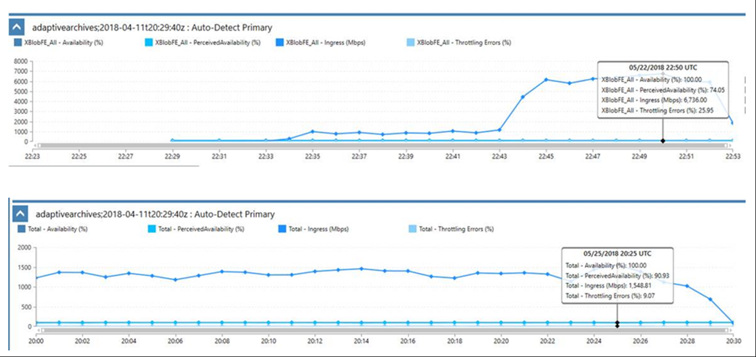
Append-only pattern – throttling issue
Activity Copy_adaptive_ssf_backups failed: ErrorCode=UserErrorBlobUploadFailed,'Type=Microsoft.DataTransfer.Common.Shared.HybridDeliveryException,Message=,Source=,''Type=Microsoft.DataTransfer.Common.Shared.HybridDeliveryException,Message=Error occurred when trying to upload blob &apos;https://adaptivearchives.blob.core.windows.net/adaptive-ssf-backups/CBB_miami/CBB_SHARES/lima:/export/home/jburton/scratch/151009_M00638_0725_MS3816724-600V3_20151012_0403/1_unknown/s_1_2_1105_qseq.txt:/20151012115724/s_1_2_1105_qseq.txt&apos;, detailed message: The remote server returned an error: (503) Server Unavailable.,Source=,''Type=Microsoft.WindowsAzure.Storage.StorageException,Message=The remote server returned an error: (503) Server Unavailable.,Source=Microsoft.WindowsAzure.Storage,StorageExtendedMessage=The server is busy.
Throttling failures on 22ndif you see all the data is being written to adaptivearchives.blob.core.windows.net/adaptive-ssf-backups/CBB_miami/CBB_SHARES/lima:/export/home/jburton/scratch
https://jarvis-west.dc.ad.msft.net/192237C1
https://adaptivearchives.blob.core.windows.net/adaptive-ssf-backups/CBB_miami/CBB_SHARES/lima:/export/home/jburton/scratch/151009_M00638_0725_MS3816724-600V3_20151012_0403/1_unknown/V/simple_scarf_a.txt:/20160229195254/simple_scarf_a.txt?comp=block&blockid=MzBmNDcxOTE0NTExNDFkN2I5ZGQzNDA1NTA3NTIwMjItMDAwMDAwMDM0OA==&timeout=300
https://adaptivearchives.blob.core.windows.net/adaptive-ssf-backups/CBB_miami/CBB_SHARES/lima:/export/home/jburton/scratch/151023_M00638_0736_MS3805325-600V3_20151026_0021/1_A4413_3__JS031_demux.only.rev2/out/262_Omnibus.txt:/20160405012545/262_Omnibus.txt?comp=block&blockid=NGQ0ZTc2YTlmZGE3NDc5MGJjOWMxNGVmOGE4ZjZhNTktMDAwMDAwMDA3Mg==&timeout=300
Notes:
Append-only pattern means all traffic goes to a single partition; the performance of a single partition is limited by a single hard drive which is also likely to be shared with other customers too. (this is a very gross simplification, there’re more hard drives involved). The system scales an account out by splitting into more partitions (so that more hard drives are to be utilized). However an append-only traffic pattern is not able to benefit from it, as the traffic does not spread out to multiple partitions even after split, it always goes to one partition.
In this case although the number of requests are low, each blob is largish. Since they all go to a single partition, this put the disk(s) backing this partition into stress. The customer is pushing more but the system is not able to scale out, thus has to throttle the requests.

Slide 36
Other elements for blob performance
Network
Client network
CDN
SAS/CORS
Caching
server garbage collection
Retries
Notes:
For an example of how to get a blob's properties to discover the last modified date using .NET, see Set and Retrieve Properties and Metadata. For more information about conditional downloads, see Conditionally Refresh a Local Copy of a Blob.
this reason, you should use an exponential back off (the client libraries default to this behavior). For example, your application may retry after 2 seconds, then 4 seconds, then 10 seconds, then 30 seconds, and then give up completely.

Slide 37
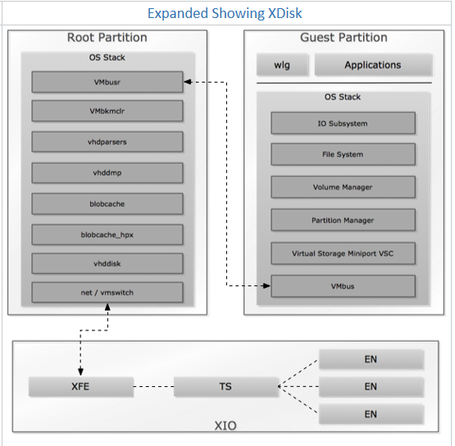
Azure host storage stack
Typical Driver Stack
Vmbusr.sys | Root partition VM bus driver
Vmbkmclr.sys | Root partition VM Bus kernel mode client library
StorVSP.sys | Storage Virtual Service Provider
Vhdparsers.sys | VHD parser driver
Vhddmp.sys | VHD Miniport driver
Blobcache.sys | Blobcache driver
Blobcache_hpx.sys | Blobcache Handle Proxy Driver
Vhddisk.sys | VHD disk driver
<networking> | Vmswitch, ndis, afp, etc…
Notes:
Data path – Vhddisk/Blobcache (touches customer data)

Slide 38
Q&A

