Slide 1


DSA04613- DATA HANDLING AND VISUALIZATION OF DATA ANALYTICS
Smart Sales and Customer Analytics Using Data Visualization
CAPSTONE PROJECT ON
Students: E.Bharath(192424421)
M.Loganath(192424399)
Guides:
Dr. Kumaragurubaran.T
Dr Senthilvadivu.S

Slide 2
INTRODUCTION
Modern businesses generate huge volumes of sales and customer data daily.
Raw data is often incomplete, inconsistent, and unstructured, requiring proper data handling.
Data handling includes data collection, cleaning, preprocessing, and transformation.
Clean and well-structured data improves the accuracy of analysis and visualization.
Data visualization converts complex data into simple and meaningful graphical formats.
Visual tools help in identifying sales trends, customer behavior, and product performance.
Charts such as bar charts, line graphs, histograms, and heatmaps are used for analysis.
Visualization supports quick understanding and better decision-making.

Slide 3
PROBLEM SATEMENT
Modern businesses generate large volumes of time-series sales and customer data, which is difficult to manage and analyze efficiently.
Sales data is often scattered, incomplete, and inconsistent, leading to unreliable analysis and decisions.
Organizations face challenges in tracking sales trends over time and identifying seasonal growth or decline patterns.
There is limited clarity on top-performing products and regions, affecting strategic and inventory planning.
Businesses struggle to understand customer purchasing behavior, loyalty, and value, limiting targeted marketing efforts.
Traditional systems provide static reports, making it difficult to detect peak periods, anomalies, and generate real-time actionable insights.

Slide 4
METHODOLOGY
Data is collected from reliable sources such as CSV files, databases, and online datasets to ensure accuracy and consistency.
Data cleaning is performed to handle missing values, remove duplicate records, and correct inconsistent or incorrect entries.
Data preprocessing includes converting date formats, standardizing numerical values, and encoding categorical variables for analysis.
Data is transformed by aggregating records on daily, monthly, or yearly levels to support trend analysis.
Important derived features such as total sales, sales growth percentage, and average order value are calculated.
The final dataset is stored in a clean, structured, and analysis-ready format for effective visualization and dashboard creation.

Slide 5
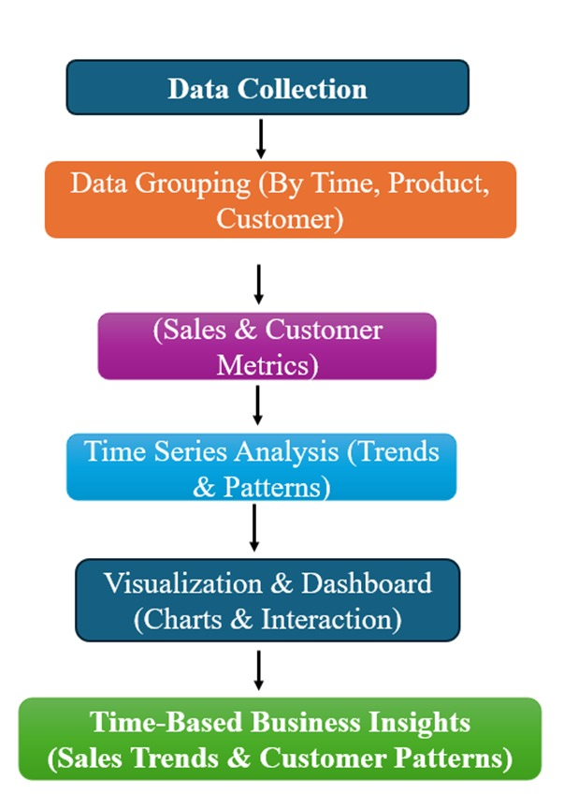
SYSTEM ARCHITECTURE

Slide 6
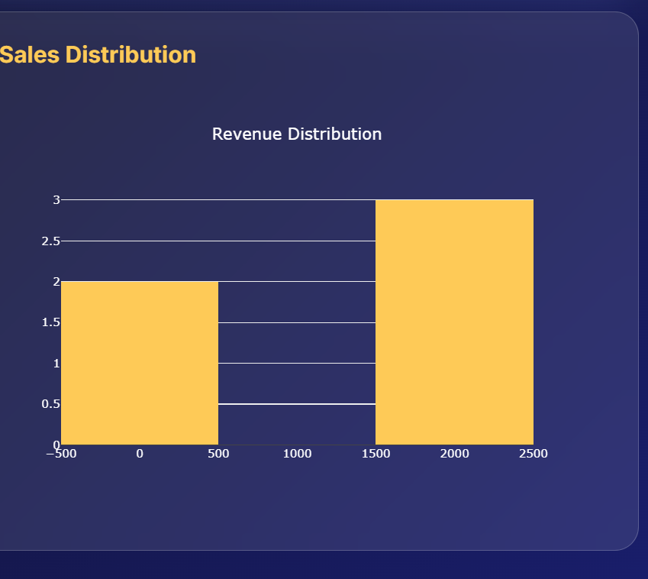
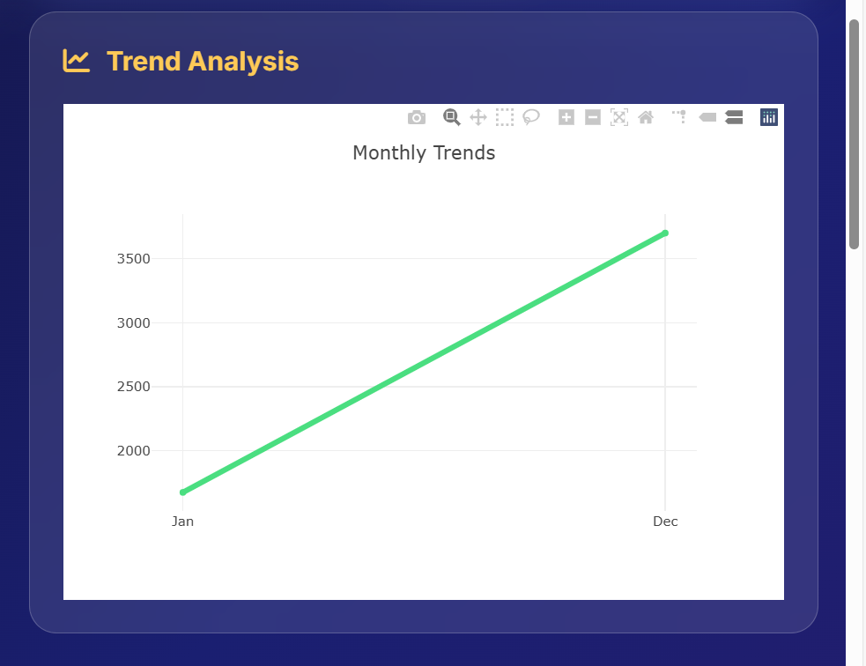
MODULE 1:SALES & CUSTOMER DATA MANAGEMENT
Collects and integrates sales and customer transaction data from different time periods.
Performs data cleaning by removing duplicates and handling missing or invalid values.
Ensures data consistency by standardizing formats such as date, region, product, and revenue.
Organizes data into time-series structure for daily, monthly, and yearly analysis.
Links customer data with sales data to understand buying patterns and loyalty behavior.
Improves data accuracy and reliability, enabling trustworthy analytics results.
Supplies clean and structured data for visual dashboards and business insights.

Slide 7
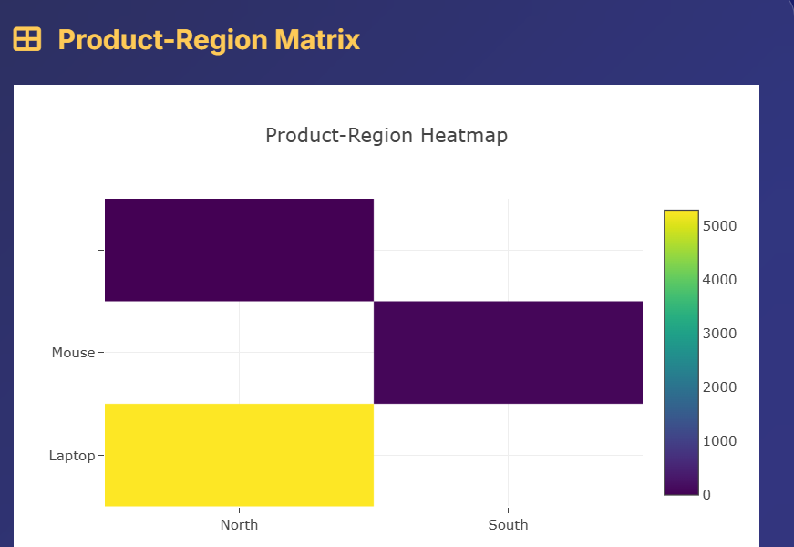
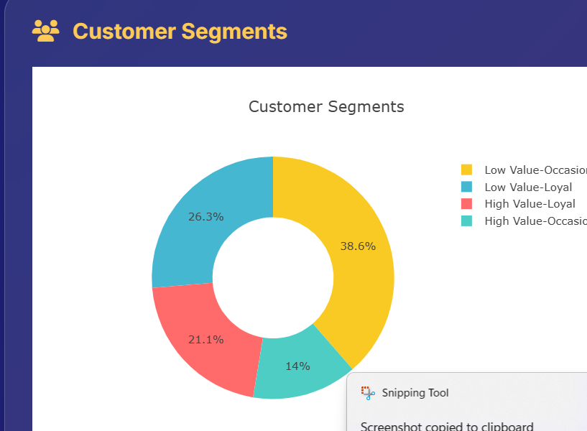
MODULE 2:INTERACTIVE ANALYTICS DASHBOARD
Provides real-time insights into sales, revenue, and customer behavior.
Offers interactive and dynamic visualizations like charts, graphs, and heatmaps for easy data exploration.
Enables filtering and segmentation by product, region, date, or customer type to focus on specific areas.
Highlights critical metrics and KPIs such as total sales, top products, revenue growth, and average order value.
Supports drill-down analysis to explore underlying data behind trends, spikes, or anomalies.
Reduces manual reporting by providing automated visual summaries for better planning and forecasting.

Slide 8
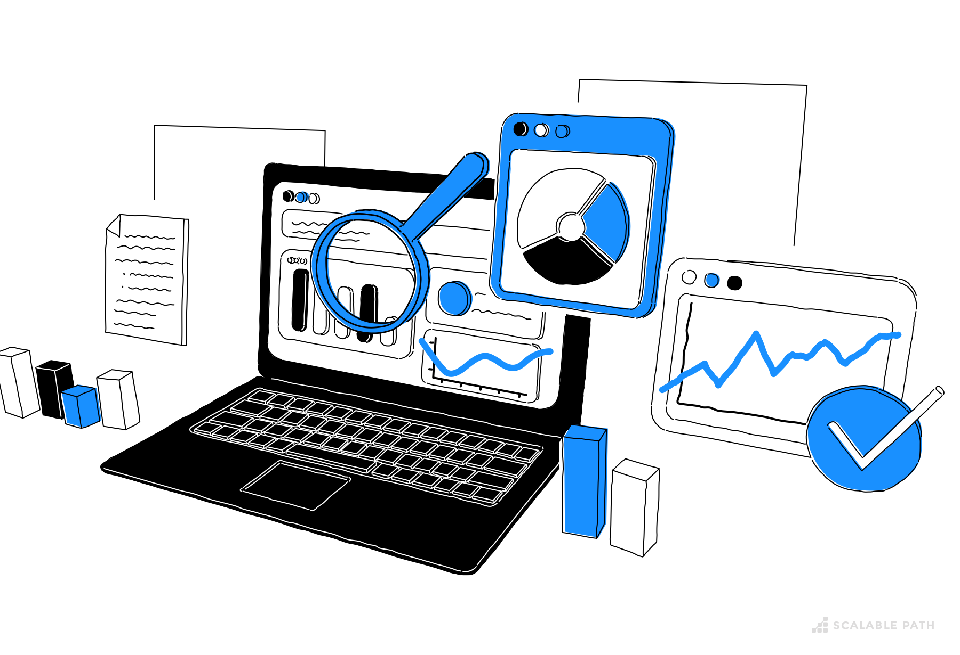
EXPLORATORY DATA ANALYSIS
Analyzed sales data over time to understand overall trends and growth patterns.
Identified seasonality and recurring patterns by examining daily, monthly, and yearly sales behavior.
Studied peak and low sales periods to understand demand fluctuations over time.
Performed product-wise and region-wise time-series analysis to compare performance across different time periods.
Detected outliers and anomalies such as sudden spikes or drops in sales that may indicate special events or data issues.
Used rolling statistics and moving averages to smooth fluctuations and observe long-term trends.
EDA results helped in selecting appropriate visualization techniques and dashboard metrics.

Slide 9
CONCLUSION AND RESULT
Helps identify sales trends, seasonal peaks, high-performing products, and customer behavior patterns to support better business strategy.
Enables informed decisions for marketing campaigns, inventory management, sales planning, and customer engagement.
Automates reporting and analysis, saving time and ensuring accurate, consistent insights for stakeholders.
Allows users to explore underlying data through filters and drill-downs to investigate anomalies or specific performance metrics.
Facilitates monitoring of KPIs and overall business health, supporting strategic planning and operational improvements.
Can be adapted for different business needs, departments, and growing datasets, making it a long-term analytics solution.

Slide 10
FUTURE SCOPE
Implement predictive analytics using AI and machine learning to forecast sales, customer behavior, and demand patterns for smarter decision-making.
Provide automated real-time alerts and recommendations for anomalies, stock shortages, or high-priority sales opportunities.
Customize dashboards for different users, departments, or roles to provide relevant insights instantly.
Enable access to dashboards from anywhere via cloud platforms or mobile apps, supporting remote monitoring and collaboration.
Combine multiple data sources such as social media, CRM, ERP, and IoT devices for more comprehensive analysis.
Use natural language queries and AI suggestions to make insights more intuitive and actionable.
Efficiently handle growing data volumes and incorporate advanced analytics for enterprise-level operations.

Slide 11
THANK YOU

