Slide 1

BUILDING A SMARTER AI-POWERED SPAM CLASSIFIER

Slide 2

Name: LOGAPRIYA T
BE (cse) 3rd year
Email ID:tlogapriyaasm@gmail.com
NM ID: au513521104024

Slide 3
01
INTRODUCTION
Phase -1
02
PROBLEM STATEMENT
Problem Definition and Design Thinking
03
PROBLEM DEFINITION
04
DESIGN THINKING
05
RESULTS
06
FUTURE WORK

Slide 4
INTRODUCTION
Spam emails can be a real nuisance, right?
In my project, I'm working on building a smarter AI-powered spam classifier to tackle this issue.
By leveraging advanced machine learning techniques, I aim to create a classifier that can accurately distinguish between legitimate emails and spam.
With this classifier, we can save time and keep our inboxes clean, Exciting, isn’t it?

Slide 5
PROJECT OVERVIEW
The goal of the project is to build a smarter AI-powered spam classifier. The project addresses the problem of overwhelming amounts of spam emails, aiming to accurately identify and filter out spam emails to improve productivity and protect against malicious activities.
To achieve this, the project involves several key steps. First, data collection is done to gather a diverse dataset of labeled emails, including both spam and legitimate emails etc.

Slide 6
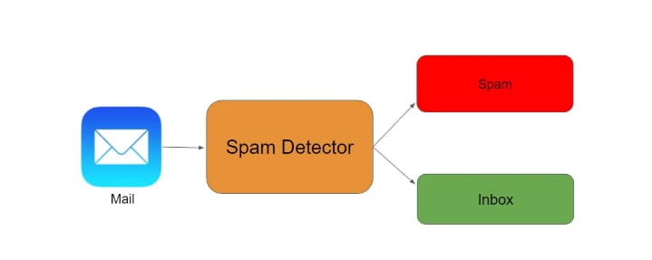
PROBLEM STATEMENT & DEFINITION
PROBLEM STATEMENT
Develop an AI-powered spam classifier using Natural Language Processing(NLP) and machine learning techniques to accurately distinguish between the spam and non-spam messages in emails or text messages.
PROBLEM DEFINITION
The problem is to build an AI-powered spam classifier that can accurately detecting unsolicited and unwanted emails, we can prevent spam messages from creeping into user’s inbox, thereby improving user experience
In today’s world, automated email management is critical since the volume of emails grows by the day. More than 55 percent of all email have been recognized as spam.
This Demonstrates that spammers waste email user’s time and resources while producing non meaningful results.

Slide 7
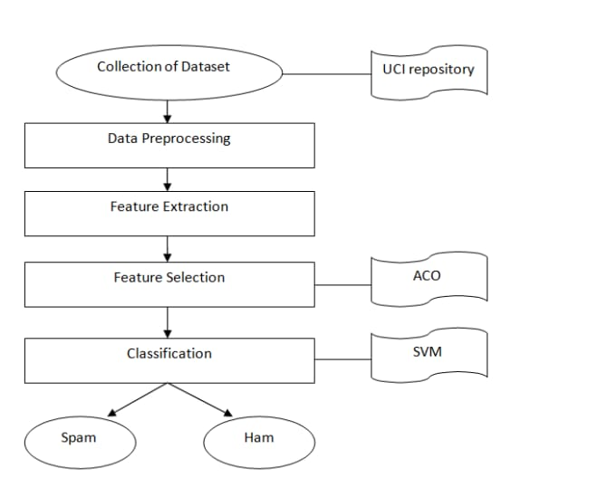
DESIGN THINKING
This research include a thorough examination and evaluation of research on several machine learning methodologies and email properties used in various machine learning approaches.
The Design Thinking of AI-powered spam classifier includes the following steps
01
Data Collection
02
Data Preprocessing
03
Features Extraction
04
Model Selection
05
Evaluation
06
Iterative Improvement

Slide 8
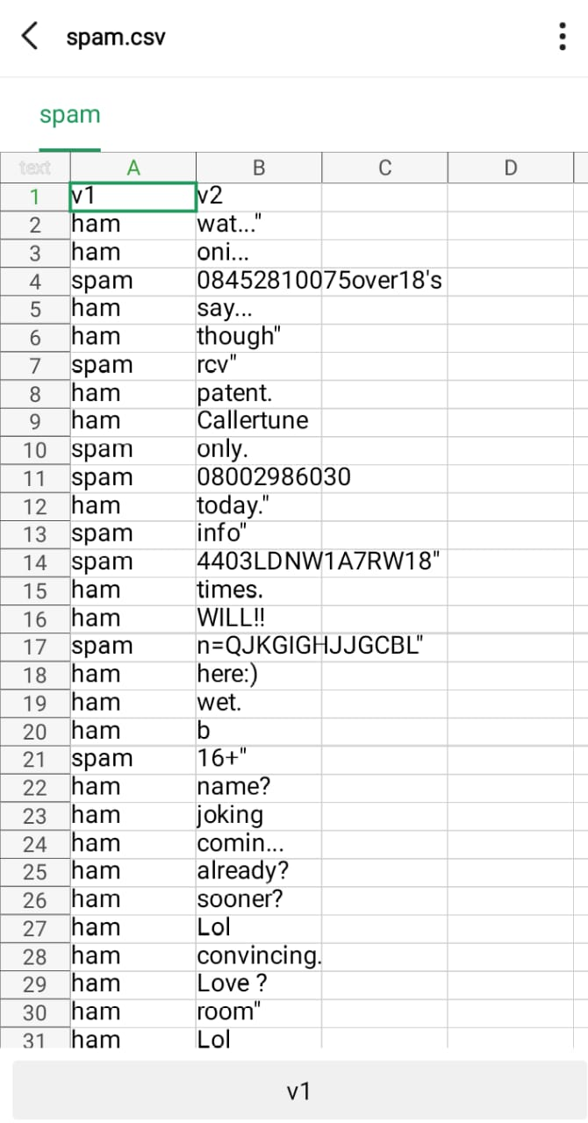
1.Data Collection
We will need a dataset containing labeled examples of spam and non spam messages. We can use a kaggle dataset for this purpose.
Dataset Link:
https://www.kaggle.com/datasets/uciml/sms-spam-collection-dataset
A Snapshot of the data is presented in the fig.
The dataset consists of both spam and ham messages.

Slide 9
1.Data Collection
Tools/Modules:
python, Naive Bayes classifier, NLTK and Scikit-Learn will be used for to build a spam classifier, you can use popular machine learning libraries and frameworks such as:
Python:
You can use libraries like scikit - learn, NLTK (Natural Language Toolkit), and Tensor Flow to implement machine learning algorithms and process text data.
2. Naive Bayes Classifier:
Naive Bayes is a commonly used algorithm for spam classification. It calculates the probability of an email being spam or legitimate based on the occurrence of certain words or feature. Data pre-processing and initial analysis.

Slide 10
2. Data Pre-processing
The text data need to be cleared and preprocessed.This involves removing the following types of text and tokenizing the text into individual word.
Text Processing:
Data usually comes from a variety of sources and often in different formats. For this reason, transforming your raw data is essential. However, this transformation is not a simple process, as text data often contain redundant and repetitive words. This means that processing the text data is the first step in our solution.
The fundamental steps involved in text pre-processing are
A. Cleaning the raw data B. Tokenizing the cleaned data

Slide 11
2. Data Pre-processing
A. Cleaning the Raw Data
This phase involves the deletion of words or characters that do not add value to the meaning of the text. Some of the standard cleaning steps are listed below:
Lowering case
Removal of special characters
Removal of stop words
Removal of hyperlinks
Removal of numbers
Removal of whitespaces
Lowering Case
Lowering the case of text is essential for the following reasons:
The words, ‘TEXT’, ‘Text’, ‘text’ all add the same value to a sentence
Lowering the case of all the words is very helpful for reducing the dimensions by
decreasing the size of the vocabulary.

Slide 12
2. Data Pre-processing
Removal of special characters
This is another text processing technique that will help to treat words like ‘hurray’ and ‘hurray!’ in the same way.
Removal of hyperlinks
Next, we remove any URLs in the data. There is a good chance that email will have some URLs in it. We don’t need them for our further analysis as they do not add any value to the results.
B. Tokenizing the Cleaned Data
Tokenization is the process of splitting text into smaller chunks, called tokens. Each token is an input to the machine learning algorithm as a feature.

Slide 13
3.Features Selection
When selecting features for your spam classifier project, consider
Word frequency
Length of the email
Uses of capital letters
Presence of certain words or phrases
We will carefully select the most relevant features that will contribute to spam classifier. This will be achieved through exploratory data analysis and feature importance analysis.
Tools/Modules:
No specific tools/modules, but domain knowledge and exploratory data analysis will be essential.

Slide 14
4. Model Selection
When it comes to model selection for your spam classifier project, here we have four options are,
Naive Bayes: This model is known for its simplicity and efficiency. It assumes that the presence of a particular feature is independent of the presence of other features, making it a good choice for text classification task.
Support Vector Machines (SVM): SVMs are powerful models that can handle high-dimensional feature spaces.
Random Forest: Random Forest is an ensemble learning method that combines multiple decision trees to make predictions. It can handle large feature sets and is less prone to over fitting.
Neural Networks: Deep learning models, such as Convolutional Neural Networks (CNNs) or Recurrent Neural Networks (RNNs), have shown promising results in text classification tasks. They can capture complex patterns and dependencies in the data.

Slide 15
5. Evaluation
spam classifier project should be evaluated using various metrics such as accuracy, precision, recall, and F1 score.
These metrics will help assess the effectiveness of your classifier in accurately identifying and filtering out spam emails.
By analyzing these metrics, you can determine the performance of your spam classifier and make improvements if needed.
To test classifier on a diverse dataset to ensure its reliability and generalizability.

Slide 16
6. Iterative Improvement:
We will fine- tune the model and experiment with hyper parameters to improve its accuracy.

Slide 17
SOLUTION
To solve the spam classifier problem, we can try the following solutions:
Use machine learning algorithms like Naive Bayes, SVM, or neural networks to train a spam classifier model.
Preprocess the email data by cleaning and standardizing it, removing unnecessary characters, and handling special cases like misspellings.
Extract relevant features from the emails, such as word frequency, presence of specific keywords.
Build a diverse dataset of labeled emails, including both spam and legitimate emails, to train and evaluate your classifier.
Fine-tune your model by adjusting its parameters and evaluating its performance using techniques like cross-validation.
Continuously monitor and update your spam classifier to adapt to evolving spam pattern.

Slide 18
RESULT
This will greatly improve productivity by reducing the overwhelming amount of unwanted emails and protecting against potential malicious activities.
The hard work and effort have paid off, and now have a smarter AI-powered spam classifier to enhance your email experience.

Slide 19
FUTURE WORK
In our ongoing efforts to enhance predictive accuracy and gain deeper insights into smarter AI Powered spam classifier. we will plan to explore advanced ensemble methods, and potentially more sophisticated feature engineering techniques. By continuously experimenting with diverse models and improving our data preprocessing, we aim to uncover hidden patterns and improve our predictions further.
Tools/Modules:
In the future, we may explore additional tools and libraries based on the specific needs of our project.

Slide 20

Thank you

