Slide 1

BUILDING A SMARTER AI-POWERED SPAM CLASSIFIER

Slide 2

Name: LOGAPRIYA T
BE (CSE) 3rd year
Email ID:tlogapriyaasm@gmail.com
NM ID: au513521104024

Slide 3

01
INTRODUCTION
Phase -5
02
PROJECT DEFINITION
PROJECT DOCUMENTATION AND SUBMISSION
03
MODEL-1 USING TF-IDF ALGORITHM
04
MODEL-2 USING OPENAI
05
EVALUATION
06
CONCLUSION

Slide 4

INTRODUCTION
Spam emails can be a real nuisance, right?
In my project, I'm working on building a smarter AI-powered spam classifier to tackle this issue.
By leveraging advanced machine learning techniques, I aim to create a classifier that can accurately distinguish between legitimate emails and spam.
With this classifier, we can save time and keep our inboxes clean, Exciting, isn’t it?

Slide 5
PROJECT OVERVIEW
The goal of the project is to build a smarter AI-powered spam classifier.
The project addresses the problem of overwhelming amounts of spam emails, aiming to accurately identify and filter out spam emails to improve productivity and protect against malicious activities.
To achieve this, the project involves several key steps.
First, data collection is done to gather a diverse dataset of labeled emails, including both spam and legitimate emails etc.

Slide 6
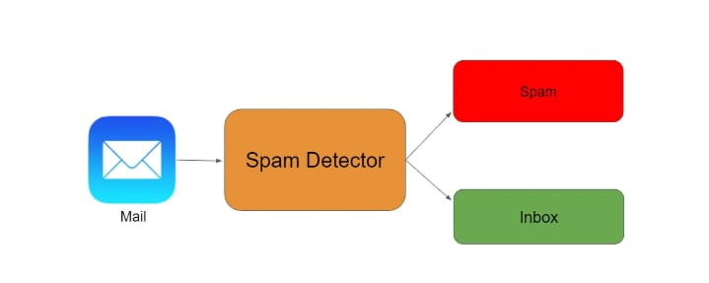
PROBLEM STATEMENT & DEFINITION
PROBLEM STATEMENT
Develop an AI-powered spam classifier using Natural Language Processing(NLP) and machine learning techniques to accurately distinguish between the spam and non-spam messages in emails or text messages.
PROBLEM DEFINITION
The problem is to build an AI-powered spam classifier that can accurately detecting unsolicited and unwanted emails, we can prevent spam messages from creeping into user’s inbox, thereby improving user experience
In today’s world, automated email management is critical since the volume of emails grows by the day. More than 55 percent of all email have been recognized as spam.
This Demonstrates that spammers waste email user’s time and resources while producing non meaningful results.

Slide 7
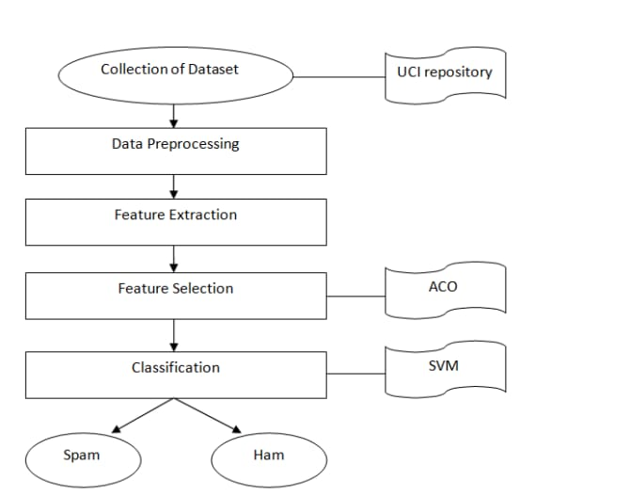
DESIGN THINKING
This research include a thorough examination and evaluation of research on several machine learning methodologies and email properties used in various machine learning approaches.
The Design Thinking of AI-powered spam classifier includes the following steps
01
Data Collection
02
Data Preprocessing
03
Features Extraction
04
Model Selection
05
Evaluation
06
Iterative Improvement

Slide 8
MODEL -1 USING TF-IDF ALGORITHM
Our Naïve Bayes model requires data to be in either Tf-IDF vectors or word vector count.
The latter is achieved using Count Vectorizer, but we’ll obtain the former through using Tf-IDF Vectorizer.
TF-IDF Vectorizer creates Tf-IDF values for every word in our text messages.
Tf-IDF values are computed in a manner that gives a higher value to words appearing less frequently.
So that words appearing many times due to English syntax don’t overshadow the less frequent yet more meaningful and interesting terms.

Slide 9
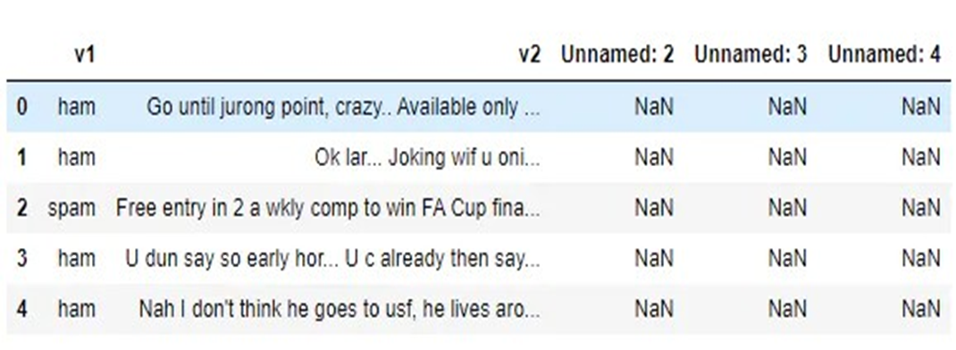
DATA COLLECTION
Tools/Modules:
python, Naive Bayes classifier, NLTK and Scikit-Learn will be used for to build a spam classifier, you can use popular machine learning libraries and frameworks such as:
Python:
You can use libraries like scikit - learn, NLTK (Natural Language Toolkit), and Tensor Flow to implement machine learning algorithms and process text data.
2. Naive Bayes Classifier:
Naive Bayes is a commonly used algorithm for spam classification. It calculates the probability of an email being spam or legitimate based on the occurrence of certain words or feature. Data pre-processing and initial analysis.
The files contain one message per line. Each line composed by two columns: v1 contains the label (ham or spam) and v2 contains the raw text.
Dataset Link:
https://www.kaggle.com/datasets/uciml/sms-spam-collection-dataset

Slide 10
DATA PREPROCESSING
Data processing :
Import the required packages
Loading the Dataset
Remove the unwanted data columns
Preprocessing and Exploring the Dataset
Build word cloud to see which message is spam and which is not.
Remove the stop words and punctuations
Convert the text data into vectors

Slide 11
IMPORT THE REQUIRED PACKAGES
%matplotlib inline
import matplotlib.pyplot as plt
import csv
import sklearn
import pickle
from wordcloud import WordCloud
import pandas as pd
import numpy as np
import nltk
from nltk.corpus import stopwords
from sklearn.feature_extraction.text import CountVectorizer, TfidfTransformer
from sklearn.tree import DecisionTreeClassifier
from sklearn.model_selection import GridSearchCV,train_test_split,StratifiedKFold,cross_val_score,learning_curve

Slide 12
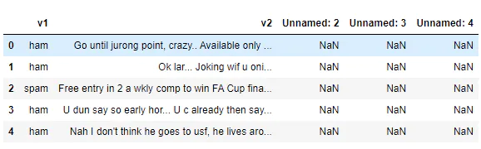
LOADING THE DATASET
data = pd.read_csv(‘D:/priya/spam.csv’, encoding='latin-1')
data.head()
OUTPUT:

Slide 13
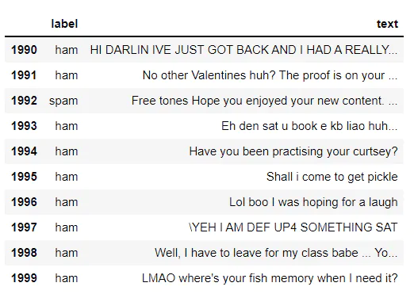
REMOVING UNWANTED COLUMNS
From the above figure, we can see that there are some unnamed columns and the label and text column name is not intuitive so let's fix those in this step.
data = data.drop(["Unnamed: 2", "Unnamed: 3", "Unnamed: 4"], axis=1)
data = data.rename(columns={"v2" : "text", "v1":"label"})
data[1990:2000]
data['label'].value_counts()
OUTPUT:
ham 4825
spam 747
Name: label, dtype: int64

Slide 14
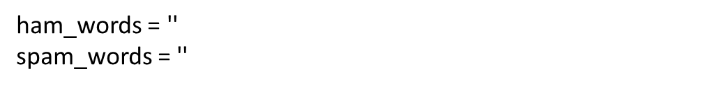
PREPROCESSING AND EXPLORING DATASET
Import nltk packages and Punkt Tokenizer Models
import nltk
nltk.download("punkt")
import warnings
warnings.filterwarnings('ignore')
BUILD WORD CLOUD TO SEE WHICH MESSAGE IS SPAM AND WHICH IS NOT
# Creating a corpus of ham messages
for val in data[data['label'] == 'ham'].text:
text = text.lower()
tokens = nltk.word_tokenize(text)
for words in tokens:
ham_words = ham_words + words + ' ‘
let's use the above functions to create Spam word cloud and ham word cloud.
spam_wordcloud = WordCloud(width=500, height=300).generate(spam_words)
ham_wordcloud = WordCloud(width=500, height=300).generate(ham_words)
#Spam Word cloud
plt.figure( figsize=(10,8), facecolor='w')
plt.imshow(spam_wordcloud)
plt.axis("off")
plt.tight_layout(pad=0)
plt.show()
# Creating a corpus of spam messages
for val in data[data['label'] == 'spam'].text:
text = val.lower()
tokens = nltk.word_tokenize(text)
for words in tokens:
spam_words = spam_words + words + ' '

Slide 15
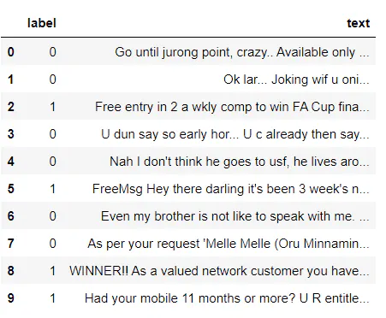
#Creating Ham wordcloud
plt.figure( figsize=(10,8), facecolor='g')
plt.imshow(ham_wordcloud)
plt.axis("off")
plt.tight_layout(pad=0)
plt.show()
from the spam word cloud, we can see that "free" is most often used in spam.
Now, we can convert the spam and ham into 0 and 1 respectively so that the machine can understand.
data = data.replace(['ham','spam'],[0, 1])
data.head(10)
OUTPUT:

Slide 16
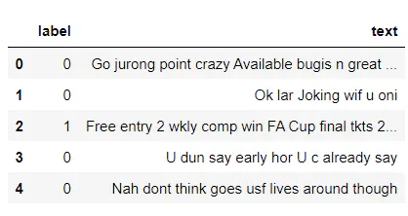
REMOVING PUNCTUATION AND STOPWORDS FROM MESSATGE
Punctuation and stop words do not contribute anything to our model, so we have to remove them. Using NLTK library we can easily do it.
import nltk
nltk.download('stopwords')
#remove the punctuations and stopwords
import string
def text_process(text):
text = text.translate(str.maketrans('', '', string.punctuation))
text = [word for word in text.split() if word.lower() not in stopwords.words('english')]
return " ".join(text)
data['text'] = data['text'].apply(text_process)
data.head()

Slide 17
FEATURES SELECTION
When selecting features for your spam classifier project, consider
Word frequency
Length of the email
Uses of capital letters
Presence of certain words or phrases
We will carefully select the most relevant features that will contribute to spam classifier. This will be achieved through exploratory data analysis and feature importance analysis.
Tools/Modules:
No specific tools/modules, but domain knowledge and exploratory data analysis will be essential.

Slide 18
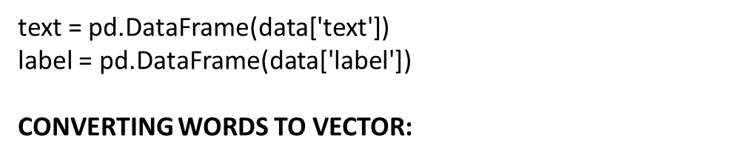
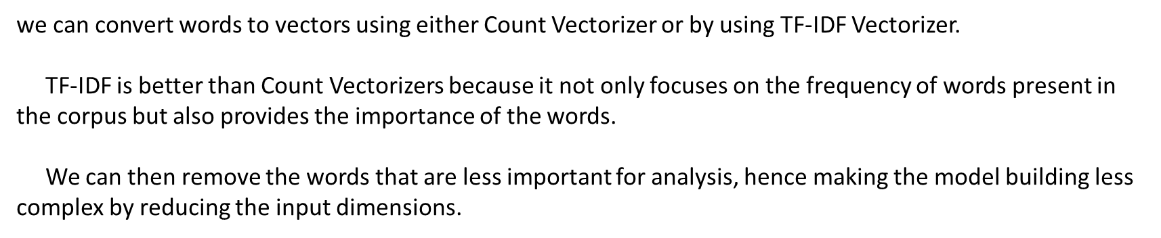
FEATURE EXTRACTION
Now, create a data frame from the processed data before moving to the next step.

Slide 19
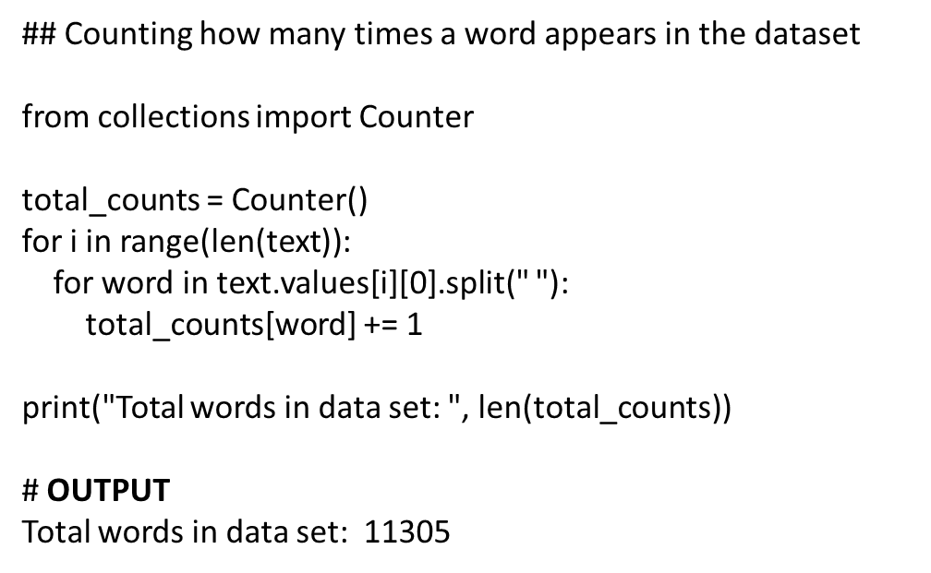

Slide 20
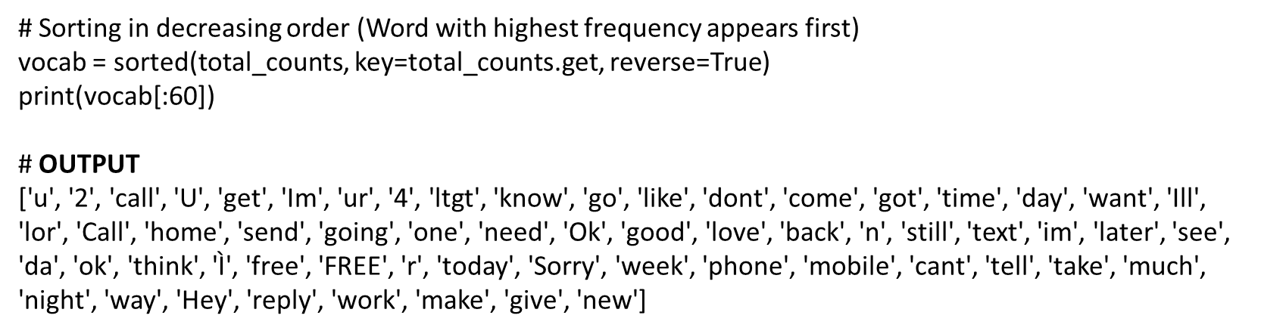
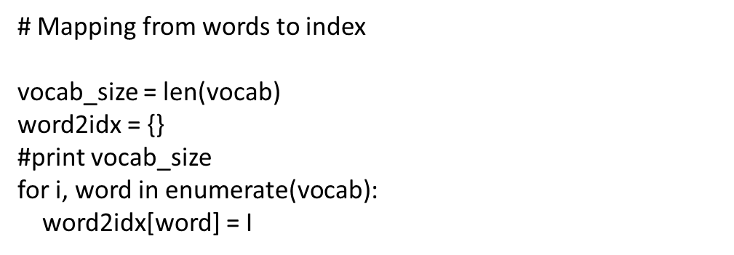

Slide 21
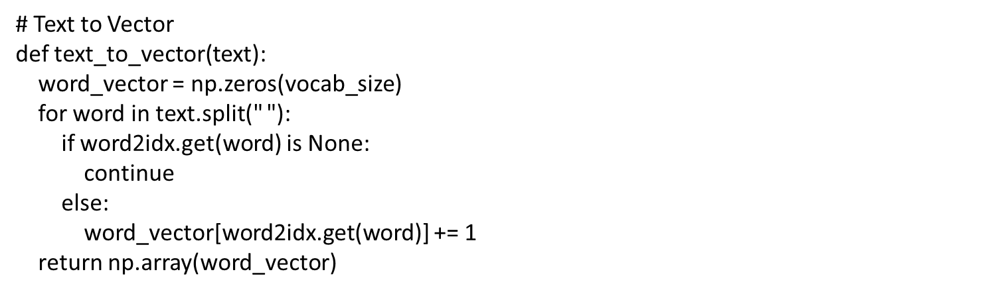
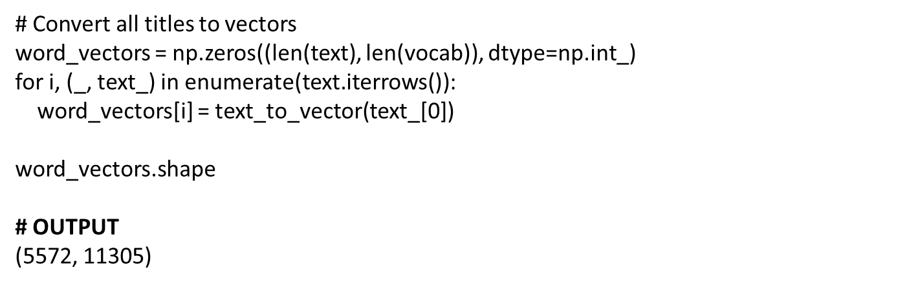

Slide 22
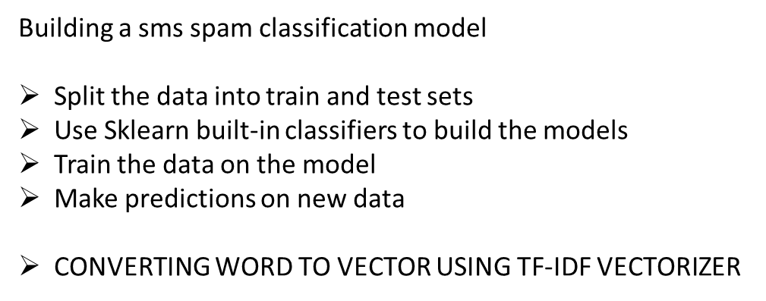
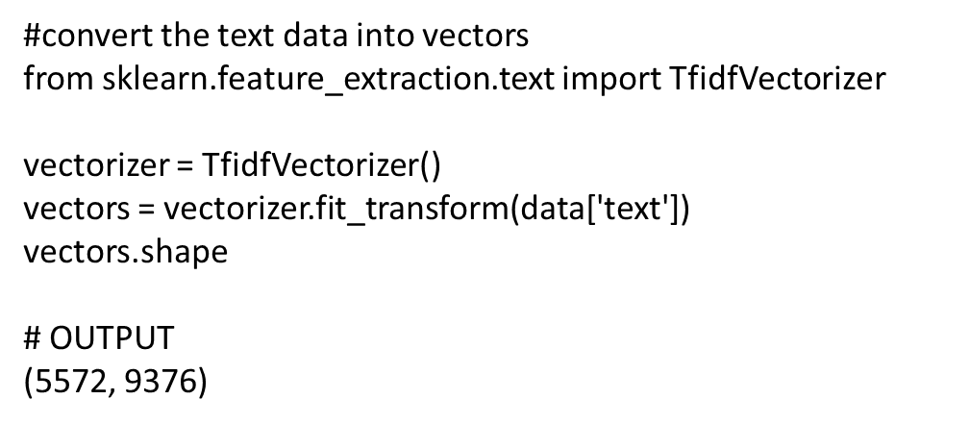
MODEL SELECTION

Slide 23
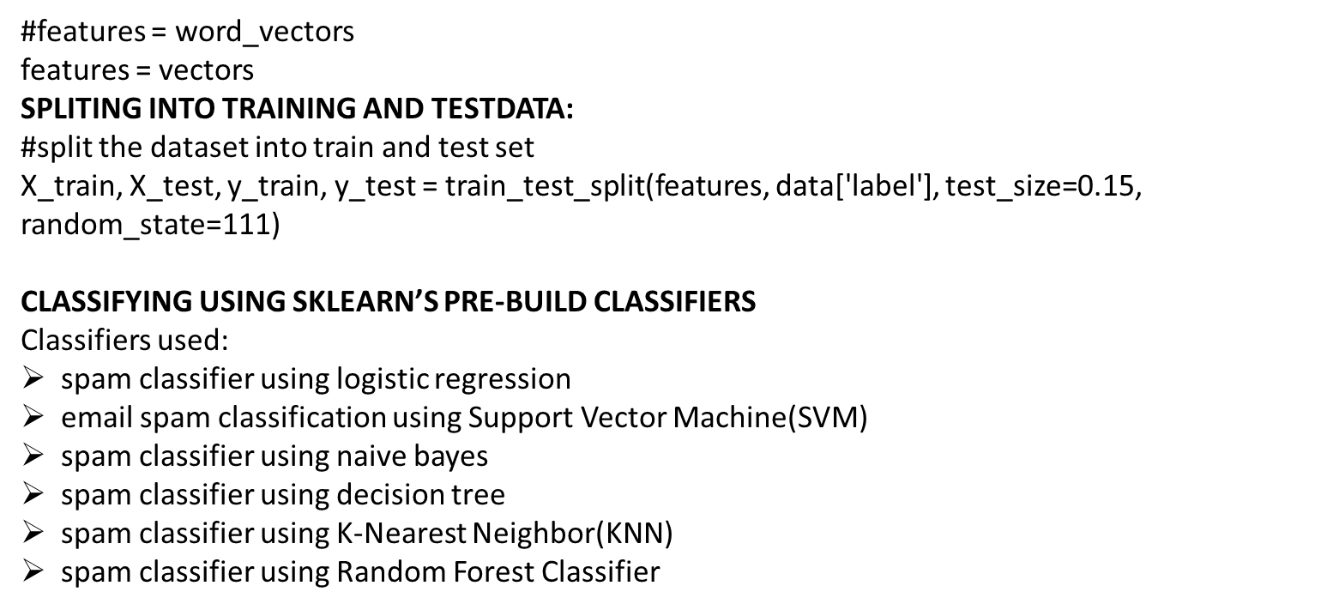

Slide 24
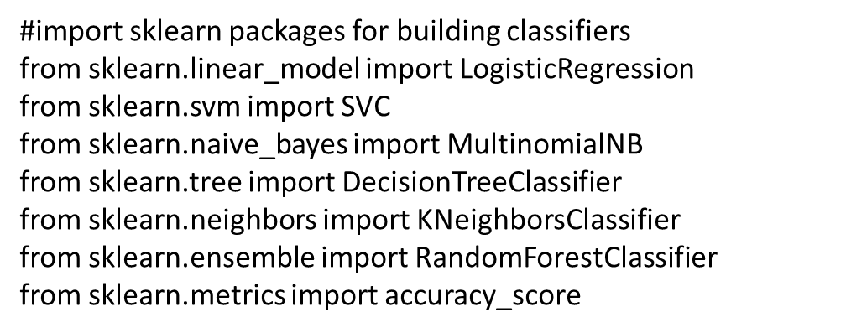
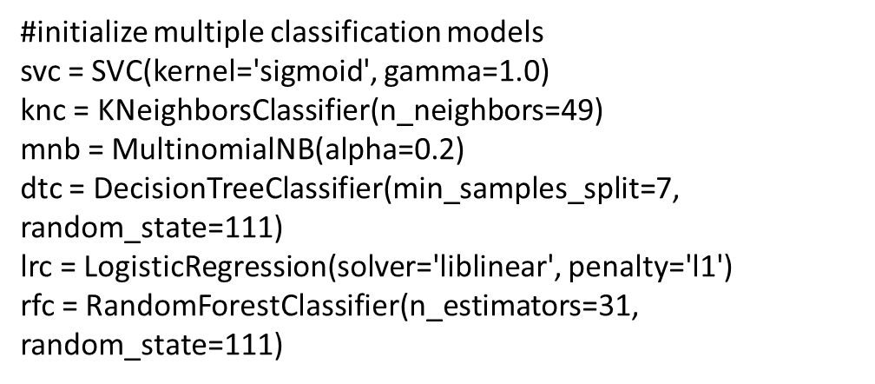

Slide 25
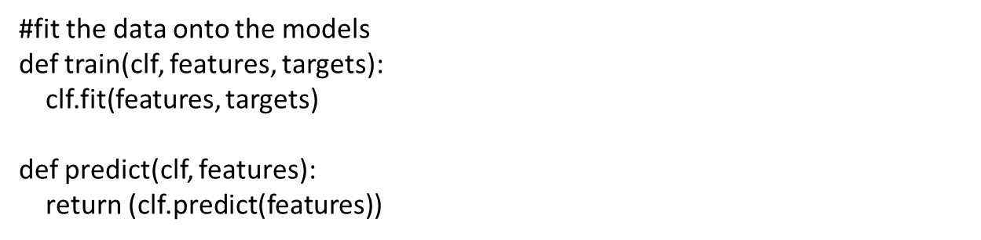
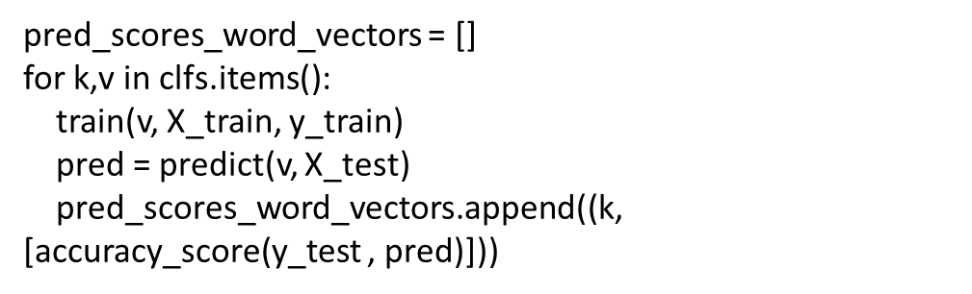

Slide 26
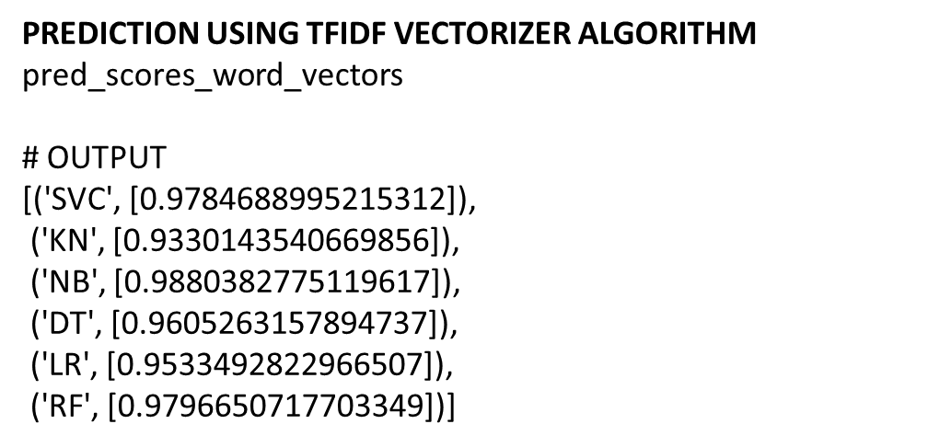
EVALUATION

Slide 27
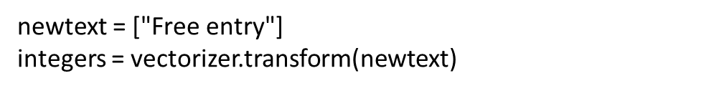
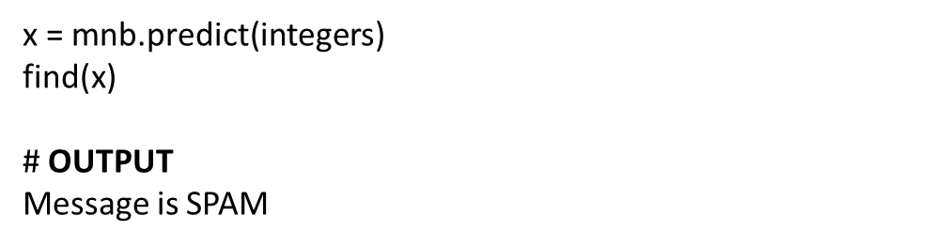
MODEL PREDICTIONS:
#write functions to detect if the message is spam or not
def find(x):
if x == 1:
print ("Message is SPAM")
else:
print ("Message is NOT Spam")

Slide 28
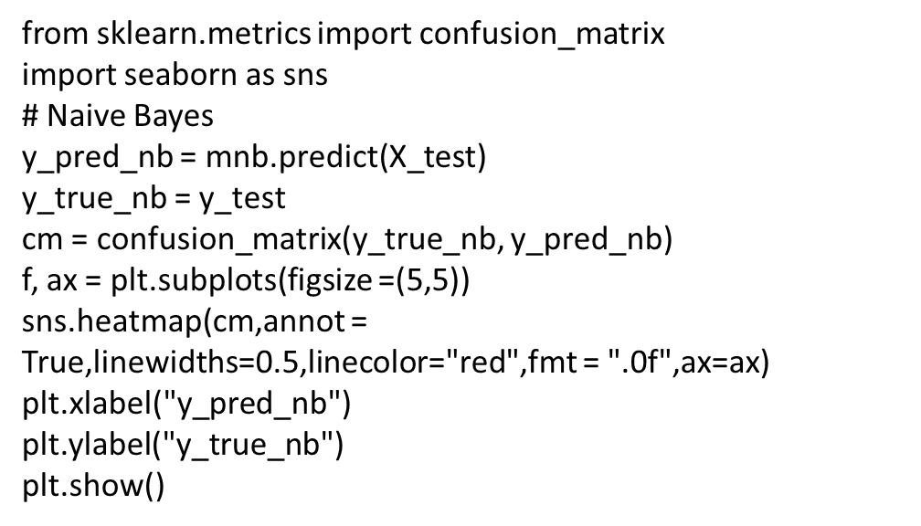
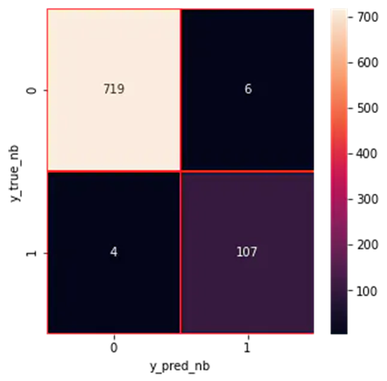

Slide 29
MODEL 2-USING OPENAI
Steps to implement Spam Classification using OpenAI
Using Embeddings API developed by OpenAI
Step 1: Install all the necessary salaries
Step 2: Import all the required libraries
Step 3: Assign your API key to the OpenAI environment
Step 4: Read the CSV file and clean the dataset
Step 5: Define a function to use Open AI’s Embedding API
Step 6: Custom Label the classes of the output variable to 1 and 0, where 1 means “spam” and 0 means “not spam”.
Step 7: Develop a Classification model.
Step 8: Calculate the accuracy of the model
Step 9: Print the confusion matrix for our classification model

Slide 30
Step 1: Install all the necessary salaries
!pip install -q openai
Step 2: Import all the required libraries
# necessary libraries
import openai
import pandas as pd
import numpy as np
# libraries to develop and evaluate a machine learning model
from sklearn.ensemble import RandomForestClassifier
from sklearn.model_selection import train_test_split
from sklearn.metrics import classification_report, accuracy_score
from sklearn.ensemble import RandomForestClassifier
from sklearn.model_selection import train_test_split
from sklearn.metrics import classification_report, accuracy_score
from sklearn.metrics import confusion_matrix

Slide 31
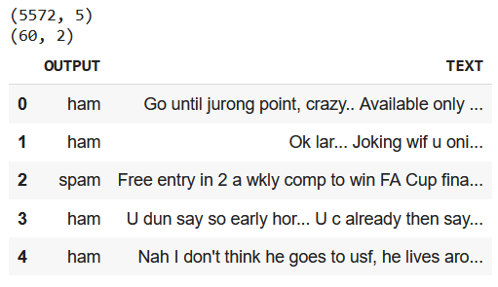
Step 3: Assign your API key to the OpenAI environment
# replace " API KEY" with your generated API key
openai.api_key = "API KEY“
Step 4: Read the CSV file and clean the dataset
Our dataset has 3 unnamed columns with NULL values,
# while loading the csv, we ignore any encoding errors and skip any bad line
df = pd.read_csv('spam.csv', encoding_errors='ignore', on_bad_lines='skip')
print(df.shape)
# we have 3 columns with NULL values, to remove that we use the below line
df = df.dropna(axis=1)
# we are taking only the first 60 rows for developing the model
df = df.iloc[:60]
# rename the columns v1 and v2 to Output and Text respectively
df.rename(columns = {'v1':'OUTPUT', 'v2': 'TEXT'}, inplace = True)
print(df.shape)
df.head()

Slide 32
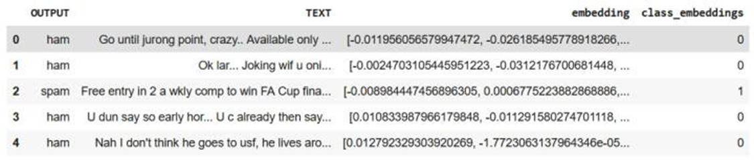
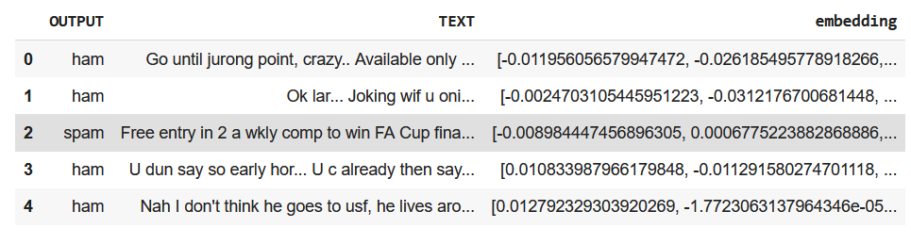
Step 5: Define a function to use Open AI’s Embedding API
# function to generate vector for a string
def get_embedding(text, model="text-embedding-ada-002"):
return openai.Embedding.create(input = , model=model)['data'][0]['embedding']
# applying the above funtion to generate vectors for all 60 text pieces
df["embedding"] = df.TEXT.apply(get_embedding).apply(np.array) # convert string to array
df.head()
Step 6: Custom Label the classes of the output variable to 1 and 0, where 1 means “spam” and 0 means “not spam”.
class_dict = {'spam': 1, 'ham': 0}
df['class_embeddings'] = df.OUTPUT.map(class_dict)
df.head()
Spam Classification dataFrame after feature engineering

Slide 33
Step 7: Develop a Classification model.
Output:
precision recall f1-score support
0 0.82 1.00 0.90 9
1 1.00 0.33 0.50 3
accuracy 0.83 12
macroavg 0.91 0.67 0.70 12
weightedavg 0.86 0.83 0.80 12
We will be splitting the dataset into a training set and validation dataset using train_test_split and training a Random Forest Classification model.
# split data into train and test
X = np.array(df.embedding)
y = np.array(df.class_embeddings)
X_train, X_test, y_train, y_test = train_test_split(X, y, test_size=0.2, random_state=42)
# train random forest classifier
clf = RandomForestClassifier(n_estimators=100)
clf.fit(X_train.tolist(), y_train)
preds = clf.predict(X_test.tolist())
# generate a classification report involving f1-score, recall, precision and accuracy
report = classification_report(y_test, preds)
print(report)
Step 8: Calculate the accuracy of the model
print("accuracy: ", np.round(accuracy_score(y_test, preds)*100,2), "%")
Output:
accuracy: 83.33 %

Slide 34
Step 9: Print the confusion matrix for our classification model
confusion_matrix(y_test, preds)
Output:
array([[9, 0],
[2, 1]])
Example 1:
out = spam_classification("""Congratulations! You've Won a $1000 gift card from walmart. Go to https://bit.ly to claim your reward.""")
print(out)
Output:
SPAM
Example 2:
out = spam_classification("Hey Alex, just wanted to let you know tomorrow is an off. Thank you")
print(out)
Output:
Not SPAM

Slide 35
ADVANTAGES,DISADVANTAGES &BENIFITS
ADVANTAGE
With the benefits of email spam filters, the security risk can be reduced since the user gets in hand the emails that have gone through various spam checks. Moreover, these email spam filters throw out malware, malicious, and virus-infested emails and protect user security.
DISADVANTAGE
Spam emails can be the source of a great amount of malware like viruses, Trojans, worms, and others which are specifically designed to disrupt or damage computer systems.
BENIFITS
Compatibility. ...
Spam Filter Relays. ...
Affordability and Pricing Flexibility. ...
Easy Maintenance. ...
Scalability. ...
Freeing Up Bandwidth.

Slide 36
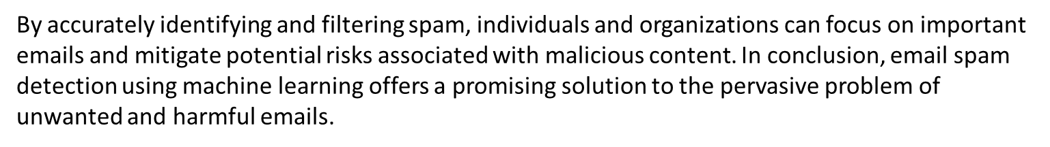

CONCLUSION

Slide 37

Thank you

