Slide 1
SEMESTER 5 PROJECT — REVIEW 1: PLANNING
Standardised Proof-of-Delivery System
Evidence-Quality Checks for a Food-Delivery Service Coordinating Restaurants, Riders & Customers
Name : LOGESH S
[College / University Name] • Department of Computer Science & Engineering • [Month, Year]

Slide 2
AGENDA
What We'll Cover
01
The Problem
02
Existing System
Why delivery evidence today is inconsistent and costly to dispute
How current platforms confirm delivery — and where it breaks down
03
Proposed Solution
04
Evidence Quality Engine
A standardised, scored Proof-of-Delivery pipeline
The weighted scoring model at the core of the system
05
Architecture & Data Design
06
Edge Cases & Validation
Modules, system architecture, and the ER model
Offline-first handling, and how we'll measure success
02

Slide 3

01 — THE PROBLEM
Delivery Proof Is Inconsistent — and Disputes Are Expensive
Every completed order ends the same way: a rider taps “Delivered.” But the evidence behind that tap is rarely verified — leaving platforms exposed to disputes they can't confidently resolve.
No quality check
Unverified GPS
on delivery photos before they're accepted as proof
accuracy or address match at the moment of confirmation
The Cost of Ambiguity
Support hours spent re-checking evidence that was never validated at capture
Refunds issued (or withheld) on a subjective, agent-by-agent judgement call
Rider and restaurant trust erodes when outcomes feel inconsistent
Every case is resolved reactively — only after the customer complains
Skipped OTP / signature
Lost evidence
under rider time pressure or customer unavailability
when the network drops during the last mile
03

Slide 4

02 — EXISTING SYSTEM
How Delivery Confirmation Works Today
Mainstream platforms mark an order “delivered” when a rider taps a status button and optionally attaches one photo. There is no scoring, no consistency check, and no structured record of why a decision was made.
No automated photo quality check
GPS unverified at confirmation
Inconsistent evidence bar
Blurred or irrelevant images accepted as valid proof
Location and address match never cross-checked
Different support agents make different subjective calls
Poor offline behaviour
No audit trail
Reactive dispute handling
Evidence capture commonly fails outright without network
Delivery status isn't traceable back to specific evidence
Issues only surface after the customer complains
04

Slide 5






03 — OBJECTIVES
Project Objectives
Standardise Evidence Capture
Automate Quality Scoring
Work Offline, Always
Five structured evidence types for every delivery: photo, GPS, timestamp, OTP, signature
A transparent, weighted rubric that classifies deliveries as Accepted, Review, or Dispute
Full evidence capture with zero GPS or network, syncing automatically on reconnect
Give Dispatchers the Final Word
Maintain a Complete Audit Trail
Measure What Matters
A logged override workflow for edge cases, with mandatory reasons
Every score and decision traceable, immutable, and reviewable
Benchmark against a manual baseline on a labelled validation dataset
05

Slide 6




04 — PROPOSED SOLUTION
From Unverified Tap to Scored Decision
The proposed system treats delivery evidence as a structured, automatically scored artifact — not an unexamined attachment. Low-quality evidence is caught before the customer ever has to complain.
01
02
03
04
Capture
Score
Classify
Resolve
Photo, GPS, timestamp, OTP/signature — online or offline
Evidence Quality Engine computes a 0–100 weighted score instantly
Accepted (≥90) · Manual Review (70–89) · Dispute (<70)
Auto-accepted, or routed to a dispatcher with full context
06

Slide 7





05 — EVIDENCE QUALITY ENGINE
A Transparent, Weighted Scoring Rubric
=
100
25
25
20
20
10
TOTAL
Photo Available
GPS Valid
Timestamp Valid
Signature
OTP
Automatic Classification
90 – 100
70 – 89
Below 70
Accepted
Needs Manual Review
Dispute
Delivery auto-confirmed. No human action needed.
Routed to the dispatcher queue within a 24-hour SLA.
Automatically opens a dispute; customer & dispatcher notified.
07

Slide 8





SYSTEM DESIGN
Five Role-Based Modules
Restaurant
Rider
Customer
Dispatcher
Admin
Create orders
Assign rider
Track status
Accept delivery
Capture evidence
Complete delivery
Receive OTP
Verify delivery
Raise dispute
Review flagged deliveries
Override decision
Maintain history
Dashboard
Reports
Delivery analytics
08

Slide 9
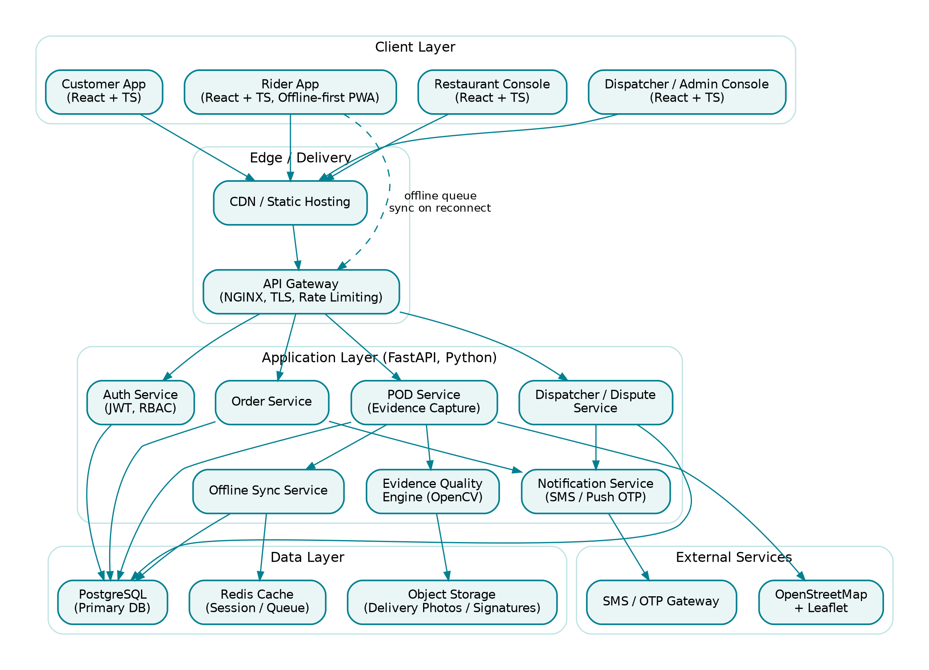
06 — ARCHITECTURE & DATA DESIGN
System Architecture
A layered client–server design with an explicit offline-sync boundary at the client edge — the Rider App queues evidence locally and syncs opportunistically.
09

Slide 10
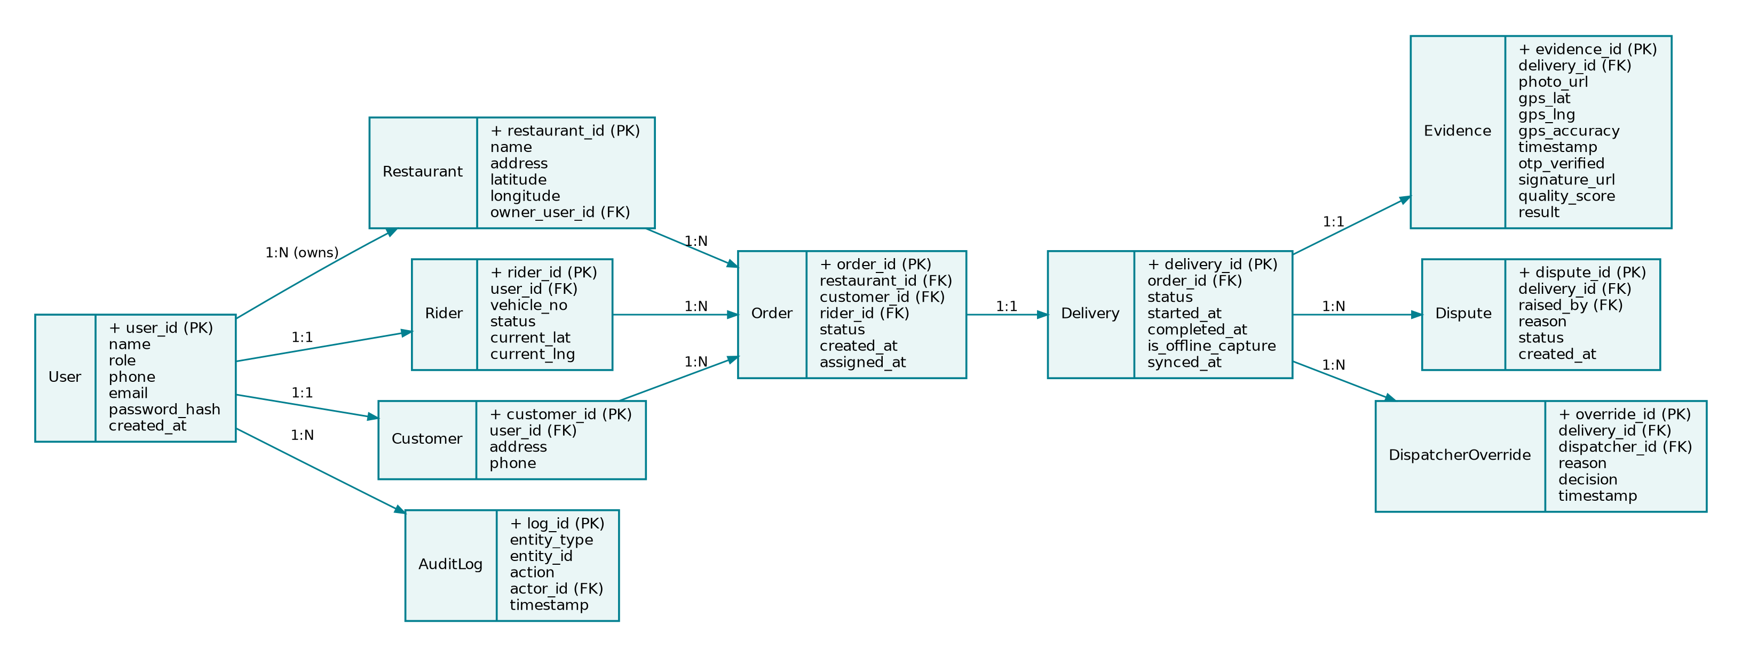
ARCHITECTURE & DATA DESIGN
Database Design — ER Model
Core entities: User (with Rider / Customer / Restaurant-owner extensions), Order, Delivery, Evidence, Dispute, Dispatcher Override, and an immutable Audit Log.
10

Slide 11

RELIABILITY
Offline-First by Design
Riders routinely work in basements, elevators, and network dead zones. The capture flow never blocks on connectivity.
Capture Locally
Work Offline
Auto-Sync
Score & Classify
Evidence written to an on-device queue first — before any network call
UI never blocks; “Complete Delivery” succeeds at zero connectivity
Background Sync Manager retries with backoff once connectivity returns
Missing GPS caps the score, correctly routing to Manual Review
11

Slide 12


ROBUSTNESS
Edge Cases the System Must Handle
Case 1
Case 2
Case 3
Case 4
Case 5
GPS Unavailable
Network Unavailable
Blurred Image
Signature Refused
GPS Mismatch
Offline mode → reduced score → manual verification
Store evidence locally → sync automatically later
Reject the image → prompt rider to retake
Fall back to OTP verification → notify dispatcher
Flag the location mismatch → route to evidence review
12

Slide 13


IMPLEMENTATION
Technology Stack
Frontend
Backend & DB
Maps
React 18 + TypeScript, Tailwind CSS, PWA offline support
FastAPI (Python), PostgreSQL, Redis
OpenStreetMap + Leaflet.js
Image Validation
Dashboard
Security
OpenCV — blur & brightness checks
Chart.js, with Power BI export
JWT auth, RBAC, TLS 1.2+, bcrypt
13

Slide 14
EVALUATION
How We'll Validate the System
A labelled validation dataset spans normal deliveries and all five edge cases. The Evidence Quality Engine's classification is benchmarked directly against a manual, photo-only baseline — simulating how platforms decide today.
Unit & Integration
Edge-Case Scenarios
Baseline Comparison
Pytest for the scoring engine
API contract tests (Postman/Newman)
RBAC & auth negative-case tests
All 5 edge cases scripted as tests
Precision / recall / F1 per class
Offline-sync and idempotency checks
Human reviewer, photo-only, vs. EQE
Agreement rate with ground truth
Cases the baseline would wrongly accept
14

Slide 15
PLAN
Project Timeline
Week 1–2
Week 9
Week 12–14
Review 1
Review 2
Testing & Docs
Requirements, SRS, architecture, ER design, wireframes
Demo of capture-to-scoring pipeline
Full test suite, baseline comparison, final report
Week 3–8
Week 10–11
Week 15
Development
Development
Review 3
Core services, evidence capture, offline sync, EQE, dispatcher workflow
Audit history, admin dashboard, validation dataset
Final testing sign-off and live demo
15

Slide 16
Thank You
Questions & Discussion
Standardised Proof-of-Delivery System — Review 1

