Slide 1

NMS-EVENT MANAGEMENT SYSTEM USING SALESFORCE
Team Members
LOGESHWARAN M - CSBS
LOGITH J - CSBS
JOEL ABI PRANESH S - CSBS
JANA R - CSBS
SACHIN M - CSBS
GUIDE: RAKESH M
MENTOR: VENKATA RAMANEN B - AP/CSBS

Slide 2
What is Salesforce ?
Salesforce is a popular cloud-based customer relationship management (CRM) platform that helps businesses manage their relationships and interactions with customers and potential customers. It offers a wide range of tools and features for sales, marketing, customer service, and more.
Salesforce allows businesses to store customer data, track leads and opportunities, automate various tasks, and provide a unified view of customer information to improve overall business efficiency and customer satisfaction. It is widely used across various industries to streamline processes and enhance customer engagement.

Slide 3
EVENT MANAGEMENT SYSTEM
The project's goal is to develop a real-time Event Management System using Salesforce.
It is designed to provide practical knowledge for students with basic Salesforce skills and professionals seeking to transition into Salesforce.
The project will enable users to gain hands-on experience and enhance their resumes with this real-world project.

Slide 4
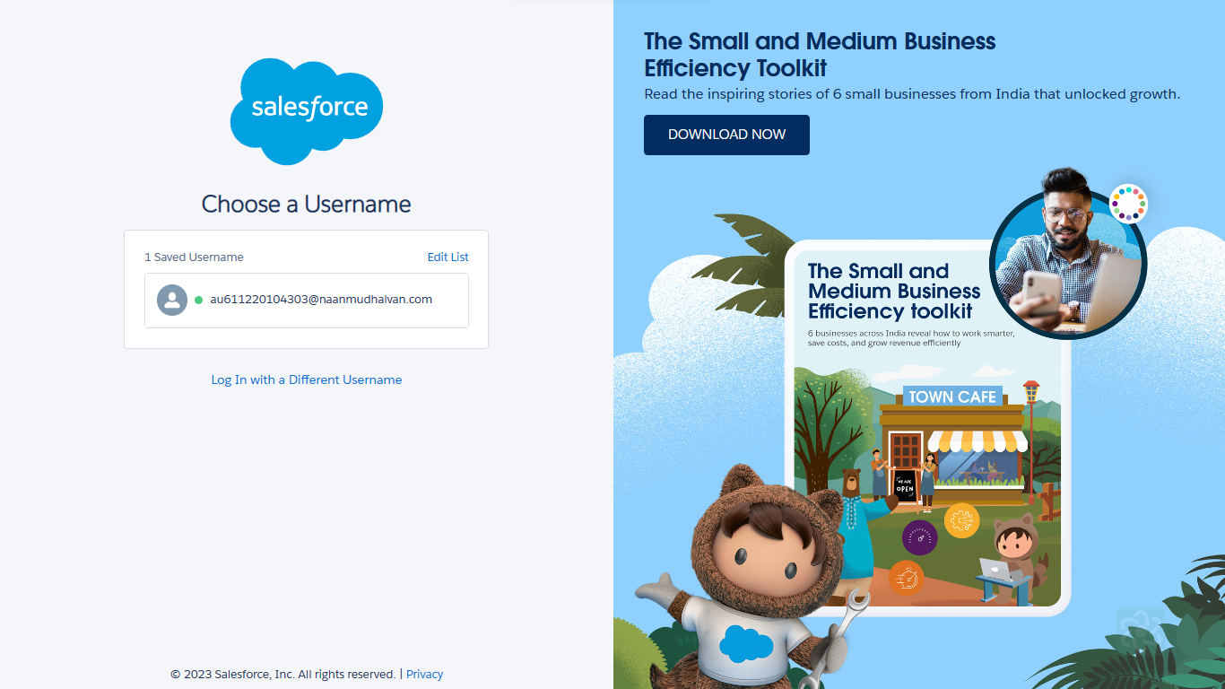
1. Creation of Developer Account
A Developer org has all the features and licenses you need to get started with Salesforce.1.Search developer.salesforce.com/signup

Slide 5
2. Object Creation
What is an Object?
In Salesforce, an object is a data structure representing a table storing specific information, comprising fields and records, crucial for efficient data management and organization.
Two Types
Standard Objects: - Predefined entities like Accounts and Contacts in Salesforce, catering to common business needs without extensive customization.
Custom Objects: - User-defined entities allowing businesses to create tailored data structures, enabling unique data storage and specialized application development.

Slide 6
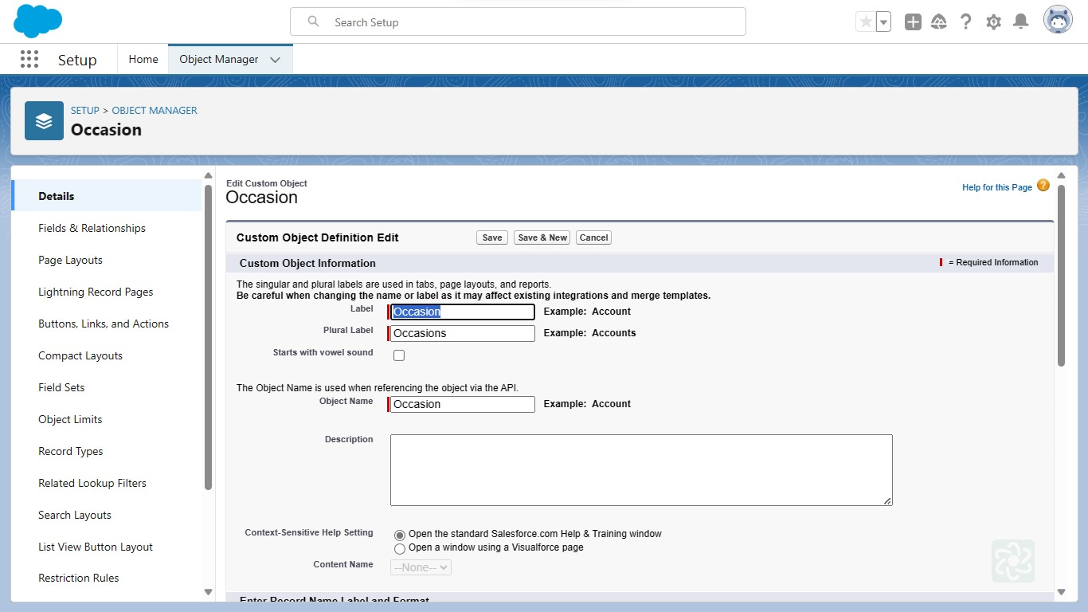
In this Application we use some Custom Objects
Occasion
Attendee
Speaker
Vendors
Event Service

Slide 7
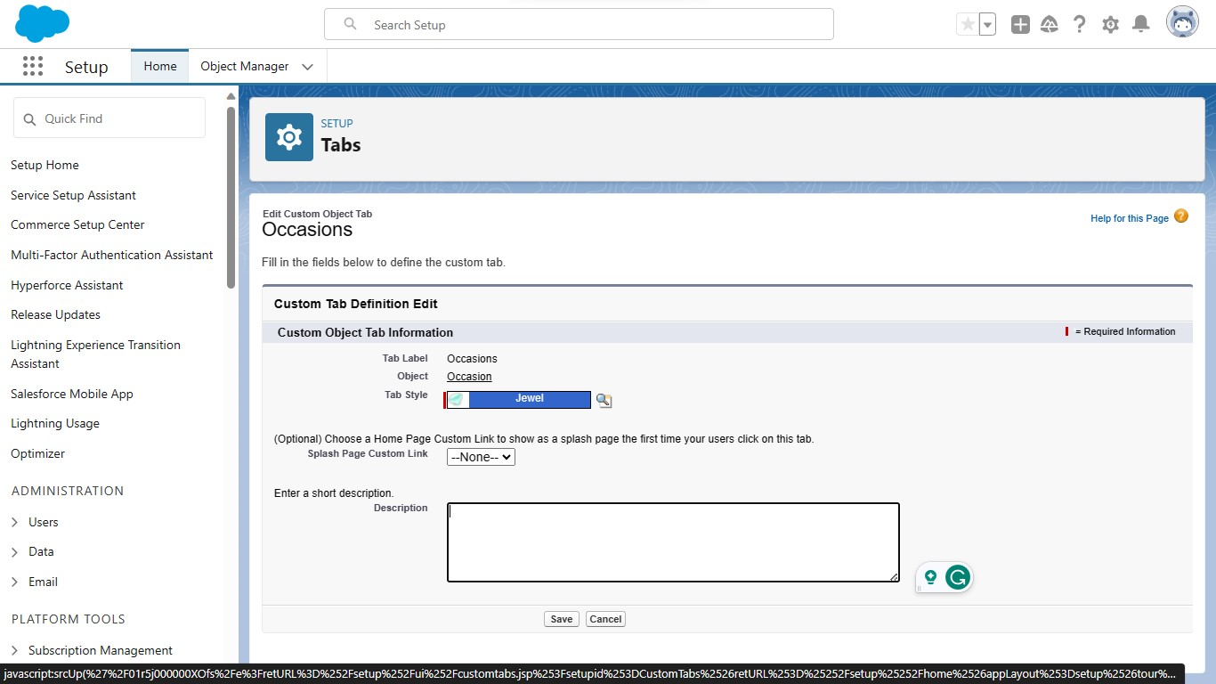
3. Tabs Creation
Tabs in Salesforce are sections for navigation, providing access to data and functions. They organize standard, custom objects, Visualforce, Lightning components, and web pages.

Slide 8
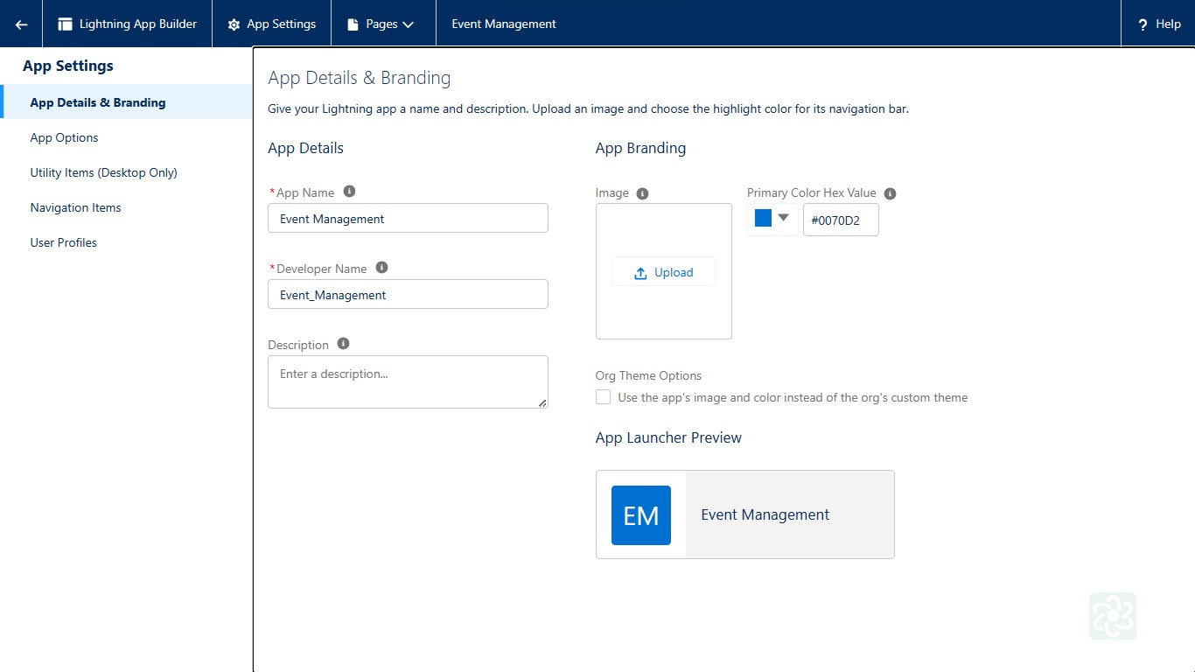
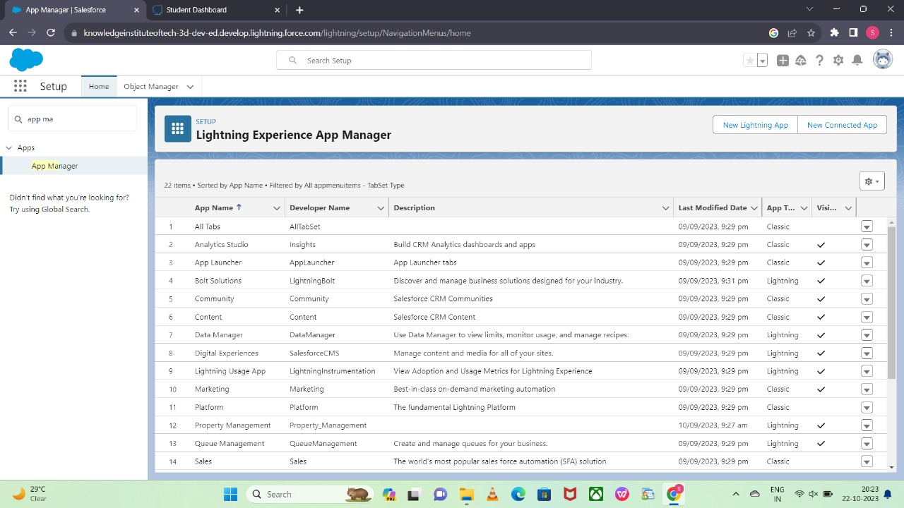
4. Create App
Salesforce offers standard (Sales Cloud), custom, and third-party apps through AppExchange.
These include mobile, community, and integration apps, empowering businesses with versatile solutions for CRM, collaboration, and efficiency.

Slide 9
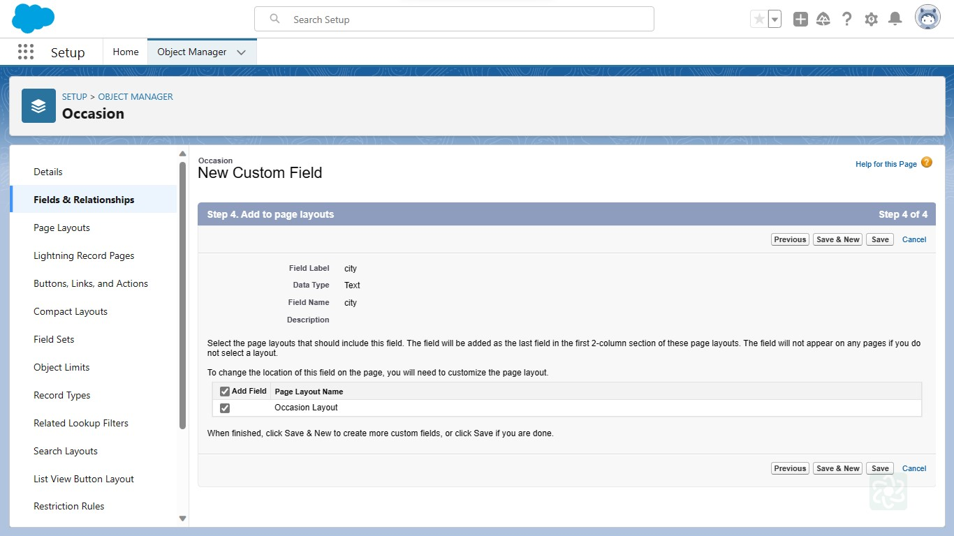
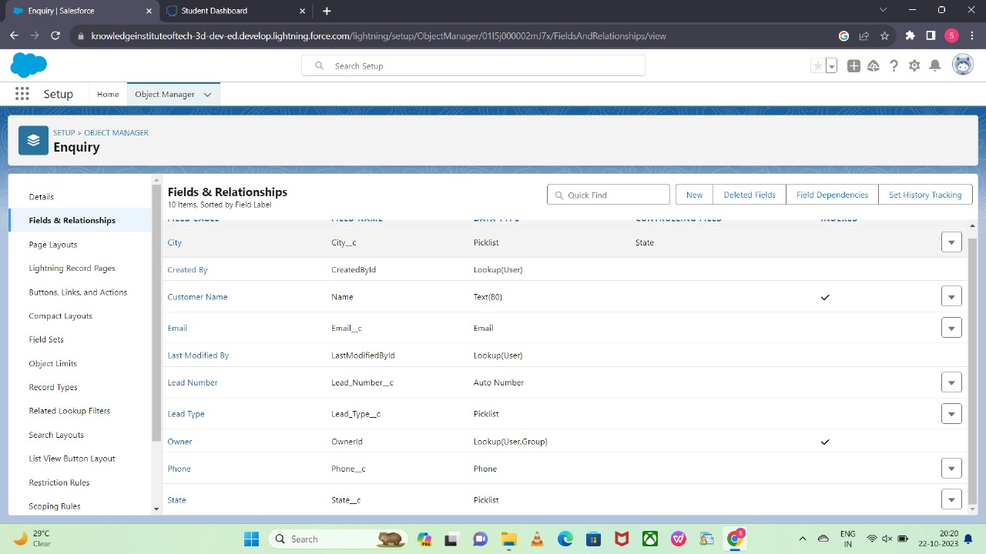
5. Fields & Relationships
Salesforce fields store diverse data types: text, numbers, dates, picklists, checkboxes, formulas, lookups, and more.
They organize information within records, crucial for efficient CRM management.

Slide 10
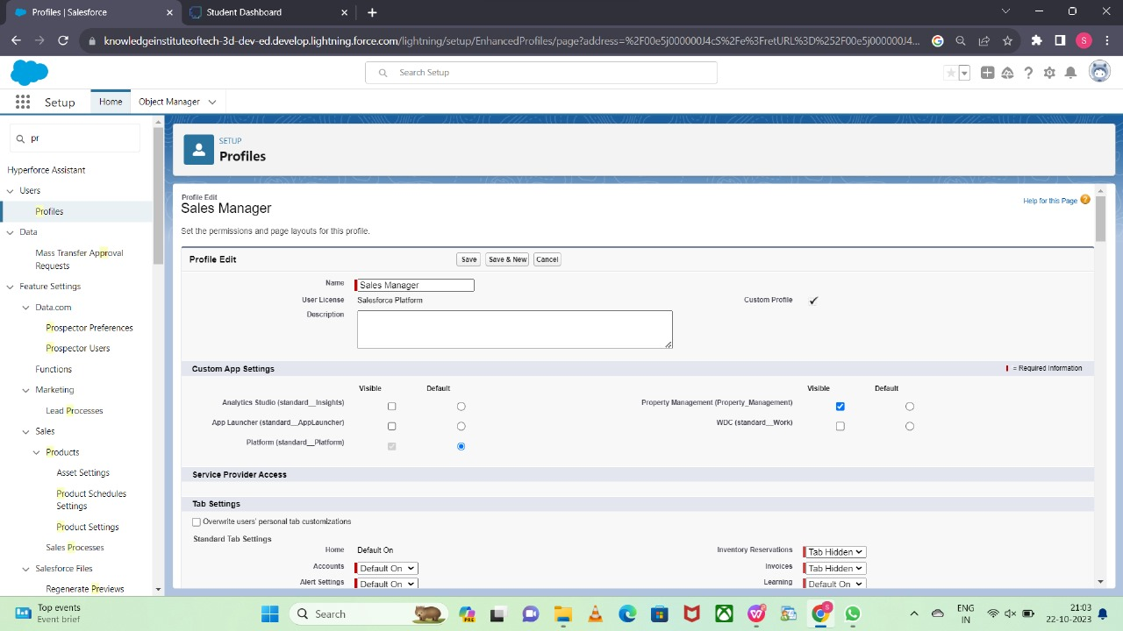
6. Profile
Salesforce profiles manage user permissions, controlling access to objects, fields, and record actions.
They’re crucial for data security and maintaining organization-specific data integrity and functionality.

Slide 11
7. User
What is a user?
A user is anyone who logs in to Salesforce. Users are employees at your company, such as sales reps, managers,
and IT specialists, who need access to the company's records. Every user in Salesforce has a user account. The user account identifies the user, and the user account settings determine what features and records the user can access.

Slide 12
9. Permission Sets
What is a Permission set?
A permission set is a collection of settings and permissions that give users access to various tools and functions. Permission sets extend users’ functional access without changing their profiles.
Create permission sets to grant access among logical groupings of users, regardless of their primary job function. For example, let’s say you have several users who must delete and transfer leads.
You can create a permission set based on the tasks that these users must perform and include the permission set within permission set groups based on job functions.

Slide 13
10. User Adoption
What is user adoption?
User adoption is the process that new users go through to start working with your product and commit to using it long-term.
Create a Record (Occasion)
Click on App Launcher on the left side of the screen.
Search Event Management & click on it.
Click on the Occasion Tab.
Click new and fill details & Save

Slide 14
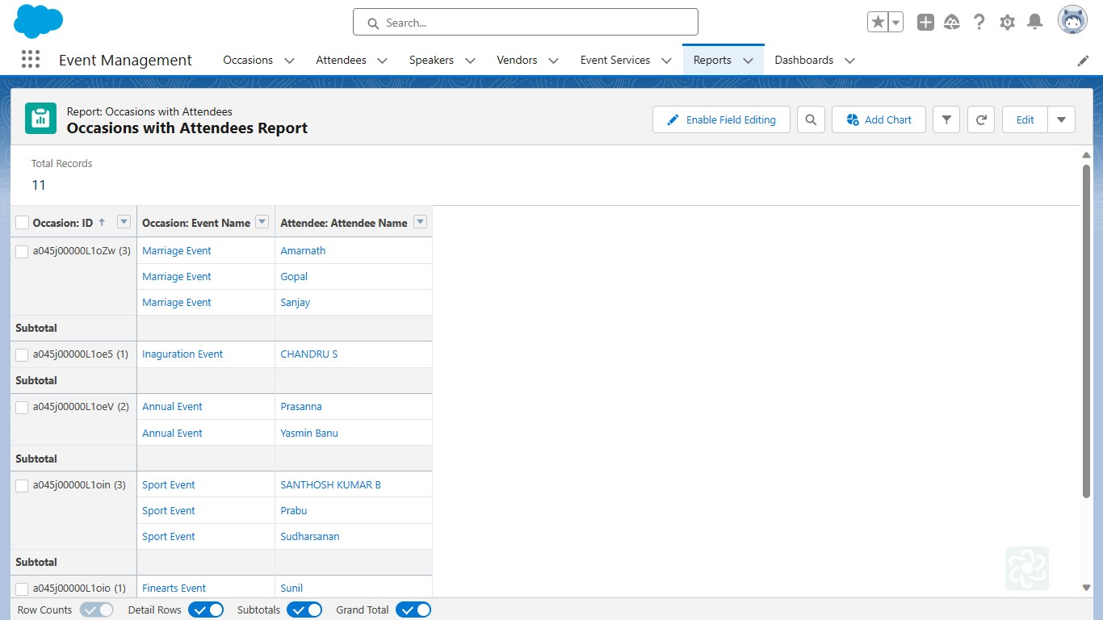
11. Reports
Salesforce reports analyze data with customizable formats, filters, and charts.
Users create insightful reports and dashboards, enabling informed decisions and enhancing overall organizational efficiency.

Slide 15
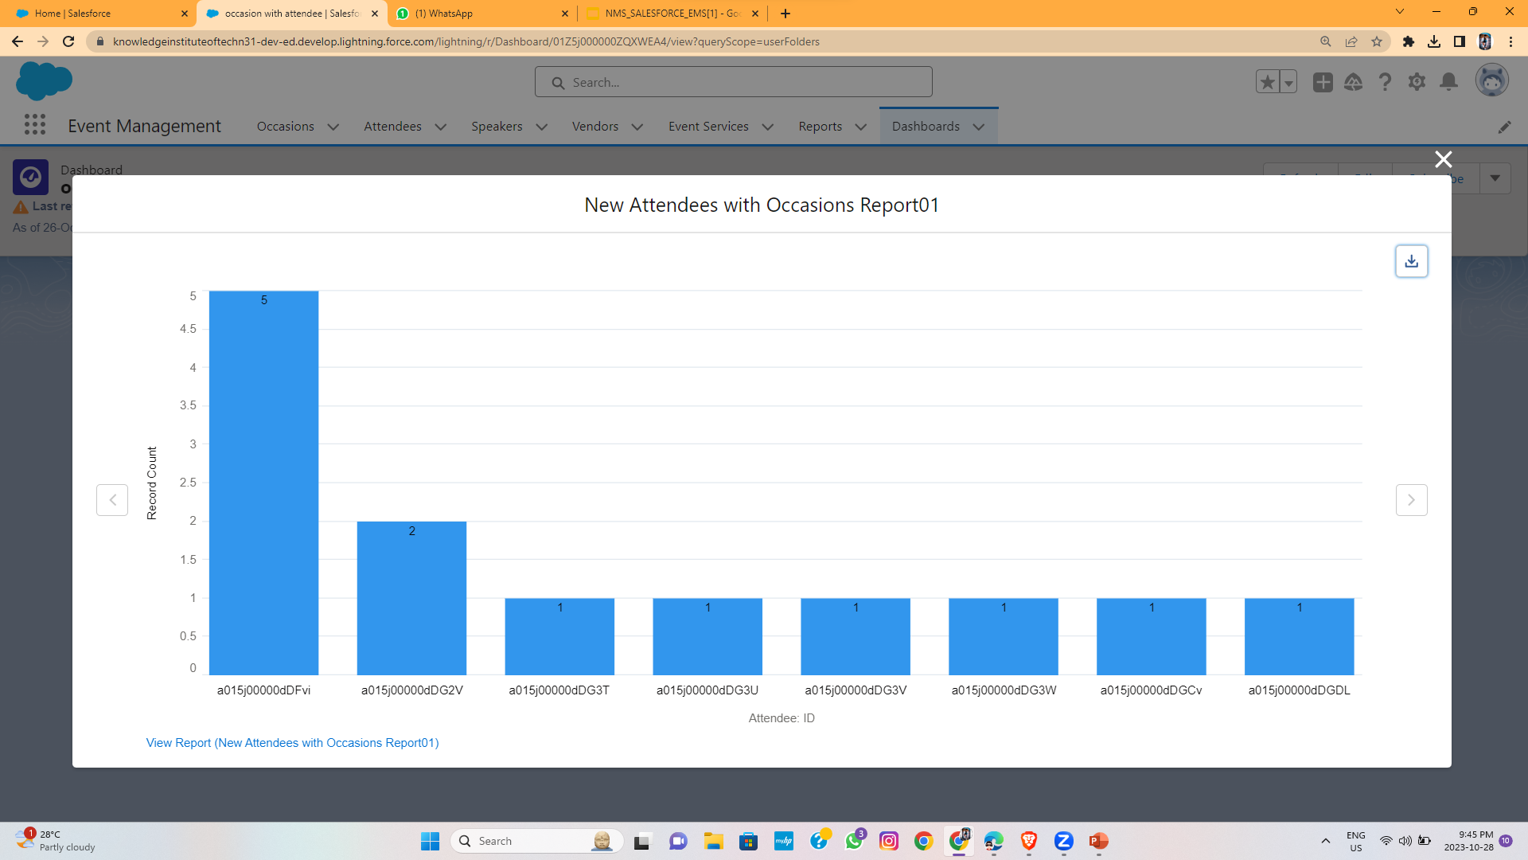
12. Dashboard
Dashboards merge data from various sources into a concise format, enabling quick insights. Visual elements like charts enhance data comprehension, and the streamlined presentation accelerates decision-making and action planning.

Slide 16
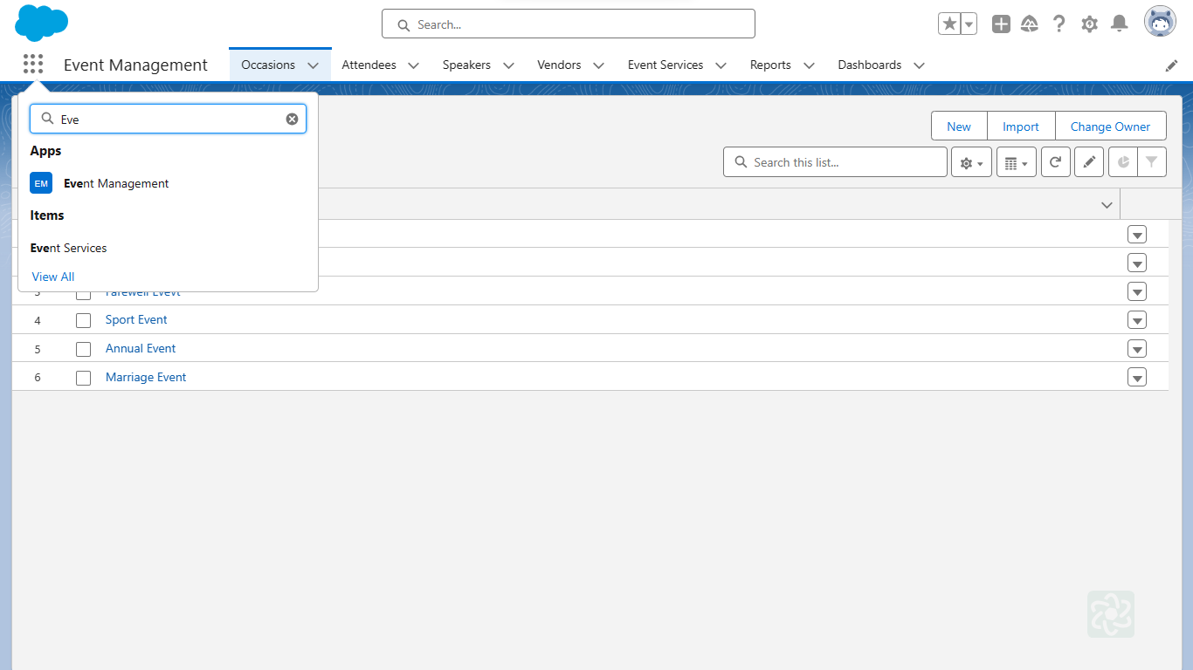
App Launcher

Slide 17
THANK YOU

