Slide 1
FINAL YEAR PROJECT · B.SC. DATA SCIENCE
RetainIQ
Signal Ops Console
signal strength
An explainable machine learning platform for customer churn prediction, risk intelligence and retention strategy.
80.34%
TEST ACCURACY
84.91%
ROC-AUC
7,043
CUSTOMERS SCORED
$92,539
MONTHLY REVENUE AT RISK IN THE HIGH-RISK BAND
Logesh S. · B.Sc. Data Science
Live application: retainiq-predictive-customer-retention-zq6x.onrender.com · Source: github.com/Logesh0247/RetainIQ_Signal_Ops_Console
Notes:
OPENING (0:00–0:35). "Good morning. A telecom knows it lost a quarter of its
customers last year. What it cannot tell you is who leaves next month, why, or
what to do about it. That gap is the whole project.
RetainIQ reads a customer's weakening signal — from raw records, to a predicted
probability, to an explained reason, to a recommended action, and finally to the
revenue that action protects. 80.34% accuracy, 84.91% ROC-AUC, 7,043 customers
scored, and $92,539 a month of recurring revenue sitting in the high-risk band."
Then move — do not read the tiles.

Slide 2
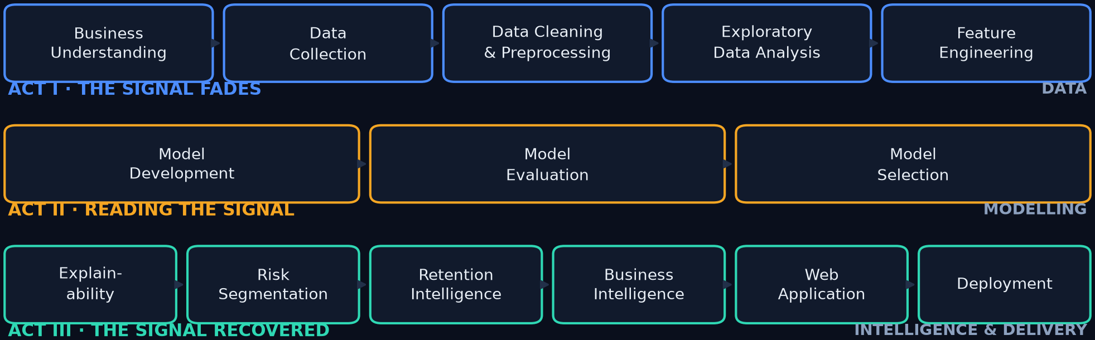
THE DEVELOPMENT CYCLE
Fourteen phases, three acts
This is the map for the whole talk — every slide that follows is one of these boxes
HOW TO READ THE DECK
Three acts — the signal fades (I), reading the signal (II), the signal recovered (III). Every slide names its phase in the footer.
RetainIQ · Signal Ops Console
02
Notes:
(0:35–1:05) "Everything I show you maps to one of these fourteen boxes, and the
boxes group into three acts."
Point along the arcs: "Act one, the signal fades — the problem and the data. Act
two, reading the signal — the model work. Act three — what it's worth and the
product."
Promise the structure and then keep it. Do not narrate every box.

Slide 3
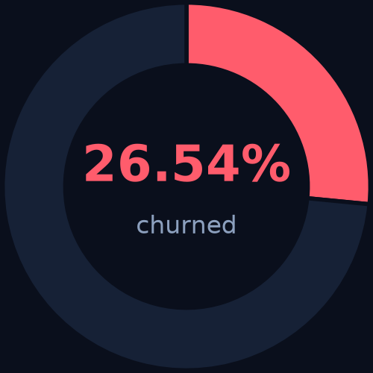
PHASE 01 · BUSINESS UNDERSTANDING
The problem: retention is still reactive
Reports explain what happened. They do not say who leaves next.
▸ Churn compounds.
26.54% of this customer base churned — 1,869 of 7,043 customers.
▸ Dashboards describe, they do not prioritise.
Knowing last quarter's churn rate does not tell a retention team whom to call today.
▸ Generic campaigns waste budget.
Blanket offers discount loyal customers and still miss the ones about to leave.
THE BASE RATE
Who is likely to churn?
Predicted churn probability per customer
Why are they at risk?
Feature contributions behind each prediction
What should we do?
A retention action matched to the risk drivers
What is at stake?
Monthly recurring revenue exposed in each risk band
1,869 churned · 5,174 retained of 7,043. Predicting "nobody churns" is already 73.46% accurate — which is why accuracy alone decides nothing here.
RetainIQ · Signal Ops Console · PHASE 01 · BUSINESS UNDERSTANDING
03
Notes:
(1:05–1:55) Frame the pain, then the four questions — they structure the entire
solution. Finish on the donut: "Notice the trap. If I predict nobody churns I'm
73.46% accurate and completely useless. That single number is why no model in
this deck is chosen on accuracy."
That line earns credibility early and sets up Phase 07.

Slide 4
PHASE 02 · DATA COLLECTION
The data that records the signal
IBM Telco Customer Churn — 7,043 customers, 34 raw fields, one binary target
7,043
CUSTOMERS
34
RAW FEATURES
30
ML FEATURES
26.54%
CHURN RATE
80 / 20
STRATIFIED SPLIT
What a row contains
▸ Customer profile — gender, senior citizen, partner, dependents
▸ Services — phone, internet, security, backup, protection, support, streaming
▸ Contract & billing — contract type, payment method, paperless, charges
▸ Value — tenure, monthly charges, total charges, CLTV
Target: Churn Label (Yes / No), converted to 1 / 0.
CLASS BALANCE AND THE SPLIT
1,869 churned against 5,174 retained. The split is stratified, so both halves carry the identical 26.54% churn rate: 5,634 rows train, 1,409 rows are held back and touched only once.
TRAIN / SERVE PARITY
The 30 encoded columns are frozen in feature_columns.pkl and rebuilt by the same preprocessing code for every upload — training and live scoring cannot drift apart. There is a unit test for exactly this.
RetainIQ · Signal Ops Console · PHASE 02 · DATA COLLECTION
04
Notes:
(1:55–2:35) Quick pass on the tiles. Spend the time on the right-hand callouts:
"the split is stratified, so both halves carry exactly the same 26.54% churn rate
— the model never sees a distorted class balance."
And the parity point: "the 30-column contract is saved next to the model and
tested, so the app cannot silently score on the wrong schema."

Slide 5
PHASE 03 · DATA CLEANING & PREPROCESSING
From raw records to 30 model-ready features
One reproducible pipeline, used identically in training and in the live app
Raw upload
7,043 records · 34 columns
Clean
types, blanks, duplicates, category names
Encode
16 categoricals → 27 flags
30 features
frozen column contract
→
→
→
LEAKAGE PREVENTION — the detail that makes the results believable
Churn Score, Churn Reason, Churn Category and Customer Status were removed before training. All four are only known after a customer has already churned, so keeping them would inflate the metrics and break the model in production. This is the difference between a demo and a deployable model.
▸ Cleaning
Data-type correction, 11 blank TotalCharges values (all zero-tenure new customers), duplicate checks, categorical normalisation, removal of ID and geographic columns that carry no predictive value.
▸ Encoding
Every service column becomes an explicit flag — Contract_Two year, Tech Support_Yes, Internet Service_Fiber optic — so no ordering is invented where none exists: 3 numeric features + 27 flags = 30.
RetainIQ · Signal Ops Console · PHASE 03 · DATA CLEANING & PREPROCESSING
05
Notes:
(2:35–3:20) Walk the four boxes quickly, then slow down on the leakage callout —
reviewers consistently reward this. "Churn Score and Churn Reason are the
dataset's most seductive columns and they're poison: they only exist after the
customer has left. I dropped them. That is why 80% here is a real 80%."
One sentence on encoding and move on.

Slide 6
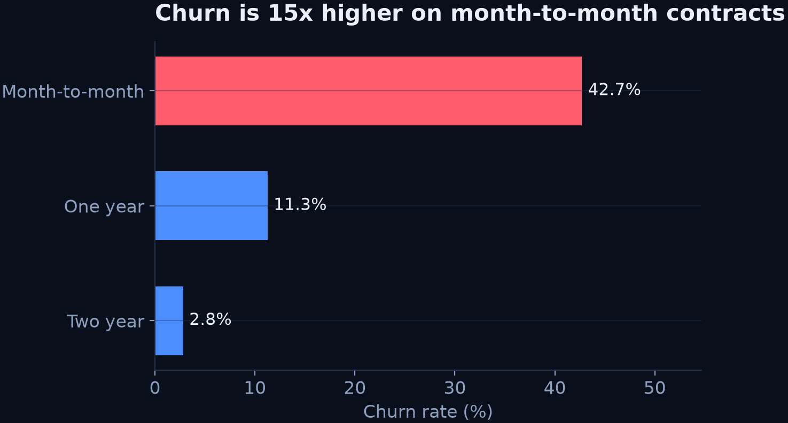
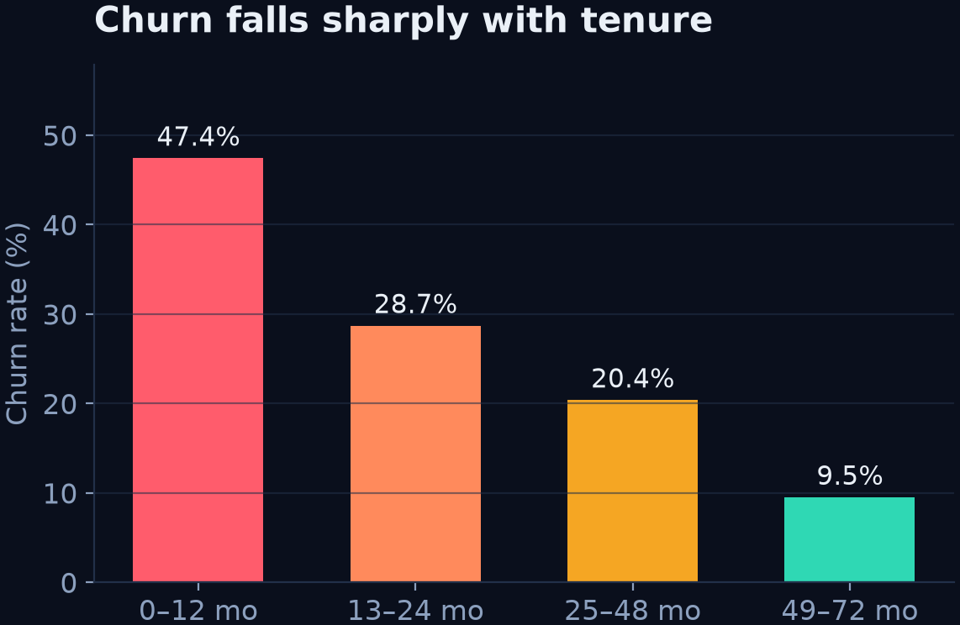
PHASE 04 · EXPLORATORY DATA ANALYSIS
What the data said
Three patterns that shaped the model — and the retention strategy
Contract is the strongest signal
42.7% churn on month-to-month vs 2.8% on two-year contracts — a 15× gap.
Churn is front-loaded
47.4% of first-year customers churn; 55.5% of all churners are in year one. Churned customers average 18.0 months vs 37.6.
It is a service-experience story
Fiber optic 41.9% vs 7.4% with no internet; customers without tech support or online security churn at 41.6% and 41.8%.
RetainIQ · Signal Ops Console · PHASE 04 · EXPLORATORY DATA ANALYSIS
06
Notes:
(3:20–4:05) Three takeaways only, no bar-by-bar narration.
"Month-to-month is a 15× risk multiplier."
"Risk is front-loaded — year one is where retention money belongs."
"And the story is service experience, not just price: fiber optic, no security,
no support."
Bridge out: "these are the patterns the model later recovered on its own — and
what the recommendation engine acts on."

Slide 7
PHASE 05 · FEATURE ENGINEERING
Thirty features, one frozen contract
Three numeric measures, twenty-seven explicit flags — and a test that guards them
3
NUMERIC FEATURES
27
BINARY FLAGS
30
TOTAL MODEL INPUTS
THE THREE NUMERIC MEASURES
Tenure Months, Monthly Charges, Total Charges — the only continuous quantities the model sees.
WHY FLAGS, NOT NUMBERS
Assigning 1, 2, 3 to DSL / Fiber / None would invent an ordering that does not exist. Flags keep the model honest about what these categories actually are.
Eleven Total Charges values are blank — every one of them belongs to a zero-tenure customer, so the missing rows never hide a churn signal.
THE COLUMN CONTRACT
The exact 30 column names are saved to feature_columns.pkl alongside the model. The app rebuilds a feature frame and checks it against that list before scoring.
If the two ever disagree, the request fails loudly rather than silently scoring on a misaligned frame — the most common way a student project works in the notebook and quietly breaks in the app.
Uploads are validated against that same list, so a mismatched CSV is rejected before a single row is scored.
RetainIQ · Signal Ops Console · PHASE 05 · FEATURE ENGINEERING
07
Notes:
(4:05–4:35) Short slide, but it answers a question examiners like: "why did you
encode it that way?"
"Three continuous measures. Everything else is a yes/no flag — because numbering
DSL as 1 and Fiber as 2 would invent an ordering that isn't real."
Then the contract point: "the 30 column names are saved with the model and
checked at scoring time, so a schema mismatch fails loudly instead of silently
producing garbage."

Slide 8
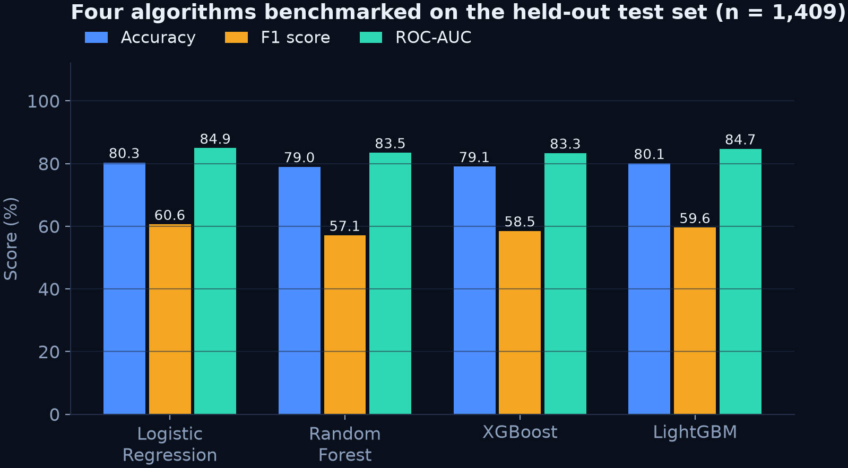
PHASE 06 · MODEL DEVELOPMENT
Four algorithms, one pipeline
Same features, same split, same scoring code — only the algorithm changes
▸ Logistic Regression
linear baseline; interpretable coefficients
▸ Random Forest
bagged trees; captures non-linearity
▸ XGBoost & LightGBM
gradient boosting; strong on tabular data
Benchmark ladder (F1)
LR 60.6 · LightGBM 59.6 · XGBoost 58.5 · RF 57.1
WHY FOUR MODELS AND NOT ONE
A single model proves nothing. Four algorithms on the same pipeline show the result is a property of the features and the problem — not of one lucky configuration. Accuracy, precision, recall, F1 and ROC-AUC were all recorded, and the winner was chosen on F1 and ROC-AUC, never accuracy.
RetainIQ · Signal Ops Console · PHASE 06 · MODEL DEVELOPMENT
08
Notes:
(4:35–5:05) "Same features, same split, same code path — the only thing that
changes is the algorithm."
Then the key observation: Logistic Regression leads on F1 and ROC-AUC, with
LightGBM a close second. Say why it matters: "churn here is largely linear in the
encoded features, so the simplest model wins — and that also buys me
explainability for free." That sets up Phase 09.

Slide 9
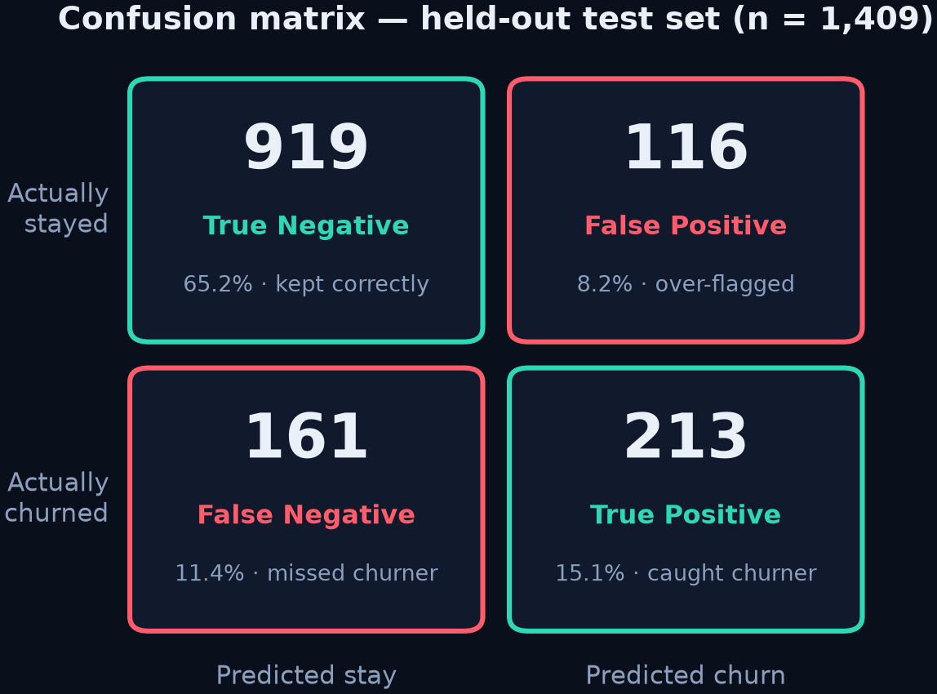
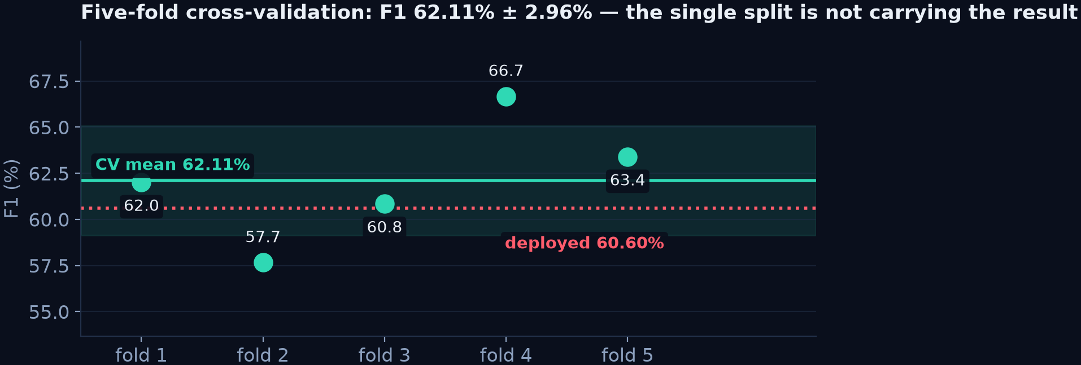
PHASE 07 · MODEL EVALUATION
Measuring the model — and its stability
Held-out test set of 1,409 customers, plus five-fold cross-validation
80.34%
ACCURACY
64.74%
PRECISION
56.95%
RECALL
60.60%
F1
84.91%
ROC-AUC
Honest reading: of 374 churners in the test set the model catches 213. The deployed 60.60% F1 sits inside a cross-validated range of 62.11% ± 2.96% (accuracy 81.19% ± 1.18%), so the single split is not carrying the result — and recall is the number this project works on next.
RetainIQ · Signal Ops Console · PHASE 07 · MODEL EVALUATION
09
Notes:
(5:05–5:55) The credibility slide — slow down.
"1,409 customers held back entirely. 919 stayed and were correctly left alone;
116 were flagged unnecessarily; 161 churners were missed; 213 caught."
Then the stability point, which most projects never show: "five-fold
cross-validation gives 62.11% F1 with a 2.96 standard deviation, and my deployed
result sits inside it. So this is a stable result, not a lucky split."
Then own the weakness: "recall is 56.95% — that is the one number I would fix
first, and I'll show you exactly how on the next slide."

Slide 10
PHASE 08 · MODEL SELECTION
Why Logistic Regression ships
Four models, five metrics, one decision — made on F1 and ROC-AUC
Model
Accuracy
Precision
Recall
F1
ROC-AUC
Logistic Regression ← selected
80.34%
64.74%
56.95%
60.60%
84.91%
LightGBM
80.06%
64.49%
55.35%
59.57%
84.71%
XGBoost
79.06%
61.72%
55.61%
58.51%
83.34%
Random Forest
78.99%
62.34%
52.67%
57.10%
83.48%
THE DECISION RULE
Accuracy alone would have picked LightGBM by one hundredth of a point. The choice was made on F1 and ROC-AUC, because a retention team cares about ranking risk correctly and catching churners — not about the share of all customers classified correctly. Logistic Regression also wins on being explainable, which the next phase depends on.
RetainIQ · Signal Ops Console · PHASE 08 · MODEL SELECTION
10
Notes:
(5:55–6:25) "Four algorithms, identical treatment. Look at how close they are —
LightGBM is within 0.28 of a point on accuracy. If I had picked on accuracy I'd
have picked a harder model to explain, for no real gain."
Then state the rule: "I selected on F1 and ROC-AUC, because what matters
operationally is ranking risk, not classifying the majority correctly."

Slide 11
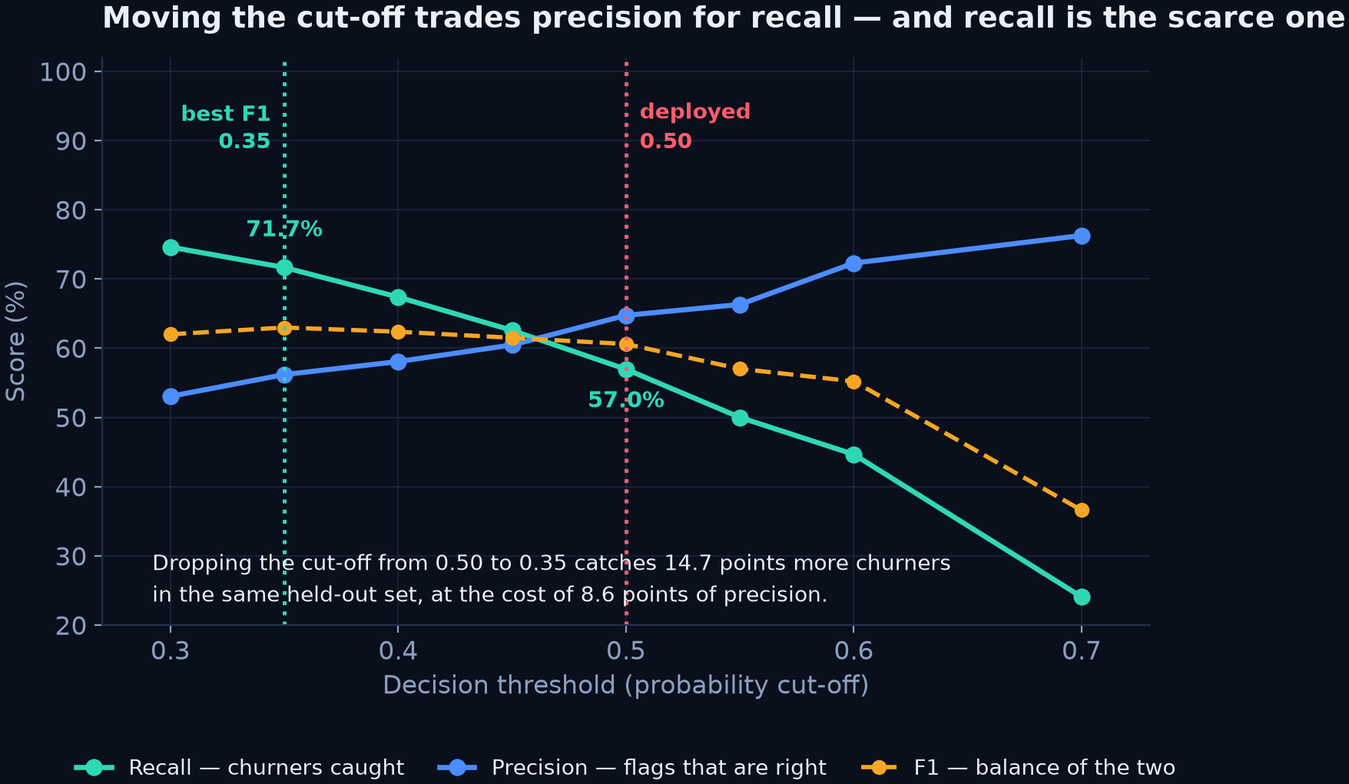
PHASE 08 · MODEL SELECTION · THE OPERATING POINT
The cut-off was a default — not a decision
0.5 is arbitrary. Measuring it turns the model's weakest number into a choice
WHAT THE SWEEP SHOWS
At 0.35 the model catches 71.7% of churners instead of 57.0%, and F1 actually improves to 62.98%. Both recall and F1 are better than the deployed setting.
THE PROOF THAT MATTERS
Training with class_weight='balanced' lifts recall to 77.81% while ROC-AUC barely moves: 84.89 against 84.90. The model already ranks customers correctly — the 0.5 cut-off was throwing churners away.
RetainIQ · Signal Ops Console · PHASE 08 · MODEL SELECTION
11
Notes:
(6:25–7:05) This is the strongest slide in the deck — give it time.
"0.5 is a library default, not a business decision. So I measured the whole range."
Point at the crossing: "at 0.35 I catch 71.7% of churners instead of 57% — and F1
actually goes UP, not down."
Then the diagnostic proof, which is the real insight: "I retrained with balanced
class weights. Recall goes from 56.95 to 77.81, and ROC-AUC doesn't move —
84.89 versus 84.90. The model was already ranking customers correctly. Only the
cut-off was discarding them."
Then be honest: "it stays at 0.5 in production today because moving it is a
business decision about the cost of a wasted offer versus a lost customer — not
something I should silently change."

Slide 12
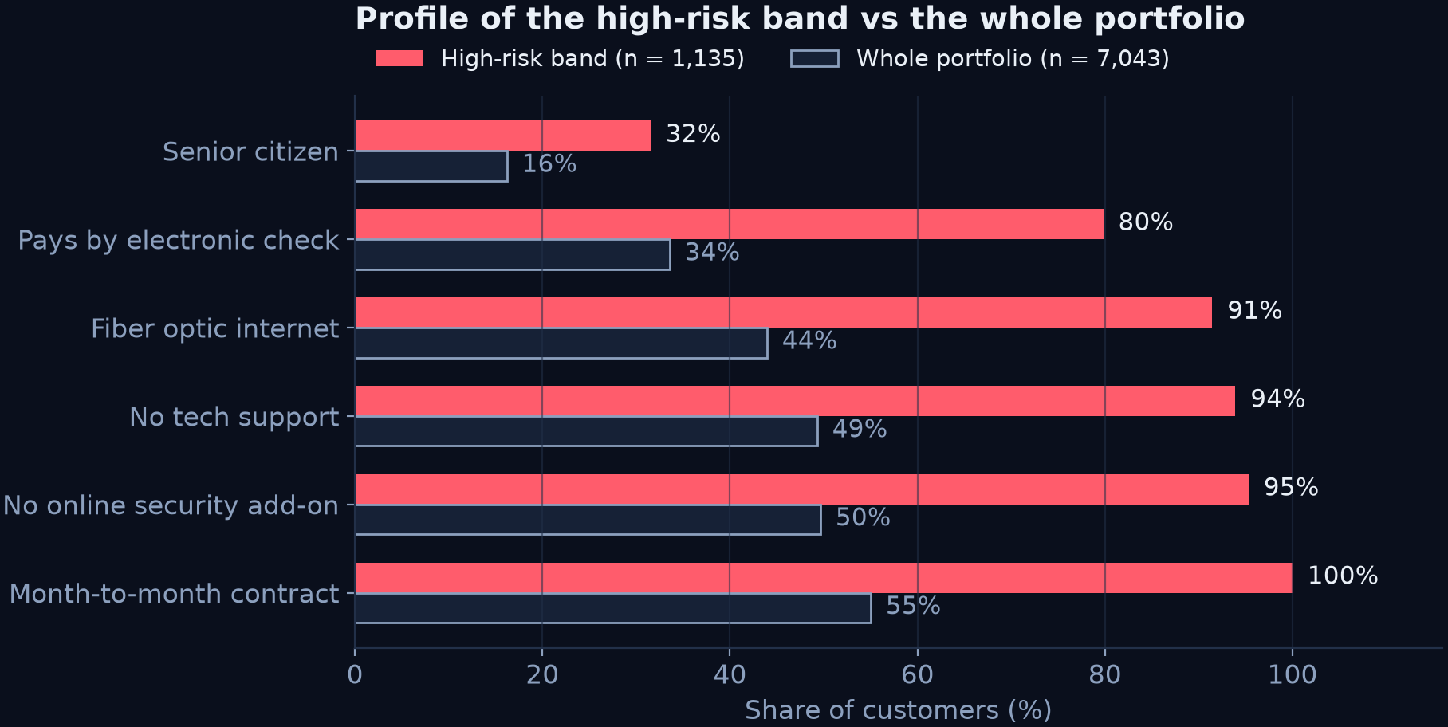
PHASE 09 · EXPLAINABILITY
Why the model flags a customer
The profile of the high-risk band, and a per-customer explanation in the app
PER-CUSTOMER EXPLANATION
For each prediction the console shows the top drivers, computed as coefficient × customer value — the honest linear explanation for a logistic model, with human labels like "Fiber optic internet" or "Account tenure".
ON SHAP — STATED PRECISELY
SHAP was explored during the project; summary, bar, dependence and waterfall plots are in the repository. Production explanation is aligned to the deployed Logistic Regression instead — accurate for a linear model, and it costs nothing at request time.
RetainIQ · Signal Ops Console · PHASE 09 · EXPLAINABILITY
12
Notes:
(7:05–7:40) Left chart: "this is who the high-risk band is — every one of them is
month-to-month, 91% are on fiber optic, 95% have no online security, and they
average under ten months of tenure."
Right: "and for a single customer the app names which of those factors pushed
this particular score."
If asked about SHAP: "I ran the SHAP analysis during experimentation; the
deployed model is linear, so I explain it with coefficients — same information,
no runtime cost." Do not overclaim here.

Slide 13
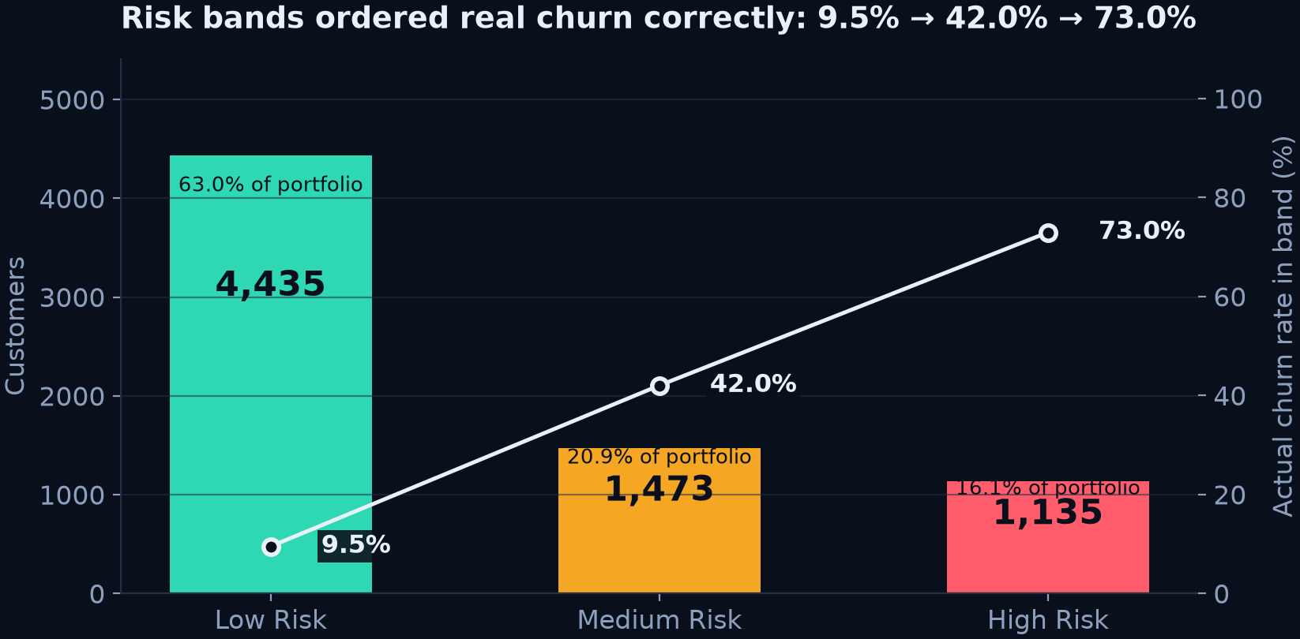
PHASE 10 · RISK SEGMENTATION
Turning a probability into a work queue
Every scored customer lands in one of three operational bands
< 30% LOW RISK
4,435 customers
30 – 60% MEDIUM RISK
1,473 customers
≥ 60% HIGH RISK
1,135 customers
VALIDATION
The bands track reality: actual churn is 9.5% in low risk, 42.0% in medium and 73.0% in high risk. The segmentation is not decoration — it orders the portfolio correctly.
THE OPERATIONAL PAYOFF
Instead of calling 7,043 customers, the team starts with 1,135 — 16.1% of the base, where 73% will actually leave — carrying $92,539 of recurring monthly charges.
RetainIQ · Signal Ops Console · PHASE 10 · RISK SEGMENTATION
13
Notes:
(7:40–8:15) "A probability isn't something a retention agent can act on, so I cut
it into three bands."
Then the validation, which is the point of the slide: "I checked the bands against
the real churn labels. Low risk actually churns 9.5%, medium 42%, high 73%. The
band is a genuine ordering of risk, not a cosmetic split."
Close operationally: "the team starts with 1,135 customers instead of 7,043."

Slide 14
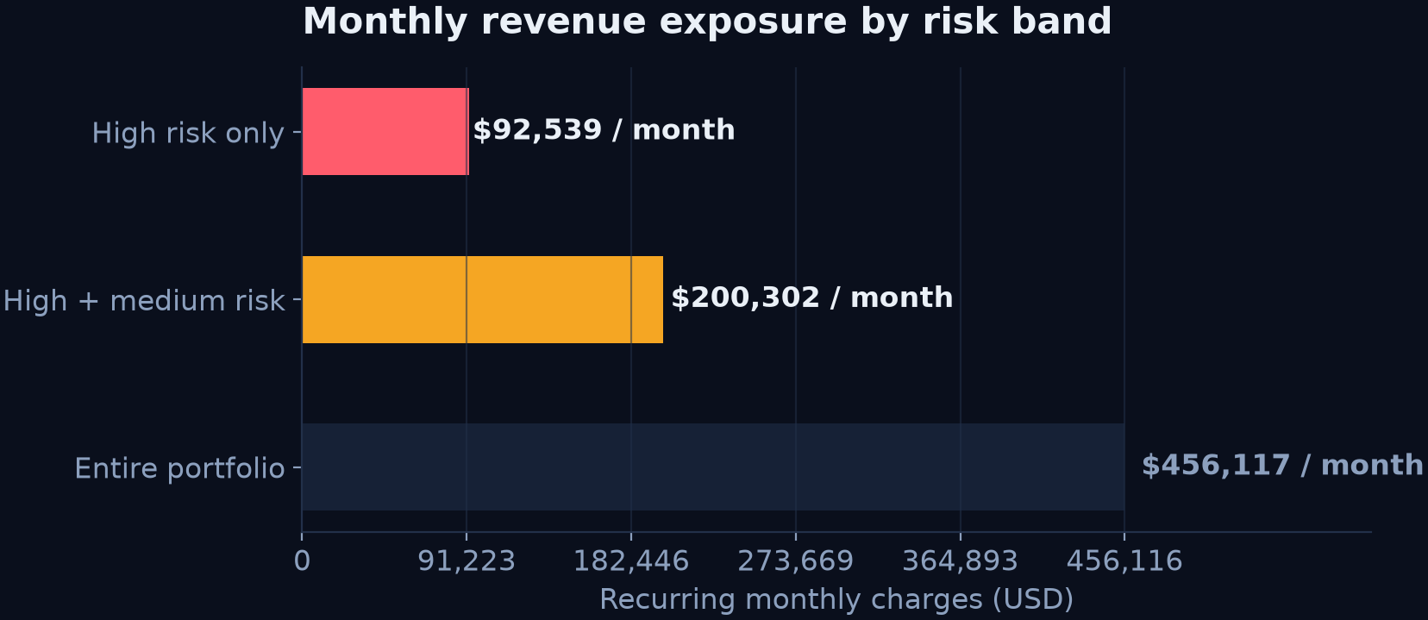
PHASE 11 · RETENTION INTELLIGENCE
From risk to action — and to money
2,608 at-risk customers each received a specific recommendation
RECOMMENDATIONS ISSUED (FULL PORTFOLIO)
Promote Long-Term Contract 792
5% Discount Offer 663
Offer 15% Discount 658
Welcome Retention Package 430
Free Online Security 45
Switch to Autopay / Check-in 18
Free Premium Support 2
Driven by each customer's own risk factors — a month-to-month customer with no security gets a different offer than a loyal high-value one.
SPEAK PRECISELY ABOUT THIS NUMBER
RetainIQ reports monthly revenue at risk — the recurring charges sitting inside flagged customers. $92,539/month in high risk, $200,302 including medium. It is exposure, not money already saved.
DECISION FRAMEWORK
Data → insight → prediction → explanation → action → business value. The platform deliberately does not stop at step three.
RetainIQ · Signal Ops Console · PHASE 11 · RETENTION INTELLIGENCE
14
Notes:
(8:15–8:50) "Prediction alone doesn't retain anyone."
Show the offer list — note the biggest group is a contract-upgrade nudge, which
follows directly from the Phase 04 finding about month-to-month risk.
Then be precise about money: "this is monthly revenue at risk — exposure, $92,539
a month sitting in the high-risk band. I deliberately do not call it savings."

Slide 15
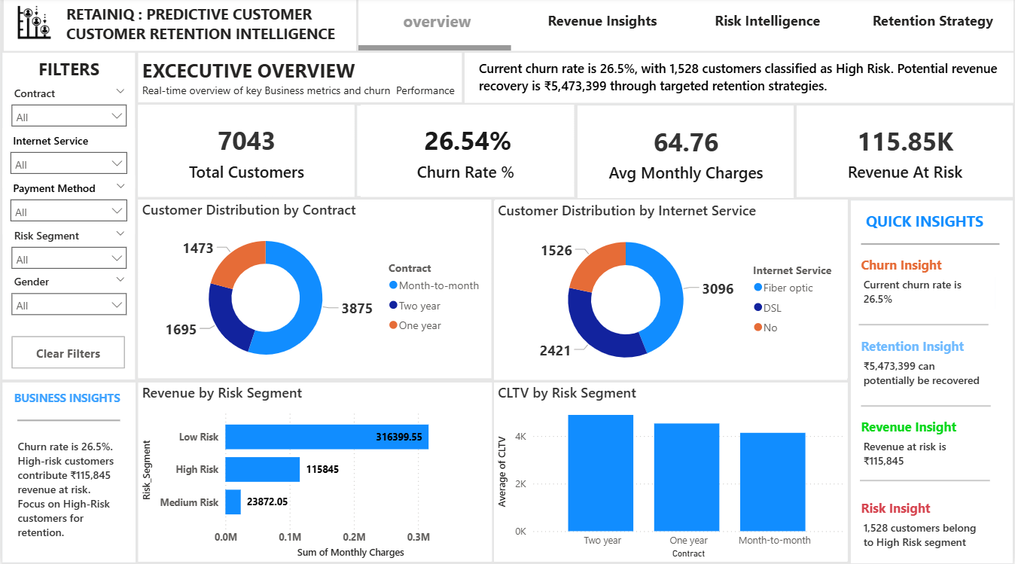
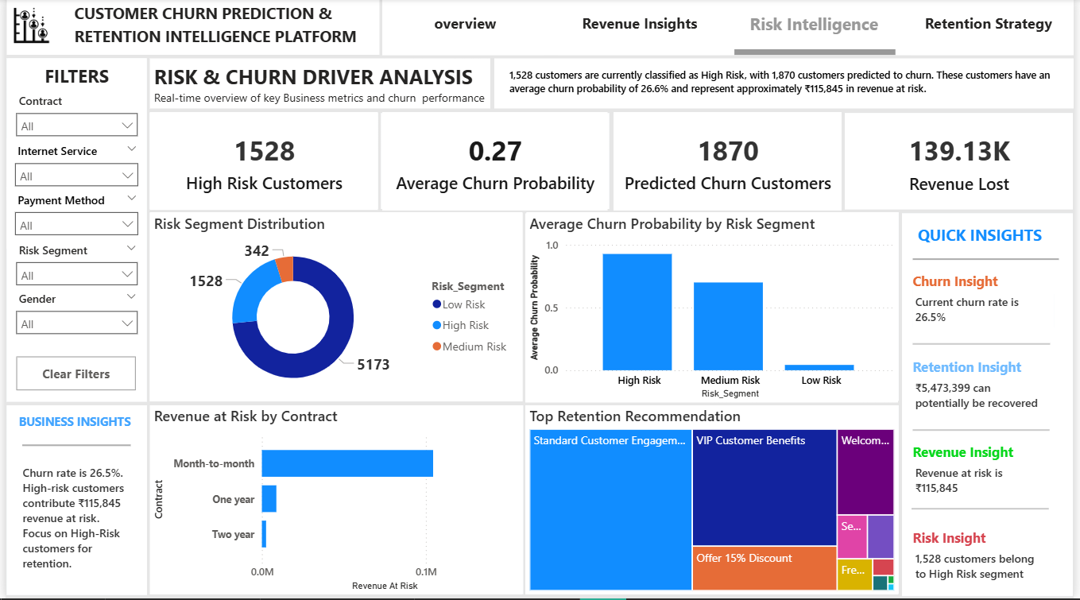
PHASE 12 · BUSINESS INTELLIGENCE
The descriptive layer beneath the predictions
A four-page Power BI dashboard for the people who fund the retention team
Executive overview
Portfolio KPIs, churn rate and revenue in one view for management.
Customer insights
Where churn concentrates — contract, tenure, service mix.
Risk intelligence
The scored risk distribution carried into BI.
Retention strategy
Which actions are recommended, and to how many customers.
RetainIQ · Signal Ops Console · PHASE 12 · BUSINESS INTELLIGENCE
15
Notes:
(8:50–9:15) "The machine learning app answers what is likely to happen. Power BI
answers what already happened and why — and it's what a non-technical
stakeholder actually opens."
Four pages: executive overview, customer insights, risk intelligence, retention
strategy. One sentence each, don't linger.

Slide 16
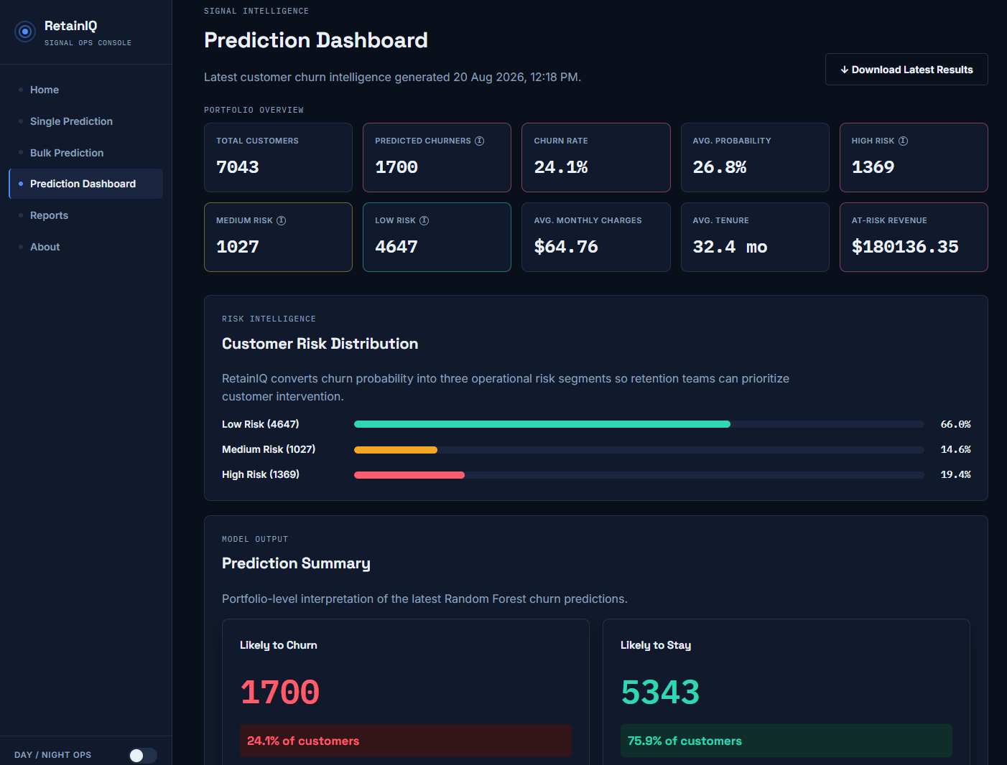
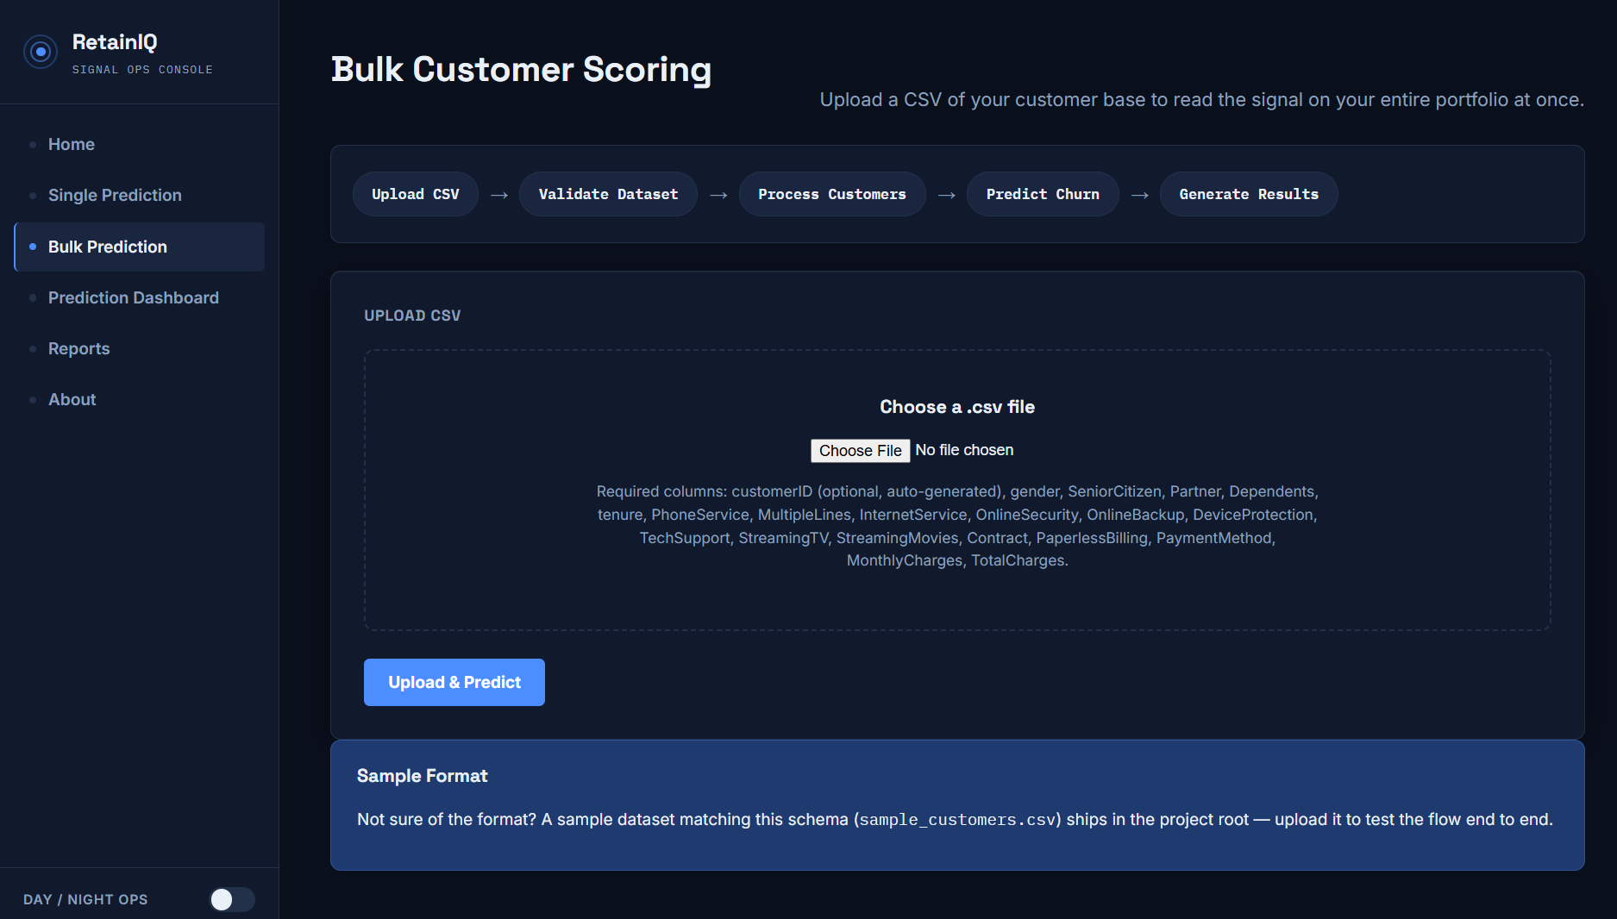
PHASE 13 · WEB APPLICATION
The product: a Signal Ops Console
A working Flask application — bulk scoring, dashboard, private reports
WHAT A REVIEWER DOES
Upload a CSV → validate the file before scoring → score the whole portfolio
Read churn rate, risk split and revenue at risk → drill into a customer → download a private report
REPORTS ARE PRIVATE — SCOPED BY SIGNED COOKIE
RetainIQ · Signal Ops Console · PHASE 13 · WEB APPLICATION
16
Notes:
(9:15–9:45) This is the demo slide. If the live site is warm, switch to it for
thirty seconds; otherwise walk the screenshots.
"Upload a portfolio, validate it before scoring, then read churn rate, risk
distribution and revenue at risk — and drill into any single customer."
One engineering detail worth a sentence: "reports are scoped to the visitor with
a signed cookie, so users never see each other's data — that has its own unit
test."

Slide 17
PHASE 14 · DEPLOYMENT
Making it survive production
Free-tier hosting is unforgiving — these are the four problems it creates
Slow scoring on a shared CPU
A large CSV can take far longer than the default 30-second worker timeout, so the worker is killed mid-request and the browser shows a 502.
→ fixed by 300-second timeout
Reloading the model per request
Reading the pickled model on every request wastes the little memory the instance has.
→ fixed by worker preload
Memory creeping past the limit
A long-lived worker grows until the platform OOM-kills it, which surfaces as a random error.
→ fixed by request recycling
The free tier sleeps
An idle instance is suspended, so the first visitor waits for a cold start.
→ fixed by warm it before demoing
SHIPPED AS
Gunicorn with a threaded worker · Dockerfile and Procfile · version-pinned requirements · hosted on Render, where the application answers at the URL on the closing slide.
RetainIQ · Signal Ops Console · PHASE 14 · DEPLOYMENT
17
Notes:
(9:45–10:10) Don't list technology here — that's the next slide. This slide is
about the production problems, which is what actually separates a notebook from
a deployed service.
"Four things broke or nearly broke when this left my laptop: slow scoring hitting
the worker timeout, the model being reloaded per request, memory creeping until
the platform killed the worker, and the free tier sleeping."
Then the honest operational note: "which means if you scan the QR at the end, and
the app has been idle, you'll wait about a minute for it to wake up. I'll warm it
before we start."

Slide 18
TECHNOLOGY STACK
Everything the project is built on
One requirement drove the whole stack: the same code must train the model and serve it
LANGUAGE & DATA
· Python 3.11
· Pandas — data handling
· NumPy — numerics
· SQL Server — extraction
· SQLAlchemy — DB layer
MACHINE LEARNING
· Scikit-learn — training
· Logistic Regression (live)
· Random Forest · XGBoost · LightGBM
· Joblib — model files
· SHAP — research only
WEB APPLICATION
· Flask — app server
· Jinja2 — templates
· HTML5 · CSS3 — design system
· Vanilla JavaScript — charts
· Gunicorn — WSGI server
APIs & DELIVERY
· FastAPI + Pydantic — API
· Docker — container
· Render — cloud host
· Git & GitHub — versioning
· Power BI (.pbix / .pbit)
THE DESIGN CHOICE BEHIND THE STACK
Preprocessing, the saved column contract and the scoring functions are a single Python package imported by the notebooks, the Flask app, the FastAPI wrapper and the evaluation scripts. That is what makes training and production behaviour the same thing rather than two similar things.
RetainIQ · Signal Ops Console
18
Notes:
(10:10–10:35) Do not read the columns. One sentence each.
"Python and pandas for the data work. Scikit-learn, four algorithms, Logistic
Regression deployed. Flask with a hand-built CSS design system for the product.
FastAPI, Docker and Render around it. Power BI for the business layer."
If asked about a tool that isn't here: only claim what can be opened in the
repository.

Slide 19
RESPONSIBLE AI, LIMITS & THE NEXT CYCLE
What this model should not be trusted with
Where it breaks, who it might treat unfairly, and what the next cycle fixes
LIMITATIONS — STATED PLAINLY
▸ Trained on historical data from one telecom; behaviour may not transfer
▸ 56.95% recall at the deployed threshold — two in five churners missed
▸ No live behavioural feed, no drift monitoring, no automatic retraining
▸ Probabilities are not guarantees; recommendations are decision support
▸ Revenue figures are exposure, not realised savings
FAIRNESS — AN OPEN QUESTION
▸ Senior citizens churn at 41.7% — nearly double the base rate. A model optimising for churn risk will systematically concentrate its retention offers on them.
▸ A blanket discount aimed at that group is not neutral; it can read as exploitative pricing.
▸ No bias audit has been run. Before this touched real customers, that would be a prerequisite, not a nice-to-have.
THE NEXT CYCLE
▸ Move the operating point deliberately — 0.35 catches 71.7% of churners at no cost to F1
▸ Decide the threshold with the business: a wasted offer is cheap, a lost customer is not
▸ Bias audit across age and other protected attributes
▸ Drift detection and scheduled retraining — which sends the project back to Phase 02
RetainIQ · Signal Ops Console
19
Notes:
(10:35–11:05) Most students hide this slide. Put it up and read it.
"Three things I would not do with this model today. I wouldn't trust it on a
different market — it has only ever seen one telecom. I wouldn't quote revenue as
savings, only as exposure. And I wouldn't ship a retention campaign aimed at
senior citizens without a bias audit — they churn at 41.7%, nearly double the
base rate, so a risk-optimising model will concentrate offers on them."
Then close the loop: "and the fix for the recall number is already measured — 0.35
catches 71.7%. That's the next cycle, which starts back at Phase 02 with drift
monitoring."

Slide 20


THANK YOU
See it running
Scan to open the live application and score a customer portfolio
LIVE APPLICATION
retainiq-predictive-customer-retention-zq6x.onrender.com
Bulk score a customer CSV, read the dashboard, and download a private report. The model, risk bands, explanations and recommendations run live — the same code paths that produced every figure in this deck.
SOURCE CODE
github.com/Logesh0247/RetainIQ_Signal_Ops_Console
Notebooks 01–09, the Flask console, the FastAPI wrapper and the nine-test suite are all in the repository.
The host is a free tier — open it once a minute before the review so the first scan is instant.
SOURCE
REPO
Thank you
Questions welcome.
RetainIQ — from a churn probability to a prioritised, explained, costed retention action.
SCAN FOR THE
LIVE APPLICATION
Logesh S. · B.Sc. Data Science · RetainIQ Signal Ops Console · 80.34% accuracy · 84.91% ROC-AUC
Notes:
CLOSING (11:05–11:30) Leave this slide up for questions. It puts the live URL and
a scannable QR in front of the examiner and ends on the thesis, not a tool list.
"The contribution isn't the 80% — it's that a probability becomes a prioritised,
explained, costed action, in a product a retention team can actually open. Thank
you — happy to take questions."
Offer the demo: "if you'd like, I can upload a customer file and score it live."
Remember the free tier sleeps — warm the app before you present.
LIKELY QUESTIONS
· Why not deep learning? 1,409 test rows and a largely linear signal; the four-way
benchmark supports the simpler model, and it stays explainable.
· Why is recall low? The 0.5 threshold is a default. Phase 08 shows 0.35 catches
71.7%, and balanced class weights reach 77.81% recall at identical ROC-AUC.
· Isn't revenue-at-risk optimistic? It's exposure, not savings — the deck and the
app both say so; validating it needs a live campaign.
· How do you know it isn't leakage? Churn Score, Reason, Category and Status are
post-outcome fields and were dropped before training.

Slide 21
APPENDIX
Full benchmark table
Held-out test set, 1,409 customers — every metric recorded
Model
Accuracy
Precision
Recall
F1
ROC-AUC
Logistic Regression ← selected
80.34%
64.74%
56.95%
60.60%
84.91%
LightGBM
80.06%
64.49%
55.35%
59.57%
84.71%
XGBoost
79.06%
61.72%
55.61%
58.51%
83.34%
Random Forest
78.99%
62.34%
52.67%
57.10%
83.48%
All four models were trained on the identical 5,634-row training split with the identical 30-feature frame, and evaluated with the same scoring code — the only variable is the algorithm.
Reproduce: python presentation/build_assets.py → writes presentation/assets/model_metrics.csv
Appendix · use only if asked
21
Notes:
Backup slide. Use if anyone questions the benchmark or wants the full metric set.

Slide 22
APPENDIX
Hyperparameters
Read directly from the saved model artifacts and the training notebook
Model
Settings
Logistic Regression
max_iter=5000, C=1.0, solver='lbfgs'
Random Forest
n_estimators=200, random_state=42
XGBoost
XGBClassifier(random_state=42) — library defaults otherwise
LightGBM
LGBMClassifier(random_state=42) — library defaults otherwise
A NOTE ON TUNING
No automated hyperparameter search was run — the algorithms were compared under their default configurations, which keeps the benchmark a fair test of the algorithms rather than of how much tuning effort each received. The XGBoost and LightGBM instances were constructed with only random_state set, so their remaining settings are library defaults; that is what the saved artifacts contain. A tuning sweep is on the next-cycle list.
Appendix · use only if asked
22
Notes:
Backup slide for 'what parameters did you use?'. Be straightforward: these are defaults, and that was deliberate so the comparison tested algorithms rather than tuning effort.

Slide 23
APPENDIX
The 30 model inputs
Three numeric measures plus twenty-seven encoded flags, in model order
1. Tenure Months
2. Monthly Charges
3. Total Charges
4. Gender_Male
5. Senior Citizen_Yes
6. Partner_Yes
7. Dependents_Yes
8. Phone Service_Yes
9. Multiple Lines_No phone service
10. Multiple Lines_Yes
11. Internet Service_Fiber optic
12. Internet Service_No
13. Online Security_No internet service
14. Online Security_Yes
15. Online Backup_No internet service
16. Online Backup_Yes
17. Device Protection_No internet service
18. Device Protection_Yes
19. Tech Support_No internet service
20. Tech Support_Yes
21. Streaming TV_No internet service
22. Streaming TV_Yes
23. Streaming Movies_No internet service
24. Streaming Movies_Yes
25. Contract_One year
26. Contract_Two year
27. Paperless Billing_Yes
28. Payment Method_Credit card (automatic)
29. Payment Method_Electronic check
30. Payment Method_Mailed check
Appendix · use only if asked
23
Notes:
Backup slide. Any question about which variables the model sees can be answered by pointing here.

Slide 24
APPENDIX
Prediction API & where every figure came from
The same engine, exposed programmatically — and the provenance of this deck
POST /api/predict
{ "gender": "Male", "SeniorCitizen": 1,
"tenure": 8, "Contract": "Month-to-month",
"InternetService": "Fiber optic", ... }
→ probability · prediction · risk_level
→ top_drivers · recommendations
GET /api/health → the uptime probe the host checks before it routes traffic
FIGURE PROVENANCE
Churn split, contract, internet, tenure → Data/01.Telco_customer_churn_Dataset.csv
Benchmark, confusion matrix, ROC → models/*.pkl on the held-out split
Threshold sweep, CV, imbalance → presentation/build_assets.py
Risk bands, profile, revenue → the production scoring pipeline
QR codes → build_qr.py, decoded back to verify
Console screenshots → templates/images/ from the running app
Power BI pages → Power_BI_dashboard/Screenshots/
THE POINT
Nothing in this deck is hand-typed. build_assets.py recomputes every figure from the saved artifacts and the production scoring path, so the deck cannot drift away from the project — retrain a model and the charts and the benchmark table regenerate together.
Appendix · use only if asked
24
Notes:
Backup slide for API and reproducibility questions. Strong answer to 'how do we know these numbers are right?'

Slide 25
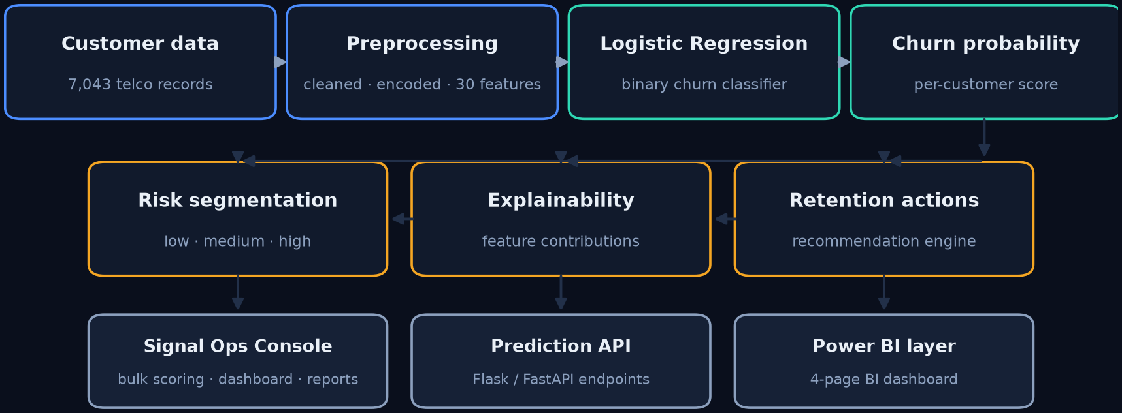
APPENDIX
How the system fits together
One shared path from raw customer data to the console, the API and the BI layer
ONE PREPROCESSING PATH
The notebook pipeline and the app import the same transformations, so a score in the console and a metric in this deck come from the same 30 features.
TWO ENTRY POINTS
The Flask console serves the reviewable UI; the FastAPI wrapper serves the same model to any other client. Both load the frozen feature list.
LAYERS ON TOP
Risk bands and recommendations are rules over the probability, not a second model — which is why they are auditable.
Appendix · use only if asked
25
Notes:
Backup slide. Use it if a reviewer asks how the pieces connect, or how the notebook work reaches the running app. The answer is one shared preprocessing path and a frozen feature contract.

