Slide 1
AIM
Implement a precise object tracking system through the fusion of Kalman filtering and advanced computer vision techniques.
Leverage the OpenCV library for seamless integration and efficient execution of computer vision algorithms.
Enhance tracking robustness by devising strategies to handle challenges, including occlusions and mitigating the impact of noisy data.
Optimize the tracking algorithm for specific environmental conditions, ensuring adaptability and reliability in diverse scenarios.
Explore and demonstrate practical applications in fields such as surveillance, robotics, or any relevant industry, showcasing the real-world impact of the developed tracking system.

Slide 2
Introduction
The Kalman filter is employed in our project to track and predict the trajectory of moving objects, serving critical roles in applications like surveillance and autonomous vehicles.
This filter excels in refining predictions, combining historical trajectory data with real-time measurements to ensure accuracy even in dynamic environments.
Its robustness to noisy sensor data enhances reliability, filtering out disturbances and maintaining tracking precision.
The Kalman filter's dynamic adjustment between motion predictions and actual measurements accommodates changing conditions, ensuring adaptability in diverse scenarios.
With computational efficiency, the Kalman filter operates in real-time, providing timely and accurate information for tracking moving objects in dynamic environments.

Slide 3
Kalman filtering
The primary purpose of the Kalman filter is to estimate the state of a dynamic system based on a series of noisy measurements.
In simple terms, it helps in making predictions about the future state of a system by combining information from the current state estimate and new measurements, taking into account the uncertainties associated with both the system dynamics and the measurements.
The filter operates in two main steps:
prediction
update.
The Kalman filter is particularly effective in situations where there is uncertainty in both the measurements and the dynamic model of the system.
It helps in providing a more accurate and stable estimate of the system state compared to using measurements or predictions alone.
The Kalman filter is widely used in various applications, including tracking objects, sensor fusion in autonomous systems, navigation systems,

Slide 4
Methodology
Import necessary libraries, including OpenCV and NumPy. Define the KalmanFilter class for position prediction and the BlueDetector class for detecting blue objects.
Configure the BlueDetector with an HSV color range for blue object detection. Open a video capture stream from the "Logesh.mp4" file.
In an object tracking loop, iterate through each video frame. Use the BlueDetector to identify the blue object and predict its trajectory with the KalmanFilter.
Visualize the process by drawing circles on the frame to represent detected and predicted positions. Display the frame in real-time.Collect predicted positions by printing and storing them in a list (e.g., i).
Check for the 'Esc' key press to exit the loop. Release the video capture object and close the OpenCV window for cleanup.

Slide 5
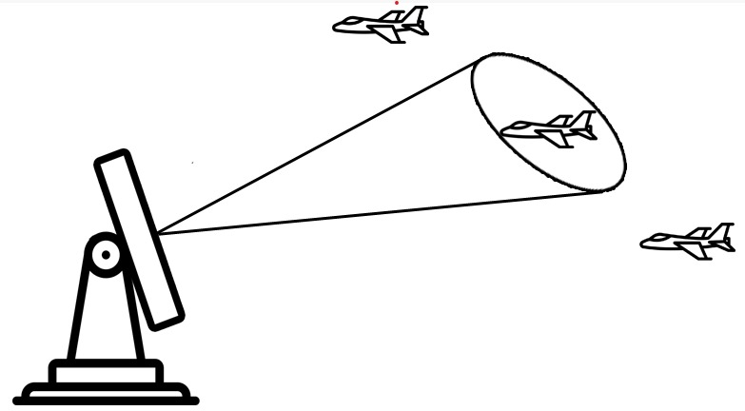
Prediction Requirement
Track cycle: 5 seconds, radar samples target.
Radar estimates current position and velocity.

Slide 6
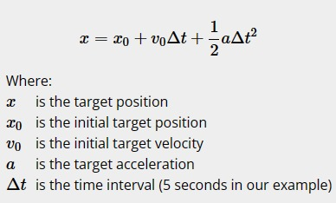
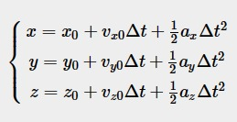
Predicts target's next position using Newton's equations.
Three-dimensional motion equations for x, y, and z.

Slide 7
System state: [x, y, z, vx, vy, vz, ax, ay, az].
Measurement noise: random errors due to radar imperfections.
Process noise: misalignment between motion equations and target motion.
To improve the radar's tracking accuracy the common tracking and prediction algorithm is the Kalman Filter.

Slide 8
Example-1
The Kalman filter operates in two phases: predict and update. During prediction, the truck's old position is adjusted based on the physical laws of motion, resulting in a new position estimate and covariance calculation.
The covariance in the prediction phase may be proportional to the truck's speed, reflecting increased uncertainty at higher speeds and greater certainty at lower speeds in the dead reckoning position estimate.
In the update phase, a measurement of the truck's position is obtained from the GPS unit, introducing a certain level of uncertainty. The covariance of this measurement relative to the prediction from the previous phase determines the impact of the new measurement on the updated prediction.
The goal during the update phase is to use the GPS measurement to bring the position estimate back toward the real position, countering the drift in dead reckoning estimates. However, the update should be balanced to avoid introducing excessive noise and causing rapid and disruptive jumps in the position estimate.
The Kalman filter, through these predict and update phases, aims to integrate both dynamic model predictions and sensor measurements, providing a refined and accurate estimate of the truck's position while effectively managing uncertainties and minimizing the impact of measurement errors.

Slide 9
Conclusion
In conclusion, the implemented object tracking system, utilizing computer vision techniques, demonstrates the successful detection and tracking of a blue-colored object in a video stream. The integration of the BlueDetector for object recognition and the KalmanFilter for trajectory prediction forms a robust foundation for real-time monitoring.
The object tracking system serves as a versatile tool with applications ranging from surveillance and robotics to augmented reality. Its adaptability and potential for future enhancements position it as a valuable asset for a diverse array of domains requiring efficient and accurate object tracking capabilities.

Slide 10
FUTURE SCOPE
.Multi-Object Tracking-Extend the system to track multiple objects simultaneously.
3D Object Tracking-Explore 3D object tracking capabilities
Dynamic HSV Range Adjustment-Implement an adaptive HSV color range adjustment based on varying lighting conditions.
Object Classification-Integrate object classification to identify different types of objects based on shape, size, or other features

Slide 11


